Slide 1








Industry/University Cooperative Research Center (I/UCRC)
Advanced Mammalian Biomanufacturing Innovation Center (AMBIC)
Advanced PAT Sensors for Rapid, High Sensitivity Detection and Control of Dipeptides, Vitamins, and Other Nutrients in Cell Culture Media
Yayuan Liu (Johns Hopkins University) Role: Sensor Development
Michael Betenbaugh (Johns Hopkins University) Role: Cell Culture Experiments
Mentor Meeting
A National Science Foundation-facilitated academic – industry – government consortia
to advance precompetitive knowledge in biomanufacturing
Contents are Proprietary to AMBIC and its Members
Terms of Center Membership Agreement Apply
www.ambic.org

Slide 2
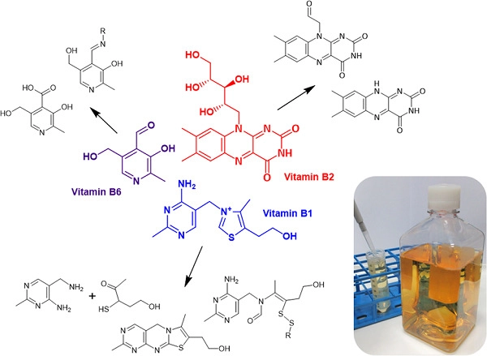
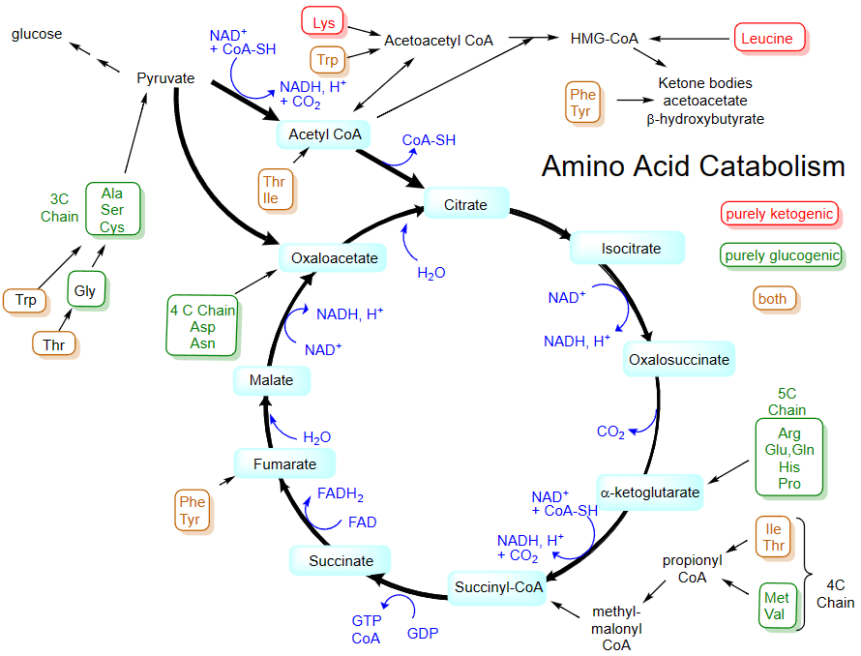
Industrial Relevance & Need
Nutrient instability (vitamins, amino acids, dipeptides, etc.) is a key contributor to variabilities in liquid cell culture media (CCM) and short storage times.
Nutrient breakdown and utilization lead to the exhaustion of media supply, alter the levels of key CCM components and lower cell culture performance.
Understanding degradation pathways and the implications on biomanufacturing is important to inform effective stabilization strategies.
Online sensing capability with high sensitivity and temporal resolution that is easy to operate, fast, and desirable
Vitamin Degradation
Johns Hopkins University
Clemson University
University of Delaware
University of Massachusetts Lowell
University of Maryland
Amino Acid Catabolism
Biotechnology and Bioengineering, 2019, 116(6), 1537-1555.

Slide 3
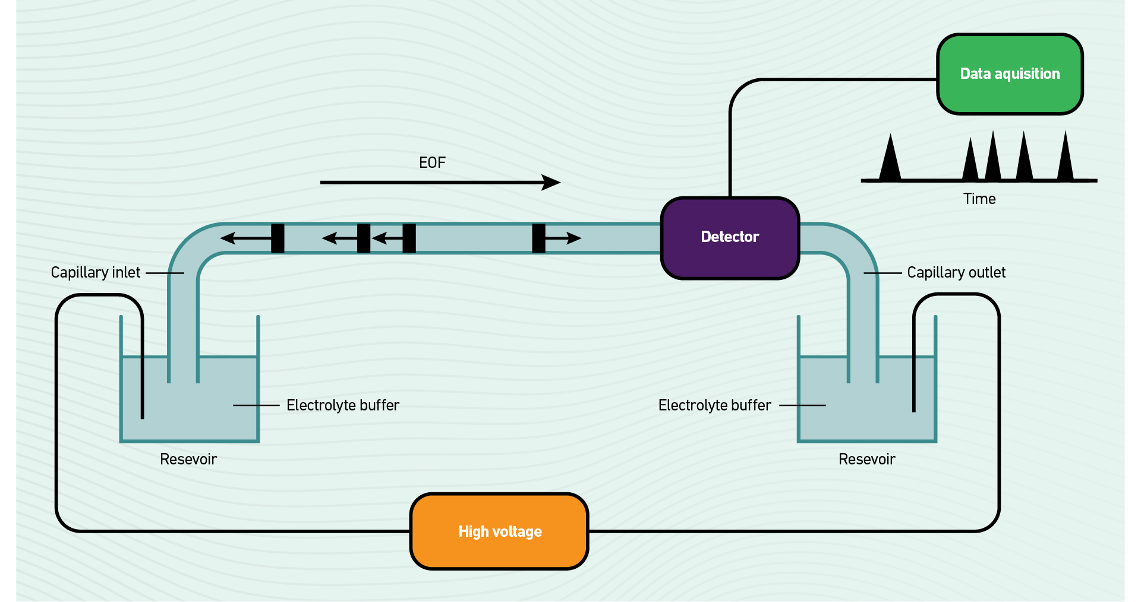
Capillary Electrophoresis
Johns Hopkins University
Clemson University
University of Delaware
University of Massachusetts Lowell
University of Maryland

Slide 4
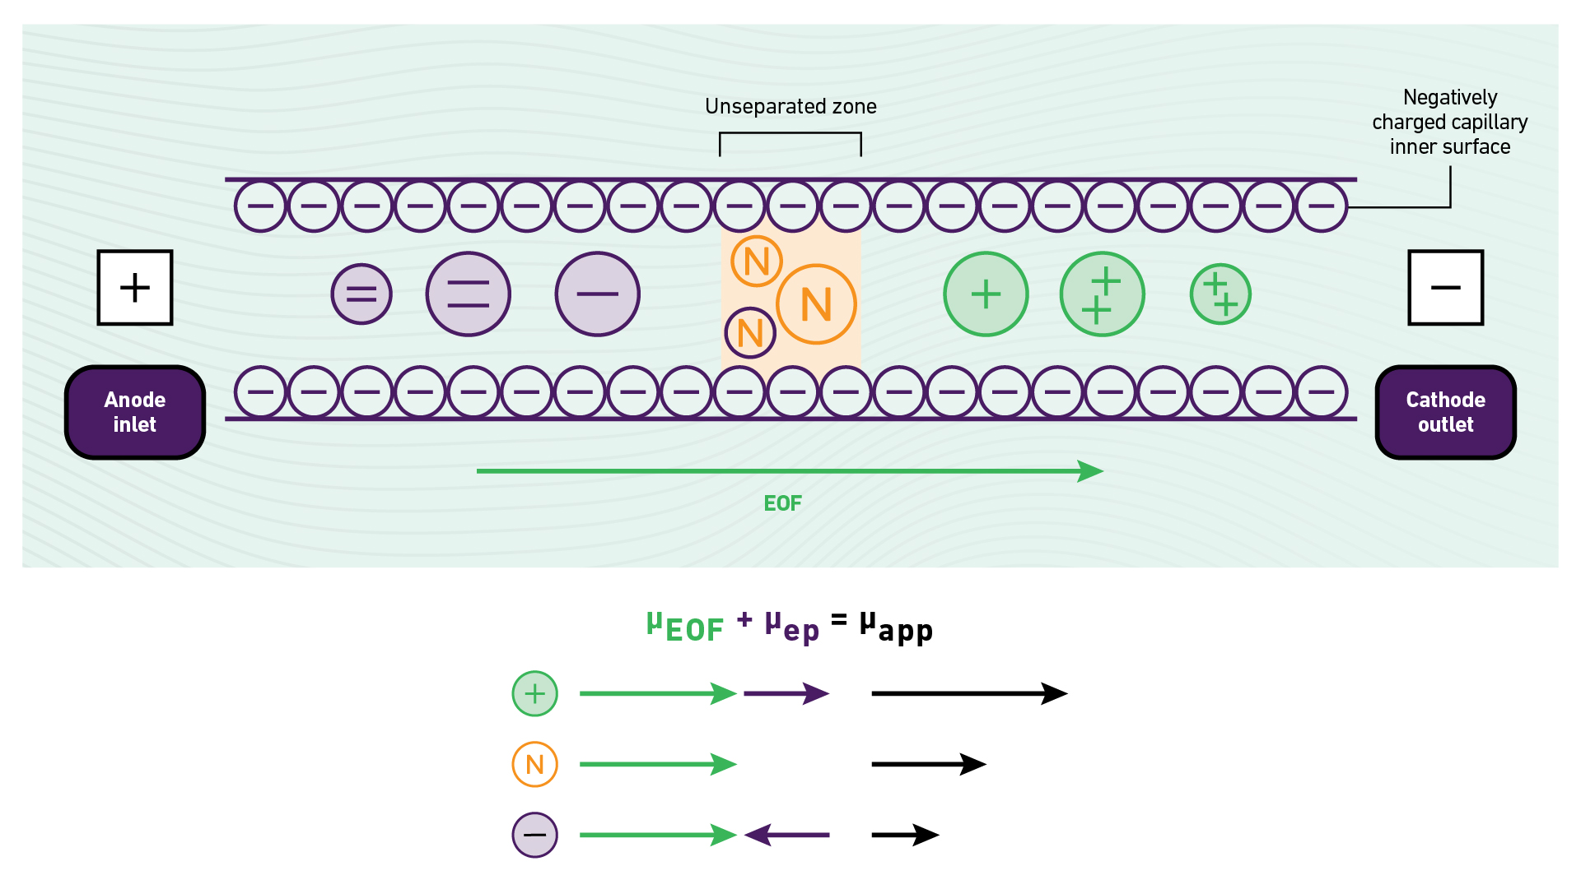
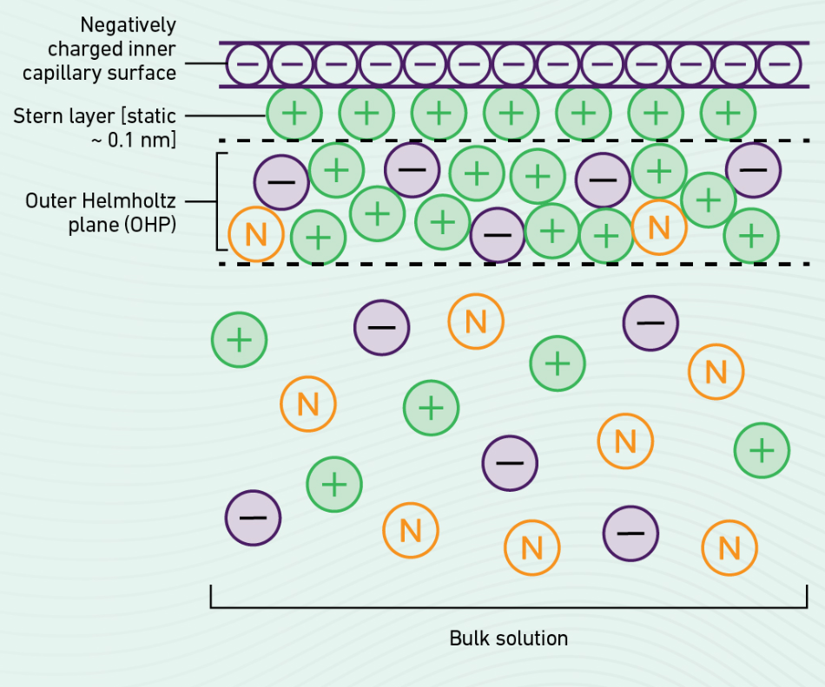
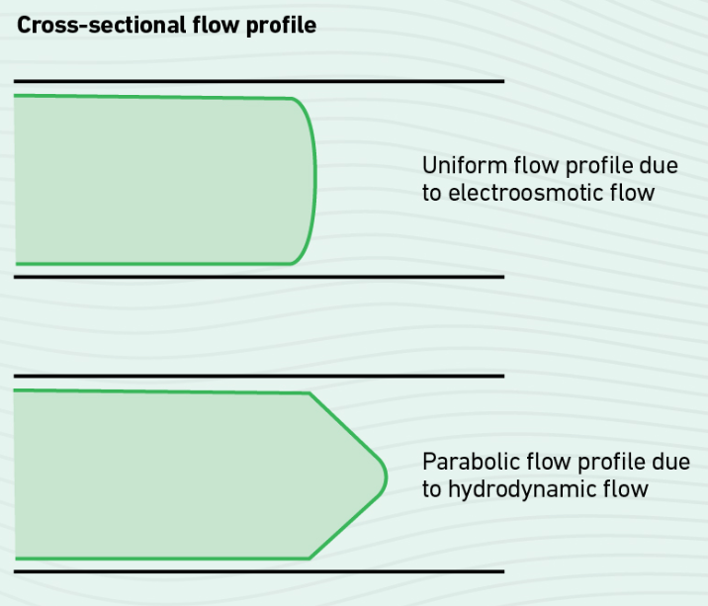
Capillary Electrophoresis
Johns Hopkins University
Clemson University
University of Delaware
University of Massachusetts Lowell
University of Maryland
Ionic or electrophoretic mobility: The migration velocity of an ion in a channel under the influence of an electric field
Electroosmotic flow (EOF): Caused by an electrical double layer that forms at the stationary/solution interface

Slide 5
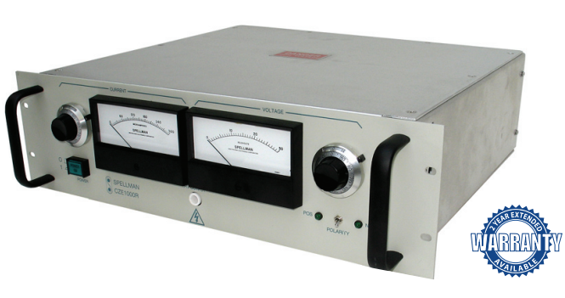
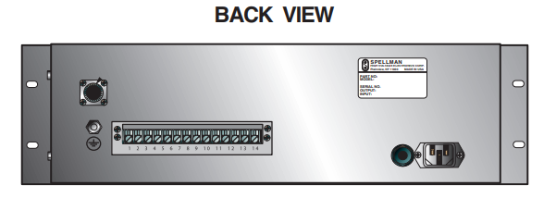
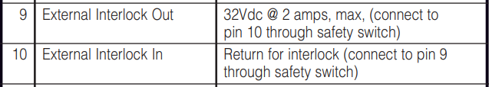
Power Supply
Johns Hopkins University
Clemson University
University of Delaware
University of Massachusetts Lowell
University of Maryland
STDP Switch safety interlock

Slide 6
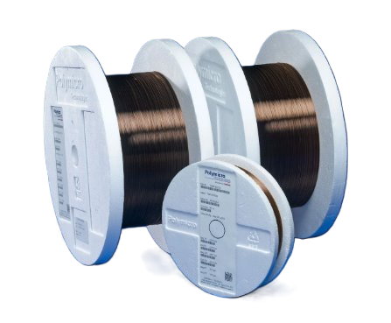
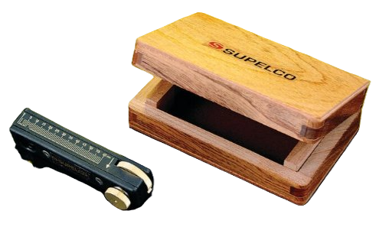
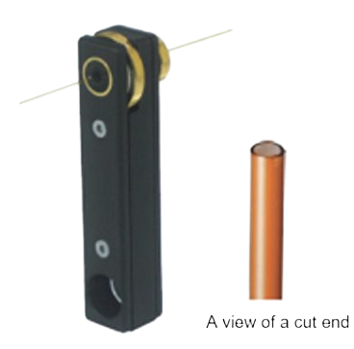
Capillary
Johns Hopkins University
Clemson University
University of Delaware
University of Massachusetts Lowell
University of Maryland
Characteristics:
Polymicro capillary
75 µm inner diameter
40-70cm length
Synthetic fused silica
Operation up to 350 °C
Purposes:
Minimizing Sample Loss
Reducing Detection Issues
Ensuring Consistent Flow
Preventing Blockages

Slide 7
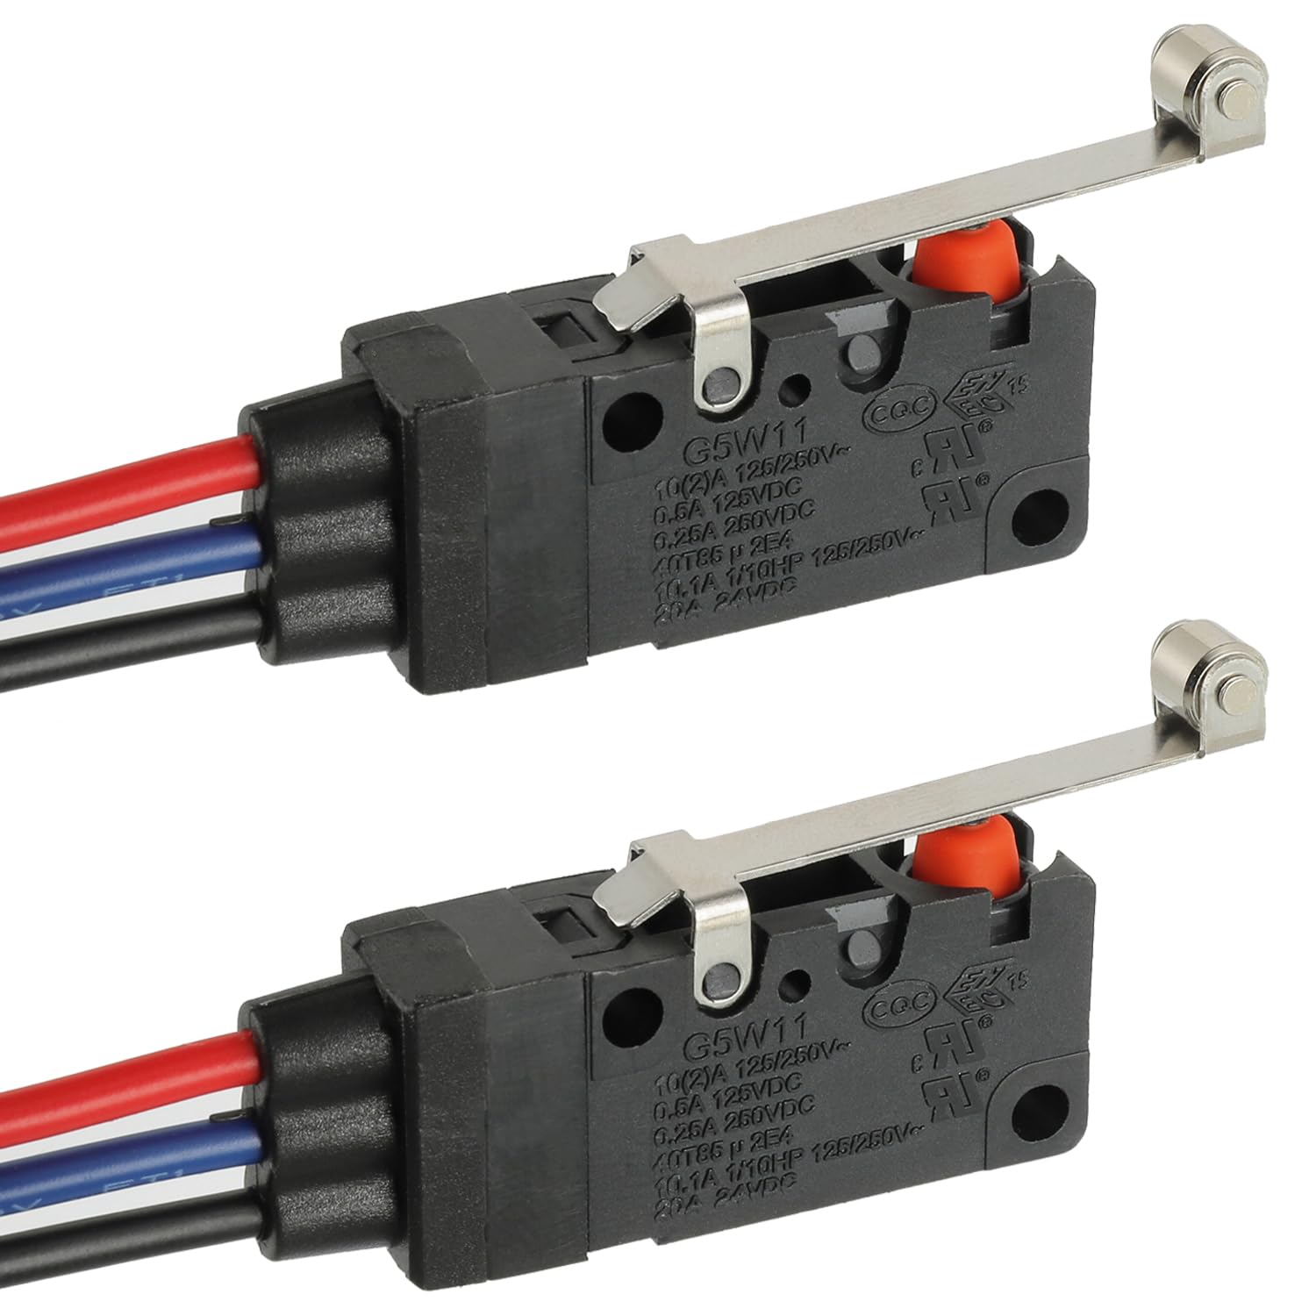
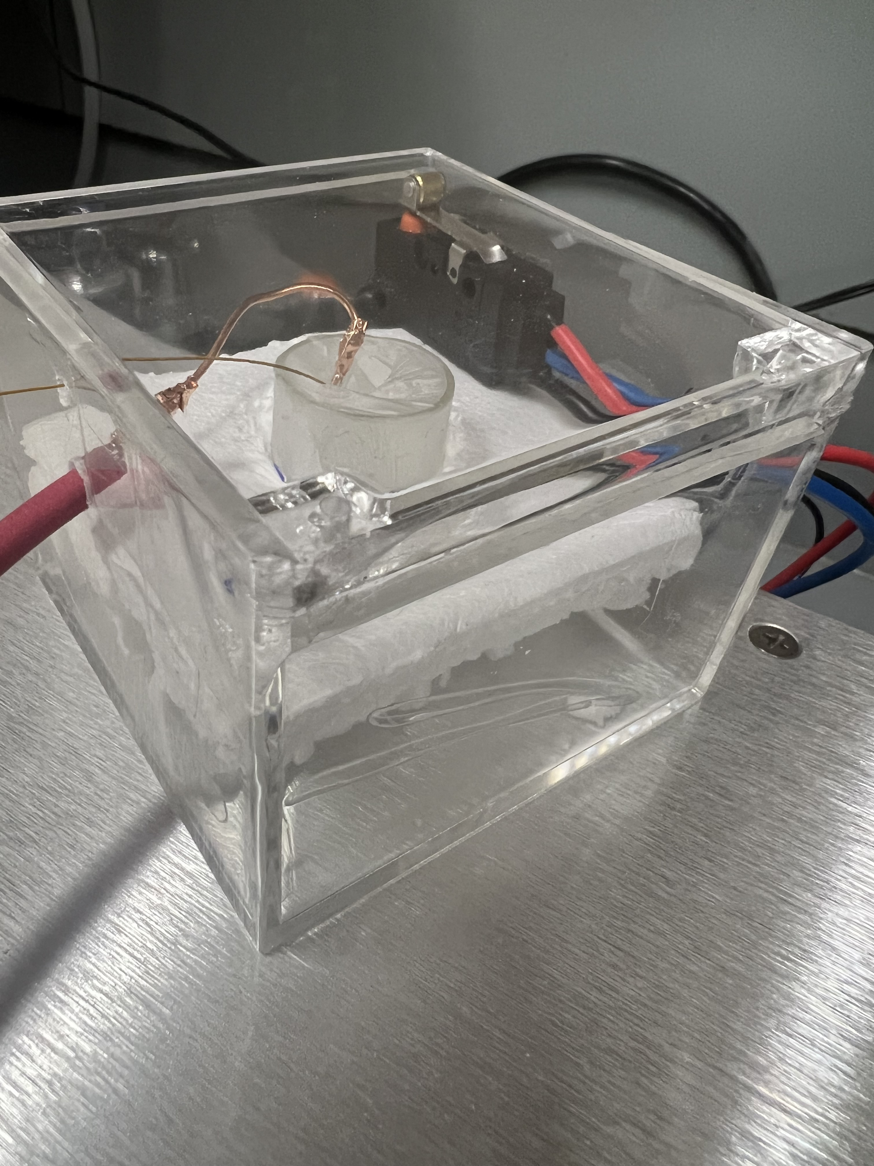
STDP Switch Safety Interlock
Purpose:
To have an outer circuit for safety control
  The switch is closed only when the lid is closed
To insulate the anode to avoid risks
Johns Hopkins University
Clemson University
University of Delaware
University of Massachusetts Lowell
University of Maryland
Potential Risk Caused by High Voltage:
Electrical Shock
Arc Flashing
Burning

Slide 8
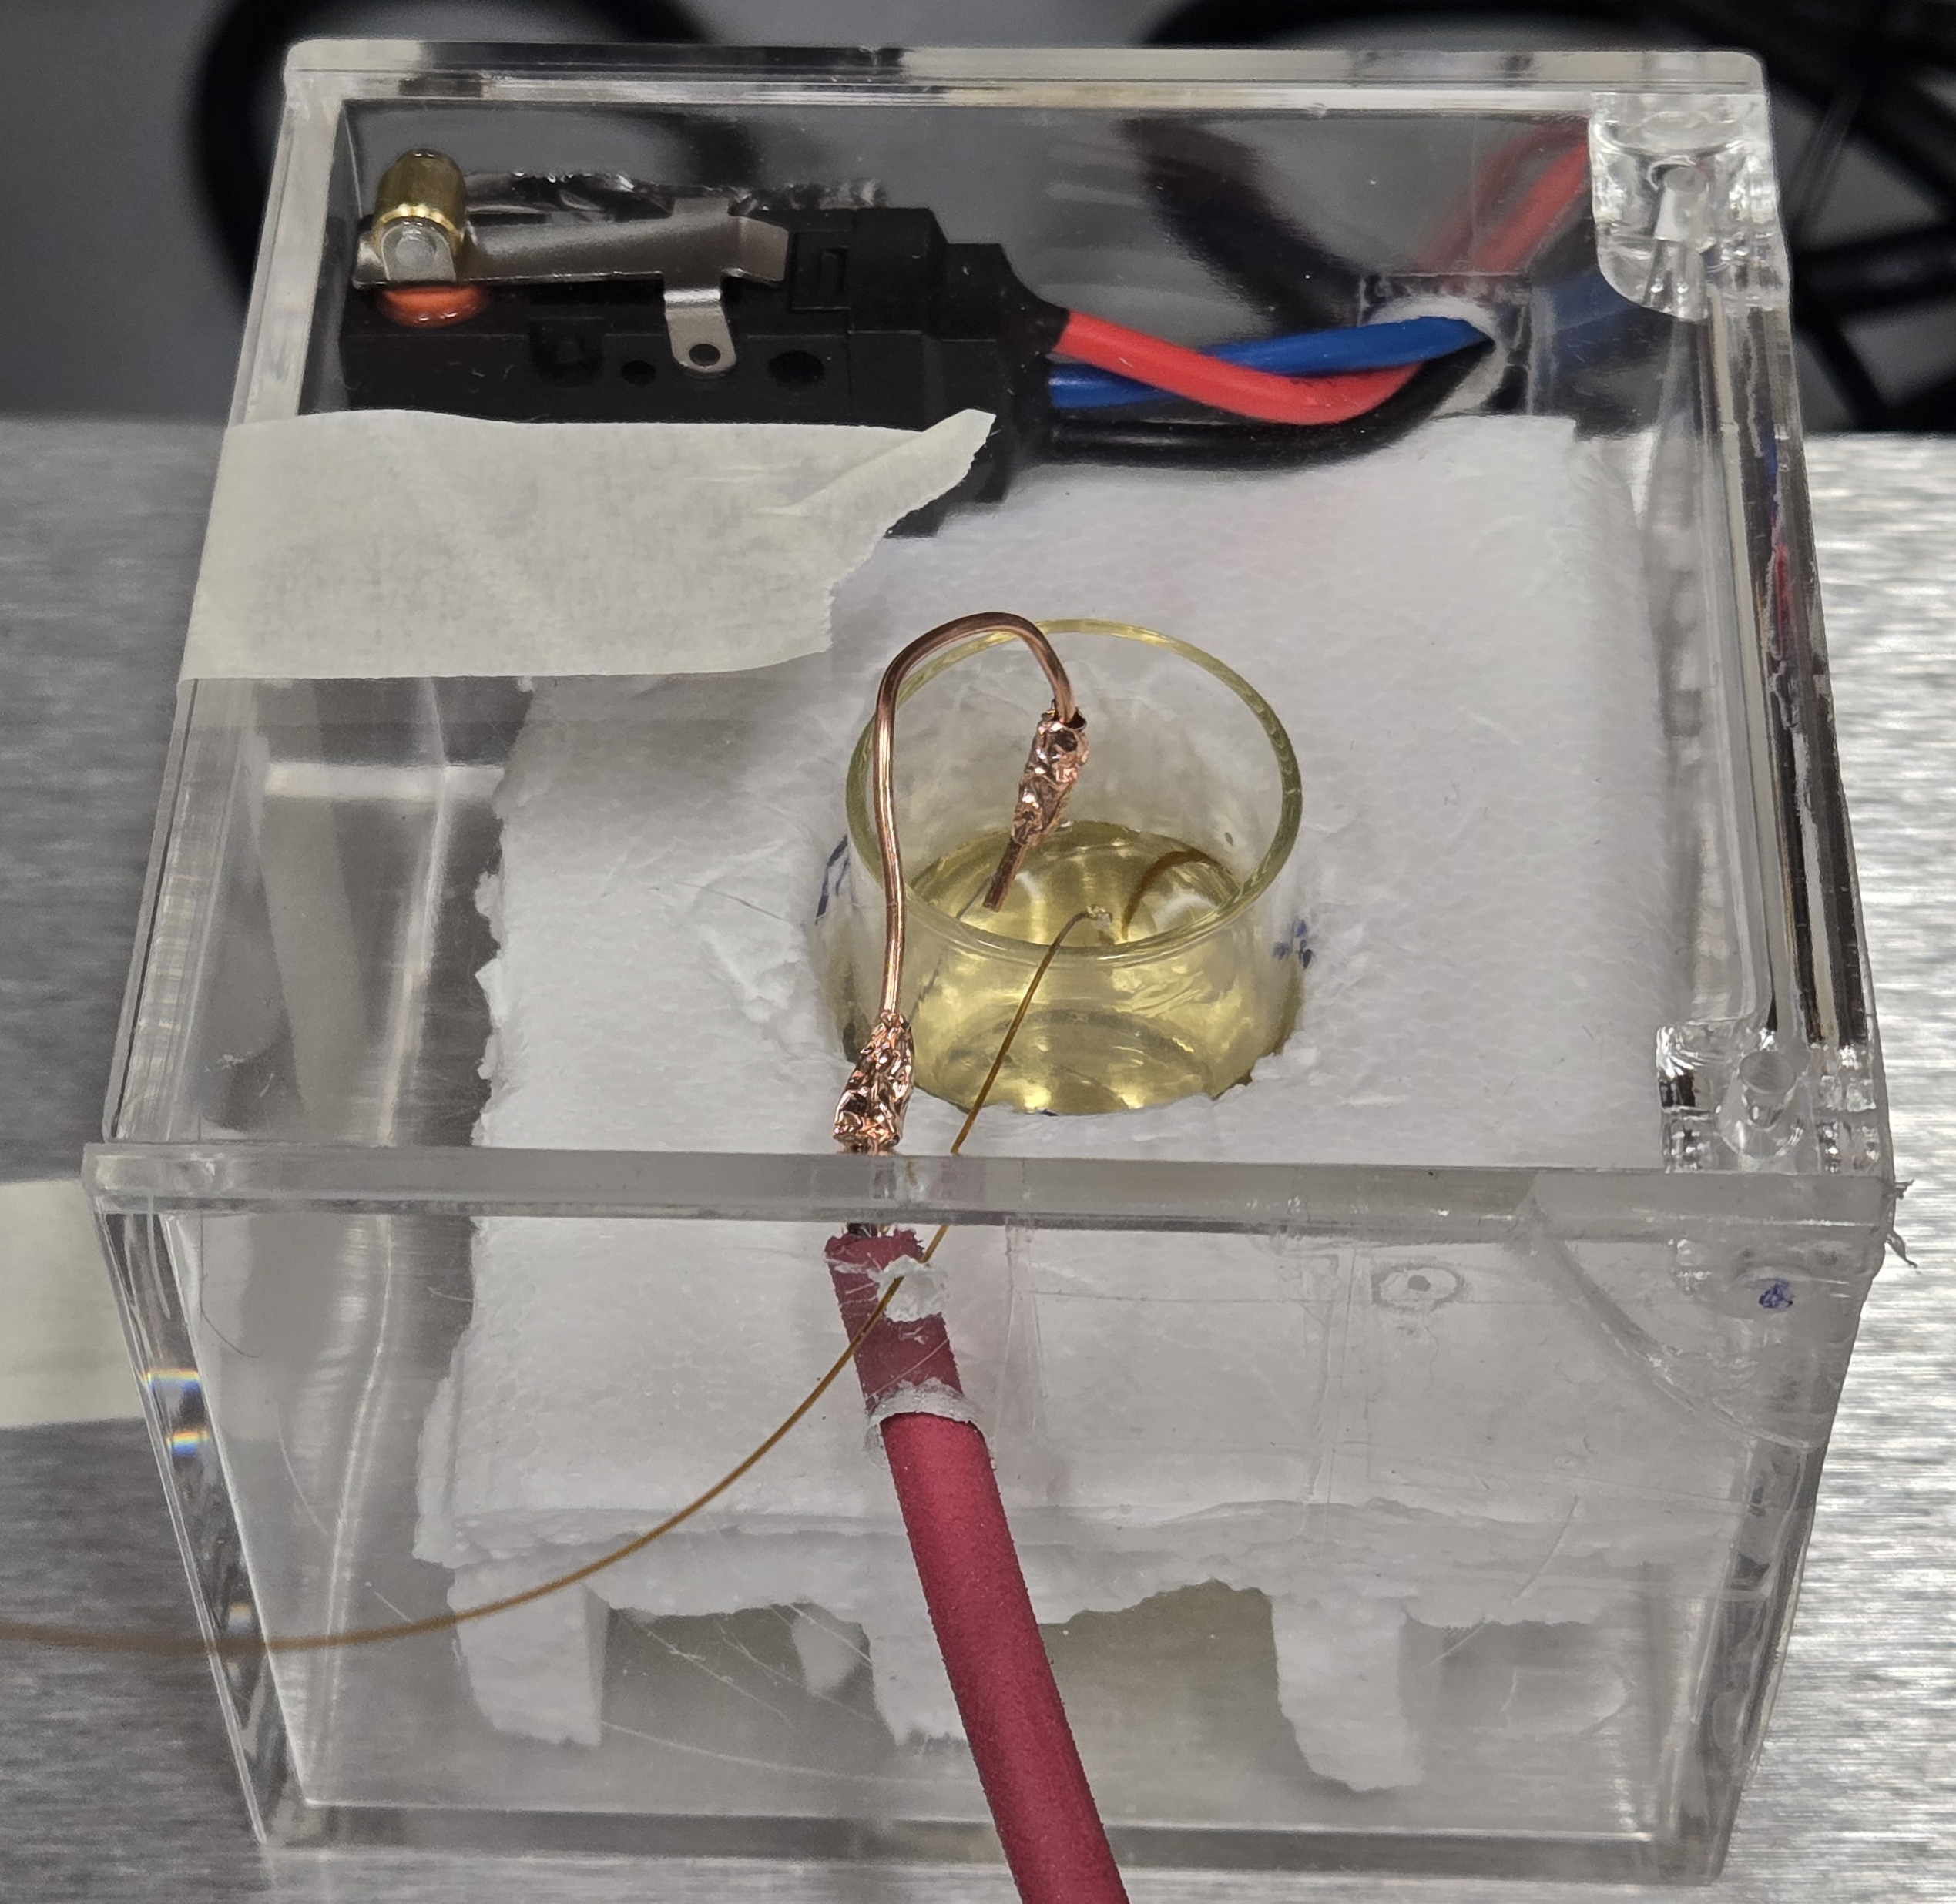
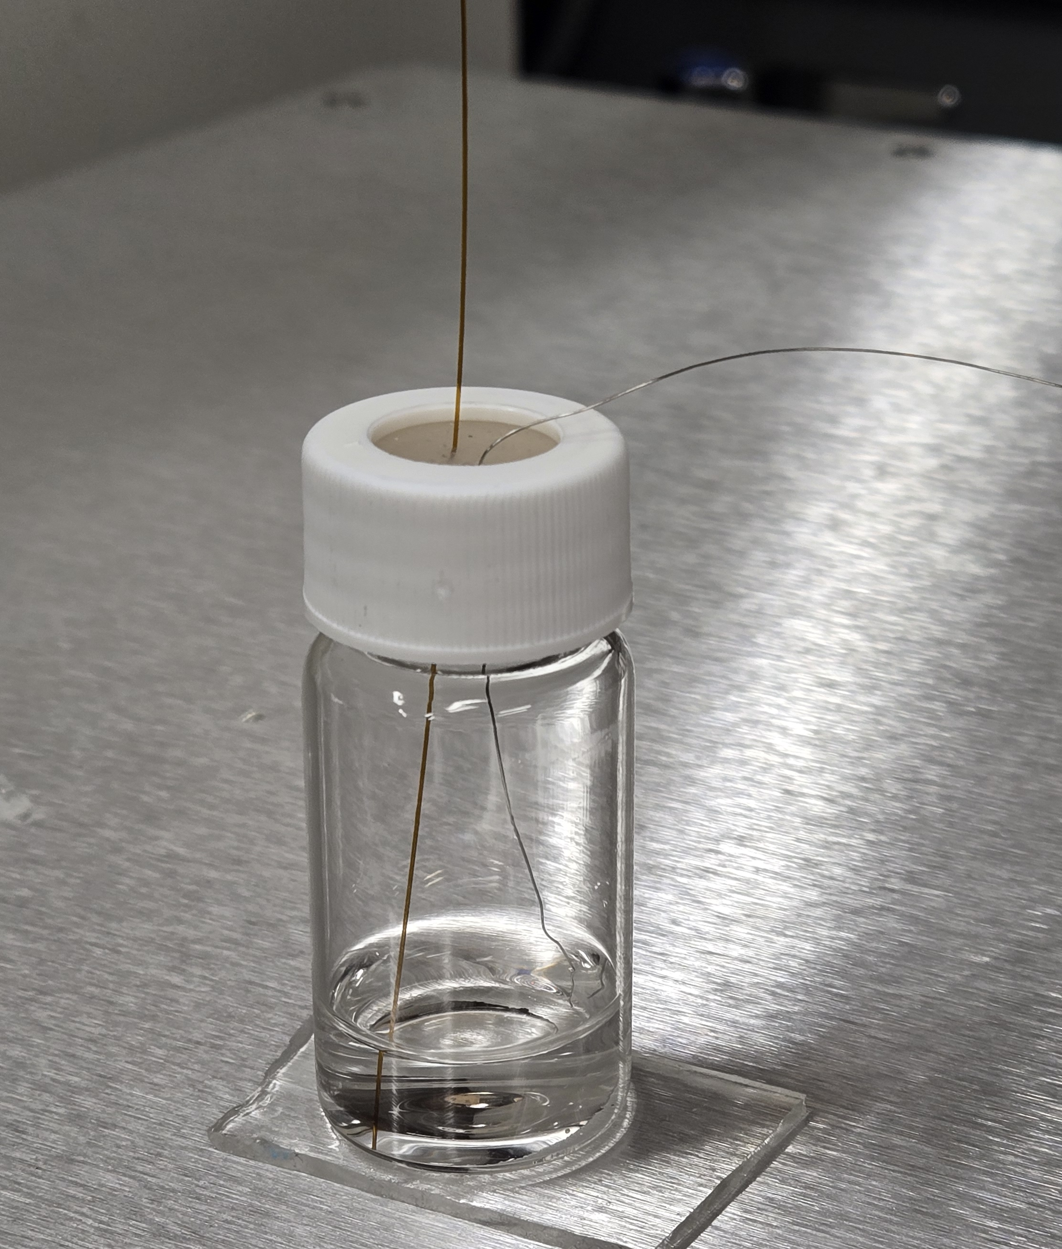
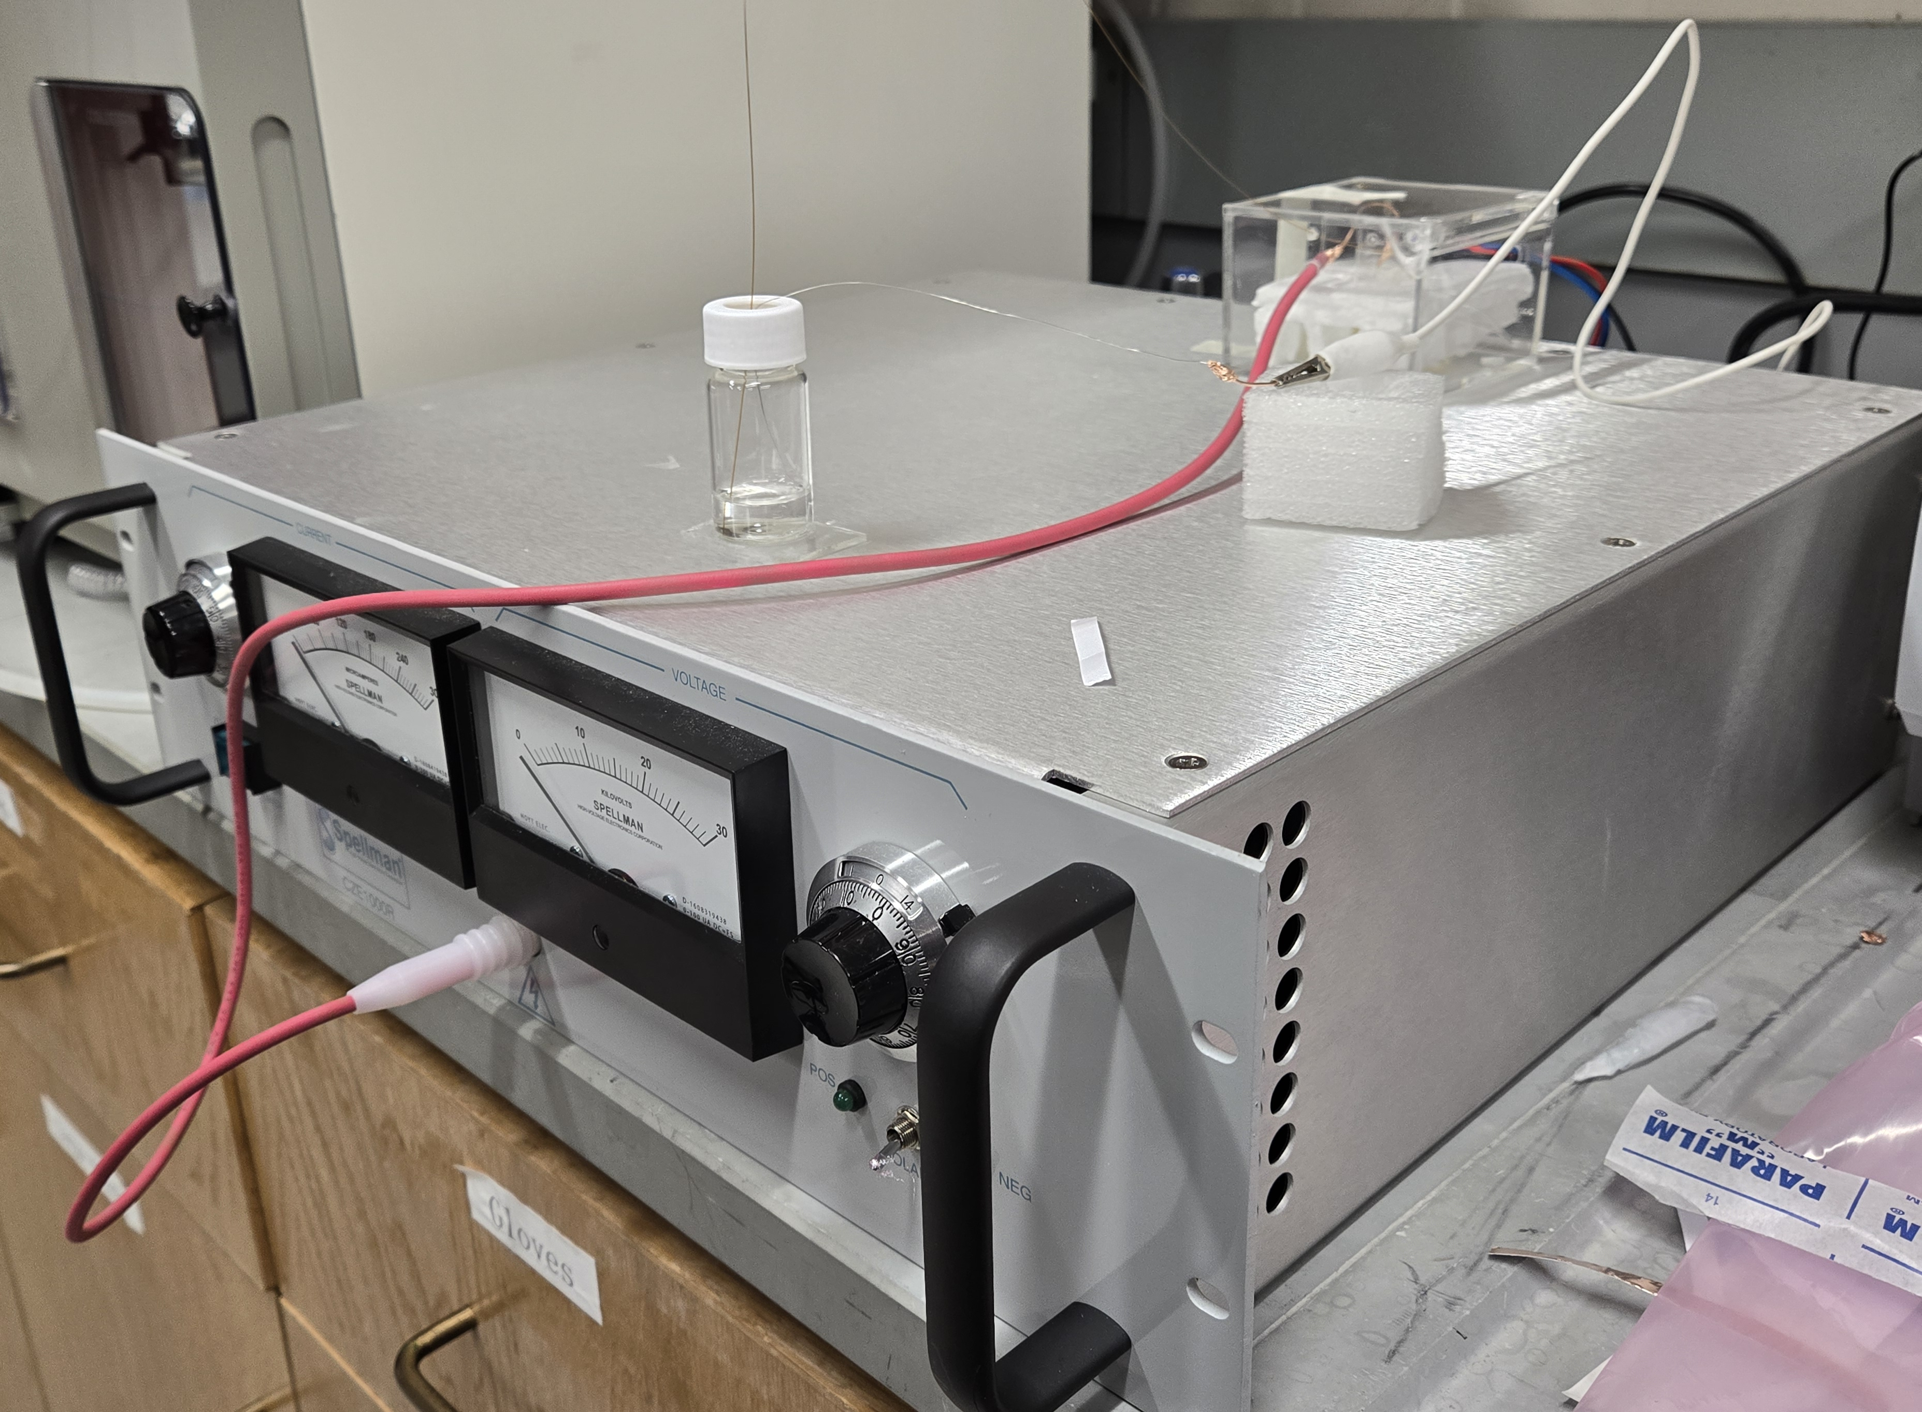
Sensor Setup
Johns Hopkins University
Clemson University
University of Delaware
University of Massachusetts Lowell
University of Maryland
Sample Reservoir
(with orange dye added)
Product Reservoir

Slide 9
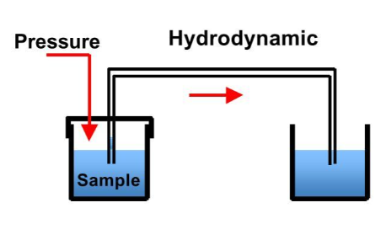
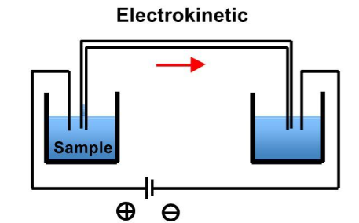
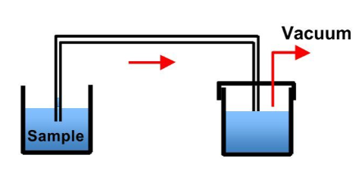
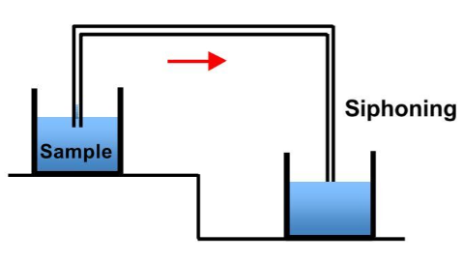
Sample Injection
Johns Hopkins University
Clemson University
University of Delaware
University of Massachusetts Lowell
University of Maryland
Build your own CE workshop, Brno, 2018

Slide 10
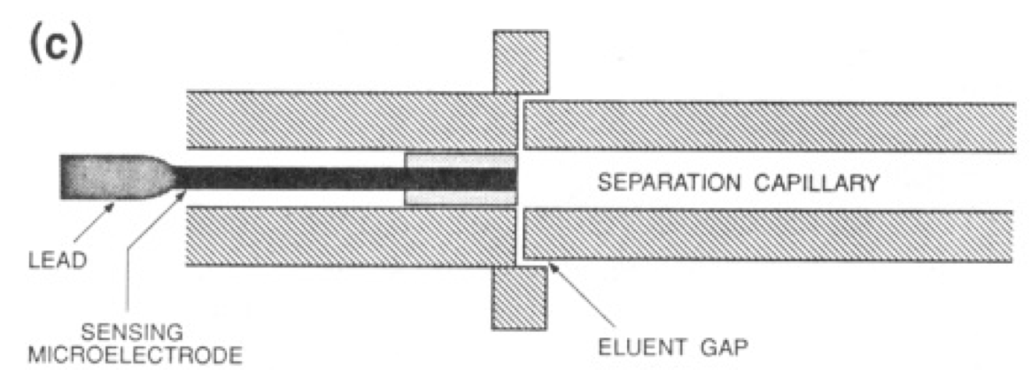
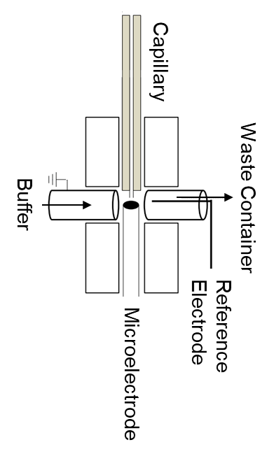
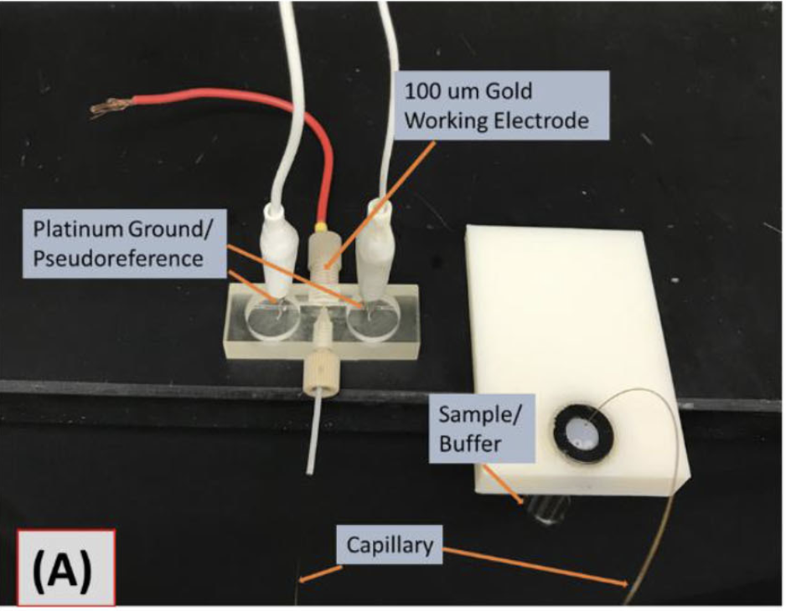
End Column Detection
If a second capillary is small enough, electrophoretic current through the capillary will be very small (1-15 nA)
Johns Hopkins University
Clemson University
University of Delaware
University of Massachusetts Lowell
University of Maryland
Electrical Field interference is minimized
Electroanalysis. 2018, 30(10), 2241-2249.

Slide 11
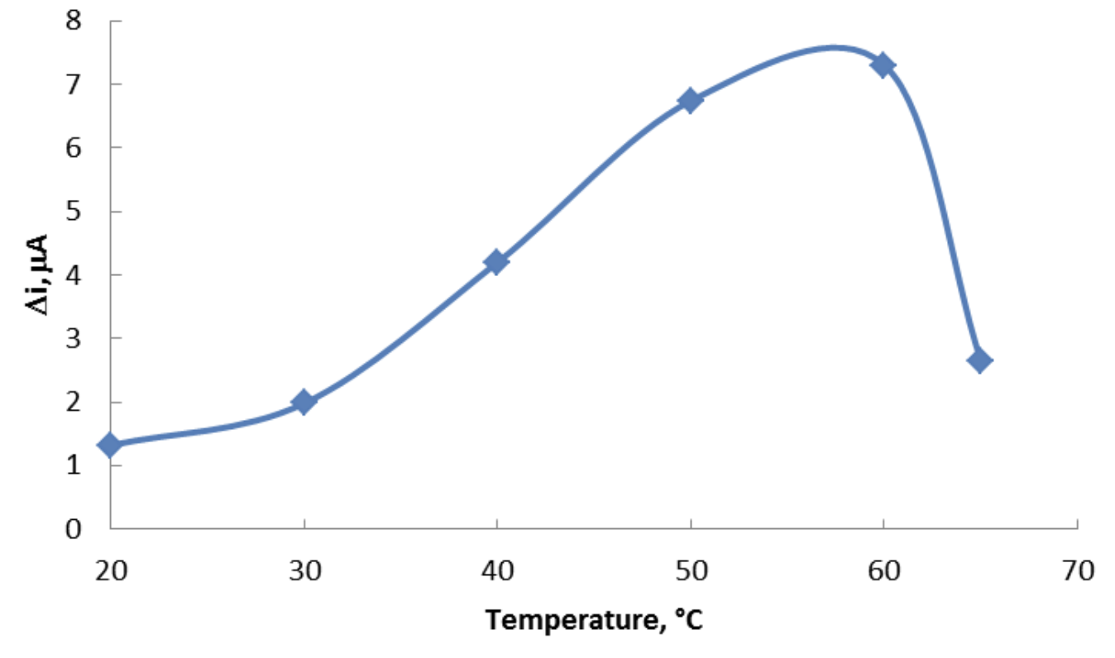
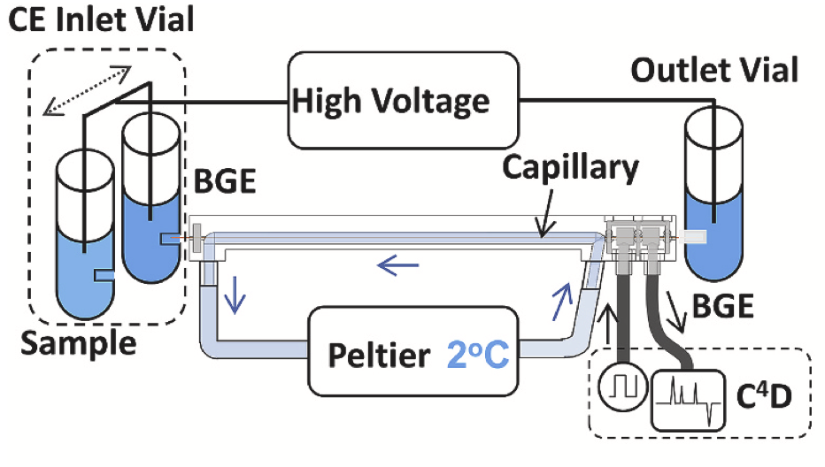
Cooling System
Effect of temperature on the response of the biosensor
Johns Hopkins University
Clemson University
University of Delaware
University of Massachusetts Lowell
University of Maryland
3D print the cooling cartridge to maintain the high performance of the separation and detection.
Int. J. Electrochem. Sci., Vol. 7, 2012.

Slide 12
Next Phase Plan
Microelectrode Design*:
  Test various materials for optimal sensitivity, stability, and low background noise.
  Experiment with shapes (e.g., round, conical, flat-tip) and size to find the best resolution and sensitivity balance.
3D Printed Liquid Cooling System:
  Use cooling-compatible materials to build a cartridge.
  Adjust flow rates and temperatures to maximize cooling efficiency and ensure stable capillary electrophoresis performance.
Sample Injection System:
  Test different systems with quick switch-outs and minimal dead volume.
  Compare syringe pump systems with pressure-driven injectors for control over injection volume and convenience.
Parameter Refinement:
  Adjust capillary length, voltage and current to evaluate effects on resolution and run time.
Johns Hopkins University
Clemson University
University of Delaware
University of Massachusetts Lowell
University of Maryland

Slide 13
Timeline since Now
Microelectrode Design: Start with common materials: gold, platinum, and carbon Test for sensitivity, stability, and background noise Choose shape: round, conical, or flat-tip for desired spatial resolution and sensitivity | Integration and Refinement of the Detection System: Optimize interface for low-resistance connectivity, ideal electrode placement, and material Refine parameters: voltage, current, capillary length, buffer conditions Ensure compatibility and performance Complete system with calibration, reproducibility tests, and LOD/LOQ assessments for accurate, reliable target analyte measurement | Application in Cell Culture: Calibrate CE-EChem detection system with known standards for nutrient and metabolite sensitivity Optimize parameters for peak sensitivity Monitor analyte concentrations in real-time within live CHO cell cultures Analyze data to assess system reliability for fed-batch and perfusion culture adjustments Enhance cell growth and productivity
Johns Hopkins University
Clemson University
University of Delaware
University of Massachusetts Lowell
University of Maryland
2
3
Months: 1-6
Months: 7-14
Months:15-18

