Slide 1








Industry/University Cooperative Research Center (I/UCRC)
Advanced Mammalian Biomanufacturing Innovation Center (AMBIC)
Controlling and applying the lactate shift for bioprocess monitoring and bioproduction improvements
Michael Betenbaugh (JHU), Maciek Antoniewicz (UMich), Bill Bentley (UMD)
30 May 2025
A National Science Foundation-facilitated
academic – industry – government consortia
to advance precompetitive knowledge in biomanufacturing
Contents are Proprietary to AMBIC and its Members
Terms of Center Membership Agreement Apply
www.ambic.org

Slide 2
Meeting outline
JHU updates
UMD updates
Johns Hopkins University
Clemson University
University of Delaware
University of Massachusetts Lowell
University of Maryland
Notes:
1: https://doi.org/10.1016/j.nbt.2012.05.021

Slide 3
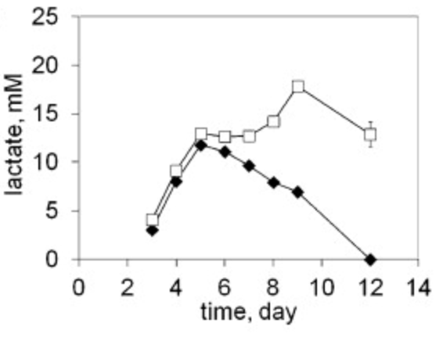
Industrial Relevance & Need
Importance of Lactate Shift
Metabolic shifts play important roles in culture longevity, titers, and product quality
Lactate shift from production to consumption (and vice versa) is particularly important, but the mechanism of this shift is poorly understood
Johns Hopkins University
Clemson University
University of Delaware
University of Massachusetts Lowell
University of Maryland
Lactate shift (production to consumption) can vary across CHO subclones.
DOI: 10.1016/j.nbt.2012.05.021
Understanding the interplay among process changes, lactate metabolism, and cellular redox state is essential in controlling lactate shift for enhanced process performance
Notes:
1: https://doi.org/10.1016/j.nbt.2012.05.021

Slide 4
Project Goals
GOAL 1
Elucidate how select process changes modulate intracellular redox state and lactate shift
        GOAL 2
        Employ novel process control/monitoring strategies to leverage lactate shift and alter redox cell physiology to improve growth, production, and product quality post-lactate shift
Johns Hopkins University
Clemson University
University of Delaware
University of Massachusetts Lowell
University of Maryland

Slide 5
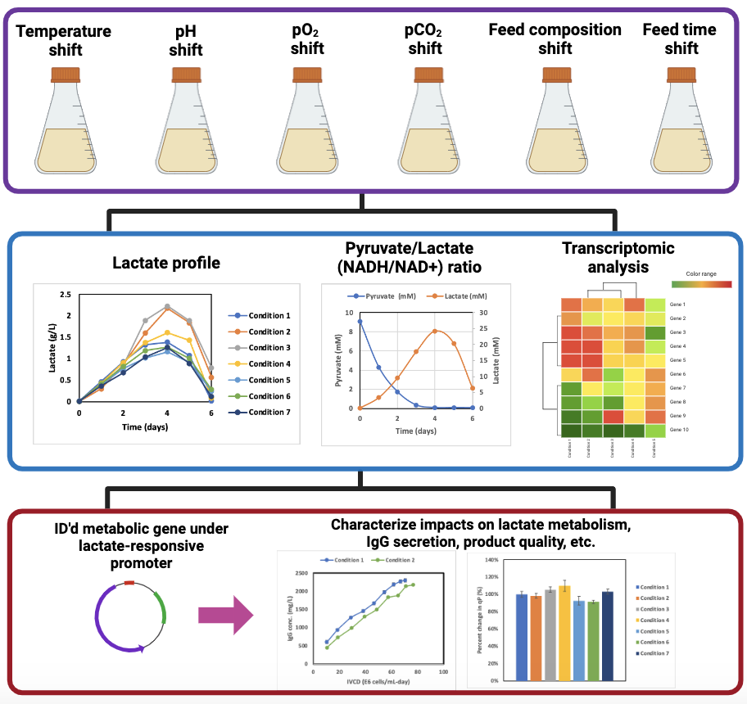
JHU Updates
To-do
(UMich has done)
Acid/Base studies
To-do
CO2 incubator change
Asn feeding studies
Perform cell culture studies under various process shifts
Johns Hopkins University
Clemson University
University of Delaware
University of Massachusetts Lowell
University of Maryland
Assess impact and identify relevant metabolic genes
Data generated from AMBIC project 2020-26
Modulate expression through lactate-responsive cassette, and characterize impact on cell culture performance

Slide 6
JHU Updates
CO2 incubator change
Perform cell culture studies under various process shifts
Johns Hopkins University
Clemson University
University of Delaware
University of Massachusetts Lowell
University of Maryland
Assess impact and identify relevant metabolic genes
Data generated from AMBIC project 2020-26
Modulate expression through lactate-responsive cassette, and characterize impact on cell culture performance

Slide 7
pCO₂ study
Completed batch culture in humidified incubators with 0-8% CO₂
5% CO₂ condition grew to highest VCD
Culture duration was consistent 5% vs. 8% CO₂
Johns Hopkins University
Clemson University
University of Delaware
University of Massachusetts Lowell
University of Maryland

Slide 8
pCO₂ study
0% CO₂ culture did not consume all Glc and did not undergo lactate shift
Johns Hopkins University
Clemson University
University of Delaware
University of Massachusetts Lowell
University of Maryland

Slide 9
pCO2 study
Initial pH values align with difference %CO₂
pH trends align with lactate profiles
Johns Hopkins University
Clemson University
University of Delaware
University of Massachusetts Lowell
University of Maryland

Slide 10
pCO2 study
Johns Hopkins University
Clemson University
University of Delaware
University of Massachusetts Lowell
University of Maryland

Slide 11
0% CO₂ screening study
No growth in 0% CO₂ when seeded at 0.3E6 cells/mL, even with manual pH correction
Mentor note: Test different seeding densities in 0% CO₂
Johns Hopkins University
Clemson University
University of Delaware
University of Massachusetts Lowell
University of Maryland
Research questions
Do CHO cells require CO₂ to grow?
Is there a minimum seeding density for growth in 0% CO₂?

Slide 12
0% CO₂ screening study
Study design
Process: Batch culture (30mL SF), 37ºC, 125 rpm
Control: 5% CO₂ incubator, seeded @ 0.3 E6 cells/mL
0% incubator conditions: 0.3, 0.5, 1.8, 3.3 E6 cells/mL seed with pH correction (match starting 5% CO₂ pH)
  Also include 0.3 E6 cells/mL seed without pH correction
Johns Hopkins University
Clemson University
University of Delaware
University of Massachusetts Lowell
University of Maryland

Slide 13
Growth data
5% CO₂ grew as expected
Highest seeded condition in 0% CO₂ grew until Glc depletion (next slide)
Other 0% CO₂ conditions:
  Seed density correlated to viability decline
Johns Hopkins University
Clemson University
University of Delaware
University of Massachusetts Lowell
University of Maryland

Slide 14
Glucose data
Growth effects explain differences in glucose consumption profiles
Johns Hopkins University
Clemson University
University of Delaware
University of Massachusetts Lowell
University of Maryland

Slide 15
Lactate data
0% CO₂, lower seeded cultures (0.3 – 0.7) do not undergo lactate shift
  Ongoing spent media analysis to assess nutrient depletion correlations
Johns Hopkins University
Clemson University
University of Delaware
University of Massachusetts Lowell
University of Maryland

Slide 16
Titer data
IgG production was consistent with different growth behaviors across conditions
Similar specific productivities across productive cultures
Johns Hopkins University
Clemson University
University of Delaware
University of Massachusetts Lowell
University of Maryland

Slide 17
8% CO₂ screening study
Johns Hopkins University
Clemson University
University of Delaware
University of Massachusetts Lowell
University of Maryland

Slide 18
8% CO₂ screening study
Study design
Process: Batch culture (35mL SF), 37ºC, 125 rpm
Control: 5% CO₂ incubator, seeded @ 0.3 E6 cells/mL
8% CO₂ incubator conditions: Seeded @ 0.3 E6 cells/mL with & without pH correction (match starting 5% CO₂ pH)
Johns Hopkins University
Clemson University
University of Delaware
University of Massachusetts Lowell
University of Maryland

Slide 19
pCO₂ study summary
Small differences between 5% and 8% regarding growth/lactate/qP
Low seed @ 0% CO₂ results in no growth
At high enough VCD, CHO cells can grow in 0% CO₂
VCD-adjustment (IVCD) suggests comparable behavior across 0% CO2 cultures, to account for differences in seeding
Ongoing: 8% CO₂ study
Next steps: measure pH/spent media of screening studies
Johns Hopkins University
Clemson University
University of Delaware
University of Massachusetts Lowell
University of Maryland

Slide 20
UMD Update
20250530

Slide 21
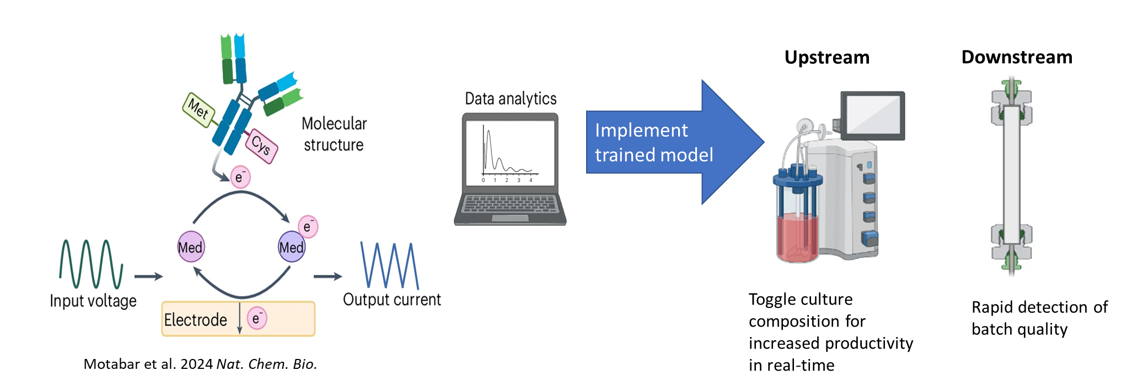
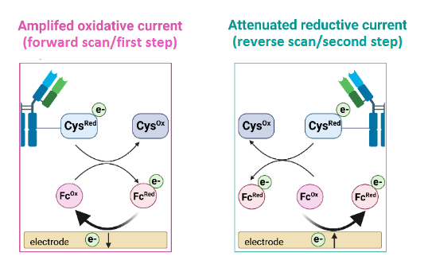
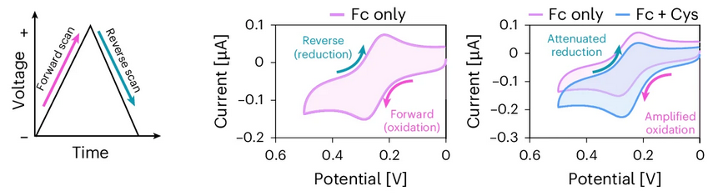
Mediated electrochemical probing (MEP) for bioprocess monitoring

Slide 22
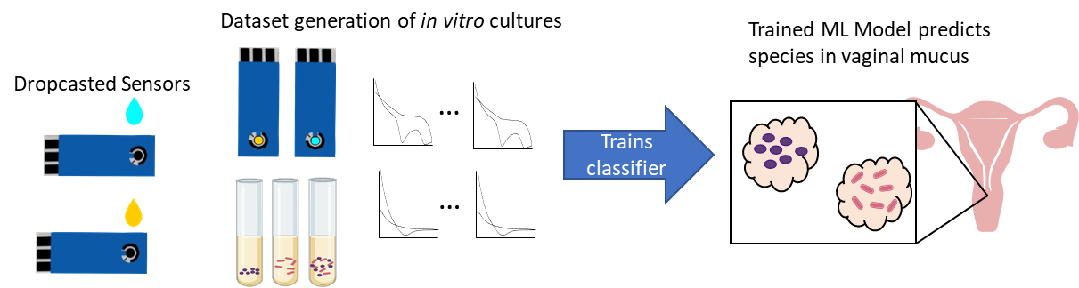
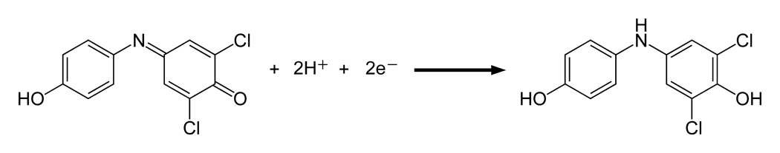
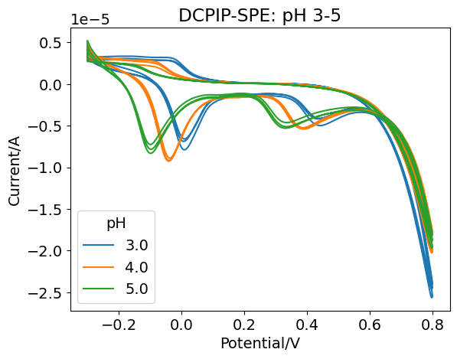
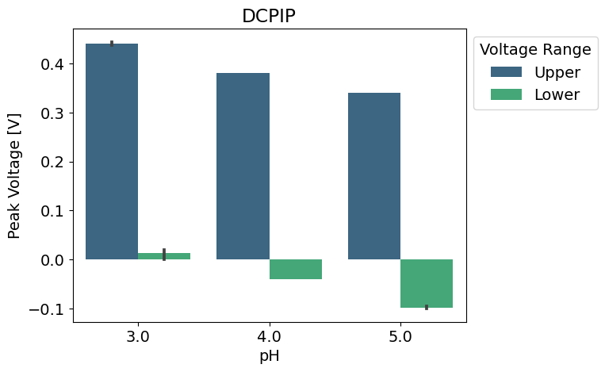
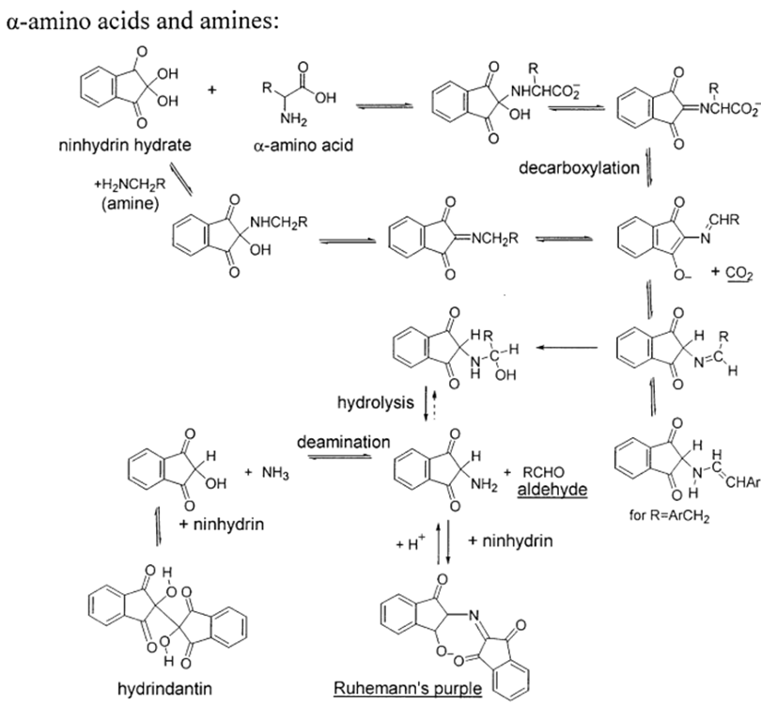

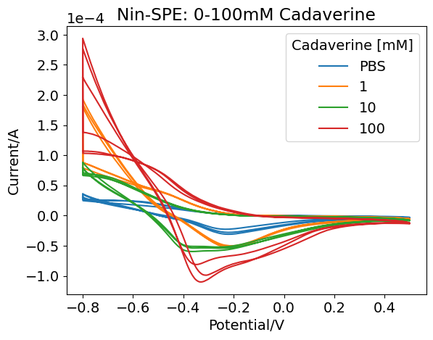
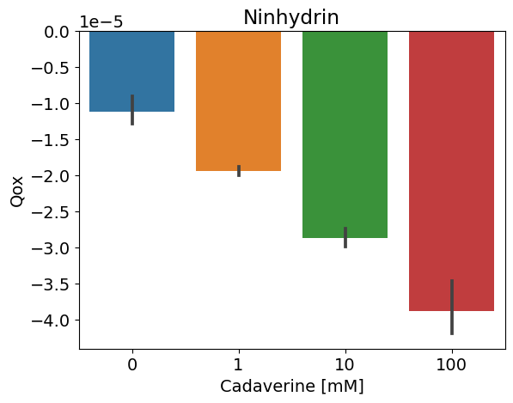
Mediators and sensor fabrication
pH probing: DCPIP
  DCPIP (blue) + H⁺ → DCPIPH (pink)
  DCPIPH (pink) + vitamin C → DCPIPH₂ (colorless)
Drop cast mediators and dry at 60°C
Amine probing:
Ninhydrin

Slide 23
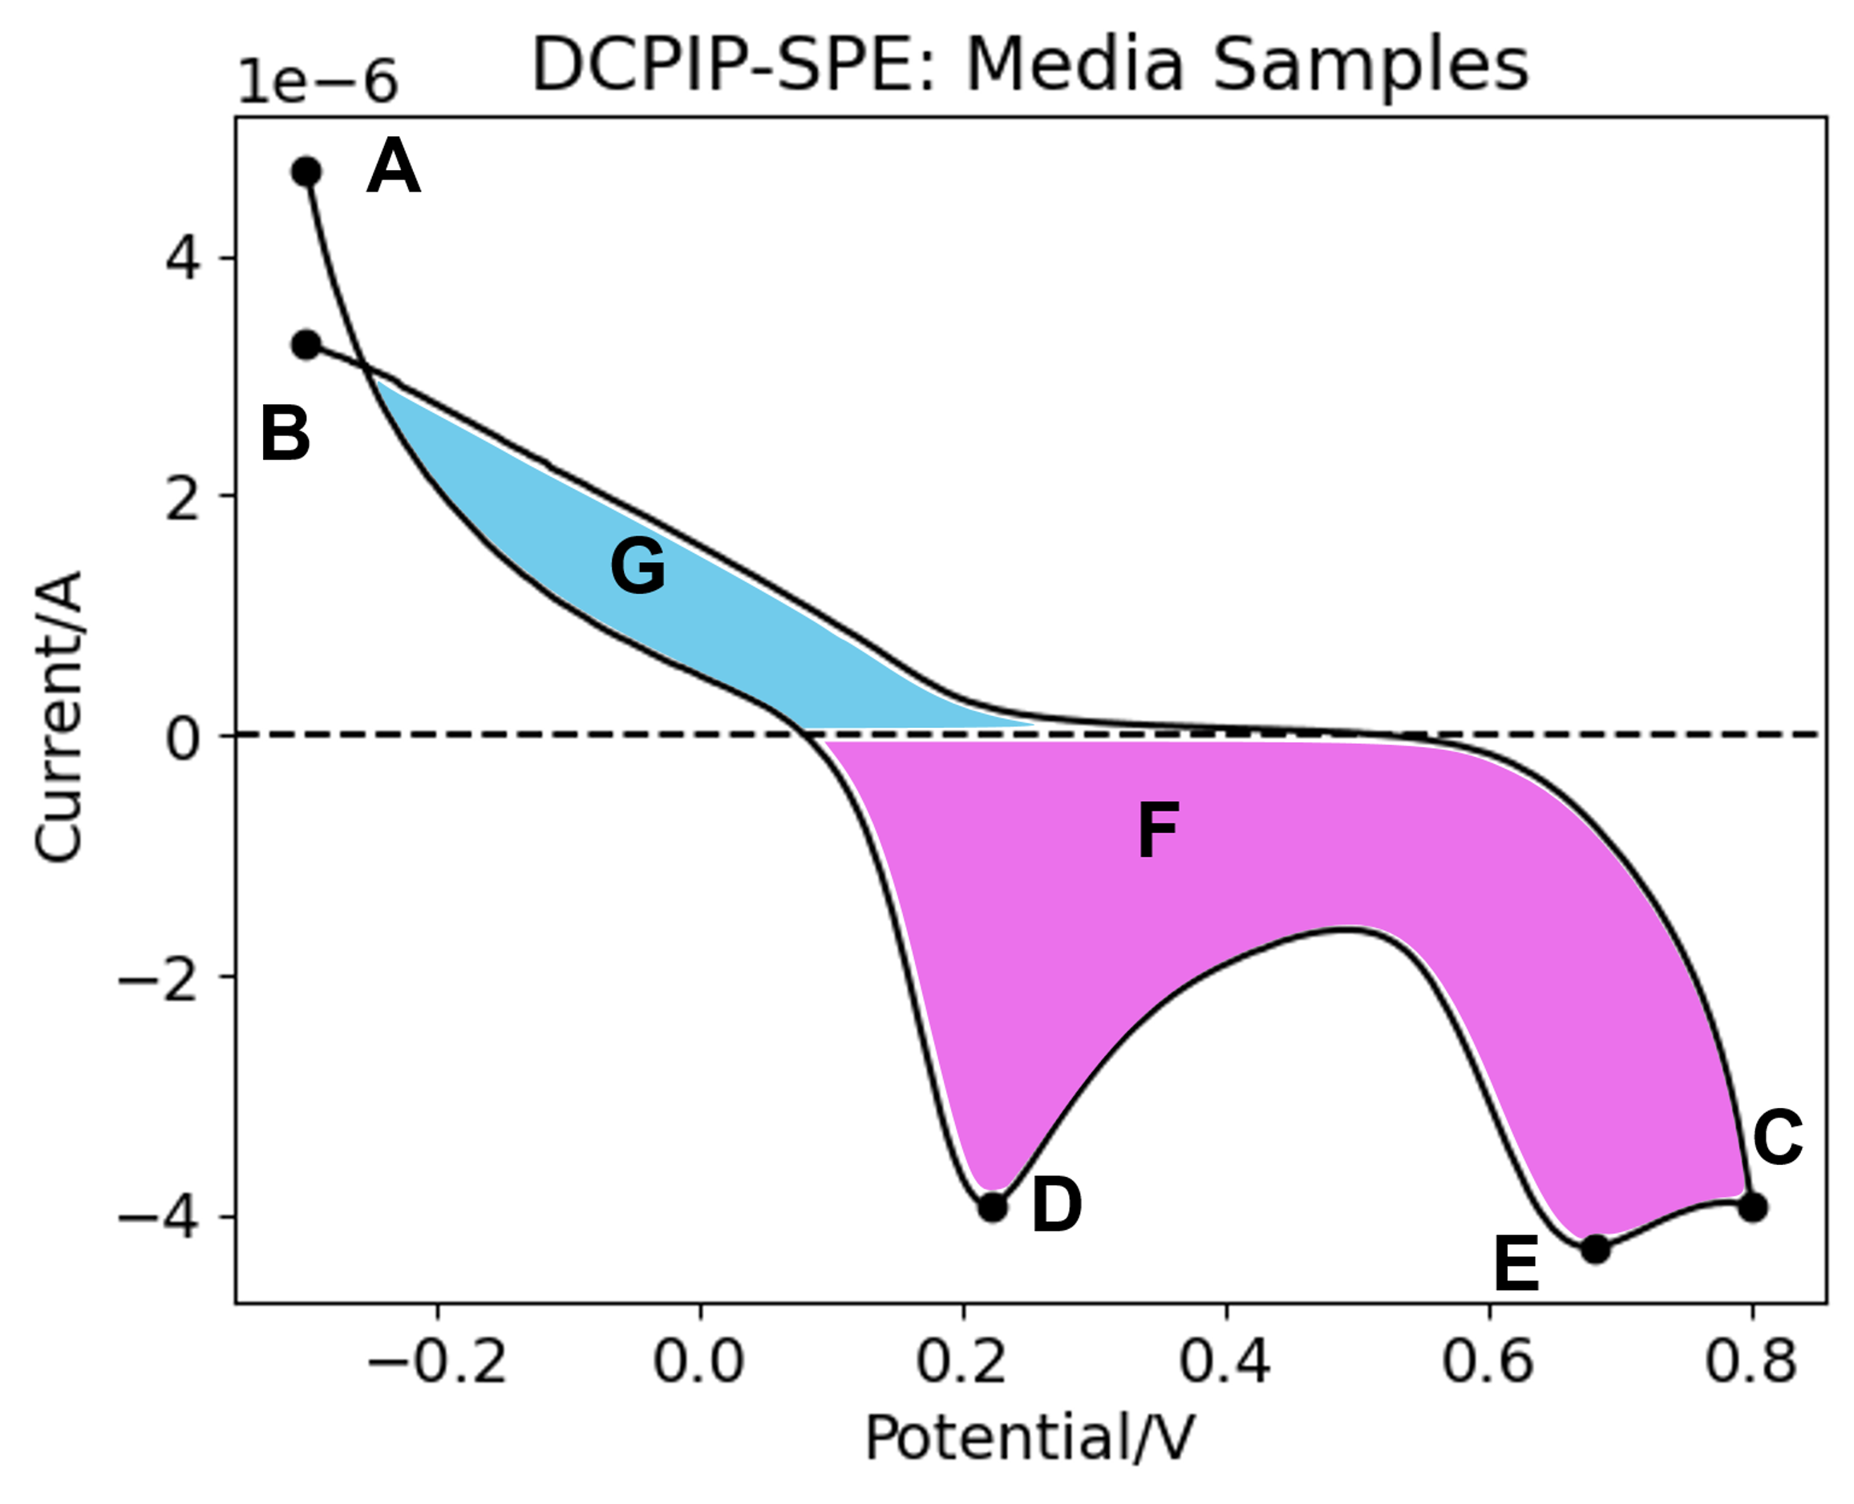
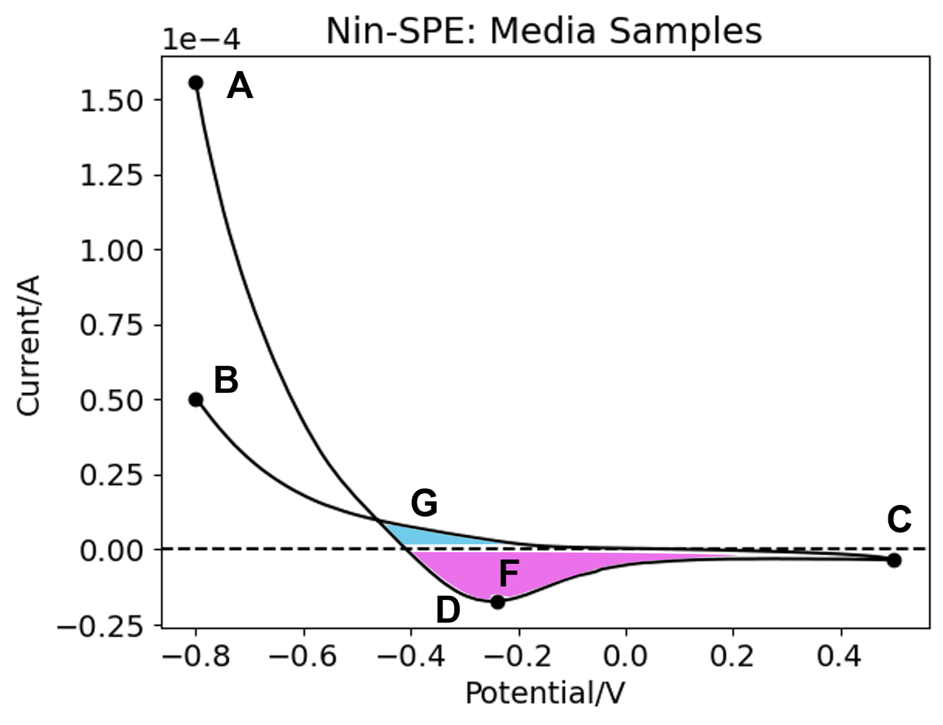
Data pipeline development
Preprocessing
Dimensionality reduction
  Principal Component Analysis
  Linear Discriminant Analysis
  Neighborhood Component Analysis
Electrochemical feature extraction
Single vs dual mediator input
Grid Search Classification Models
Support Vector Machine
Logistic Regression
Random Forest
K-Neighbors
Multi-layer Perceptron
A | Initial/Final current
B | Reductive peak
C | Switching current
D-E | Oxidative peaks
F | Oxidative charge
G | Reductive charge
Compare 5-fold cross-validation metrics
Receiver-operating-characteristic area-under-the-curve

Slide 24
Next steps
Test DCPIP and Ninhydrin modified electrodes on AMBIC media controls
Test DCPIP and Ninhydrin modified electrodes on CHO supernatant samples from shake flasks of various conditions (JHU)

