Slide 1








Industry/University Cooperative Research Center (I/UCRC)
Advanced Mammalian Biomanufacturing Innovation Center (AMBIC)
Controlling and applying the lactate shift for bioprocess monitoring and bioproduction improvements
Michael Betenbaugh (JHU), Maciek Antoniewicz (UMich), Bill Bentley (UMD)
25 October 2024
A National Science Foundation-facilitated
academic – industry – government consortia
to advance precompetitive knowledge in biomanufacturing
Contents are Proprietary to AMBIC and its Members
Terms of Center Membership Agreement Apply
www.ambic.org

Slide 2
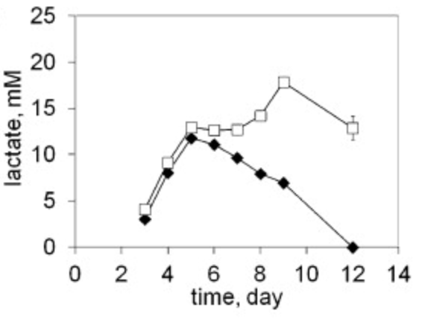
Industrial Relevance & Need
Importance of Lactate Shift
Metabolic shifts play important roles in culture longevity, titers, and product quality
Lactate shift from production to consumption (and vice versa) is particularly important, but the mechanism of this shift is poorly understood
Johns Hopkins University
Clemson University
University of Delaware
University of Massachusetts Lowell
University of Maryland
Lactate shift (production to consumption) can vary across CHO subclones.
DOI: 10.1016/j.nbt.2012.05.021
Understanding the interplay among process changes, lactate metabolism, and cellular redox state is essential in controlling lactate shift for enhanced process performance
Notes:
1: https://doi.org/10.1016/j.nbt.2012.05.021

Slide 3
Project Goals
GOAL 1
Elucidate how select process changes modulate intracellular redox state and lactate shift
        GOAL 2
        Employ novel process control/monitoring strategies to leverage lactate shift and alter redox cell physiology to improve growth, production, and product quality post-lactate shift
Johns Hopkins University
Clemson University
University of Delaware
University of Massachusetts Lowell
University of Maryland

Slide 4
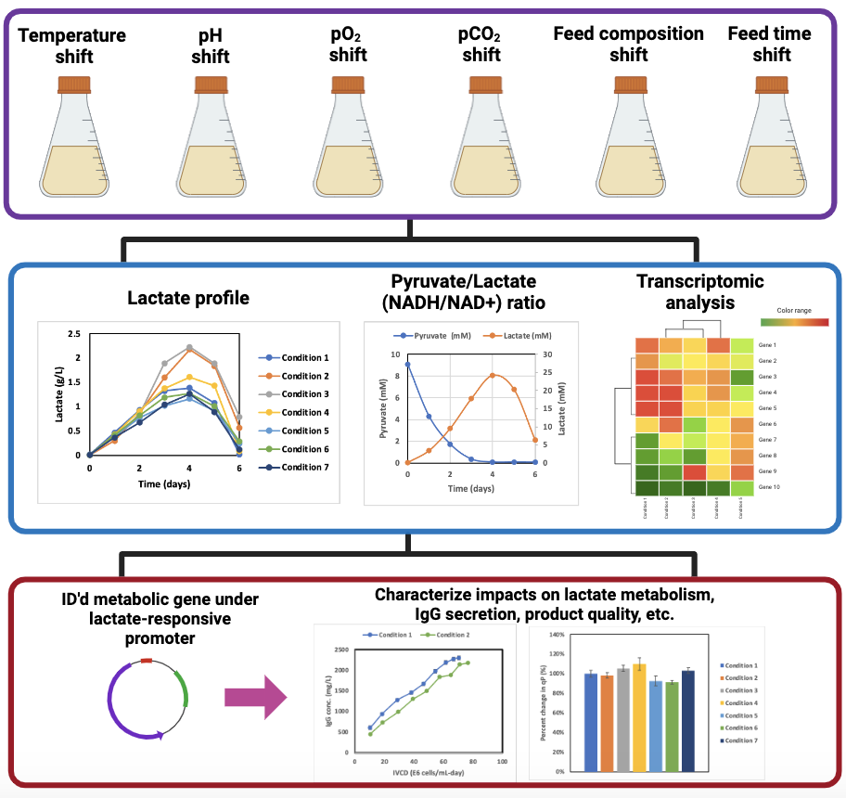
JHU Updates
Perform cell culture studies under various process shifts
Johns Hopkins University
Clemson University
University of Delaware
University of Massachusetts Lowell
University of Maryland
Assess impact and identify relevant metabolic genes
Data generated from AMBIC project 2020-26
Modulate expression through lactate-responsive cassette, and characterize impact on cell culture performance

Slide 5
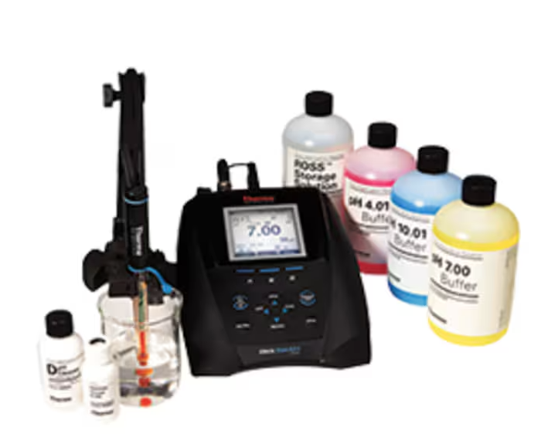
Study Design
Cell Line: Sigma CHO-K1 GS knockout (CHOZN)
Product: IgG with glycosylation on heavy chain
Basal Media: Sigma Immediate AdvantageTM (87093C)
pH adjustment: 5N NaOH or 5N HCl, filter sterilize
Batch Process: 30mL culture volume (shake flask), 37°C, 5% CO₂ incubator, 125 rpm agitation
Johns Hopkins University
Clemson University
University of Delaware
University of Massachusetts Lowell
University of Maryland
Control pH w/ CO₂ buffer = 7.5
Orion Star pH meter

Slide 6
Acidic Conditions
Decreasing pH shifted peak lactate ~ 1 day early, with reduced peak lactate at lowest pH condition
Johns Hopkins University
Clemson University
University of Delaware
University of Massachusetts Lowell
University of Maryland

Slide 7
Basic Conditions
Increased pH increased peak lactate level
Johns Hopkins University
Clemson University
University of Delaware
University of Massachusetts Lowell
University of Maryland

Slide 8

Comparing acidic vs. basic
Differences in glucose uptake and lactate secretion
Johns Hopkins University
Clemson University
University of Delaware
University of Massachusetts Lowell
University of Maryland

Slide 9
Next steps
Complete measuring IgG concentration for pH shift study
Repeat pH shift study with wider range of pH shift
Next study: temperature shift (open to suggestions)
Johns Hopkins University
Clemson University
University of Delaware
University of Massachusetts Lowell
University of Maryland

Slide 10
UMich Updates
Johns Hopkins University
Clemson University
University of Delaware
University of Massachusetts Lowell
University of Maryland

Slide 11
Temperature shift
Experiment #1 – Temperature shift (37ºC vs 33ºC)
Pre-culture
37ºC
Batch culture 37ºC
Johns Hopkins University
Clemson University
University of Delaware
University of Massachusetts Lowell
University of Maryland
Batch culture 33ºC
Experiment #2 – Reverse temperature shift (37ºC vs 33ºC)
Pre-culture
37ºC
Pre-culture
33ºC
Batch culture 37ºC
Batch culture 33ºC

Slide 12
Temperature shift
(37ºC vs 33ºC)
Johns Hopkins University
Clemson University
University of Delaware
University of Massachusetts Lowell
University of Maryland
Pre-culture
37ºC
Batch culture 37ºC
Batch culture 33ºC

Slide 13
Temperature shift
(37ºC vs 33ºC)
Johns Hopkins University
Clemson University
University of Delaware
University of Massachusetts Lowell
University of Maryland

Slide 14
Reverse temperature shift
(37ºC vs 33ºC)
Johns Hopkins University
Clemson University
University of Delaware
University of Massachusetts Lowell
University of Maryland
Pre-culture
37ºC
Pre-culture
33ºC
Batch culture 37ºC
Batch culture 33ºC

Slide 15
Next experiments
Experiment #3 – Temperature shift (37ºC vs 39ºC)
Pre-culture
37ºC
Batch culture 37ºC
Johns Hopkins University
Clemson University
University of Delaware
University of Massachusetts Lowell
University of Maryland
Batch culture 39ºC
Experiment #4 – pCO₂ shift (0% vs 5% vs 10% CO₂)
Pre-culture
5% CO₂
Batch culture 5% CO₂
Batch culture 0% CO₂
Batch culture 10% CO₂

Slide 16
Next meeting
Friday, December 6th @ 10:30am ET
Johns Hopkins University
Clemson University
University of Delaware
University of Massachusetts Lowell
University of Maryland

