Slide 1








Industry/University Cooperative Research Center (I/UCRC)
Advanced Mammalian Biomanufacturing Innovation Center (AMBIC)
Controlling and applying the lactate shift for bioprocess monitoring and bioproduction improvements
Michael Betenbaugh (JHU), Maciek Antoniewicz (UMich), Bill Bentley (UMD)
Project Pitch – June 2024
A National Science Foundation-facilitated
academic – industry – government consortia
to advance precompetitive knowledge in biomanufacturing
Contents are Proprietary to AMBIC and its Members
Terms of Center Membership Agreement Apply
www.ambic.org

Slide 2
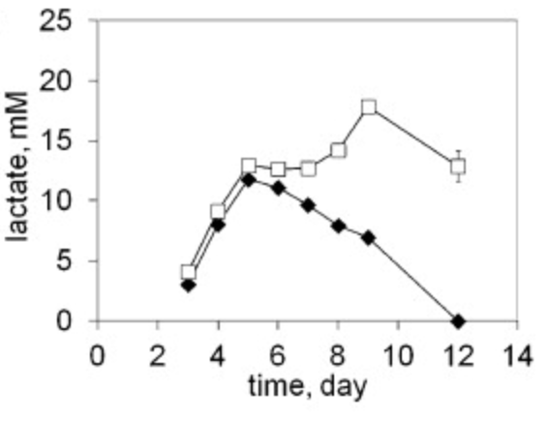
Industrial Relevance & Need
Importance of Lactate Shift
Metabolic shifts play important roles in culture longevity, titers, and product quality
Lactate shift from production to consumption (and vice versa) is particularly important, but the mechanism of this shift is poorly understood
Johns Hopkins University
Clemson University
University of Delaware
University of Massachusetts Lowell
University of Maryland
Lactate shift (production to consumption) can vary across CHO subclones.
DOI: 10.1016/j.nbt.2012.05.021
Understanding the interplay among process changes, lactate metabolism, and cellular redox state is essential in controlling lactate shift for enhanced process performance
Notes:
1: https://doi.org/10.1016/j.nbt.2012.05.021

Slide 3
Importance of Lactate Shift
Mechanisms proposed to affect lactate metabolism include:
1) lactate/H⁺ gradient across cell membrane 2) intracellular NAD⁺/NADH ratio
3) intracellular lactate/pyruvate ratio
4) lactate dehydrogenase expression / inhibition
5) glycolysis vs. oxidative phosphorylation flux
Despite general agreement of the potential mechanisms involved in this switch, no consensus exists to explain precisely why lactate shift occurs and how to best control it
Johns Hopkins University
Clemson University
University of Delaware
University of Massachusetts Lowell
University of Maryland

Slide 4
Project Goals
GOAL 1
Elucidate how select process changes modulate intracellular redox state and lactate shift
        GOAL 2
        Employ novel process control/monitoring strategies to leverage lactate shift and alter redox cell physiology to improve growth, production, and product quality post-lactate shift
Johns Hopkins University
Clemson University
University of Delaware
University of Massachusetts Lowell
University of Maryland

Slide 5
Objectives
Identify impact of temperature shift, pH shift, pO₂ shift, pCO₂ shift, feed medium composition & timing on lactate shift and redox state
Use cellular sensors to monitor redox state/ROS and identify approaches to alter redox state for improved performance
Employ ¹³C-flux analysis to quantify intracellular metabolic fluxes and identify lactate shift levers
Identify shift-related metabolic genes through transcriptomic analysis and alter expression through lactate-responsive switches
Johns Hopkins University
Clemson University
University of Delaware
University of Massachusetts Lowell
University of Maryland

Slide 6
Research Approach
In this project, we bring together three labs to investigate how to use process shifts to optimize process performance and engineer better cell lines
Antoniewicz Lab: ¹³C metabolic analysis
Bentley Lab: redox state analysis
Betenbaugh Lab: ‘omics data analysis
Johns Hopkins University
Clemson University
University of Delaware
University of Massachusetts Lowell
University of Maryland

Slide 7
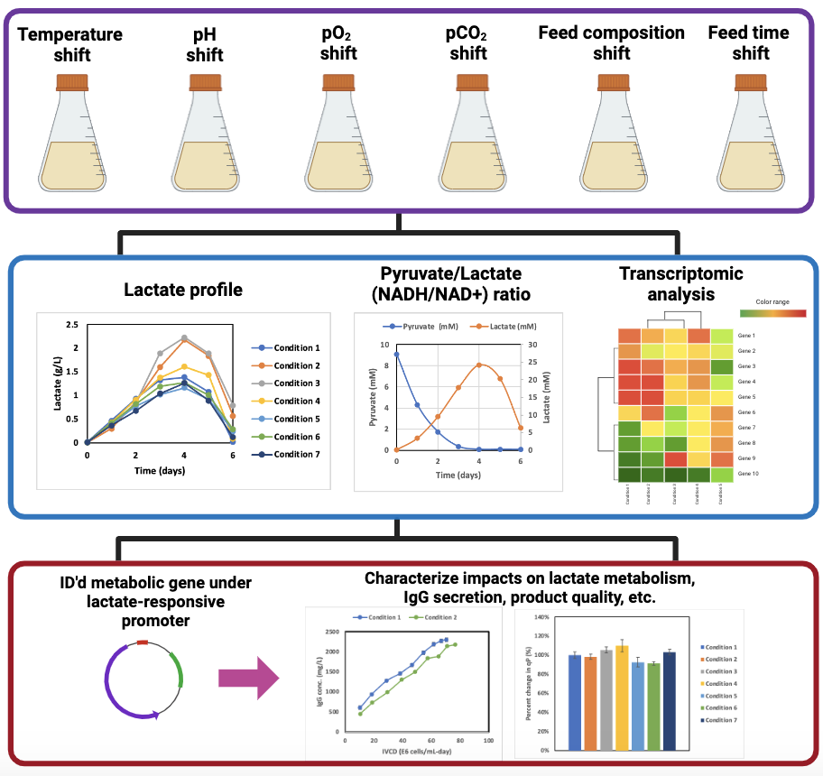
Research Approach (1)
Perform cell culture studies under various process shifts
Johns Hopkins University
Clemson University
University of Delaware
University of Massachusetts Lowell
University of Maryland
Assess impact and identify relevant metabolic genes
Data generated from AMBIC project 2020-26
Modulate expression through lactate-responsive cassette, and characterize impact on cell culture performance

Slide 8
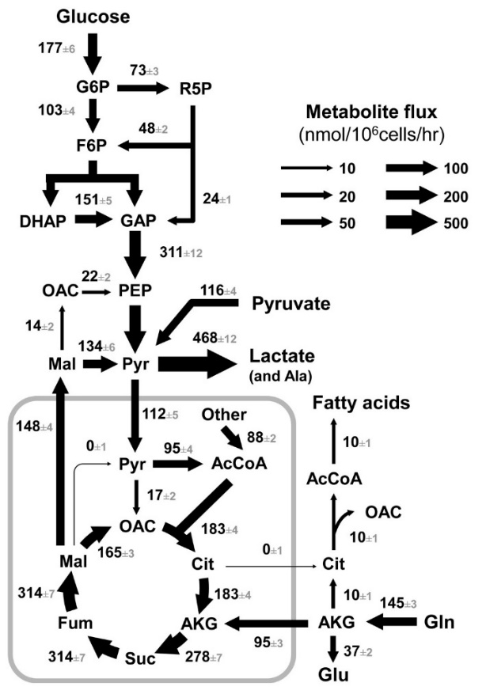

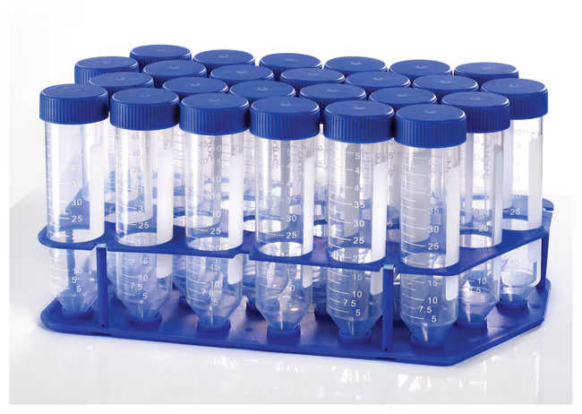
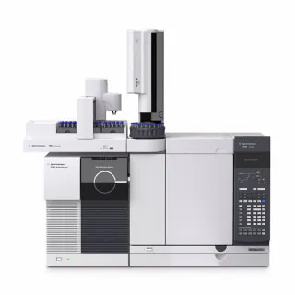

Research Approach (2)
Apply ¹³C-flux analysis and measured intracellular metabolite dynamics to characterize relationship among process shifts, lactate metabolism and oxidative phosphorylation
Tools to measure intracellular fluxes and metabolite concentrations:
Johns Hopkins University
Clemson University
University of Delaware
University of Massachusetts Lowell
University of Maryland
¹³C-Metabolic Flux Analysis
¹³C internal standards to measure intracellular concentrations in CHO
Yeast or E. coli cells grown on
[U-¹³C]glucose
Extracted intracellular metabolites (¹³C labeled)
+
¹³C-standard
CHO cell
pellet
Mass Spec
Analysis

Slide 9
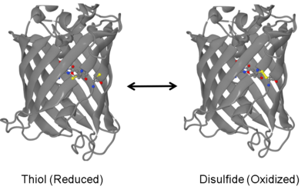
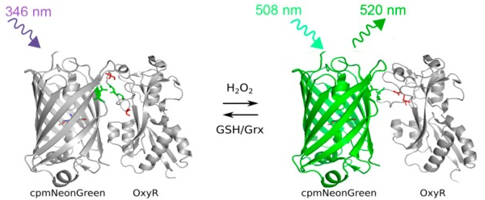
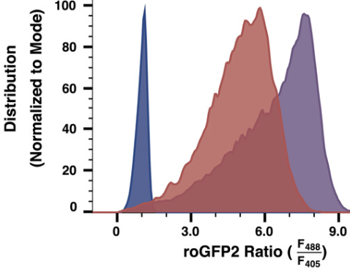
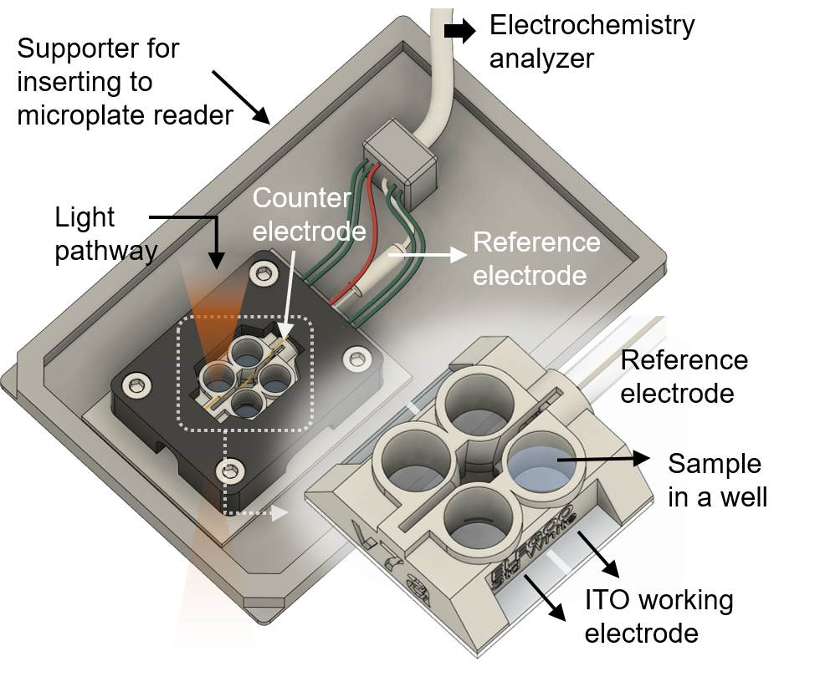
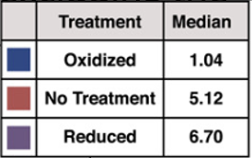

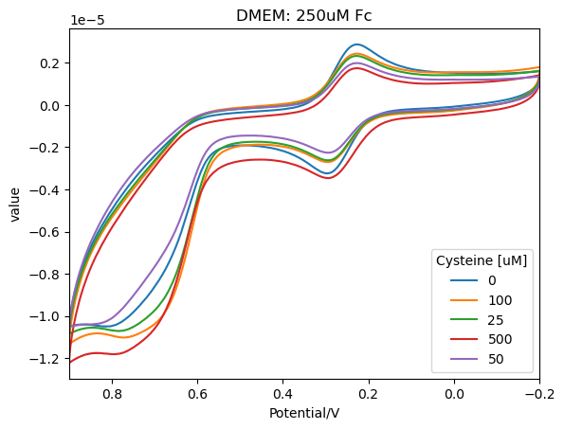
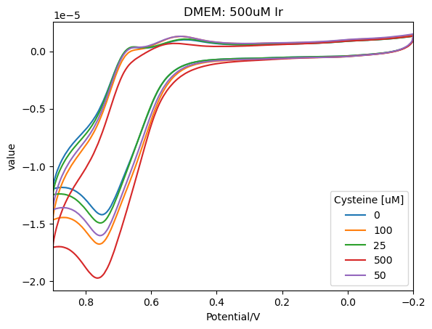
Research Approach (3)
Apply redox sensing techniques to characterize relationship among process shifts, lactate metabolism, and redox state
Current tools to measure intracellular redox state:
roGFP (ROS, redox sensor) NAD/NADH
Hyper (H₂O₂ sensor)
Johns Hopkins University
Clemson University
University of Delaware
University of Massachusetts Lowell
University of Maryland
Mediated Electrochemical Probing (MEP)
of extracellular environment
Cysteine
& Amino Acids
From McFarland, Betenbaugh, Handlogten, Biotech. Bioeng., 2022, DOI: 10.1002/bit.28067
Investigate how intracellular lactate, extracellular acidification, and shifts in glucose/lactate metabolism affect ROS/redox
Notes:
Lactate switch in CHO cells is proposed due to cellular redox state, Biotech Bioeng. DOI 10.1002/bit.26603 (nice review).
Intracellular lactate level, Extracellular acidification, correlate with oxidative phosphorylation (OXPHOS) Kim et al., Oxid Med Cell Longev, DOI 10.1155/2021/5428364.
Shifts in glucose metabolism lead to mitochondrial disfunction, changes in ROS and redox signaling, Antioxid Redox Signal, DOE 10.1089/ars.2018.7657.

Slide 10
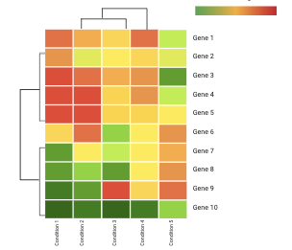
Outcomes
Year 1
Quantify impacts of process shifts
on intracellular metabolism and
activation of lactate shift
Evaluate cell sensors of redox state
and ROS of CHO pre- & post-lactate shift
Apply transcriptomics to identify
metabolic genes related to lactate shift
Year 2
Detailed metabolic flux maps for CHO cells before and after process shifts
Quantitative measurements of redox states & ROS
Analysis of potential synergies between temperature shift, pH shift, etc. and the impact on lactate shift
Johns Hopkins University
Clemson University
University of Delaware
University of Massachusetts Lowell
University of Maryland

Slide 11
Research Impact
New fundamental insights regarding the impact of process shifts on lactate metabolism and redox state
Identification of altered metabolic fluxes, gene expression, and redox state in relation to lactate shift
Implementation of redox monitoring and metabolic control to modulate lactate shift for improved culture performance
Johns Hopkins University
Clemson University
University of Delaware
University of Massachusetts Lowell
University of Maryland

Slide 12
Project Duration & Budget
Project Duration 2 years
Project Budget $165,000 per year
Johns Hopkins University
Clemson University
University of Delaware
University of Massachusetts Lowell
University of Maryland
3 students ($30k ea., $90k total)
Tuition ($4k ea., $12k total)​
Materials and supplies ($30k)​
Analytics ($16.5k)​
Overhead ($16.5k)​
​

Slide 13
Anticipated Business Value Deliverables
Project Name: Controlling and applying the lactate shift for bioprocess monitoring and bioproduction improvements
Project Academic PI: Michael Betenbaugh (JHU), Maciek Antoniewicz (UMich), Bill Bentley (UMD)
Project IAB Lead:
Category | Sub-Category | Business Value Deliverables
Technical Data | Digital Data | Growth & productivity, metabolite profiles during process-shifted cultures Redox sensing data during process-shifted cultures 13C tracing data Transcriptomic data of lactate-responsive genetic elements
 | Printed Data
Procedure | Manual
 | Protocols | Protocols for sample prep for GCMS metabolite analysis Protocols for redox sensing studies Protocols for transcriptomic analysis
 | Design Specifications
Computer Programs | Web-accessed, server-hosted
 | Distributed compiled software
 | Formatted, annotated code
 | Printed algorithm
Reports | Meeting Slides and Minutes | Monthly meeting slide deck and minutes stored on www.AMBIC.org
 | Peer-reviewed publication
 | Thesis or Dissertation
 | Internal Technical Report | Make available thesis or dissertation/s associated to this project
 | Public Presentation
Training | Individual Study Documents
 | Recorded Webinar
 | Live Class, Course or lab
Material | Organism | Chinese Hamster Ovary (CHO) cells
 | Process Product or Byproduct | Product - IgG
 | Reference Material | Sigma Immediate Advantage Media
Analysis | Testing of IAB material
 | Evaluation with IAB data
Johns Hopkins University
Clemson University
University of Delaware
University of Massachusetts Lowell
University of Maryland
Confidential

