Slide 1








Industry/University Cooperative Research Center (I/UCRC)
Advanced Mammalian Biomanufacturing Innovation Center (AMBIC)
Controlling and applying the lactate shift for bioprocess monitoring and bioproduction improvements
Michael Betenbaugh (JHU), Maciek Antoniewicz (UMich), Bill Bentley (UMD)
06 December 2024
A National Science Foundation-facilitated
academic – industry – government consortia
to advance precompetitive knowledge in biomanufacturing
Contents are Proprietary to AMBIC and its Members
Terms of Center Membership Agreement Apply
www.ambic.org

Slide 2
Meeting outline
JHU updates (follow-up pH shift study)
UMD updates (electrochemiluminescnce monitoring)
Johns Hopkins University
Clemson University
University of Delaware
University of Massachusetts Lowell
University of Maryland
Notes:
1: https://doi.org/10.1016/j.nbt.2012.05.021

Slide 3
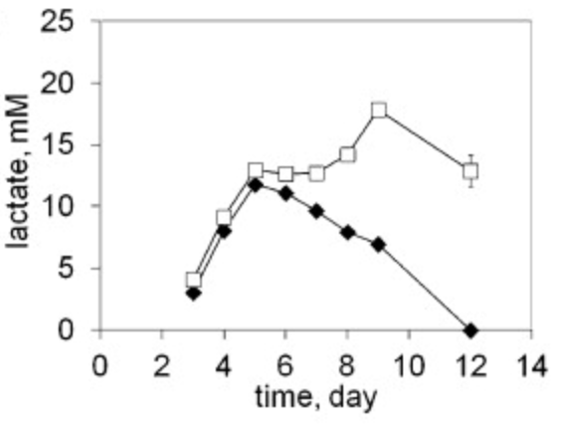
Industrial Relevance & Need
Importance of Lactate Shift
Metabolic shifts play important roles in culture longevity, titers, and product quality
Lactate shift from production to consumption (and vice versa) is particularly important, but the mechanism of this shift is poorly understood
Johns Hopkins University
Clemson University
University of Delaware
University of Massachusetts Lowell
University of Maryland
Lactate shift (production to consumption) can vary across CHO subclones.
DOI: 10.1016/j.nbt.2012.05.021
Understanding the interplay among process changes, lactate metabolism, and cellular redox state is essential in controlling lactate shift for enhanced process performance
Notes:
1: https://doi.org/10.1016/j.nbt.2012.05.021

Slide 4
Project Goals
GOAL 1
Elucidate how select process changes modulate intracellular redox state and lactate shift
        GOAL 2
        Employ novel process control/monitoring strategies to leverage lactate shift and alter redox cell physiology to improve growth, production, and product quality post-lactate shift
Johns Hopkins University
Clemson University
University of Delaware
University of Massachusetts Lowell
University of Maryland

Slide 5
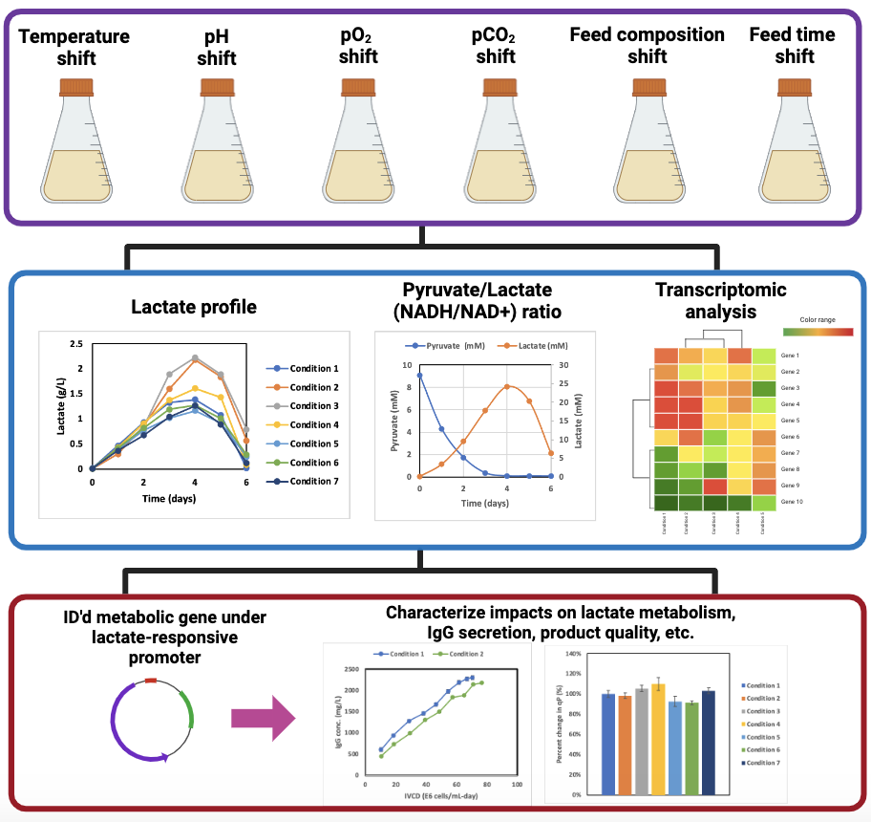
JHU Updates
Perform cell culture studies under various process shifts
Johns Hopkins University
Clemson University
University of Delaware
University of Massachusetts Lowell
University of Maryland
Assess impact and identify relevant metabolic genes
Data generated from AMBIC project 2020-26
Modulate expression through lactate-responsive cassette, and characterize impact on cell culture performance

Slide 6
Study Design
Cell Line: Sigma CHO-K1 GS knockout (CHOZN)
Product: IgG with glycosylation on heavy chain
Basal Media: Sigma Immediate AdvantageTM (87093C)
pH adjustment: HCl or NaOH addition, filter sterilize
Final acid/base concentration: 0-10mM (duplicate)
Batch Process: 30mL culture volume (shake flask), 37°C, 5% CO₂ incubator, 125 rpm agitation
Johns Hopkins University
Clemson University
University of Delaware
University of Massachusetts Lowell
University of Maryland
Control pH: 7.3
Target acidic pH range: 7.0-7.3
Target basic pH range: 7.3-7.5

Slide 7
Acidic Conditions
Decreasing pH reduced glucose consumption, lactate secretion, and extended culture duration
Johns Hopkins University
Clemson University
University of Delaware
University of Massachusetts Lowell
University of Maryland

Slide 8
Basic Conditions
Increasing pH increased glucose consumption, lactate secretion, and reduced culture duration
Johns Hopkins University
Clemson University
University of Delaware
University of Massachusetts Lowell
University of Maryland

Slide 9
pH trends and lactate
Cultures achieve similar pH minimum (despite initial offset) by adjusting peak lactate secretion
Johns Hopkins University
Clemson University
University of Delaware
University of Massachusetts Lowell
University of Maryland

Slide 10
Next steps
Complete IgG measurements of acid/base runs
Next studies: pCO2, temperature shift (open to suggestions)
Johns Hopkins University
Clemson University
University of Delaware
University of Massachusetts Lowell
University of Maryland
Effect of %CO₂, acid/base addition on media pH

Slide 11
AMBIC 2025 Winter Conference
14-16
Johns Hopkins University
Clemson University
University of Delaware
University of Massachusetts Lowell
University of Maryland
Effect of %CO₂, acid/base addition on media pH

Slide 12
Relevant publications
Elevated pCO2 affects the lactate metabolic
shift in CHO cell culture processes
Deciphering molecular drivers of lactate metabolic shift in mammalian cell cultures
Johns Hopkins University
Clemson University
University of Delaware
University of Massachusetts Lowell
University of Maryland

