Slide 1








Industry/University Cooperative Research Center (I/UCRC)
Advanced Mammalian Biomanufacturing Innovation Center (AMBIC)
Controlling and applying the lactate shift for bioprocess monitoring and bioproduction improvements
Michael Betenbaugh (JHU), Maciek Antoniewicz (UMich), Bill Bentley (UMD)
25 April 2025
A National Science Foundation-facilitated
academic – industry – government consortia
to advance precompetitive knowledge in biomanufacturing
Contents are Proprietary to AMBIC and its Members
Terms of Center Membership Agreement Apply
www.ambic.org

Slide 2
Meeting outline
JHU updates
UMD updates
Johns Hopkins University
Clemson University
University of Delaware
University of Massachusetts Lowell
University of Maryland
Notes:
1: https://doi.org/10.1016/j.nbt.2012.05.021

Slide 3
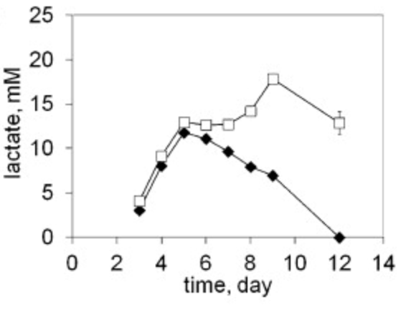
Industrial Relevance & Need
Importance of Lactate Shift
Metabolic shifts play important roles in culture longevity, titers, and product quality
Lactate shift from production to consumption (and vice versa) is particularly important, but the mechanism of this shift is poorly understood
Johns Hopkins University
Clemson University
University of Delaware
University of Massachusetts Lowell
University of Maryland
Lactate shift (production to consumption) can vary across CHO subclones.
DOI: 10.1016/j.nbt.2012.05.021
Understanding the interplay among process changes, lactate metabolism, and cellular redox state is essential in controlling lactate shift for enhanced process performance
Notes:
1: https://doi.org/10.1016/j.nbt.2012.05.021

Slide 4
Project Goals
GOAL 1
Elucidate how select process changes modulate intracellular redox state and lactate shift
        GOAL 2
        Employ novel process control/monitoring strategies to leverage lactate shift and alter redox cell physiology to improve growth, production, and product quality post-lactate shift
Johns Hopkins University
Clemson University
University of Delaware
University of Massachusetts Lowell
University of Maryland

Slide 5
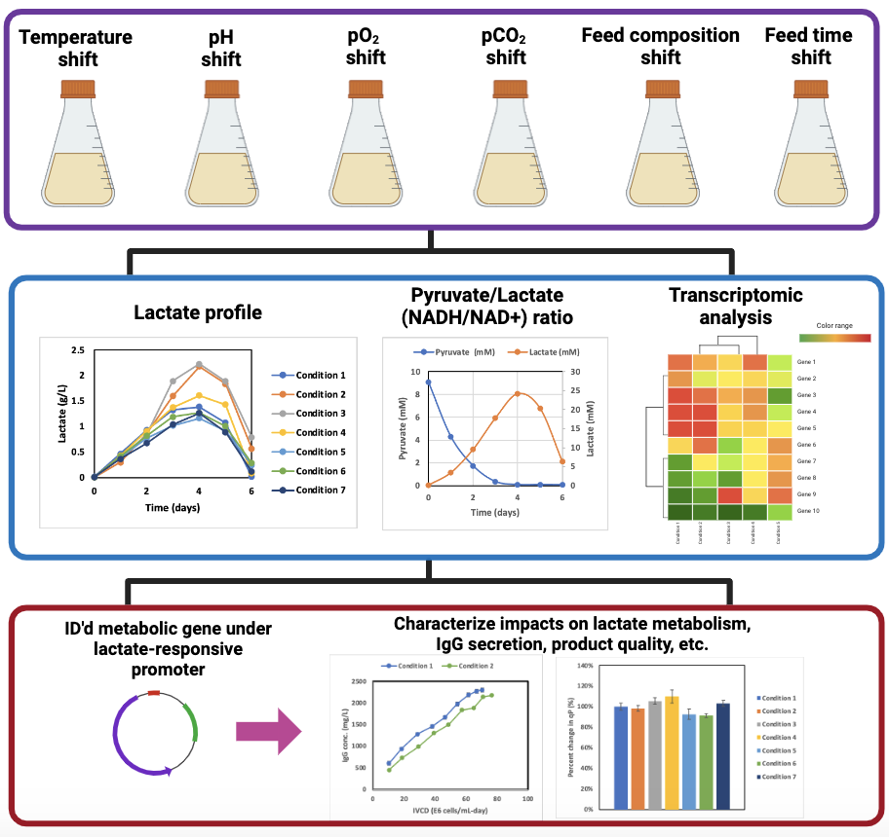
JHU Updates
Last meeting
New this meeting
Perform cell culture studies under various process shifts
Johns Hopkins University
Clemson University
University of Delaware
University of Massachusetts Lowell
University of Maryland
Assess impact and identify relevant metabolic genes
Data generated from AMBIC project 2020-26
Modulate expression through lactate-responsive cassette, and characterize impact on cell culture performance

Slide 6
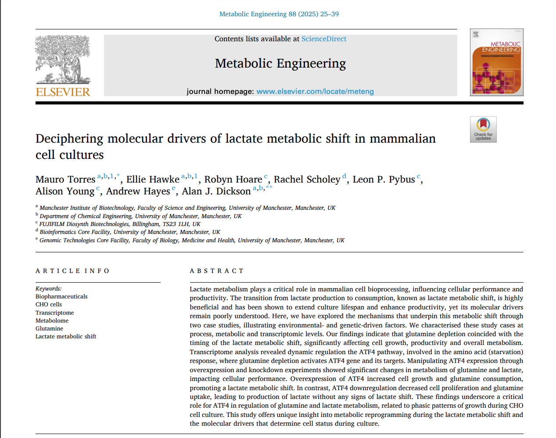
Recent publication related to Gln depletion and lactate shift
Results indicate that Gln depletion coincided with lactate shift in CHODG44 (DHFR expression system)
Gln depletion activates ATF4 pathway (amino acid starvation response)
ATF4 over/under-expression affected glutamine and lactate metabolism
Johns Hopkins University
Clemson University
University of Delaware
University of Massachusetts Lowell
University of Maryland
We observe lactate shift in our CHO-GS cell culture, but do not have Gln supplemented
    Is there another AA related to starvation response/ATF4 pathway activation?

Slide 7
Asparagine depletion coincides with lactate shift in CHO-GS cultures
YSI and GC-MS quantification of extracellular metabolite concentrations
Glucose, most amino acids (e.g., Val) are depleted after lactate shift occurs
Asn = amino acid with coincidental depletion with lactate shift
Does feeding Asn to delay depletion affect timing of lactate shift?
Johns Hopkins University
Clemson University
University of Delaware
University of Massachusetts Lowell
University of Maryland

Slide 8
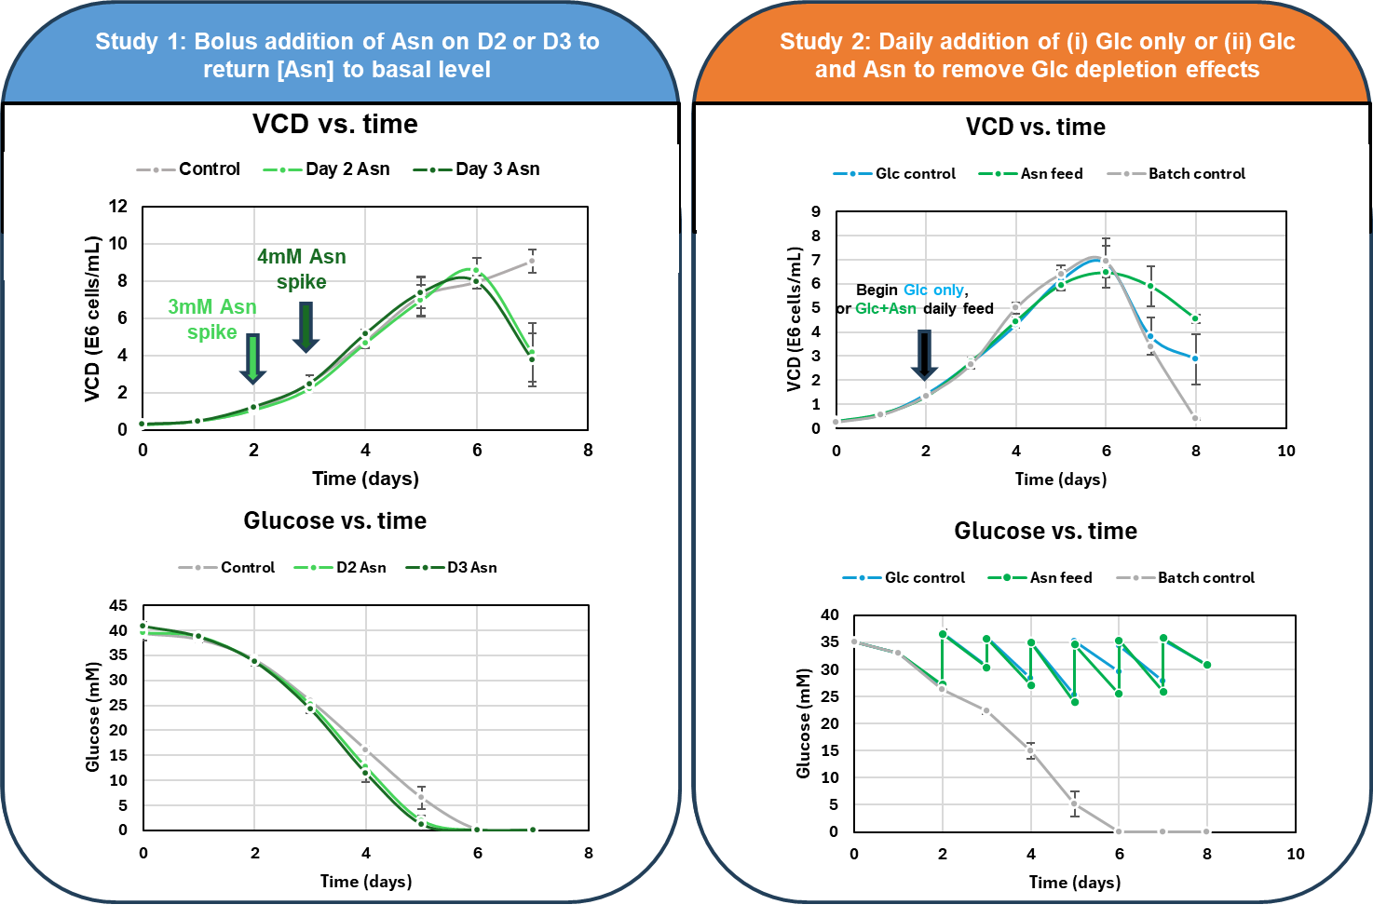
Asn feed studies
Johns Hopkins University
Clemson University
University of Delaware
University of Massachusetts Lowell
University of Maryland

Slide 9
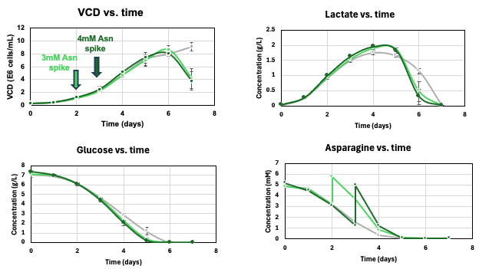
Asn study 1: Bolus addition
Johns Hopkins University
Clemson University
University of Delaware
University of Massachusetts Lowell
University of Maryland
Asn-fed cultures depleted glucose 1 day quicker than control, and had slight elevations in peak lactate
Cultures depleted Asn at similar times despite differences in feeding times

Slide 10
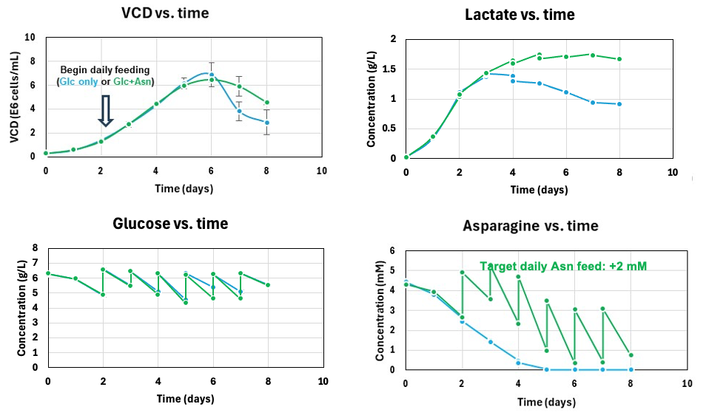
Asn feed study 2:
+2mM Asn daily feed
Asn-fed culture had higher lactate accumulation than control and possibly plateaued instead of switching to consumption
Johns Hopkins University
Clemson University
University of Delaware
University of Massachusetts Lowell
University of Maryland

Slide 11
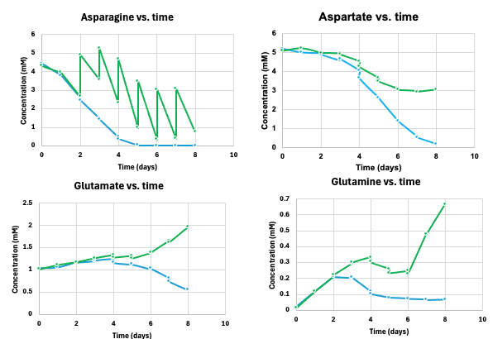
Asn feed study 2:
+2mM Asn daily feed
Asn-fed culture experienced reduced Asp uptake, increased Glu/Gln secretion
Johns Hopkins University
Clemson University
University of Delaware
University of Massachusetts Lowell
University of Maryland

Slide 12
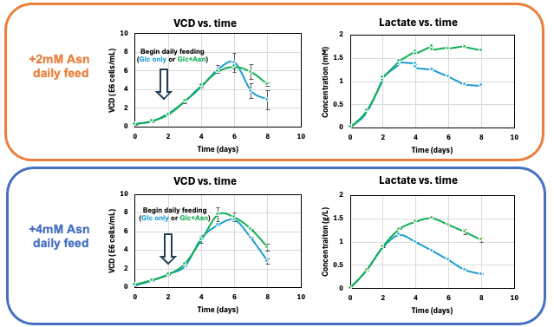
Asn feed study 2:
+2mM vs. +4mM Asn daily feed
No change in lactate trend after increasing Asn daily feed
Johns Hopkins University
Clemson University
University of Delaware
University of Massachusetts Lowell
University of Maryland

Slide 13
Asn feed studies: Next Steps
Measure IgG concentration in supernatant (HPLC)
Measure extracellular metabolites in inscreased Asn study
Johns Hopkins University
Clemson University
University of Delaware
University of Massachusetts Lowell
University of Maryland

Slide 14
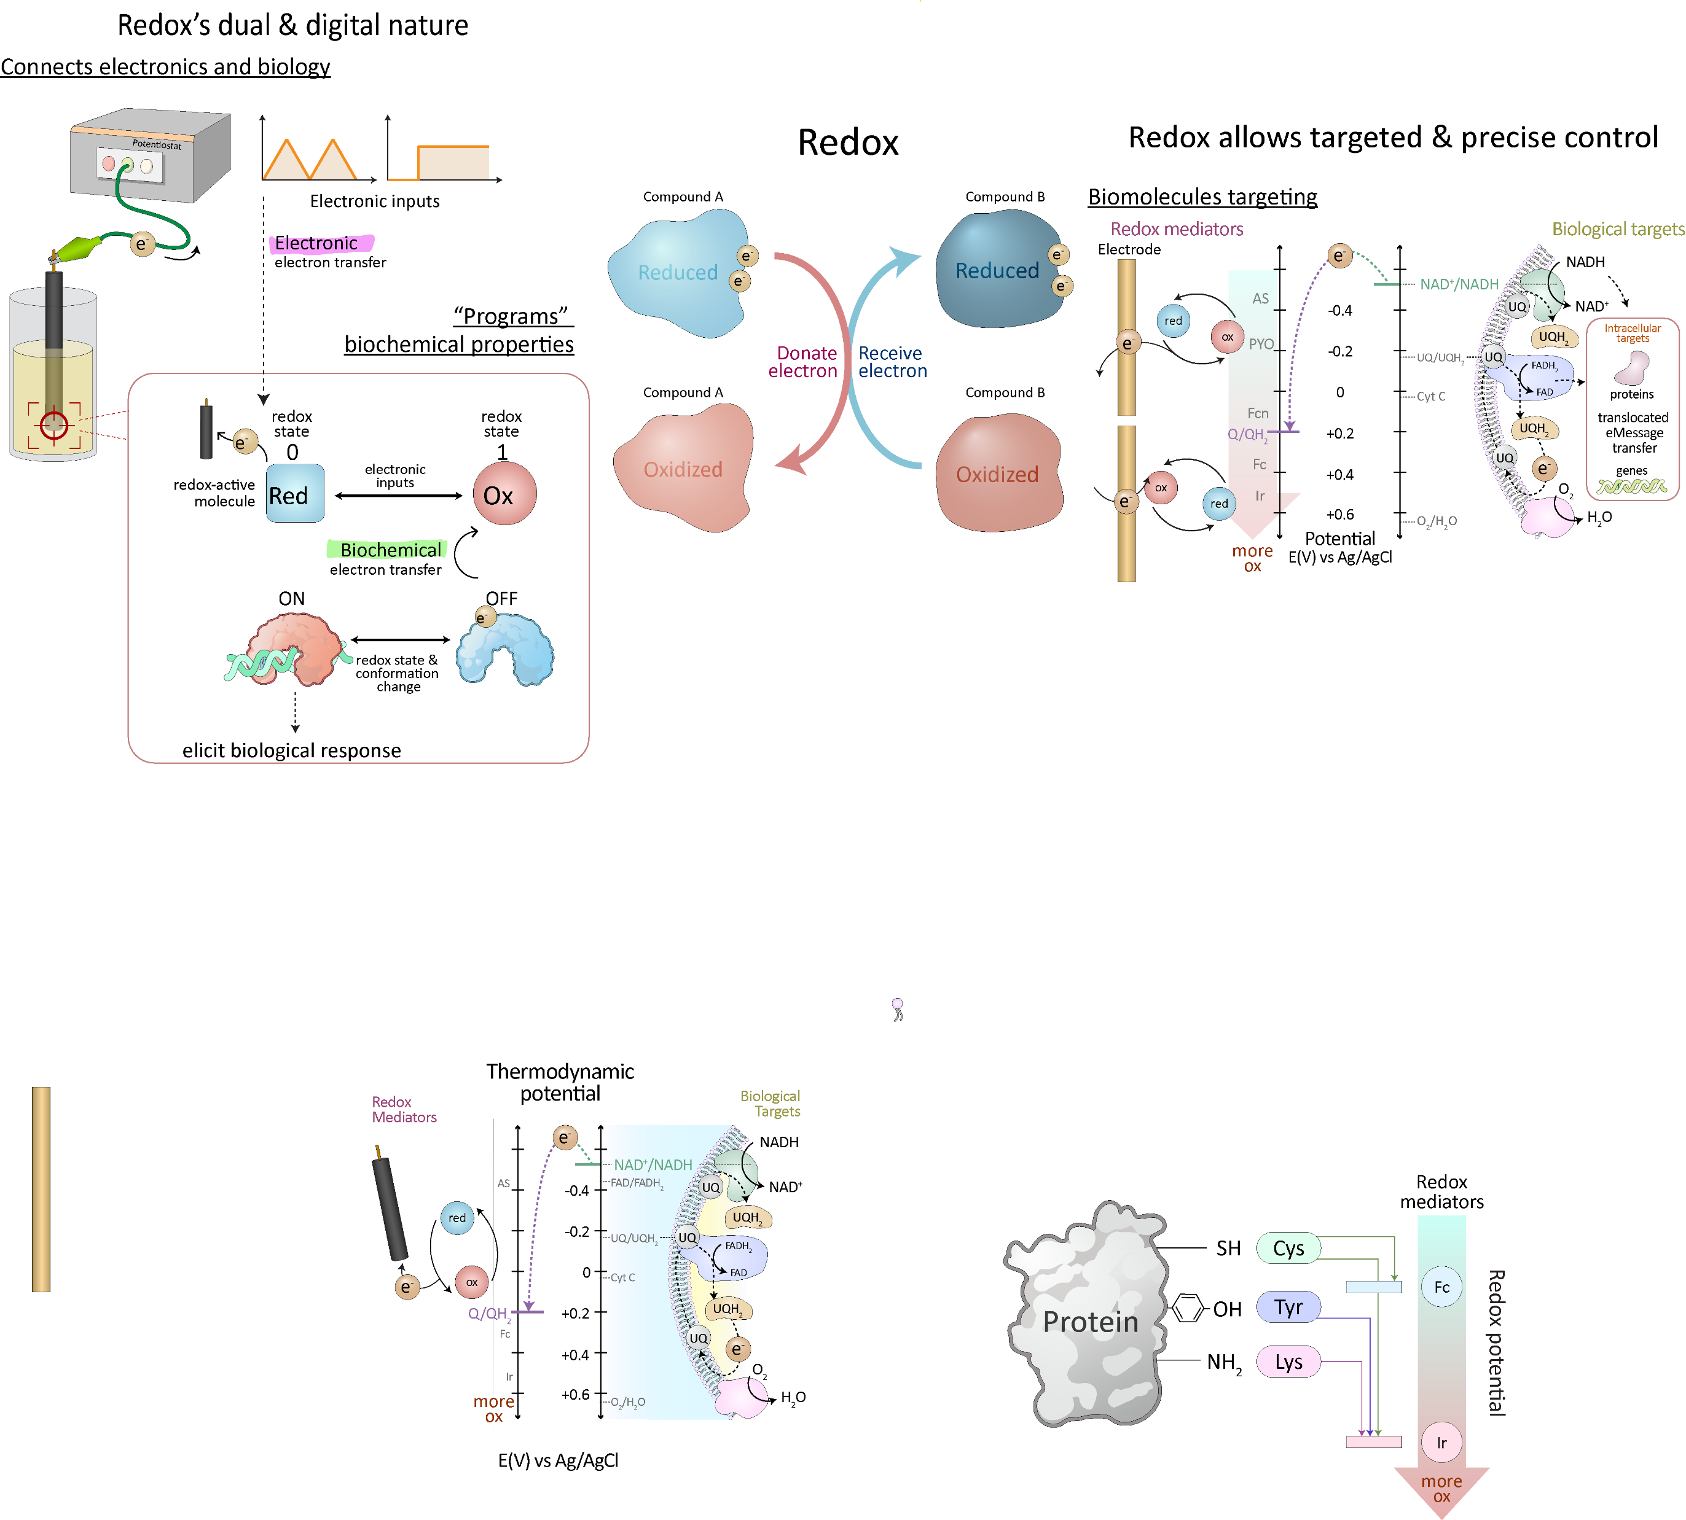
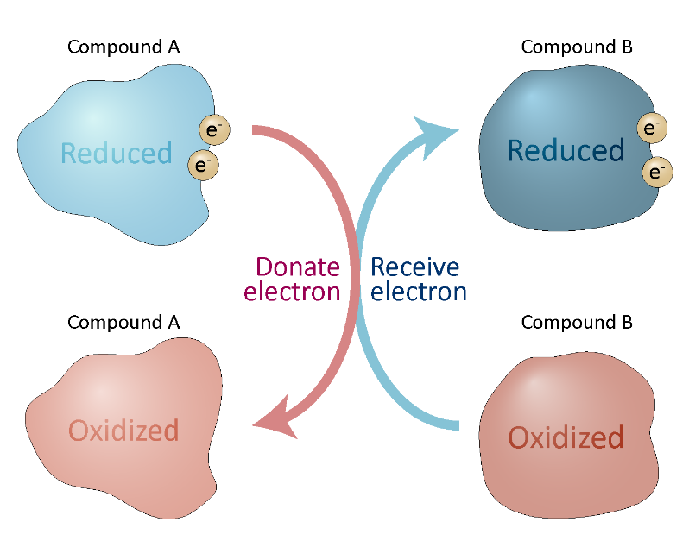
UMD Updates – Background
Electrochemical access to redox active components
Redox
Fc – Ferrocene
Dimethanol
-SH
Modified from Wang et al. (2024) Current Opinion in Biotechnology

Slide 15
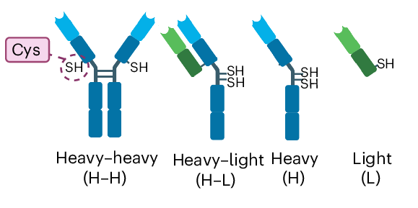
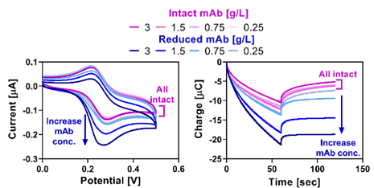
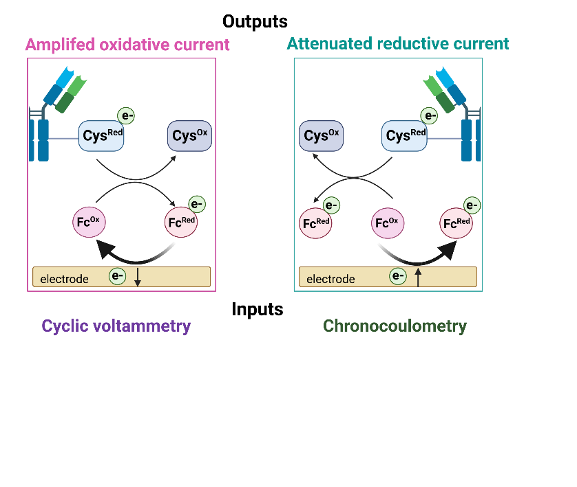
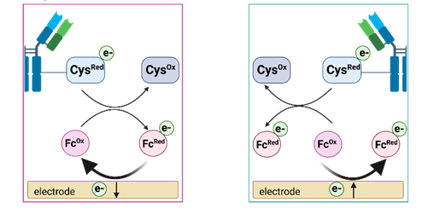
Exposed sulfhydryl of reduced mAbs can be electronically accessed using mediator Ferrocene (Fc)
Mechanism of electrochemically accessing exposed sulfhydryl of reduced mAb
Fc Mediated Electrochemical Probing (MEP) for identifying mAb reduction
Motabar et al. (2024) Nature Chemical Biology
Notes:
mediated electrochemical probing (MEP) ²³⁻²⁶, for the simple, rapid, and sensitive detection of mAb reduction
In MEP, redox mediators (acting as electron shuttles) are added to biological samples which then interact with redox-active elements through the exchange of electrons^{27,29}.
When the appropriate input voltage is applied, Fc is oxidized by the electrode (Fc^{Ox}), diffuses away from the electrode surface, and exchanges electrons with cysteine.
redox cycling reaction regenerates the reduced form (Fc^{Red}) due to the transfer of electrons from cysteine
resulting in an amplification in the oxidative current relative to the mediator alone in solution
attenuation in the reductive current occurs due to the decrease in availability of Fc^{Ox}

Slide 16
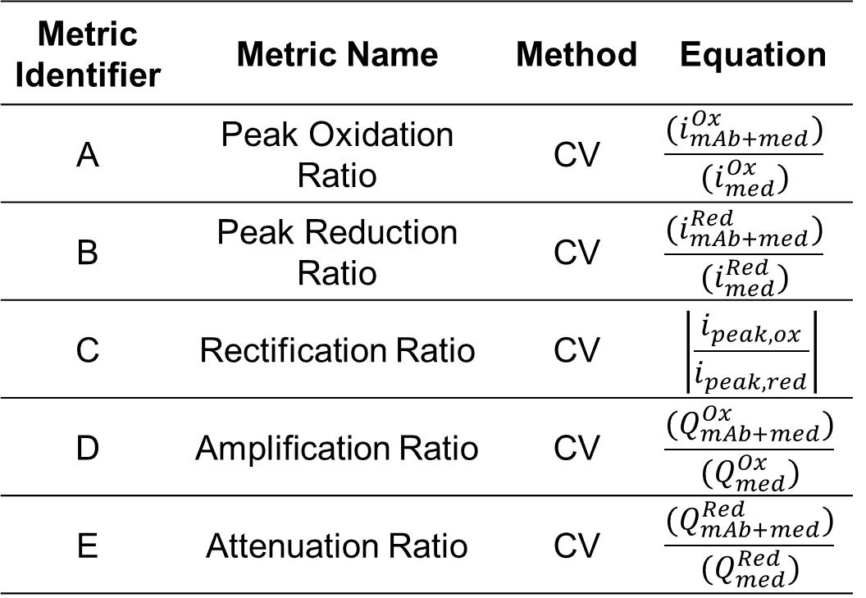
Exposed sulfhydryl of varied reduced mAb can be electronically accessed and quantified with different metrics
Metrics of assessing cyclic voltammograms
Varying reduced mAb concentrations
Motabar et al. (2024) Nature Chemical Biology
Notes:
mediated electrochemical probing (MEP) ²³⁻²⁶, for the simple, rapid, and sensitive detection of mAb reduction
In MEP, redox mediators (acting as electron shuttles) are added to biological samples which then interact with redox-active elements through the exchange of electrons^{27,29}.
When the appropriate input voltage is applied, Fc is oxidized by the electrode (Fc^{Ox}), diffuses away from the electrode surface, and exchanges electrons with cysteine.
redox cycling reaction regenerates the reduced form (Fc^{Red}) due to the transfer of electrons from cysteine
resulting in an amplification in the oxidative current relative to the mediator alone in solution
attenuation in the reductive current occurs due to the decrease in availability of Fc^{Ox}
PEG is used industrially used with minimal immunogenic properties and lacks detrimental interaction with biologics
We are using PEG as a gel that is thiolated to take advantage of electrochemical access to sulfhydryl

Slide 17


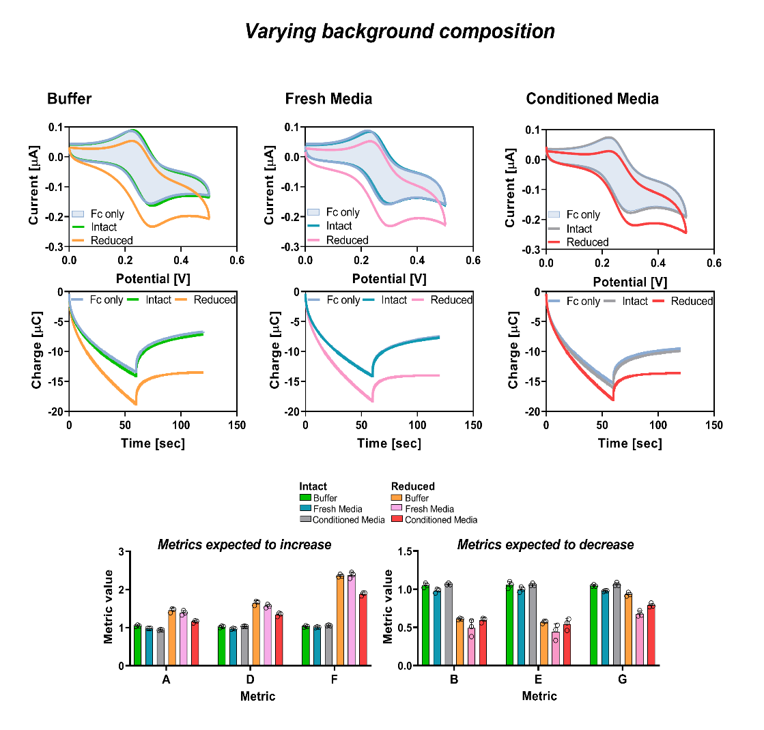
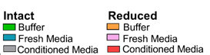
Exposed sulfhydryl of reduced mAb can be electronically accessed and quantified in different medium
MEP of reduced mAb in varied media
Motabar et al. (2024) Nature Chemical Biology

Slide 18
MEP of supernatants without Fc across HCl experimental conditions
Overall trend of Qox seem to begin high on day 0, attenuate with time for days 1-3, and begin increasing with time for all
conditions evaluated.

Slide 19
MEP of supernatants with Fc across HCl experimental conditions
Increase of reduced mAb with time
Least reduced mAbs indicated with 10mM HCl
Overall trend of i_{peak,Ox} seem to begin high, attenuate with time for days 1-4, and begin increasing Day 5-6 or 7 for all conditions evaluated. 10mM HCl indicates the least variation in Qox and i_{peak,Ox} throughout duration of study.

Slide 20
MEP of supernatants comparison of oxidative, reductive, or total charge (w/ AUC)
Fc trends based on relative fold change to mediator indicate increase in reduced mAb fragments with the addition of HCl, and increases with time. Day 6 may have the greatest fold change in Qox for all conditions.

Slide 21
Potential Correlations of Data Trends
More work needs to be done to assess if there may be correlations of electrochemical data with other culture metrics.

Slide 22
Next Steps
Ellman’s + CE-SDS to evaluate exposed thiol amount/reduced mAb fragment distribution respectively, to compare MEP results
Determining if Kayla’s method of feature extraction and ML model could be used to further improve signal identification from this MEP data

