Slide 1








Industry/University Cooperative Research Center (I/UCRC)
Advanced Mammalian Biomanufacturing Innovation Center (AMBIC)
Controlling and applying the lactate shift for bioprocess monitoring and bioproduction improvements
Michael Betenbaugh (JHU), Maciek Antoniewicz (UMich), Bill Bentley (UMD)
14 February 2024
A National Science Foundation-facilitated
academic – industry – government consortia
to advance precompetitive knowledge in biomanufacturing
Contents are Proprietary to AMBIC and its Members
Terms of Center Membership Agreement Apply
www.ambic.org

Slide 2
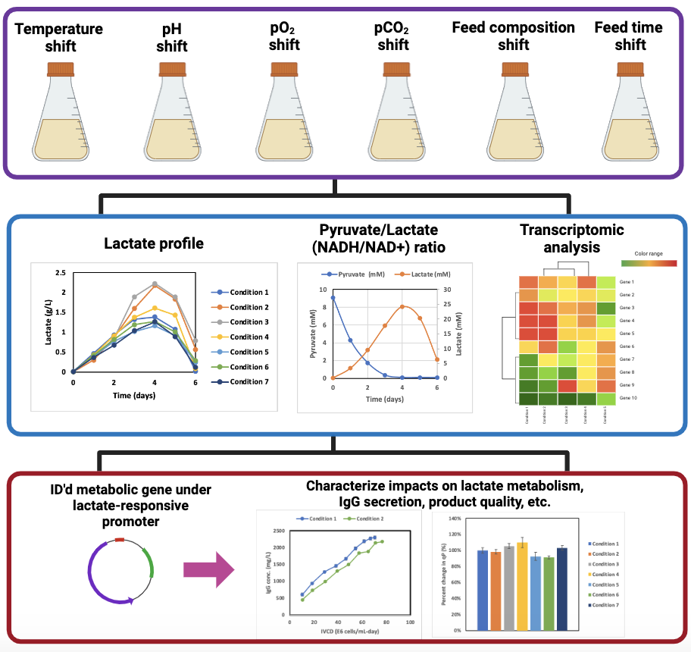
UMich Updates
New this meeting
New this meeting
Perform cell culture studies under various process shifts
Johns Hopkins University
Clemson University
University of Delaware
University of Massachusetts Lowell
University of Maryland
Assess impact and identify relevant metabolic genes
Data generated from AMBIC project 2020-26
Modulate expression through lactate-responsive cassette, and characterize impact on cell culture performance

Slide 3
Temperature shift
(37ºC vs 33ºC)
Johns Hopkins University
Clemson University
University of Delaware
University of Massachusetts Lowell
University of Maryland

Slide 4
Temperature shift
(37ºC vs 33ºC)
Johns Hopkins University
Clemson University
University of Delaware
University of Massachusetts Lowell
University of Maryland

Slide 5
Temperature shift
(37ºC vs 33ºC)
Johns Hopkins University
Clemson University
University of Delaware
University of Massachusetts Lowell
University of Maryland

Slide 6
Temperature shift
(37ºC vs 33ºC)
Johns Hopkins University
Clemson University
University of Delaware
University of Massachusetts Lowell
University of Maryland

Slide 7
Temperature shift
(37ºC vs 33ºC)
Johns Hopkins University
Clemson University
University of Delaware
University of Massachusetts Lowell
University of Maryland

Slide 8
Temperature shift
(37ºC vs 33ºC)
Johns Hopkins University
Clemson University
University of Delaware
University of Massachusetts Lowell
University of Maryland

Slide 9
Temperature shift
(37ºC vs 33ºC)
Johns Hopkins University
Clemson University
University of Delaware
University of Massachusetts Lowell
University of Maryland

Slide 10
Temperature shift
(37ºC vs 39ºC)
Johns Hopkins University
Clemson University
University of Delaware
University of Massachusetts Lowell
University of Maryland

Slide 11
Temperature shift
(37ºC vs 39ºC)
Johns Hopkins University
Clemson University
University of Delaware
University of Massachusetts Lowell
University of Maryland

Slide 12
Temperature shift
(37ºC vs 39ºC)
Johns Hopkins University
Clemson University
University of Delaware
University of Massachusetts Lowell
University of Maryland

Slide 13
Temperature shift
(37ºC vs 38ºC)
Johns Hopkins University
Clemson University
University of Delaware
University of Massachusetts Lowell
University of Maryland

Slide 14
Temperature shift
(37ºC vs 38ºC)
Medium analysis pending
Johns Hopkins University
Clemson University
University of Delaware
University of Massachusetts Lowell
University of Maryland

Slide 15
Acid/Base-adjusted medium
Basal Media: Sigma Immediate AdvantageTM (87093C)
pH adjustment: HCl or NaOH addition, filter sterilize
Johns Hopkins University
Clemson University
University of Delaware
University of Massachusetts Lowell
University of Maryland
Base Medium +6mM Glutamine
Base Medium

Slide 16
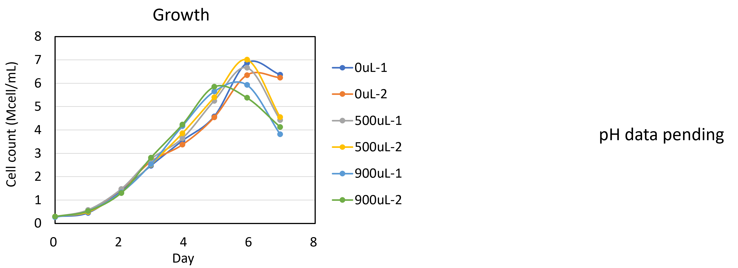
Base addition at 5% CO₂
Johns Hopkins University
Clemson University
University of Delaware
University of Massachusetts Lowell
University of Maryland
500 μL of NaOH (0.5N) added to 25 mL medium = 10 mM base added
900 μL of NaOH (0.5N) added to 25 mL medium = 18 mM base added

Slide 17
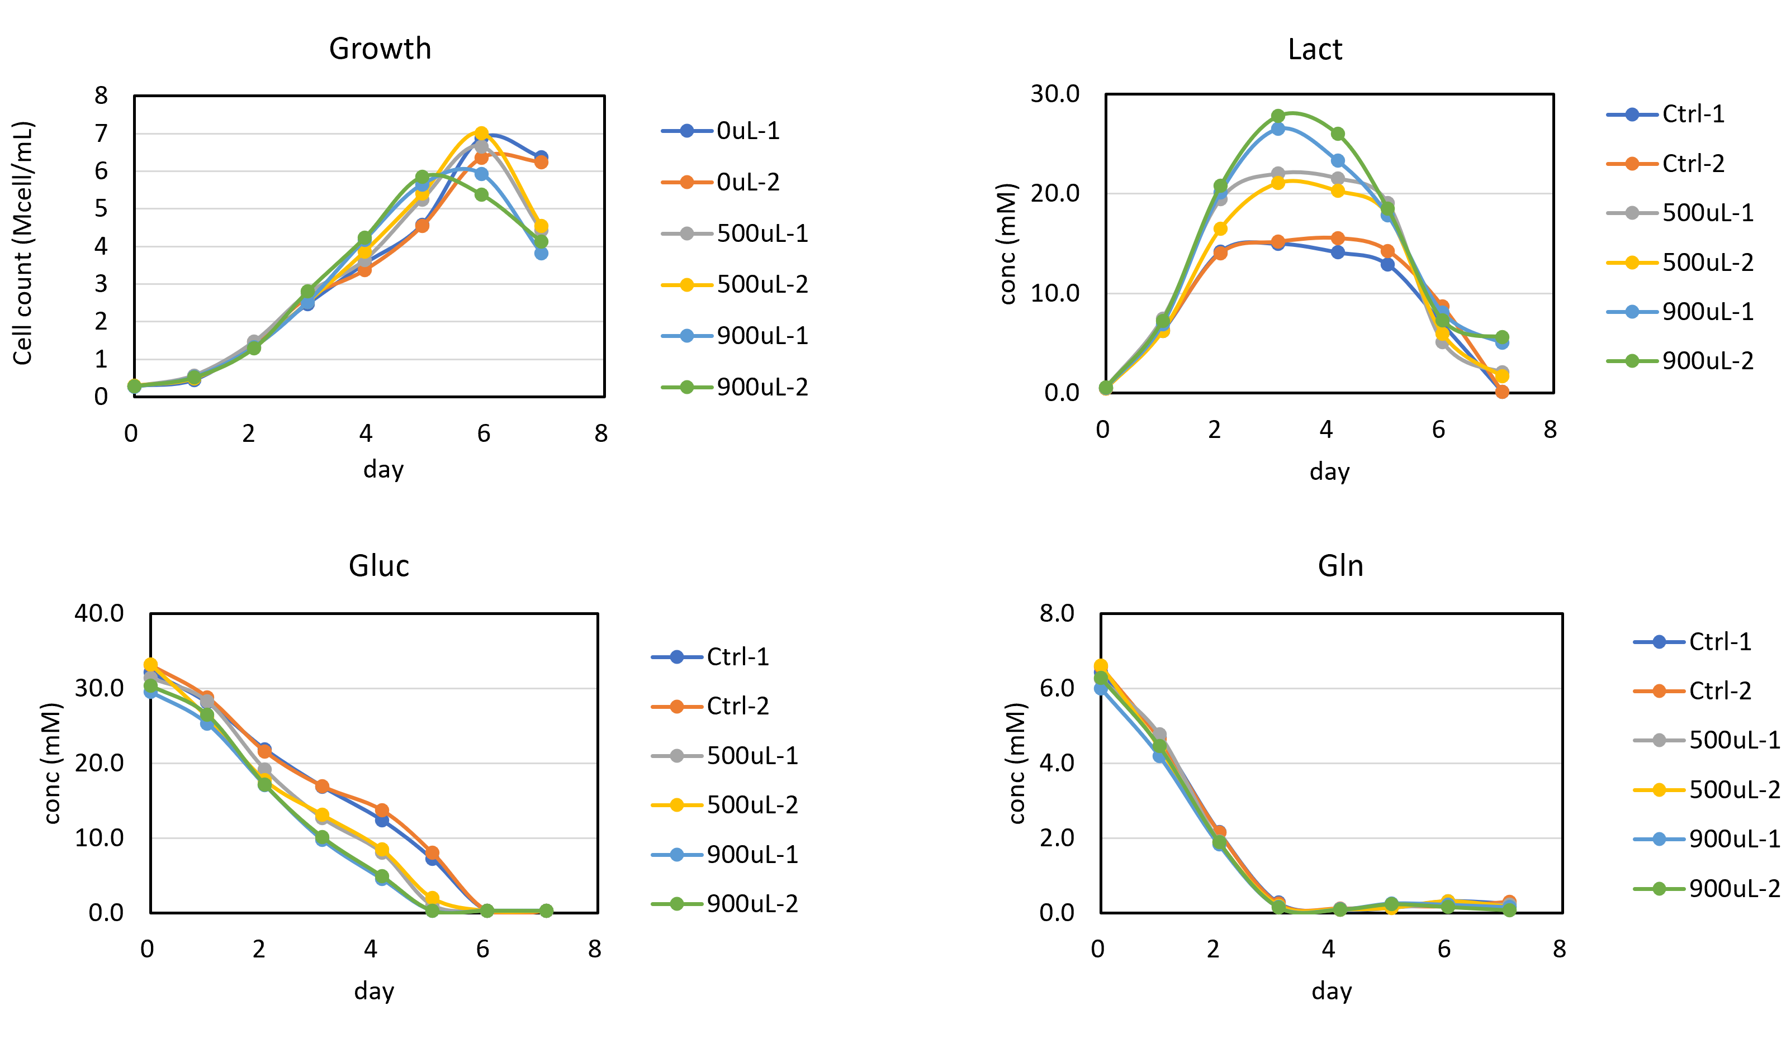
Base addition at 5% CO₂
Johns Hopkins University
Clemson University
University of Delaware
University of Massachusetts Lowell
University of Maryland
500 μL of NaOH (0.5N) added to 25 mL medium = 10 mM base added
900 μL of NaOH (0.5N) added to 25 mL medium = 18 mM base added

Slide 18
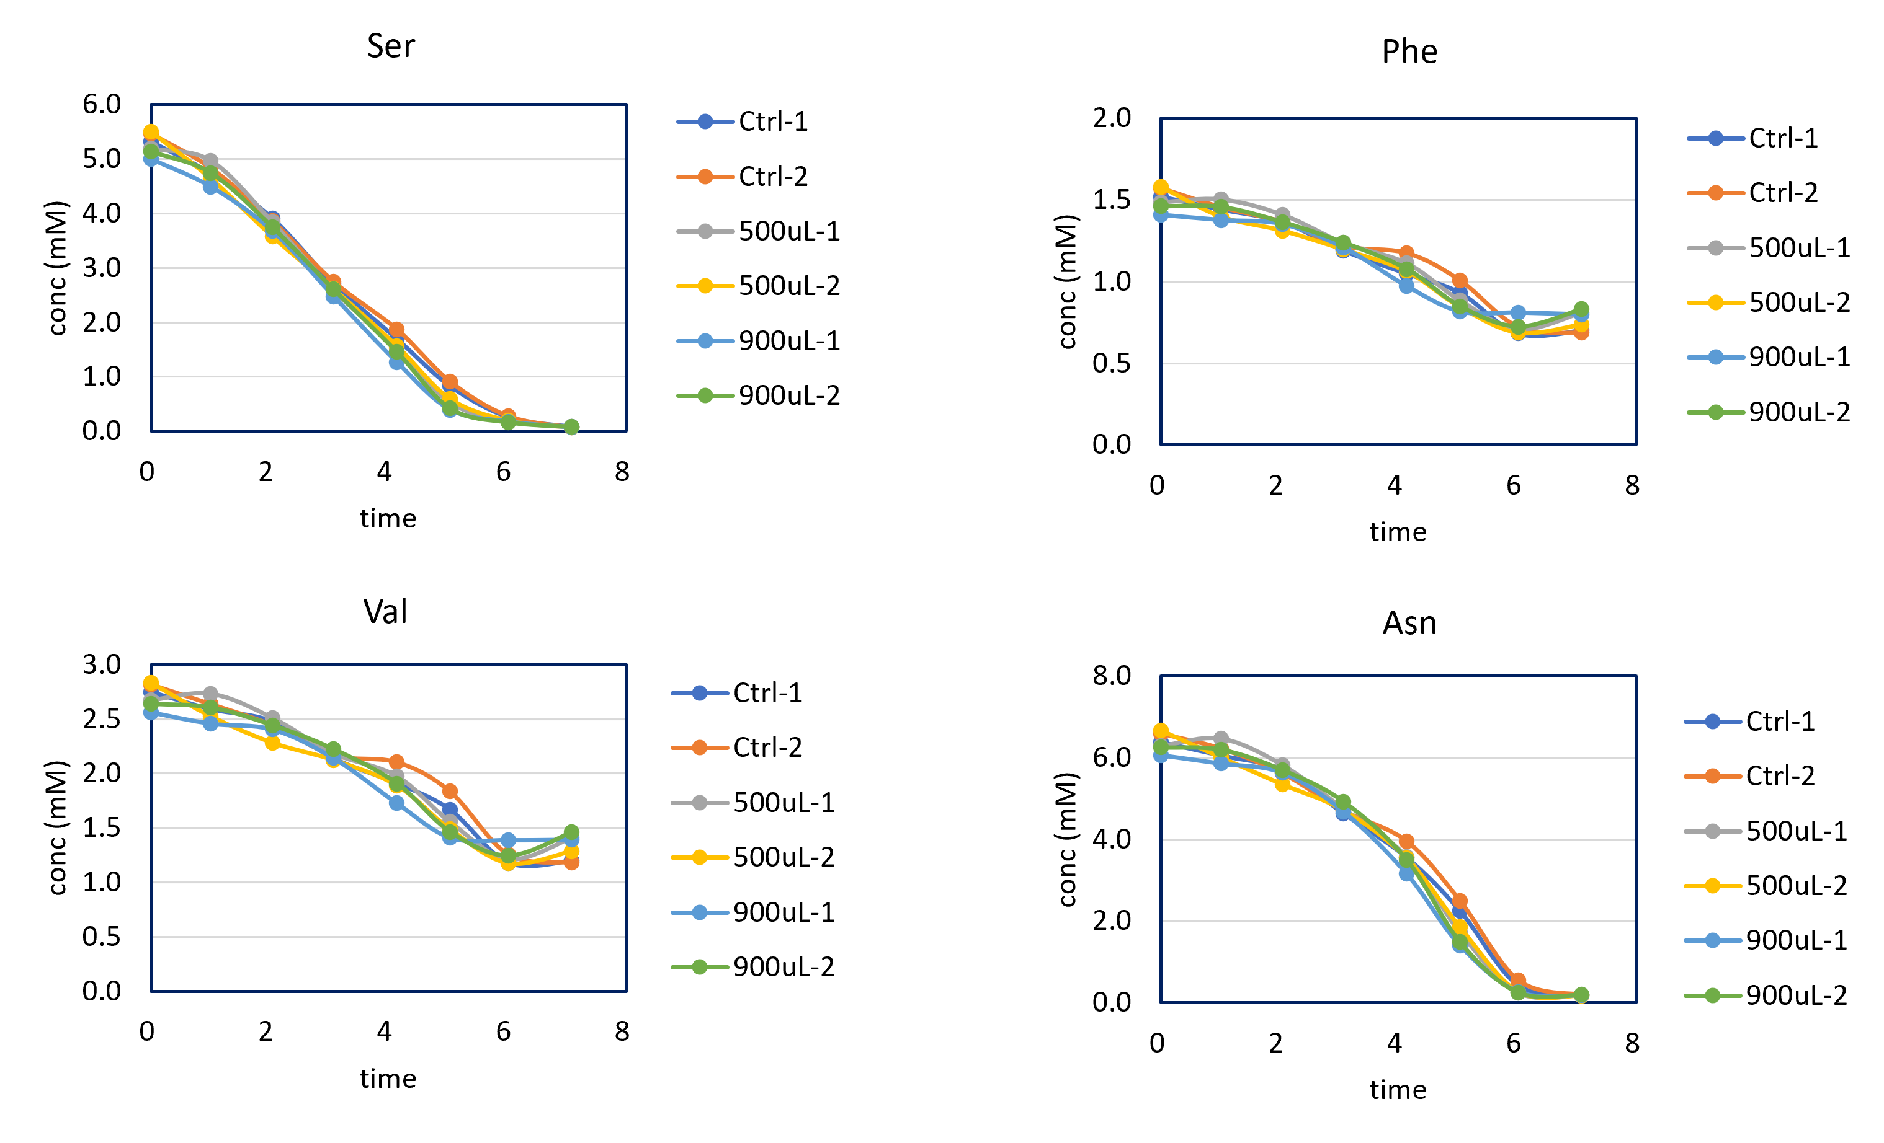
Base addition at 5% CO₂
Johns Hopkins University
Clemson University
University of Delaware
University of Massachusetts Lowell
University of Maryland
500 μL of NaOH (0.5N) added to 25 mL medium = 10 mM base added
900 μL of NaOH (0.5N) added to 25 mL medium = 18 mM base added

Slide 19
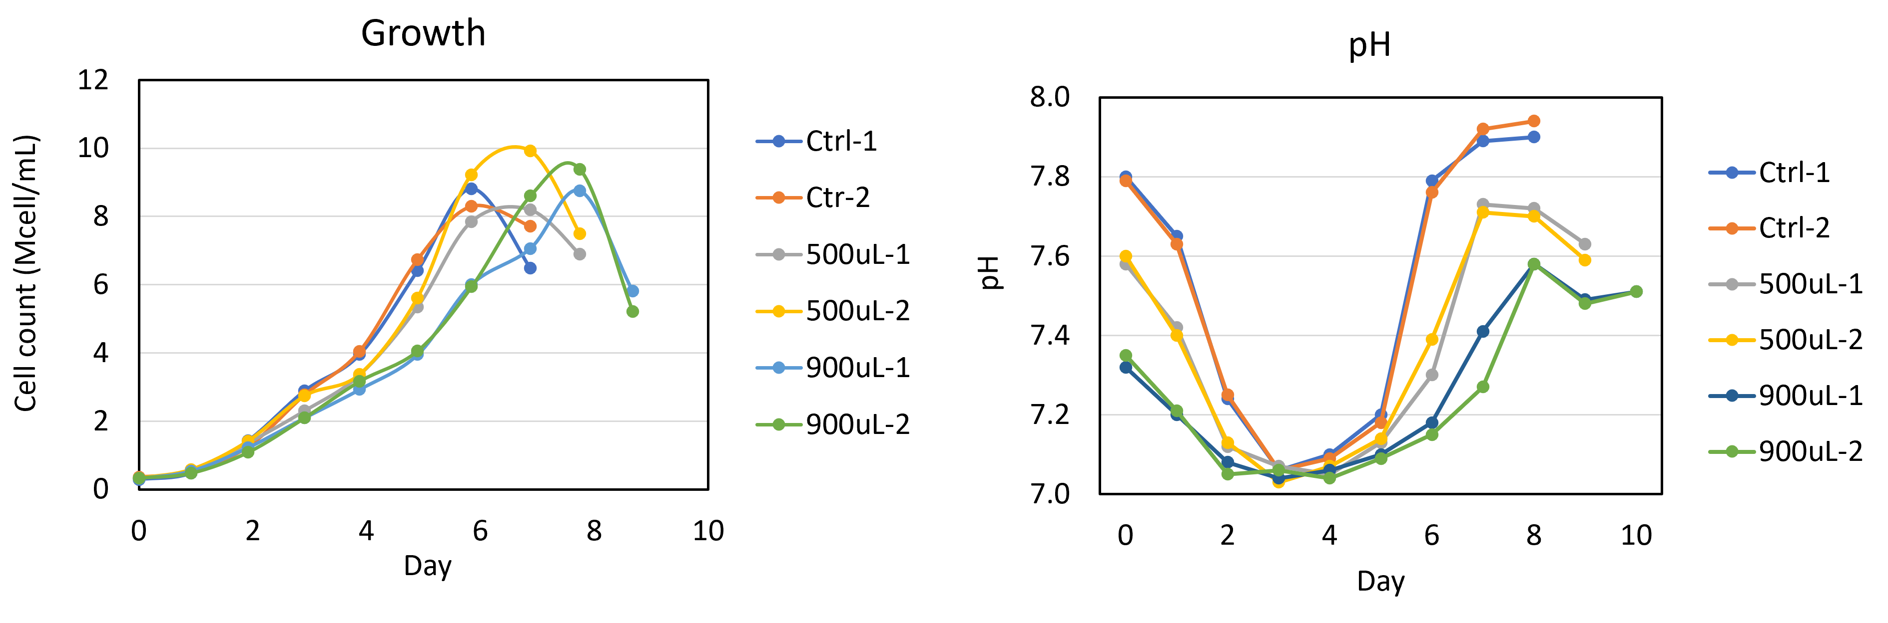
Acid addition at 5% CO₂
Johns Hopkins University
Clemson University
University of Delaware
University of Massachusetts Lowell
University of Maryland
500 μL of HCl (0.5N) added to 25 mL medium = 10 mM acid added
900 μL of HCl (0.5N) added to 25 mL medium = 18 mM acid added

Slide 20
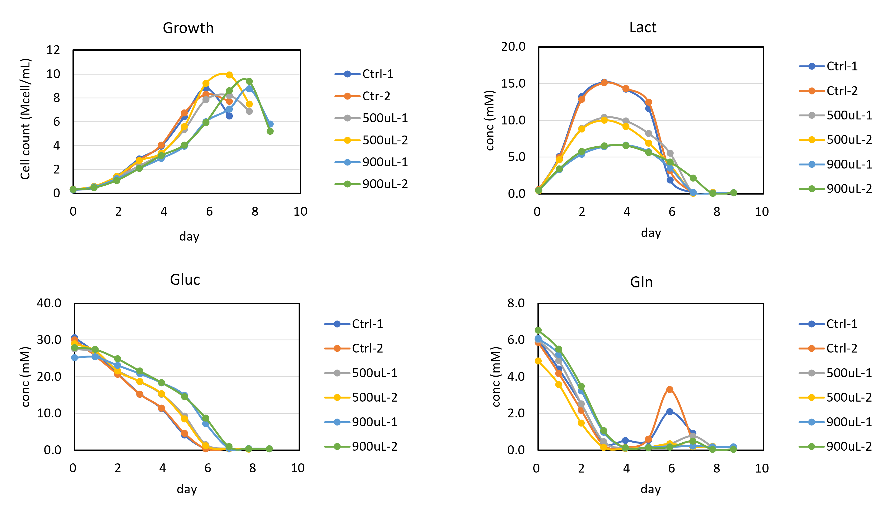
Acid addition at 5% CO₂
Johns Hopkins University
Clemson University
University of Delaware
University of Massachusetts Lowell
University of Maryland
500 μL of HCl (0.5N) added to 25 mL medium = 10 mM acid added
900 μL of HCl (0.5N) added to 25 mL medium = 18 mM acid added

Slide 21
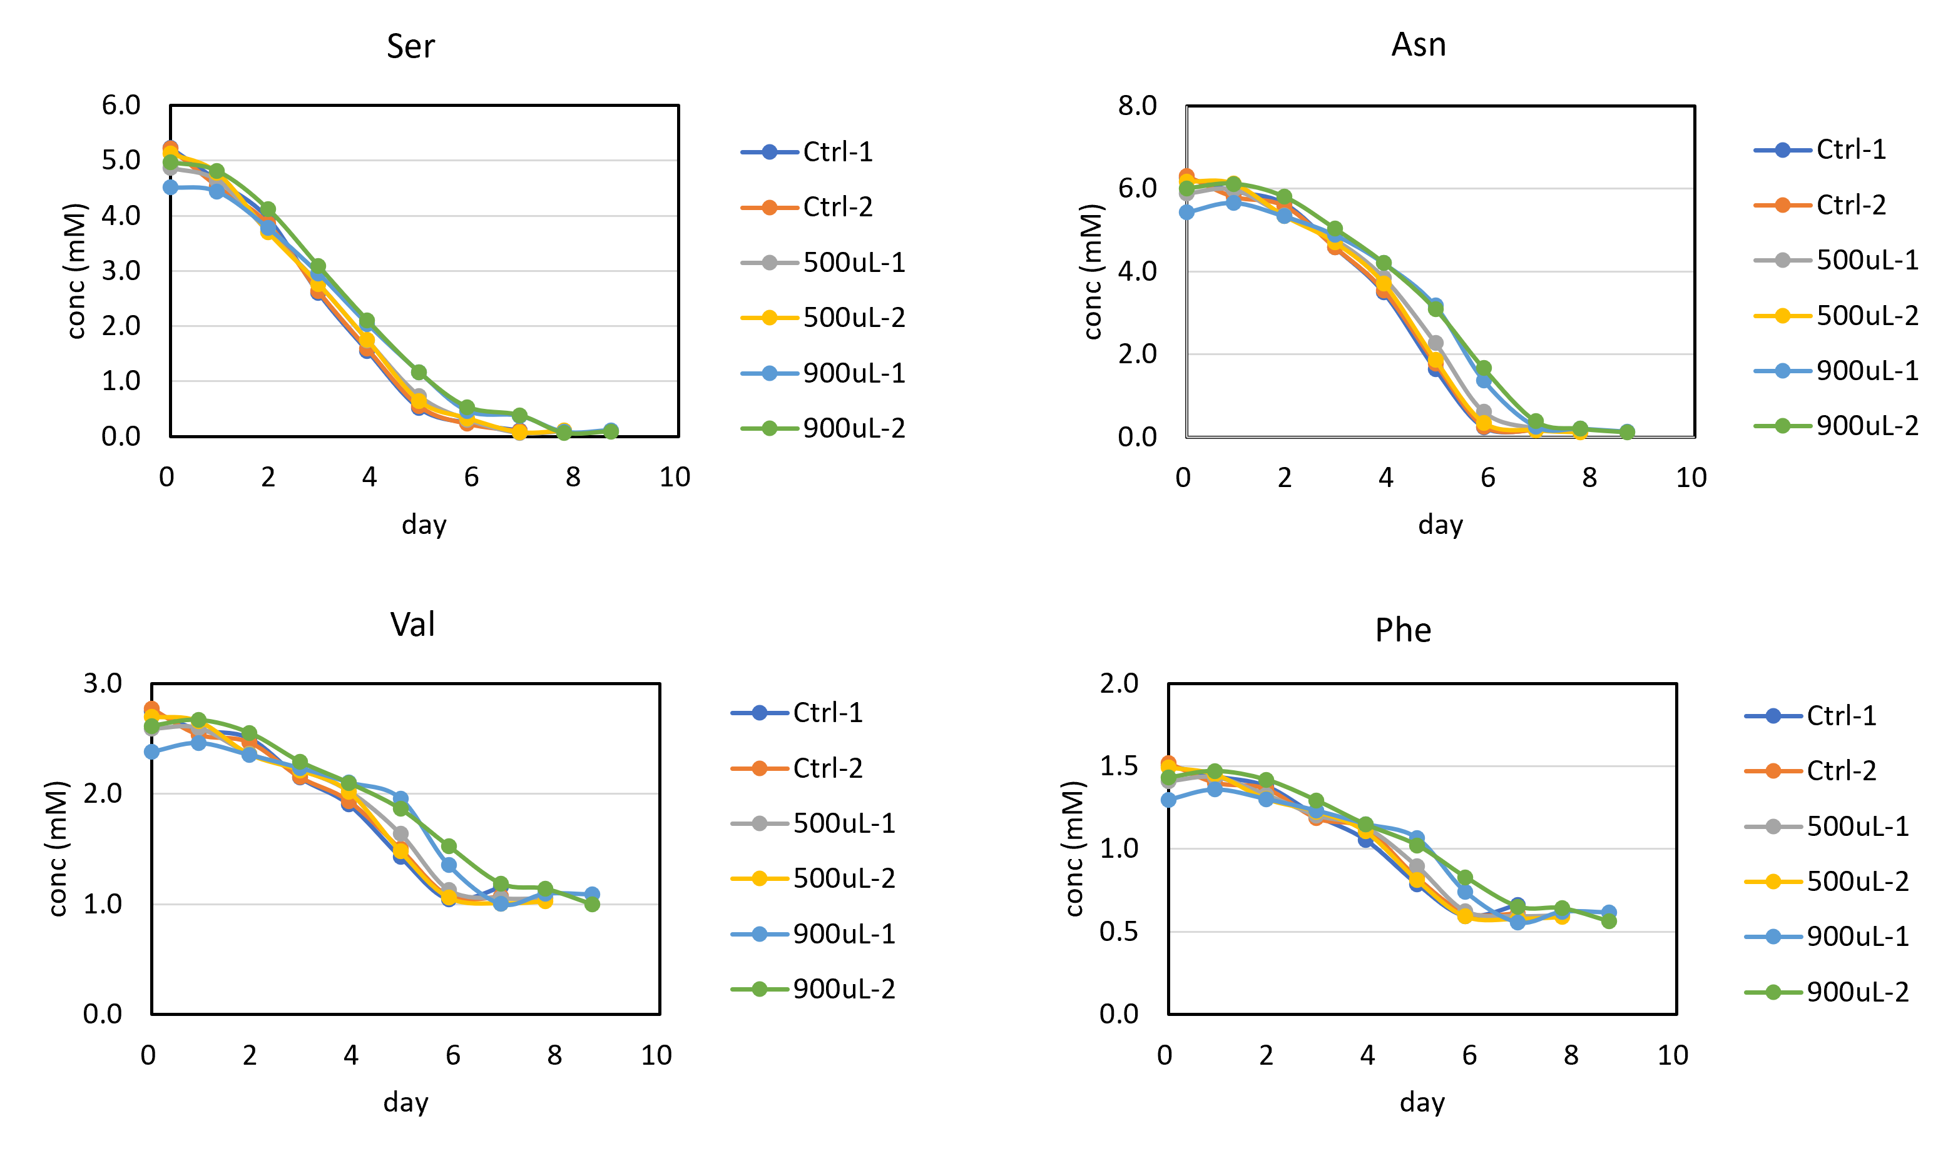
Acid addition at 5% CO₂
Johns Hopkins University
Clemson University
University of Delaware
University of Massachusetts Lowell
University of Maryland
500 μL of HCl (0.5N) added to 25 mL medium = 10 mM acid added
900 μL of HCl (0.5N) added to 25 mL medium = 18 mM acid added

Slide 22
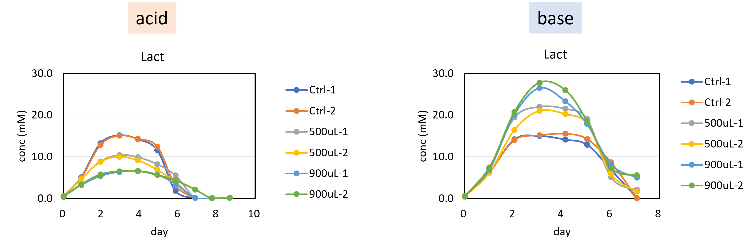
Summary of pH effect
Johns Hopkins University
Clemson University
University of Delaware
University of Massachusetts Lowell
University of Maryland

Slide 23
CO₂ levels (0%, 5%, 10%)
Johns Hopkins University
Clemson University
University of Delaware
University of Massachusetts Lowell
University of Maryland

Slide 24
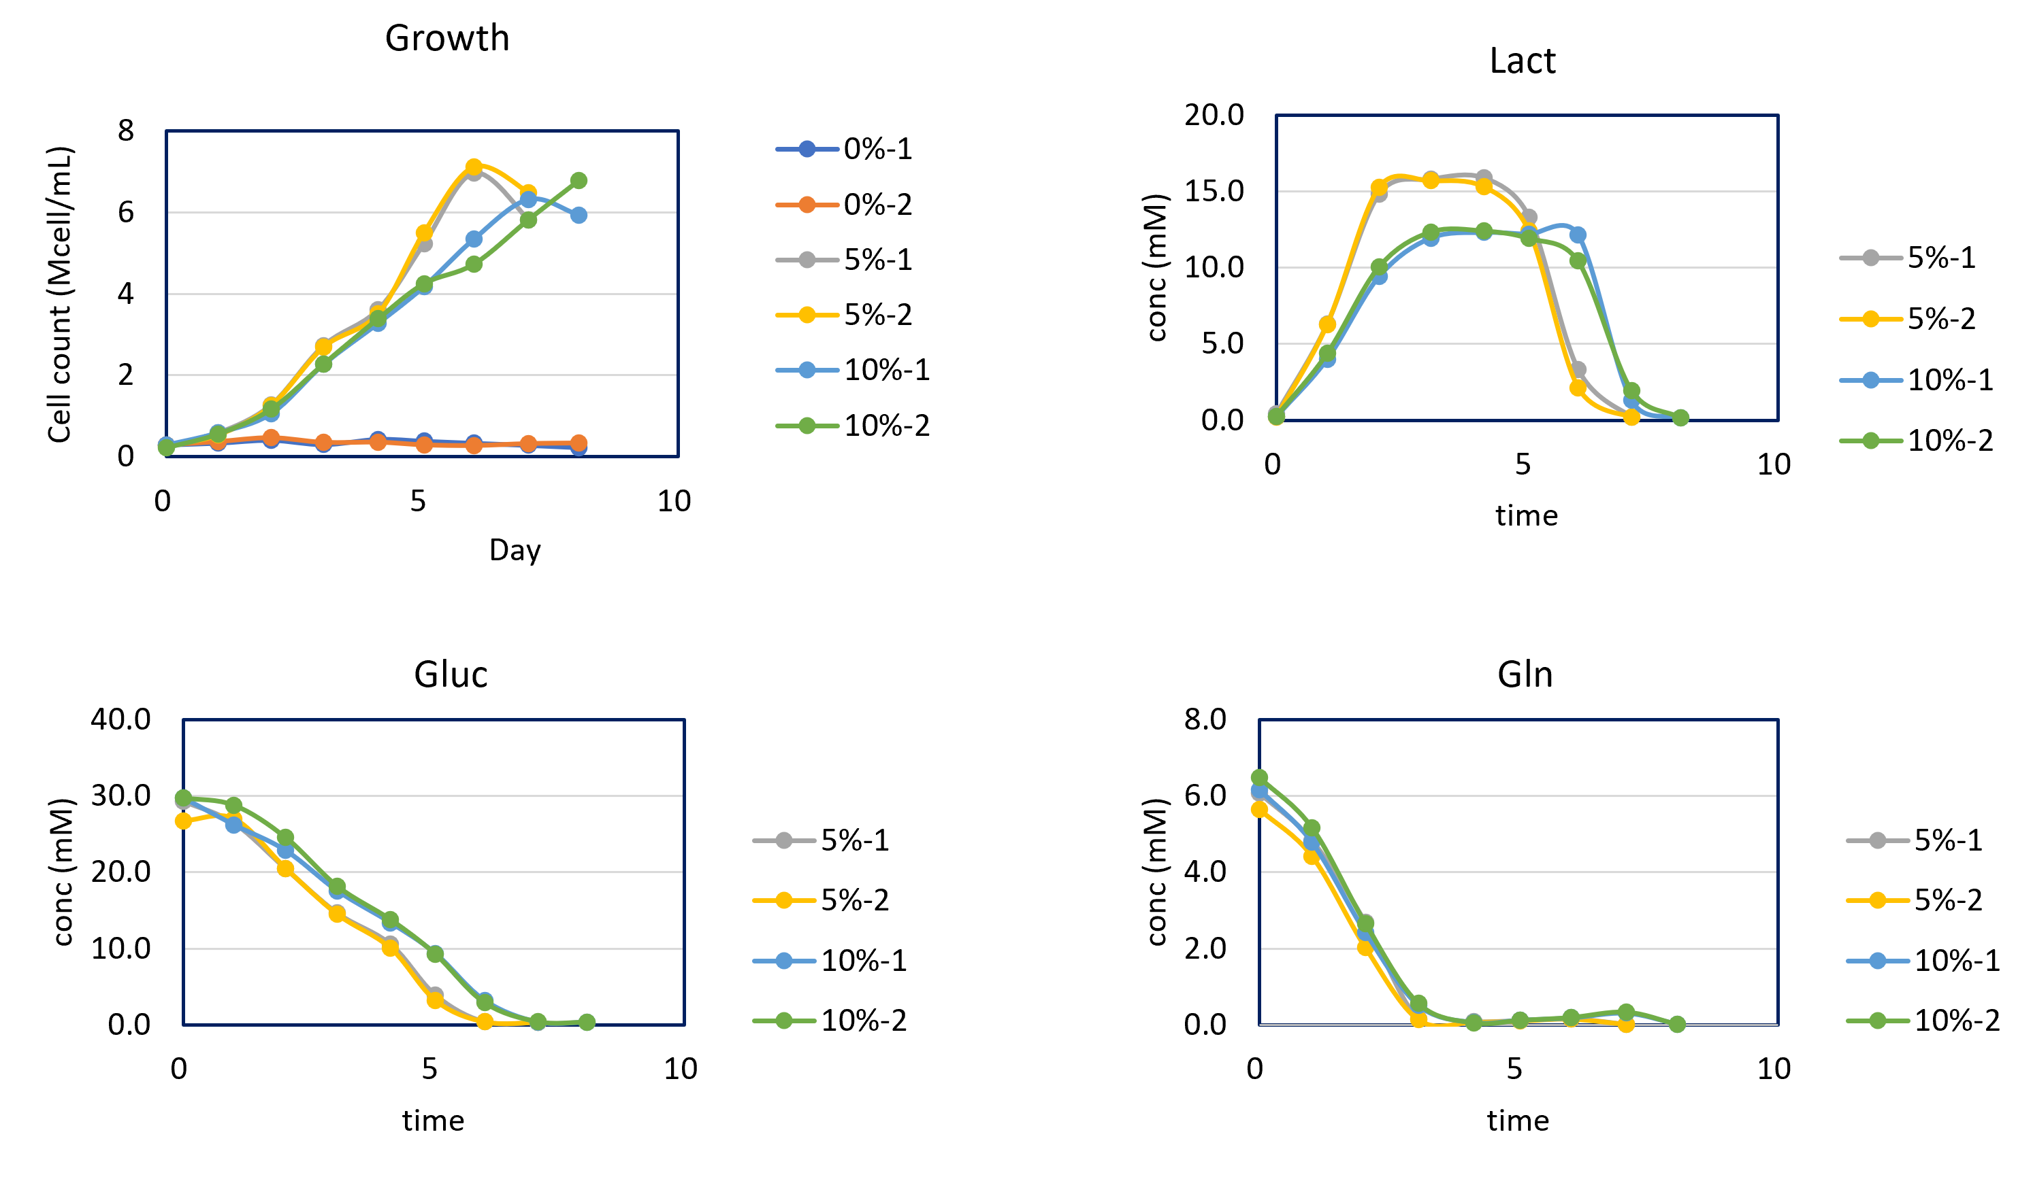
CO₂ levels (0%, 5%, 10%)
Johns Hopkins University
Clemson University
University of Delaware
University of Massachusetts Lowell
University of Maryland

Slide 25
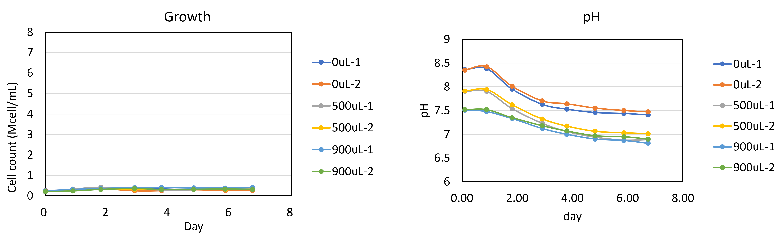
No growth at 0% CO₂
_{(even after pH adjustment)}
Johns Hopkins University
Clemson University
University of Delaware
University of Massachusetts Lowell
University of Maryland

Slide 26
Next Steps
Cell culture experiments
Temperature shift on different days of culture
Base addition at 10% CO2
Acid addition at 10% CO2
Sample analysis
Measure pH of medium samples
Measure titer levels
Johns Hopkins University
Clemson University
University of Delaware
University of Massachusetts Lowell
University of Maryland

