Slide 1








Industry/University Cooperative Research Center (I/UCRC)
Advanced Mammalian Biomanufacturing Innovation Center (AMBIC)
Tracking the Evolution of Instability
via Barcoded Population Dynamics
Reza Kalhor PhD, Michael Betenbaugh PhD
Project Pitch – January 2023
A National Science Foundation-facilitated
academic – industry – government consortia
to advance precompetitive knowledge in biomanufacturing
Contents are Proprietary to AMBIC and its Members
Terms of Center Membership Agreement Apply
www.ambic.org

Slide 2
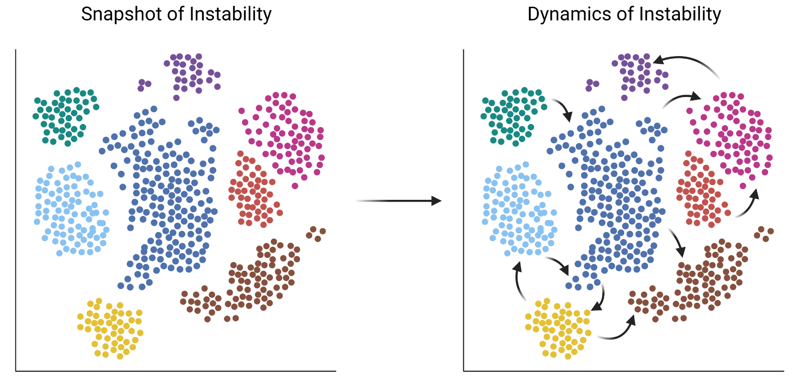
Industrial Relevance & Need
CHO producer cell lines are often unstable
Methods for characterizing cell line stability are time-consuming
Current instability analyses provide a snapshot of cultures but minimal information on how clonal lineages move between subpopulations
Johns Hopkins University
Clemson University
University of Delaware
University of Massachusetts Lowell
University of Maryland

Slide 3
Project Goals
Gradual Reduction vs. Stochastic Reduction
Questions:
What are the dynamics of instability?
  Do clones gradually lose production?
  Or do clones lose productivity in a stochastic manner?
  How does this behavior differ between stable and unstable lines?
  These insights would help illuminate mechanisms of instability
How does production level affect stability?
  Is production uniformly anticorrelated with stability at a clonal level?
  Are there regimes of production that are stable?
  These insights will illuminate strategies to minimize instability or maximize production without incurring instability
Solution: Simultaneously characterize subclonal dynamics and production levels within stable and unstable CHO producer lines
(subclones are defined as individual cells within a clonal line at a given timepoint)
Subclone3
Production
Subclone1
Johns Hopkins University
Clemson University
University of Delaware
University of Massachusetts Lowell
University of Maryland
Subclone2
Time
Time
Direct Descent vs. Stepwise Descent
Production
Stability
Stability

Slide 4
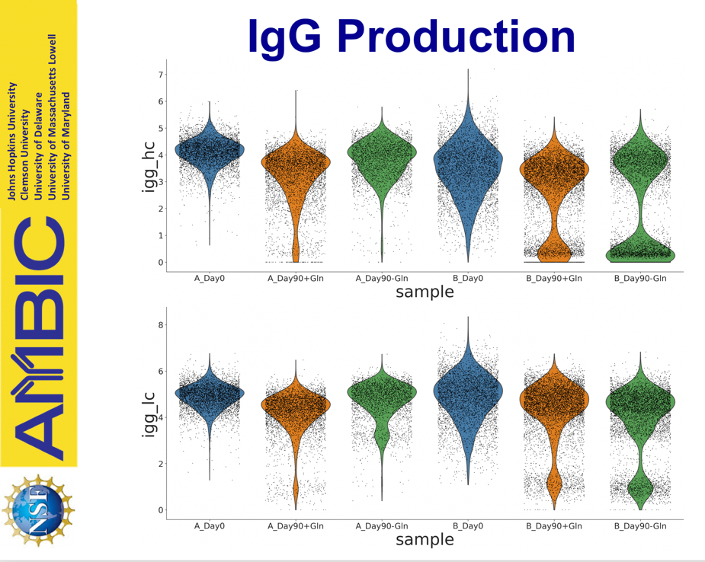
Objectives
Previous data from AMBIC single-cell project
Understand the heterogeneity and dynamics of instability and shed light on its mechanisms
  How often do high producers become low producers?
Johns Hopkins University
Clemson University
University of Delaware
University of Massachusetts Lowell
University of Maryland
Does this sublineage stay stable…
…or become unstable?
Notes:
Instability drive lose of productivity

Slide 5
Objectives
Previous data from AMBIC single-cell project
Understand the heterogeneity and dynamics of instability and shed light on its mechanisms
  How often do high producers become low producers?
  Are low producers always low producers?
Johns Hopkins University
Clemson University
University of Delaware
University of Massachusetts Lowell
University of Maryland
Can low producers become high producers…
…or are they always low producers?

Slide 6
Objectives
Previous data from AMBIC single-cell project
Understand the heterogeneity and dynamics of instability and shed light on its mechanisms
  How often do high producers become low producers?
  Are low producers always low producers?
  Is there a threshold of stability, above which subclones are stable and below which subclones are unstable?
Johns Hopkins University
Clemson University
University of Delaware
University of Massachusetts Lowell
University of Maryland
Is there a threshold of stability?

Slide 7
Objectives
Previous data from AMBIC single-cell project
Understand the heterogeneity and dynamics of instability and shed light on its mechanisms
Establish a strategy for early characterization of producer line stability
  Can an initial titer screen tell us if a cell line will be stable?
  Will the dynamics of the cell line’s titer distribution tell us if it will be stable?
How can early characterization predict long-term (in)stability?
Johns Hopkins University
Clemson University
University of Delaware
University of Massachusetts Lowell
University of Maryland

Slide 8
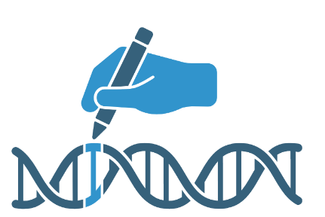
Objectives
Previous data from AMBIC single-cell project
Understand the heterogeneity and dynamics of instability and shed light on its mechanisms
Establish a strategy for early characterization of producer line stability
Establish a foundation for genetic engineering and screening to create more stable CHO cell lines
Johns Hopkins University
Clemson University
University of Delaware
University of Massachusetts Lowell
University of Maryland

Slide 9
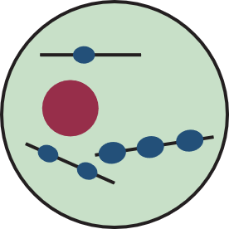
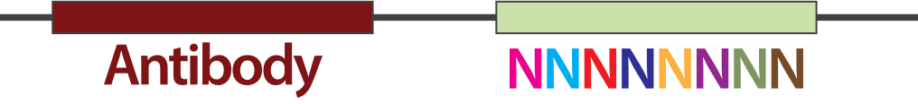
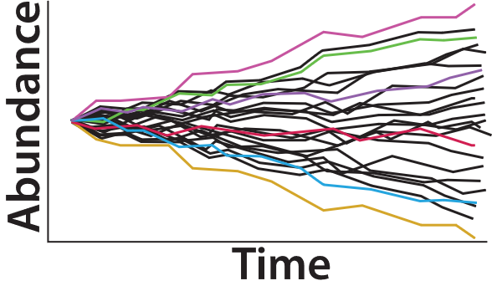
Research Approach (1)
Determine Sublineage Abundance in the Population over Time
Single clone
Stable clone (A) or unstable clone (B) from single-cell,
epigenetics, and phenotypic stability projects
Label subclones with unique barcodes→
Johns Hopkins University
Clemson University
University of Delaware
University of Massachusetts Lowell
University of Maryland
This will allow us to determine:
  If a single sublineage overtakes the culture
  How quickly instability is detectable in a culture
  The population’s mutation rate
Age for 90 days and track abundance of each subclone’s lineage in the population every 10 days

Slide 10
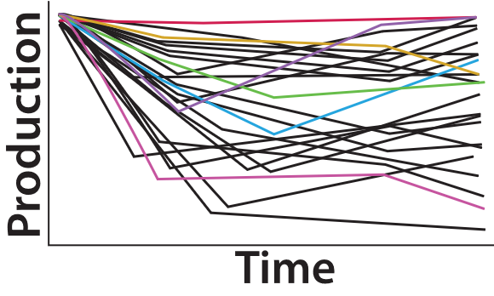
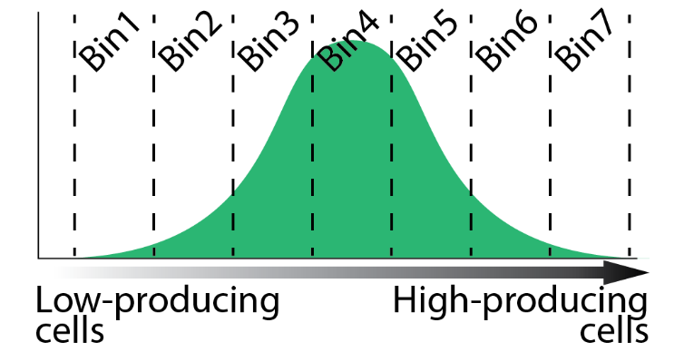

Research Approach (2)
Determine Sublineage Production Dynamics over Time
Johns Hopkins University
Clemson University
University of Delaware
University of Massachusetts Lowell
University of Maryland
Age for 90 days
Sample every 30 days
This will allow us to determine:
  How quickly productivity loss occurs
  How production level affects stability
  The relative contribution of epigenetic and genetic changes to instability
FACS into several bins based on antibody titer
Sequence barcodes in each bin

Slide 11
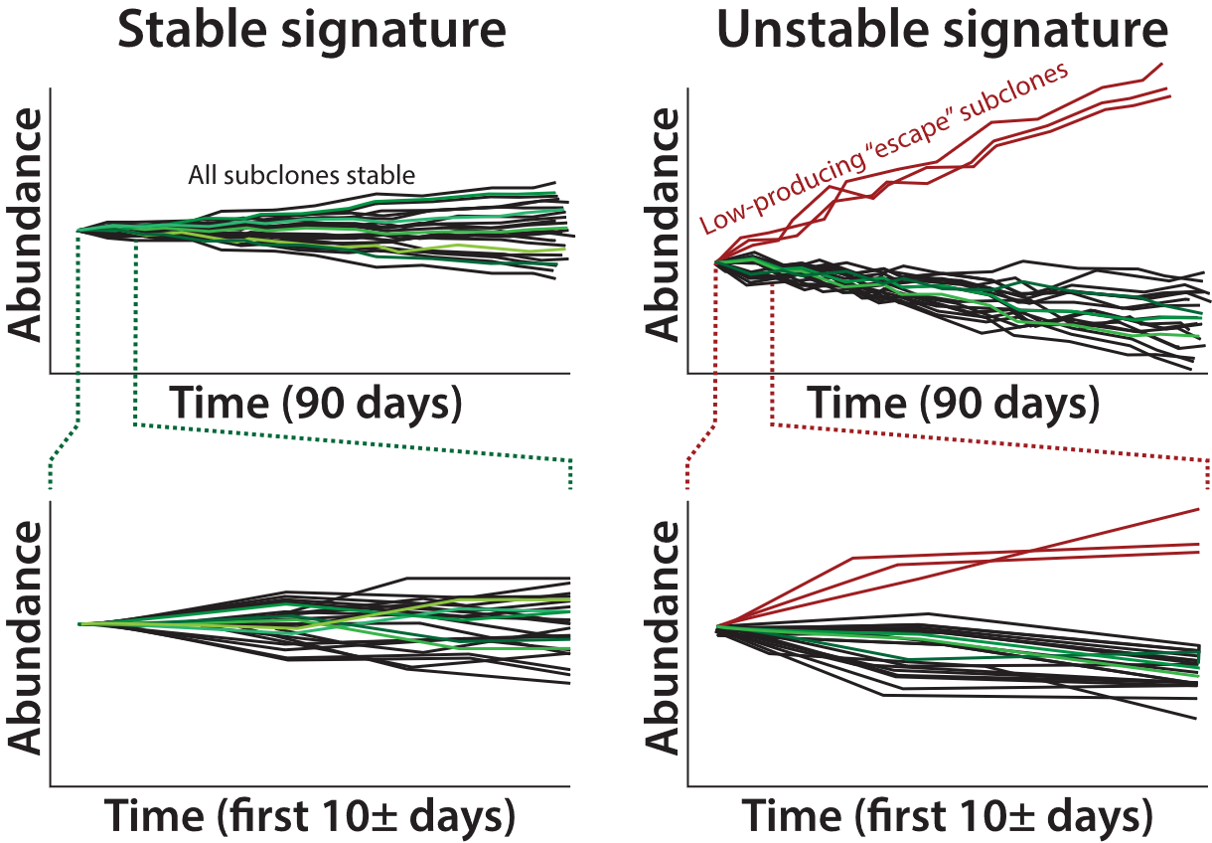
Research Approach (3)
Develop a Model of Instability
Establish criteria for early identification of instability based on clonal dynamics signatures
Develop clonal dynamics model to predict the probability a clone is stable
Use insights to inform future engineering efforts to address stability
Johns Hopkins University
Clemson University
University of Delaware
University of Massachusetts Lowell
University of Maryland

Slide 12
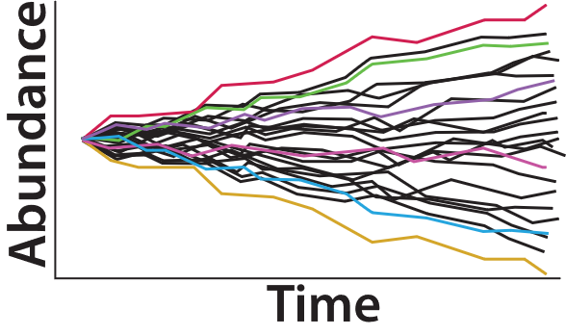
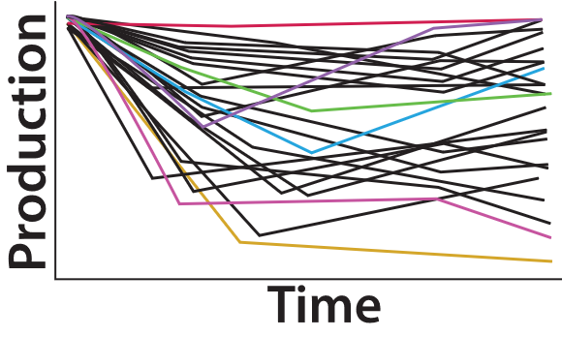
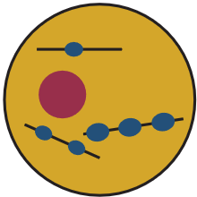
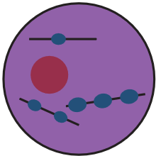
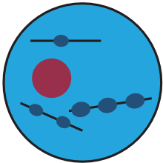
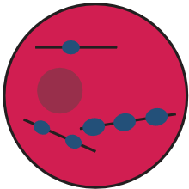
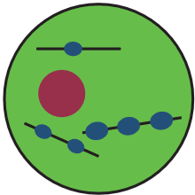
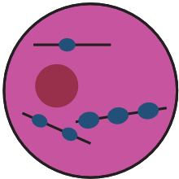
Research Approach (4)
Develop High-Throughput Method to Isolate a Stable Clone
Host cell line
Transfect potential clones with antibody and unique barcodes→
Johns Hopkins University
Clemson University
University of Delaware
University of Massachusetts Lowell
University of Maryland
Massively parallel stable clone identification and selection
Simultaneously screen millions of clones in parallel over time
Isolate clone with best growth, productivity, and stability characteristics
Barcodes facilitate tracking of individual clones
Best stable clone
(consistently high growth and productivity)
Determine best clonal lineage from early population dynamics and productivity analysis
Worst unstable clone
(consistently low growth and productivity)
Isolate lineage and use for production
Cell sorting
Targeted selection using barcode
Colony screening

Slide 13
Outcomes
Milestones with anticipated deadlines
Q1-Q2
Create barcoding library
Establish stable and unstable barcoded CHO lines
Q3-Q4
30 passage (90 day) culture study on stable and unstable cell lines
Cell sorting into bins of high and low production
Q5-Q7
Determine long-term population dynamics of unstable cell lines
Q6-Q8
Develop barcoding library for high-throughput clone identification and selection
Transfect host cell line with barcoded construct containing protein of interest
Prepare sequencing libraries and generate next-generation sequencing data
Establish sequencing data analysis pipeline
Establish model of instability and simulation pipeline
Validate estimated parameters of producer cell behavior in simulation (i.e., division rate, production level, production loss probability per division as a function of production level, etc)
Use insights from previous cell dynamics studies to identify best-performing stable clones
Johns Hopkins University
Clemson University
University of Delaware
University of Massachusetts Lowell
University of Maryland

Slide 14
Research Impact
Fundamental insight into stability at single-cell, genealogical level
Rapid, high-throughput characterization of producer line stability
A foundational strategy to establish screening and engineering conditions in which stable CHO producer cells are rapidly identified
Johns Hopkins University
Clemson University
University of Delaware
University of Massachusetts Lowell
University of Maryland

Slide 15
Project Duration & Budget
Project Duration (2 years)
Project Budget ($100,000 per year)
Johns Hopkins University
Clemson University
University of Delaware
University of Massachusetts Lowell
University of Maryland
Graduate Student Stipend (80% effort)
Tuition (20%)
Fringe Benefits
Health Insurance (Grad Student, 80%)
Materials and Supplies (includes deep sequencing)
Cluster computing costs
Travel
Indirect
$30,000/yr
$12,000/yr
$2,000/yr
$1,600/yr
$38,200/yr
$5,000/yr
$1,200/yr
$10,000/yr
If you have an unusual budget item and/or big ticket purchase, please highlight it on this slide.

Slide 16
Anticipated Business Value Deliverables
Project Name: Tracking the Evolution of Instability via Barcoded Population Dynamics
Project Academic PI: Reza Kalhor, Michael Betenbaugh
Project IAB Lead:
Category | Sub-Category | Business Value Deliverables
Technical Data | Digital Data | Sequencing data
 | Printed Data
Procedure | Manual
 | Protocols | Protocol for development of barcoded cell lines and analysis of cell lineage sequencing data
 | Design Specifications | Guidelines to identify stable and unstable clones based on early evolutionary dynamics
Computer Programs | Web-accessed, server-hosted
 | Distributed compiled software
 | Formatted, annotated code | Clonal dynamics simulation software to fit parameters of cellular behavior
 | Printed algorithm
Reports | Meeting Slides and Minutes | Mentor meeting slides and notes will be posted to the AMBIC website
 | Peer-reviewed publication | At least one publication in a notable journal
 | Thesis or Dissertation | PhD thesis
 | Internal Technical Report
 | Public Presentation | Project updates at AMBIC semi-annual meetings; presentations of (published) data at relevant conferences and seminars
Training | Individual Study Documents
 | Recorded Webinar | Webinar on applying barcoding to CHO cell selection and stability
 | Live Class, Course or lab
Material | Organism | Stable and unstable CHO populations
 | Process Product or Byproduct | mAbs and other recombinant proteins of interest
 | Reference Material | Barcoding toolkit for establishing stable and unstable CHO cell lines
Analysis | Testing of IAB material
 | Evaluation with IAB data
Johns Hopkins University
Clemson University
University of Delaware
University of Massachusetts Lowell
University of Maryland
Confidential

