Slide 1


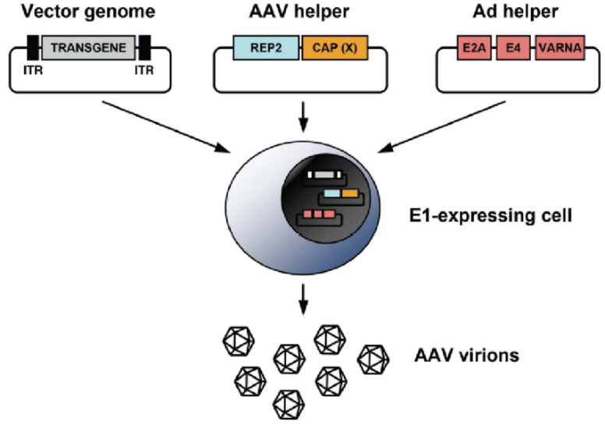
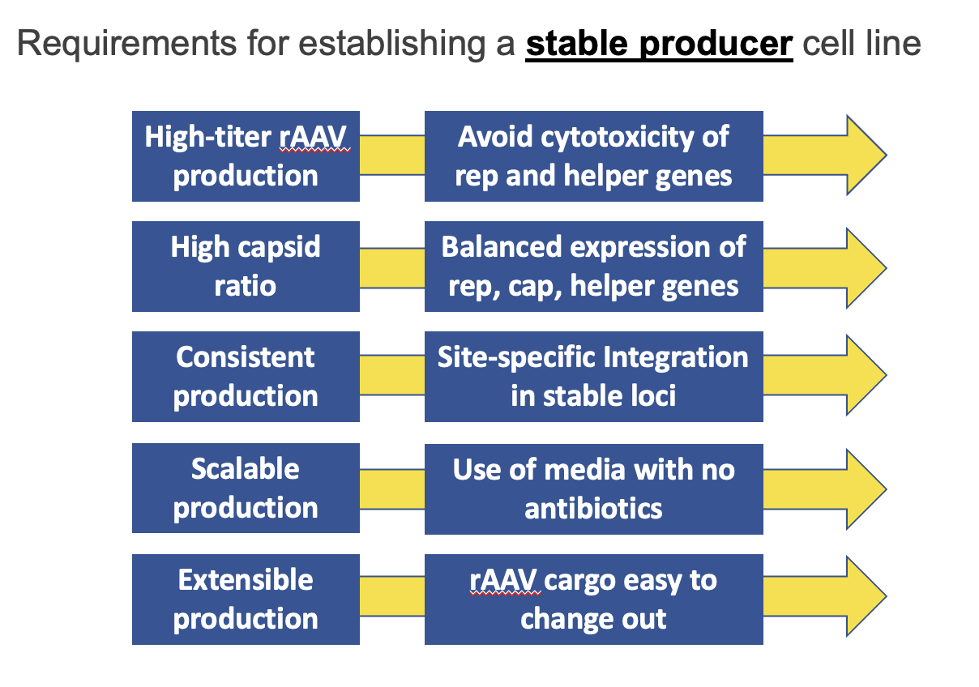
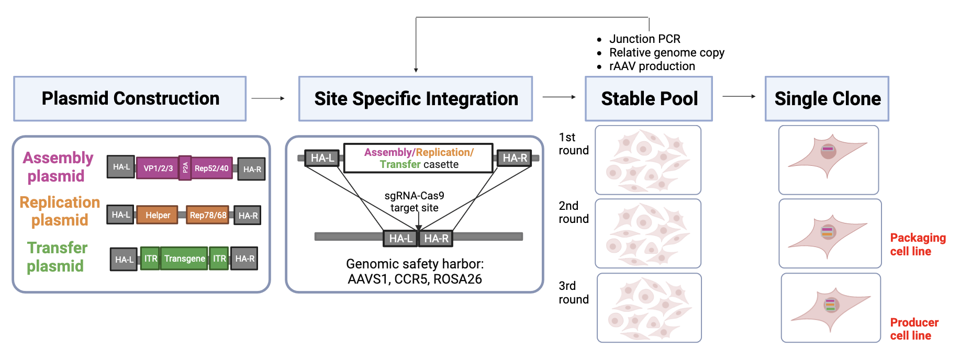
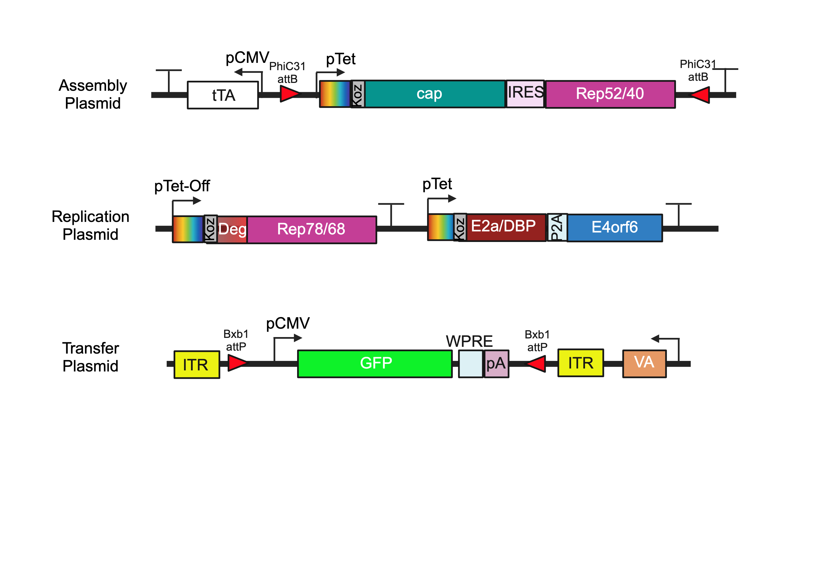
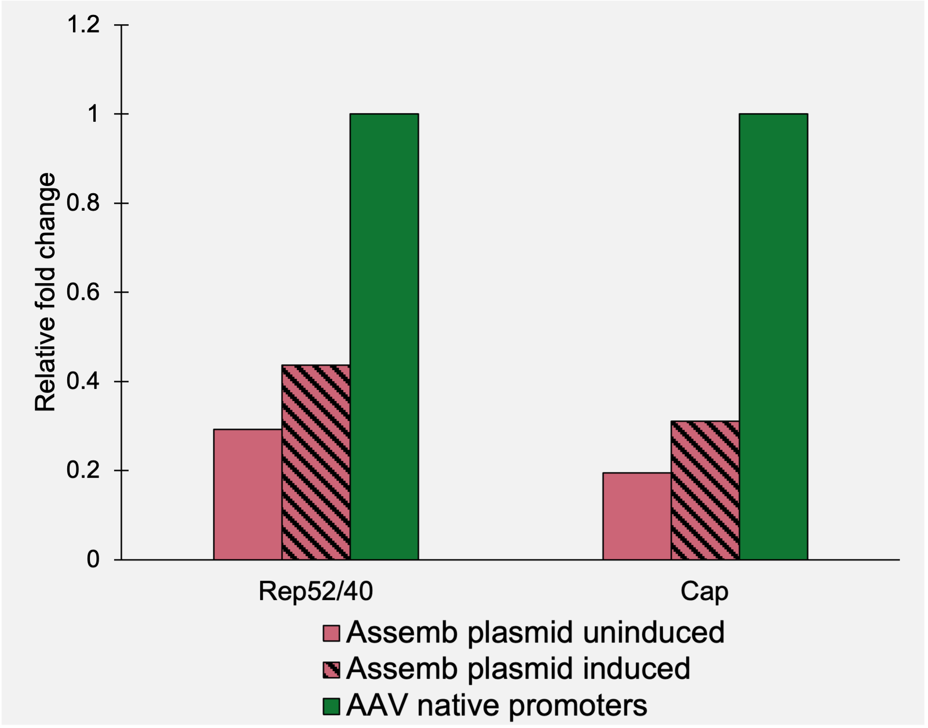
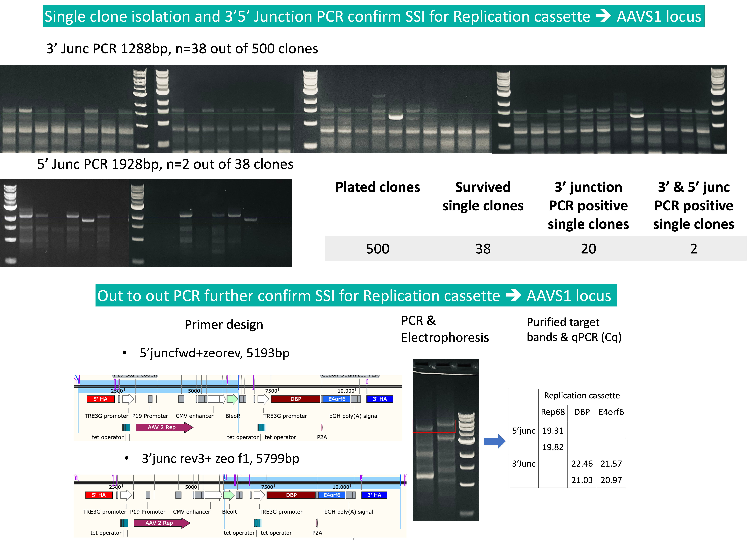
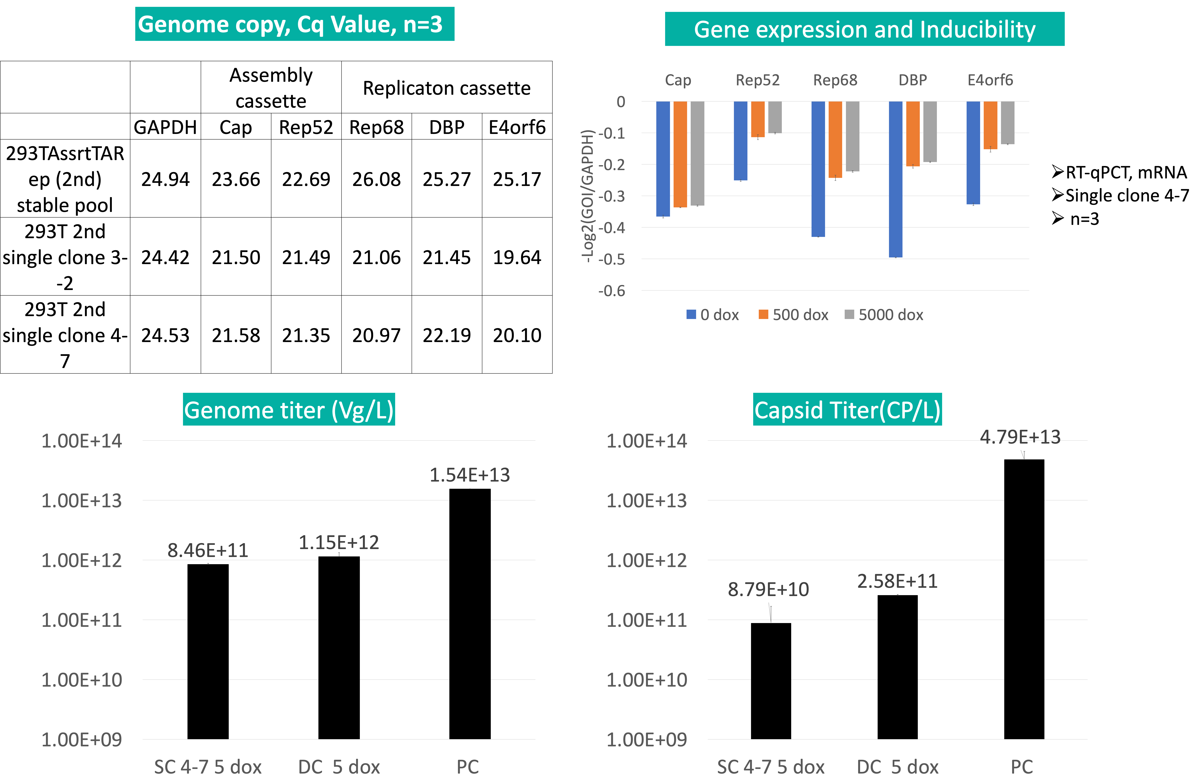
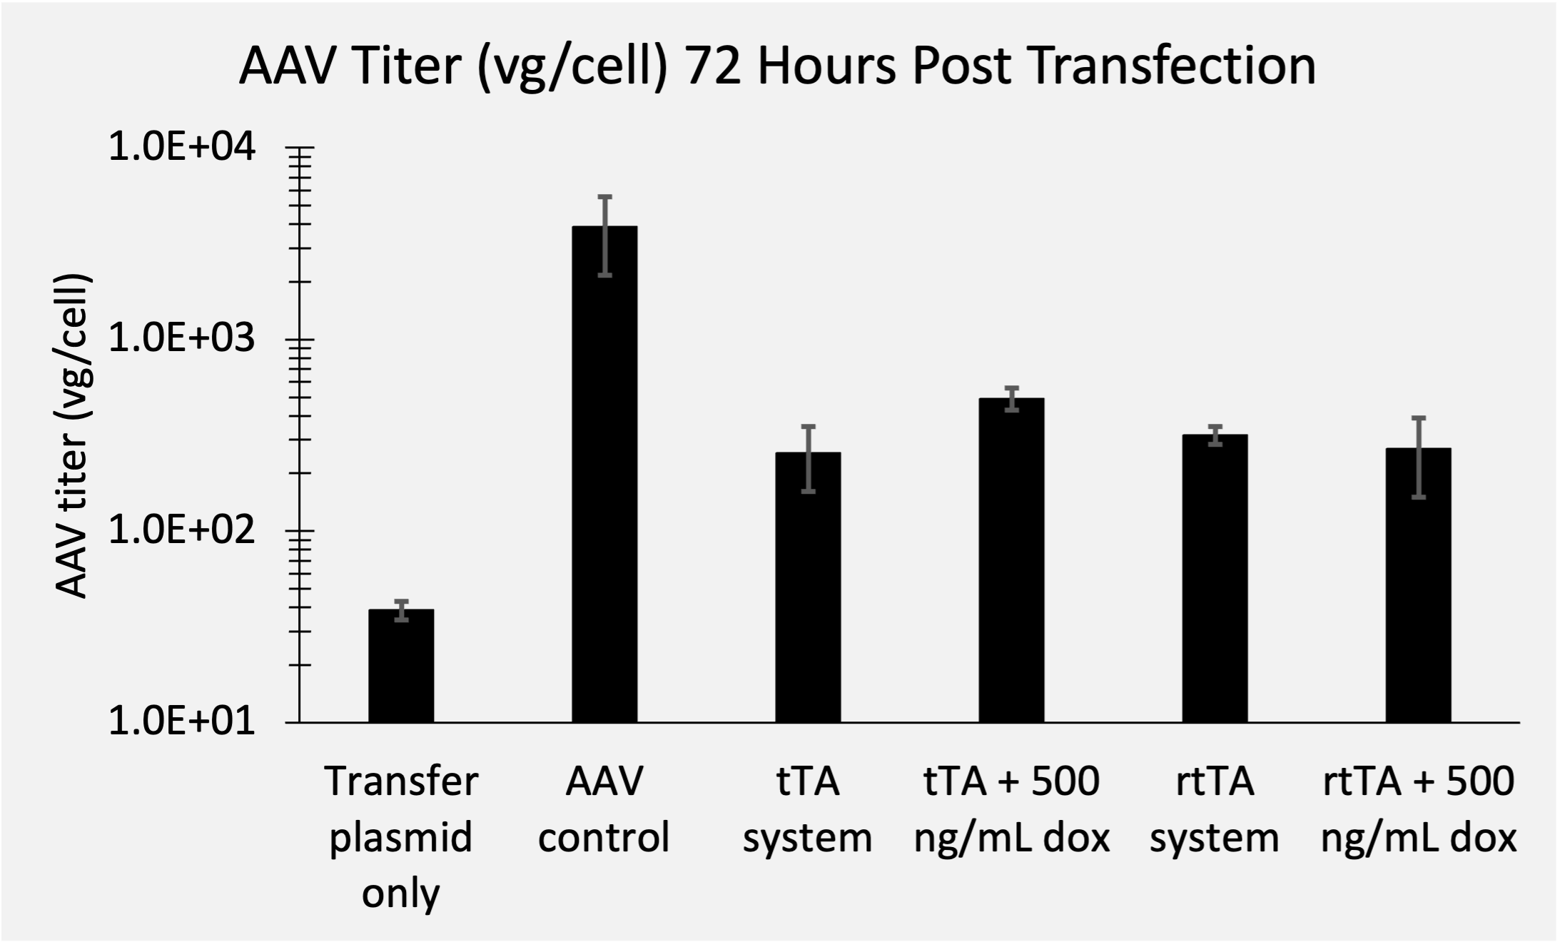
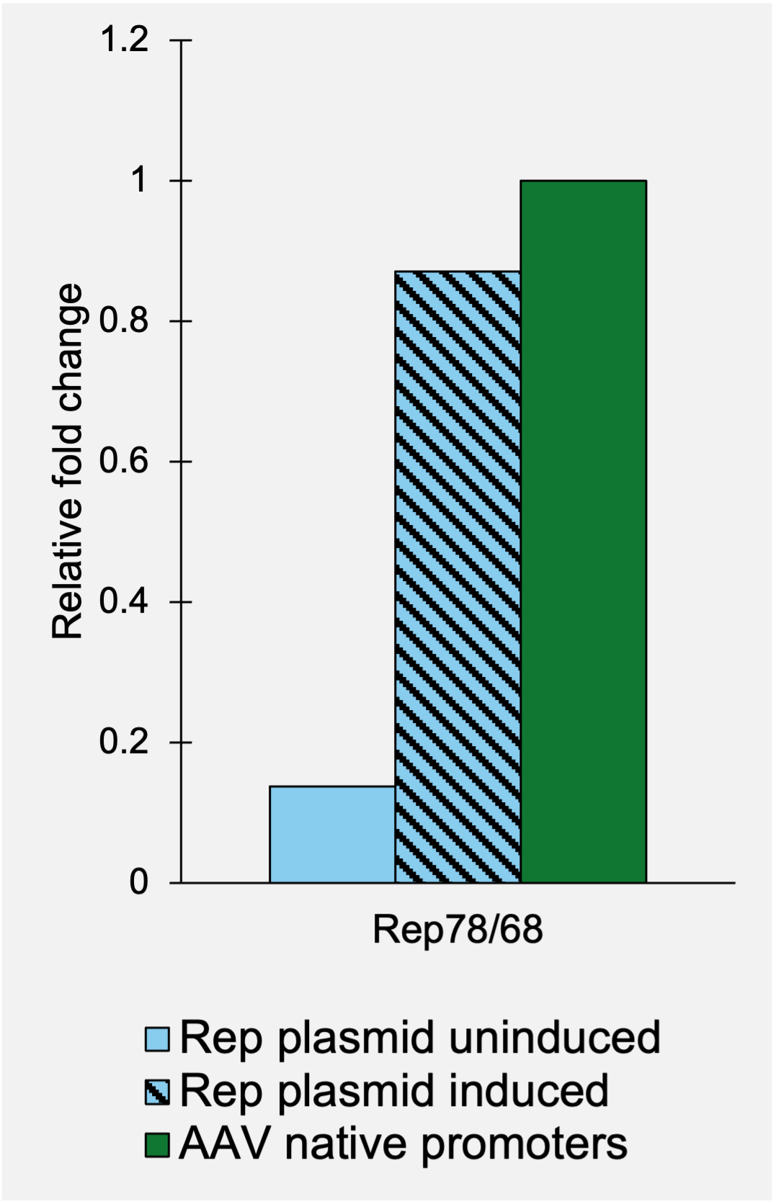
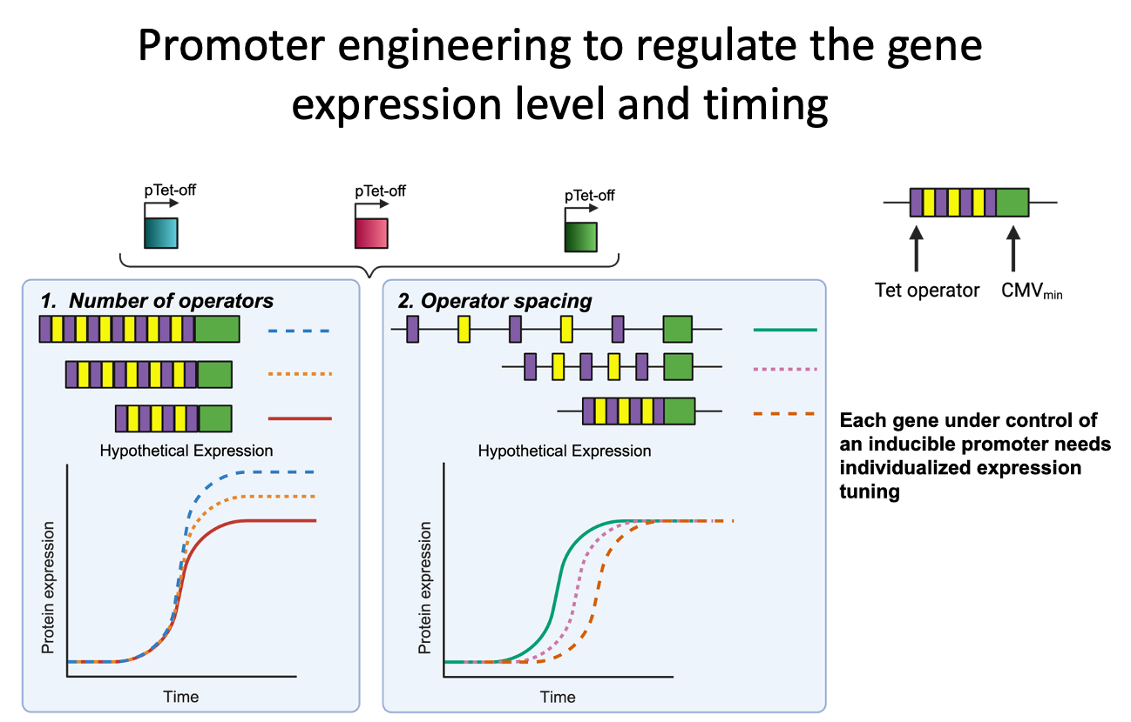
Qiang Fu (UML), Emily Doleh (UD), Yongdan Wang (UML)
Dr. Seongkyu Yoon (PI) / Dr. Mark Blenner (Co-PI)
Develop an Inducible Stable Packaging / Producer Cell Line for rAAV Production via Site-Specific Integration
Johns Hopkins University
University of Massachusetts Lowell
University of Delaware
Clemson University
University of Maryland
Project Overview
Research Approach
Project Goals
Design inducible circuits that can regulate the timing and level of gene expression for all components necessary to make rAAV
Develop an inducible stable producer cell line with site-specific integration for extensible rAAV production
Stage 1. Develop the baseline stable producer
Integrate the three inducible rAAV plasmids into the safe harbor site of HEK293 cells
Stage 2. Develop the optimized stable producer
Optimize the baseline producer via promoter engineering
Drawbacks of the traditional rAAV production process that uses transient transfection in HEK293 cells
Complicated and expensive process consuming considerable amount of transfection reagent and plasmids
The lot-to-lot variation of the products
Difficult to scale up
A stable producer of rAAV is needed!
Recent Results
Stable packaging cell line characterization
Figure 1. New three plasmid design for AAV production.
Figure 3. qRT-PCR showing induced gene expression for Rep and Cap genes relative to the native AAV promoters.
Figure 2. Transient transfection test for new three plasmid design using both Tet-off (tTA) and Tet-on (rtTA) promoters.
Next Step
Milestones and Timelines
Design of Tet-on/off inducible circuits (UD)
Tet off/on switch for 2 AAV cassettes via Golden gate, 1, transfer plasmid, 2, assembly plasmid(UD)
Q3-4 2023
Q1-2 2024
Q1 2023
Q2 2023
Tet off/on switch for the 3rd AAV cassette via Golden gate, 3, replication plasmid(UD)
Enhance the Knockin efficiency
Site-specific integration of 2 cassettes (UML)
Testing inducible plasmids via transient (UML/UD)
Site-specific integration of the 3rd cassette and develop the baseline of stable cells (UML)
Q3-4 2024
Cell line productivity and stability evaluation(UML/UD)
AAV production bottlenecks investigation(UD/UML)
Other investigations (UML/UD)
Crispr-Cas9 platform development and testing AAVS1, CCR5 and ROSA26 loci (UML)
Analytical methods (qPCR, Elisa, RT-qPCR, WB, proteomics) (UML/UD)
Optimization of gene level and dynamics by engineered inducible variants, Kozak variants
Optimization of gene level and dynamics by Kozak, and Degron tags (UD); Evaluate optimized plasmids via transient(UML/UD)
Optimized AAV parts integration, The optimized stable cell line(UML)

