Slide 1


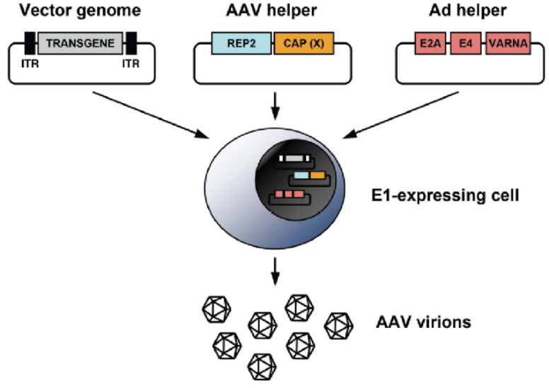
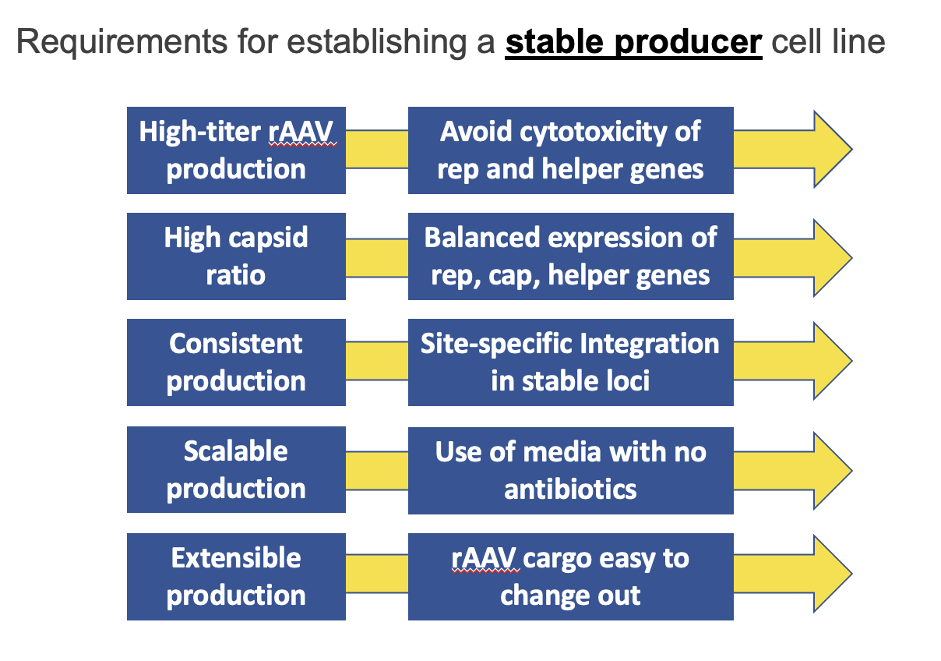
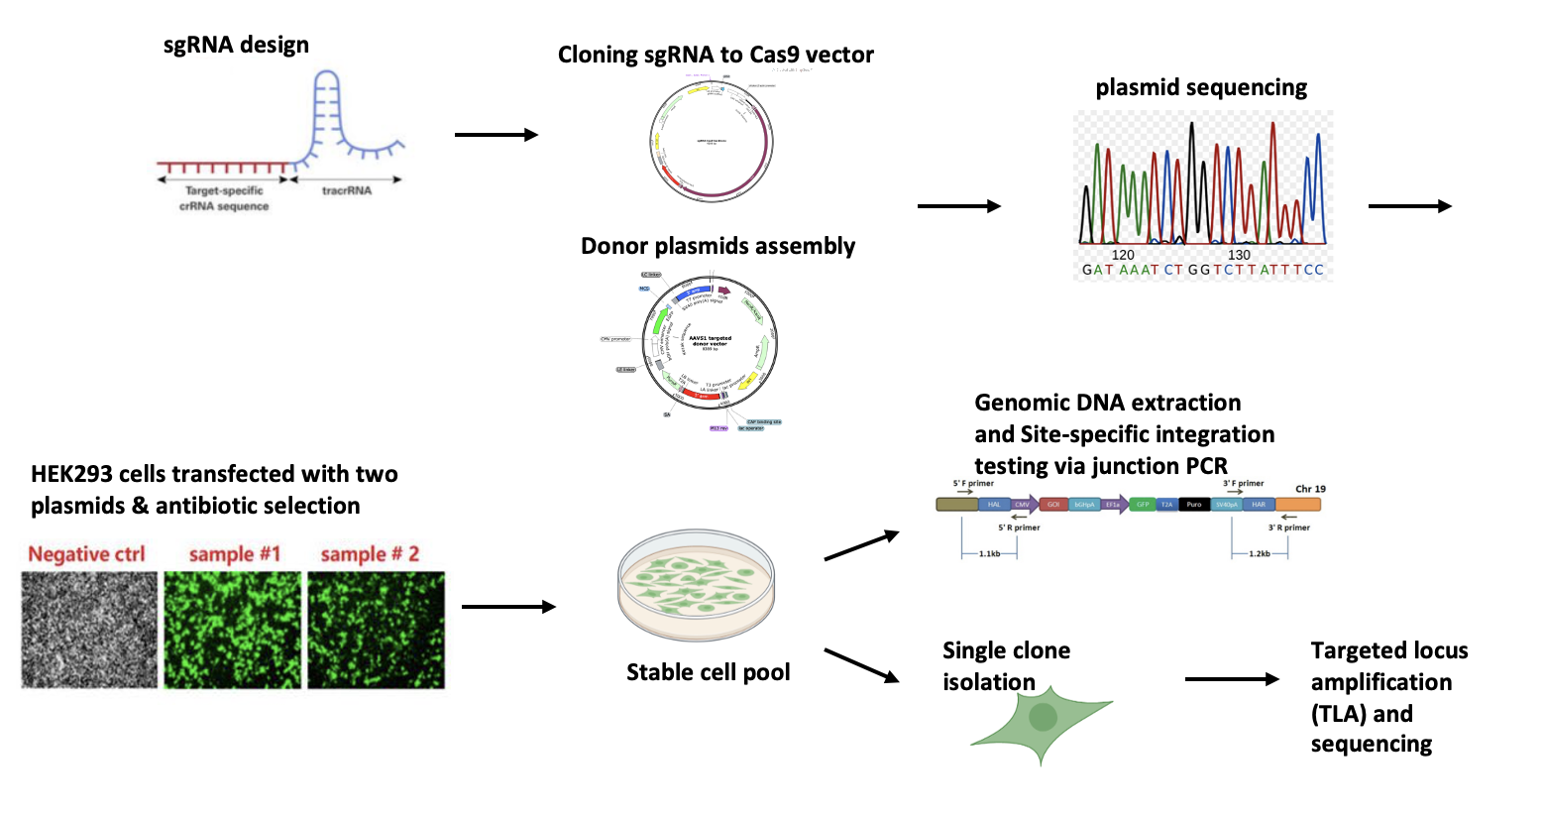
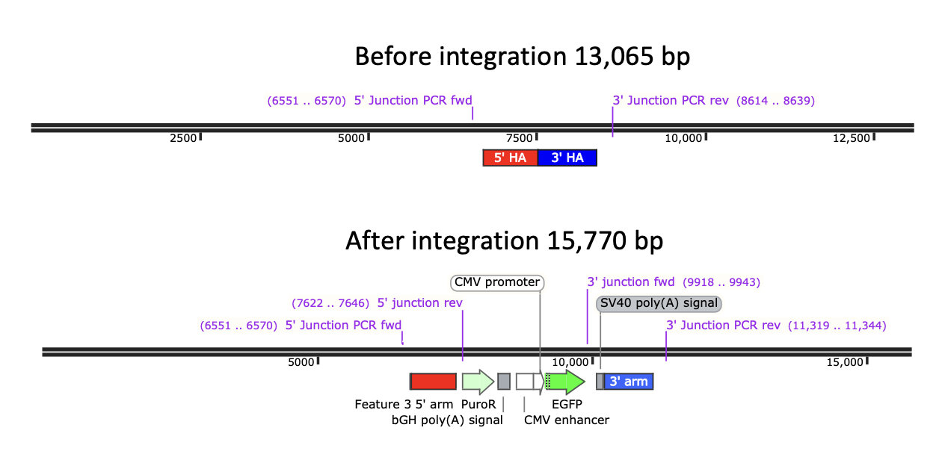
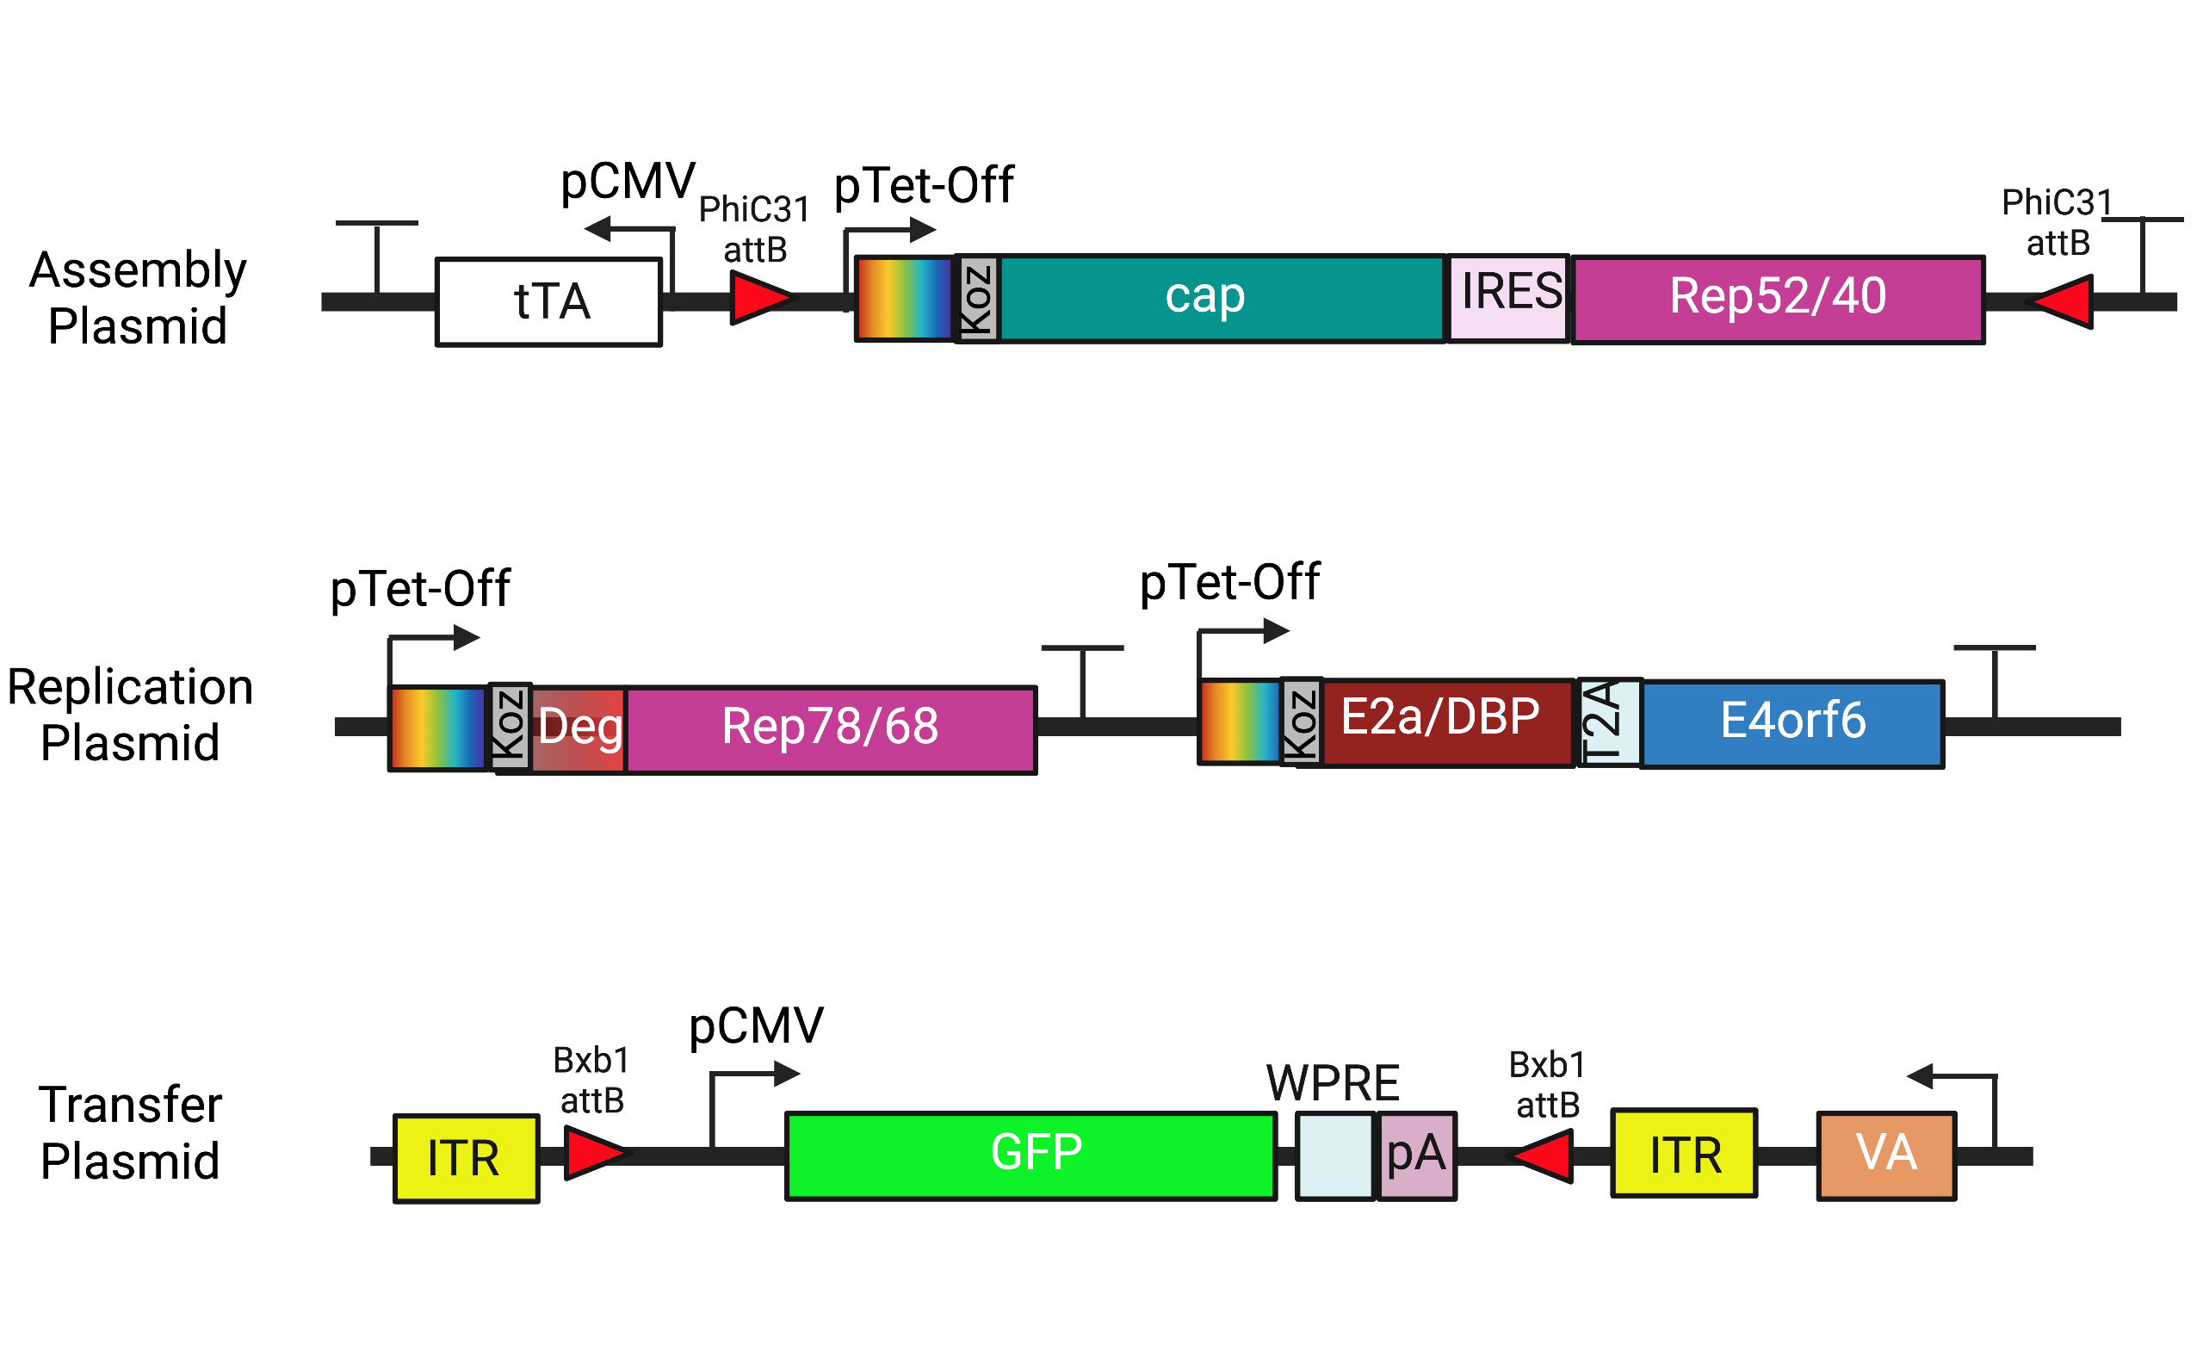
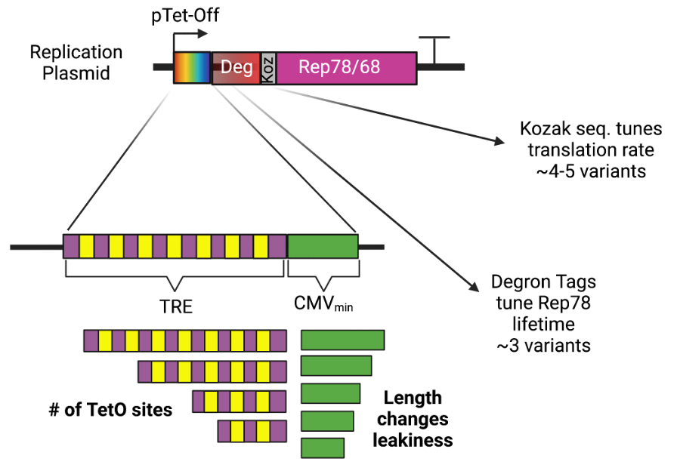
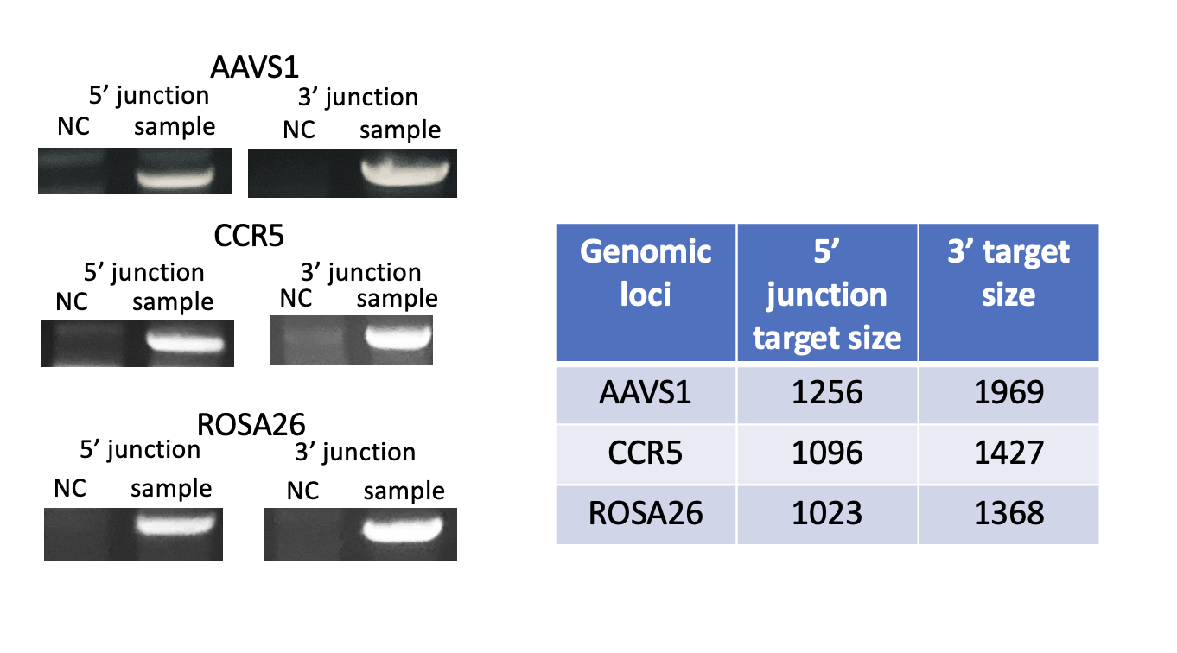
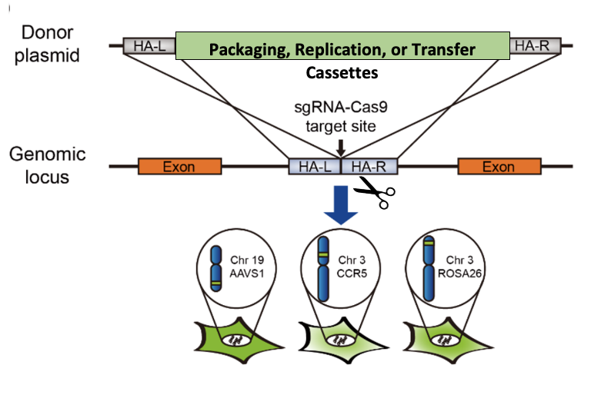
Qiang Fu (UML), Emily Doleh (UD), Yongdan Wang (UML), Spencer Grissom (UD)
Dr. Seongkyu Yoon (PI) / Dr. Mark Blenner (Co-PI)
Develop an Inducible Stable Producer Cell Line for rAAV Production via Site-Specific Integration
Johns Hopkins University
University of Massachusetts Lowell
University of Delaware
Clemson University
University of Maryland
Project Overview
Research Approach
Project Goals
Design inducible circuits that can regulate the timing and level of gene expression for all components necessary to make rAAV
Develop an inducible stable producer cell line with site-specific integration for extensible rAAV production
Stage 1. Develop the baseline stable producer
Integrate the three inducible rAAV plasmids into the safe harbor site of HEK293 cells
Stage 2. Develop the optimized stable producer
Optimize the baseline producer via promoter engineering
UD
inducible design and plasmid assembly
UML & UD
UML
Crisp-cas9, cell culture, integration
Design of Tet-on/off inducible circuits
Analytical methods (qPCR, Elisa, RT-qPCR, WB, proteomics)
Crispr-Cas9 platform development and testing AAVS1, CCR5 and ROSA26 loci
Tet off/on switch for 3 cassettes via Golden gate
Transfer plasmid
Assembly plasmid
Replication plasmids
Testing inducible plasmids via transient
AAV parts integration, The baseline of Stable cell line
Drawbacks of the traditional rAAV production process that uses transient transfection in HEK293 cells
Complicated and expensive process consuming considerable amount of transfection reagent and plasmids
The lot-to-lot variation of the products
Difficult to scale up
Optimization of gene-level and dynamics by engineered inducible variants, Kozak, and Degron tags
Evaluate optimized plasmids via transient
Optimized AAV parts integration, The optimized stable cell line
A stable producer of rAAV is needed!
Recent Results
Figure 3. CRISPR-CAS9 Gene Knock-in Workflow
Three Genomic Safe Harbor Sites in human cells
AAVS1, chromosome 19
CCR5, chromosome 3
Rosa26, chromosome 3
Figure 1. Three plasmid design for AAV production
Figure 2. Possible variables to influence gene expression
Figure 4. Junction PCR to verify Site-specific integration. Upper shows strategy, and down shows the electro results.
Next Step
Milestones and Timelines
Design of Tet-on/off inducible circuits (UD)
Tet off/on switch for 2 AAV cassettes via Golden gate, 1, transfer plasmid, 2, assembly plasmid(UD)
Q3 2023
Q4 2023
Q1 2023
Q2 2023
Tet off/on switch for the 3rd AAV cassette via Golden gate, 3, replication plasmid(UD)
Optimization of gene level and dynamics by engineered inducible variants, Kozak, and Degron tags (UD)
Crispr-Cas9 platform development and testing AAVS1, CCR5 and ROSA26 loci (UML)
Analytical methods (qPCR, Elisa, RT-qPCR, WB, proteomics) (UML/UD)
Site-specific integration of 2 cassettes (UML)
Testing inducible plasmids via transient (UML/UD)
Site-specific integration of the 3rd cassette and develop the baseline of stable cells (UML)
Evaluate optimized plasmids via transient(UML/UD)
Optimized AAV parts integration, The optimized stable cell line(UML)
2024
Cell line productivity and stability evaluation(UML/UD)
AAV production bottlenecks investigation(UD/UML)
Other investigations (UML/UD)
Figure 5. Site-specific integration of three AAV-related cassettes into three different loci in HEK293 cells.

