Slide 1








Industry/University Cooperative Research Center (I/UCRC)
Advanced Mammalian Biomanufacturing Innovation Center (AMBIC)
Develop an Inducible Stable Producer Cell Line for rAAV Production via Site-Specific Integration
Qiang Fu and Emily Doleh
Seongkyu Yoon (PI) / Mark Blenner (Co-PI)
Mentor Meeting – February 26, 2023
A National Science Foundation-facilitated
academic – industry – government consortia
to advance precompetitive knowledge in biomanufacturing
Contents are Proprietary to AMBIC and its Members
Terms of Center Membership Agreement Apply
www.ambic.org

Slide 2
Agenda
Project overview
UD Progress
UML Progress
Action Items

Slide 3
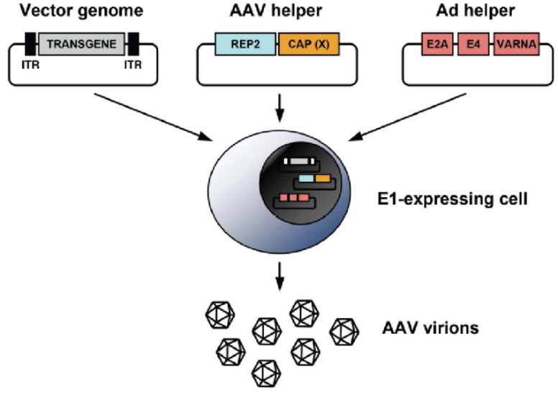
Industrial Relevance & Need
HEK 293 cells
Drawbacks of the traditional rAAV production process that uses transient transfection in HEK293 cells
Complicated and expensive process consuming considerable amount of transfection reagent and plasmids
The lot-to-lot variation of the products
Difficult to scale up
A stable producer of rAAV is needed!

Slide 4
Project Goals
Design inducible circuits that can regulate the timing and level of gene expression for all components necessary to make rAAV
Develop an inducible stable producer cell line with site-specific integration for extensible rAAV production
Objectives
Refactor rAAV rep, cap, and helper genes using variations of the inducible Tet-off promoter
Optimize the rAAV rep, cap, and helper gene expression levels for high titer rAAV, by Kozak sequences and degrons
Establish an inducible stable producer cell line with site specific integration in well-known human genomic safe harbors for rAAV production
Notes:
Why Tet-off promoter rather than Tet-on?
The tet-off-based inducible circuit will be used to eliminate the antibiotics in the rAAV production stage.

Slide 5
UD Progress

Slide 6
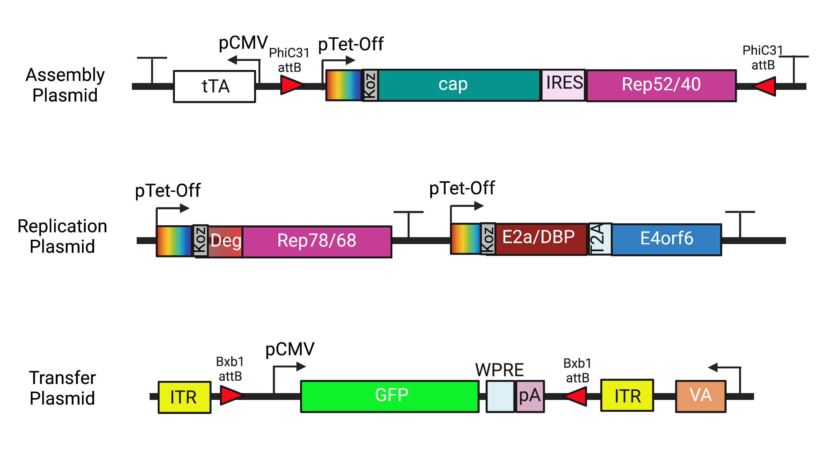
Plasmid Design

Slide 7
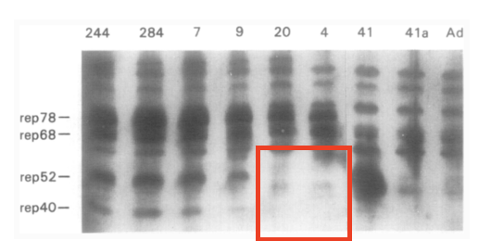
Fragment Design
 | Rep78/68
Sequence Change (AA) | 225: ATG → GGG
Reason | Removal of p19 start codon
Comments | Previous work reported the silencing of the p19 promoter through the mutation of the start codon¹
(1) Chejanovsky, N.; Carter, B. J. Mutagenesis of an AUG Codon in the Adeno-Associated Virus Rep Gene: Effects on Viral DNA Replication. Virology 1989, 173 (1), 120–128. https://doi.org/10.1016/0042-6822(89)90227-4.

Slide 8
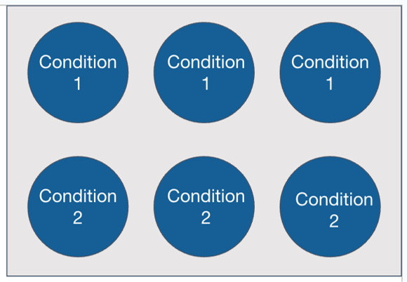
Transient Transfection Test
Using 6-well plates with 3 replicates each I am looking to test 6 conditions:​
1: Transfer plasmid only transfection (negative control)
2: AAV triple transfection using traditional 3 plasmids​
3: tTA (Tet-off) assembly, replication, and transfer plasmid transfection
4: tTA (Tet-off) assembly, replication, and transfer plasmid transfection + 500 ng/mL dox​
5: rtTA (Tet-on) assembly, replication, and transfer plasmid transfection
6: rtTA (Tet-on) assembly, replication, and transfer plasmid transfection + 500 ng/mL dox
Transfection conditions (PEI)
Media working volume | 3 mL
Plating density | 5E5
Total DNA | 2 ug
Plasmid ratio | 1:1:1
PEI:DNA | 1:1
Cocktail volume | 300 uL
Incubation time | 15 min
Cocktail media | OptiMEM

Slide 9
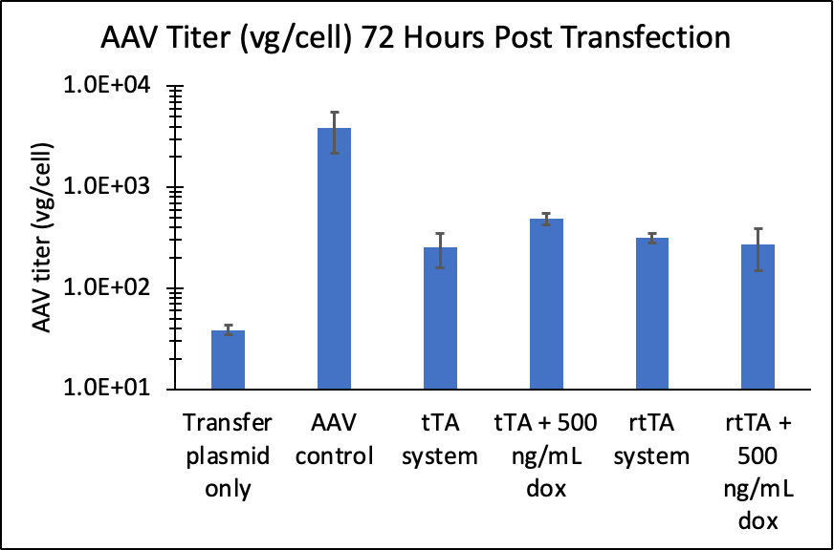
Transient Transfection Test
1: Transfer plasmid only transfection (negative control)
2: AAV triple transfection using traditional 3 plasmids​
3: tTA (Tet-off) assembly, replication, and transfer plasmid transfection
4: tTA (Tet-off) assembly, replication, and transfer plasmid transfection + 500 ng/mL dox​
5: rtTA (Tet-on) assembly, replication, and transfer plasmid transfection
6: rtTA (Tet-on) assembly, replication, and transfer plasmid transfection + 500 ng/mL dox
GOI is replicated but on/off production is not functional currently (in transient transfection)

Slide 10
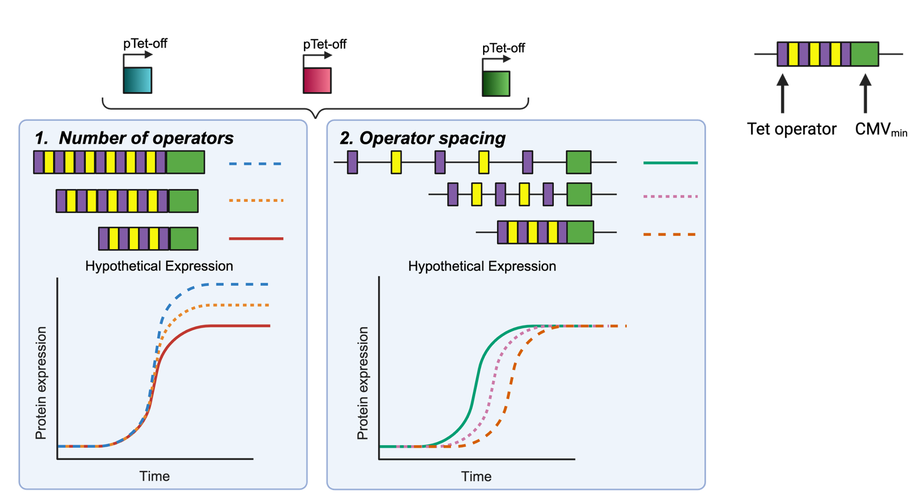
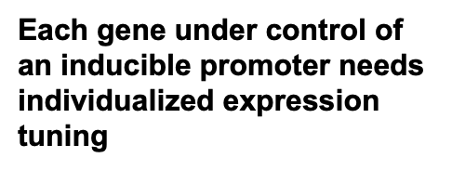
Future Promoter Variants

Slide 11
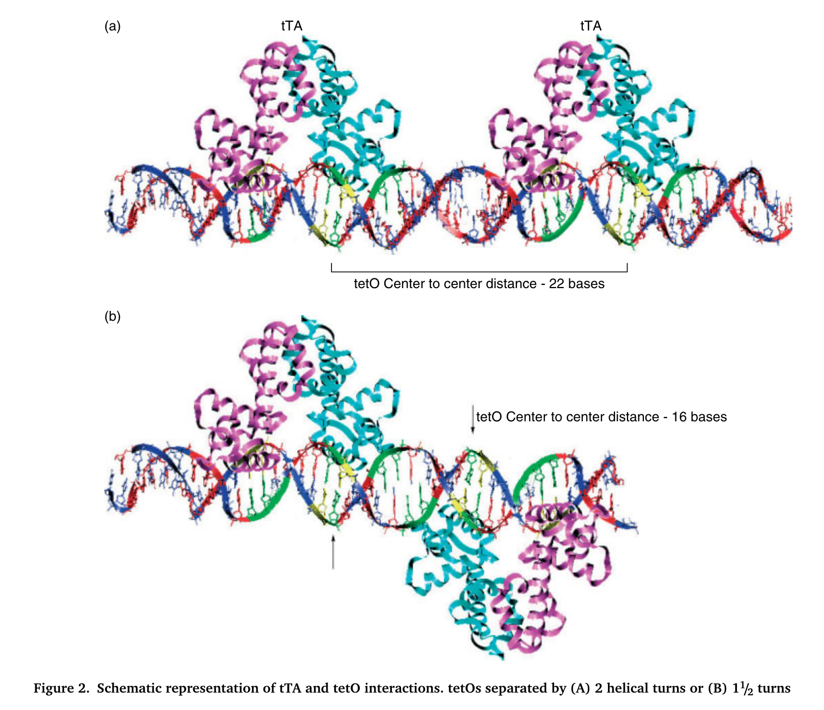
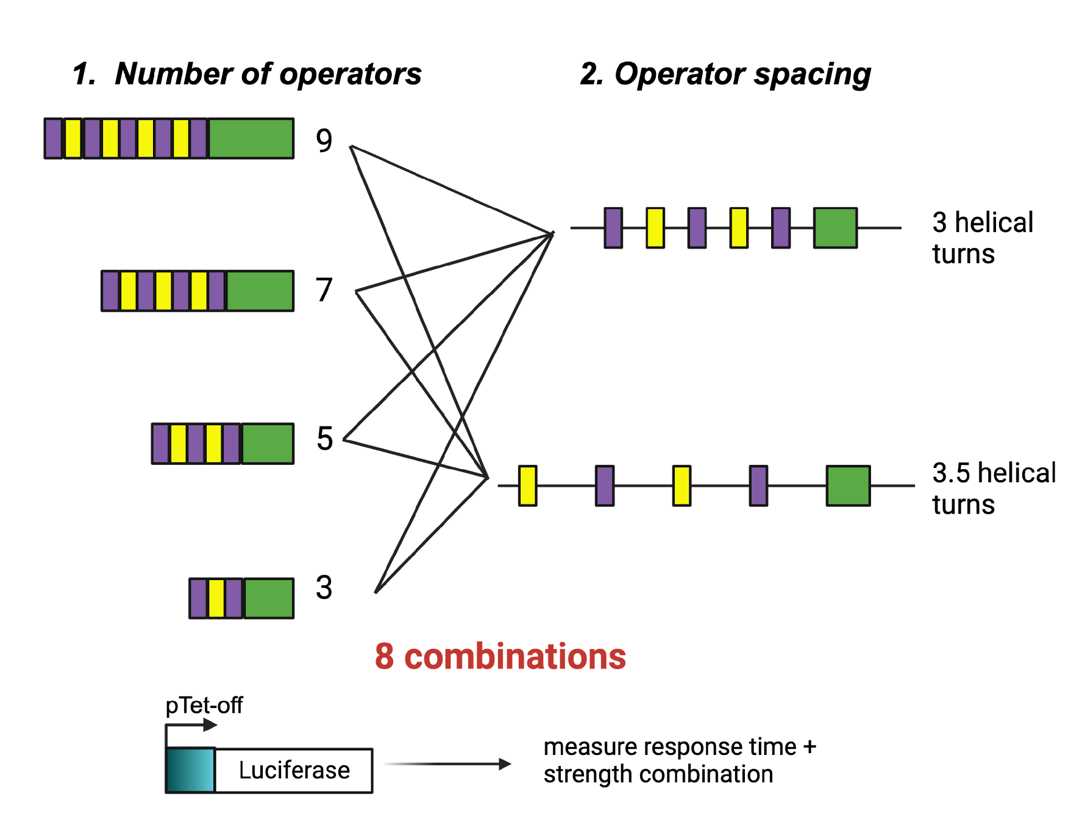
Future Promoter Variants
(short)
Agha-Mohammadi, Siamak et. al. The Journal of Gene Medicine 6, no. 7 (July 2004): 817–28. https://doi.org/10.1002/jgm.566

Slide 12
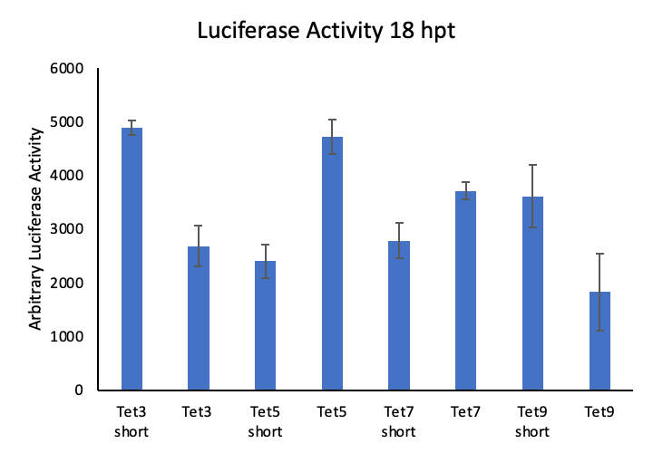
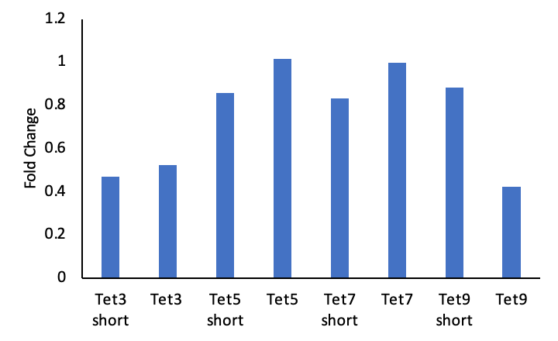
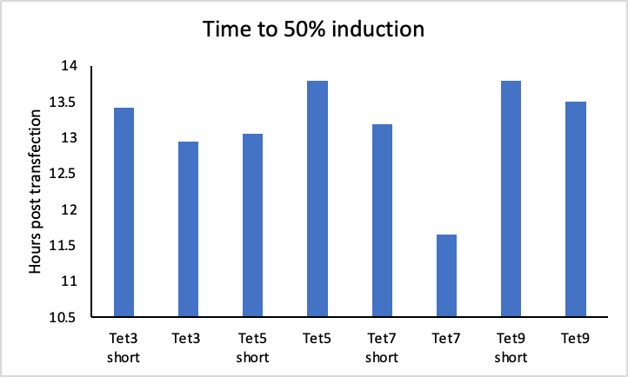
Tet-on Promoter Characterization
Factor | Mean | Group
Tet3 short | 4885 | A
Tet5 | 4718 | A
Tet7 (tre3g) | 3711 | A B
Tet9 short | 3611 | A B
Tet7 short | 2784 | B
Tet3 | 2684 | B
Tet5 short | 2404 | B
Tet9 | 1824 | B C
Short = 3 helical turns separating operators
Otherwise, 3.5 helical turns
Groups that do not share a letter are significant

Slide 13
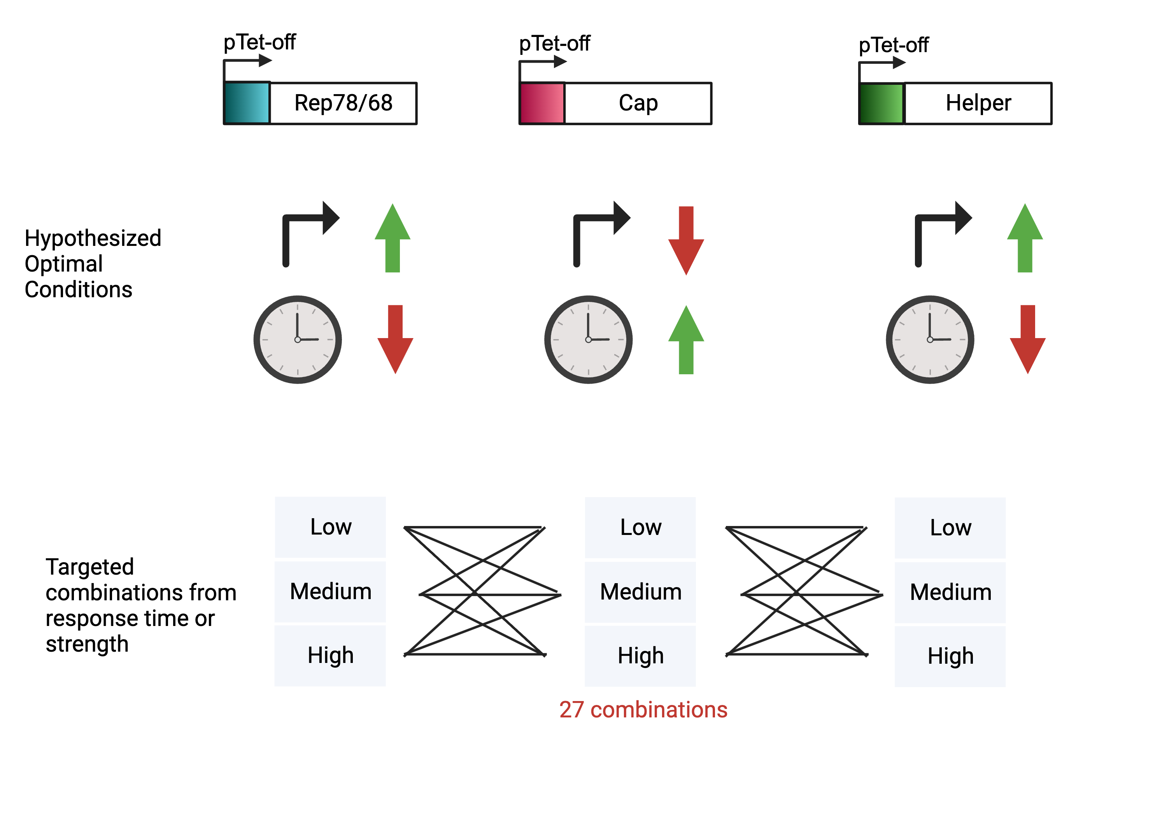
Future Promoter Variants
Nguyen, Tam N.T. et. al. Molecular Therapy - Methods & Clinical Development 21 (June 2021): 642–55. https://doi.org/10.1016/j.omtm.2021.04.006.

Slide 14
UML Progress

Slide 15
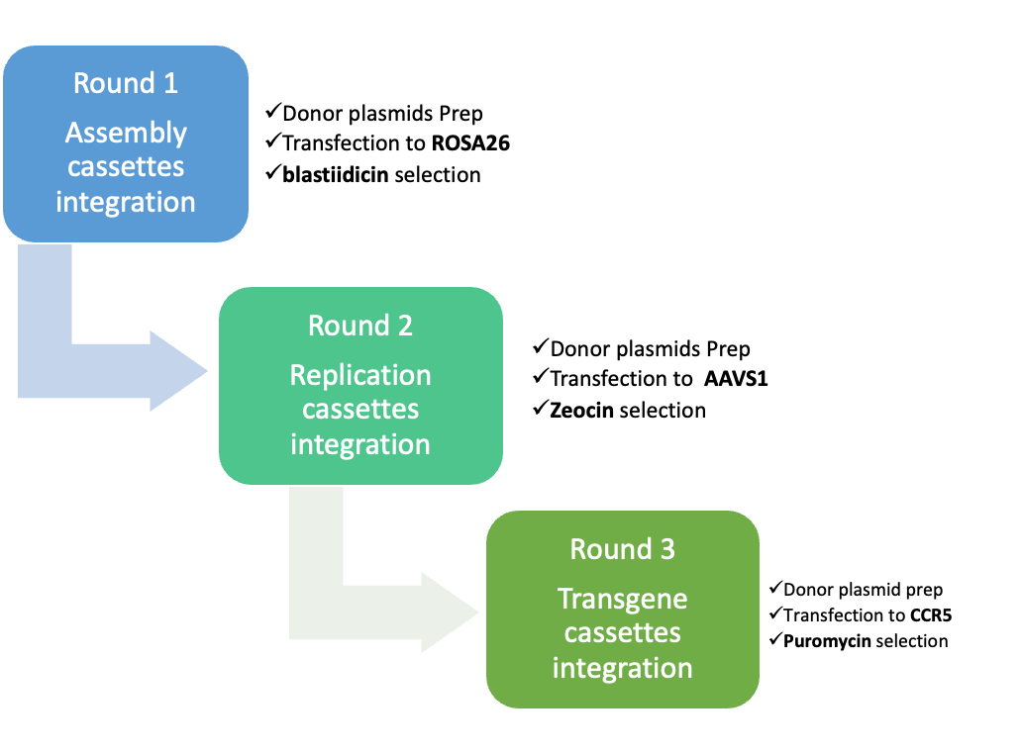
Site-specific Integration Strategy for Inducible Baseline Development –293T cells
Stable cell pool
5’ 3’ Junction PCR
Genome copy number
Transient other two plasmids for rAAV production
Single clone knock in efficiency (5%)
5’ 3’ Junction PCR
Stable cell pool
5’ 3’ Junction PCR
Genome copy
Transient one plasmid for rAAV production
Single clone knock in efficiency (5%)
5’ 3’ Junction PCR
Characterization
Packaging cell line
Stable cell pool
5’ 3’ Junction PCR
Genome copy
rAAV produciton
Single clone knock in efficiency (17%)
5’ 3’ Junction PCR
Characterization
producer cell line

Slide 16
Site-specific Integration Strategy for Inducible Baseline Development –293T cells
Stable cell pool
5’ 3’ Junction PCR
Genome copy number
Transient other two plasmids for rAAV production
Stable cell pool
5’ 3’ Junction PCR
Genome copy number
Transient other two plasmids for rAAV production
Single clone knock in efficiency (5%)
5’ 3’ Junction PCR
Single clone knock in efficiency (5%)
5’ 3’ Junction PCR
Stable cell pool
5’ 3’ Junction PCR
Genome copy
Transient one plasmid for rAAV production
Stable cell pool
5’ 3’ Junction PCR
Genome copy
Transient one plasmid for rAAV production
Single clone knock in efficiency (5%)
5’ 3’ Junction PCR
Characterization
Packaging cell line
Stable cell pool
5’ 3’ Junction PCR
Genome copy
rAAV produciton
Single clone knock in efficiency (17%)
5’ 3’ Junction PCR
Characterization
producer cell line

Slide 17
Packaging cell line characterization– Genome copy
Genome copy, Cq value
 |  | Assembly cassette |  | Replicaton cassette
 | GAPDH | Cap | Rep52 | Rep68 | DBP | E4orf6
293TAssrtTARep (2nd) stable pool | 24.94±0.3 | 23.66±0.02 | 22.69±0.14 | 26.08±0.05 | 25.27±0.01 | 25.17±0.07
293T 2nd single clone 3--2 | 24.42±0.04 | 21.5±0.07 | 21.49±0.08 | 21.06±0.03 | 21.45±0.05 | 19.64±0.07
293T 2nd single clone 4-7 | 24.53±0.3 | 21.58±0.02 | 21.35±0.14 | 20.97±0.05 | 22.19±0.01 | 20.1±0.07
NC | 24.04±0.06 | 34.92±0.47 | 35.4±0.43 | 37.93±2.18 | 38±1.93 | 30.1±0.25
20ng gDNA as templates and GAPDH as internal reference
Single clones (SC3-2, SC4-7) contain at least 1 copy of AAV components

Slide 18
Packaging cell line characterization-- transcripts
transcripts | House keeping | Assembly cassette |  | Replication cassette
n=3 | GAPDH | Cap | Rep52 | Rep68 | DBP | E4orf6
sc 4-7 0 dox | 17.86± 0.05 | 23.03± 0.04 | 21.23±0.08 | 24.07±0.06 | 25.19±0.07 | 22.38±0.1
sc 4-7 0.5 dox | 17.91± 0.06 | 22.61± 0.05 | 19.32±0.07 | 21.13±0.07 | 20.63±0.02 | 19.85±0.06
sc 4-7 5 dox | 17.64± 0.04 | 22.17± 0.05 | 18.94±0.06 | 20.57±0.01 | 20.14±0.04 | 19.39±0.05
The transcript level of viral genes fold change with 0, 0.5, and 5 µg/mL dox induction at 68 HPT for packaging single clone (SC4-7), normalized to housekeeping gene GAPDH.
Genes expression were detected for all AAV components (Cap, Rep52, Rep68, DBP, and E4orf6).
Gene expression leakage in 0 dox, and the gene expression level increased after adding the inducible reagent.
Notes:
Change dox number to ug/mL

Slide 19
Packaging cell line characterization – genome and capsid titer
(a) Genome titer
(b) Capsid titer
Specific genome titer (a) and capsid titer (b) evaluation for packaging single clone SC4-7 with 0 and 5 µg/mL dox induction. Positive control (PC) represents traditional transfection with commercial triple plasmids. Donor control (DC) represents transfection with refactored donor plasmids with 5 µg/mL dox induction. LOD represents the lower limit of detection. Error bars represent the standard deviation of biological triplicates (n=3).
Notes:
Y axis consistency, change donor control to DC, positive control to PC. Dox number change

Slide 20
Site-specific Integration Strategy for Inducible Baseline Development –293T cells
Stable cell pool
5’ 3’ Junction PCR
Genome copy number
Transient other two plasmids for rAAV production
Single clone knock in efficiency (5%)
5’ 3’ Junction PCR
Stable cell pool
5’ 3’ Junction PCR
Genome copy
Transient one plasmid for rAAV production
Single clone knock in efficiency (5%)
5’ 3’ Junction PCR
Characterization
Packaging cell line
Stable cell pool
5’ 3’ Junction PCR
Genome copy
rAAV produciton
Single clone knock in efficiency (17%)
5’ 3’ Junction PCR
Characterization
producer cell line

Slide 21
The 3rd integration- stable pool issue
Genome titer
Relative genome copy analysis summary of viral components for stable cell pools after each round of integration
Relative genome copy | House keeping | Assembly cassette |  | Replication cassette |  |  | Transfer cassette
n=3 | GAPDH | Cap | Rep52 | Rep68 | DBP | E4orf6 | GFP
293TAssrtTARepTrans (3rd) | 24.47± 0.21 | 23.4±0.73 | 25.06±1.11 | 26.17±0.17 | 24.81±0.1 | 25.25±0.1 | 22.92± 0.05
293TAssrtTARep (2nd) | 24.94± 0.35 | 23.66±0.13 | 22.69±0.17 | 26.08±0.25 | 25.27±0.14 | 25.17±0.18
293TASSrtTA (1st) | 23.88± 0.11 | 24.86±0.03 | 23.68±0.04
NC | 24.04± 0.06 | 34.92±0.47 | 35.4±0.43 | 37.93±2.18 | 38.0± 1.93 | 30.1± 0.25 | 34.83± 0.41
Capsid titer
GFP genome copy was detected
Capsid titer was detected.
Genome titer was missing.

Slide 22
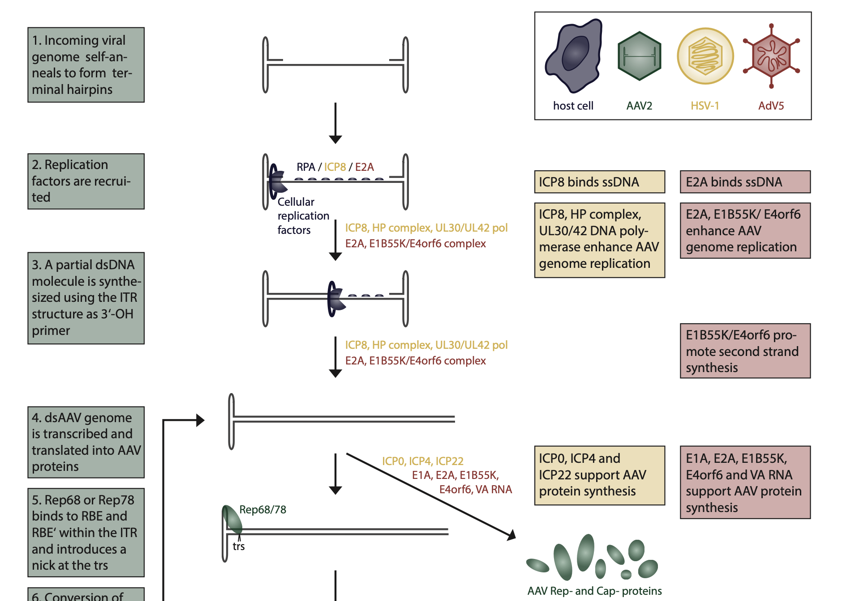
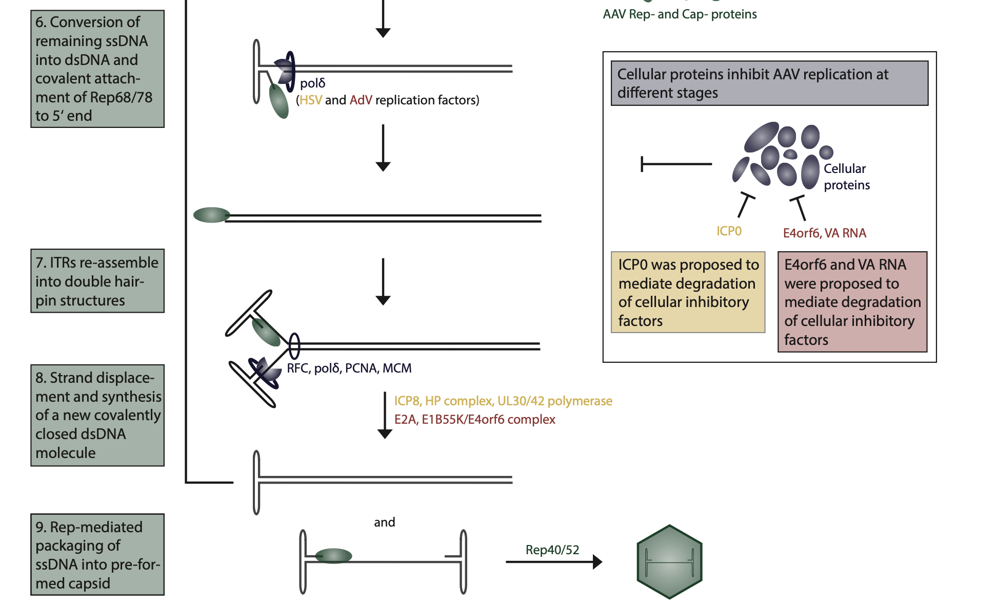
Genome titer missing in the 3rd stable pool
Low genome copy number compared to transient
low packaging efficiency
Meier, A. F., Fraefel, C., & Seyffert, M. (2020). The interplay between adeno-associated virus and its helper viruses. Viruses, 12(6), 662.

Slide 23
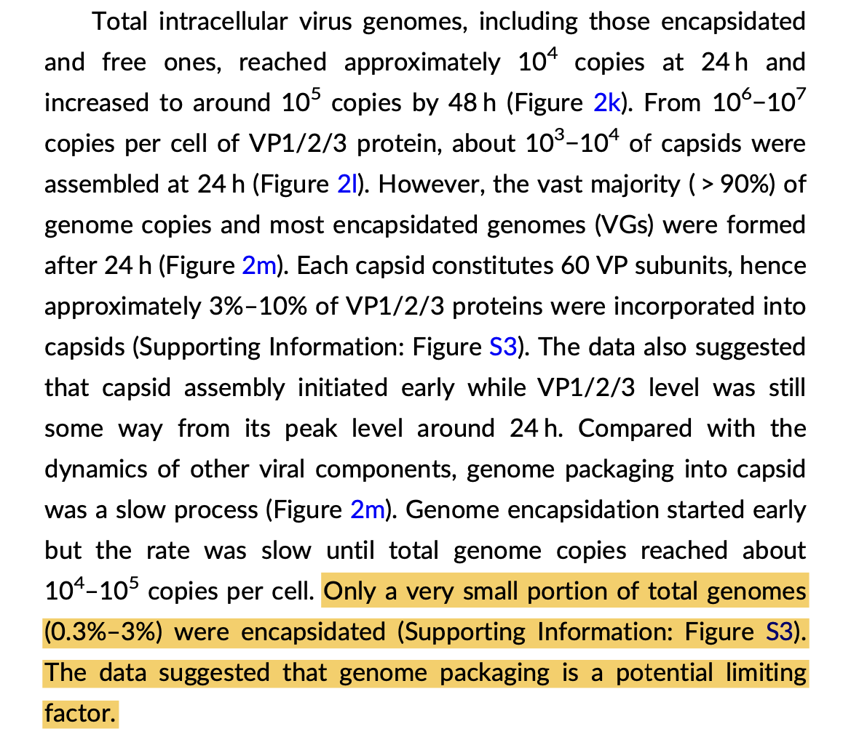
Genome titer missing in the 3rd stable pool
Low genome copy number compared to transient
low packaging efficiency
Lu, M., Lee, Z., Lin, Y. C., Irfanullah, I., Cai, W., & Hu, W. S. (2024). Enhancing the production of recombinant adeno‐ associated virus in synthetic cell lines through systematic characterization. Biotechnology and bioengineering.

Slide 24
Site-specific Integration Strategy for Inducible Baseline Development –293T cells
Stable cell pool
5’ 3’ Junction PCR
Genome copy number
Transient other two plasmids for rAAV production
Single clone knock in efficiency (5%)
5’ 3’ Junction PCR
Stable cell pool
5’ 3’ Junction PCR
Genome copy
Transient one plasmid for rAAV production
Single clone knock in efficiency (5%)
5’ 3’ Junction PCR
Characterization
Packaging cell line
Stable cell pool
5’ 3’ Junction PCR
Genome copy
rAAV produciton
Single clone knock in efficiency (17%)
5’ 3’ Junction PCR
Characterization
producer cell line

Slide 25
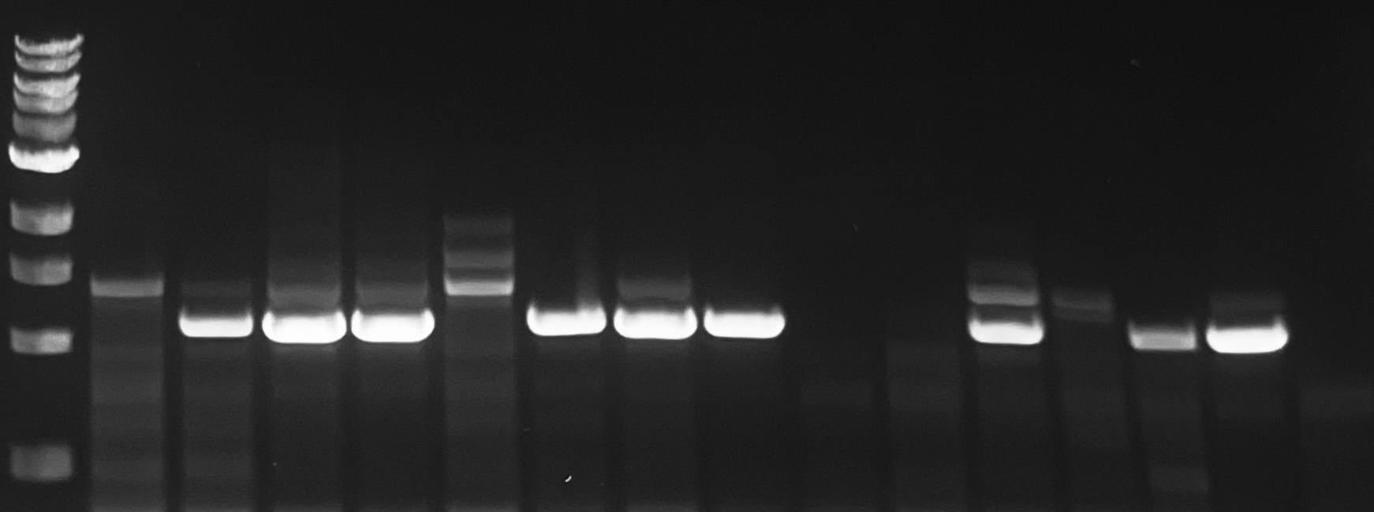
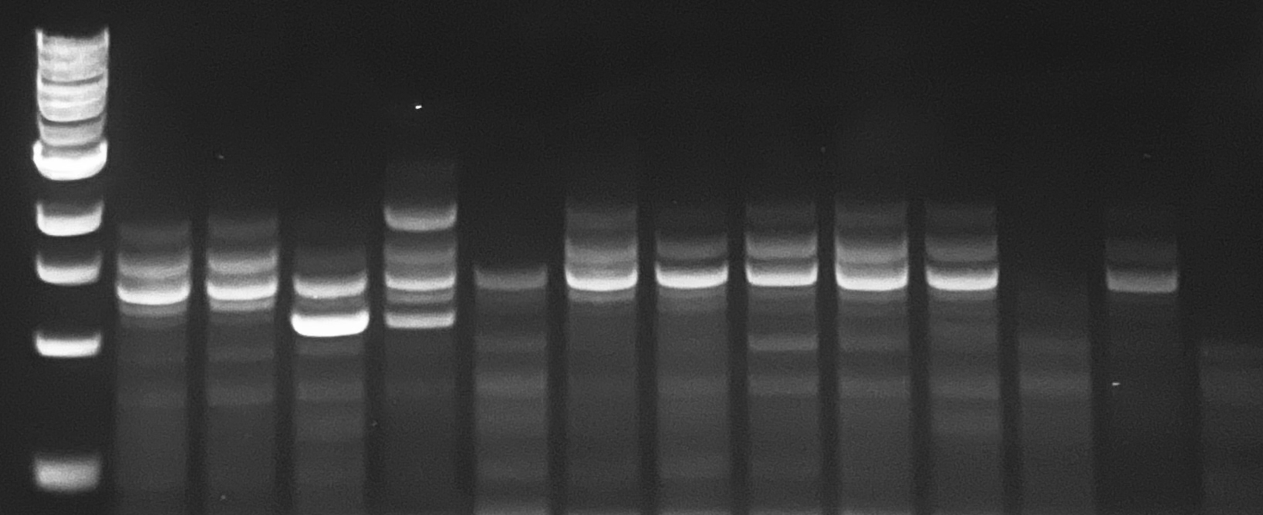
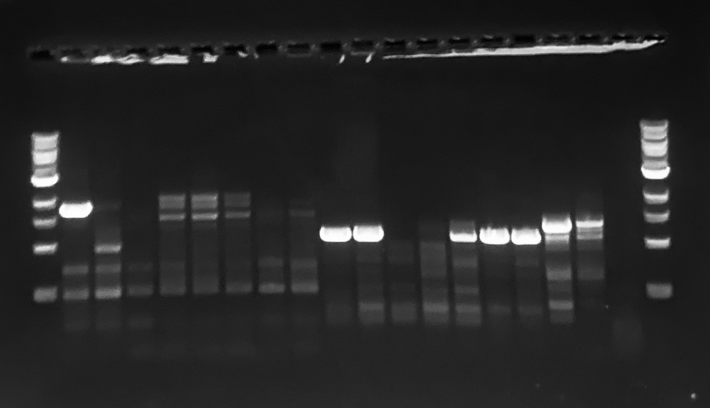
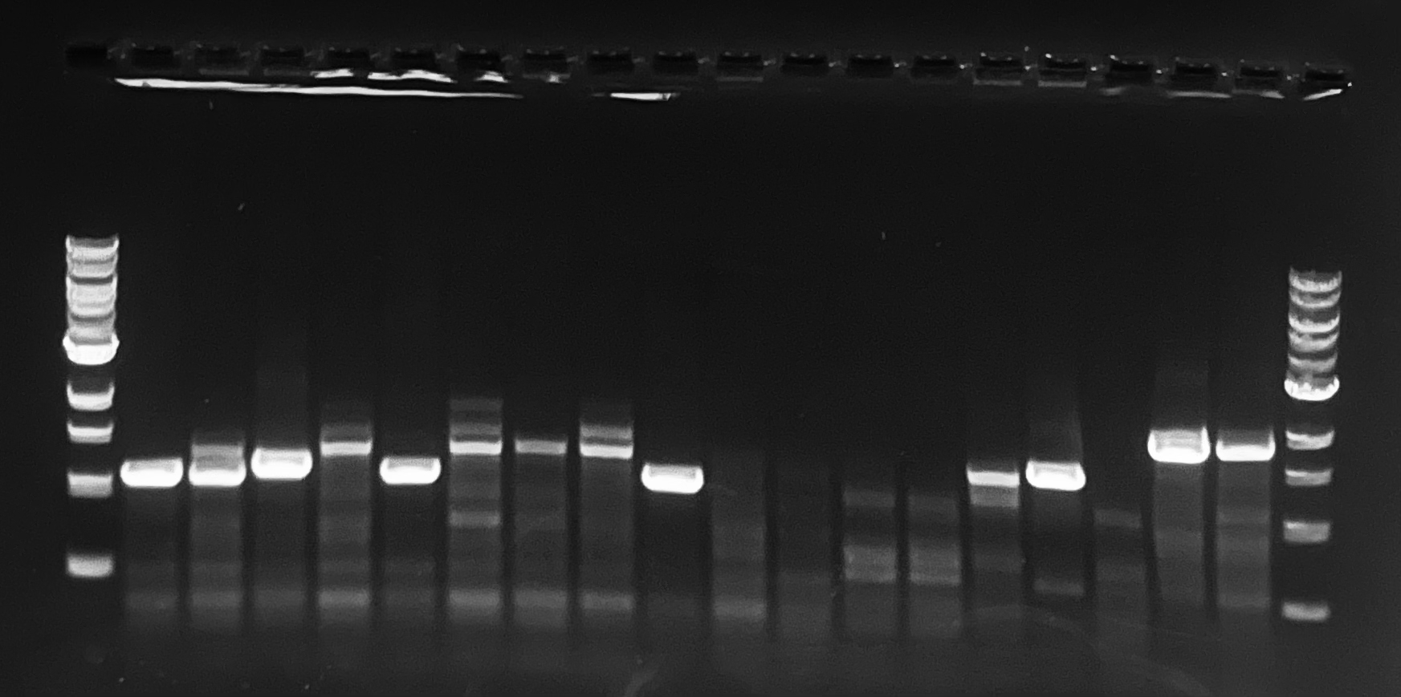
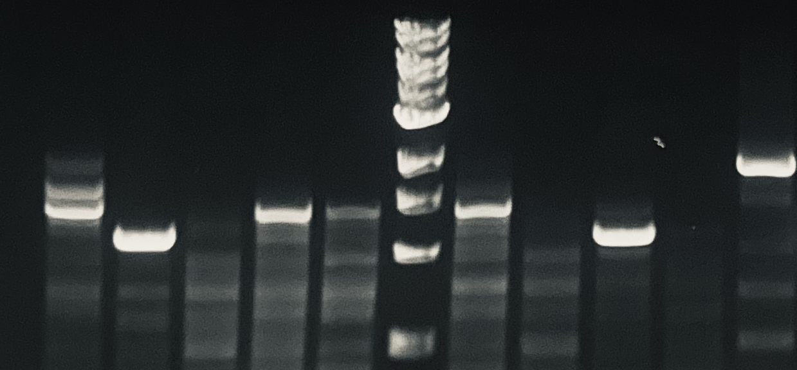
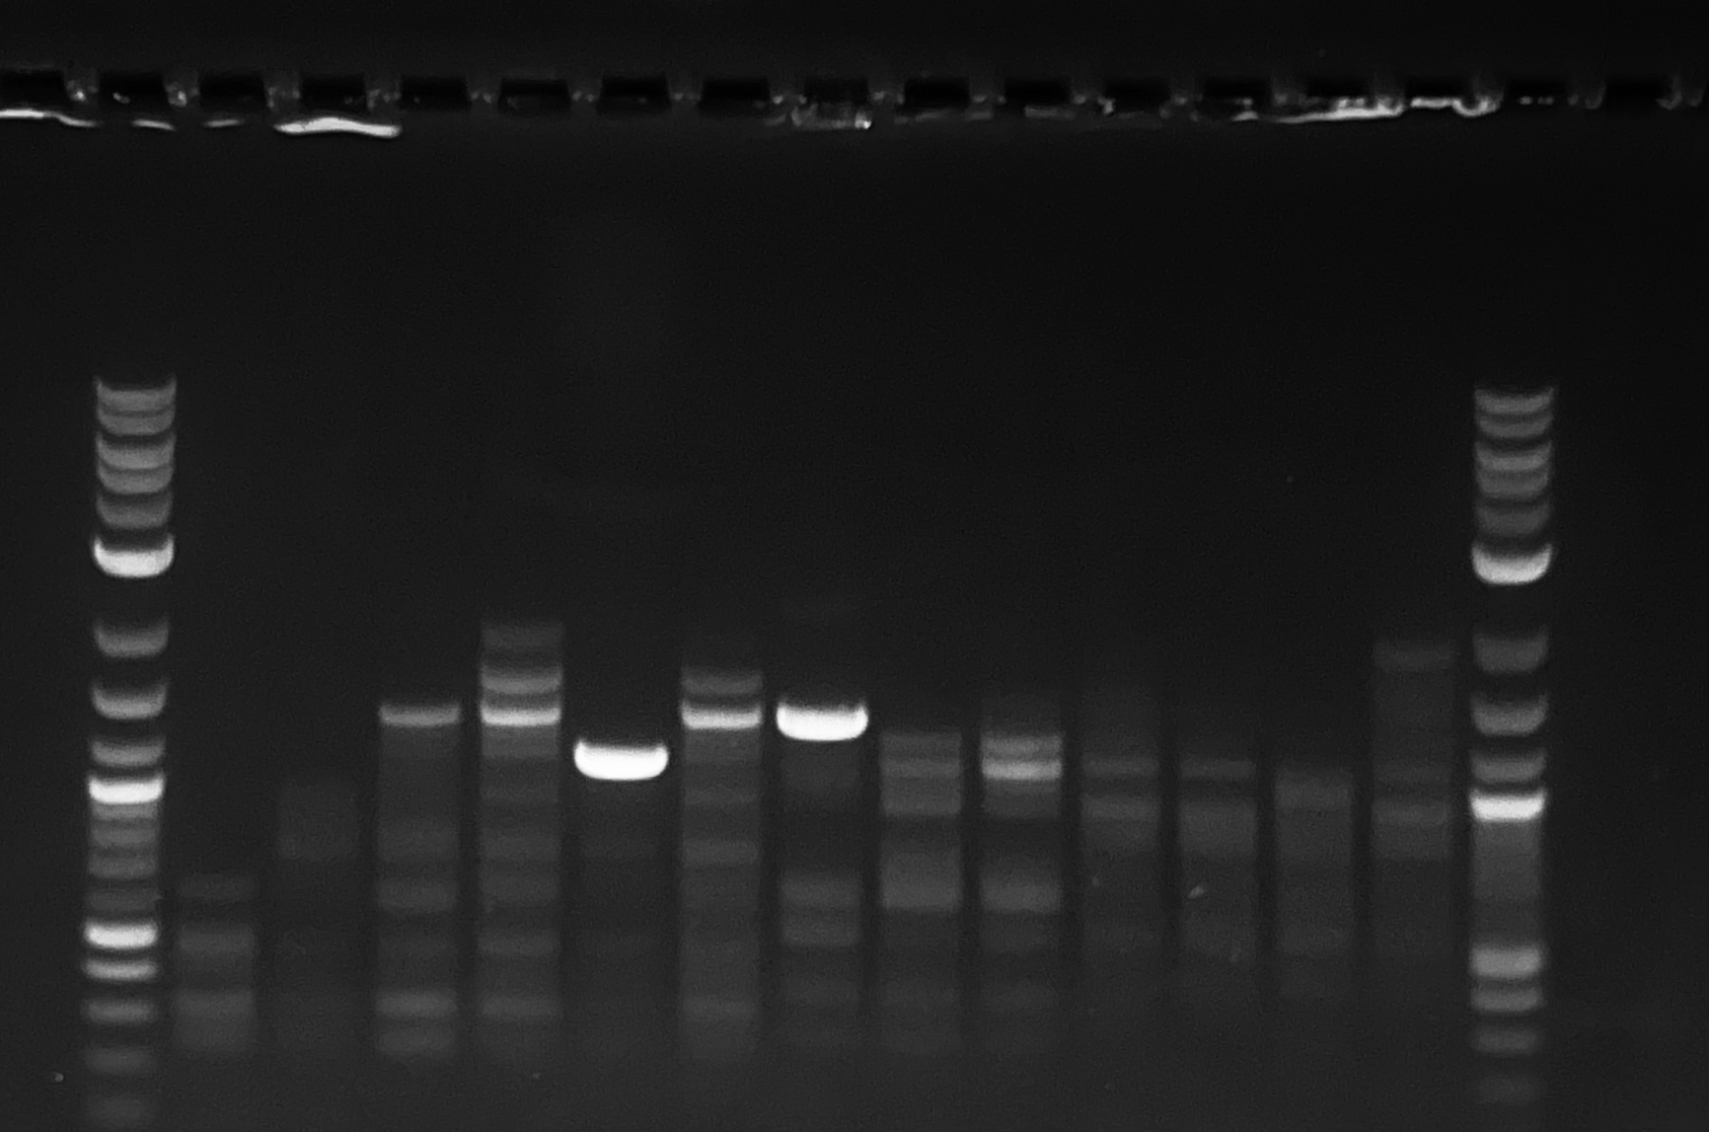
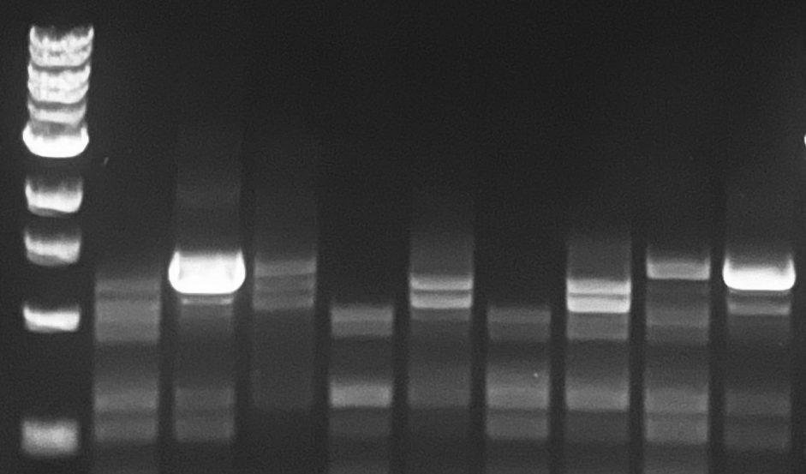
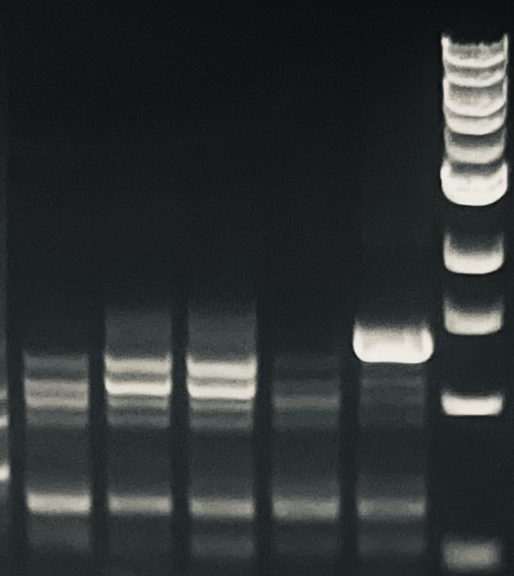
3rd Round Integration – single clones (Producer)
Transfer cassette (5982 bp insertion) ➔ CCR5 locus
5’ Junc PCR 1120bp, n= 62
Single clones | 5’ junction PCR | 5’&3’ junc PCR
62 | 24 | 11
 | Knockin efficiency ~ 39% | Knockin efficiency ~ 17.7%
3’ Junc PCR 1379bp
5’ junction PCR for 62 single clones.
Based on the 5’ junction results, select the positive clones to do 3’ junction PCR

Slide 26
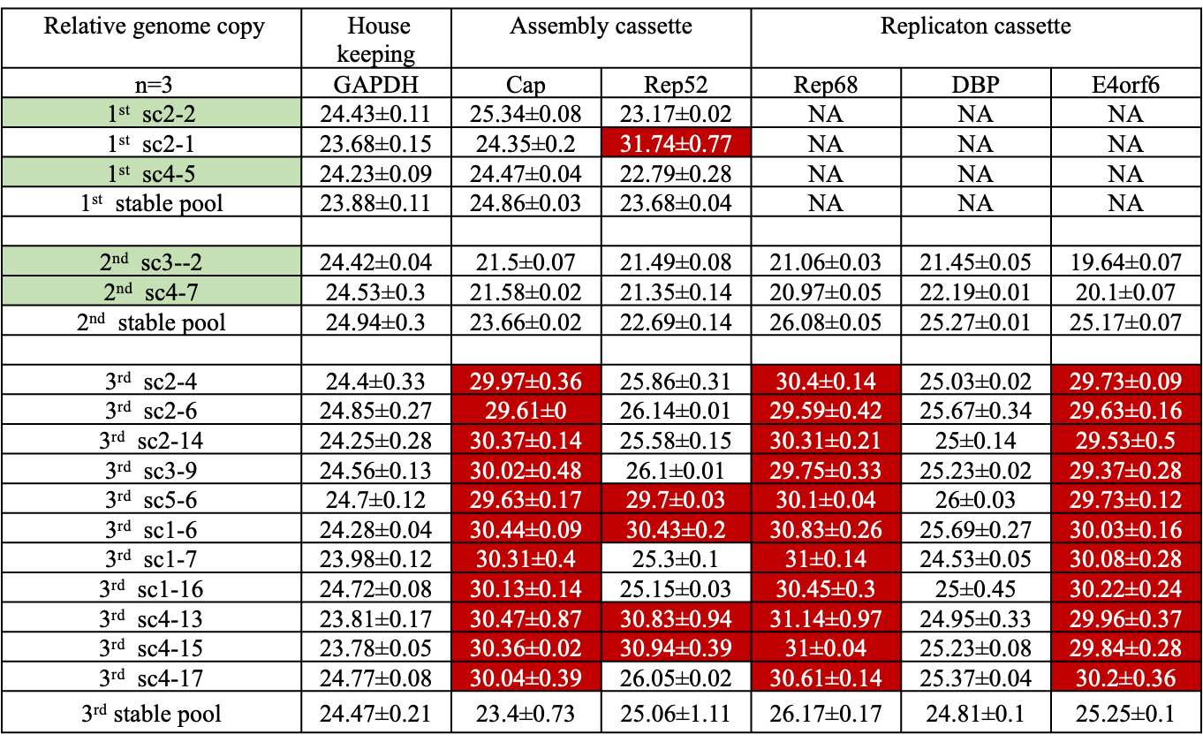
Table. Genome copy analysis summary for isolated single clones from each stable cell pool.
Low knockin efficiency
1st and 2nd
Footnote: Red highlight represents the missing of corresponding viral genes. Green highlight means the isolated single clones have all the components integrated and can be confirmed by genome copy analysis.

Slide 27
Action Items
UML
Increase the genome copy for transfer cassette (Transposon, e.g sleeping beauty or PiggyBac)
Large insertions lead to low knock-in efficiency. Strategies for enhancement
Manuscript Revision
UD
Assemble future AAV production plasmids
Test tet-off promoters
Explore kozak and degron tag options for future tuning of system

Slide 28
Research Sites – Timeline and Milestones
Q1 2023
Design of Tet-on/off inducible circuits (UD)
Crispr-Cas9 platform development and testing AAVS1, CCR5 and ROSA26 loci (UML)
Q2 2023
Tet off/on switch for 2 AAV cassettes via Golden gate. 1, replication plasmid, 2, assembly plasmid(UD)
Q3-4 2023
Analytical methods (qPCR, Elisa, RT-qPCR, WB, proteomics) (UML/UD)
Testing inducible plasmids via transient (UML/UD)
Q1-2 2024
Q3-4 2024
Cell line productivity and stability evaluation(UML/UD)
Tet off/on switch for the 3rd AAV cassette via Golden gate, 3, transfer plasmid(UD)
Site-specific integration of the 2nd and 3rd cassette and develop the baseline of stable cells (UML)
Optimized AAV parts integration, The optimized stable cell line(UML)
Optimization of gene level and dynamics by engineered inducible variants, Kozak and Degron tags (UD); Evaluate optimized plasmids via transient(UML/UD)
Site-specific integration of replication cassette made by UD (UML)
AAV production bottlenecks investigation(UD/UML)
Enhancing the Knockin efficiency and increase the genome copy for transfer cassette (UML)

