Slide 1








Industry/University Cooperative Research Center (I/UCRC)
Advanced Mammalian Biomanufacturing Innovation Center (AMBIC)
Develop an Inducible Stable Producer Cell Line for rAAV Production via Site-Specific Integration
Qiang Fu and Emily Doleh
Seongkyu Yoon (PI) / Mark Blenner (Co-PI)
Mentor Meeting – November 20, 2023
A National Science Foundation-facilitated
academic – industry – government consortia
to advance precompetitive knowledge in biomanufacturing
Contents are Proprietary to AMBIC and its Members
Terms of Center Membership Agreement Apply
www.ambic.org

Slide 2
Agenda
Project overview
UD Progress
UML Progress
Action Items

Slide 3
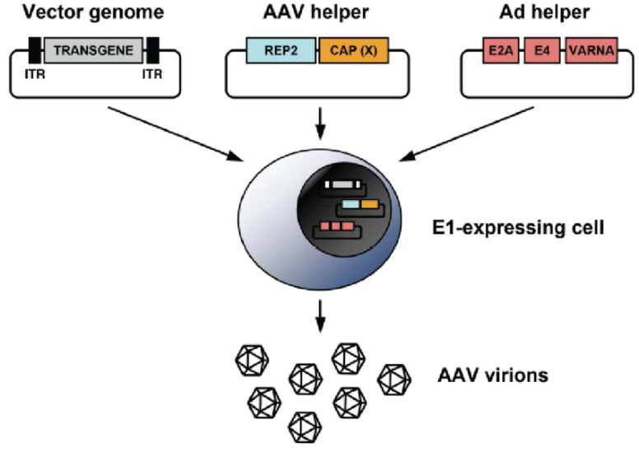
Industrial Relevance & Need
HEK 293 cells
Drawbacks of the traditional rAAV production process that uses transient transfection in HEK293 cells
Complicated and expensive process consuming considerable amount of transfection reagent and plasmids
The lot-to-lot variation of the products
Difficult to scale up
A stable producer of rAAV is needed!

Slide 4
Project Goals
Design inducible circuits that can regulate the timing and level of gene expression for all components necessary to make rAAV
Develop an inducible stable producer cell line with site-specific integration for extensible rAAV production
Objectives
Refactor rAAV rep, cap, and helper genes using variations of the inducible Tet-off promoter
Optimize the rAAV rep, cap, and helper gene expression levels for high titer rAAV, by Kozak sequences and degrons
Establish an inducible stable producer cell line with site specific integration in well-known human genomic safe harbors for rAAV production
Notes:
Why Tet-off promoter rather than Tet-on?
The tet-off-based inducible circuit will be used to eliminate the antibiotics in the rAAV production stage.

Slide 5
UD Progress

Slide 6
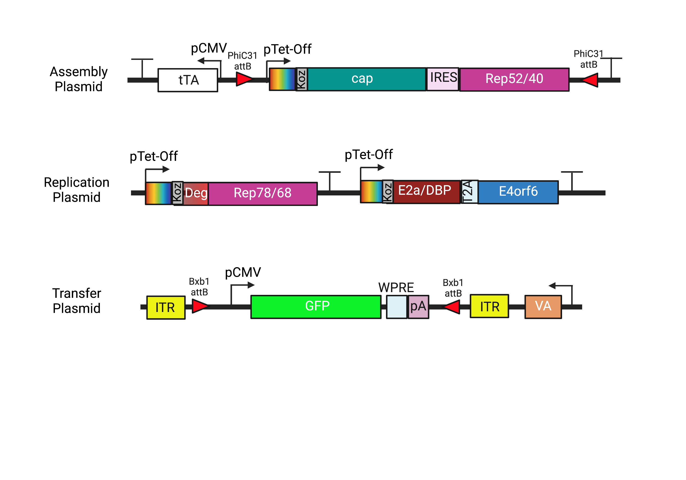
Plasmid Design

Slide 7
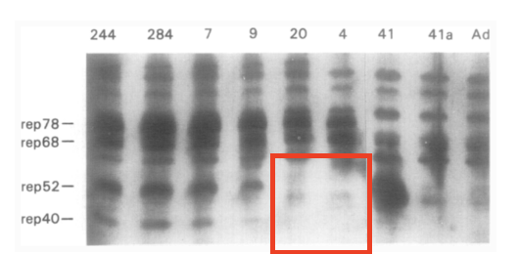
Fragment Design
 | Rep78/68
Sequence Change (AA) | 225: ATG → GGG
Reason | Removal of p19 start codon
Comments | Previous work reported the silencing of the p19 promoter through the mutation of the start codon¹
(1) Chejanovsky, N.; Carter, B. J. Mutagenesis of an AUG Codon in the Adeno-Associated Virus Rep Gene: Effects on Viral DNA Replication. Virology 1989, 173 (1), 120–128. https://doi.org/10.1016/0042-6822(89)90227-4.

Slide 8
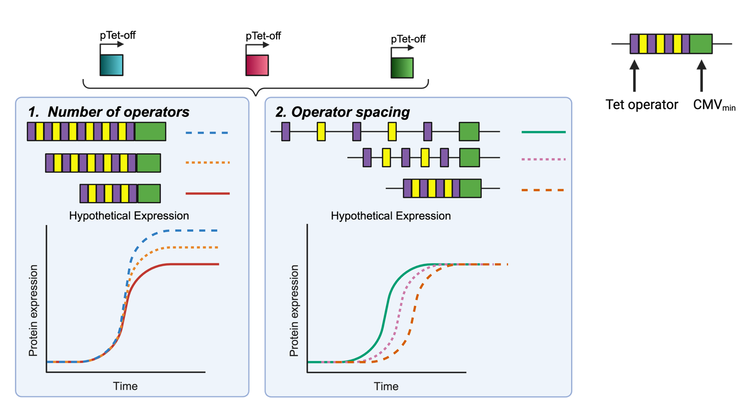
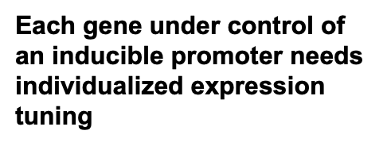
Future Promoter Variants

Slide 9
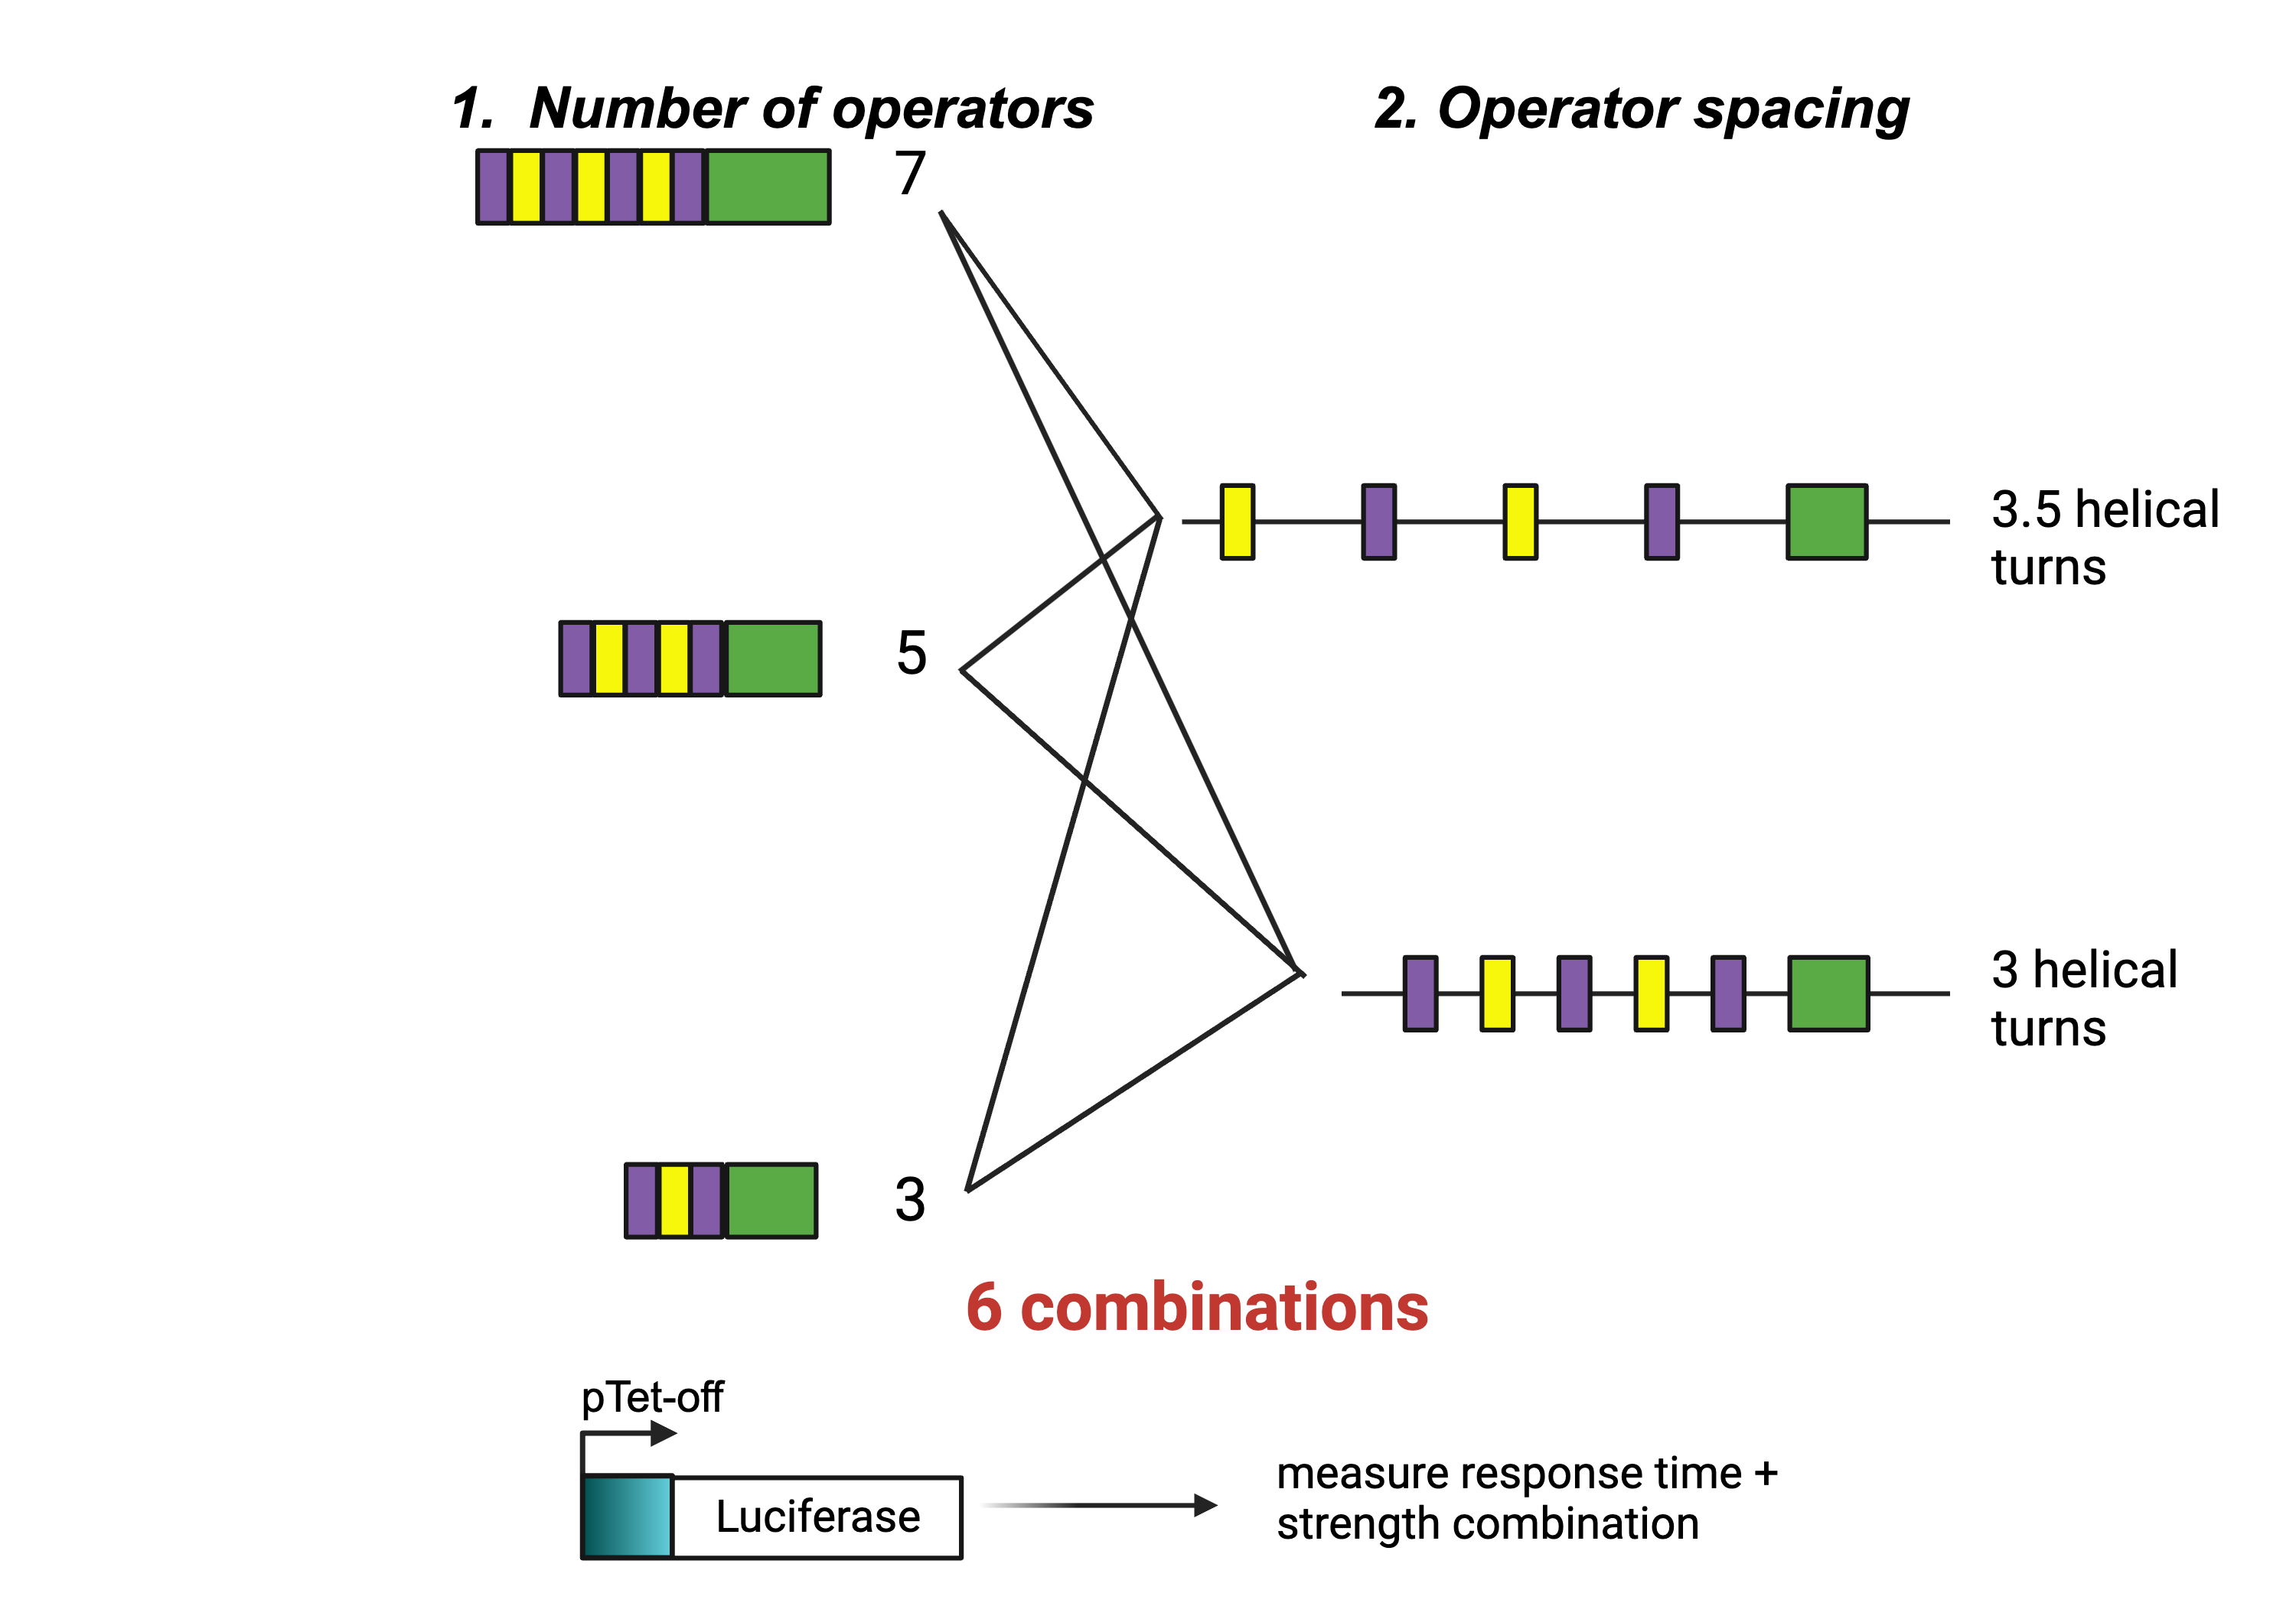
Future Promoter Variants

Slide 10
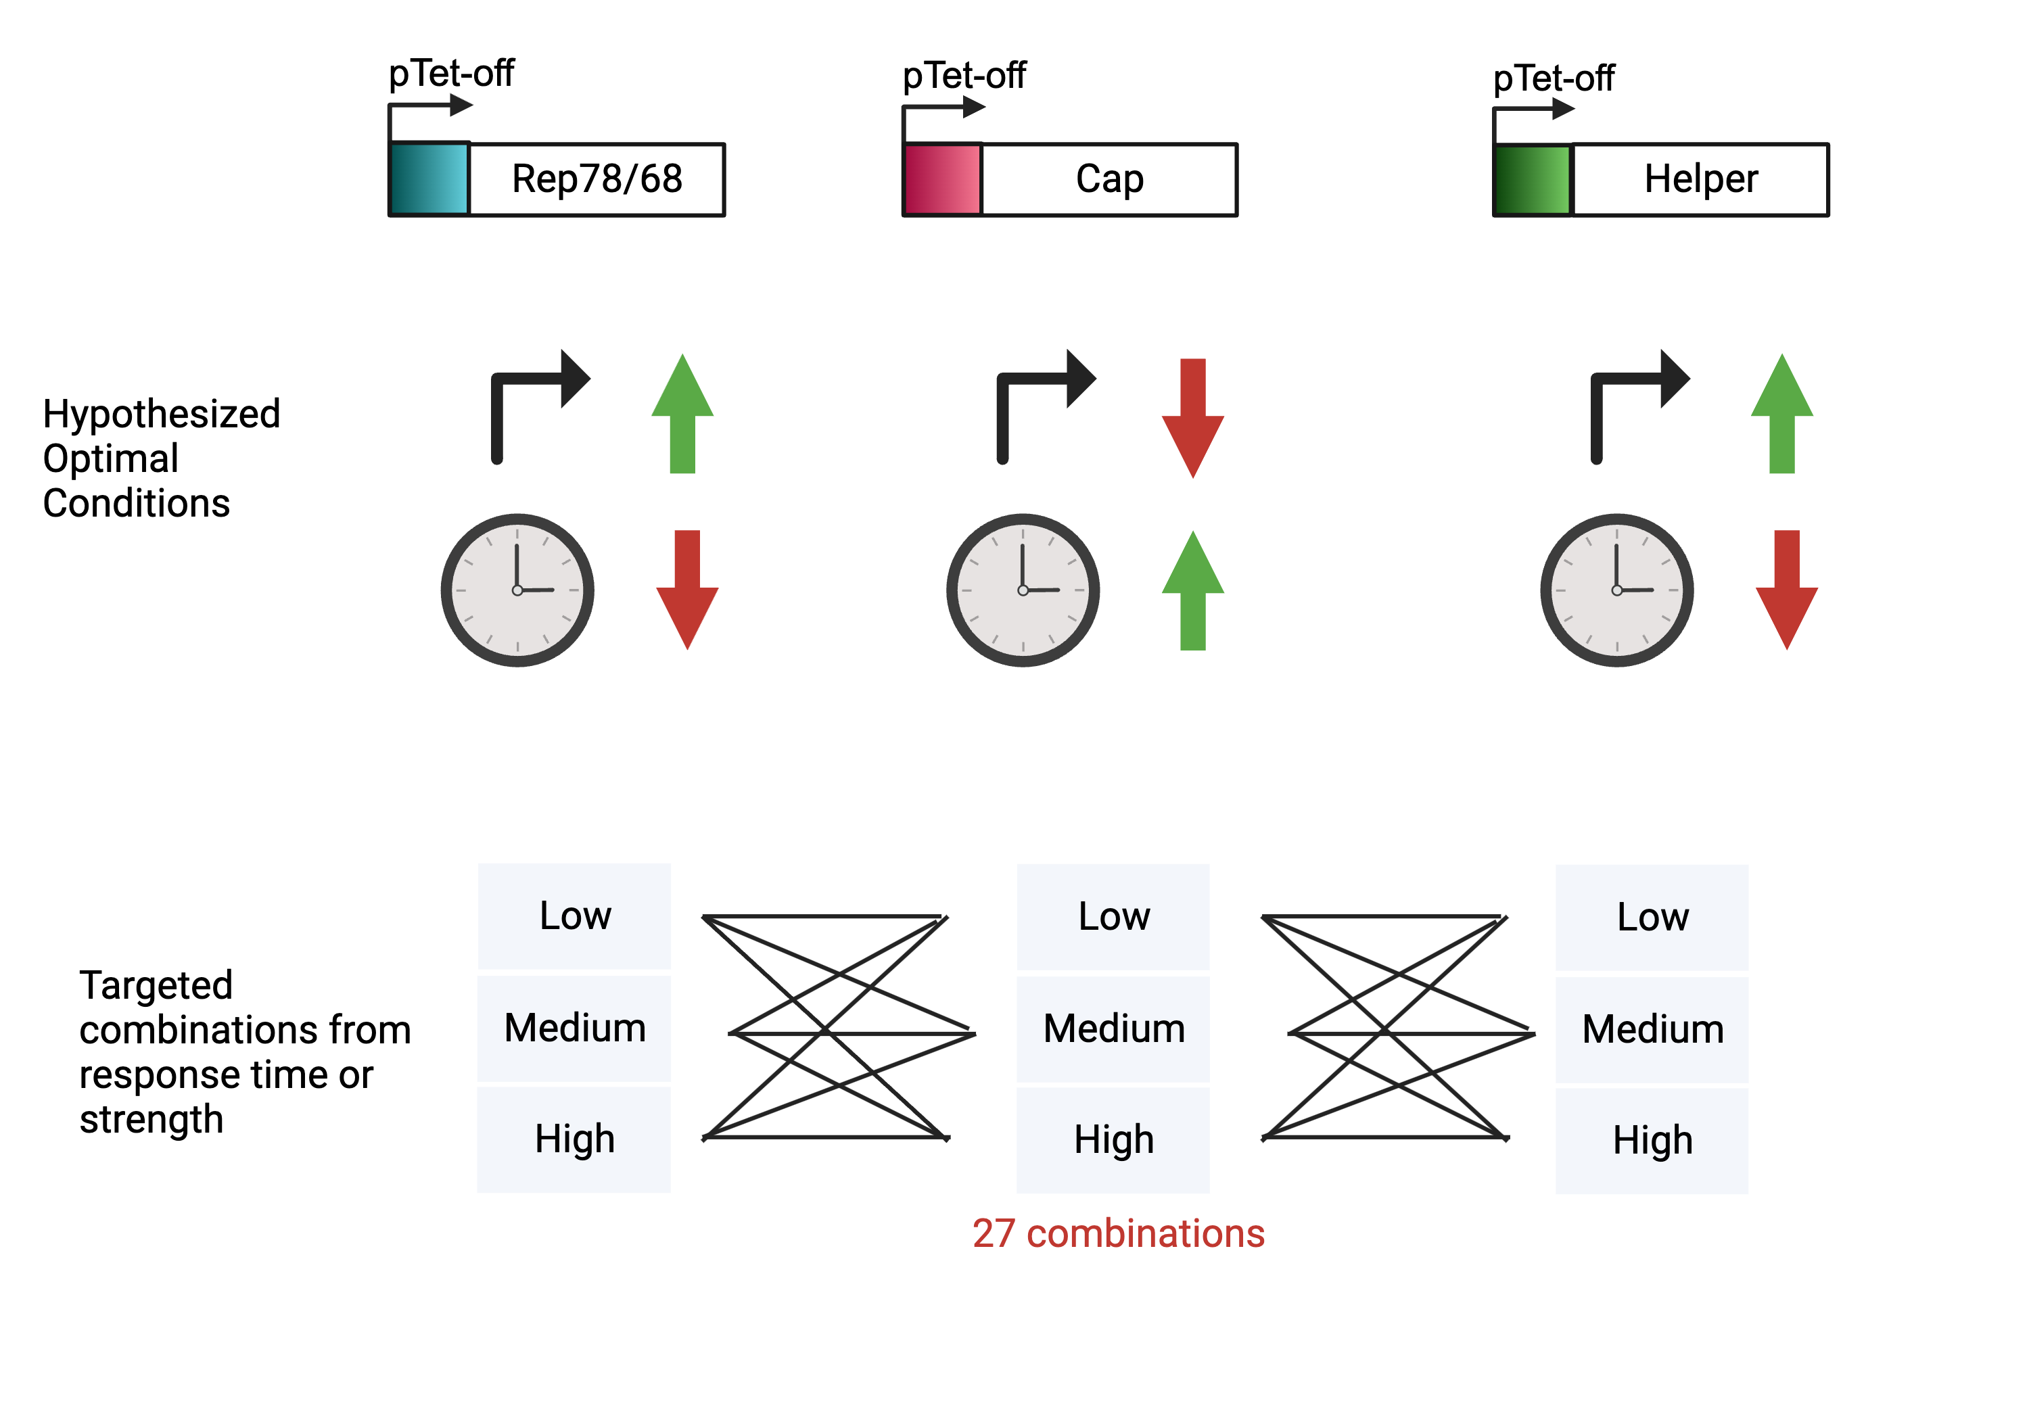
Future Promoter Variants
Nguyen, Tam N.T. et. al. Molecular Therapy - Methods & Clinical Development 21 (June 2021): 642–55. https://doi.org/10.1016/j.omtm.2021.04.006.

Slide 11
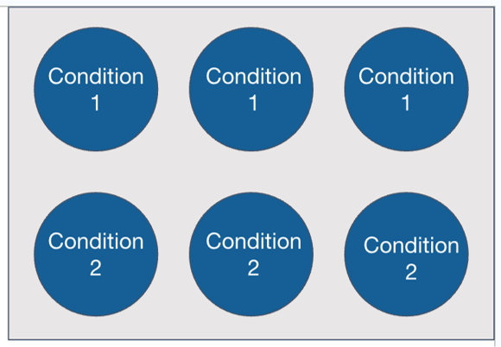
Transient Transfection Test
Using 6-well plates with 3 replicates each I am looking to test 6 conditions:​
1: single plasmid GFP transfection using AAV GFP plasmid​
2: AAV triple transfection using traditional 3 plasmids​
3: tTA assembly and replication plasmids with AAV CMV GFP triple transfection​
4: tTA assembly and replication plasmids with AAV CMV GFP triple transfection + 500 ng/mL dox​
5: rtTA assembly and replication plasmids with AAV CMV GFP ​triple transfection​
6: rtTA assembly and replication plasmids with AAV CMV GFP triple transfection + 500 ng/mL dox
Transfection conditions (PEI)
Media working volume | 3 mL
Plating density | 5E5
Total DNA | 2 ug
Plasmid ratio | 1:1:1
PEI:DNA | 1:1
Cocktail volume | 300 uL
Incubation time | 15 min
Cocktail media | OptiMEM

Slide 12
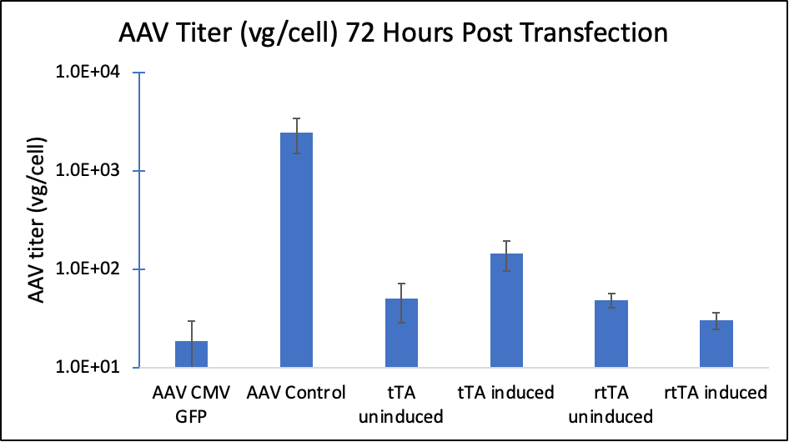
Transient Transfection Test

Slide 13
UML Progress

Slide 14
Integration summary
 | 1st integration | 2nd integration
HEK293 | AAVS1(replication) Stable pool Junction PCR Genome copy | ROSA26(Assembly) Stable pool Junction PCR, ROSA26 is good, but AAVS1 missing Genome copy, All genes can be detected Single clone Junction PCR, Knockin efficiency <10% in ROSA26
293T | ROSA26(Assembly) Stable pool Junction PCR Genome copy | AAVS1(replication) Stable pool 293TAssrtTARep (Tet-on) Junction PCR, rtTA is good for both ROSA26 and AAVS1; Genome copy, good for rtTA. 293TAsstTARep (Tet-off) Junction PCR, tTA is good for AAVS1, but ROSA26 missing; Genome copy, the Cap gene missing in tTA Single clone 293TAssrtTARep single clone is in progress.
3rd

Slide 15
Site-specific integration strategy for inducible baseline development –293T cells
Round 1
Assembly cassettes integration
Transfection to ROSA26
Round 2
Replication cassettes integration
Round 3
Transgene cassettes integration
Transfection to CCR5
blastiidicin selection
Transfection to AAVS1
Zeocin selection
Puromycin selection
Donor plasmids Prep
Donor plasmid prep
Donor plasmids Prep
Stable cell pool
5’ 3’ Junction PCR
Genome copy number v
Transient other two plasmids for rAAV production
Single clone knock in efficiency
5’ 3’ Junction PCR
Stable cell pool
5’ 3’ Junction PCR
Genome copy
Transient one plasmid for rAAV production
Single clone knock in efficiency
5’ 3’ Junction PCR
Packaging cell line
Stable cell pool
5’ 3’ Junction PCR
Genome copy
rAAV produciton
Stable producer cell line
Single clone Characterization

Slide 16
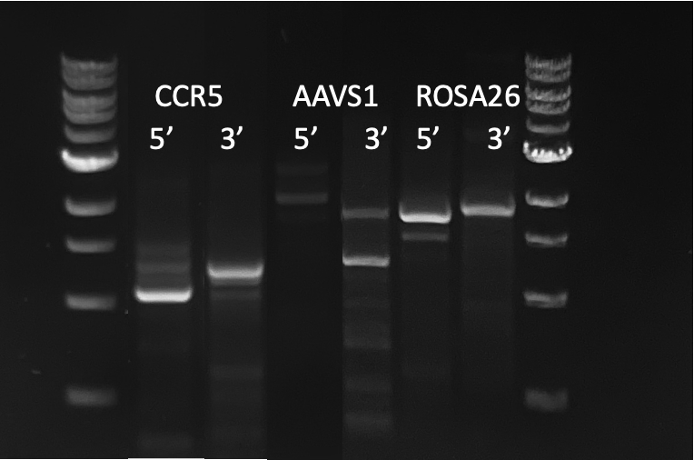
3rd round integration in 293T stable pool --Junction PCR
CCR5 5’ 1120bp 3’ 1379bp
AAVS1 5’ 1928bp 3’ 1288bp
ROSA26 5’ 1784bp 3’ 1932bp

Slide 17
3rd round integration in 293T stable pool Genome Copy
 |  | Assembly cassette |  | Replicaton cassette |  |  | Transfer cassette
 | GAPDH | Cap | Rep52 | Rep68 | DBP | E4orf6 | GFP
293TAssrtTARepTrans (3rd) | 24.50 | 23.39 | 25.10 | 26.16 | 24.81 | 25.27 | 22.95
 | 24.44 | 23.41 | 25.02 | 26.18 | 24.82 | 25.23 | 22.89
average | 24.47 | 23.40 | 25.06 | 26.17 | 24.81 | 25.25 | 22.92
293TAssrtTARep (2nd) | 24.72 | 23.67 | 22.60 | 26.05 | 25.26 | 25.13
 | 25.15 | 23.64 | 22.79 | 26.11 | 25.28 | 25.22
average | 24.94 | 23.66 | 22.69 | 26.08 | 25.27 | 25.17
293TASSrtTA (1st) | 23.07 | 22.60 | 24.02
 | 23.11 | 22.55 | 24.10
average | 23.09 | 22.57 | 24.06
NC | 22.96 | 35.66 | 35.42
 | 22.76 | 36.61 | 35.23
average | 22.86 | 36.14 | 35.33

Slide 18
rAAV Production in 293T stable cell pool
Negative control, 3 plasmid transfection
  Replication plasmid+ assembly plasmid+ transfer plasmid
1st integration, 2 plasmid transfection
2nd integration, 1 plasmid transfection
3rd integration, no plasmid
rtTA, Tet- on, Dox (5ug/mL); 72h post-transfection harvest; Cell growth on D3, genome titer, capsid titer
6 well plate Transfection conditions
Media working volume | 3mL
Plating Density (total cells) | 5E5
Total DNA amount | 2ug
Plasmid ratio | 1:1:1
PEI:DNA | 1:1
Cocktail volume | 300 uL
Incubation time | 15min
Cocktail media | OptiMEM

Slide 19
Cell growth profile
The seeding density is 5*10^5 cells/well (D0), biological duplicates, 72 hours post-transfection
 | 72 Hours VCD(10^6cell/mL) | std | 72 Hours Viability(%) | std
NC + | 2.295 | ±0.26163 | 94.45 | ±0.919239
1st + | 1.975 | ±0.021213 | 94.2 | ±0.424264
2nd + | 1.565 | ±0.275772 | 93.4 | ±2.262742
3rd + | 1.725 | ±0.091924 | 93 | ±0.707107

Slide 20
rAAV productivity
Genome titer via qPCR
Capsid titer via Elisa
Didn’t detect the genome titer after the 3rd integration, but capsid titer was detected.

Slide 21
Site-specific integration strategy for inducible baseline development –293T cells
Round 1
Assembly cassettes integration
Transfection to ROSA26
Round 2
Replication cassettes integration
Round 3
Transgene cassettes integration
Transfection to CCR5
blastiidicin selection
Transfection to AAVS1
Zeocin selection
Puromycin selection
Donor plasmids Prep
Donor plasmid prep
Donor plasmids Prep
Stable cell pool
5’ 3’ Junction PCR
Genome copy number v
Transient other two plasmids for rAAV production
Single clone knock in efficiency
5’ 3’ Junction PCR
Stable cell pool
5’ 3’ Junction PCR
Genome copy
Transient one plasmid for rAAV production
Single clone knock in efficiency
5’ 3’ Junction PCR
Packaging cell line
Stable cell pool
5’ 3’ Junction PCR
Genome copy
rAAV produciton
Stable producer cell line
Single clone Characterization

Slide 22
2nd integration knock in efficiency evaluation
Replication cassette (8397bp insertion) ➔ AAVS1 locus
Single clones | 3’ junction PCR | 3’&5’ junc PCR
38 | 20 | 2
 | Knockin efficiency ~ 52% | Knockin efficiency ~ 5.2%
Next step: Out-to-out PCR for 2 clones to check the insertion and sequencing.

Slide 23
Enhancement of Knock in efficiency
Compounds | Reported optimal dose
RS-1 | 10uM [1, 3, 5, 6, 8]
SCR-7 | 1uM [1, 3, 4, 5, 6, 7, 8, 9]
Nocodazole | 100ng/mL [1, 6]
XL413 | 33uM [1]
Nu7441 | 2uM-10uM [2, 4, 6, 8]
L755507 | 5uM [1, 3, 6, 8]
AZD7648(5mg) | 0.25-1uM [10]
KU-0060648 | 250nM [2]
Maurissen, T. L., & Woltjen, K. (2020). Nature communications, 11(1), 2876.
Robert, F., Barbeau, M., Éthier, S., Dostie, J., & Pelletier, J. (2015). Genome medicine, 7, 1-11.
Riesenberg, S., & Maricic, T. (2018). Nature communications, 9(1), 2164.
Canny, M. D., Moatti, N., (2018). Nature biotechnology, 36(1), 95-102.
Song, J., Yang, D. (2016). Nature communications, 7(1), 10548.
Zhang, J. P., (2017). Genome biology, 18(1), 1-18.
Maruyama, T. (2015). Nature biotechnology, 33(5), 538.
Jayavaradhan, R. (2019). Journal of molecular biology, 431(1), 102-110.
Chu, V. T. (2015). Nature biotechnology, 33(5), 543-548.
Selvaraj, Sridhar, et al. Nature Biotechnology (2023): 1-14.

Slide 24
Next Steps
UML
  Isolate single clones in 1st integration and evaluate the knockin efficiency.
  Isolate single clones in 3rd integration, knockin efficiency, capsid titer, genome titer, etc.
  Sequencing to verify the insertion.
  Conduct the proposed strategies to enhance the Knockin efficiency.
UD
  Assemble plasmids for luciferase assay
  Begin testing of promoters
  Explore kozak and degron tag options for future tuning of system

Slide 25
Research Sites – Timeline and Milestones
Q1 2023
Design of Tet-on/off inducible circuits (UD)
Crispr-Cas9 platform development and testing AAVS1, CCR5 and ROSA26 loci (UML)
Q2 2023
Tet off/on switch for 2 AAV cassettes via Golden gate. 1, replication plasmid, 2, assembly plasmid(UD)
Q3-4 2023
Analytical methods (qPCR, Elisa, RT-qPCR, WB, proteomics) (UML/UD)
Testing inducible plasmids via transient (UML/UD)
Q1-2 2024
Q3-4 2024
Cell line productivity and stability evaluation(UML/UD)
Tet off/on switch for the 3rd AAV cassette via Golden gate, 3, transfer plasmid(UD)
Site-specific integration of the 2nd and 3rd cassette and develop the baseline of stable cells (UML)
Optimized AAV parts integration, The optimized stable cell line(UML)
Optimization of gene level and dynamics by Kozak, and Degron tags (UD); Evaluate optimized plasmids via transient(UML/UD)
Site-specific integration of replication cassette made by UD (UML)
Optimization of gene level and dynamics by engineered inducible variants (UD); Evaluate optimized plasmids via transient(UML/UD)
AAV production bottlenecks investigation(UD/UML)
Enhance the Knockin efficiency (UML)

