Slide 1








Industry/University Cooperative Research Center (I/UCRC)
Advanced Mammalian Biomanufacturing Innovation Center (AMBIC)
Develop an Inducible Stable Producer Cell Line for rAAV Production via Site-Specific Integration
Qiang Fu and Emily Doleh
Seongkyu Yoon (PI) / Mark Blenner (Co-PI)
Mentor Meeting – October 16, 2023
A National Science Foundation-facilitated
academic – industry – government consortia
to advance precompetitive knowledge in biomanufacturing
Contents are Proprietary to AMBIC and its Members
Terms of Center Membership Agreement Apply
www.ambic.org

Slide 2
Agenda
Project overview
UD Progress
UML Progress
Action Items

Slide 3
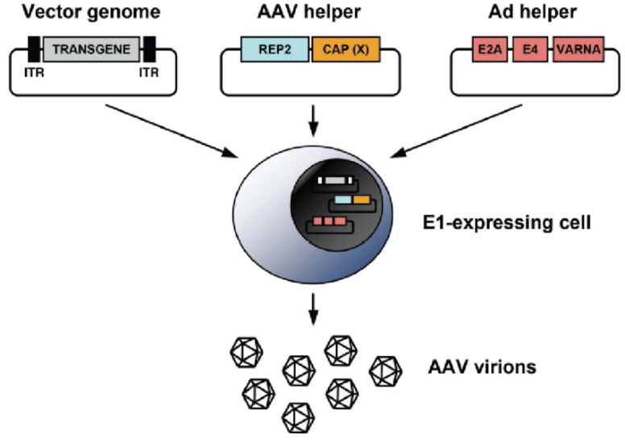
Industrial Relevance & Need
HEK 293 cells
Drawbacks of the traditional rAAV production process that uses transient transfection in HEK293 cells
Complicated and expensive process consuming considerable amount of transfection reagent and plasmids
The lot-to-lot variation of the products
Difficult to scale up
A stable producer of rAAV is needed!

Slide 4
Project Goals
Design inducible circuits that can regulate the timing and level of gene expression for all components necessary to make rAAV
Develop an inducible stable producer cell line with site-specific integration for extensible rAAV production
Objectives
Refactor rAAV rep, cap, and helper genes using variations of the inducible Tet-off promoter
Optimize the rAAV rep, cap, and helper gene expression levels for high titer rAAV, by Kozak sequences and degrons
Establish an inducible stable producer cell line with site specific integration in well-known human genomic safe harbors for rAAV production
Notes:
Why Tet-off promoter rather than Tet-on?
The tet-off-based inducible circuit will be used to eliminate the antibiotics in the rAAV production stage.

Slide 5
Research Workflow & Timeline
Udel
inducible design and plasmid assembly
UML
Crisp-cas9, cell culture, integration
UML & UD
Design of Tet-on/off inducible circuits
Crispr-Cas9 platform development and testing AAVS1, CCR5 and ROSA26 loci
Analytical methods (qPCR, Elisa, RT-qPCR, WB, proteomics)
1-3 M
Tet off/on switch for 3 cassettes via Golden gate
Transfer plasmid
Assembly plasmid
Replication plasmids
AAV parts integration, The baseline of Stable cell line
Testing inducible plasmids via transient
4-8 M
Optimization of gene-level and dynamics by engineered inducible variants, Kozak, and Degron tags
Optimized AAV parts integration, The optimized stable cell line
Evaluate optimized plasmids via transient
9-14 M

Slide 6
UD Progress

Slide 7
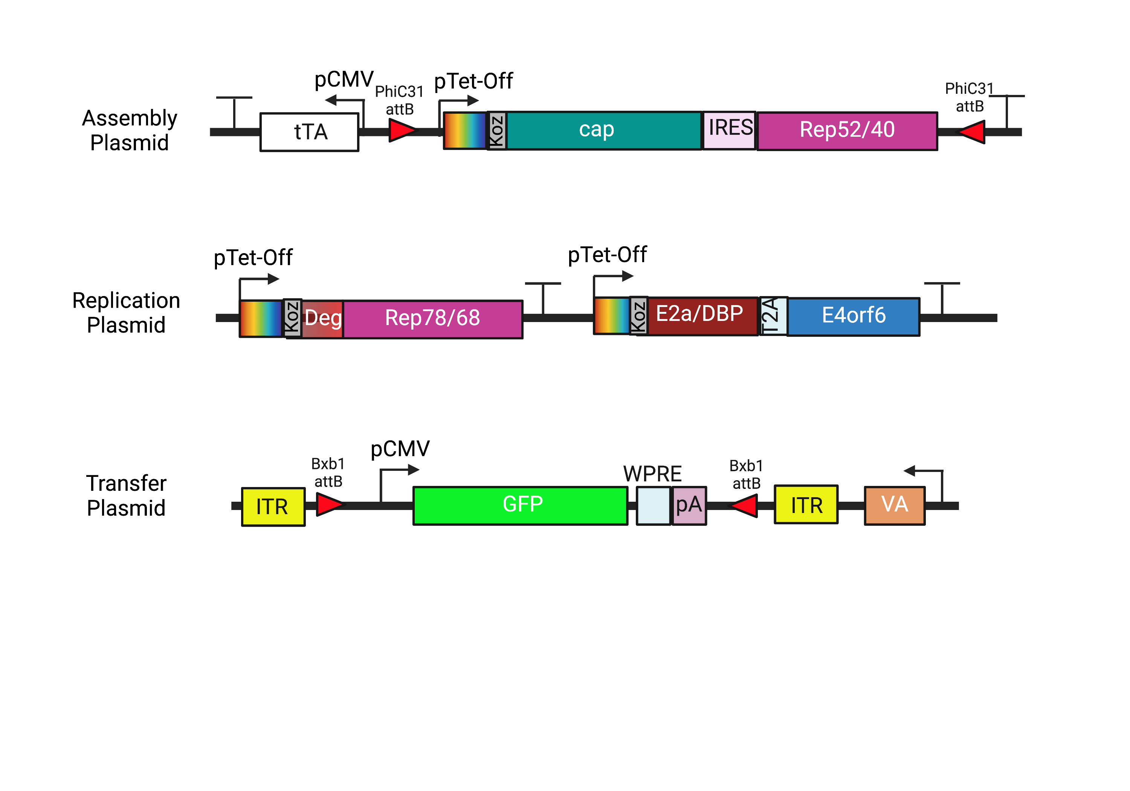
Plasmid Design

Slide 8
Plasmid Design
Addition of PhiC31 integrase on assembly plasmid to exchange serotypes in future

Slide 9
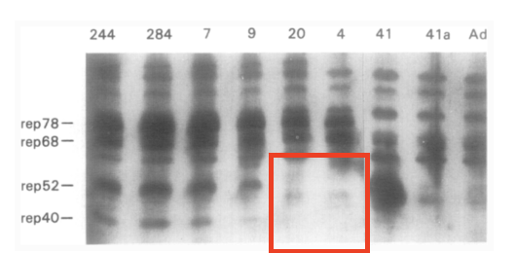
Plasmid Design
Silencing of internal p19 promoter through removal of start codon to stop transcription of Rep52/40
Is this sufficient to silence p19?
Chejanovsky, N.; Carter, B. J. Mutagenesis of an AUG Codon in the Adeno-Associated Virus Rep Gene: Effects on Viral DNA Replication. Virology 1989, 173 (1), 120–128. https://doi.org/10.1016/0042-6822(89)90227-4.

Slide 10
Plasmid Design
Bxb1 sites moved inside ITRs for ease of cloning/payload exchange

Slide 11
Fragment Design
 | Rep78/68
Sequence Change (AA) | 225: ATG → GGG
Reason | Removal of p19 start codon
Comments | Previous work reported the silencing of the p19 promoter through the mutation of the start codon¹
(1) Chejanovsky, N.; Carter, B. J. Mutagenesis of an AUG Codon in the Adeno-Associated Virus Rep Gene: Effects on Viral DNA Replication. Virology 1989, 173 (1), 120–128. https://doi.org/10.1016/0042-6822(89)90227-4.

Slide 12
Plasmid Assembly Timeline
Version 1: Complete
 | Assembly Plasmid | Replication Plasmid | Transfer Plasmid
Designing | 02/10 - 03/29 | 02/10 - 03/29 | 02/10 - 03/02
Ordering | 03/02 - 04/11 | 03/02 - 04/11 | 03/02 - 3/15
Entry Vector Preparations | 03/15 - 4/25 | 03/15 - 4/25 | 03/15 - 4/25
Golden Gate Assembly | 04/25-06/22 | 04/25-06/05 | 04/25-09/22

Slide 13
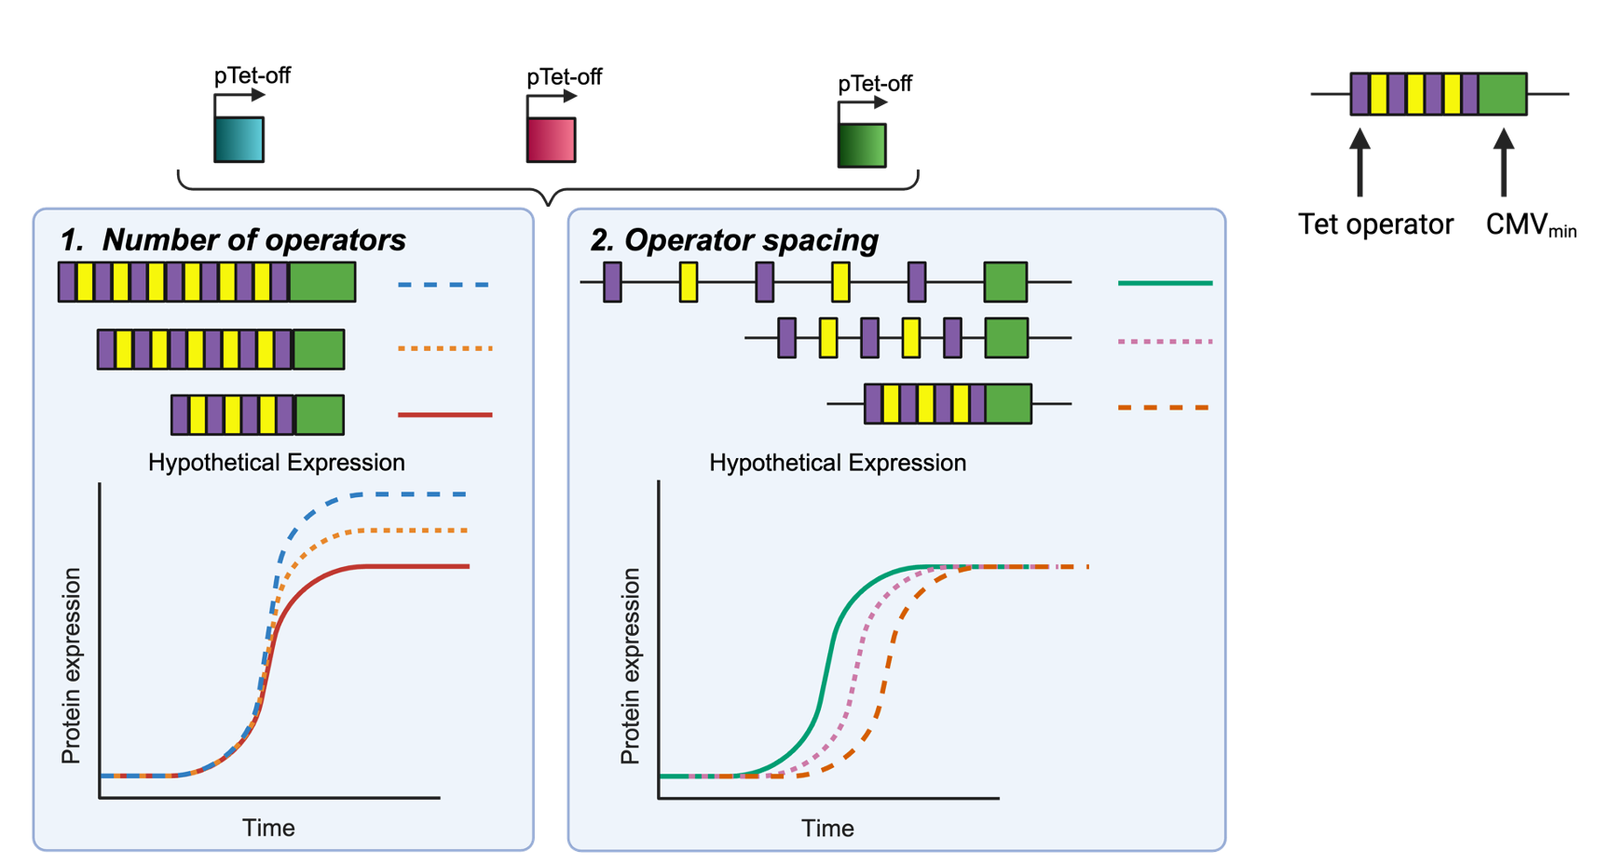
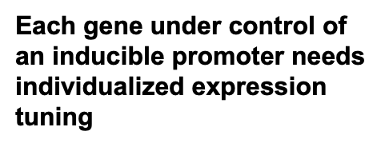
Future Promoter Variants

Slide 14
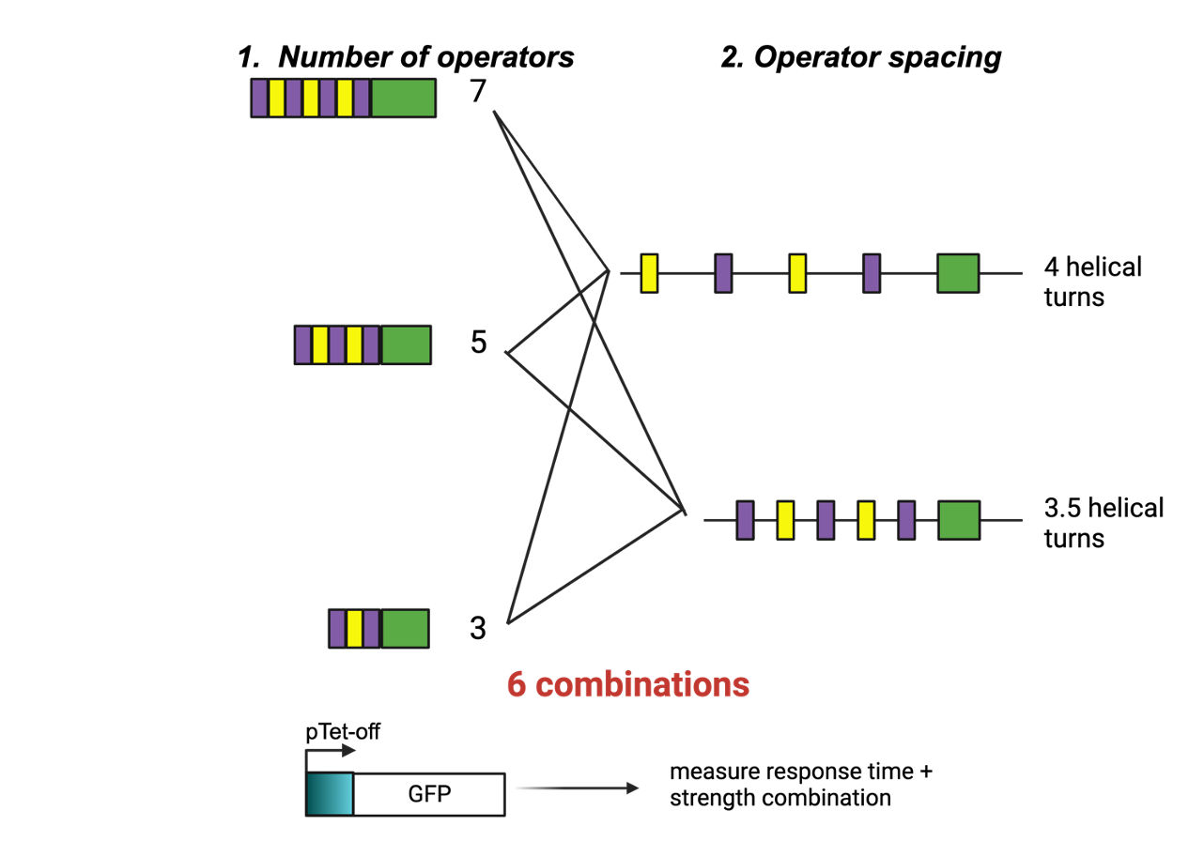
Future Promoter Variants
*Also considering using a luciferase assay

Slide 15
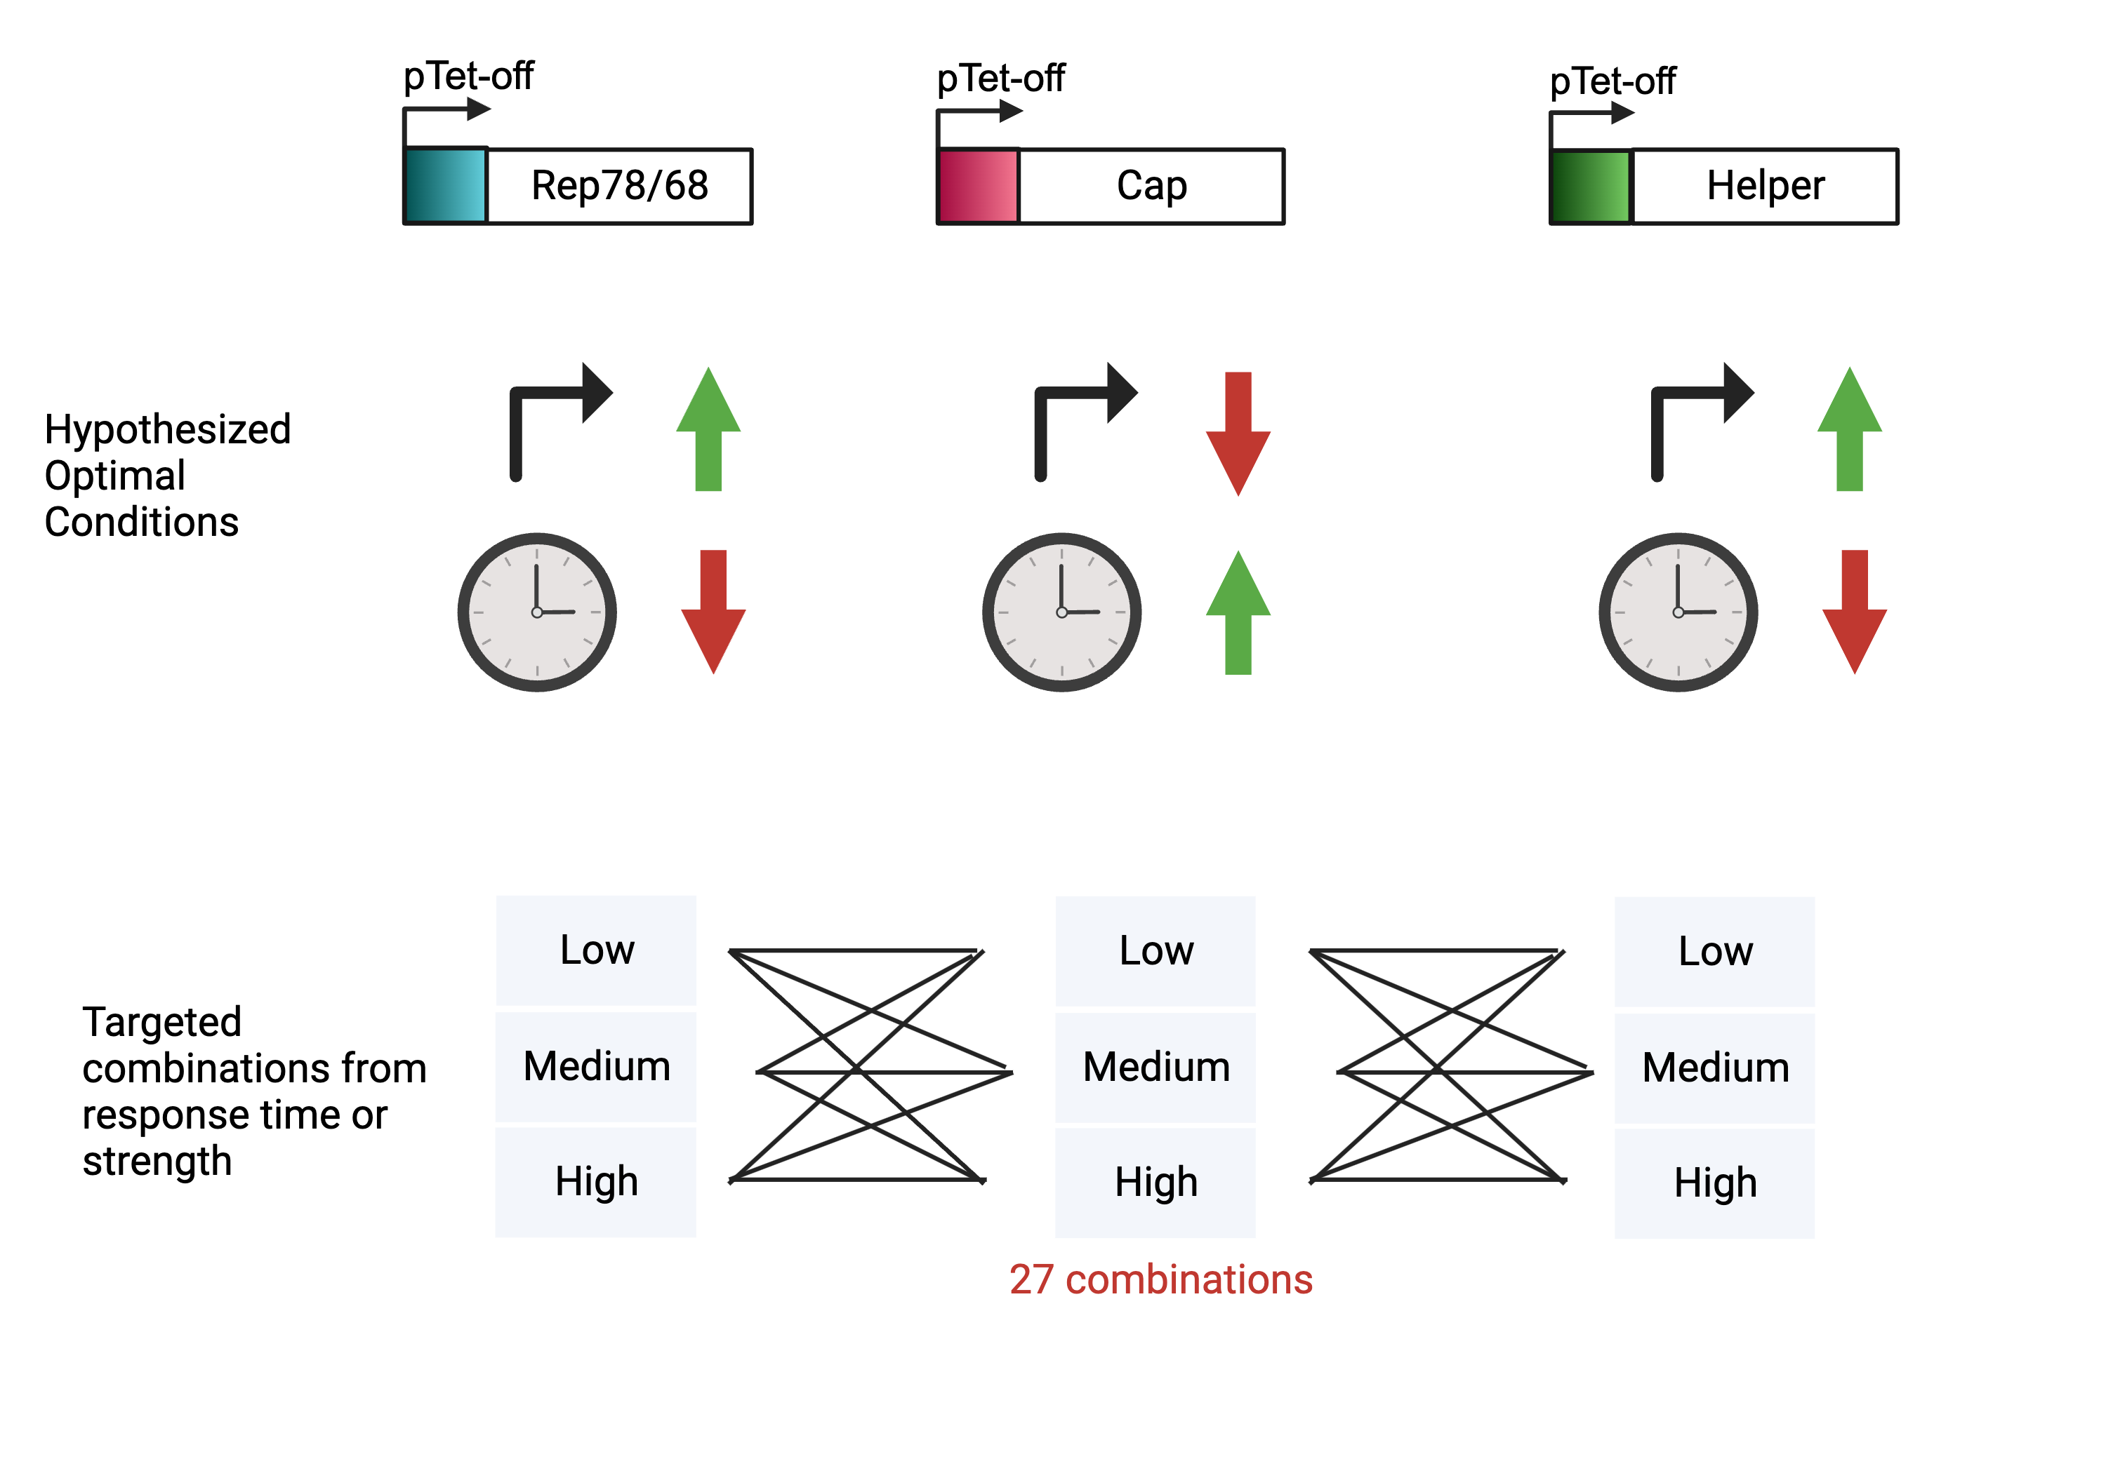
Future Promoter Variants
Nguyen, Tam N.T. et. al. Molecular Therapy - Methods & Clinical Development 21 (June 2021): 642–55. https://doi.org/10.1016/j.omtm.2021.04.006.

Slide 16
UML Progress

Slide 17
Site-specific integration strategy for inducible baseline development
Round 1
Replication cassettes integration
Transfection to AAVS1
Round 2
Assembly cassettes integration
Round 3
Transgene cassettes integration
Transfection to CCR5
G418 selection
Transfection to ROSA26
Blasticidin selection
Puromycin selection
Donor plasmids Prep
Donor plasmid prep
Donor plasmids Prep
Stable cell pool
5’ 3’ Junction PCR
Cell sorting assay
Genome copy number via qPCR
Transient other two plasmids for rAAV production
Intermediate QC checkpoints
5’ 3’ Junction PCR
Transient the third plasmid for rAAV production
SSI pool
Cell sorter
Single clone
Junction & copy number
Stable cell pool
5’ 3’ Junction PCR
Packaging cell line
RI pool (discard)
Round 2 SSI pool
SSI pool
Cell sorter
Stable cell pool
Single clone
RI pool (discard)
Stable producer cell line

Slide 18
HEKRepAss single clone progress
~20 out of 96 wells grow cells
HEKRepAss rtTA/ tTA Single clone Junction PCR
  For the 2nd integration in ROSA26 locus (Assembly part), Knockin efficiency <10% via Junction PCR.
  No band detection for the 1st integration in AAVS1 locus (Replication part).
Knock-in efficiency might be low due to the large fragment insertion

Slide 19
Integration summary
 | 1st integration | 2nd integration
HEK293 | AAVS1(replication) Stable pool Junction PCR Genome copy | ROSA26(Assembly) Stable pool Junction PCR, ROSA26 is good, but AAVS1 missing Genome copy, All genes can be detected, but the genes in AAVS1(replication) seem lower than in ROSA26(assembly). Single clone Junction PCR, Knockin efficiency <10% in ROSA26; AAVS1 missing
293T | ROSA26(Assembly) Stable pool Junction PCR Genome copy | AAVS1(replication) Stable pool Junction PCR, rtTA is good for both ROSA26 and AAVS1 Junction PCR, tTA is good for AAVS1, but ROSA26 missing Genome copy, good for rtTA, Genome copy, the Cap gene missing in tTA Single clone 293TAssrtTARep single clone is in progress.

Slide 20
2nd integration genome copy
20ng gDNA as template (stable pool)
HEK293 |  | Replication cassette(1st) |  |  | Assembly cassette(2nd )
 | GAPDH | Rep68 | DBP | E4orf6 | Cap | Rep52
tTA average | 24.34 | 27.02 | 27.90 | 28.76 | 26.38 | 25.49
rtTA average | 25.22 | 28.73 | 28.28 | 29.89 | 27.33 | 26.33
293T |  | Replication cassette(2nd) |  |  | Assembly cassette(1st)
 | GAPDH | Rep68 | DBP | E4orf6 | Cap | Rep52
tTA average | 24.58 | 23.88 | 23.34 | 22.79 | 34.31 | 22.77
rtTA average | 24.94 | 26.08 | 25.27 | 25.17 | 23.66 | 22.69

Slide 21
Enhance the knock-in efficiency
Name | type | mechanism | reference
Scr7 | small molecule | decrease NHEJ | (Maruyama et al., 2015)
L755705 | small molecule | decrease NHEJ | (Yu et al., 2015)
NU7441/KU0060648 | small molecule | decrease NHEJ | (Robert et al., 2015)
RS-1 | small molecule | increase HDR | (Song et al., 2016)
Nocodazole | small molecule | modulate cell cycle G2/M | (Lin et al., 2014)
ABT | small molecule | modulate cell cycle G2/M | (Yang et al., 2016)
E1B55K/E4orf6 | protein | decrease NHEJ | (Chu et al., 2015)
Geminin | protein | modulate cell cycle G2/M | (Gutschner et al., 2016)
Rad51 | protein | increase HDR | (Takayama et al., 2017; Kurihara et al., 2020)
Rad52 | protein | increase HDR | (Shao et al., 2017)
CtIP | protein | increase HDR | (Charpentier et al., 2018)
si-KU70/80/DNA ligase IV | siRNA | decrease NHEJ | (Chu et al., 2015; Li et al., 2018)
CRISPRi/a | RNP | decrease NHEJ | (Ye et al., 2018)
Decrease the insertion size.
Modulate the host cell physiology via small molecules and proteins
  Increase homology-directed repair (HDR), the mechanism for crispr knock-in.
  Decrease the Non-homologous end joining (NHEJ), the mechanism for gene knockout.
  Modulate the cell cycle. HDR is predominantly active in the late S–G2 phases of the cell cycle, while the NHEJ pathway dominates DNA repair during the G1, S, and G2 phases. the error-prone NHEJ pathway out-competes the HDR pathway.

Slide 22
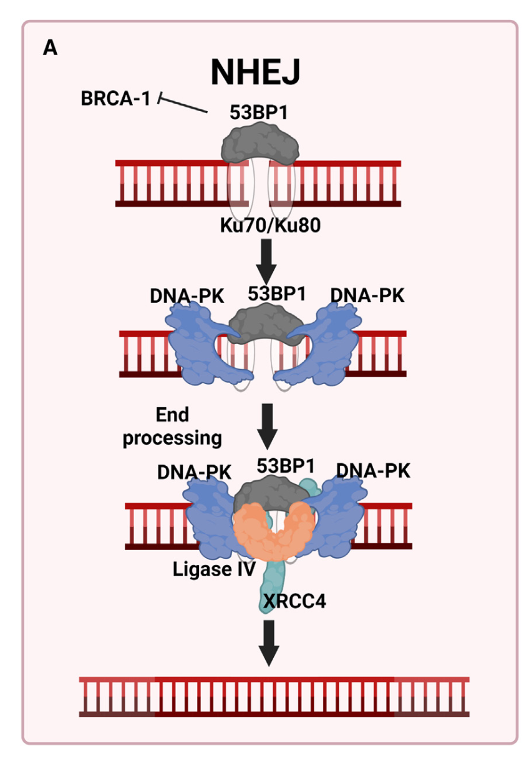
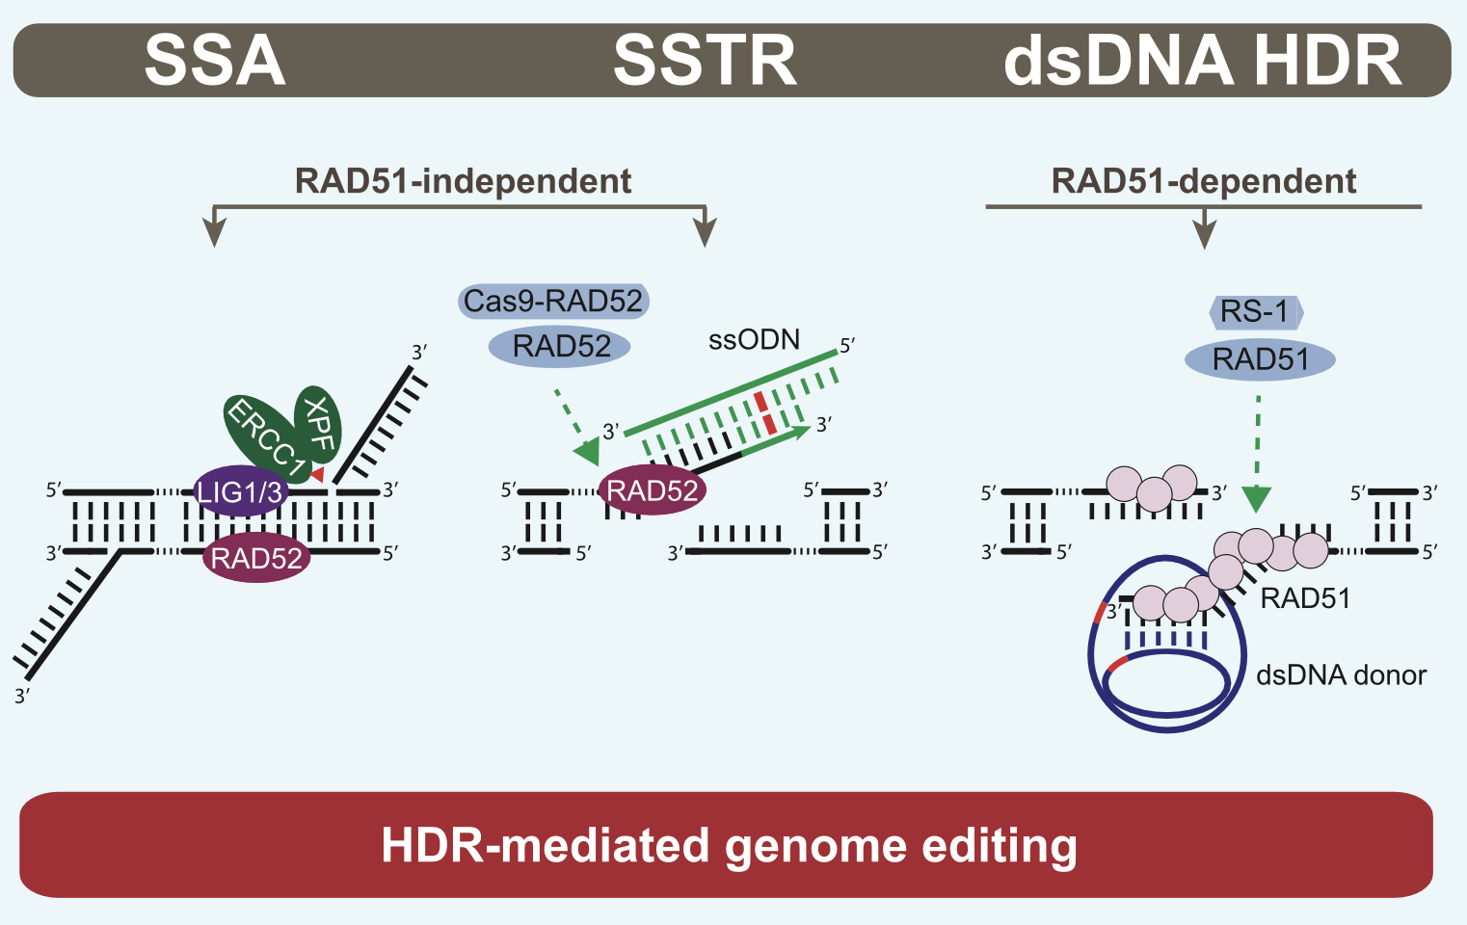
Proposed strategies
Decrease the NHEJ while increasing HDR via Spiking small molecules.
Scr7 - inhibition of DNA ligase IV
NU7441/KU-0060648- inhibition of DNA-PKcs
RS-1 - stimulation of RAD 51
Nambiar et al. 2021

Slide 23
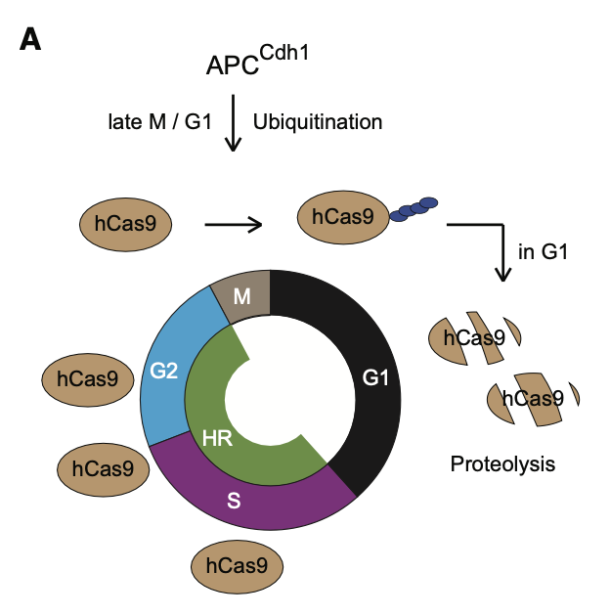
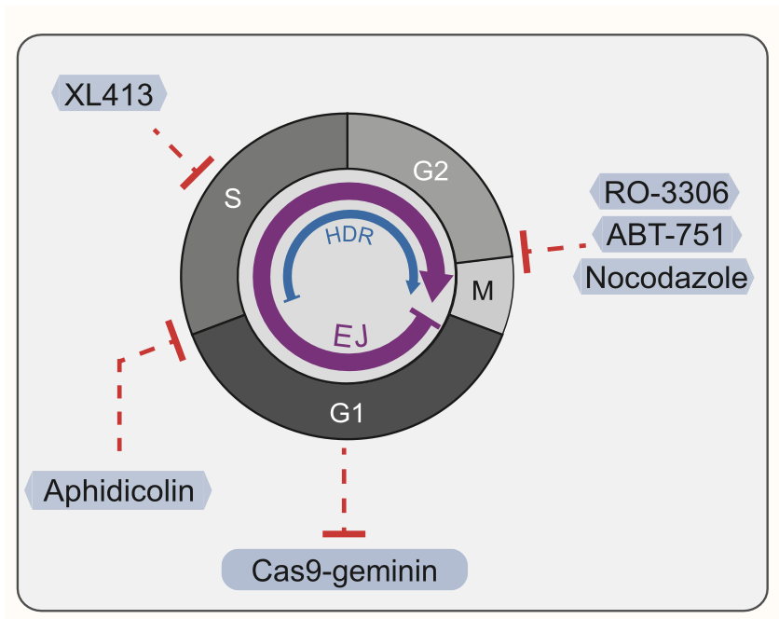
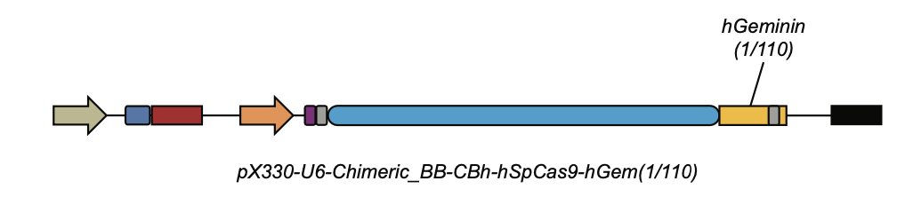
Proposed strategies
2. Increase HDR via modulating the cell cycle(Nocodazole) and Geminin
hCas9-hGem(1/110) Protein Expression Is Cell Cycle Dependent
(Gutschner et al. 2016)

Slide 24
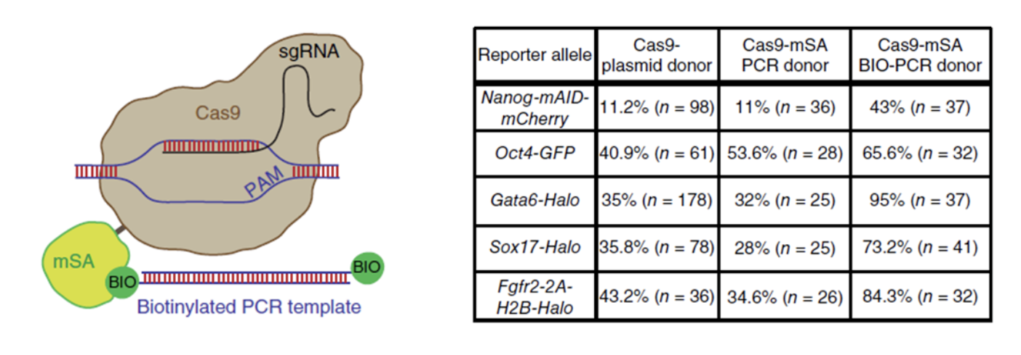
Proposed strategies
3. Enrichment of homologous recombination templates at gene editing sites
Enhancing HDR Efficiency Using Biotin-Streptavidin Coupled RNP and Donor (Guet et al., 2018)

Slide 25
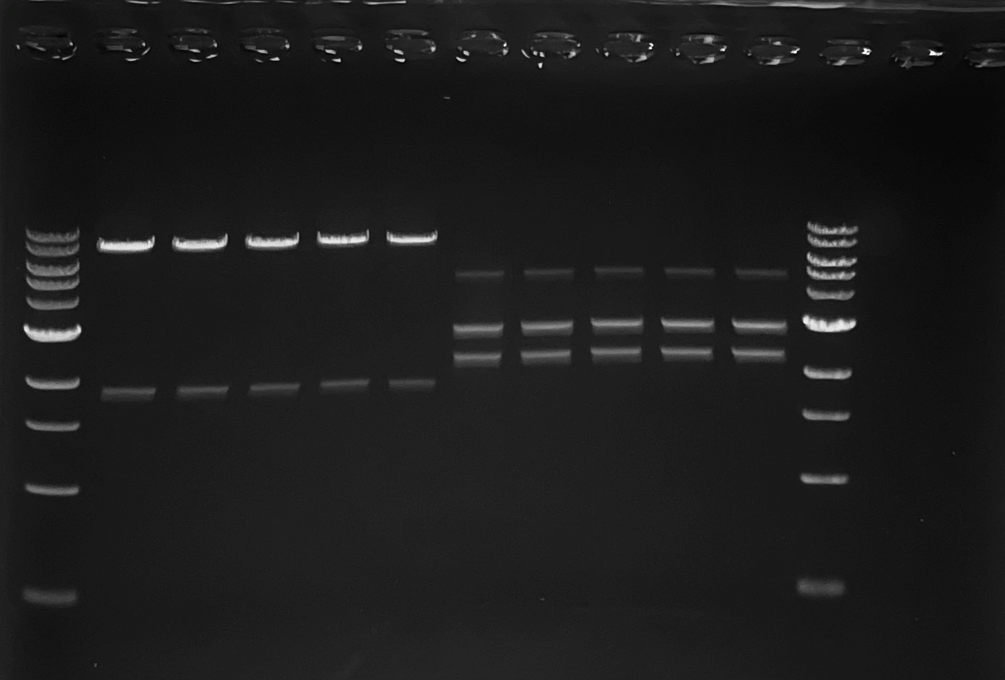
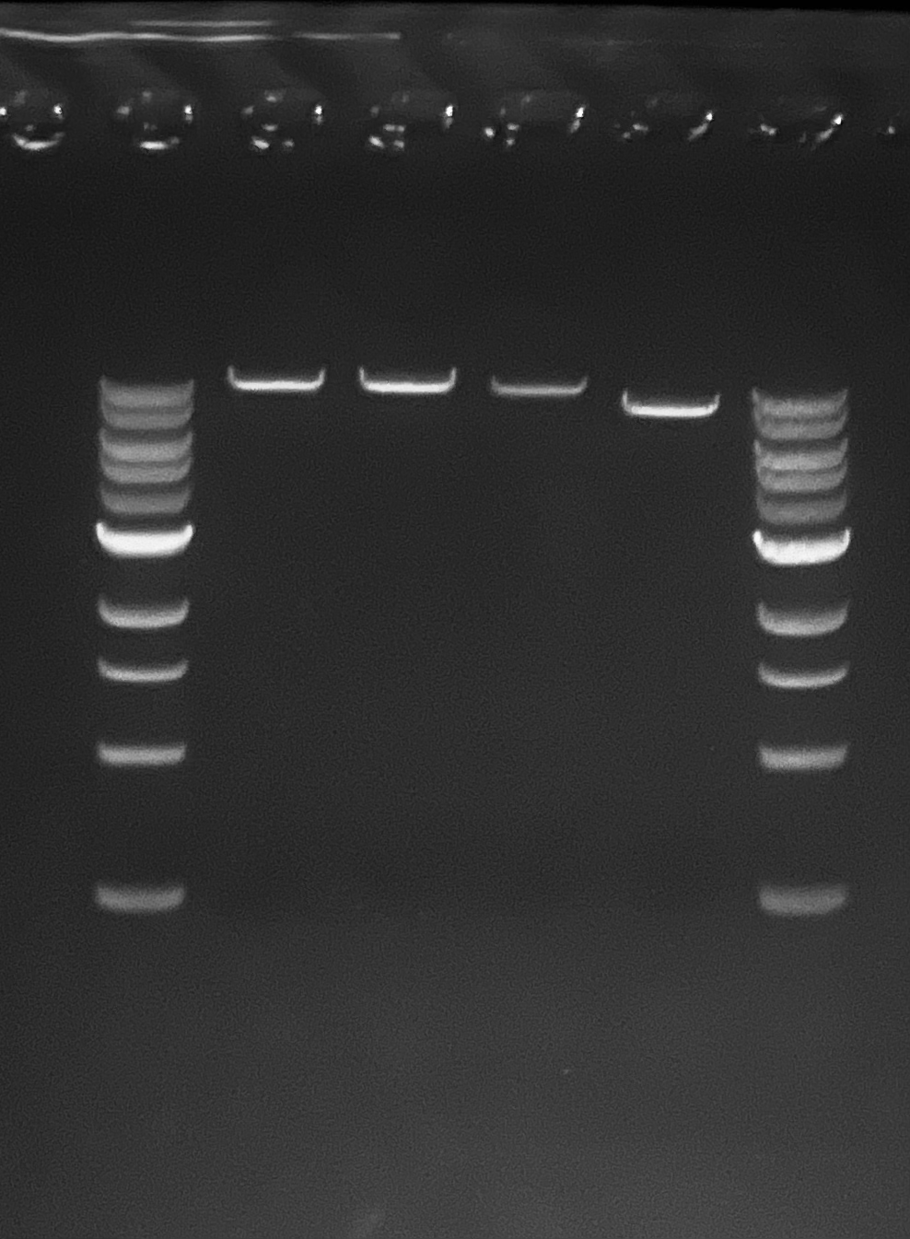
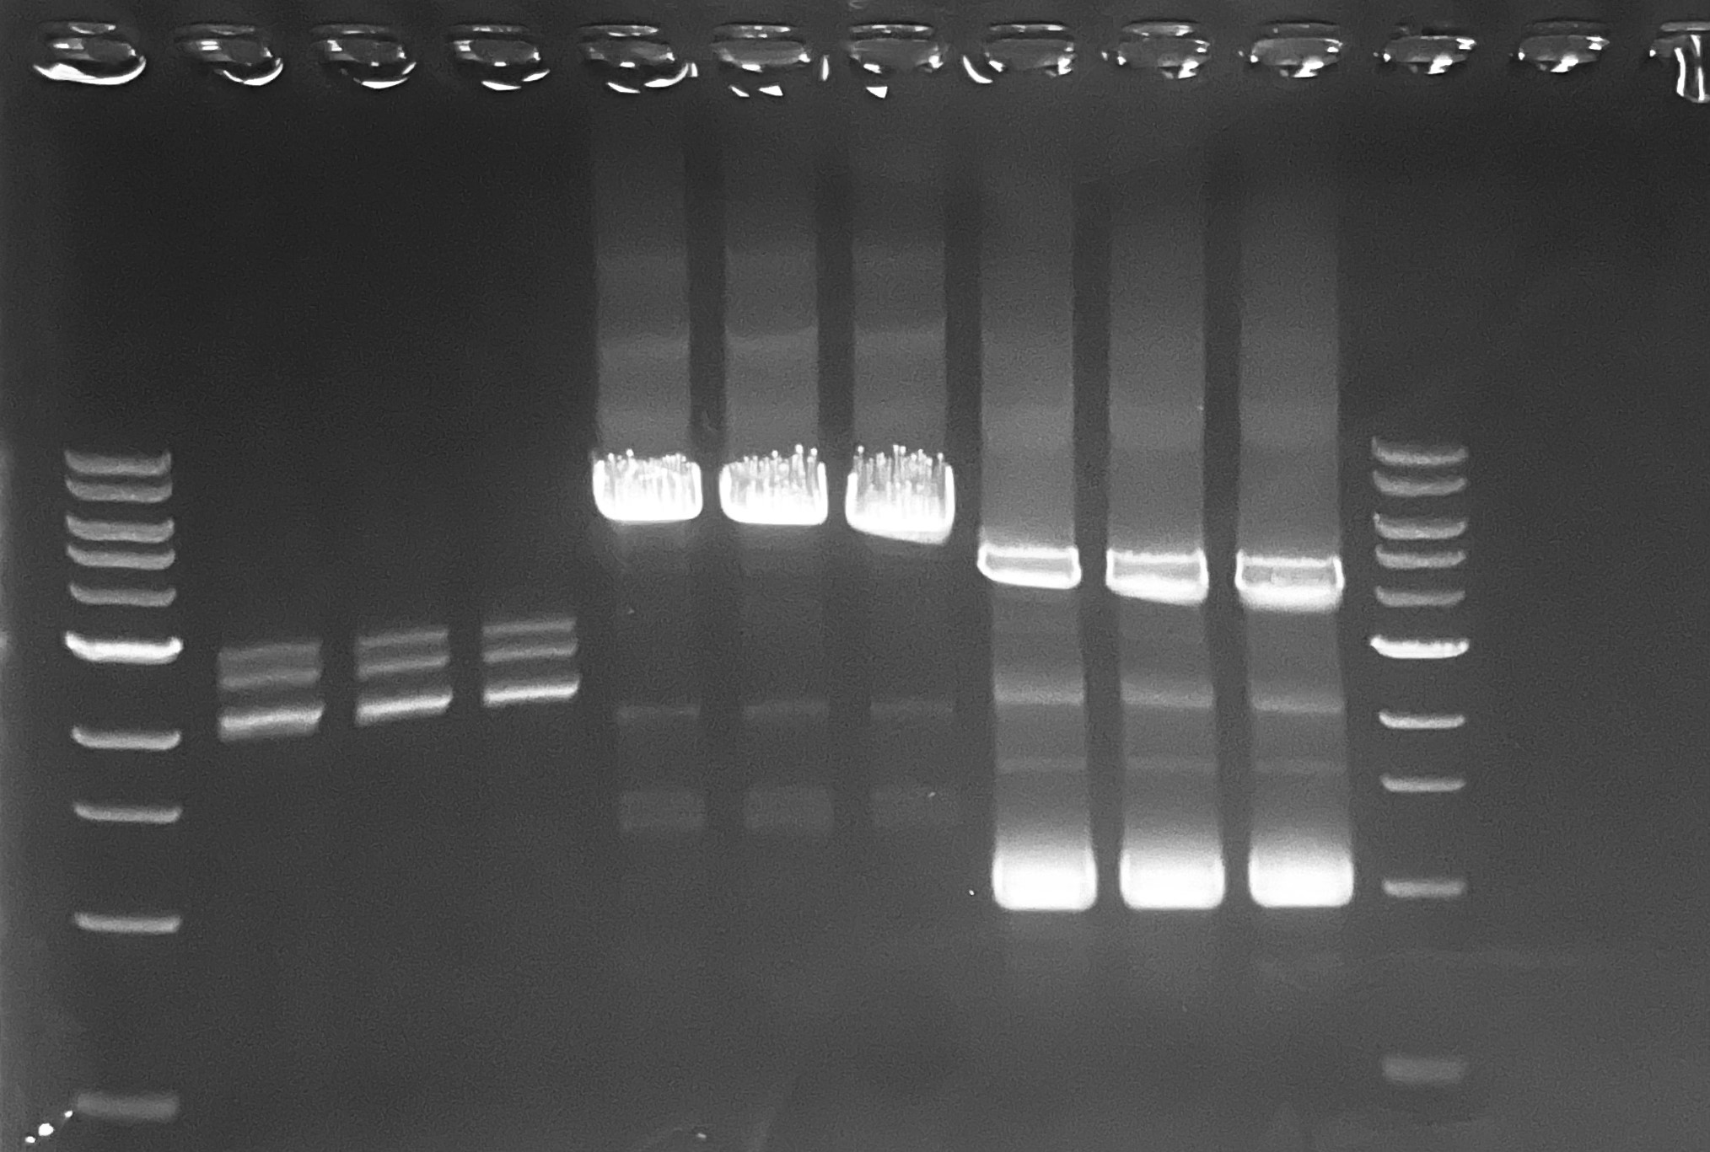
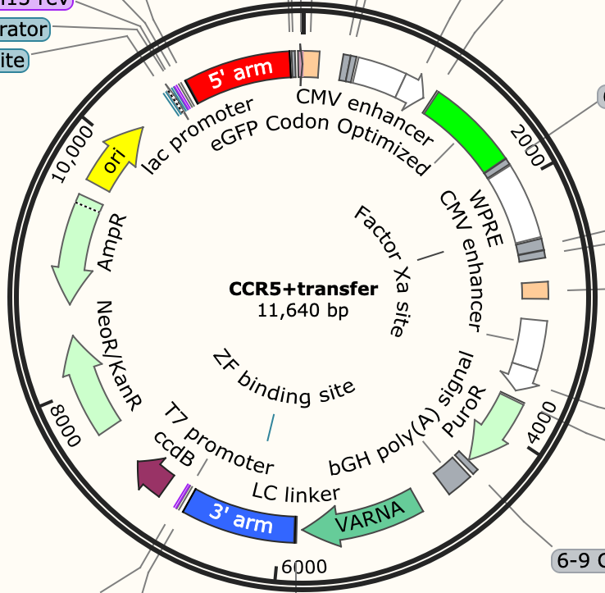
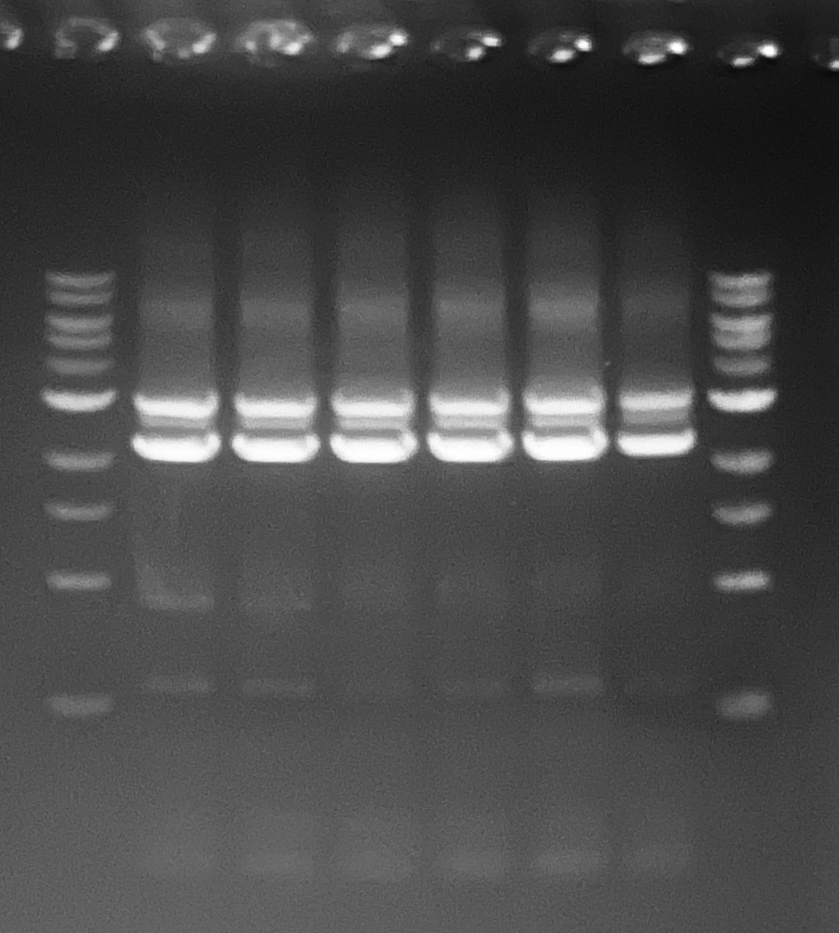



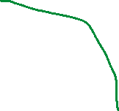

Transfer plasmid assembly
puVII-HF cut transfer piece 1 2925bp
PCR transfer piece 2 2980bp
CCR5 backbone 5811bp
CCR5+transfer, 11640

Slide 26
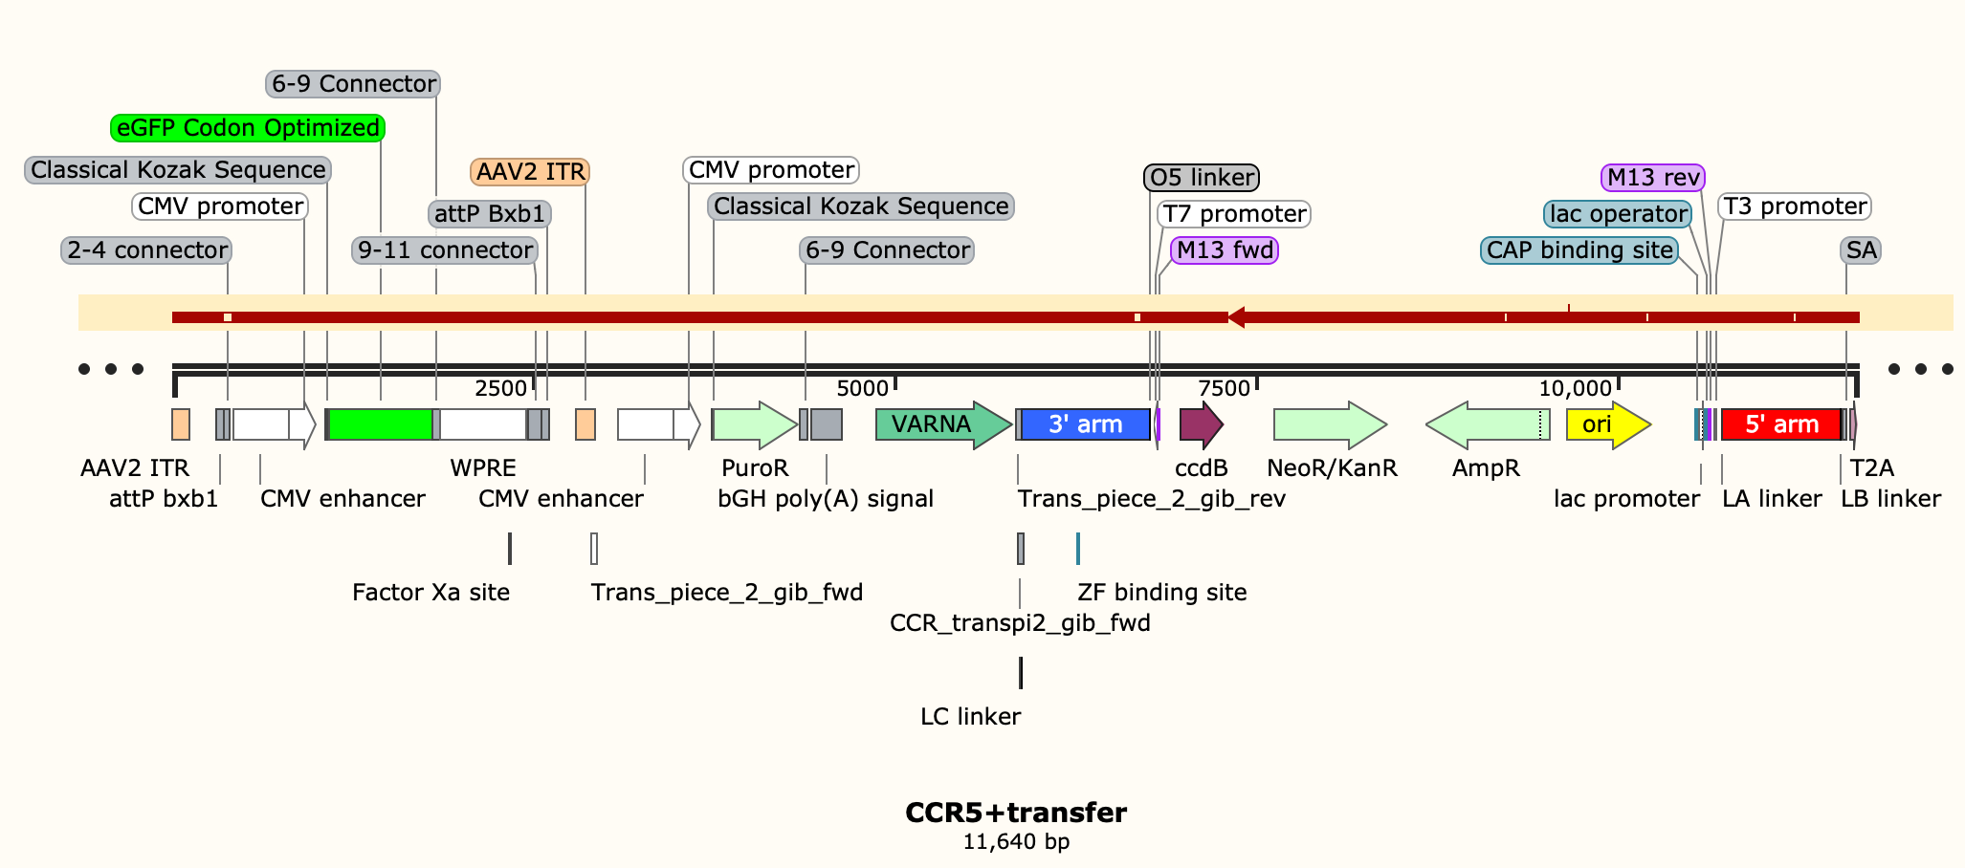
Plasmid sequencing

Slide 27
Next Steps
UML
  HEKRepAss, 293TAssrtTARep conducts 3rd integration of the transfer part.
  Conduct the proposed strategies to enhance the Knockin efficiency.
UD
  Transient testing of three plasmids
  Continue assemblies of future promoter variants

Slide 28
Research Sites – Timeline and Milestones
Q1 2023
Design of Tet-on/off inducible circuits (UD)
Crispr-Cas9 platform development and testing AAVS1, CCR5 and ROSA26 loci (UML)
Q2 2023
Tet off/on switch for 2 AAV cassettes via Golden gate. 1, replication plasmid, 2, assembly plasmid(UD)
Q3 2023
Analytical methods (qPCR, Elisa, RT-qPCR, WB, proteomics) (UML/UD)
Testing inducible plasmids via transient (UML/UD)
Q4 2023
2024
Cell line productivity and stability evaluation(UML/UD)
Tet off/on switch for the 3rd AAV cassette via Golden gate, 3, transfer plasmid(UD)
Site-specific integration of the 2nd and 3rd cassette and develop the baseline of stable cells (UML)
Optimized AAV parts integration, The optimized stable cell line(UML)
Optimization of gene level and dynamics by engineered inducible variants, Kozak, and Degron tags (UD)
Site-specific integration of replication cassette made by UD (UML)
Optimization of gene level and dynamics by engineered inducible variants, Kozak, and Degron tags (UD)
Evaluate optimized plasmids via transient(UML/UD)
AAV production bottlenecks investigation(UD/UML)
Other investigations (UML/UD)

