Slide 1








Industry/University Cooperative Research Center (I/UCRC)
Advanced Mammalian Biomanufacturing Innovation Center (AMBIC)
Develop an Inducible Stable Producer Cell Line for rAAV Production via Site-Specific Integration
Qiang Fu and Emily Doleh
Seongkyu Yoon (PI) / Mark Blenner (Co-PI)
Mentor Meeting – April 17, 2023
A National Science Foundation-facilitated
academic – industry – government consortia
to advance precompetitive knowledge in biomanufacturing
Contents are Proprietary to AMBIC and its Members
Terms of Center Membership Agreement Apply
www.ambic.org

Slide 2
Agenda
Project overview
UD Progress
  Plasmid design and timeline for assembly
UML Progress
Action Items

Slide 3
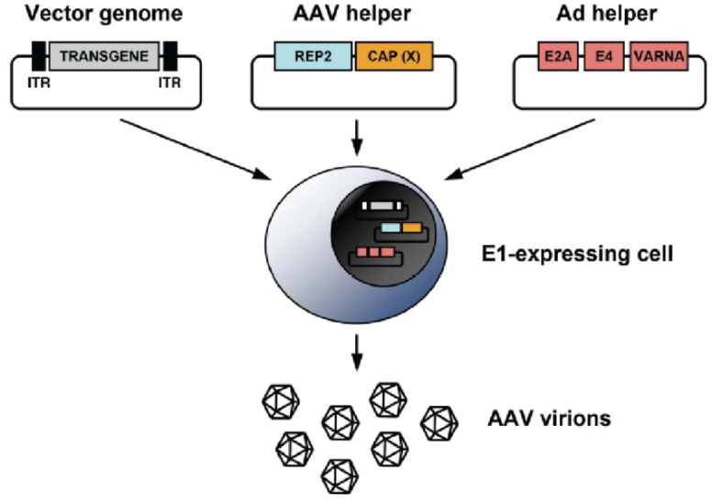
Industrial Relevance & Need
HEK 293 cells
Drawbacks of the traditional rAAV production process that uses transient transfection in HEK293 cells
Complicated and expensive process consuming considerable amount of transfection reagent and plasmids
The lot-to-lot variation of the products
Difficult to scale up
A stable producer of rAAV is needed!

Slide 4
Project Goals
Design inducible circuits that can regulate the timing and level of gene expression for all components necessary to make rAAV
Develop an inducible stable producer cell line with site-specific integration for extensible rAAV production
Objectives
Refactor rAAV rep, cap, and helper genes using variations of the inducible Tet-off promoter
Optimize the rAAV rep, cap, and helper gene expression levels for high titer rAAV, by Kozak sequences and degrons
Establish an inducible stable producer cell line with site specific integration in well-known human genomic safe harbors for rAAV production
Notes:
Why Tet-off promoter rather than Tet-on?
The tet-off-based inducible circuit will be used to eliminate the antibiotics in the rAAV production stage.

Slide 5
Research Workflow & Timeline
Udel
inducible design and plasmid assembly
UML
Crisp-cas9, cell culture, integration
UML & UD
Design of Tet-on/off inducible circuits
Crispr-Cas9 platform development and testing AAVS1, CCR5 and ROSA26 loci
Analytical methods (qPCR, Elisa, RT-qPCR, WB, proteomics)
1-3 M
Tet off/on switch for 3 cassettes via Golden gate
Transfer plasmid
Assembly plasmid
Replication plasmids
AAV parts integration, The baseline of Stable cell line
Testing inducible plasmids via transient
4-8 M
Optimization of gene-level and dynamics by engineered inducible variants, Kozak, and Degron tags
Optimized AAV parts integration, The optimized stable cell line
Evaluate optimized plasmids via transient
9-14 M

Slide 6
UD Progress

Slide 7
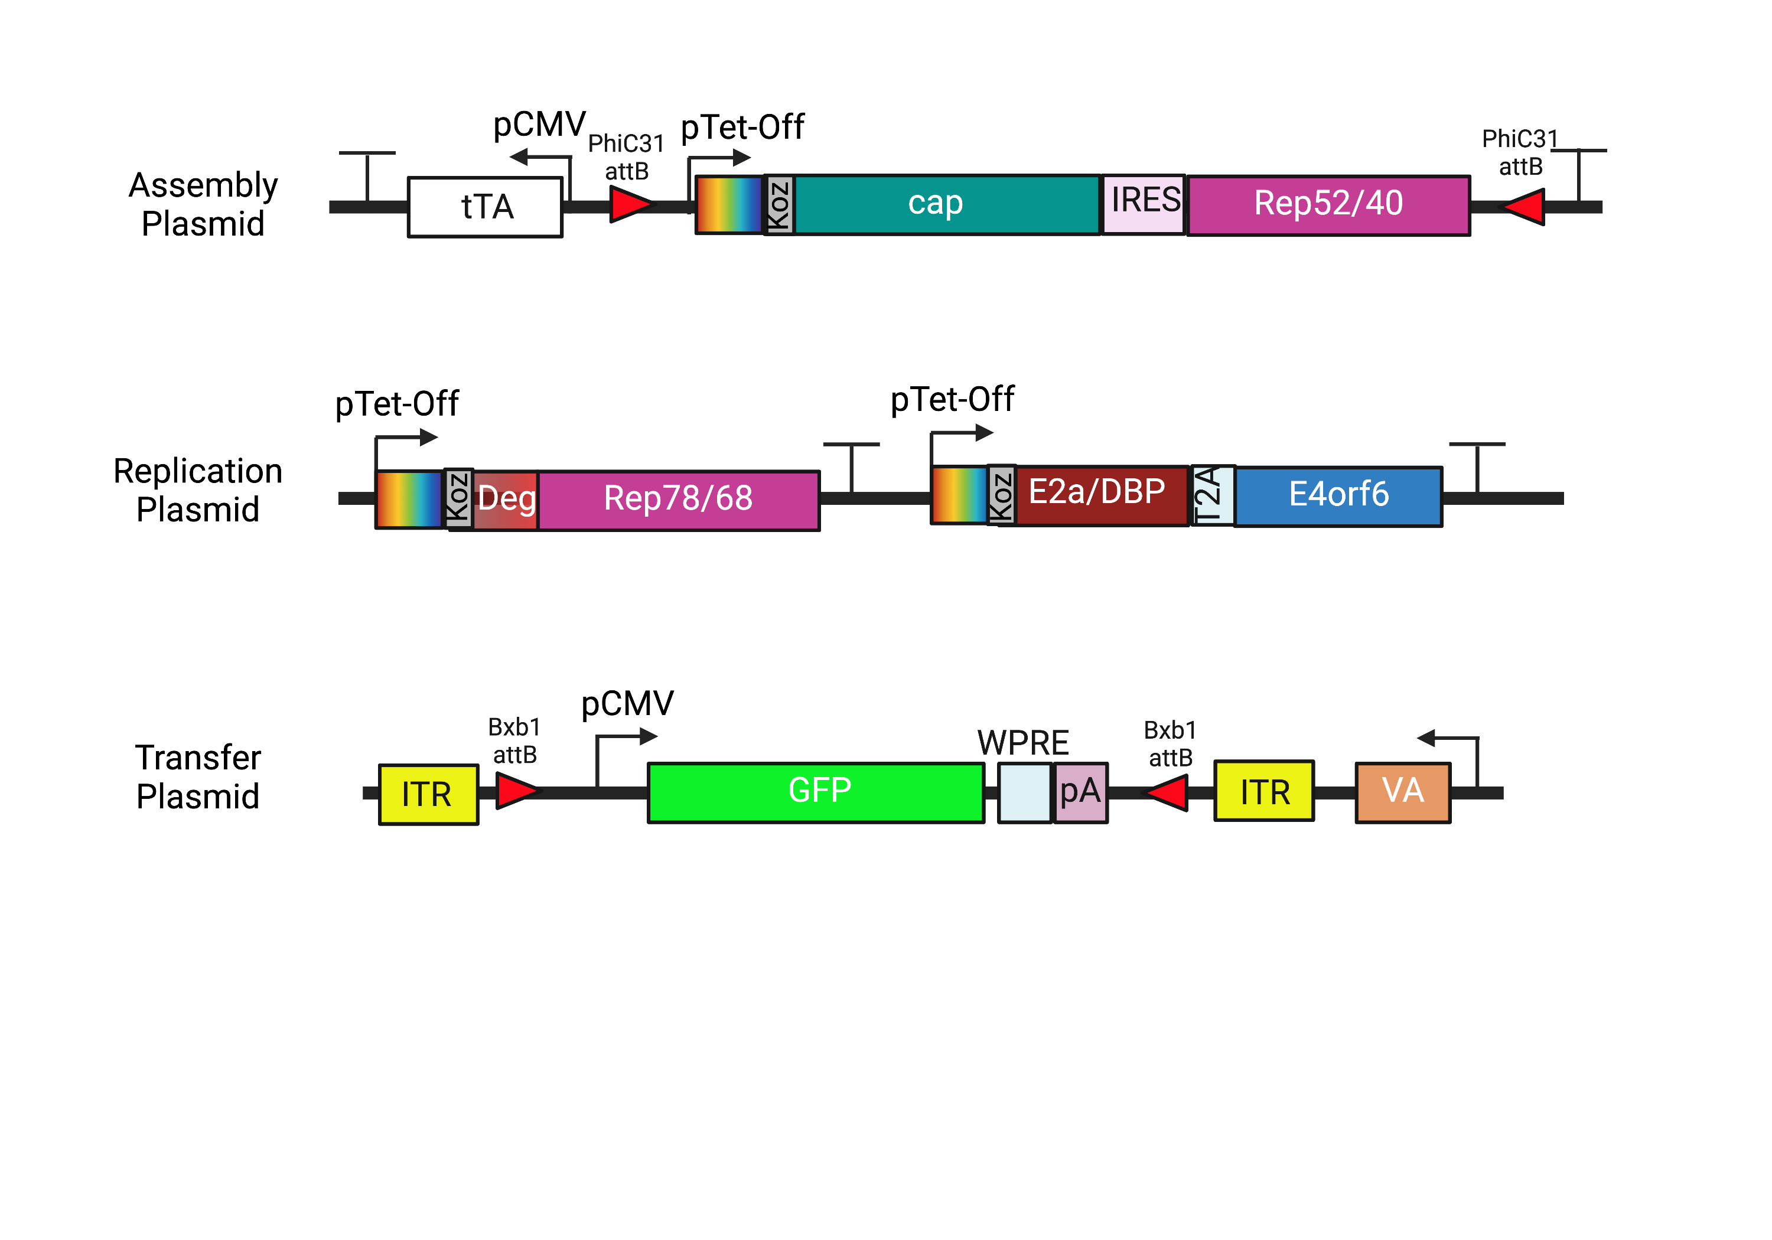
Plasmid Design

Slide 8
Plasmid Design
Addition of PhiC31 integrase on assembly plasmid to exchange serotypes in future

Slide 9
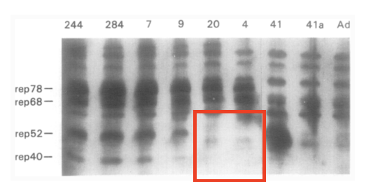
Plasmid Design
Silencing of internal p19 promoter through removal of start codon to stop transcription of Rep52/40
Is this sufficient to silence p19?
Chejanovsky, N.; Carter, B. J. Mutagenesis of an AUG Codon in the Adeno-Associated Virus Rep Gene: Effects on Viral DNA Replication. Virology 1989, 173 (1), 120–128. https://doi.org/10.1016/0042-6822(89)90227-4.

Slide 10
Plasmid Design
Bxb1 sites moved inside ITRs for ease of cloning/payload exchange

Slide 11
Fragment Design
 | Rep78/68
Sequence Change (AA) | 225: ATG → GGG
Reason | Removal of p19 start codon
Comments | Previous work reported the silencing of the p19 promoter through the mutation of the start codon¹
(1) Chejanovsky, N.; Carter, B. J. Mutagenesis of an AUG Codon in the Adeno-Associated Virus Rep Gene: Effects on Viral DNA Replication. Virology 1989, 173 (1), 120–128. https://doi.org/10.1016/0042-6822(89)90227-4.

Slide 12
Plasmid Assembly Timeline
Version 1
 | Assembly Plasmid | Replication Plasmid | Transfer Plasmid
Designing | 02/10 - 03/29 | 02/10 - 03/29 | 02/10 - 03/02
Ordering | 03/02 - 04/11 | 03/02 - 04/11 | 03/02 - 3/15
Entry Vector Preparations | 03/15 - 4/25 | 03/15 - 4/25 | 03/15 - 4/25
Golden Gate Assembly | 04/25-06/22 | 04/25-06/05 | 04/25-present

Slide 13
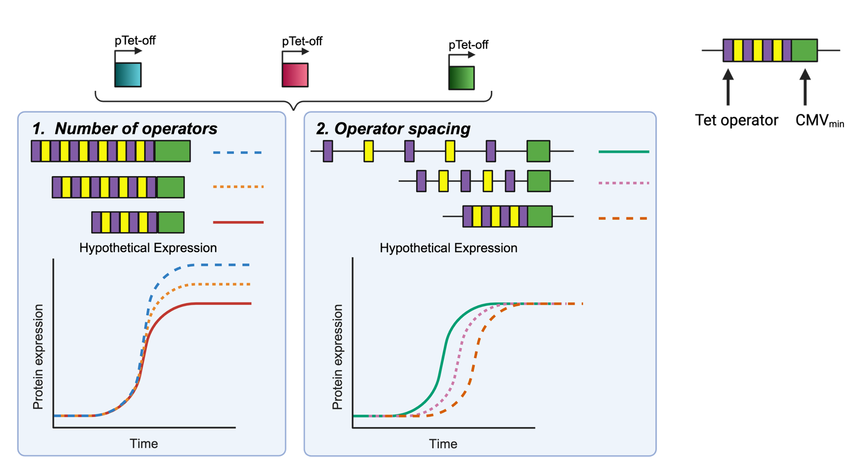
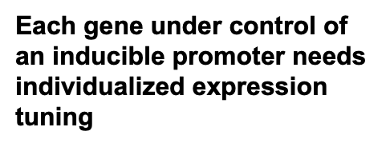
Future Promoter Variants

Slide 14
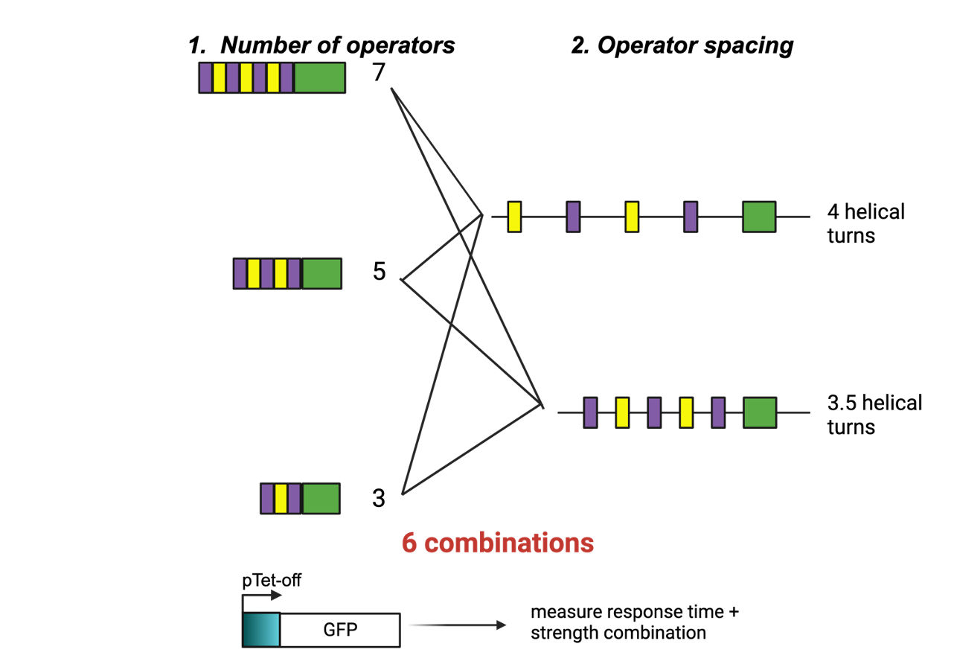
Future Promoter Variants

Slide 15
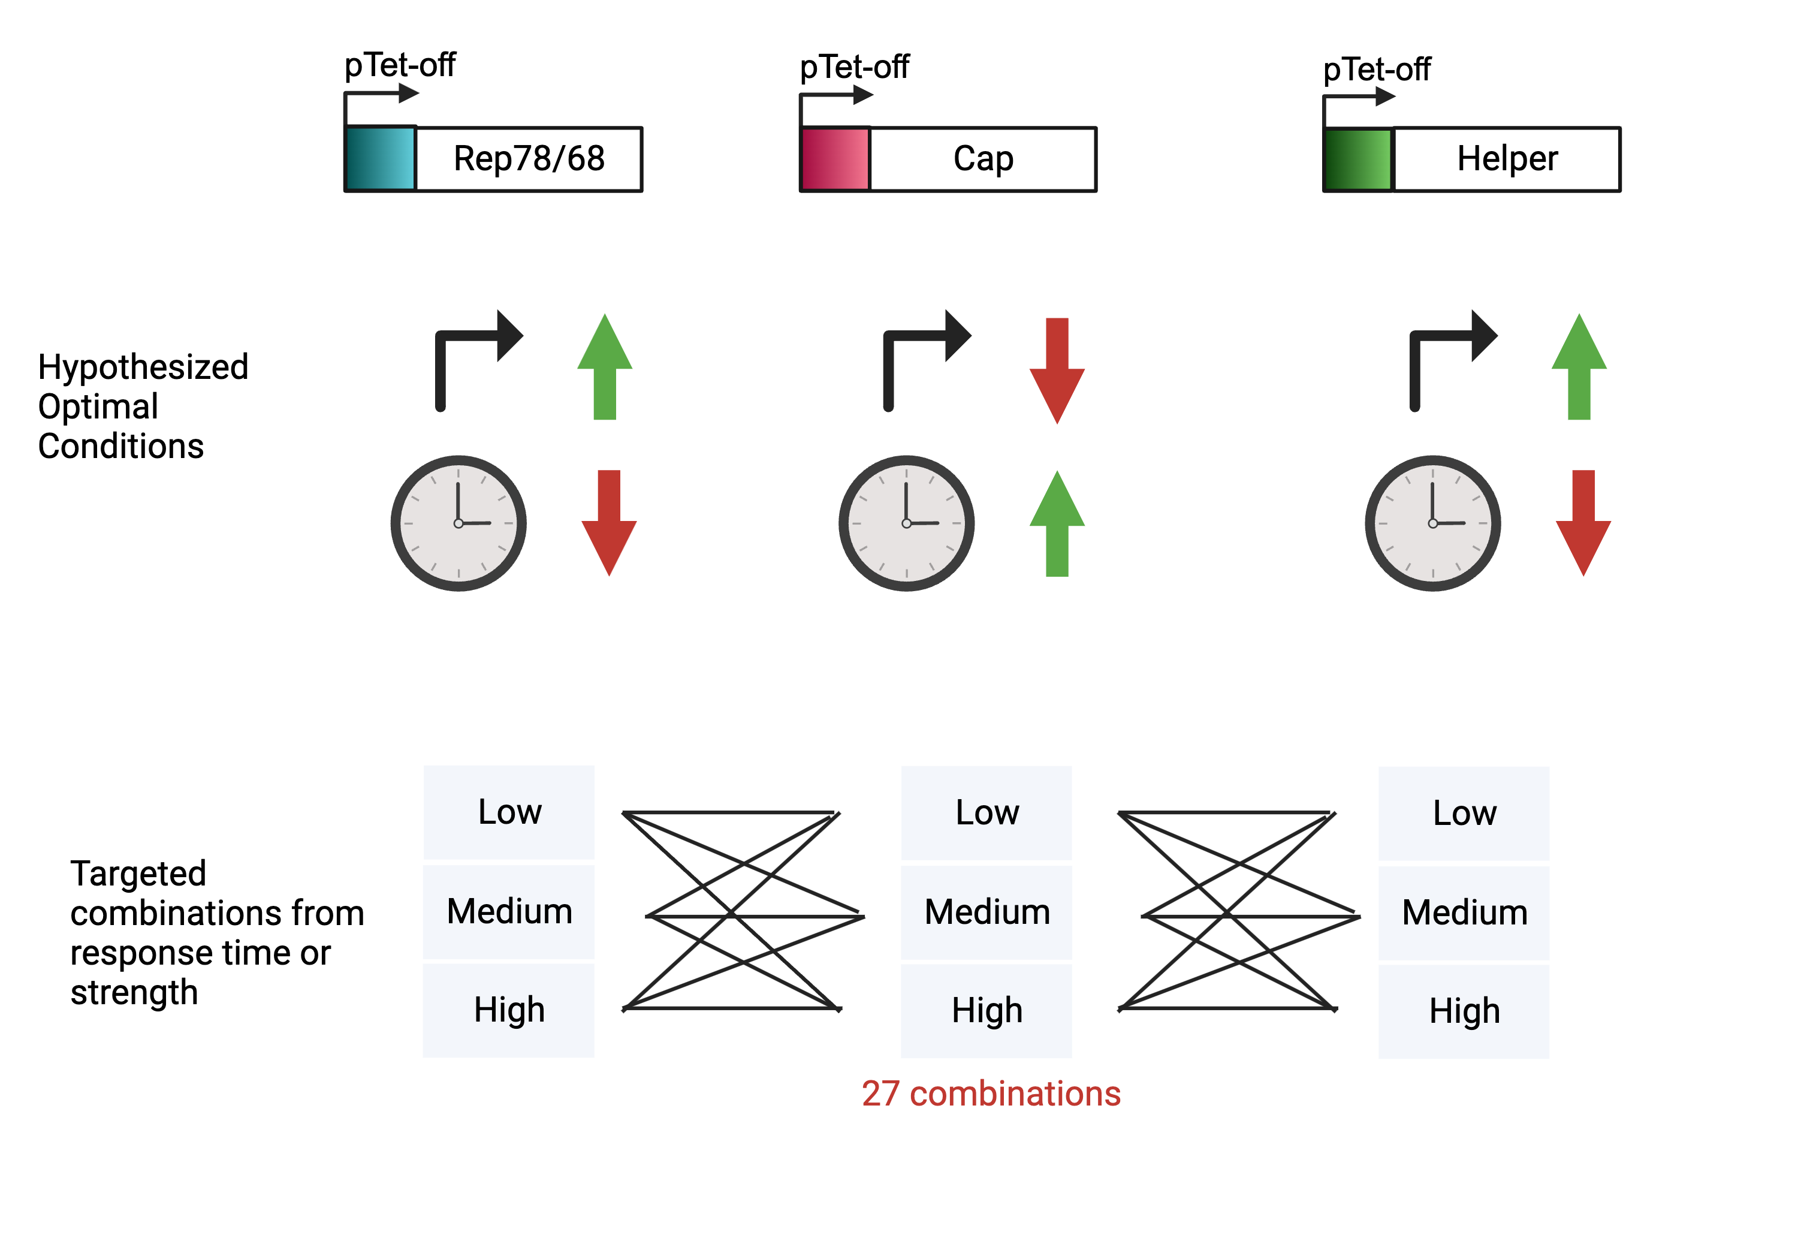
Future Promoter Variants

Slide 16
UML Progress

Slide 17
Site-specific integration strategy for inducible baseline development
Round 1
Replication cassettes integration
Co-transfect with sgRNA + replication donor plasmid in AAVS1
Round 2
Assembly cassettes integration
Round 3
Transgene cassettes integration
Co-transfect with sgRNA + transgene donor plasmid in CCR5
Antibiotic selection
Co-transfect with sgRNA + assembly donor plasmid in ROSA26
Antibiotic selection
Antibiotic selection
Donor plasmids Prep
Donor plasmid prep
Donor plasmids Prep
Stable cell pool
5’ 3’ Junction PCR
Cell sorting assay
Genome copy number via qPCR
Transient other two plasmids for rAAV production
Intermediate QC checkpoints
5’ 3’ Junction PCR
Transient the third plasmid for rAAV production
SSI pool
Cell sorter
Single clone
Junction & copy number
Stable cell pool
5’ 3’ Junction PCR
Packaging cell line
RI pool (discard)
Round 2 SSI pool
SSI pool
Cell sorter
Stable cell pool
Single clone
RI pool (discard)
Stable producer cell line

Slide 18
Antibiotic selection
Most of cells dead, ~10 clones survive. cells recover but grow slow
HEK293REP
080523 antibiotic selection
Blasticidin,10ug/mL
293T
Stable pool
081223 antibiotic selection
Blasticidin. 5ug/mL
HEK293REP
Stable pool
Notes:
The same workflow. We need to reassemble the donor plasmid.

Slide 19
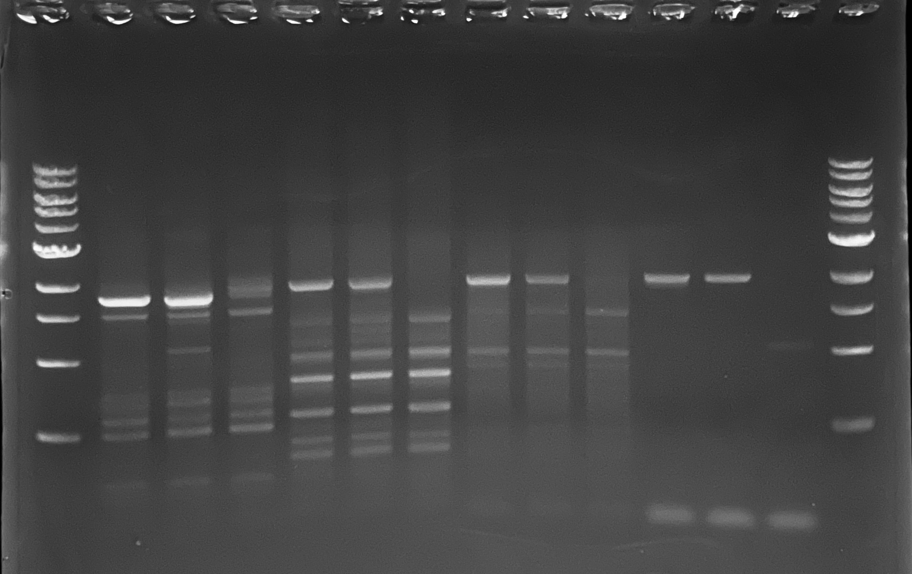
5’ 3’ Junction PCR for Round 2 stable pool
5’ junc
3’ junc
HEKREP Assembly (SV40)_ROSA26 Junction PCR
5’ junction (p1-1, 1784; p3-3, 1912)
3’ junction (p2-2, 1932; p3-3, 1956)
rtTA, tTA and NC side by side
rtTA tTA NC
rtTA tTA NC
rtTA tTA NC
rtTA tTA NC

Slide 20
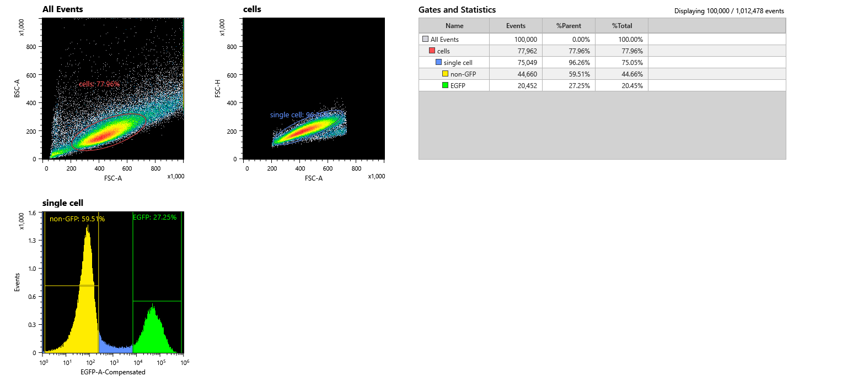
Cell Sorting
Cells
Single cells
Non-GFP cells
SSI pools &
single clones

Slide 21
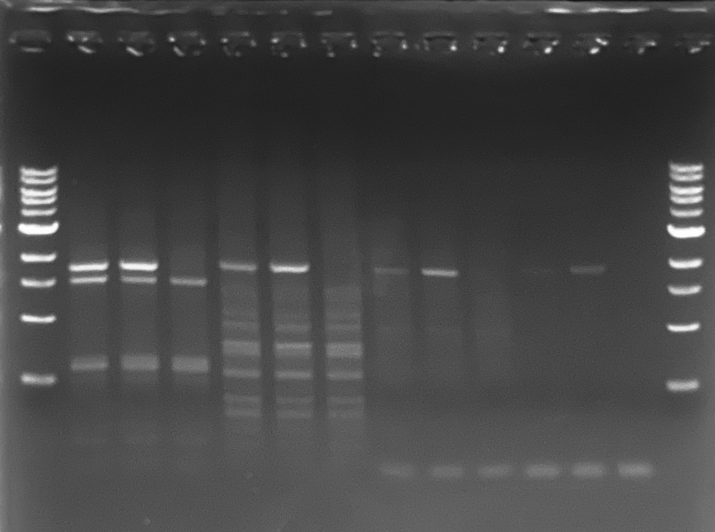
5’ 3’ Junction PCR for Round 2 SSI pool
5’ junc
3’ junc
HEKREP Assembly (SV40)_ROSA26 Junction PCR
5’ junction (p1-1, 1784; p3-3, 1912)
3’ junction (p2-2, 1932; p3-3, 1956)
tTA, rtTA and NC side by side
tTA rtTA NC
tTA rtTA NC
tTA rtTA NC
tTA rtTA NC

Slide 22
Transient ITR-GFP plasmid for rAAV production in HEK293 cells
6 well plate Transfection conditions
Media working volume | 3mL
Plating Density (total cells) | 5E5
Total DNA amount | 2ug
Plasmid ratio | -
PEI:DNA | 1:1
Cocktail volume | 300 uL
Incubation time | 15min
Cocktail media | OptiMEM
Transfection conditions
Helper+ Rep/Cap+ ITR-GFP
tTA, ITR-GFP +500ng/mL Dox
tTA, ITR-GFP no dox
rtTA, ITR-GFP +500ng/mL Dox
rtTA, ITR-GFP no dox
Notes:
The same workflow. We need to reassemble the donor plasmid.

Slide 23
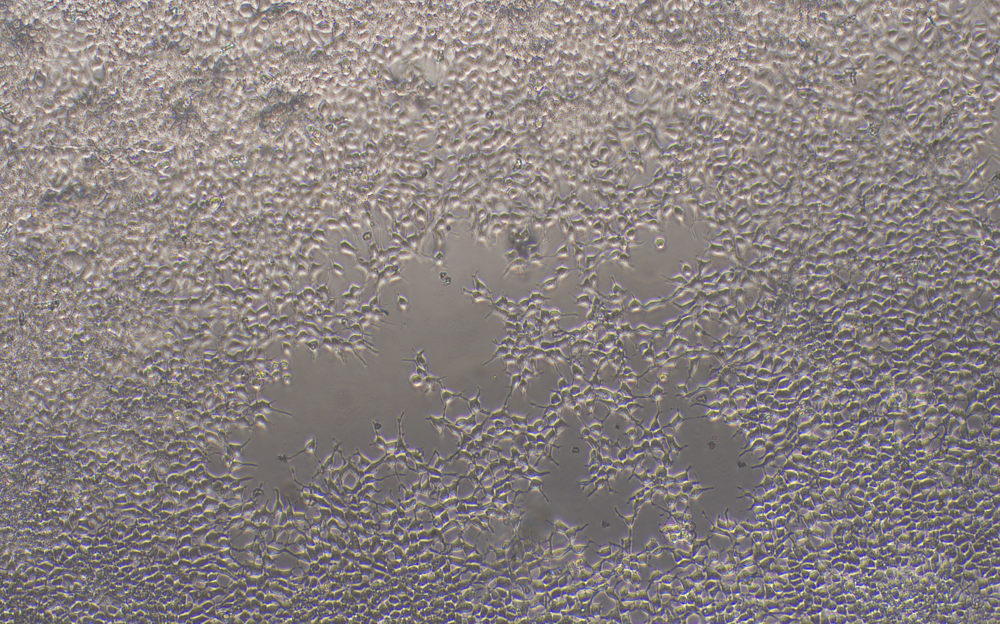
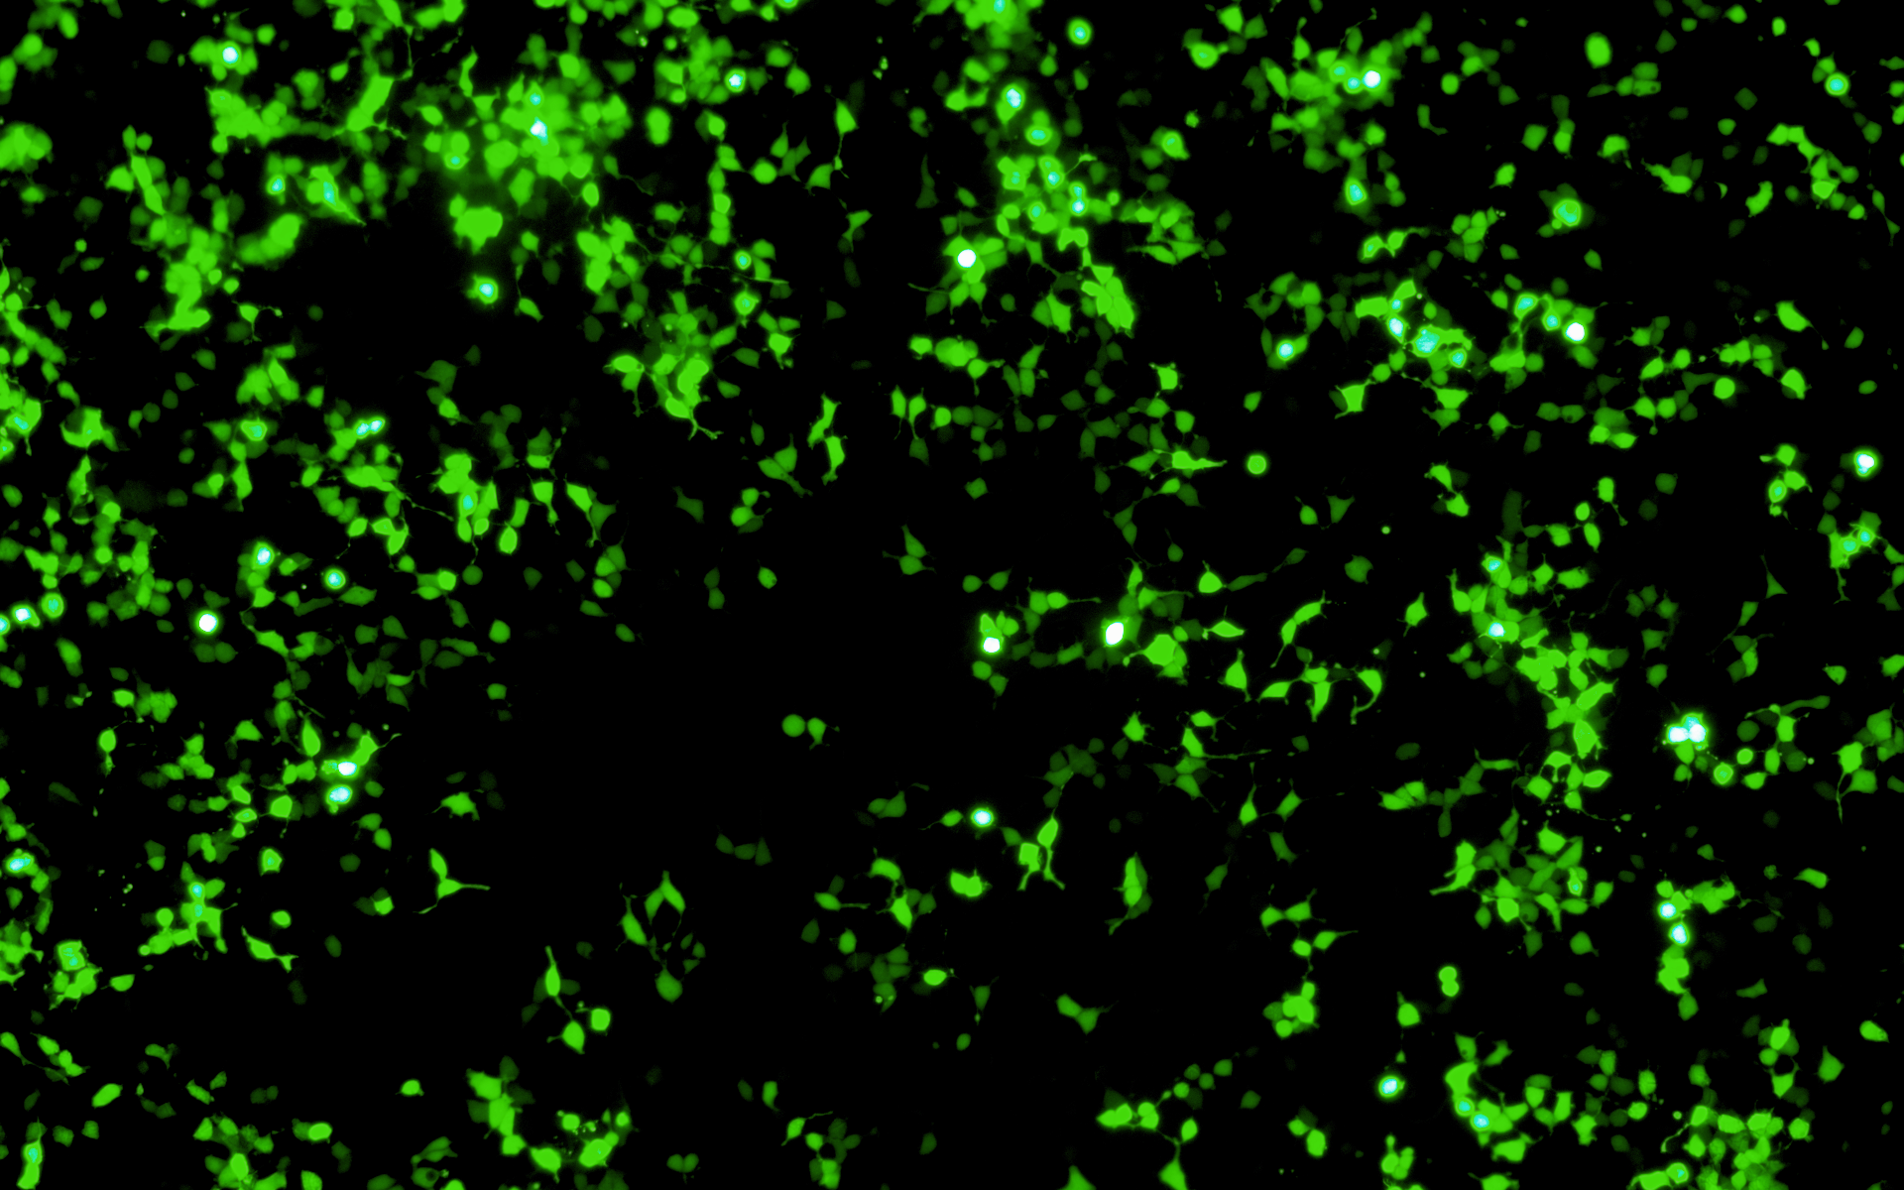
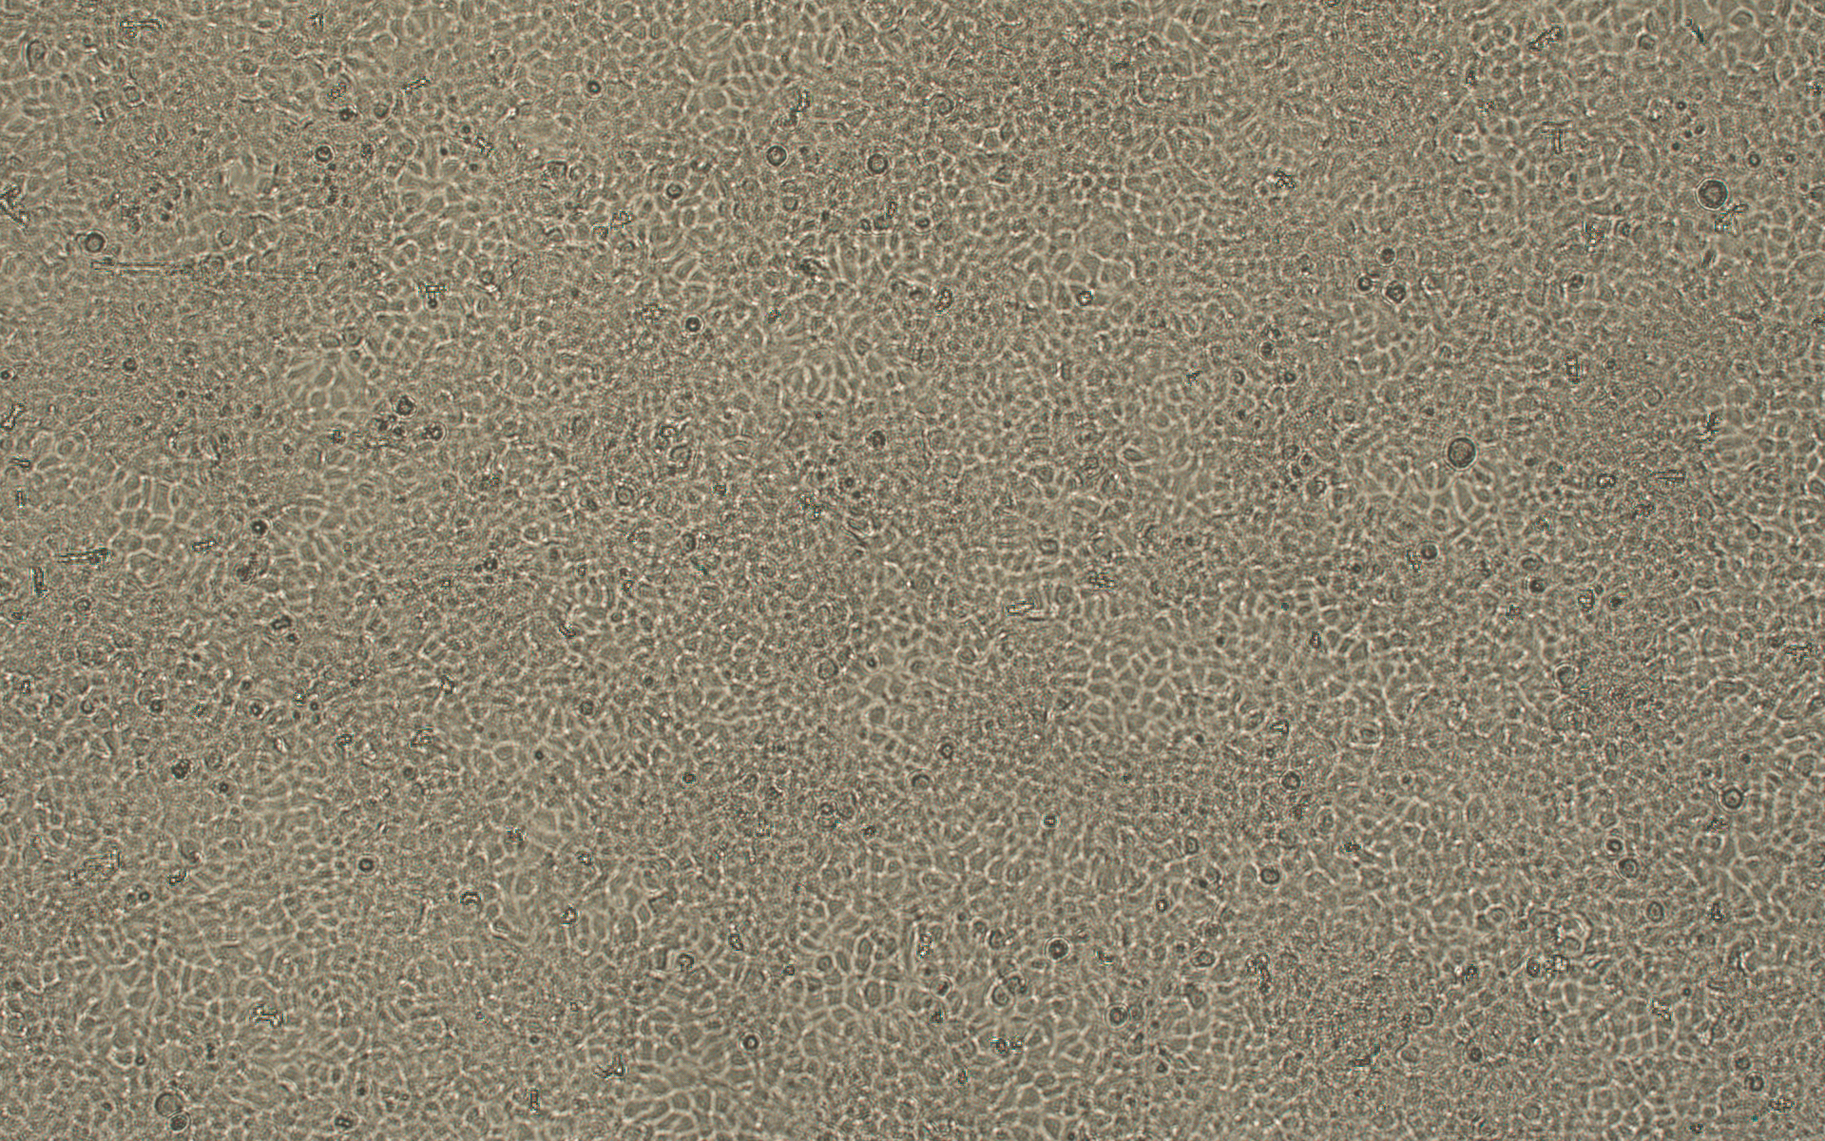
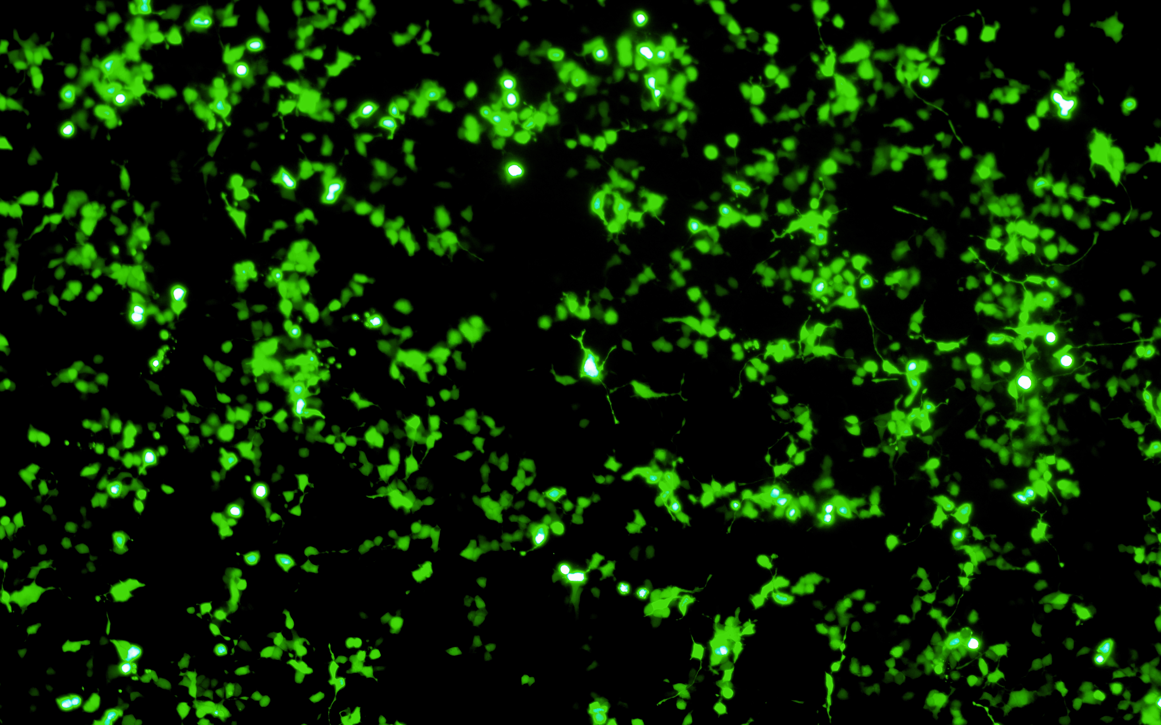
Transient ITR-GFP plasmid for rAAV production in HEK293 cells
>95% confluency at day 3 post-transfection for all condition.
Cell morphology is normal
tTA w/o dox
rtTA w/ dox
Notes:
The same workflow. We need to reassemble the donor plasmid.

Slide 24
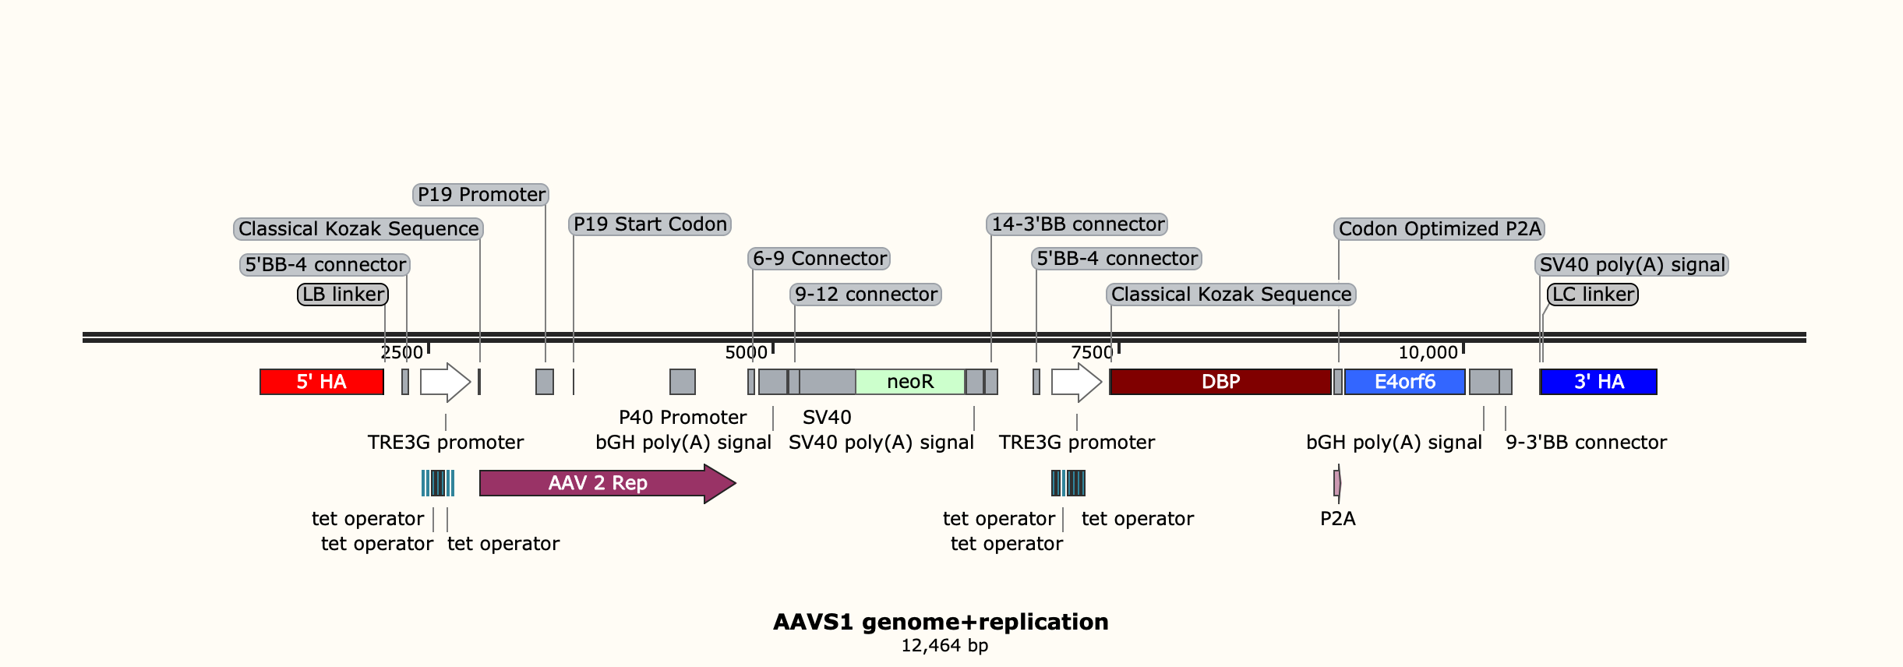
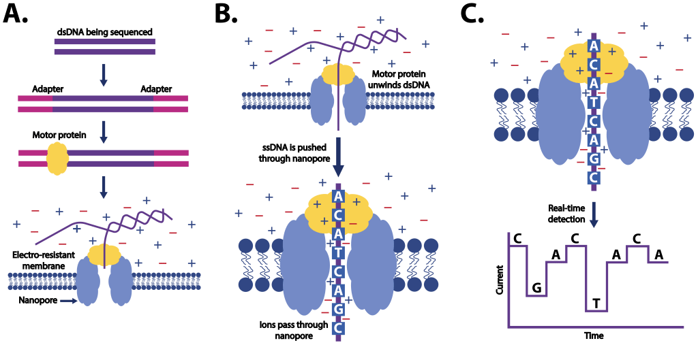
Targeted genome sequencing workflow
Out-Out PCR, ~12,000 bp
$300/sequencing, Long reads; small 300 Mbp/300k reads
$40 / sample, Bioinformatics
5’ junc
3’ junc
Nanopore sequencing
DNA Gel extraction

Slide 25
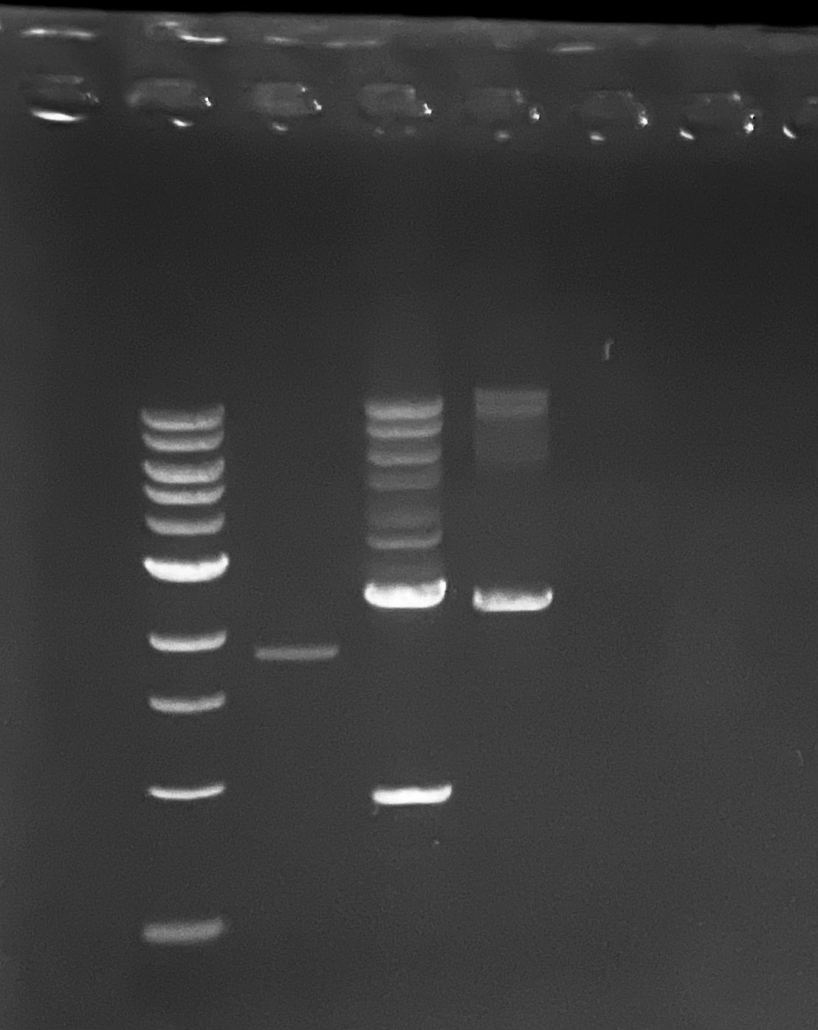
Out-out PCR
HEKREP stable pool gDNA out-to-out PCR (AAVS1 locus)
AAVS1F2R2
  no insertion, 2549bp
  After insertion, 10946bp
AAVS1F4R3
  no insertion 2448bp
  After insertion, 10845bp

Slide 26
Site-specific integration strategy for inducible baseline development
Round 1
Replication cassettes integration
Co-transfect with sgRNA + replication donor plasmid in AAVS1
Round 2
Assembly cassettes integration
Round 3
Transgene cassettes integration
Co-transfect with sgRNA + transgene donor plasmid in CCR5
Antibiotic selection
Co-transfect with sgRNA + assembly donor plasmid in ROSA26
Antibiotic selection
Antibiotic selection
Donor plasmids Prep
Donor plasmid prep
Donor plasmids Prep
Stable cell pool
5’ 3’ Junction PCR
Cell sorting assay
Genome copy number via qPCR
Transient other two plasmids for rAAV production
Intermediate QC checkpoints
5’ 3’ Junction PCR
Transient the third plasmid for rAAV production
SSI pool
Cell sorter
Single clone
Junction & copy number
Stable cell pool
5’ 3’ Junction PCR
Packaging cell line
RI pool (discard)
Round 2 SSI pool
SSI pool
Cell sorter
Stable cell pool
Single clone
RI pool (discard)
Stable producer cell line

Slide 27
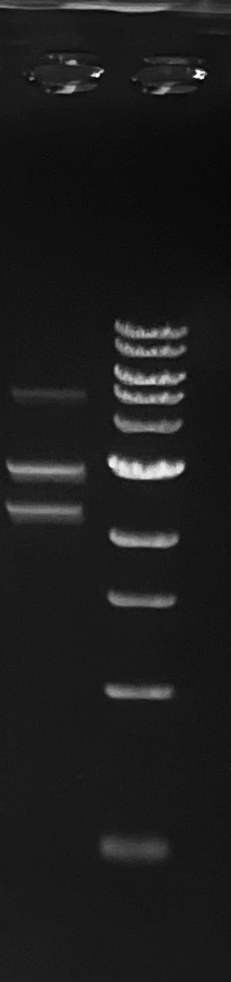
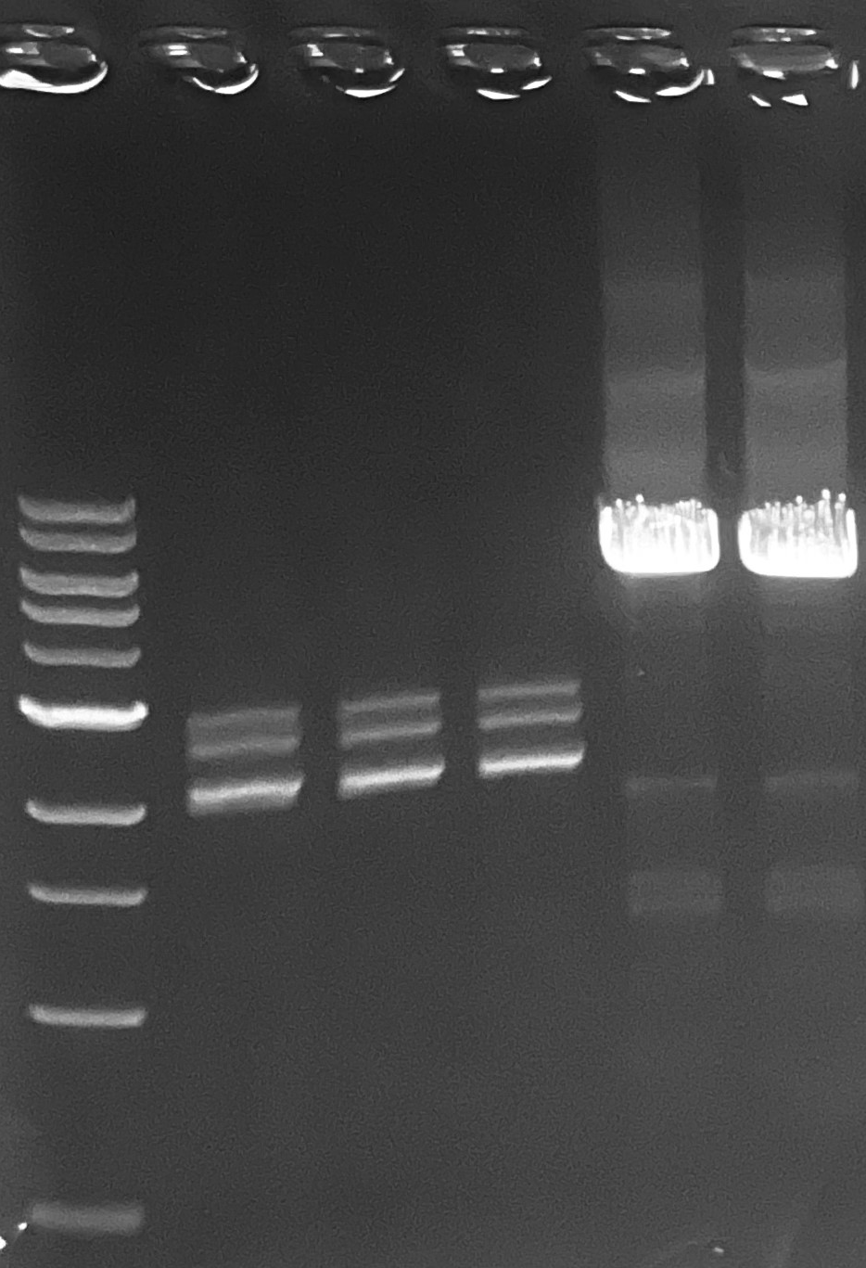
Transfer plasmid assembly
puVII-HF cut transfer piece 1 2925bp
PCR transfer piece 2 2980bp. fail
PCR CCR5 backbone 5811bp

Slide 28
Next Steps
UML
  Transfer donor plasmid construction and integration
UD
  Finish transfer plasmid cloning
    Transient testing of 3 plasmids
  Begin assembly of future promoter variants

Slide 29
Research Sites – Timeline and Milestones
Q1 2023
Design of Tet-on/off inducible circuits (UD)
Crispr-Cas9 platform development and testing AAVS1, CCR5 and ROSA26 loci (UML)
Q2 2023
Tet off/on switch for 2 AAV cassettes via Golden gate. 1, replication plasmid, 2, assembly plasmid(UD)
Q3 2023
Analytical methods (qPCR, Elisa, RT-qPCR, WB, proteomics) (UML/UD)
Testing inducible plasmids via transient (UML/UD)
Q4 2023
2024
Cell line productivity and stability evaluation(UML/UD)
Tet off/on switch for the 3rd AAV cassette via Golden gate, 3, transfer plasmid(UD)
Site-specific integration of the 2nd and 3rd cassette and develop the baseline of stable cells (UML)
Optimized AAV parts integration, The optimized stable cell line(UML)
Optimization of gene level and dynamics by engineered inducible variants, Kozak, and Degron tags (UD)
Site-specific integration of replication cassette made by UD (UML)
Optimization of gene level and dynamics by engineered inducible variants, Kozak, and Degron tags (UD)
Evaluate optimized plasmids via transient(UML/UD)
AAV production bottlenecks investigation(UD/UML)
Other investigations (UML/UD)

