Slide 1








Industry/University Cooperative Research Center (I/UCRC)
Advanced Mammalian Biomanufacturing Innovation Center (AMBIC)
Develop an Inducible Stable Producer Cell Line for rAAV Production via Site-Specific Integration
Qiang Fu and Emily Doleh
Seongkyu Yoon (PI) / Mark Blenner (Co-PI)
Mentor Meeting – April 17, 2023
A National Science Foundation-facilitated
academic – industry – government consortia
to advance precompetitive knowledge in biomanufacturing
Contents are Proprietary to AMBIC and its Members
Terms of Center Membership Agreement Apply
www.ambic.org

Slide 2
Agenda
Project overview
UD Progress
  Plasmid design and timeline for assembly
UML Progress
Action Items

Slide 3
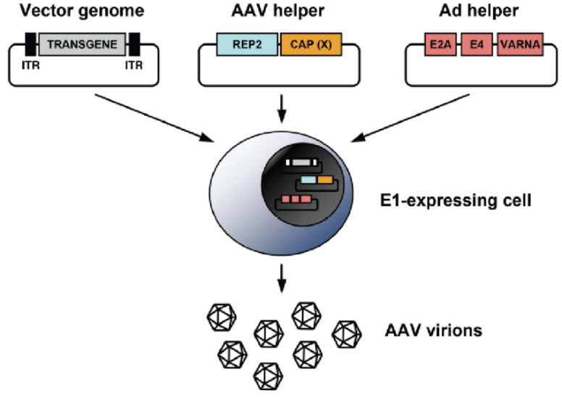
Industrial Relevance & Need
HEK 293 cells
Drawbacks of the traditional rAAV production process that uses transient transfection in HEK293 cells
Complicated and expensive process consuming considerable amount of transfection reagent and plasmids
The lot-to-lot variation of the products
Difficult to scale up
A stable producer of rAAV is needed!

Slide 4
Project Goals
Design inducible circuits that can regulate the timing and level of gene expression for all components necessary to make rAAV
Develop an inducible stable producer cell line with site-specific integration for extensible rAAV production
Objectives
Refactor rAAV rep, cap, and helper genes using variations of the inducible Tet-off promoter
Optimize the rAAV rep, cap, and helper gene expression levels for high titer rAAV, by Kozak sequences and degrons
Establish an inducible stable producer cell line with site specific integration in well-known human genomic safe harbors for rAAV production
Notes:
Why Tet-off promoter rather than Tet-on?
The tet-off-based inducible circuit will be used to eliminate the antibiotics in the rAAV production stage.

Slide 5
Research Workflow & Timeline
Udel
inducible design and plasmid assembly
UML
Crisp-cas9, cell culture, integration
UML & UD
Design of Tet-on/off inducible circuits
Crispr-Cas9 platform development and testing AAVS1, CCR5 and ROSA26 loci
Analytical methods (qPCR, Elisa, RT-qPCR, WB, proteomics)
1-3 M
Tet off/on switch for 3 cassettes via Golden gate
Transfer plasmid
Assembly plasmid
Replication plasmids
AAV parts integration, The baseline of Stable cell line
Testing inducible plasmids via transient
4-8 M
Optimization of gene-level and dynamics by engineered inducible variants, Kozak, and Degron tags
Optimized AAV parts integration, The optimized stable cell line
Evaluate optimized plasmids via transient
9-14 M

Slide 6
UD Progress

Slide 7
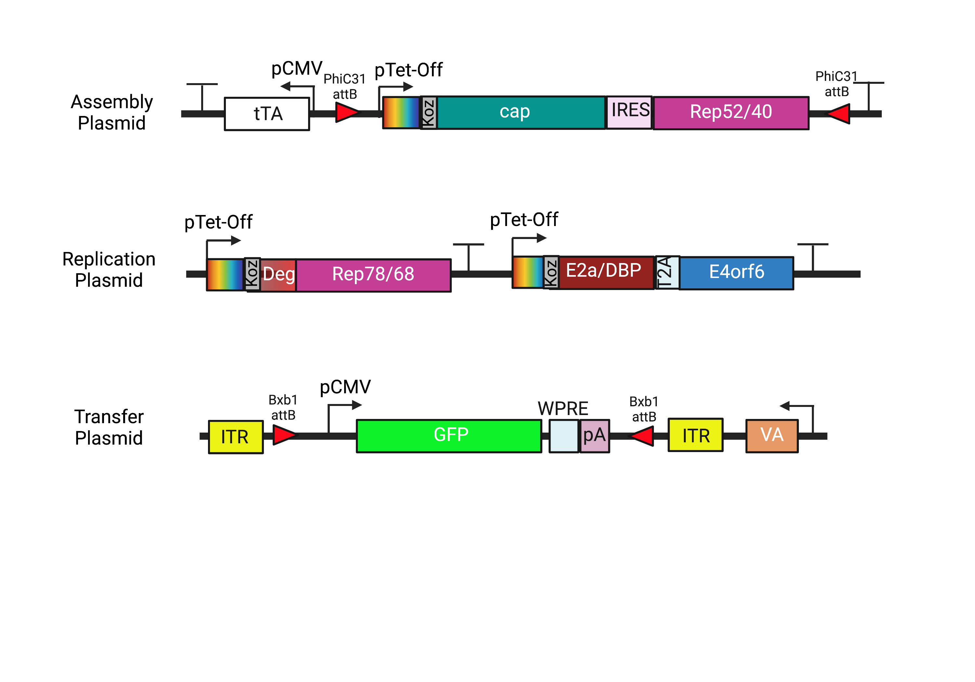
Plasmid Design

Slide 8
Plasmid Design
Addition of PhiC31 integrase on assembly plasmid to exchange serotypes in future

Slide 9
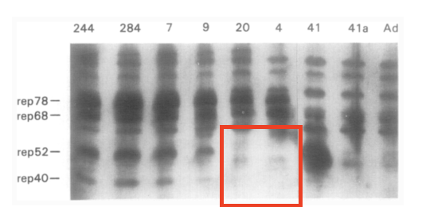
Plasmid Design
Silencing of internal p19 promoter through removal of start codon to stop transcription of Rep52/40
Is this sufficient to silence p19?
Chejanovsky, N.; Carter, B. J. Mutagenesis of an AUG Codon in the Adeno-Associated Virus Rep Gene: Effects on Viral DNA Replication. Virology 1989, 173 (1), 120–128. https://doi.org/10.1016/0042-6822(89)90227-4.

Slide 10
Plasmid Design
Bxb1 sites moved inside ITRs for ease of cloning/payload exchange

Slide 11
Fragment Design
 | Rep78/68
Sequence Change (AA) | 225: ATG → GGG
Reason | Removal of p19 start codon
Comments | Previous work reported the silencing of the p19 promoter through the mutation of the start codon¹
(1) Chejanovsky, N.; Carter, B. J. Mutagenesis of an AUG Codon in the Adeno-Associated Virus Rep Gene: Effects on Viral DNA Replication. Virology 1989, 173 (1), 120–128. https://doi.org/10.1016/0042-6822(89)90227-4.

Slide 12
Plasmid Assembly Timeline
Version 1
 | Assembly Plasmid | Replication Plasmid | Transfer Plasmid
Designing | 02/10 - 03/29 | 02/10 - 03/29 | 02/10 - 03/02
Ordering | 03/02 - 04/11 | 03/02 - 04/11 | 03/02 - 3/15
Entry Vector Preparations | 03/15 - 4/25 | 03/15 - 4/25 | 03/15 - 4/25
Golden Gate Assembly | 04/25-06/22 | 04/25-06/05 | 04/25-present

Slide 13
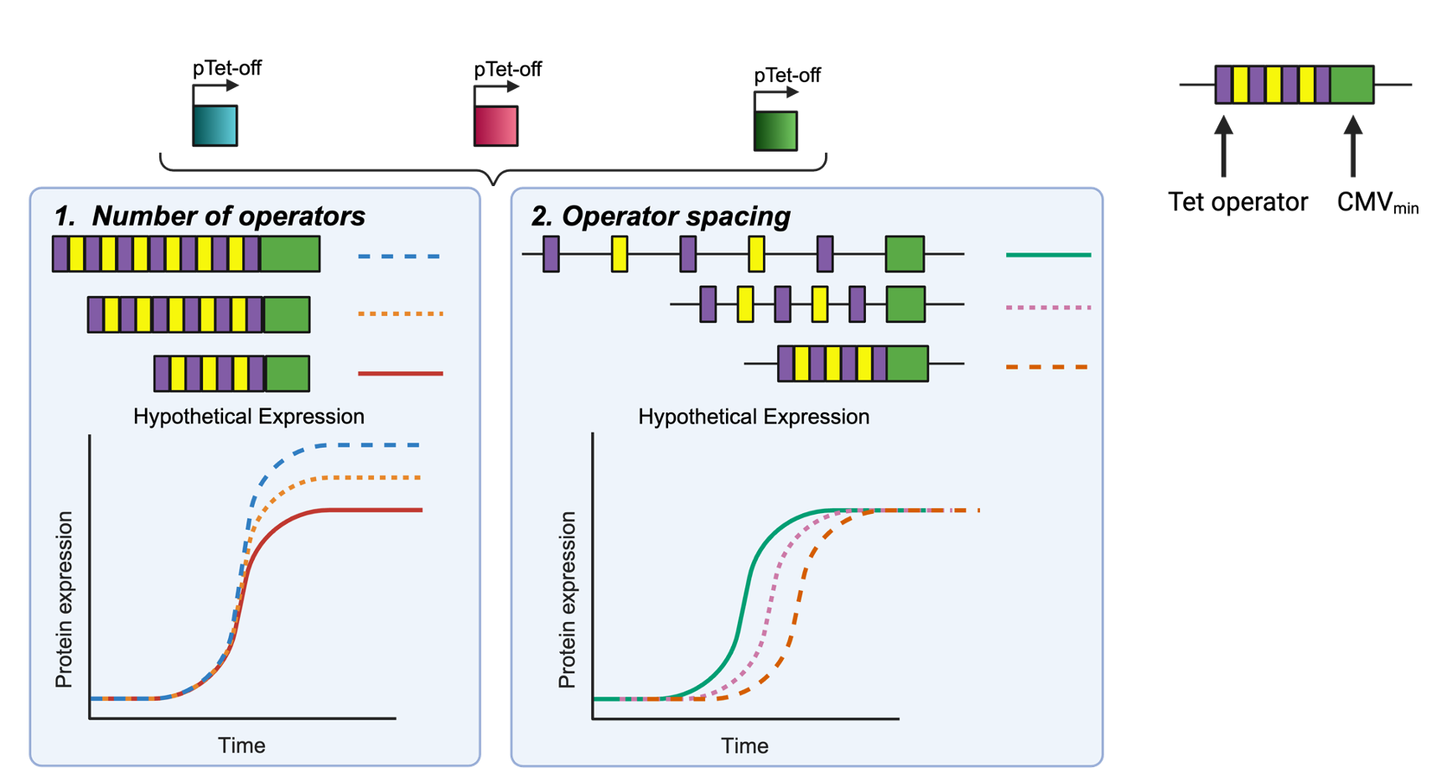
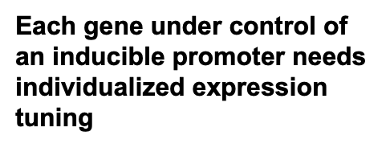
Future Promoter Variants

Slide 14
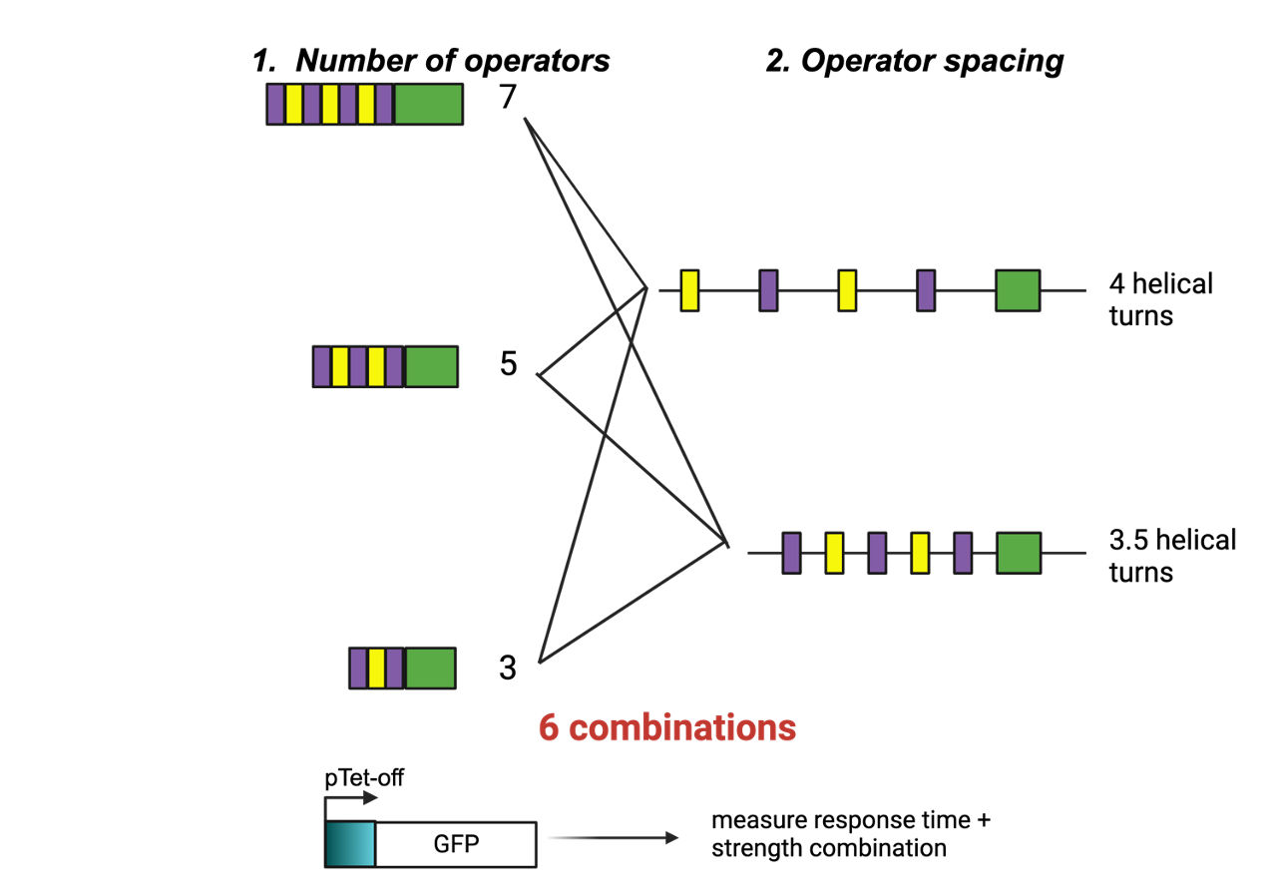
Future Promoter Variants

Slide 15
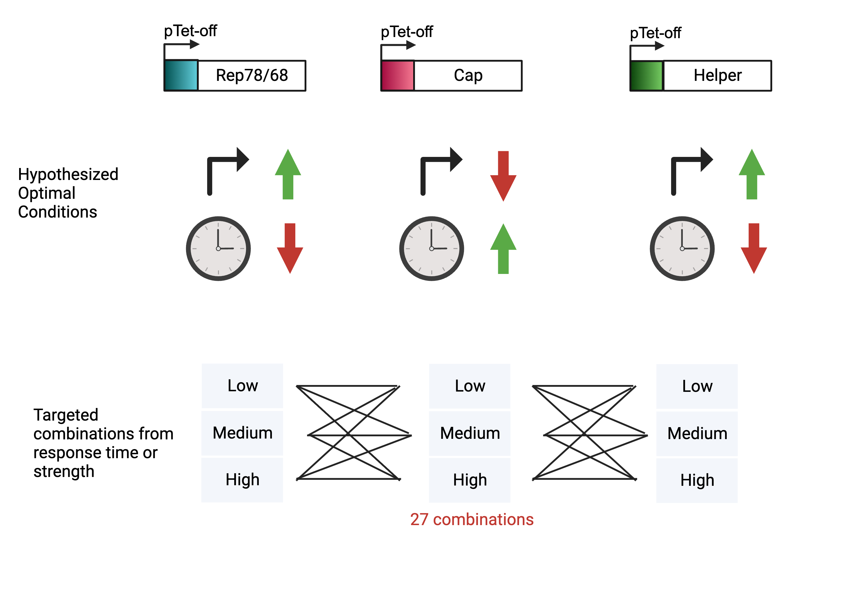
Future Promoter Variants

Slide 16
UML Progress

Slide 17
Previous site-specific integration strategy
RI pool (discard)
Intermediate QC checkpoints
5’ 3’ Junction PCR
Transient other two plasmids for rAAV production
Single clone via cell sorter for knock-in evaluation (qPCR relative genome copy and junction PCR)
Round 1
Replication cassettes integration
Co-transfect with sgRNA + replication donor plasmid in AAVS1
Round 2
Assembly cassettes integration
Round 3
transgene cassettes integration
Co-transfect with sgRNA + transgene donor plasmid in CCR5
Antibiotic selection for two weeks
Co-transfect with sgRNA + assembly donor plasmid in ROSA26
Antibiotic selection for two weeks
Antibiotic selection for two weeks
Stable cell pool
5’ 3’ Junction PCR
Cell sorter
SSI pool 1
RI pool (discard)
SSI pool 1 for Round 2
Stable cell pool
Cell sorter
SSI pool 2
SSI pool 2 for Round 3
RI pool (discard)
Stable cell pool
Cell sorter
SSI pool 3

Slide 18
Adjustment: site-specific integration strategy
Round 1
Replication cassettes integration
Co-transfect with sgRNA + replication donor plasmid in AAVS1
Round 2
Assembly cassettes integration
Round 3
transgene cassettes integration
Co-transfect with sgRNA + transgene donor plasmid in CCR5
Antibiotic selection
Co-transfect with sgRNA + assembly donor plasmid in ROSA26
Antibiotic selection
Antibiotic selection
Donor plasmids Prep
Intermediate QC checkpoints
5’ 3’ Junction PCR
Transient the third plasmid for rAAV production
Stable cell pool
5’ 3’ Junction PCR
Cell sorting assay
Genome copy number via qPCR
Transient other two plasmids for rAAV production
Cell sorter
SSI pool
Single clone
Junction & copy number
Stable cell pool
RI pool (discard)
SSI pool 2 for Round 3
RI pool (discard)
Stable cell pool
Cell sorter
SSI pool 3

Slide 19
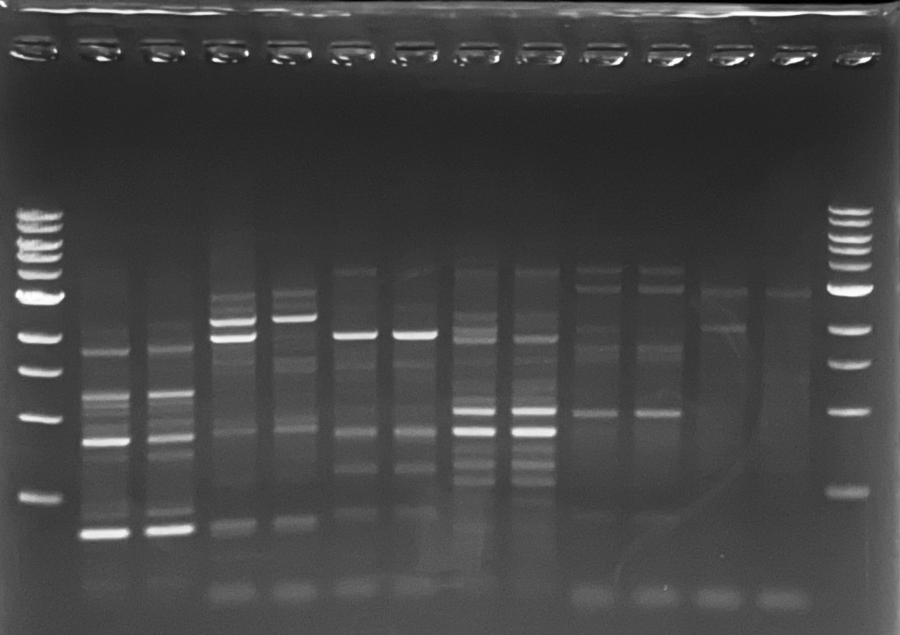
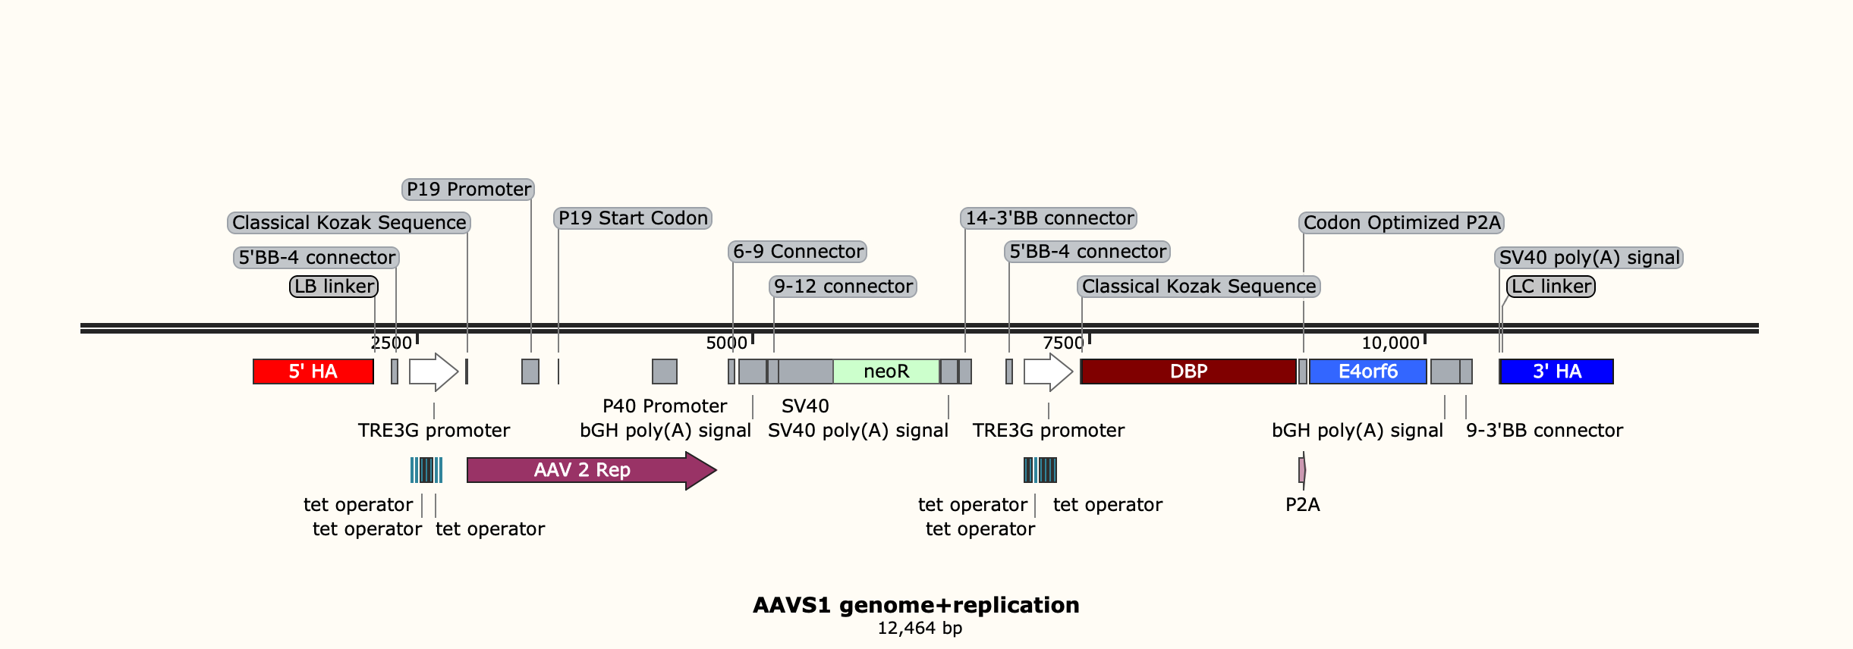
5’ 3’ Junction PCR for stable pool
5’ junc 1928bp
3’ junc 1967bp
5’ junc
3’ junc
3000
2000
1500
Notes:
The same workflow. We need to reassemble the donor plasmid.

Slide 20
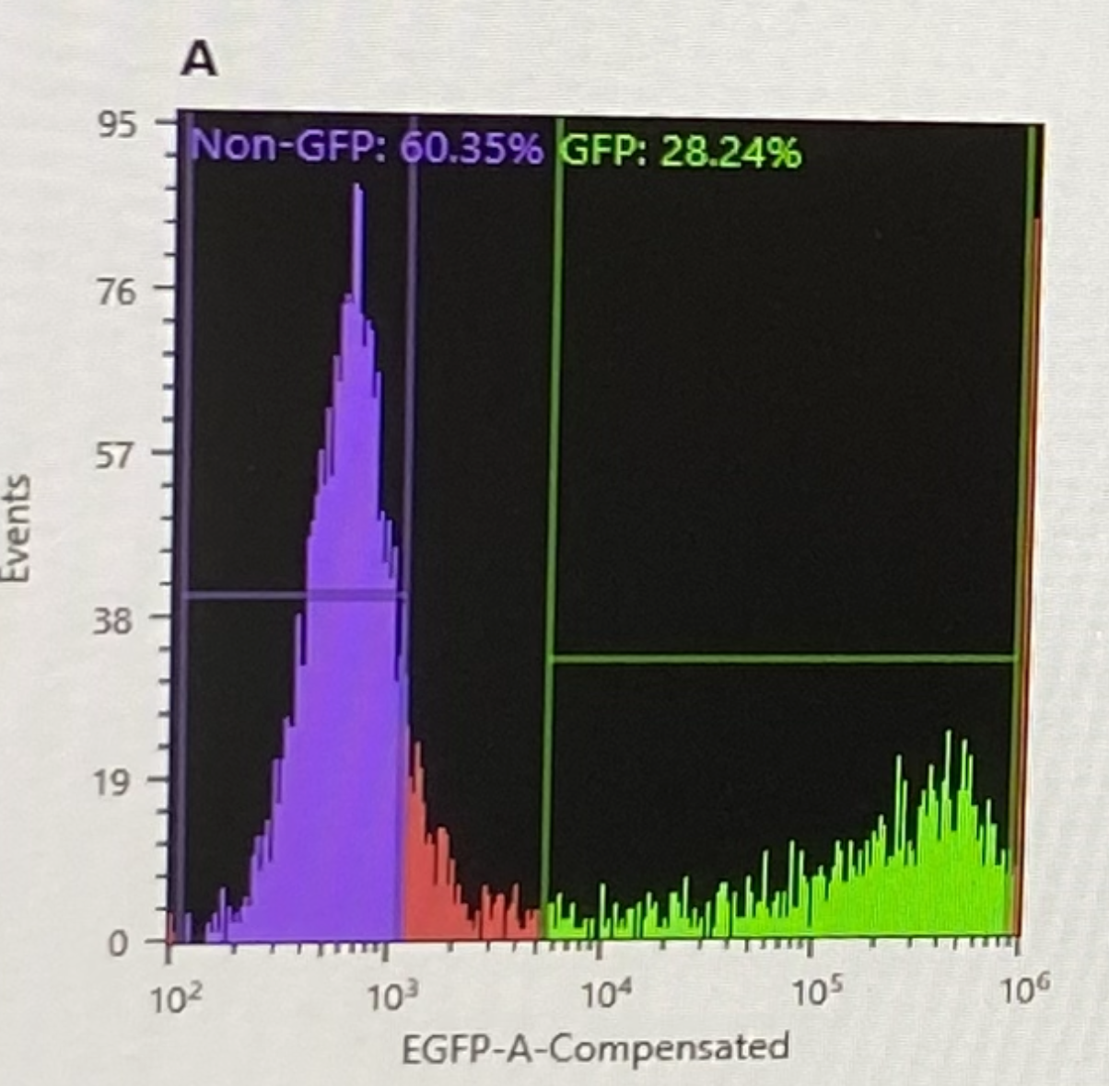
Cell sorting
GFP expression in stable pool
Non-GFP ratio ~70% (SSI)
GFP ratio ~30% (RI)
Cell sorting
Purple part
Issue
Contamination,
  Bleach/IPA wash the tube
  add two antibiotics (e.g. pen/strep) to eliminate bacteria.
Notes:
The same workflow. We need to reassemble the donor plasmid.

Slide 21
Genome copy numbers via qPCR
 | Cq1 | Cq2 | Cq ave
AAVS1_rep68 | 24.82 | 24.75 | 24.78
AAVS1_DBP | 24.68 | 24.64 | 24.66
AAVS1_E4orf6 | 24.83 | 25.12 | 24.98
AAVS1_GAPDH | 22.60 | 22.61 | 22.61
NC_rep68 | 33.10 | 32.76 | 32.93
NC_DBP | 34.39 | 34.33 | 34.36
NC_E4orf6 | 31.52 | 31.21 | 31.37
NC_GAPDH | 22.06 | 22.16 | 22.11
Stable pool
Control, HEK293
40ng gDNA as template for qPCR
Rep68, DBP and E4orf6 in stable pool detected the amplified signals compared to control cells .
Based on the amplified signals from single clones, could obtain the relative genome copy number via 2-△△Ct
Notes:
The same workflow. We need to reassemble the donor plasmid.

Slide 22
Genome copy numbers via qPCR
 | C4 | C5 | C6 | C8 | C9 | C10 | stable pool
Gapdh | 24.60 | 24.02 | 23.77 | 23.98 | 23.80 | 24.36 | 23.98
 | 24.42 | 24.03 | 24.01 | 24.19 | 23.78 | 24.46 | 24.01
ave | 24.51 | 24.03 | 23.89 | 24.09 | 23.79 | 24.41 | 24.00
Rep68/78 | 27.23 | 32.25 | 26.04 | 26.21 | 25.73 | 26.40 | 26.06
 | 27.12 | 32.04 | 26.23 | 26.01 | 25.65 | 26.43 | 26.11
ave | 27.17 | 32.15 | 26.13 | 26.11 | 25.69 | 26.42 | 26.08
deltaT | 2.67 | 8.12 | 2.24 | 2.02 | 1.90 | 2.01 | 2.09
deltadeltaT | 0.00 | 5.45 | -0.43 | -0.64 | -0.76 | -0.66 | -0.58
2-deltadeltaT | 1.00 | 0.02 | 1.34 | 1.56 | 1.70 | 1.58 | 1.49
20ng gDNA as template for qPCR
Select C4 to normalize the gene. Will use TLA/nanopore to select the final standard.
The stable clones, which harbor one copy of the transgene at AAVS1 locus, had values that range from 0.5 to 1.5 based on the qPCR results
Notes:
The same workflow. We need to reassemble the donor plasmid.

Slide 23
Transient other two plasmids for rAAV production in HEK293 cells
6 well plate Transfection conditions
Media working volume | 3mL
Plating Density (total cells) | 5E5
Total DNA amount | 2ug
Plasmid ratio | 1:1
PEI:DNA | 1:1
Cocktail volume | 300 uL
Incubation time | 15min
Cocktail media | OptiMEM
Transfection conditions
Helper+ Rep/Cap+ ITR-GFP
assembly plasmid(tTA)+ ITR-GFP
assembly plasmid(tTA)+ ITR-GFP +500ng/mL Dox
assembly plasmid(tTA)+ ITR-GFP ( with plasmids but no PEI)
HEK293
Condition 1
HEK293
Condition 2
HEK293
Condition 3
HEK293
Condition 4
HEK293
Condition 1
HEK293
Condition 2
HEK293
Condition 3
HEK293
Condition 4
The effective concentration range of Dox is 10-1000ng/mL in mammalian cells based on the literature investigation. (doi:10.1038/sj.mt.6300383) (DOI: 10.1002/jgm.3067)
Notes:
The same workflow. We need to reassemble the donor plasmid.

Slide 24
Site-specific integration strategy
Round 1
Replication cassettes integration
Co-transfect with sgRNA + replication donor plasmid in AAVS1
Round 2
Assembly cassettes integration
Round 3
transgene cassettes integration
Co-transfect with sgRNA + transgene donor plasmid in CCR5
Antibiotic selection
Co-transfect with sgRNA + assembly donor plasmid in ROSA26
Antibiotic selection
Antibiotic selection
Donor plasmids Prep
Intermediate QC checkpoints
5’ 3’ Junction PCR
Transient the third plasmid for rAAV production
Stable cell pool
5’ 3’ Junction PCR
Cell sorting assay
Genome copy number via qPCR
Transient other two plasmids for rAAV production
Cell sorter
SSI pool
Single clone
Junction & copy number
Stable cell pool
RI pool (discard)
SSI pool 2 for Round 3
RI pool (discard)
Stable cell pool
Cell sorter
SSI pool 3

Slide 25
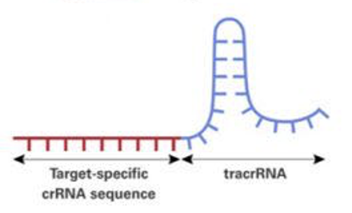
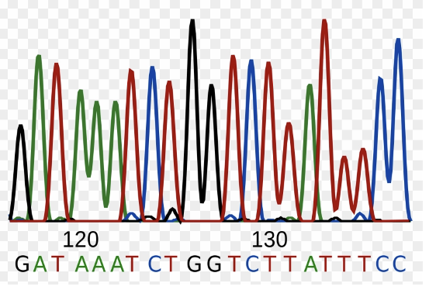
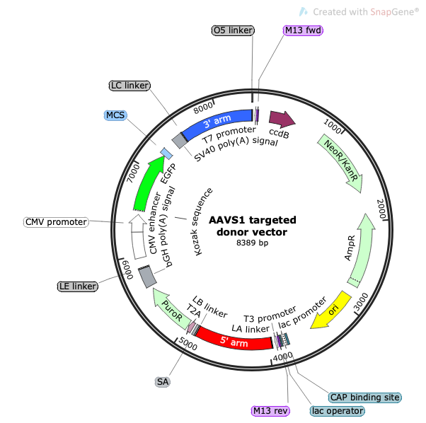
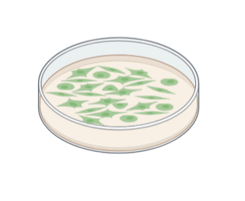
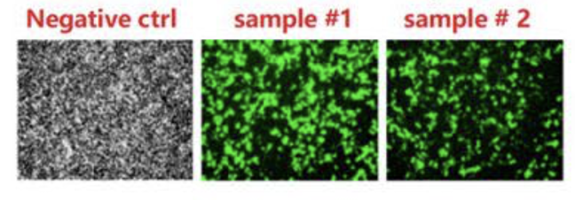
Donor plasmid assembly
sgRNA design
Cloning sgRNA to Cas9 vector
plasmid sequencing
Donor plasmids assembly
Replication plasmid
Assembly plasmid
Transfer plasmid
HEK293 cells transfected with two plasmids & antibiotic selection
Stable cell pool
Notes:
The same workflow. We need to reassemble the donor plasmid.

Slide 26
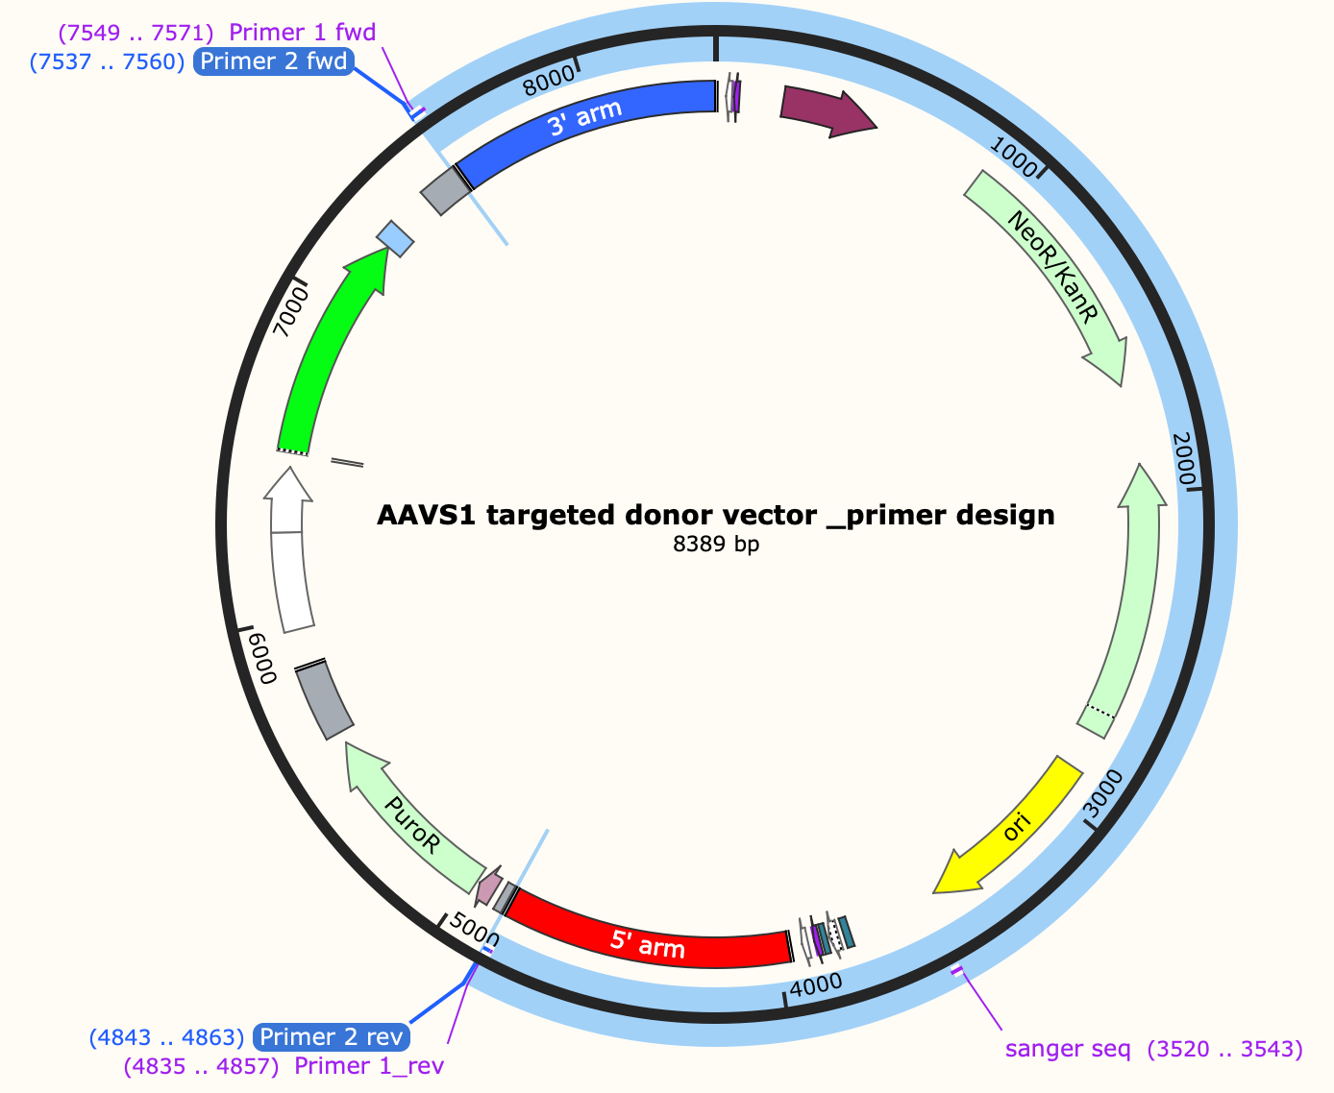
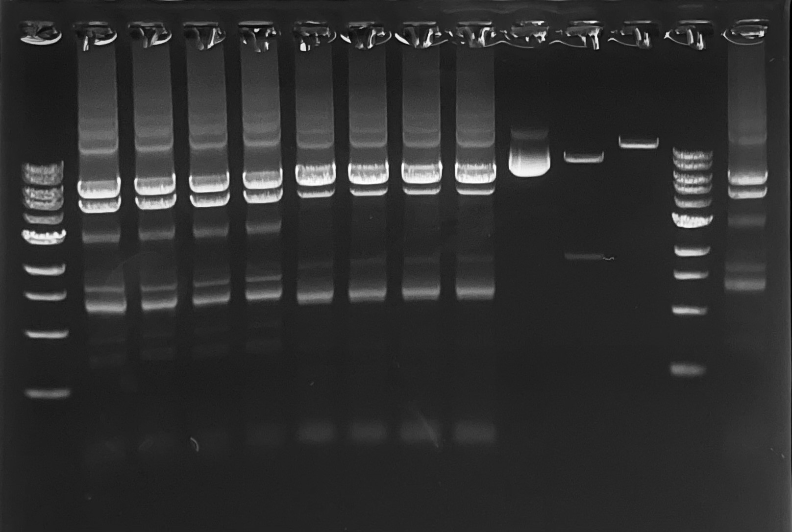
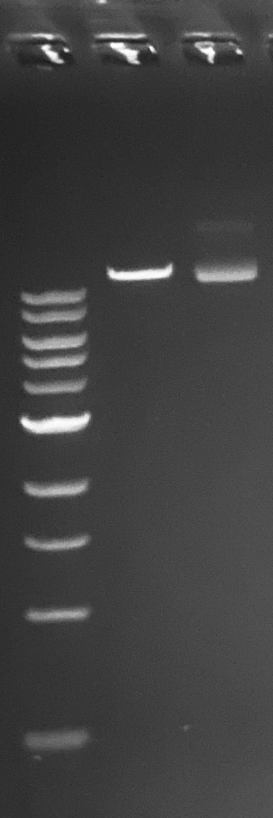
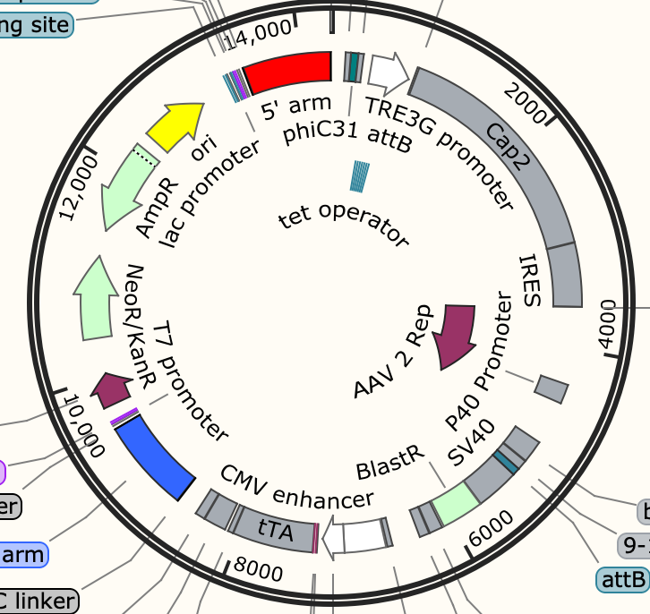
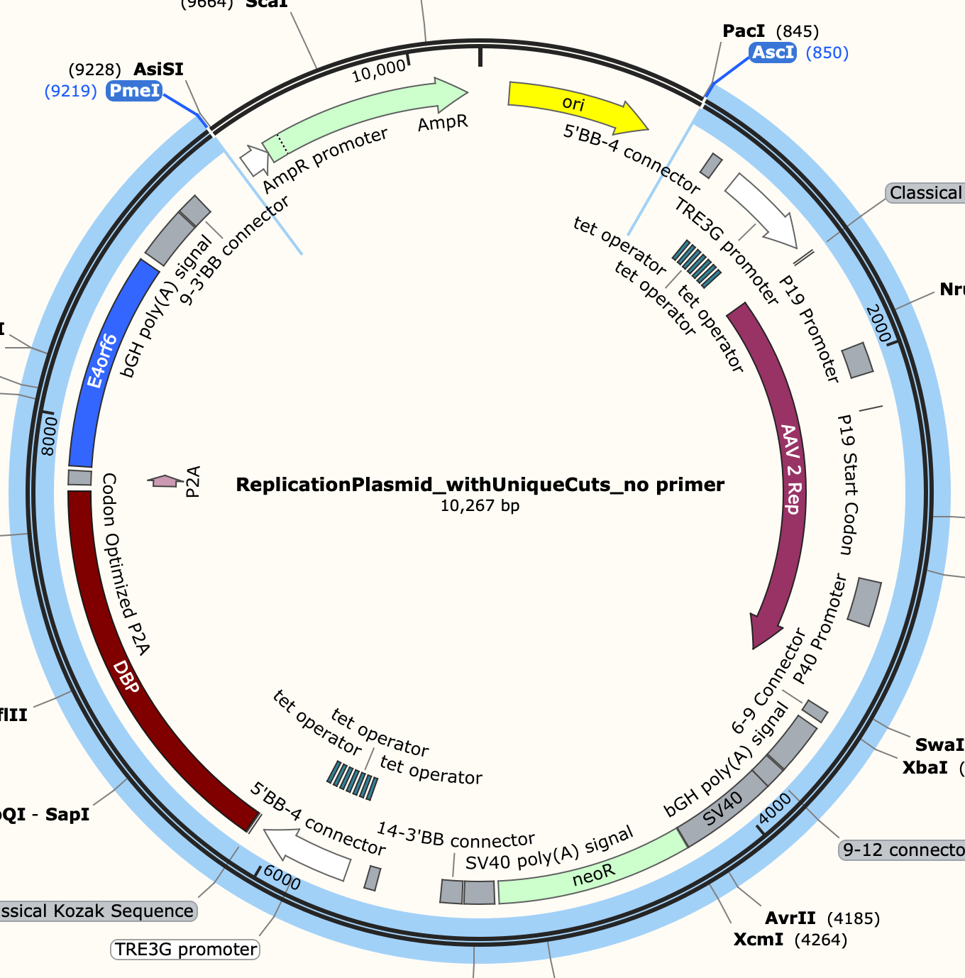
AAV assembly donor plasmid Gibson 1--
Connect assembly and ROSA HA
Part 1 -- PCR，~6000bp
Part 1+ part 2
Aasembly+ ROSA, 14289bp
Gibson
Part 2, PmeI & PacI cut 8641bp

Slide 27
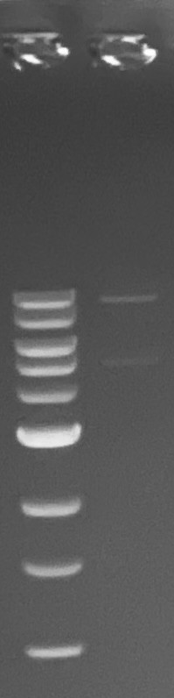
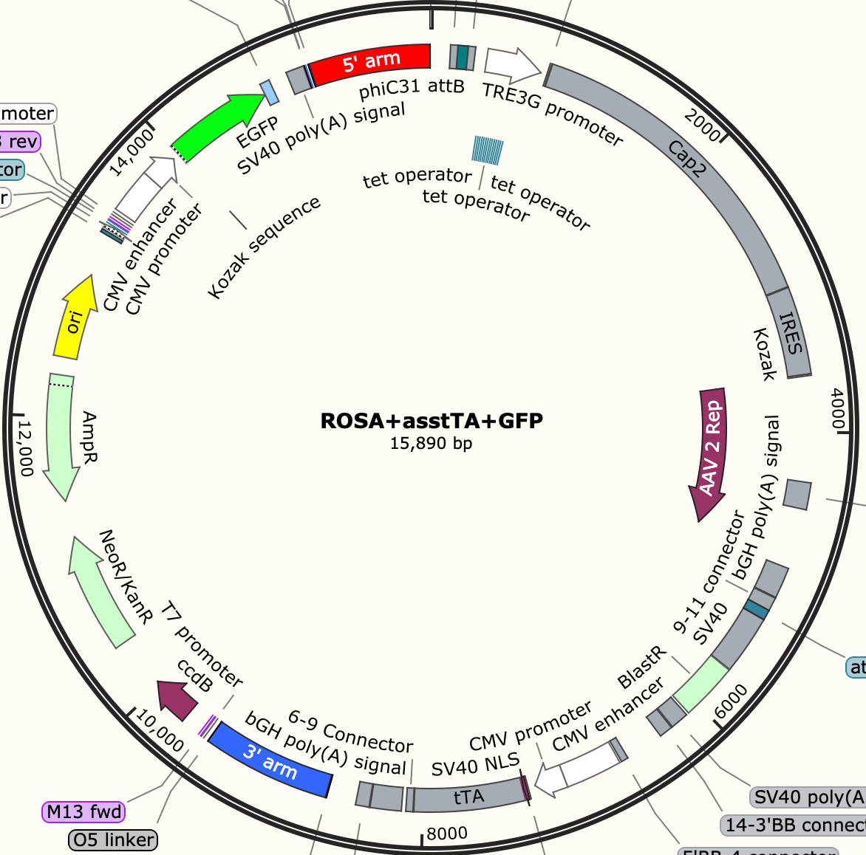
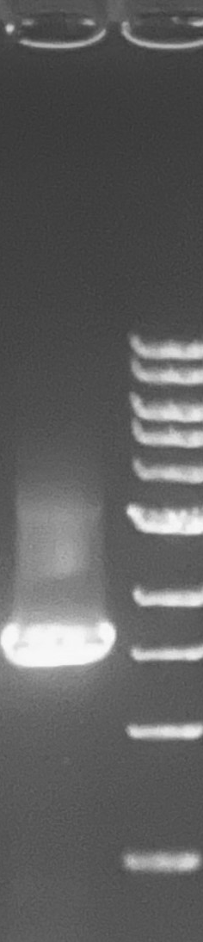
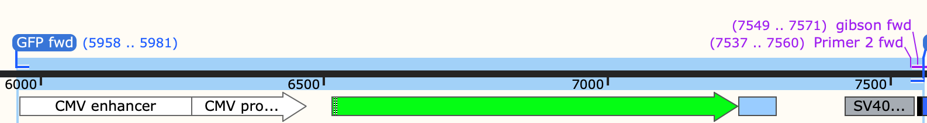
Part 1+ part 2
Aasembly+ ROSA, 14289bp
AAV Assembly donor plasmid Gibson 2--
Connect Assembly+ROSA26HA and GFP(outside HA)
Part 1+ part 2
Assembly + ROSA+GFP, 15890bp
Gibson
Part 2, PCR, 1601bp
10578+5312

Slide 28
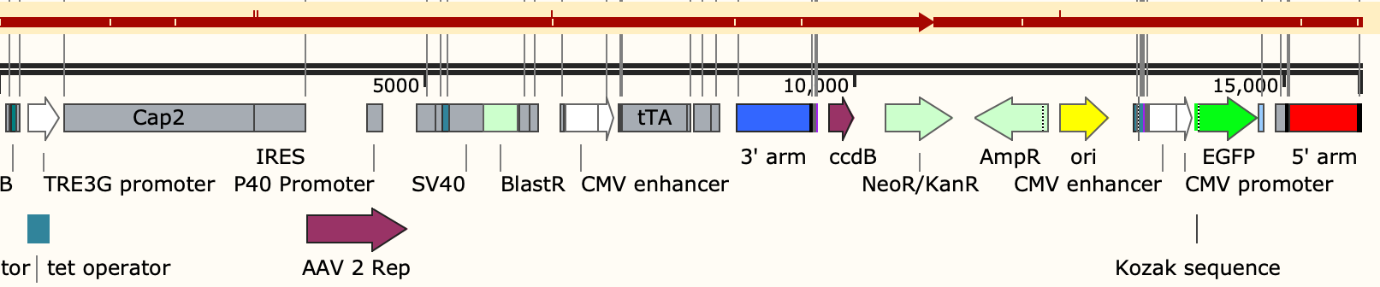
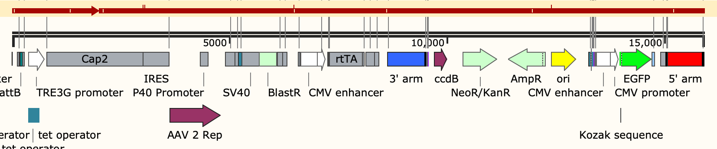
Whole plasmid sequencing
ROSA+tTA assemble+ GFP
Measured seq
Theoretical seq
ROSA+ rtTA assemble+ GFP
Measured seq
Theoretical seq
Notes:
The same workflow. We need to reassemble the donor plasmid.

Slide 29
Stable transfection and antibiotic selection
sgRNA design
Cloning sgRNA to Cas9 vector
plasmid sequencing
Donor plasmids assembly
Replication plasmid
Assembly plasmid
Transfer plasmid
HEK293 cells transfected with two plasmids & antibiotic selection
Stable cell pool
Notes:
The same workflow. We need to reassemble the donor plasmid.

Slide 30
Antibiotic selection
Most of cells dead, ~10 clones survive. cells recover but grow slow
HEK293REP
080523 antibiotic selection
Blasticidin,10ug/mL
Most of cells dead, several clones survive. Cells recover good so far. Better than HEK293REP
293T
Issue, Recovery of antibiotics selection in HEK293 is not good.
  SV40 promoter for Blasticidin didn’t work well, E.g. the blastin Conc. Is too high, and the promoter is weak that cells can’t survive. Udel is doing the CMV promoter blasticidin.
  The leakage of toxic rAAV component, e.g. Rep 68/78, Rep 52/40, Helper gene.
Action
  Set up two antibiotics selection conditions after stable transfection: Blasticidin, 0 ug/mL and 5 ug/mL
0 ug/mL, all good
081223 antibiotic selection
Blasticidin, 0, 5ug/mL
HEK293REP
5 ug/mL, half of cells survive, still ongoing
Notes:
The same workflow. We need to reassemble the donor plasmid.

Slide 31
Next Steps
UML
  Assembly donor plasmid integration and Intermediate QC checkpoints.
UD
  Finish transfer plasmid cloning
    Transient testing of 3 plasmids
  Begin assembly of future promoter variants

Slide 32
Research Sites – Timeline and Milestones
Q1 2023
Design of Tet-on/off inducible circuits (UD)
Crispr-Cas9 platform development and testing AAVS1, CCR5 and ROSA26 loci (UML)
Q2 2023
Tet off/on switch for 2 AAV cassettes via Golden gate. 1, replication plasmid, 2, assembly plasmid(UD)
Q3 2023
Analytical methods (qPCR, Elisa, RT-qPCR, WB, proteomics) (UML/UD)
Testing inducible plasmids via transient (UML/UD)
Q4 2023
2024
Cell line productivity and stability evaluation(UML/UD)
Tet off/on switch for the 3rd AAV cassette via Golden gate, 3, transfer plasmid(UD)
Site-specific integration of the 2nd and 3rd cassette and develop the baseline of stable cells (UML)
Optimized AAV parts integration, The optimized stable cell line(UML)
Optimization of gene level and dynamics by engineered inducible variants, Kozak, and Degron tags (UD)
Site-specific integration of replication cassette made by UD (UML)
Optimization of gene level and dynamics by engineered inducible variants, Kozak, and Degron tags (UD)
Evaluate optimized plasmids via transient(UML/UD)
AAV production bottlenecks investigation(UD/UML)
Other investigations (UML/UD)

