Slide 1
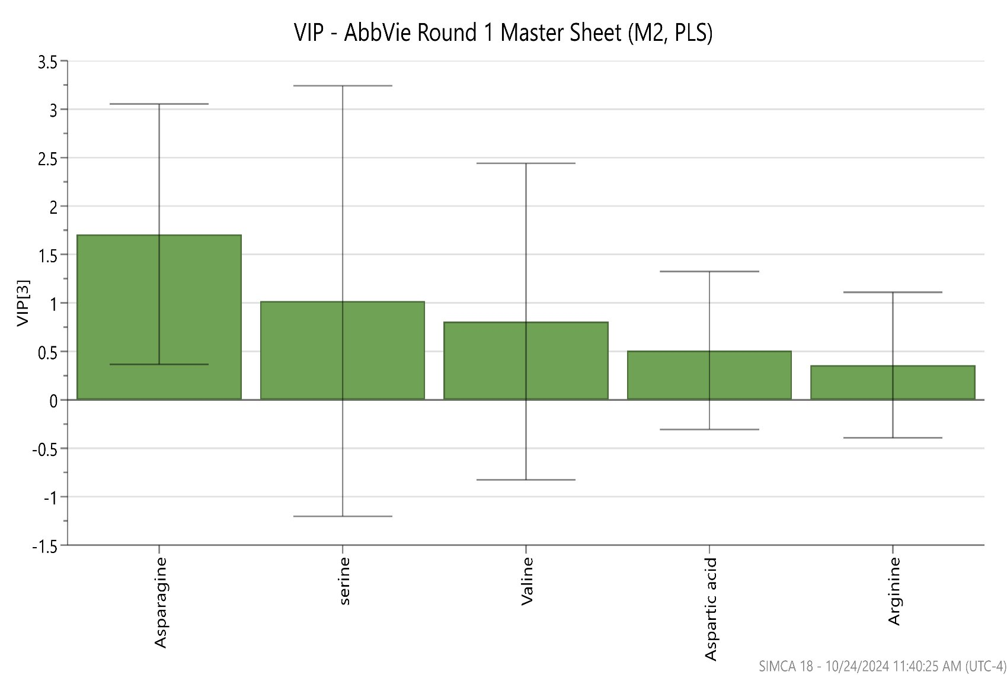
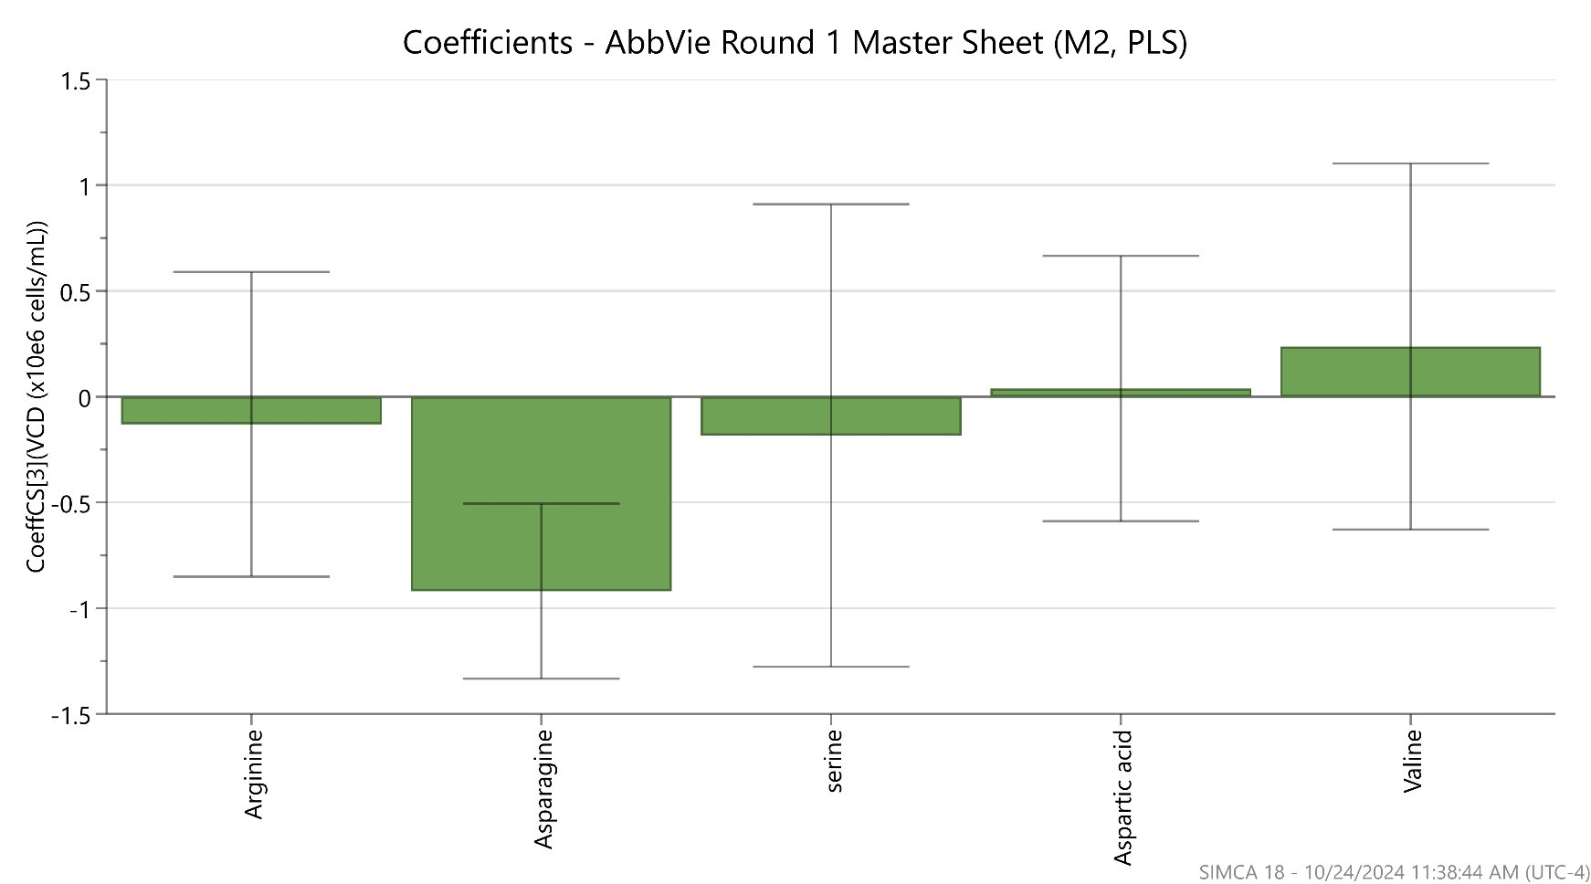
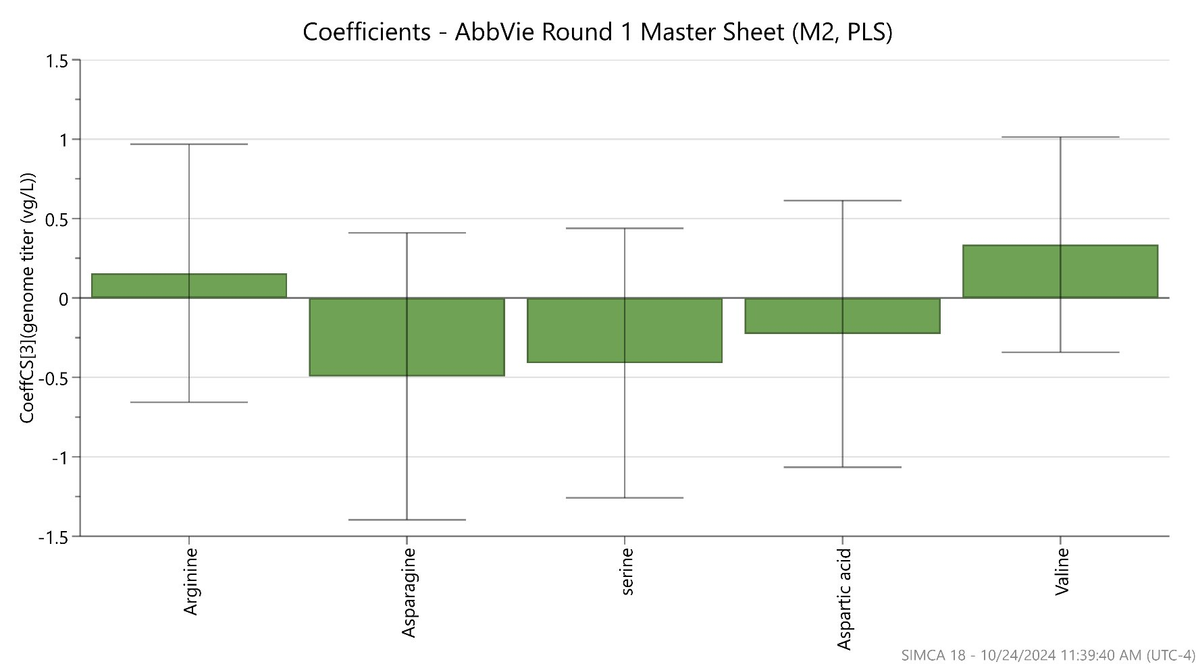
Plackett-Burman design
Genome titer measurement
Std Order | Run Order | PtType | Blocks | Arginine | Asparagine | Serine | Aspartic acid | Valine | cell growth (cells/ml) | genome titer (vg/l)
1 | 1 | 1 | 1 | 5 | 2 | 10 | 2 | 1 | 3.00E+06 | 8.32E+11
2 | 2 | 1 | 1 | 5 | 8 | 2 | 10 | 1 | 4.00E+05 | 1.39E+11
3 | 3 | 1 | 1 | 1 | 8 | 10 | 2 | 4 | 2.00E+05 | 1.39E+11
4 | 4 | 1 | 1 | 5 | 2 | 10 | 10 | 1 | 2.50E+06 | 5.38E+11
5 | 5 | 1 | 1 | 3 | 5 | 6 | 6 | 2.5 | 2.30E+06 | 1.50E+12
6 | 6 | 1 | 1 | 5 | 8 | 2 | 10 | 4 | 1.00E+05 | 1.41E+11
7 | 7 | 1 | 1 | 5 | 8 | 10 | 2 | 4 | 2.00E+05 | 1.43E+11
8 | 8 | 1 | 1 | 1 | 8 | 10 | 10 | 1 | 3.00E+05 | 3.23E+11
9 | 9 | 1 | 1 | 1 | 2 | 10 | 10 | 4 | 4.70E+06 | 4.75E+11
10 | 10 | 1 | 1 | 3 | 5 | 6 | 6 | 2.5 | 2.20E+06 | 2.00E+12
11 | 11 | 1 | 1 | 1 | 2 | 2 | 10 | 4 | 5.80E+06 | 4.00E+12
12 | 12 | 1 | 1 | 5 | 2 | 2 | 2 | 4 | 5.40E+06 | 1.04E+13
13 | 13 | 1 | 1 | 1 | 8 | 2 | 2 | 1 | 1.00E+05 | 1.22E+11
14 | 14 | 1 | 1 | 1 | 2 | 2 | 2 | 1 | 3.90E+06 | 1.78E+12
15 | 15 | 1 | 1 | 3 | 5 | 6 | 6 | 2.5 | 2.10E+06 | 1.02E+12
Five highest genome titer (excluding 3 center points)
  Run 12> Run 11>Run 14>Run 1>Run 4
VIP plot
Coefficients-VCD
Coefficients-genome titer

Slide 2
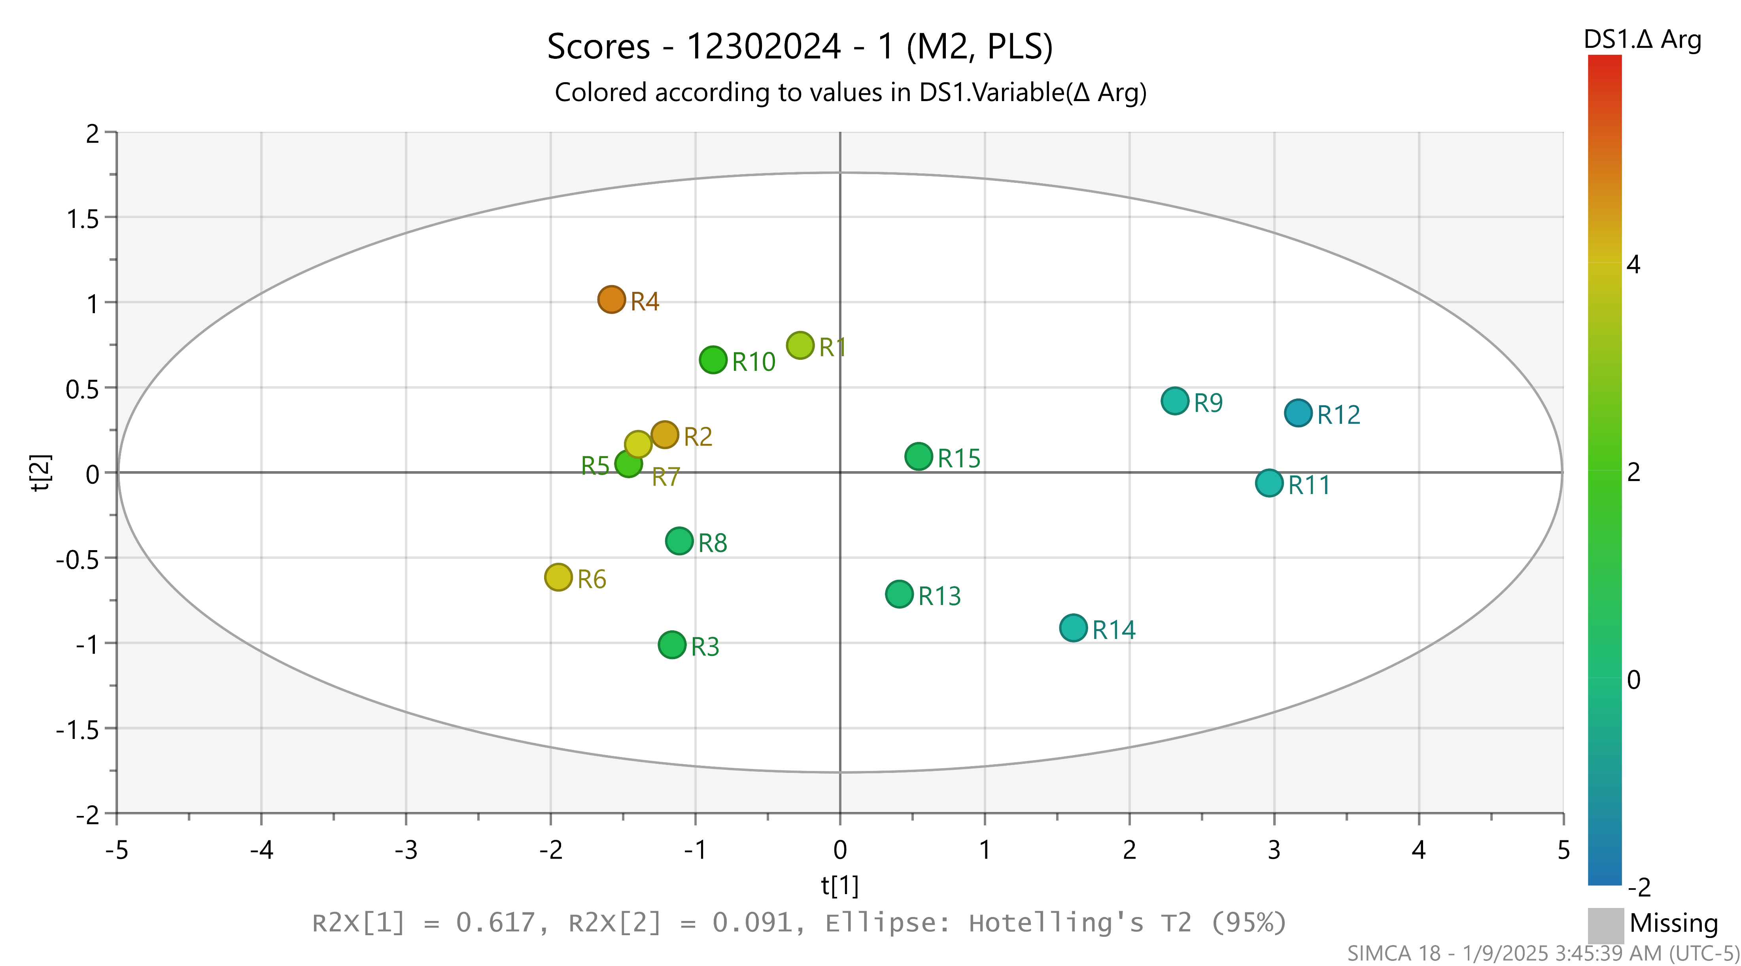
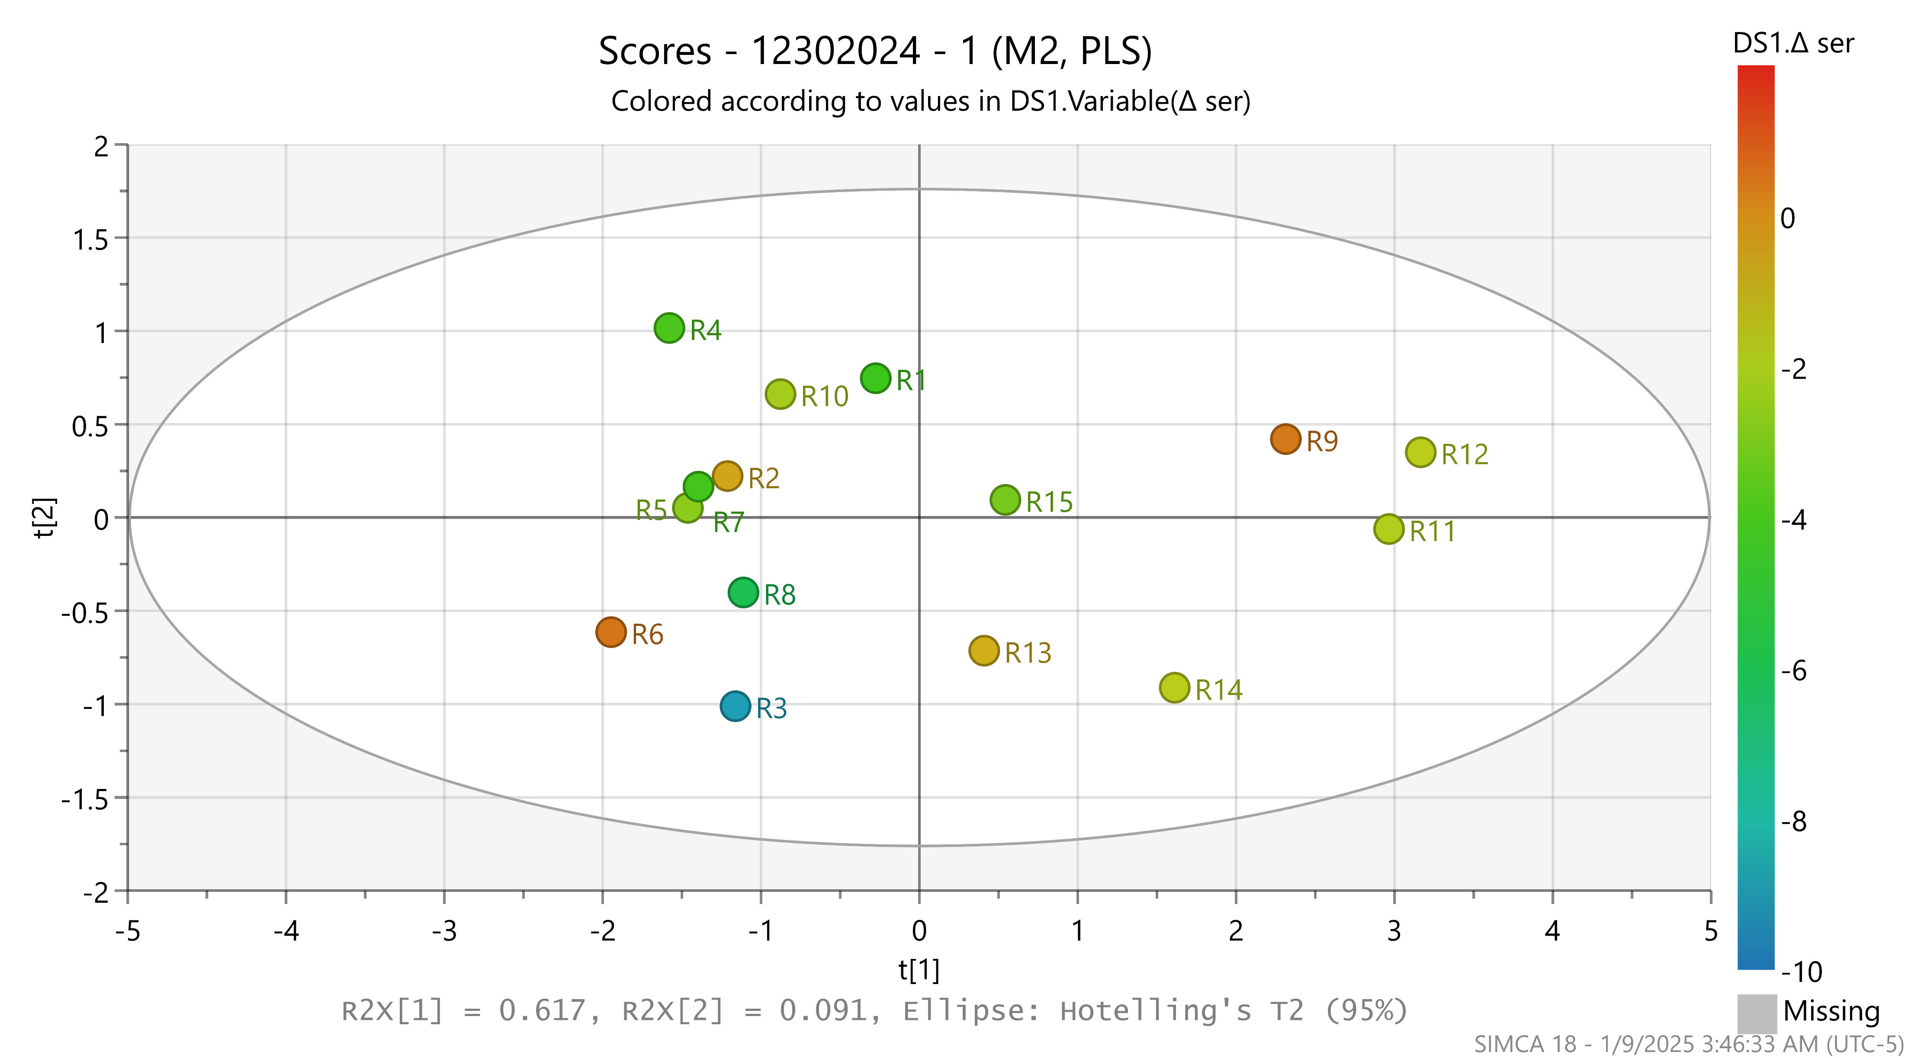
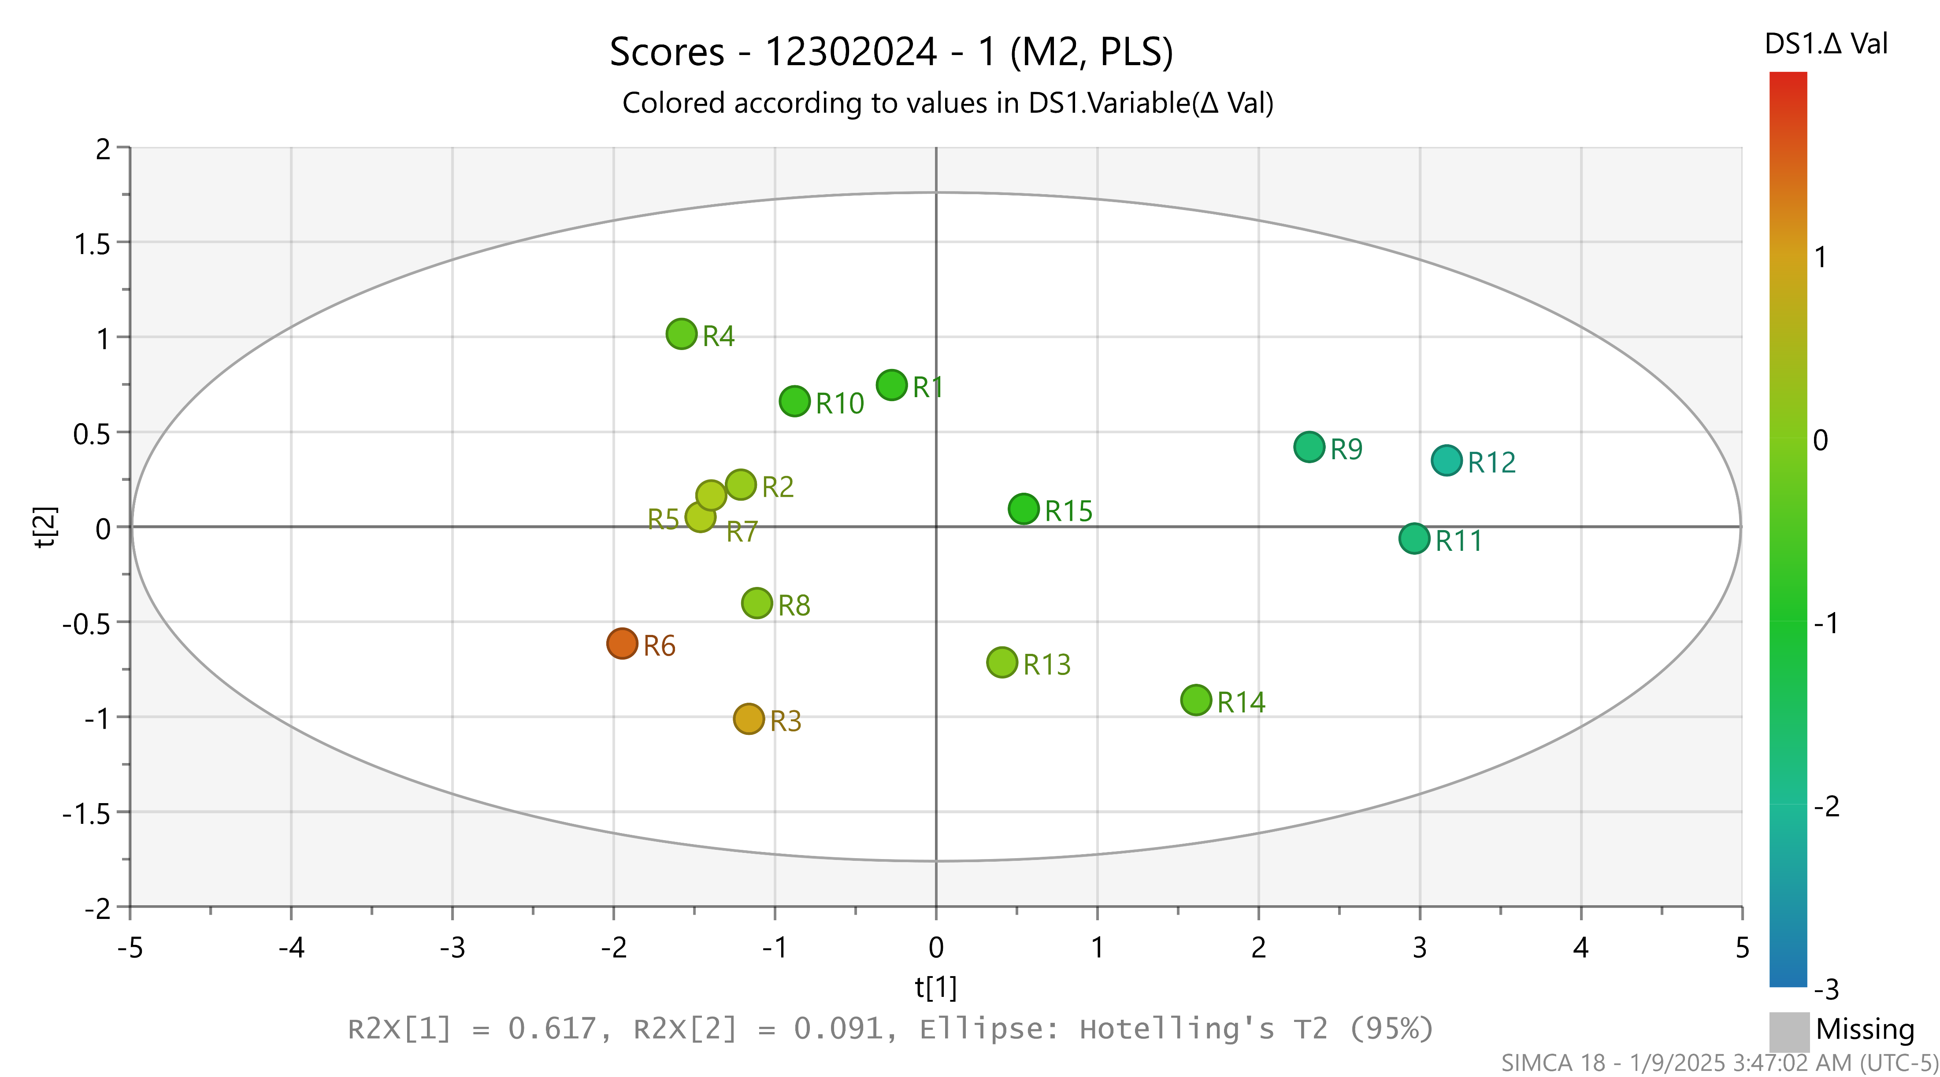
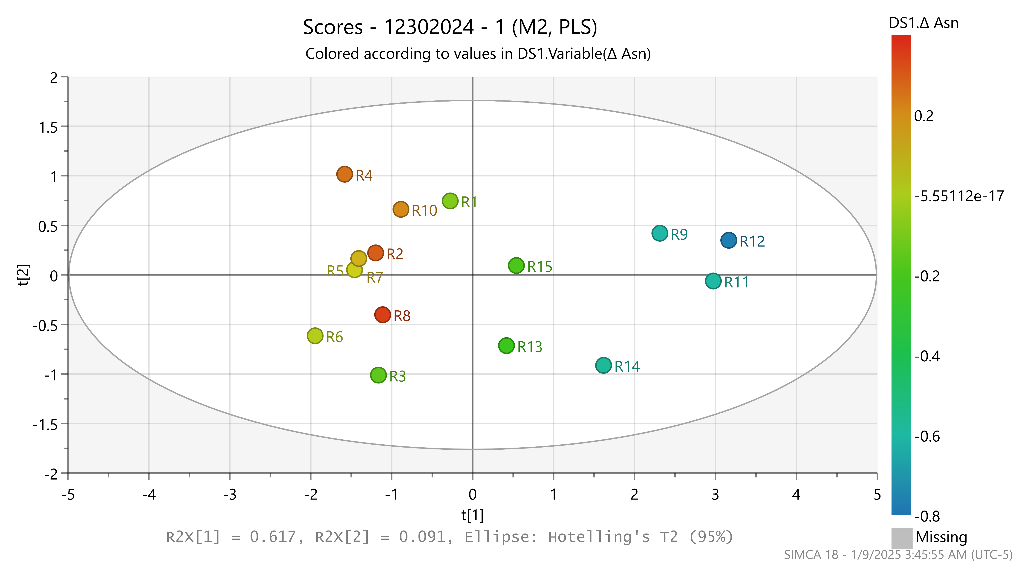
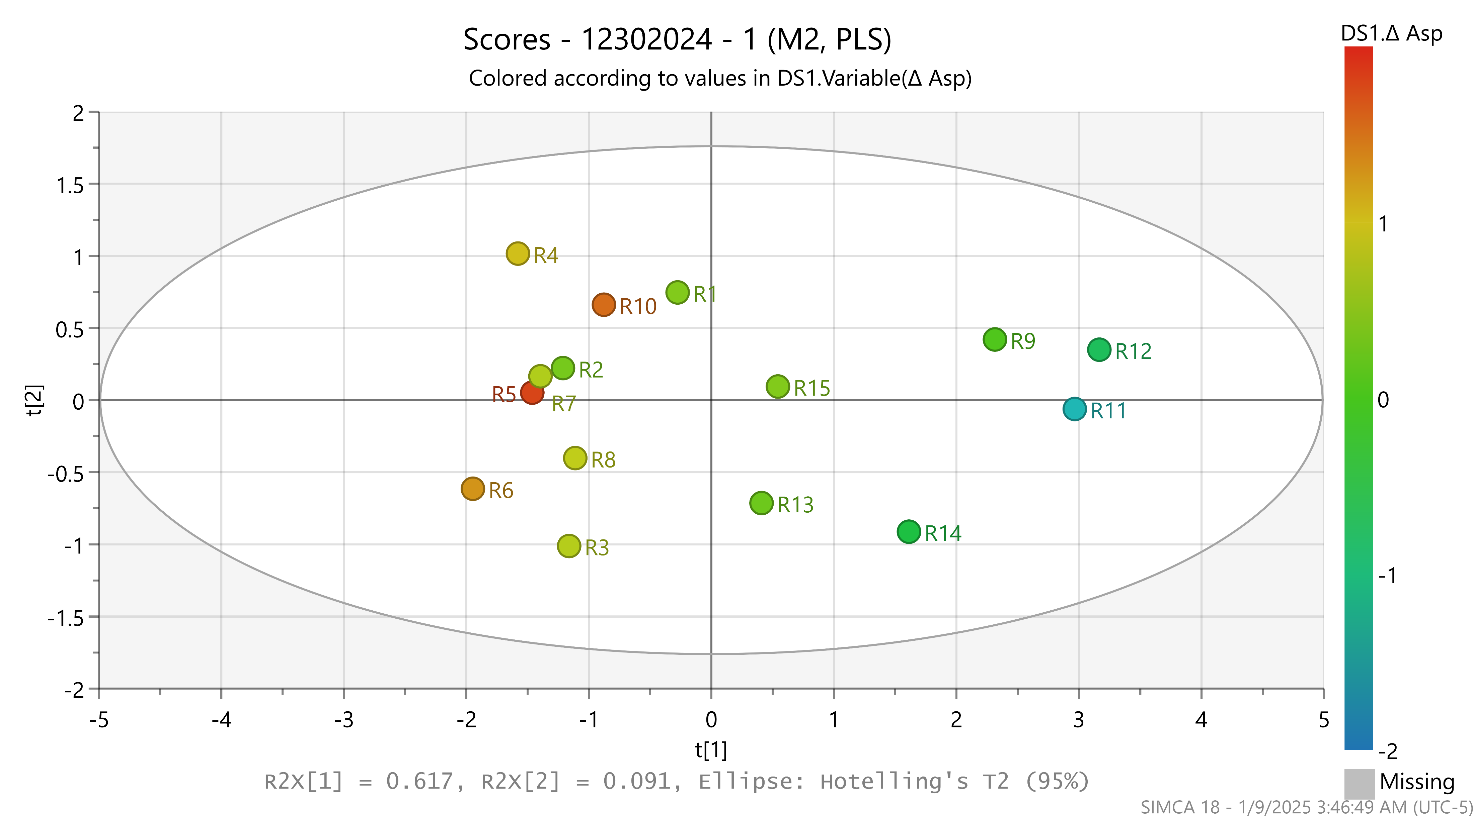
Arginine variation
Serine variation
Valine variation
Asparagine variation
Aspartic acid variation
Top-performing runs:
Depletion of Arg, Asn, Asp, Ser, and Val (efficient uptakes across all 5 amino acids)
Low-titer runs:
Partial amino acid utilization with some inefficiencies in uptakes (accumulation of Arg, Val, and Asp), indicating metabolic bottlenecks.

