Slide 1
Maximizing Yields of rAAV and Elucidating the Role of Media Components Through Design and Optimization of AMBIC.293 Media
David McNally (MassBiologics/UML), Seongkyu Yoon (UML), Mike Betenbaugh/Michael Bevan (JHU), Kelvin Lee (UD)

Slide 2
UML Update
Original AMBIC media preparation
  Adding back additives to the media
Reconstituted AMBIC media preparation based on the Plackett-Burman design
  Adding back the Non-Essential amino acids (NEAAs) and other additives to the media
Cell thaw and passaging in the original media and 15 different reconstituted media
Transfection of AMBIC HEK293 cells for AAV9 production
Genome titer measurement
Next steps

Slide 3
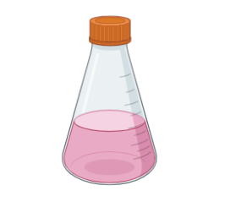
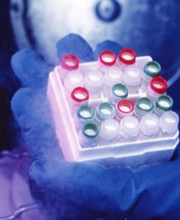
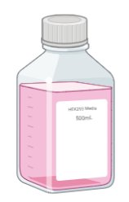
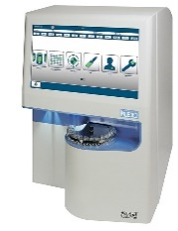
Workflow for DOE Study
Switching from the original media to the reconstituted media
cell thaw and passaging until recovery
P4
3 passages in each of 13 reconstituted media
Transfection of AMBIC HEK293 cells [one shake flask for each condition]
original media
reconstituted media
Checking the cell growth
capsid empty/full ratio
Transduction efficiency
Cell harvest on day 3 post-transfection
qPCR (Taqman)
3 times freeze/thaw for cell lysis
DNA integrity

Slide 4
Original AMBIC Media Preparation
Using for the cell thaw and 4 passaging until recovery
Adding back 5 additives
Osmo adjustment
AMBIC media without 5 additives (Cacl2, CaPanto, FeEDTA, EDTA, and NaCl)
original media
275 mOsm/kg
Adding back 5 additives to the media (Cacl2, CaPanto, FeEDTA, EDTA, and NaCl)
Osmolality adjustment at 275 mOsm/kg by adding NaCl
Filtration of the media (original media)

Slide 5
Cell Growth in the Original AMBIC Media

Slide 6
Plackett-Burman Design Review
Std Order | Run Order | PtType | Blocks | Arginine | Asparagine | Serine | Aspartic acid | Valine | cell growth | genome titer | Transduction efficiency | Empty/full Capsid ratio | DNA integrity
1 | 1 | 1 | 1 | 5 | 2 | 10 | 2 | 1
2 | 2 | 1 | 1 | 5 | 8 | 2 | 10 | 1
3 | 3 | 1 | 1 | 1 | 8 | 10 | 2 | 4
4 | 4 | 1 | 1 | 5 | 2 | 10 | 10 | 1
5 | 5 | 1 | 1 | 3 | 5 | 6 | 6 | 2.5
6 | 6 | 1 | 1 | 5 | 8 | 2 | 10 | 4
7 | 7 | 1 | 1 | 5 | 8 | 10 | 2 | 4
8 | 8 | 1 | 1 | 1 | 8 | 10 | 10 | 1
9 | 9 | 1 | 1 | 1 | 2 | 10 | 10 | 4
10 | 10 | 1 | 1 | 3 | 5 | 6 | 6 | 2.5
11 | 11 | 1 | 1 | 1 | 2 | 2 | 10 | 4
12 | 12 | 1 | 1 | 5 | 2 | 2 | 2 | 4
13 | 13 | 1 | 1 | 1 | 8 | 2 | 2 | 1
14 | 14 | 1 | 1 | 1 | 2 | 2 | 2 | 1
15 | 15 | 1 | 1 | 3 | 5 | 6 | 6 | 2.5
Input: NEAA conc
Output (response): cell growth and productivity, transduction efficiency, capsid empty/full ratio, DNA integrity
Range: 2X Formulation; 0.5X Formulation
Plackett-Burman design
5 factors
12 runs + 3 center points runs 15 total runs
1 block

Slide 7
Workflow for DOE Study
Switching from the original media to the reconstituted media
cell thaw and passaging until recovery
P4
3 passages in each of 13 reconstituted media
Transfection of AMBIC HEK293 cells [one shake flask for each condition]
original media
reconstituted media
Checking the cell growth
capsid empty/full ratio
Transduction efficiency
Cell harvest on day 3 post-transfection
qPCR (Taqman)
3 times freeze/thaw for cell lysis
DNA integrity

Slide 8
Reconstituted AMBIC Media Preparation
Adding back 5 additives
Adding back 5 NEAAs
13 different media formulations with their distinct NEAAs concentrations based on the DOE
AMBIC media without 5 additives (Cacl2, CaPanto, FeEDTA, EDTA, and NaCl) and 5 NEAAs (Arg, Asn, Asp, Ser, Val)
Reconstituted media
Using Sigma-Aldrich amino acid standards (Arg, Asp, Asn, Ser, and Val).​
MilliQ water for dissolving the amino acids.
0.22 µm filtration of amino acid solutions.
Adding the filtered amino acid solutions and additives to the deleted media (Cacl2, CaPanto, FeEDTA, EDTA, and NaCl)
Osmolality adjustment by adding NaCl
Filtration of the media post reconstitution with amino acids and additives

Slide 9
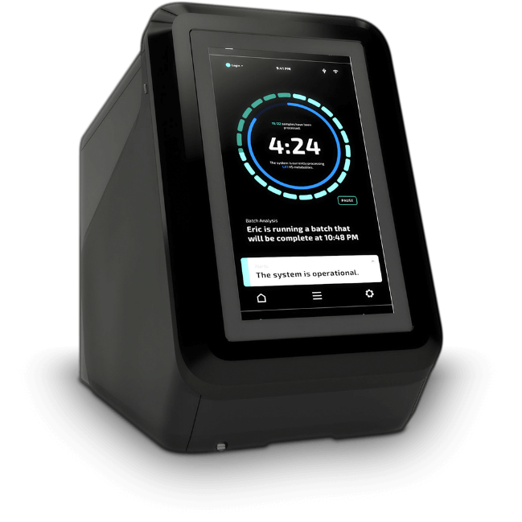
The NEAAs measurement by REBEL
  Checking the consistency between the 13 prepared reconstituted media formulations and Plackett-Burman design prior to execution
13 different media formulations with their distinct NEAAs concentrations based on the prepared DOE
Reconstituted media
NEAAs measurement

Slide 10
The NEAAs measurement by REBEL – Good Alignment
(theoretical vs. measured values)
Run 3
Run 1
Run 2
Run 5
Run 6
Run 4

Slide 11
The NEAAs measurement by REBEL - Good Alignment
(theoretical vs. measured values)
Run 7
Run 8
Run 9
Run 10
Run 11
Run 12

Slide 12
The NEAAs measurement by REBEL - Good Alignment
(theoretical vs. measured values)
Run 13
Run 14
Run 15

Slide 13
Workflow for DOE Study
Switching from the original media to the reconstituted media
cell thaw and passaging until recovery
P4
3 passages in each of 13 reconstituted media
Transfection of AMBIC HEK293 cells [one shake flask for each condition]
original media
reconstituted media
Checking the cell growth
capsid empty/full ratio
Transduction efficiency
Cell harvest on day 3 post-transfection
qPCR (Taqman)
3 times freeze/thaw for cell lysis
DNA integrity

Slide 14
HEK293 Cell Growth in the original media
Seeding density: 0.3E6 cells/mL
In the original media: D0 D1 D2 D3 D4 (4.8-5E6 cells/mL)
(3-3.5E6 cells/mL)
μ growth in the original media is ≈ 0.57 – 0.6 !
Expected VCD
*2
*2
*2
*2
Actual VCD

Slide 15
Cell Growth in the Reconstituted AMBIC Media
Cells with poor growth following transition (μ growth is 0.4 or below)
Run # | Seeding density (cells/mL) | Peak VCD (cells/mL) | Viability (%) | μ growth
1 | 0.3 E6 | 2.44E+06 | 88.3 | 0.39
2 | 0.3 E6 | 2.33E+06 | 84.1 | 0.37
6 | 0.3 E6 | 1.40E+06 | 75 | 0.39
7 | 0.3 E6 | 1.37E+06 | 72 | 0.21
12 | 0.3 E6 | 4.98E+06 | 99 | 0.40
15 | 0.3 E6 | 2.70E+06 | 92.1 | 0.30

Slide 16
Cell Growth in the Reconstituted AMBIC Media
Cells with poor growth following transition
Run 1
Run 2
Run 6
No recovery
Run 12
Run 15
Run 7

Slide 17
Cell Growth in the Reconstituted AMBIC Media
Cells with moderate growth following transition (μ growth is between 0.4 and 0.5)
Run # | Seeding density (cells/mL) | Peak VCD (cells/mL) | Viability (%) | μ growth
3 | 0.3 E6 | 2.43E+06 | 93 | 0.45
4 | 0.3 E6 | 2E+06 | 96 | 0.47
5 | 0.3 E6 | 1.78E+06 | 93.2 | 0.45
9 | 0.3 E6 | 3.79E+06 | 96 | 0.47
10 | 0.3 E6 | 1.78E+06 | 93.2 | 0.45
13 | 0.3 E6 | 1.8E+06 | 83 | 0.45
8 | 0.3 E6 | 3.5E+06 | 86 | 0.47

Slide 18
Cell Growth in the Reconstituted AMBIC Media
Cells with moderate growth following transition
Run 3
Run 4
Run 5
Run 8
Run 13
Run 9
Run 10

Slide 19
Cell Growth in the Reconstituted AMBIC Media
Cells with good growth following transition (μ growth is above 0.5)
Run # | Seeding density (cells/mL) | Peak VCD (cells/mL) | Viability (%) | μ growth
11 | 0.3 E6 | 4.93E+06 | 98 | 0.63
14 | 0.3 E6 | 3.2E+06 | 99 | 0.59

Slide 20
Cell Growth in the Reconstituted AMBIC Media
Cells with good growth following transition
Run 11
Run 14

Slide 21
Transfection of AMBIC HEK293 cells (AAV9)
Optimized transfection condition for AAV-9
Transfection variables | AMBIC media verification condition
PEI:DNA | 1:1
Cell density | 4E6 Cells/mL
pHelper: pGOI | 2.6
pHelper: pRepCap | 0.2
DNA amount | 1.0 pg/cell
Cocktail volume | 3 mL
Incubation time | 7 min

Slide 22
Decrease in VCD Post-transfection
Blue : VCD
Orange : viability

Slide 23
Decrease in Cell growth and Viability Post-transfection
Blue : VCD
Orange : viability

Slide 24
Increase in VCD Post-transfection
Blue : VCD
Orange : viability

Slide 25
Increase in VCD Post-transfection (cont.)
Blue : VCD
Orange : viability

Slide 26
Cell growth (post-transfection)
Decrease in VCD during transfection: SF13, SF3, SF6, SF7, SF2, SF8
5 highest VCDs on D3-post transfection: SF11, SF12, SF9, SF14, SF1

Slide 27
Genome titer measurement
Five highest genome titer (excluding 3 center points runs)
  Run 12> Run 11>Run 14>Run 1>Run 4
Center points are indicated with arrow

Slide 28
Next steps
Data analysis (SIMCA)
Capsid titer
Transduction efficiency
Share samples with UD for analysis

