Slide 1
Maximizing Yields of rAAV and Elucidating the Role of Media Components Through Design and Optimization of AMBIC.293 Media
David McNally (MassBiologics/UML), Seongkyu Yoon (UML), Mike Betenbaugh/Michael Bevan (JHU), Kelvin Lee (UD)

Slide 2
UML Update
Original AMBIC media preparation
  Adding back the additives to the media
Reconstituted AMBIC media preparation based on the Plackett-Burman design
  Adding back the Non-Essential amino acids (NEAAs) and additives to the media
Cell thaw and passaging in the original media and 15 different reconstituted media
Cell expansion for transfection
Next steps

Slide 3
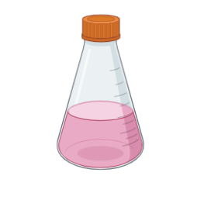
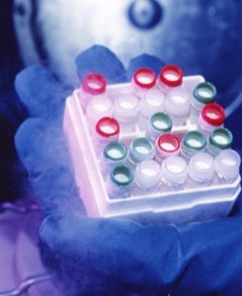
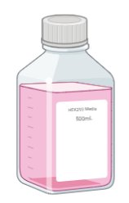
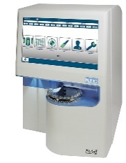
Workflow for DOE Study
Switching from the original media to the reconstituted media
cell thaw and passaging until recovery
P4
3 passages in each of 13 reconstituted media
Transfection of AMBIC HEK293 cells [one shake flask for each condition]
original media
reconstituted media
Checking the cell growth
capsid empty/full ratio
Transduction efficiency
Cell harvest on day 3 post-transfection
qPCR (Taqman)
3 times freeze/thaw for cell lysis
DNA integrity

Slide 4
Original AMBIC Media Preparation
Using for the cell thaw and 4 passaging until recovery
Adding back 5 additives
Osmo adjustment
AMBIC media without 5 additives (Cacl2, CaPanto, FeEDTA, EDTA, and NaCl)
original media
275 mOsm/kg
Adding back 5 additives to the media (Cacl2, CaPanto, FeEDTA, EDTA, and NaCl)
Osmolality adjustment at 275 mOsm/kg by adding NaCl
Filtration of the media (original media)

Slide 5
Cell Growth in the Original AMBIC Media

Slide 6
Plackett-Burman Design Review
Std Order | Run Order | PtType | Blocks | Arginine | Asparagine | Serine | Aspartic acid | Valine | cell growth | genome titer | Transduction efficiency | Empty/full Capsid ratio | DNA integrity
1 | 1 | 1 | 1 | 5 | 2 | 10 | 2 | 1
2 | 2 | 1 | 1 | 5 | 8 | 2 | 10 | 1
3 | 3 | 1 | 1 | 1 | 8 | 10 | 2 | 4
4 | 4 | 1 | 1 | 5 | 2 | 10 | 10 | 1
5 | 5 | 1 | 1 | 3 | 5 | 6 | 6 | 2.5
6 | 6 | 1 | 1 | 5 | 8 | 2 | 10 | 4
7 | 7 | 1 | 1 | 5 | 8 | 10 | 2 | 4
8 | 8 | 1 | 1 | 1 | 8 | 10 | 10 | 1
9 | 9 | 1 | 1 | 1 | 2 | 10 | 10 | 4
10 | 10 | 1 | 1 | 3 | 5 | 6 | 6 | 2.5
11 | 11 | 1 | 1 | 1 | 2 | 2 | 10 | 4
12 | 12 | 1 | 1 | 5 | 2 | 2 | 2 | 4
13 | 13 | 1 | 1 | 1 | 8 | 2 | 2 | 1
14 | 14 | 1 | 1 | 1 | 2 | 2 | 2 | 1
15 | 15 | 1 | 1 | 3 | 5 | 6 | 6 | 2.5
Input: NEAA conc
Output (response): cell growth and productivity, transduction efficiency, capsid empty/full ratio, DNA integrity
Range: 2X Formulation; 0.5X Formulation
Plackett-Burman design
5 factors
12 runs + 3 center points runs 15 total runs
1 block

Slide 7
Workflow for DOE Study
Switching from the original media to the reconstituted media
cell thaw and passaging until recovery
P4
3 passages in each of 13 reconstituted media
Transfection of AMBIC HEK293 cells [one shake flask for each condition]
original media
reconstituted media
Checking the cell growth
capsid empty/full ratio
Transduction efficiency
Cell harvest on day 3 post-transfection
qPCR (Taqman)
3 times freeze/thaw for cell lysis
DNA integrity

Slide 8
Reconstituted AMBIC Media Preparation
Adding back 5 additives
Adding back 5 NEAAs
13 different media formulations with their distinct NEAAs concentrations based on the DOE
AMBIC media without 5 additives (Cacl2, CaPanto, FeEDTA, EDTA, and NaCl) and 5 NEAAs (Arg, Asn, Asp, Ser, Val)
Reconstituted media
Using Sigma-Aldrich amino acid standards (Arg, Asp, Asn, Ser, and Val).​
MilliQ water for dissolving the amino acids.
0.22 µm filtration of amino acid solutions.
Adding the filtered amino acid solutions and additives to the deleted media (Cacl2, CaPanto, FeEDTA, EDTA, and NaCl)
Osmolality adjustment by adding NaCl
Filtration of the media post reconstitution with amino acids and additives

Slide 9
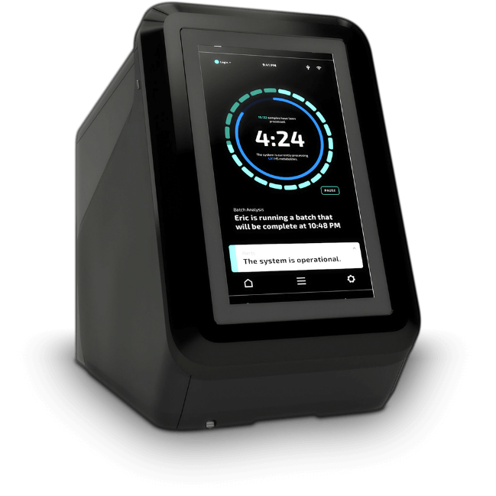
The NEAAs measurement by REBEL
  Checking the consistency between the 13 prepared reconstituted media formulations and Plackett-Burman design prior to execution
13 different media formulations with their distinct NEAAs concentrations based on the prepared DOE
Reconstituted media
NEAAs measurement

Slide 10
The NEAAs measurement by REBEL – Good Alignment
(theoretical vs. measured values)
Run 3
Run 1
Run 2
Run 5
Run 6
Run 4

Slide 11
The NEAAs measurement by REBEL - Good Alignment
(theoretical vs. measured values)
Run 7
Run 8
Run 9
Run 10
Run 11
Run 12

Slide 12
The NEAAs measurement by REBEL - Good Alignment
(theoretical vs. measured values)
Run 13
Run 14
Run 15

Slide 13
Workflow for DOE Study
Switching from the original media to the reconstituted media
cell thaw and passaging until recovery
P4
3 passages in each of 13 reconstituted media
Transfection of AMBIC HEK293 cells [one shake flask for each condition]
original media
reconstituted media
Checking the cell growth
capsid empty/full ratio
Transduction efficiency
Cell harvest on day 3 post-transfection
qPCR (Taqman)
3 times freeze/thaw for cell lysis
DNA integrity

Slide 14
HEK293 Cell Growth in the original media
Seeding density: 0.3E6 cells/mL
In the original media: D0 D1 D2 D3 D4 (4.8-5E6 cells/mL)
(3-3.5E6 cells/mL)
μ growth in the original media is ≈ 0.57 – 0.6 !
Expected VCD
*2
*2
*2
*2
Actual VCD

Slide 15
Cell Growth in the Reconstituted AMBIC Media
Cells with poor growth following transition (μ growth is 0.4 or below)
Run # | Seeding density (cells/mL) | Peak VCD (cells/mL) | Viability (%) | μ growth
1 | 0.3 E6 | 2.44E+06 | 88.3 | 0.39
2 | 0.3 E6 | 2.33E+06 | 84.1 | 0.37
6 | 0.3 E6 | 1.40E+06 | 75 | 0.39
7 | 0.3 E6 | 1.37E+06 | 72 | 0.21
12 | 0.3 E6 | 4.98E+06 | 99 | 0.40
15 | 0.3 E6 | 2.70E+06 | 92.1 | 0.30

Slide 16
Cell Growth in the Reconstituted AMBIC Media
Cells with poor growth following transition
Run 1
Run 2
Run 6
No recovery
Run 12
Run 15
Run 7

Slide 17
Cell Growth in the Reconstituted AMBIC Media
Cells with moderate growth following transition (μ growth is between 0.4 and 0.5)
Run # | Seeding density (cells/mL) | Peak VCD (cells/mL) | Viability (%) | μ growth
3 | 0.3 E6 | 2.43E+06 | 93 | 0.45
4 | 0.3 E6 | 2E+06 | 96 | 0.47
5 | 0.3 E6 | 1.78E+06 | 93.2 | 0.45
9 | 0.3 E6 | 3.79E+06 | 96 | 0.47
10 | 0.3 E6 | 1.78E+06 | 93.2 | 0.45
13 | 0.3 E6 | 1.8E+06 | 83 | 0.45
8 | 0.3 E6 | 3.5E+06 | 86 | 0.47

Slide 18
Cell Growth in the Reconstituted AMBIC Media
Cells with moderate growth following transition
Run 3
Run 4
Run 5
Run 8
Run 13
Run 9
Run 10

Slide 19
Cell Growth in the Reconstituted AMBIC Media
Cells with good growth following transition (μ growth is above 0.5)
Run # | Seeding density (cells/mL) | Peak VCD (cells/mL) | Viability (%) | μ growth
11 | 0.3 E6 | 4.93E+06 | 98 | 0.63
14 | 0.3 E6 | 3.2E+06 | 99 | 0.59

Slide 20
Cell Growth in the Reconstituted AMBIC Media
Cells with good growth following transition
Run 11
Run 14

Slide 21
Question
Should we transfect the cells with poor growth following transition?

Slide 22
Next steps
Transfection of AMBIC HEK293 cells
Cell harvest
Genome titer measurement
Capsid titer
Transduction efficiency

Slide 23
JHU Overview
Recovering AMBIC HEK293 cell line at JHU site
Material preparation for DOE on essential amino acids

Slide 24
JHU Overview
Thaw troubleshooting
  UML sent samples, recovering in AMBIC
  Slow recovery until switch to 98C media
  On second round of thaw
Prepped all plasmids for incoming DOE
  Did QC via gel
  And QC via sequencing

Slide 25
AMBIC thaw troubleshoot
77C: Full 1.293 medium
+Add Glx
98C: Missing Ca, Fe nutrients
+Add NaCl, CaCl, EDTA, Iron EDTA, CaPa, Glx
General positive upward trend in VCD and viability, but not to acceptable density for banking
98C (+additives) seems to outperform
  Similar experience to UML?
Advice for recovery?
  Shipping
  Thawing
  Culturing
Notes:
3.5-4E6
275
Thaw in AMBIC1.293 (98C)

Slide 26
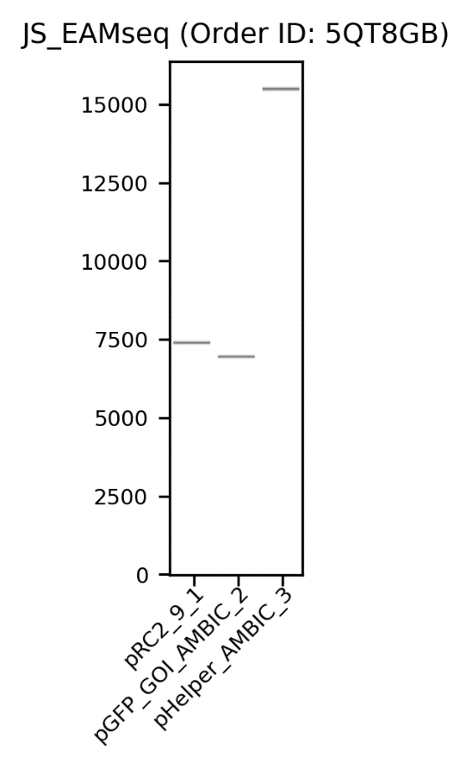
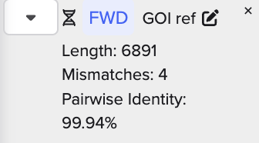
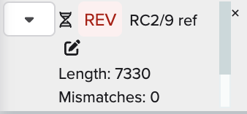
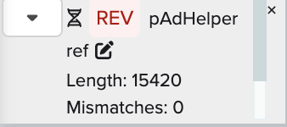
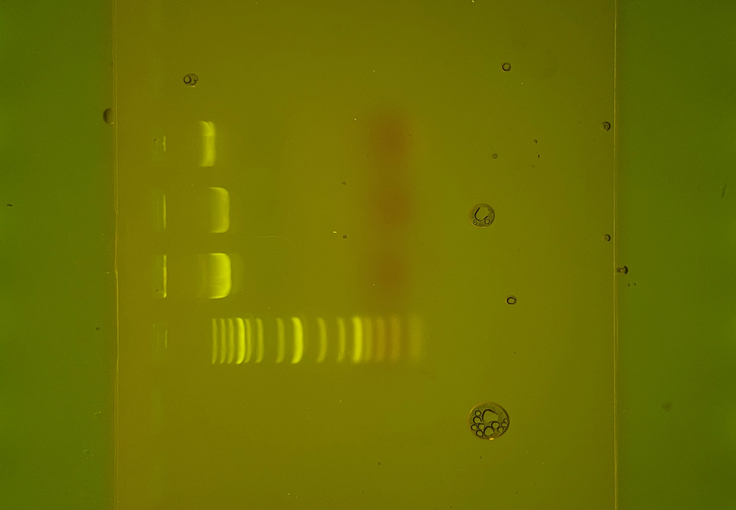
Plasmid prep and QC for DOE
Plasmids prepped and fully sequenced
 | Plasmid | Size (bp) | Amount generated (ug)
1 | pAAV-GFP | 6,891 | ~1050
2 | RepCap2/9 | 7,330 | ~1050
3 | pAdHelper | 15,420 | ~250
L
1
2
3
20kb
5kb
Supplies sufficient for screening DoE
No deleterious mutations
Will use as base lot for comparisons to future preps
1.5kb
0.5kb
Notes:
https://www.addgene.org/32395/
https://www.addgene.org/112867/

Slide 27
Next steps
Recover HEK293 ATCC cells and create long term cell bank
Osmo measurements and formulation of all DOE designs
Begin DoE screens for essential amino acid deleted media
  Finalized good range for AA differences: Osmo, literature or screening

Slide 28
UD Overview
HPLC Full Empty Analysis
  Case Study

Slide 29

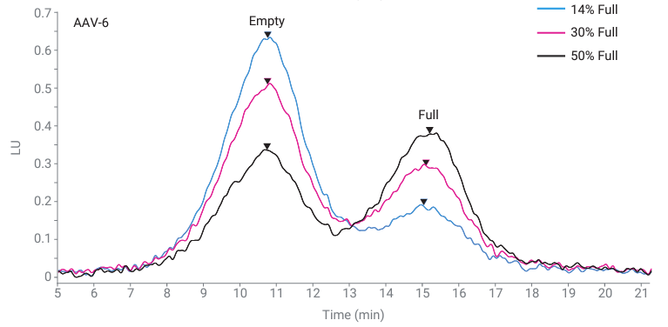
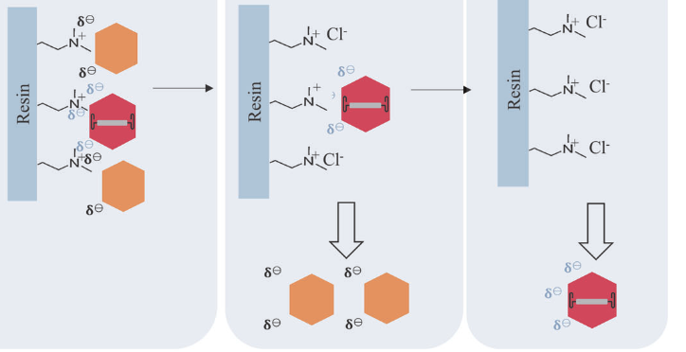



Improved analytical methods are needed to measure packaging efficiency
Johns Hopkins University
Clemson University
University of Delaware
University of Massachusetts Lowell
University of Maryland
Anion Exchange High Performance Liquid Chromatography
Efficient (< 30 minutes), small volume of purified material (1 x 10¹⁰ capsids / sample)
Relative peak height or area ~ F/E ratio
Serotype specific binding profiles
1
1
Binary Pump- step gradient
A: 20 mM bis-tris propane, pH 9.0, 2 mM MgCl₂
B: 20 mM bis-tris propane, 250 mM sodium acetate trihydrate, pH 9.0, 2 mM MgCl₂
Liau, B. Agilent Applications, 2022‌
Notes:
Going back to my first slide on PE- we see that error is quite high- because ---- not sensitive enough to measure small changes in PE
Column loading- sample binds, lower salt wash removes empty capsids without negatively charged DNA inside first, higher salt wash removes full capsids in separate peaks
Serotype specific binding profiles- may be due to overall differences in amino acid composition, resulting in varying capsid surface charge profile and overall structural characteristics of different AAV serotypes.
Challenging because there is such as small difference in isoelectric point pI of empty vs full capsids- for serotype 6 for example – pI diff is < 0.4 -- full = 6.3 and empty = 5.9

Slide 30
VG titer/capsid titer is not a good estimator of packaging efficiency
Johns Hopkins University
Clemson University
University of Delaware
University of Massachusetts Lowell
University of Maryland
Two independently derived standard curves from two different instruments
Case study for AAV2 sample qPCR/octet PE vs HPLC PE: same sample shows over 40% difference in packaging
All error bars represent 1 SD from the mean for 3 biological and technical replicates at 2.5- or 7.5-ml culture scale

Slide 31
wtAAV sample qPCR/octet PE vs HPLC PE
Johns Hopkins University
Clemson University
University of Delaware
University of Massachusetts Lowell
University of Maryland
Injections of serial dilutions of certified full and empty standards to determine correction factor
AAV2 sample (MOI=10:10)
  44.4% full by AEX-HPLC
  5.8 % full by VG titer/capsid titer

