Slide 1
Maximizing Yields of rAAV and Elucidating the Role of Media Components Through Design and Optimization of AMBIC.293 Media
David McNally (MassBiologics/UML), Seongkyu Yoon (UML), Mike Betenbaugh/Michael Bevan (JHU), Kelvin Lee (UD)

Slide 2
UML and JHU Update (Media)
Original AMBIC media preparation
  Adding back the additives to the media
Cell banking
Reconstituted AMBIC media preparation based on the Plackett-Burman design
  Adding back the Non-Essential amino acids (NEAAs) and additives to the media
Next steps

Slide 3
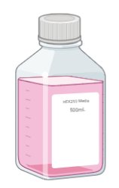
Original AMBIC Media Preparation
260 mOsm/kg
Adding back 5 additives
Osmo adjustment
AMBIC media without 5 additives (Cacl2, CaPanto, FeEDTA, EDTA, and NaCl)
original media
300 mOsm/kg
Adding back 5 additives to the media (Cacl2, CaPanto, FeEDTA, EDTA, and NaCl)
Osmolality adjustment by adding NaCl
Filtration of the media (original media)

Slide 4
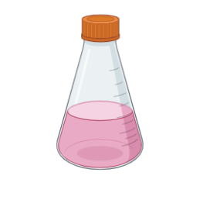
Original AMBIC Media Preparation
Using for the cell thaw and passaging until recovery
P3D4:
Viability: 93%
VCD: 5E6 cells/mL
Adding back 5 additives
Osmo adjustment
260 mOsm/kg
Using for the cell thaw and passaging until recovery
P3D4:
Viability: 92%
VCD: 3E6 cells/mL
AMBIC media without 5 additives (Cacl2, CaPanto, FeEDTA, EDTA, and NaCl)
original media
300 mOsm/kg

Slide 5
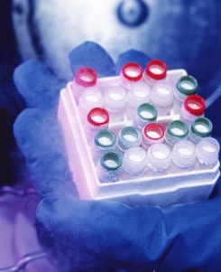
Cell banking
Using for the cell thaw and passaging until recovery
P3D4:
Viability: 93%
VCD: 5E6 cells/mL
Adding back 5 additives
Osmo adjustment
260 mOsm/kg
Using for the cell thaw and passaging until recovery
P3D4:
Viability: 92%
VCD: 3E6 cells/mL
AMBIC media without 5 additives (Cacl2, CaPanto, FeEDTA, EDTA, and NaCl)
original media
300 mOsm/kg
Today is P4D4
Sending some vials to JHU and UD
Cell banking

Slide 6
Plackett-Burman Design Review
Std Order | Run Order | PtType | Blocks | Arginine | Asparagine | Serine | Aspartic acid | Valine | cell growth | genome titer | Transduction efficiency | Empty/full Capsid ratio | DNA integrity
1 | 1 | 1 | 1 | 5 | 2 | 10 | 2 | 1
2 | 2 | 1 | 1 | 5 | 8 | 2 | 10 | 1
3 | 3 | 1 | 1 | 1 | 8 | 10 | 2 | 4
4 | 4 | 1 | 1 | 5 | 2 | 10 | 10 | 1
5 | 5 | 1 | 1 | 3 | 5 | 6 | 6 | 2.5
6 | 6 | 1 | 1 | 5 | 8 | 2 | 10 | 4
7 | 7 | 1 | 1 | 5 | 8 | 10 | 2 | 4
8 | 8 | 1 | 1 | 1 | 8 | 10 | 10 | 1
9 | 9 | 1 | 1 | 1 | 2 | 10 | 10 | 4
10 | 10 | 1 | 1 | 3 | 5 | 6 | 6 | 2.5
11 | 11 | 1 | 1 | 1 | 2 | 2 | 10 | 4
12 | 12 | 1 | 1 | 5 | 2 | 2 | 2 | 4
13 | 13 | 1 | 1 | 1 | 8 | 2 | 2 | 1
14 | 14 | 1 | 1 | 1 | 2 | 2 | 2 | 1
15 | 15 | 1 | 1 | 3 | 5 | 6 | 6 | 2.5
Input: NEAA conc
Output (response): cell growth and productivity, transduction efficiency, capsid empty/full ratio, DNA integrity
Range: 2X Formulation; 0.5X Formulation
Plackett-Burman design
5 factors
12 runs + 3 center points runs 15 total runs
1 block

Slide 7
Reconstituted AMBIC Media Preparation (NEAA Example)
Adding back 5 additives
Adding back 5 NEAAs
13 different media formulations with their distinct NEAAs concentrations based on the DOE
AMBIC media without 5 additives (Cacl2, CaPanto, FeEDTA, EDTA, and NaCl) and 5 NEAAs (Arg, Asn, Asp, Ser, Val)
Reconstituted media
Using Sigma-Aldrich amino acid standards (Arg, Asp, Asn, Ser, and Val).​
MilliQ water for dissolving the amino acids.
0.22 µm filtration of amino acid solutions.
Adding the filtered amino acid solutions and additives to the deleted media (Cacl2, CaPanto, FeEDTA, EDTA, and NaCl)
Osmolality adjustment by adding NaCl
Filtration of the media post reconstitution with amino acids and additives

Slide 8
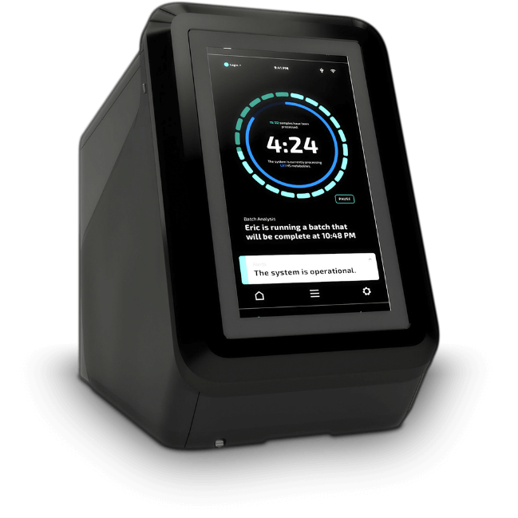
Confirmation of Amino Acid Concentration in Reconstituted Media
  Checking the consistency between the 13 prepared reconstituted media formulations and Plackett-Burman design prior to execution
13 different media formulations with their distinct NEAAs concentrations based on the prepared DOE
Reconstituted media
NEAAs measurement

Slide 9
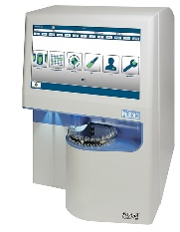
Workflow for DoE Study
Switching from the original media to the reconstituted media
cell thaw and passaging until recovery
P3 or P4?
3 passages in each of 13 reconstituted media
Transfection of AMBIC HEK293 cells [one shake flask for each condition]
original media
reconstituted media
Daily cell counts
capsid empty/full ratio
Transduction efficiency
Cell harvest on day 3 post-transfection
qPCR (Taqman)
3 times freeze/thaw for cell lysis
DNA integrity

Slide 10
Next steps
Recover HEK293 ATCC cell bank, ensure all sites have the same cells before DOE (UML)
Osmo measurements and formulation of all DOE designs (UML and JHU)
Begin DoE screens for essential amino acid deleted media (UML and JHU)
  Finalized good range for AA differences: Osmo, literature or screening
Mass photometry development for full/total capsid analysis (JHU)

Slide 11
UDel Updates
Progress of Full:Empty enrichment process
Full:Empty measurement by HPLC

Slide 12
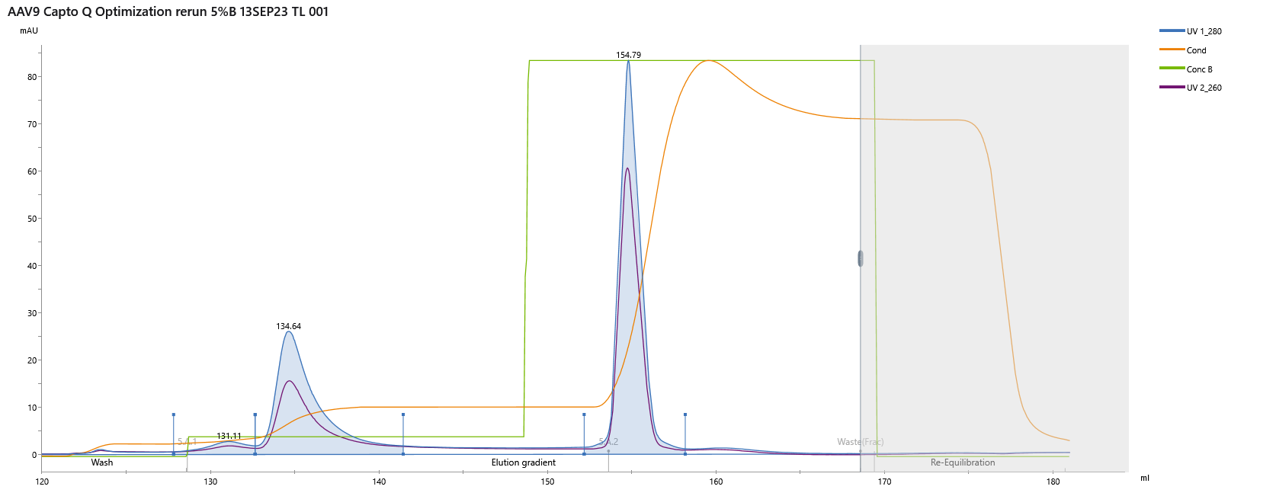
First gen F/E AEX separation
Full elution
59% of capsids
91% of VGs
Empty removal
41% of capsids
9% of VGs
Buffer A – 20 mM BTP, 2 mM MgCl2, pH 9
Buffer B – 20 mM BTP, 2 mM MgCl2, 200 mM NaAc, pH 9
Flow rate – 5 mL/min
Resin – Capto Q
Column – TRICORN 5/100
System – Akta AVANT
Good
Process achieved full capsid enrichment with high yield (~91%)
Bad
Removed less than half of total capsids loaded (est. 15% full load material)
Co-elution of full capsids with aggregates and impurities (HCPs)

Slide 13
Optimized AAV9 F/E Separation
Full capsid collection
Impurity removal
Empty capsid removal
Three step process developed for improved impurity clearance (HCPs, aggregates)
3.2-fold enrichment in full capsids with >50% VG processing recovery (based on AAVX Octet and qPCR data)

Slide 14
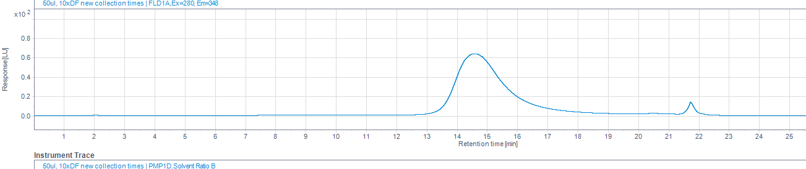
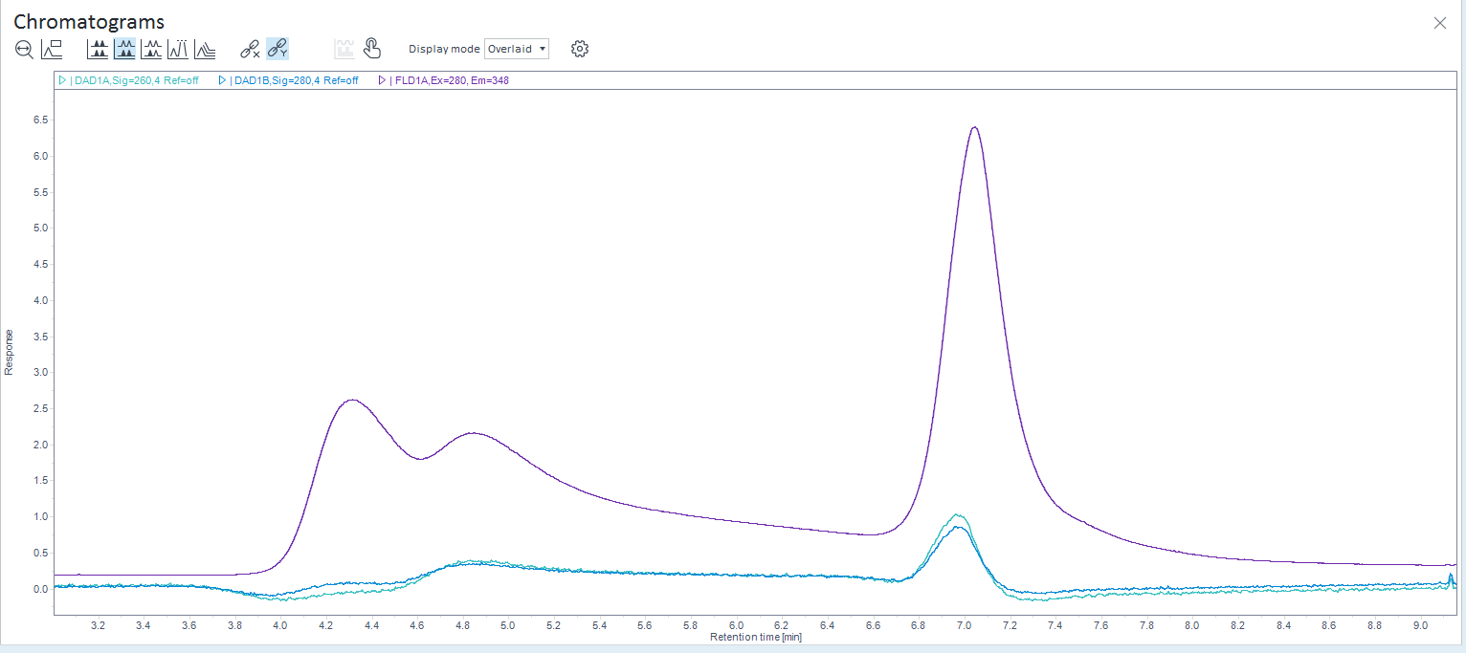
Scale up processing completed
After processing and buffer exchange, approx. 5E13 capsids were recovered at 1E13 capsids per mL (5 mL)
Bulk material was measured to be approx. 50% full based on HPLC peak integration
Pre-AEX
empty
full
full
Post-AEX
empty
partial

Slide 15
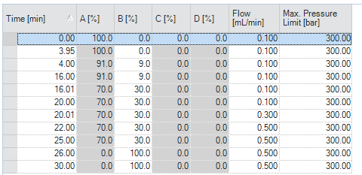
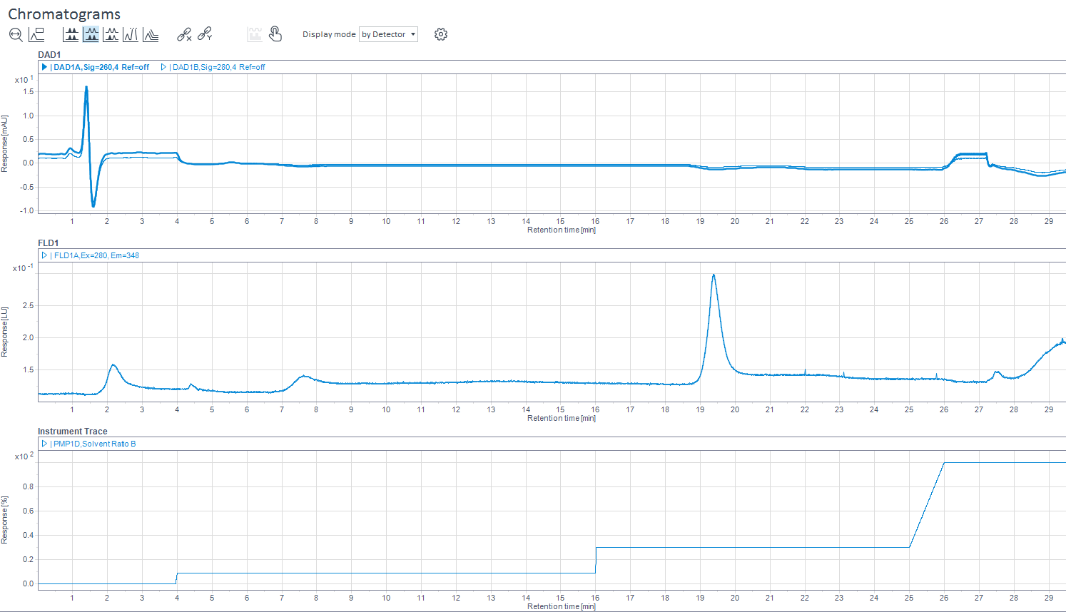
HPLC method development for F/E measurement
Optimized for serotype 9 by lowering concentration of bis-tris propane and salt and adjusting step gradients and isocratic hold
Binary Pump
A: 20 mM bis-tris propane, pH 9.0, 2 mM MgCl₂
B: 20 mM bis-tris propane + 250 mM sodium acetate trihydrate, pH 9.0, 2 mM MgCl₂
30% B
0% B
9% B

Slide 16
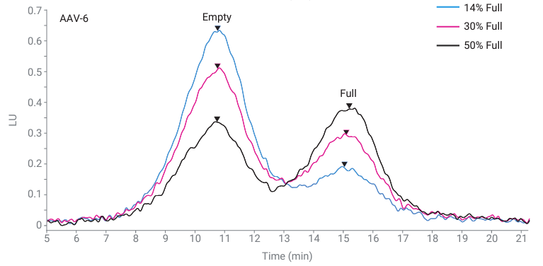
HPLC method development for F/E measurement
Accurate and reproducible full-to-empty capsid ratios can be measured with Agilent Bio SAX strong anion exchange columns
Efficient, simple, small volume, excellent linearity and reproducibility
Relative peak height or area~ F/E ratio
Best method to integrate peaks?
(1)
(1) Liau, B. Agilent Applications, 2022‌

