Slide 1
Maximizing Yields of rAAV and Elucidating the Role of Media Components Through Design and Optimization of AMBIC.293 Media
David McNally (MassBiologics/UML), Seongkyu Yoon (UML), Mike Betenbaugh/Michael Bevan (JHU), Kelvin Lee (UD)

Slide 2
UML Update
Original AMBIC media preparation
  Adding back the additives to the media
Cell banking
Reconstituted AMBIC media preparation based on the Plackett-Burman design
  Adding back the Non-Essential amino acids (NEAAs) and additives to the media
Next steps

Slide 3
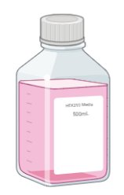
Original AMBIC Media Preparation
260 mOsm/kg
Adding back 5 additives
Osmo adjustment
AMBIC media without 5 additives (Cacl2, CaPanto, FeEDTA, EDTA, and NaCl)
original media
300 mOsm/kg
Adding back 5 additives to the media (Cacl2, CaPanto, FeEDTA, EDTA, and NaCl)
Osmolality adjustment by adding NaCl
Filtration of the media (original media)

Slide 4
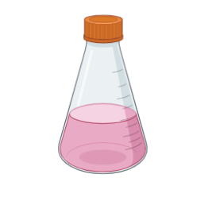
Original AMBIC Media Preparation
Using for the cell thaw and passaging until recovery
P3D4:
Viability: 93%
VCD: 5E6 cells/mL
Adding back 5 additives
Osmo adjustment
260 mOsm/kg
Using for the cell thaw and passaging until recovery
P3D4:
Viability: 92%
VCD: 3E6 cells/mL
AMBIC media without 5 additives (Cacl2, CaPanto, FeEDTA, EDTA, and NaCl)
original media
300 mOsm/kg

Slide 5
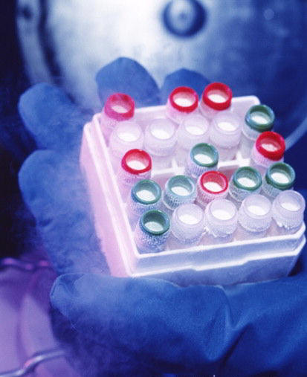
Cell banking
Using for the cell thaw and passaging until recovery
P3D4:
Viability: 93%
VCD: 5E6 cells/mL
Adding back 5 additives
Osmo adjustment
260 mOsm/kg
Using for the cell thaw and passaging until recovery
P3D4:
Viability: 92%
VCD: 3E6 cells/mL
AMBIC media without 5 additives (Cacl2, CaPanto, FeEDTA, EDTA, and NaCl)
original media
300 mOsm/kg
Today is P4D4
Sending some vials to JHU and UD
Cell banking

Slide 6
Plackett-Burman design
Std Order | Run Order | PtType | Blocks | Arginine | Asparagine | Serine | Aspartic acid | Valine | cell growth | genome titer | Transduction efficiency | Empty/full Capsid ratio | DNA integrity
1 | 1 | 1 | 1 | 5 | 2 | 10 | 2 | 1
2 | 2 | 1 | 1 | 5 | 8 | 2 | 10 | 1
3 | 3 | 1 | 1 | 1 | 8 | 10 | 2 | 4
4 | 4 | 1 | 1 | 5 | 2 | 10 | 10 | 1
5 | 5 | 1 | 1 | 3 | 5 | 6 | 6 | 2.5
6 | 6 | 1 | 1 | 5 | 8 | 2 | 10 | 4
7 | 7 | 1 | 1 | 5 | 8 | 10 | 2 | 4
8 | 8 | 1 | 1 | 1 | 8 | 10 | 10 | 1
9 | 9 | 1 | 1 | 1 | 2 | 10 | 10 | 4
10 | 10 | 1 | 1 | 3 | 5 | 6 | 6 | 2.5
11 | 11 | 1 | 1 | 1 | 2 | 2 | 10 | 4
12 | 12 | 1 | 1 | 5 | 2 | 2 | 2 | 4
13 | 13 | 1 | 1 | 1 | 8 | 2 | 2 | 1
14 | 14 | 1 | 1 | 1 | 2 | 2 | 2 | 1
15 | 15 | 1 | 1 | 3 | 5 | 6 | 6 | 2.5
Input: NEAA conc
Output (response): cell growth and productivity, transduction efficiency, capsid empty/full ratio, DNA integrity
Range: 2X Formulation; 0.5X Formulation
Plackett-Burman design
5 factors
12 runs + 3 center points runs 15 total runs
1 block

Slide 7
Reconstituted AMBIC Media Preparation
Adding back 5 additives
Adding back 5 NEAAs
13 different media formulations with their distinct NEAAs concentrations based on the DOE
AMBIC media without 5 additives (Cacl2, CaPanto, FeEDTA, EDTA, and NaCl) and 5 NEAAs (Arg, Asn, Asp, Ser, Val)
Reconstituted media
Using Sigma-Aldrich amino acid standards (Arg, Asp, Asn, Ser, and Val).​
MilliQ water for dissolving the amino acids.
0.22 µm filtration of amino acid solutions.
Adding the filtered amino acid solutions and additives to the deleted media (Cacl2, CaPanto, FeEDTA, EDTA, and NaCl)
Osmolality adjustment by adding NaCl
Filtration of the media post reconstitution with amino acids and additives

Slide 8
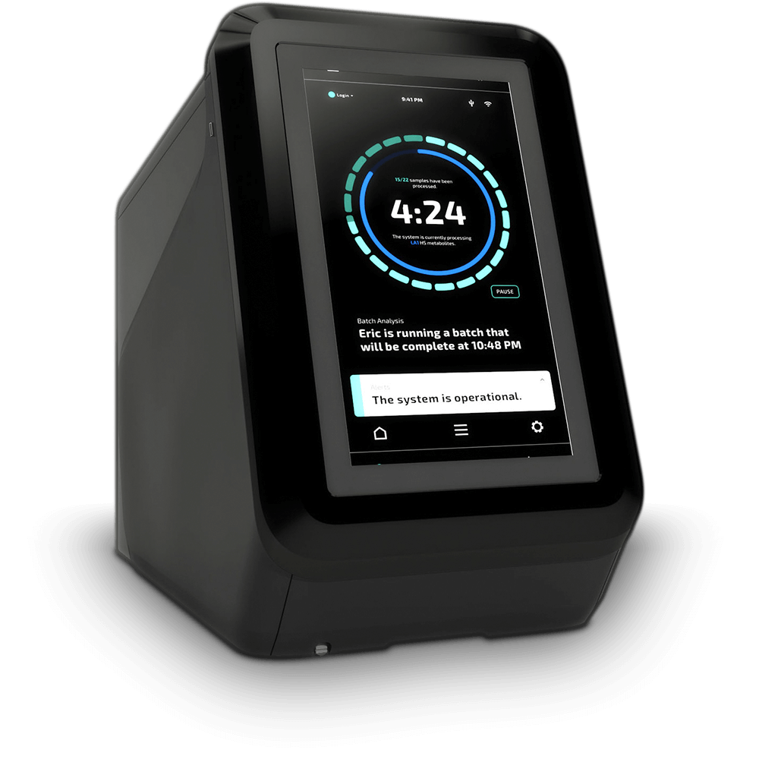
Next steps
Measurement of Amino Acid concentrations in the reconstituted media
  Checking the consistency between the 13 prepared reconstituted media formulations and Plackett-Burman design
13 different media formulations with their distinct NEAAs concentrations based on the prepared DOE
Reconstituted media
NEAAs measurement

Slide 9
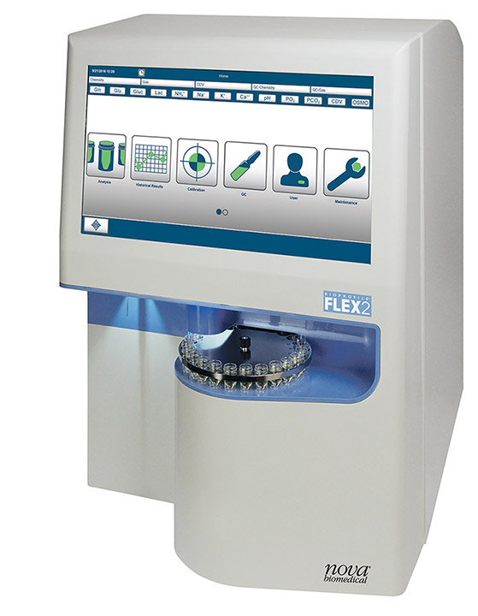
Next plans
Switching from the original media to the reconstituted media
cell thaw and passaging until recovery
P3 or P4?
3 passages in each of 13 reconstituted media
Transfection of AMBIC HEK293 cells [one shake flask for each condition]
original media
reconstituted media
Daily cell counts
capsid empty/full ratio
Transduction efficiency
Cell harvest on day 3 post-transfection
qPCR (Taqman)
3 times freeze/thaw for cell lysis
DNA integrity

