Slide 1
Maximizing Yields of rAAV and Elucidating the Role of Media Components Through Design and Optimization of AMBIC.293 Media
David McNally (MassBiologics/UML), Seongkyu Yoon (UML), Mike Betenbaugh/Michael Bevan (JHU), Kelvin Lee (UD)

Slide 2
UML Update
Deleted media preparation (adding back the amino acids and additives)
Amino acid measurement for both the original media and the deleted media after adding back the amino acids
Transfection of deleted AMBIC HEK293 cells after adding back the amino acids
  Two scales (deep-well plate and shake flask)
Next steps

Slide 3
Deleted media preparation (adding back the amino acids and additives)
Using the sigmaaldrich amino acid standards (Arg, Asp, Asn, Ser, and Val).​
Using MilliQ water for dissolving the amino acids.
Using 0.22 µm filters for filtration of amino acid solutions.
Adding back the filtered amino acid solutions and additives to the deleted media (Cacl2, CaPanto, FeEDTA, EDTA, and NaCl)
Osmolality adjustment to 302 mOsm/kg (should be within 280-320 mOsm/kg ) by adding back the NaCl
Filtration of the media after adding back all the amino acids and additives

Slide 4
The non-essential amino acids (NEAAs) measurement by REBEL
Checking the consistency between the original media and the deleted media based on the formulation after adding back the amino acids
100X dilution (duplicate)
Overall consistency between the original media and deleted media

Slide 5
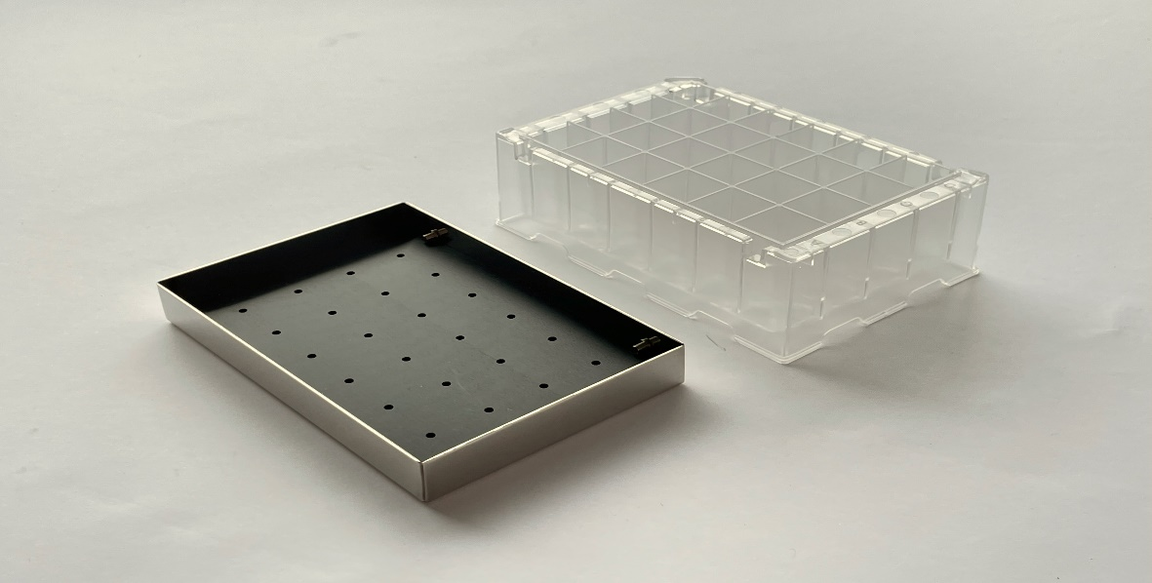
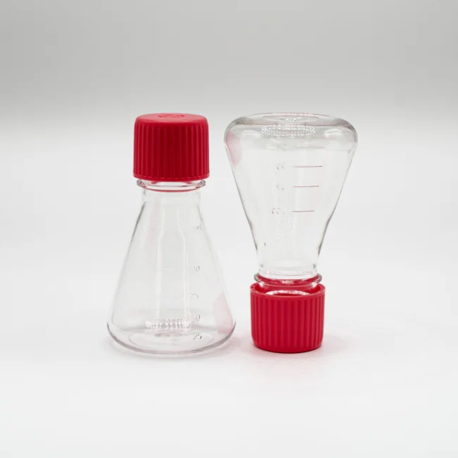
Transfection of deleted AMBIC HEK293 Cells after adding back the A.As (AAV9)
Conducting transfection at two different scales (2 shake flasks and 4 deep-well plates)
  To ensure that we can get the consistent results across the original media and the deleted media after adding back NEAAs (Arg, Asp, Asn, Ser, and Val).​
Transfection Variables in shake flask/deep-well | AMBIC Media verification Condition
1. PEI:DNA | 1:1 (Fixed)
2. Cell density | 4.35*10⁶ Cells/mL
3. pHelper: pGOI | 1:2
4. pHelper: pRepCap | 1:2
5. DNA amount | 1.0 pg/Cell (Fixed)
6. Incubation time | 7 min (Fixed)
7. Total volume | 30 mL/3mL
8. Cocktail volume | 10% (Fixed)
Temperature: 37 °C
CO2: 5%
Rotation speed: 300 rpm
Shaking amplitude: 25mm
Temperature: 37 °C
CO2: 5%
Rotation speed: 125 rpm
Shaking amplitude: 25mm

Slide 6
Comparison of VCD between transfection of original media and deleted media
2 shake flasks and 4 deep- well plates
Adding back the glucose on D2-post transfection to keep it above 1 g/L
D3-post transfection in the deleted media
D3-post transfection in the original media

Slide 7
Next steps
Testing the genome titer
  Check the consistency between the original and the deleted media
Transfection of the AMBIC HEK293 cells according to the prepared DOE

