Slide 1
Maximizing Yields of rAAV and Elucidating the Role of Media Components Through Design and Optimization of AMBIC.293 Media
David McNally (MassBiologics/UML), Seongkyu Yoon (UML), Mike Betenbaugh/Michael Bevan (JHU), Kelvin Lee (UD)

Slide 2
UML Update
Transfection of original AMBIC HEK293 cells
  Two scales (deep-well plate and shake flask)
Genome titer measurement (qPCR) to check the consistency across two different scales
Next steps

Slide 3
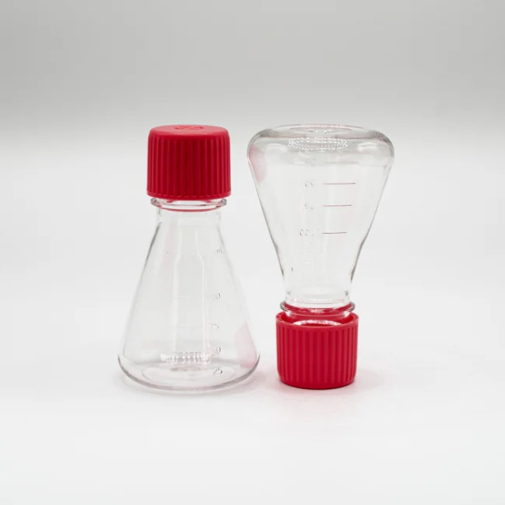
Transfection of AMBIC HEK293 Cells (AAV9)
Conducting transfection at two different scales (shake flask and deep-well plate)
  To ensure that we can get the consistent results across diverse experimental scales.​
Transfection Variables in shake flask | AMBIC Media verification Condition
1. PEI:DNA | 1:1 (Fixed)
2. Cell density | 4.35*10⁶ Cells/mL
3. pHelper: pGOI | 1:2
4. pHelper: pRepCap | 1:2
5. DNA amount | 1.0 pg/Cell (Fixed)
6. Incubation time | 7 min (Fixed)
7. Total volume | 30 mL
8. Cocktail volume | 3 mL/10% (Fixed)
125mL
Temperature: 37 °C
CO2: 5%
Rotation speed: 300 rpm
Shaking amplitude: 25mm

Slide 4
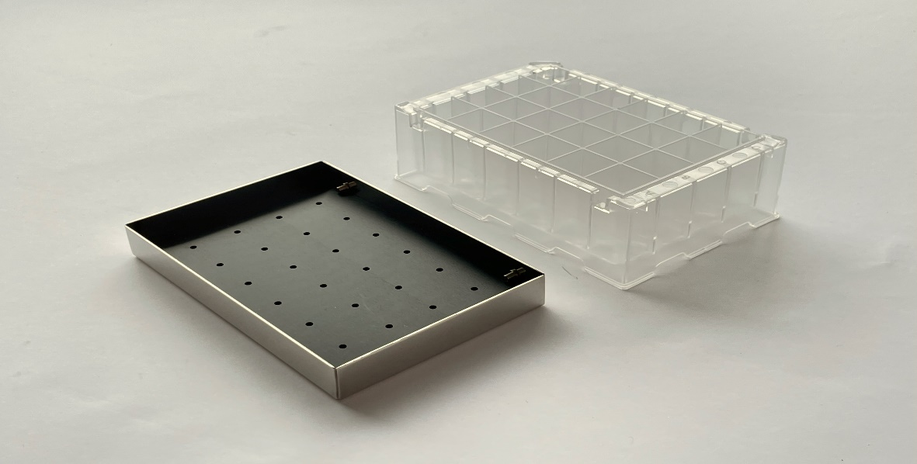
Transfection of AMBIC HEK293 Cells (AAV9)
Conducting transfection at two different scales (shake flask and deep-well plate)
  To ensure that we can get the consistent results across diverse experimental scales.​
Transfection Variables in deep-well plate | AMBIC Media verification Condition
1. PEI:DNA | 1:1 (Fixed)
2. Cell density | 4.35*10⁶ Cells/mL
3. pHelper: pGOI | 1:2
4. pHelper: pRepCap | 1:2
5. DNA amount | 1.0 pg/Cell (Fixed)
6. Incubation time | 7 min (Fixed)
7. Total volume | 3 mL
8. Cocktail volume | 0.3 mL/10% (Fixed)
CR1424cl: polystyrene transparent square 24 deep well microplates with lid
Temperature: 37 °C
CO2: 5%
Rotation speed: 300 rpm
Shaking amplitude: 25mm

Slide 5
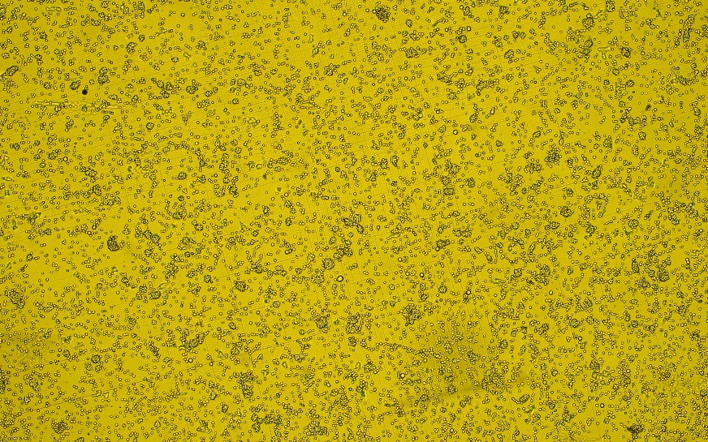
Transfection of AMBIC HEK293 Cells (AAV9)
D3-post transfection (AAV9)
D3-post transfection (AAV9)

Slide 6
Genome titer measurement (AAV9)
Switching from AAV5 to linearized GFP as the reference standard
  Employment of both AAV5 and linearized GFP in the last qPCR Robust alignment

Slide 7
Next steps
Preparing the deleted media for transfection (adding back the amino acids according to the original media formulation)
Testing the genome titer of the transfected AMBIC HEK293 Cells
  Check the consistency between the original and the deleted media
Transfection of the AMBIC HEK293 cells according to the prepared DOE

Slide 8
Future DOE Experiments
Any comments or suggestions?
Using PBS (1X) pH 7.4 as the solvent to dissolve the amino acids?
Adaptations when switching to the new media? If yes, how many passages before each transfection?

Slide 9
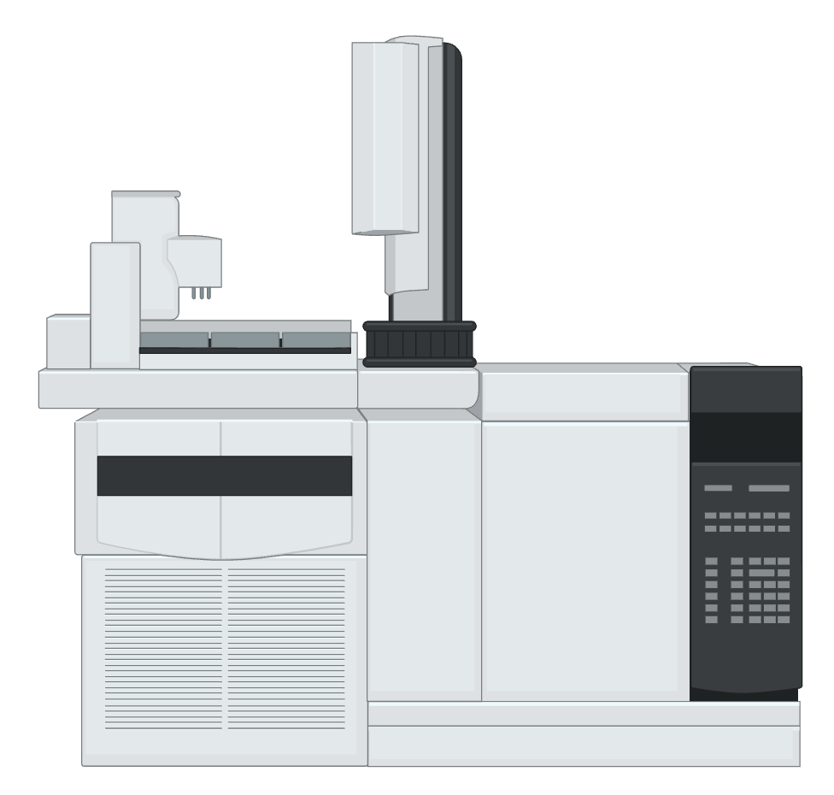

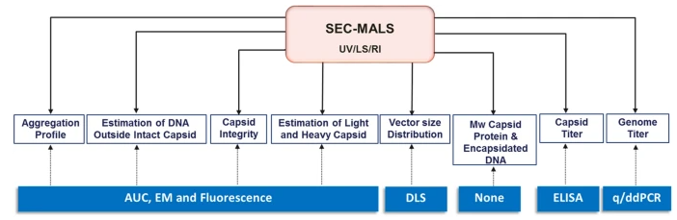


JHU Overview
Inputs
 | Isoleucine (mM) | Leucine (mM) | Lysine (mM) | Tryptophan (mM) | Valine (mM)
1 | 1.2 | 1.8 | 1.3 | 0.25 | 0.93
2 | 1.2 | 1.8 | 2.5 | 0.57 | 3.70
3 | 1.2 | 3.5 | 1.3 | 1.14 | 3.70
4 | 2.3 | 3.5 | 2.5 | 0.57 | 1.85
5 | 2.3 | 3.5 | 5.1 | 1.14 | 0.93
6 | 2.3 | 7.0 | 2.5 | 0.25 | 0.93
7 | 4.6 | 1.8 | 5.1 | 0.57 | 1.85
8 | 4.6 | 7.0 | 1.3 | 0.25 | 1.85
9 | 4.6 | 7.0 | 5.1 | 1.14 | 3.70
Essential Amino Acid DOE
AMBIC 1.293 received, waiting on deleted media
Orthogonal spent media analysis
Spent media trends quantified and analyzed
3. Serotype-specific AAV depletion study
Spent media trends quantified and analyzed
4. Full/empty capsid quantification development
SEC-MALS results; mass photometry plan

Slide 10
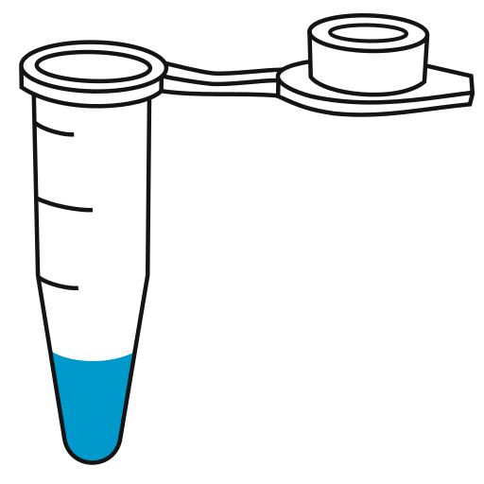
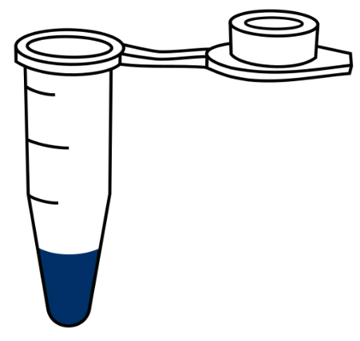
Serotype-specific media consumption studies
Initial Experiment (D0 seed @ 1E6 cells/mL):
S#​ | Condition​ | Description​
1.​ | NT (Gln) | Untreated freely growing cells in glutamine​
2. | NT (Glx) | Untreated freely growing cells in Glutamax
3.​ | AAV2 | Typical AAV2 transfection process 1pg/cell​
4. | AAV9 | AAV9 transfection 1pg/cell​, same ratio
5.​ | Blank Tx | Transfection with pcDNA3.1+ backbone plasmid 1pg/cell​
Daily
Days 3-5
Supernatant for AAV secretion
Supernatant for amino acid analysis via REBEL
Bulk sample for AAV titer (standard)
Count, watch viability
Pellet for in-cell AAV

Slide 11
Orthogonal spent media analysis (GC-MS)
Consumption
Low flux
F1 = control, no Tx, with Q
F2 = control, no Tx, with AQ
F3 = Tx for AAV2, with Q
F4 = Tx with AAV9, with Q
F5 = Tx with pcDNA
All Conditions
Tx Only Conditions
Results agree with REBEL (early consumption for most amino acids into late near-zero flux)
Difference in magnitude between AAV and non-AAV conditions
  Major serotype-specific trends not observed

Slide 12
Orthogonal spent media analysis (GC-MS)
GC-MS method valuable for other metabolites (but more time intensive)
AAV2 and AAV9 similar to each other, but differ from NT, pcDNA
AAV
AAV
AAV
F1 = control, no Tx, with Q
F2 = control, no Tx, with AQ
F3 = Tx for AAV2, with Q
F4 = Tx with AAV9, with Q
F5 = Tx with pcDNA
AAV
Potential takeaway: media optimizations may improve product attributes across many serotypes

Slide 13
Next steps: serotype-specific media consumption studies
From study 1
Depletion of some amino acids for NT conditions
No depletion in AAV2, AAV9, or pcDNA Tx
Will differences emerge with higher cell densities?
F1 = control, no Tx, with Q
F2 = control, no Tx, with AQ
F3 = Tx for AAV2, with Q
F4 = Tx with AAV9, with Q
F5 = Tx with pcDNA

Slide 14
High density AAV study conditions
Follow-up experiment (D0 seed @ 2E6 cells/mL):
Daily (D0-D5)*:
S#​ | Condition​ | Description​
1/2 | NT (Gln) | Untreated freely growing cells in glutamine​
3/4​ | AAV2 | Typical AAV2 transfection process 1pg/cell​
5/6 | AAV9 | AAV9 transfection 1pg/cell​, same ratio
7/8 | Blank Tx | Transfection with pcDNA3.1+ 1pg/cell​
Supernatant for amino acid analysis via REBEL
Bulk sample for AAV titer (standard)
Count, watch viability
*Is it more appropriate to normalize by IVCD, integral titer, something else?

Slide 15
High density AAV study growth trends
Experiment 1: “Low” Seed
Experiment 2: “High” Seed

Slide 16
High density AAV study growth trends (VCD)
Experiment 1: “Low” Seed
Experiment 2: “High” Seed
Lower peak VCD in NT condition but similar D0-5 IVCD
Higher peak VCD and IVCD in both AAV2 and AAV9 conditions, and 2x D0-5 IVCD
  Good conditions for potential amino acid depletion; proceed with REBEL/GC-MS

Slide 17
High density AAV study growth trends (Viability)
Experiment 1: “Low” Seed
Experiment 2: “High” Seed
Cell death comparable between low/high seed for AAV2 and AAV9
Early viability drops for NT and pcDNA Tx at high seed
  Depletion of …? (TBD from REBEL, GC-MS, YSI)
  Plan to monitor and feed glucose in the future

Slide 18
Standard material received for SEC-MALS method development
 | 280/260 of AAV peak
 | injection 1 | injection 2 | injection 3 | Average A280/A260 | Calculated % full
Full AAV2 | 0.8021 | 0.7899 | 0.7890 | 0.7937 | 104%± 0.77%
Empty AAV2 | 1.4532 | 1.4377 | 1.4435 | 1.4448 | 9%±0.22%
SEC-MALS quantification is a precise tool but requires large amounts of AAV >1e12 purified VPs per run. Mass photometry may offer similar analysis with ~x100 less material

Slide 19
Next steps
Compare AAV2 and AAV9 amino acid consumption with higher seed density
  Aim to exhaust one or multiple amino acids
  Measure AAV titer daily to get consumption/vector produced
  Try different densities at once
Determine equipment capabilities for SEC-MALS and mass photometry
Begin DoE screens for essential amino acid deleted media

Slide 20
UD Update
HPLC method development for F/E measurement
AAV9 F/E preparation chromatography development
  Capto Q

Slide 21

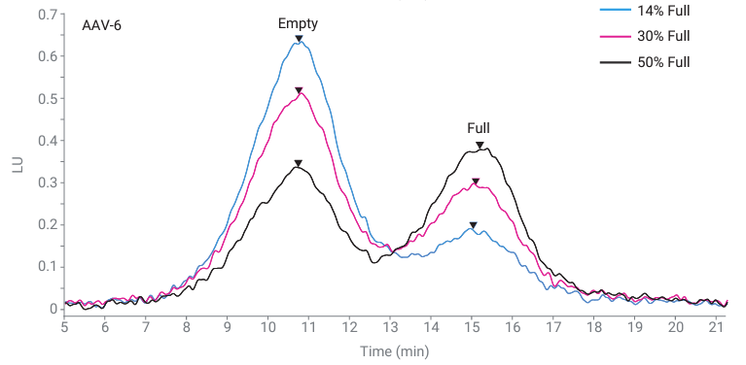

HPLC method development for F/E measurement
Accurate and reproducible full-to-empty capsid ratios can be measured with Agilent Bio SAX strong anion exchange columns
Efficient, simple, small volume, excellent linearity and reproducibility
Relative peak height ~ F/E ratio
Serotype specific binding profiles
Johns Hopkins University
Clemson University
University of Delaware
University of Massachusetts Lowell
University of Maryland
(1)
(1) Liau, B. Agilent Applications, 2022‌

Slide 22
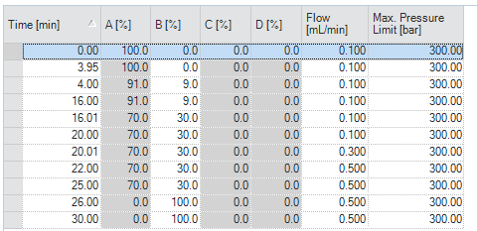
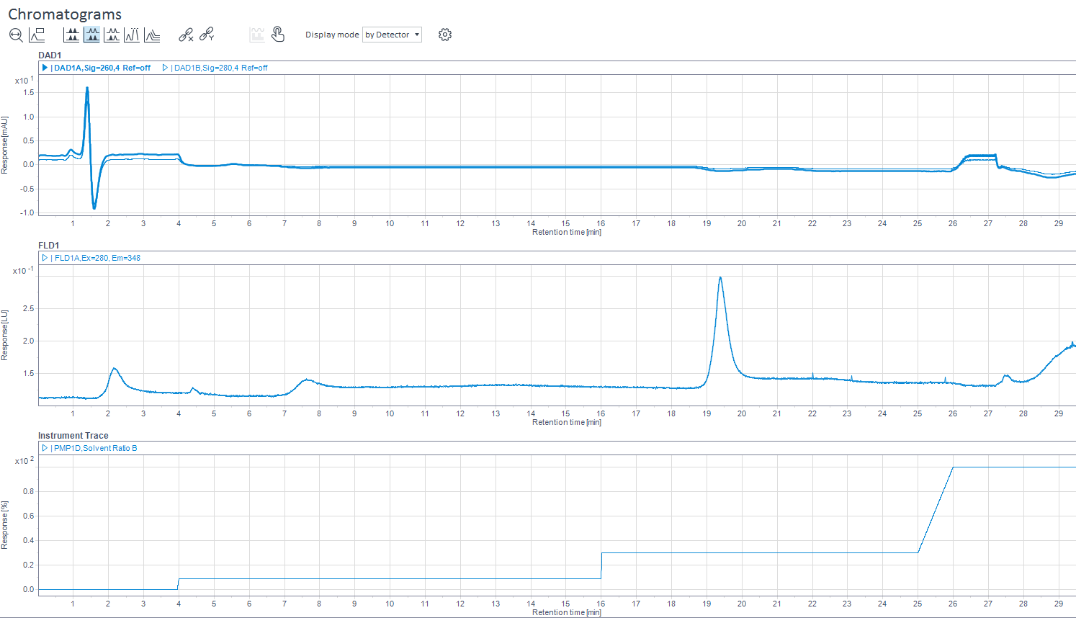
HPLC method development for F/E measurement
Optimized for serotype 9 by lowering concentration of bis-tris propane and salt and adjusting step gradients and isocratic hold
Binary Pump
A: 20 mM bis-tris propane, pH 9.0, 2 mM MgCl₂
B: 20 mM bis-tris propane + 250 mM sodium acetate trihydrate, pH 9.0, 2 mM MgCl₂
Johns Hopkins University
Clemson University
University of Delaware
University of Massachusetts Lowell
University of Maryland
30% B
0% B
9% B

Slide 23
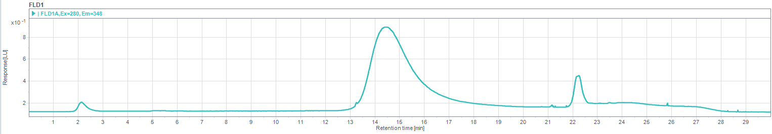
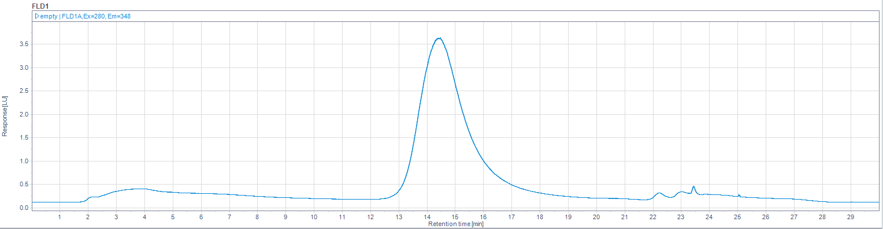
HPLC method development for F/E measurement
Injection = 5E10 capsids (20x DF)
Full sample = 15-25% full based on historical data
Full and empty peaks eluted off column as expected
TL full sample
Johns Hopkins University
Clemson University
University of Delaware
University of Massachusetts Lowell
University of Maryland
TL empty sample
TL samples:
- Produced in 1L shake flasks (standard transfection). Lysate produced by resuspending cell pellets in lysis buffer and freeze/thaw. Lysate and supernatant pooled together and purified with 1 cycle of POROS CaptureSelect AAV9 affinity chromatography using 6 mL column (Akta Avant). Elution pool collected in 20 mM Glycine-HCl, pH 2.6 elution buffer and neutralized by addition of 1M TRIS-HCl pH 8.7.
-1E14 capsids/mL (injection volume- 10 µl of 20x diluted sample)
-Full sample: 15-25% full based on historical data
- Samples in 20 mM glycine, 100mM TRIS=HCl, pH~8-8.2

Slide 24
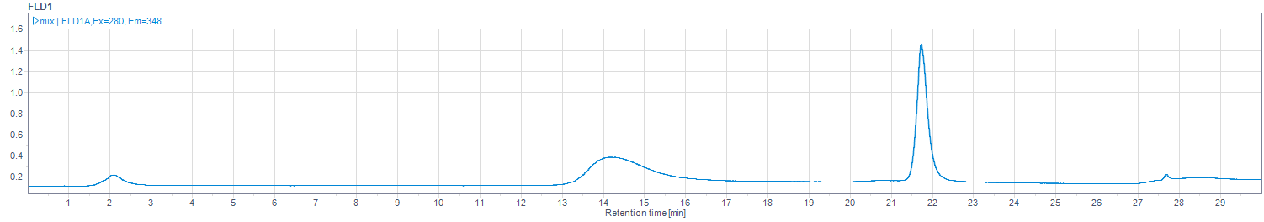
HPLC method development for F/E measurement
Full and empty peaks eluted off column as anticipated
Mixing full standard with empty sample resulted in emergence of empty peak
Full Addgene standard
Johns Hopkins University
Clemson University
University of Delaware
University of Massachusetts Lowell
University of Maryland
TL empty sample
50% Full Addgene standard and 50% TL empty sample

Slide 25
HPLC method development for F/E measurement
Next steps: validation and optimization
- Validate method with orthogonal methods including Octet Biolayer interferometry for capsid titer and qPCR for VG titer (AUC and Cyro-TEM if needed)
- Optimize method with respect to peak resolution, tailing, and asymmetry- flow rate, isocratic hold time, step gradients, run time etc.
Johns Hopkins University
Clemson University
University of Delaware
University of Massachusetts Lowell
University of Maryland

Slide 26
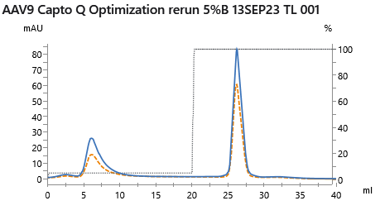
AAV9 F/E preparation chromatography development
Current method
Capto Q (strong anion exchange) FPLC
  Buffer A – 20 mM Bis Tris Propane, 2 mM MgCl2, pH 9.0
  Buffer B – 20 mM Bis Tris Propane, 2 mM MgCl2, 250 mM sodium acetate, pH 9.0
5% B isocratic empty capsid removal step
100% B full capsid elution step
Showed 3-fold enrichment of full capsids with ~90% VG recovery
UV 260/280 - 0.75
Capsid yield – 59%
VG yield – 91%
UV 260/280 - 0.61
Capsid yield – 41%
VG yield – 9%
Current method development
Aiming to achieve increased impurity clearance by adjusting full capsid elution condition to reduce HCP co-elution

Slide 27
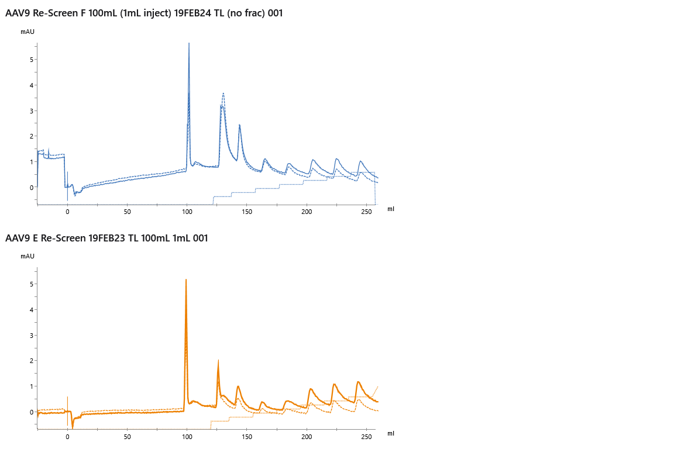
Capto Q AEX F/E separation – Full and empty capsid load
Full-containing rAAV9 screening
Full-containing vs. empty capsid load
Based on chromatograms, full capsid elution occurs between 5 – 20% B
Additional peaks with higher salt concentration likely populations of residual HCPs carried through affinity purification
Johns Hopkins University
Clemson University
University of Delaware
University of Massachusetts Lowell
University of Maryland
Empty capsid rAAV9 screening

Slide 28
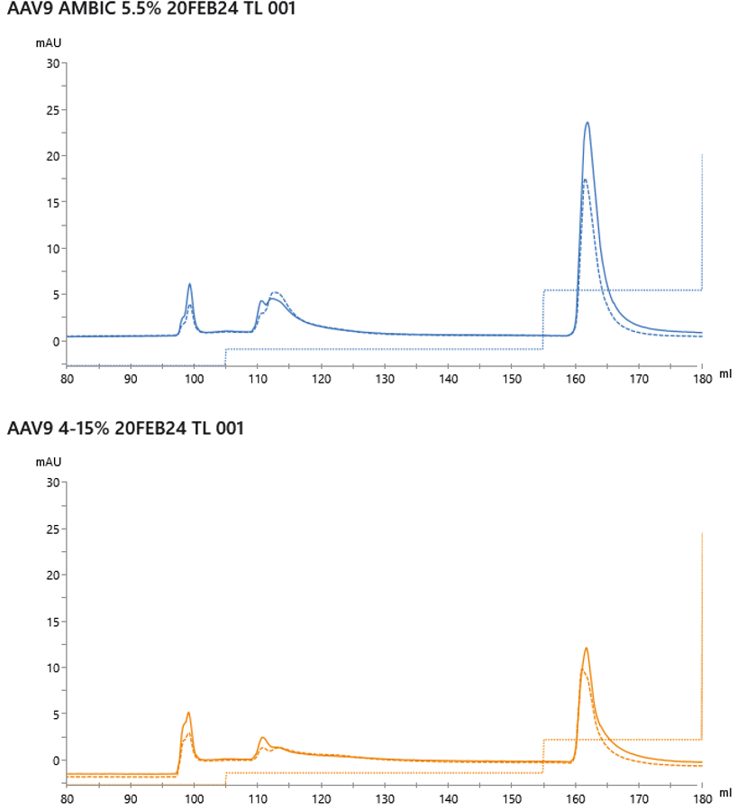
Capto Q AEX F/E separation – re-optimized for improved impurity clearance
Full elution (25%B)
5.5% B empty capsid removal
25% B full capsid elution
Johns Hopkins University
Clemson University
University of Delaware
University of Massachusetts Lowell
University of Maryland
Empty removal (5.5%B)
Wash, empty removal, full elution, and strip (100%B) fractions collected
Measuring VG (qPCR) and capsid (octet) titer for analysis
Wash (0%B)
Full elution (15%B)
4% B empty capsid removal
15% B full capsid elution
Wash (0%B)
Empty removal (4%B)

Slide 29
Supplemental information- HPLC method development for F/E measurement
Octet Biolayer Interferometry- AAV capsid titer is determined based on binding rate of AAV to biosensor surface (binding rate is proportional to AAV titer)
Sensors pre-immobilized with CaptureSelectTM Biotin Anti-AAVX Conjugate (TM), that binds with high affinity and specificity
Works with crude or purified cell culture samples with titer in the range of 8.5 x 10⁸ – 1 x 10¹³ vp/mL
Advantages:
  -Faster and less expensive than ELISA
  -Sensors can be regenerated up to 20 times
Johns Hopkins University
Clemson University
University of Delaware
University of Massachusetts Lowell
University of Maryland
TL samples:
-5 x 1L shake flasks (standard transfection process for AAV9). Lysate was produced by resuspending each cell pellet in 25 mL lysis buffer and 3X freeze/thaw. Lysate and supernatant for all conditions (125 mL lysate, approx 900 mL supernatant) were pooled together and purified with 1 cycle of POROS CaptureSelect AAV9 affinity chromatography using 6 mL column (Akta Avant). 30 mL elution pool collected in 20 mM Glycine-HCl, pH 2.6 elution buffer. Neutralized by addition of 3 mL 1M TRIS-HCl pH 8.7.
-1E14 capsids/mL
-Full sample: 15-25% full based on historical data
- samples in 20 mM glycine, 100mM TRIS=HCl, pH~8-8.2, diluted 20x for injection
Literature method used as a starting point: Liau, B. Agilent Applications, 2022 ‌
Binary Pump
A: 70 mM bis-tris propane, pH 9.0, 2 mM MgCl₂
B: 70 mM bis-tris propane + 1 M tetramethylammonium chloride, pH 9.0, 2 mM MgCl₂
Time | % A | % B | Flow Rate (mL/min)
0 | 85 | 15 | 0.1
25 | 72.5 | 27.5 | 0.1
25.1 | 0 | 100 | 0.3
28 | 0 | 100 | 0.3

