Slide 1
Maximizing Yields of rAAV and Elucidating the Role of Media Components Through Design and Optimization of AMBIC.293 Media
David McNally (MassBiologics/UML), Seongkyu Yoon (UML), Mike Betenbaugh/Michael Bevan (JHU), Kelvin Lee (UD)

Slide 2
UML Update
Batch-to-Batch variation troubleshooting
  Sending materials to JHU
AMBIC HEK293 Cell thaw
Transfection of AMBIC HEK293 cells
Amino acid measurement in AMBIC HEK293 media
  Fresh and spent media

Slide 3
Batch-to-batch variation troubleshooting for low genome titer (AAV2)
Purpose: Establishment of the potential reason for low genome titer (<1E13 vg/L)
  Transfection of BalanCD HEK293 cells for AAV2 production
Materials sent to JHU
  3 different plasmids including GFP, pAd, and AAV2 to do transfection for checking our plasmids
  1 vial of D3-post transfection samples as the control sample to check our qPCR method
    Taqman (UML) vs. SYBR Green (JHU)

Slide 4
AMBIC HEK293 Cell recovery after cell thaw
Cells were recovered after passage 3
  Viability increased gradually from P0 to P3 (>95%)

Slide 5
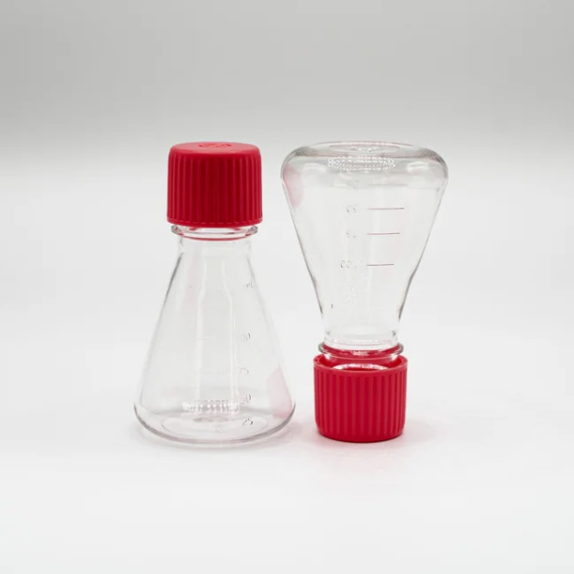
Transfection of AMBIC HEK293 Cells (AAV9)
Conducting transfection at two different scales (shake flask and deep-well plate)
  To ensure that we can get the consistent results across diverse experimental scales.​
Transfection Variables in shake flask | AMBIC Media verification Condition
1. PEI:DNA | 1:1 (Fixed)
2. Cell density | 4.35*10⁶ Cells/mL
3. pHelper: pGOI | 1:2
4. pHelper: pRepCap | 1:2
5. DNA amount | 1.0 pg/Cell (Fixed)
6. Incubation time | 7 min (Fixed)
7. Total volume | 30 mL
8. Cocktail volume | 3 mL/10% (Fixed)
125mL
Temperature: 37 °C
CO2: 5%
Rotation speed: 300 rpm
Shaking amplitude: 25mm

Slide 6
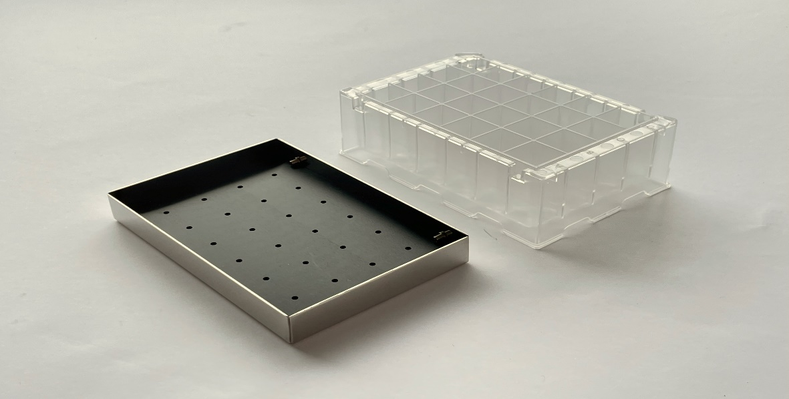
Transfection of AMBIC HEK293 Cells (AAV9)
Conducting transfection at two different scales (shake flask and deep-well plate)
  To ensure that we can get the consistent results across diverse experimental scales.​
Transfection Variables in deep-well plate | AMBIC Media verification Condition
1. PEI:DNA | 1:1 (Fixed)
2. Cell density | 4.35*10⁶ Cells/mL
3. pHelper: pGOI | 1:2
4. pHelper: pRepCap | 1:2
5. DNA amount | 1.0 pg/Cell (Fixed)
6. Incubation time | 7 min (Fixed)
7. Total volume | 3 mL
8. Cocktail volume | 0.3 mL/10% (Fixed)
CR1424cl: polystyrene transparent square 24 deep well microplates with lid
Temperature: 37 °C
CO2: 5%
Rotation speed: 300 rpm
Shaking amplitude: 25mm

Slide 7
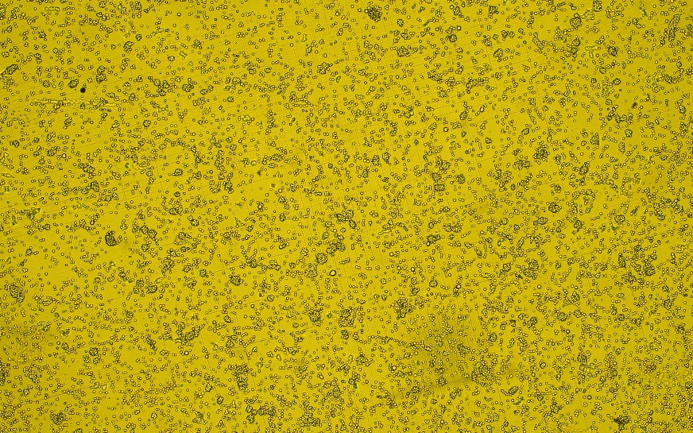
Transfection of AMBIC HEK293 Cells (AAV9)
D3-post transfection (AAV9)
D3-post transfection (AAV9)

Slide 8
Amino acid measurement in AMBIC media by REBEL
Samples: AMBIC fresh media, D1, D2, and D3 AMBIC HEK293 post transfection supernatant
Dilution factor
  Range finding (10X, 25X, 50X, 100X, 200X)
    50X for Asparagine and Serine
    200X for Arginine, Aspartic acid, Valine

Slide 9
Amino acid measurement in AMBIC media by REBEL
Overall consistency between formulation and fresh media batch
Overall consistency of replications for each batch (triplicate running of each batch)
Overall consumption rate (Fresh media vs. D3-PT)
  Serine and Valine (92%)
  Arginine (57%)
  Asparagine (38%)
  Aspartic acid (32%)

Slide 10
Amino acid measurement in AMBIC media by REBEL
  Most consumed amino acids throughout the transfection are Serine and Valine (92%)
  All amino acids show almost similar consumption trend with a gradual decrease throughout the transfection, expect Serine and Valine which show a significant decrease in this period.
  Serine and Valine consumption from day 0 to day 1 is three times (~60%) higher than those of other amino acids (~20%) in the same period.

Slide 11
Next steps
Conducting qPCR for collected samples on D3-post transfection
Conducting transfection of AMBIC HEK293 Cells for AAV9 production in AMBIC HEK depleted media after adding back the amino acids

Slide 12
UD Update
Full Empty Separation
  AEX Method iteration
qPCR titration
  Improvements across all sites

Slide 13
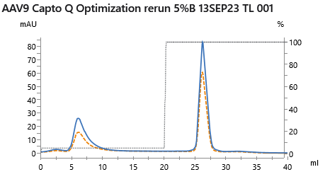
AAV9 Full / Empty separation optimization run
Capsid yield balance calculated using AAVX octet
VG yield balance calculated using qPCR
F/E calculated using both AAVX octet and qPCR data
UV 260/280 - 0.61
Capsid yield – 41%
VG yield – 9%
UV 260/280 - 0.75
Capsid yield – 59%
VG yield – 91%
 | F/E calc - load | F/E calc - high salt
AAV9 | 13.0% | 39.8%
Next steps
Re-optimize to further enrich full capsid content
  Use shallow elution gradient
  Use higher % salt step
Apply ‘more accurate’ method to measure F/E
Apply method to affinity-purified vector lots to generate reference material

Slide 14
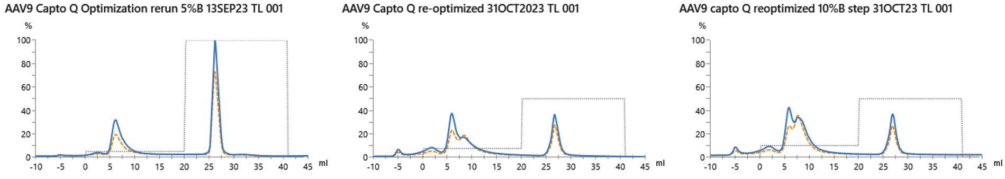
AAV9 F/E Separation Method Development
5% B step
7.5% B step
10% B step
41% capsids
59% capsids
74% capsids
26% capsids
77% capsids
23% capsids
Shifted empty capsid removal step to 7.5% and 10% high-salt buffer B to increased full capsid enrichment
Peaks fractionated and planning to analyze using qPCR and capsid titer measurement
Capsid titer data shows increasing shift of capsids into low salt fraction

Slide 15
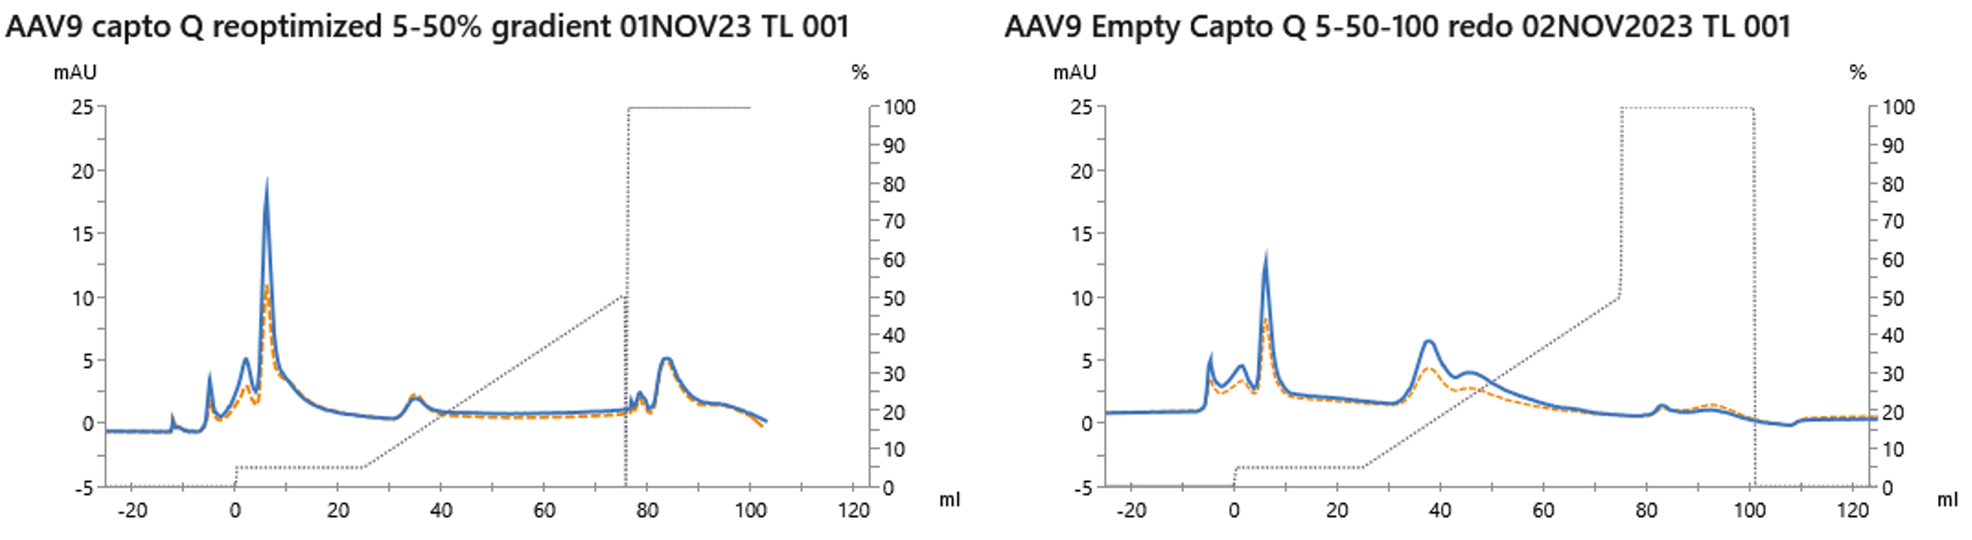
AAV9 F/E Separation Method Development
Full-containing capsid load
5% B step → 5 – 50% gradient → 100% B step
Empty capsid load
5% B step → 5 – 50% gradient → 100% B step
Ran process with 5% initial step followed by shallow gradient to increase empty/partial capsid removal
Process run using both ‘full-containing’ AAV9 lot and ‘empty’ AAV9 lot to better gauge separation
Peaks fractionated and planning to analyze using qPCR and capsid titer measurement
Shows

Slide 16
Standardized qPCR procedure would improve our ability to interpret results
Goal: standardized qPCR method for VG titer quantification in adherence with MIQE guidelines to be used across all schools
Reproducible
Sensitive
Efficient
Improved ability to compare VG titers across schools
Results that are more uniform, comparable, and reliable
Bustin, S. A. Clinical Chemistry 2009, 55 (4), 611–622.

Slide 17
Common standards, controls and protocols can be used
Standard curve- linearized and purified eGFP plasmid produced from AAV9 (UD supplies)
Controls – HEK293 cells solely transfected with eGFP (consistent background matrix will prevent artificial inflation of VG titer) (UD supplies)
Standardize protocol- harvest, clarification, and qPCR preparation (DNA removal, capsid digestion, dilutions, type of master mix, purifications, etc.)
Notes:
How to translate VG titers into other VG titers – standards- items 1 and 2 – make and distribute to schools

Slide 18
Common standards, controls and protocols can be used
Standard curve- linearized and purified eGFP plasmid produced from AAV9 (UD supplies)
Controls – HEK293 cells solely transfected with eGFP (consistent background matrix will prevent artificial inflation of VG titer) (UD supplies)
Standardize protocol- harvest, clarification, and qPCR preparation (DNA removal, capsid digestion, dilutions, type of master mix, purifications, etc.)
Notes:
How to translate VG titers into other VG titers – standards- items 1 and 2 – make and distribute to schools

Slide 19
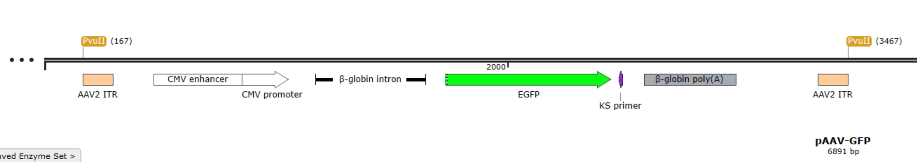
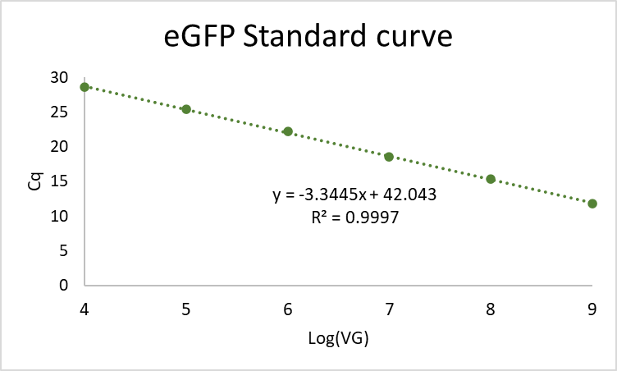
Standard curve background
VG | log (VG) | Cq
10⁹ | 9 | 11.86
10⁸ | 8 | 15.35
10⁷ | 7 | 18.54
10⁶ | 6 | 22.16
10⁵ | 5 | 25.36
10⁴ | 4 | 28.55
PCR amplification efficiency
= 10^{(-1/slope)} – 1
= 99 %

Slide 20
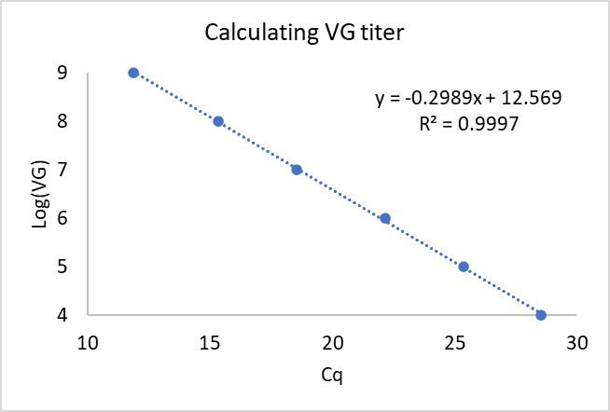
Calculating VG titer from standard curve
Cq | Log copies | Copies/mL
# | (Cq*slope) + y-intercept | DF * 2 *10^{(log copies)} * 1000
Cq | Log copies | Copies/mL
18 | 7.2 | 1.06E+12
Copies/mL explanation:
- log copies is on a per PCR well basis → need to convert to volumetric basis
- DF = dilution factor
- 2 = converting from single-stranded vector to double-stranded standard
- 1000 = converting from µL to mL

Slide 21
Standard curve material generation
1. Restriction enzyme digest
2. Check plasmid on gel
3. Nanodrop for concentration
4. Calculate volume needed for 10⁹ VG
5. Aliquot into single tubes to minimize freeze-thaw
6. For each assay thaw one PCR tube and perform dilutions to generate standard curve
1.42x10⁸ molecules/ng
Molec/ul = molec/ng * ng/ul
Molec/ul | DF | DNA | DNA stk | Water
1.95E+9 | 1.0
3.33E+8 | 5.8 | 8.57 | 1.00E+09 | 41.43
3.33E+7 | 10.0 | 5.00 | 1.00E+08 | 45.00
3.33E+6 | 10.0 | 5.00 | 1.00E+07 | 45.00
3.33E+5 | 10.0 | 5.00 | 1.00E+06 | 45.00
3.33E+4 | 10.0 | 5.00 | 1.00E+05 | 45.00
- Made enough material for each school to run 30 qPCR plates
- Working with lab manager to schedule shipments

Slide 22



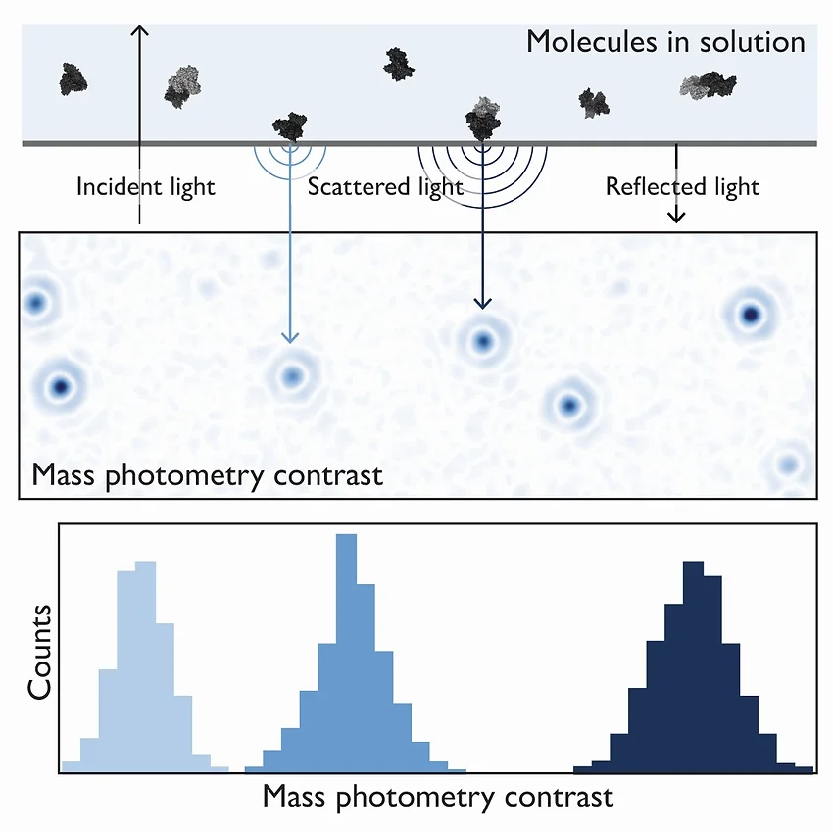
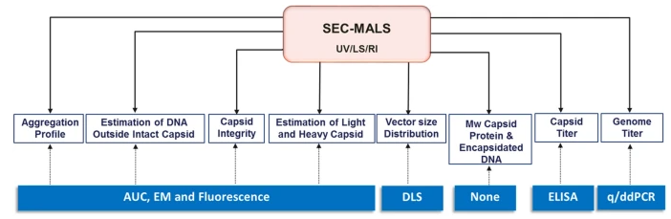
JHU Overview
Inputs
 | Isoleucine (mM) | Leucine (mM) | Lysine (mM) | Tryptophan (mM) | Valine (mM)
1 | 1.2 | 1.8 | 1.3 | 0.25 | 0.93
2 | 1.2 | 1.8 | 2.5 | 0.57 | 3.70
3 | 1.2 | 3.5 | 1.3 | 1.14 | 3.70
4 | 2.3 | 3.5 | 2.5 | 0.57 | 1.85
5 | 2.3 | 3.5 | 5.1 | 1.14 | 0.93
6 | 2.3 | 7.0 | 2.5 | 0.25 | 0.93
7 | 4.6 | 1.8 | 5.1 | 0.57 | 1.85
8 | 4.6 | 7.0 | 1.3 | 0.25 | 1.85
9 | 4.6 | 7.0 | 5.1 | 1.14 | 3.70
Essential Amino Acid DOE
AMBIC 1.293 received, waiting on deleted media
Comparing AAV2 vs AAV9
Spent media trends quantified and analyzed
3. Full/empty capsid quantification development
SEC-MALS calibration run; Mass Photometry setup in progress

Slide 23

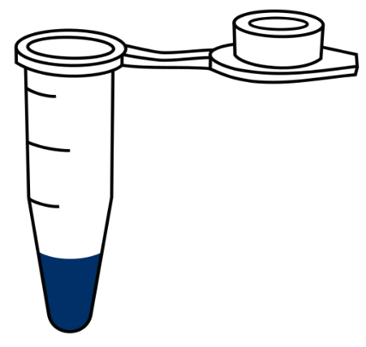
Ongoing AAV Media consumption experiment (Commercial HEK in media)
AAV2 vs AAV9
S#​ | Condition​ | Description​
1.​ | NT (Gln) | Untreated freely growing cells in glutamine​
2. | NT (Glx) | Untreated freely growing cells in Glutamax
3.​ | AAV2 | Typical AAV2 transfection process 1pg/cell​
4. | AAV9 | AAV9 transfection 1pg/cell​, same ratio
5.​ | Blank Tx | Transfection with blanks backbone plasmid 1pg/cell​
Daily
Days 3-5
Supernatant for AAV secretion
Supernatant for amino acid analysis via REBEL
Bulk sample for AAV titer (standard)
Count, watch viability
Pellet for in-cell AAV

Slide 24
Growth data for AAV2 v AAV9 (Process 1)
Original process (P1) showed slow growth and exaggerated viability drop compared to typical process
Decided to repeat with new thawed cells due to unusual growth

Slide 25

Growth data for AAV2 v AAV9 (Process 2)
Second process (P2) showed expected growth trends
Viral titer determined by qPCR to be in range of expected historical values
Day 0-5 spent media samples were analyzed for both P1 and P2 via REBEL

Slide 26
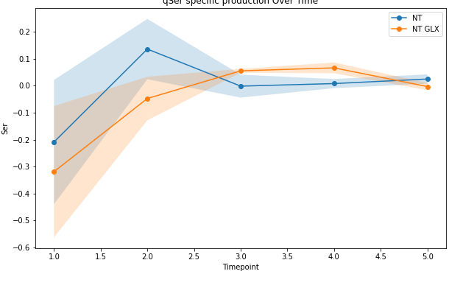
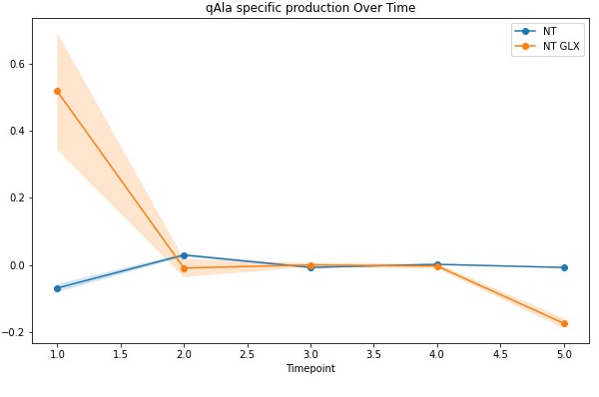
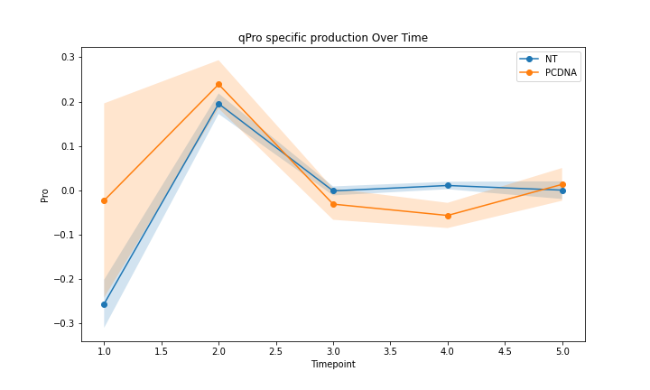
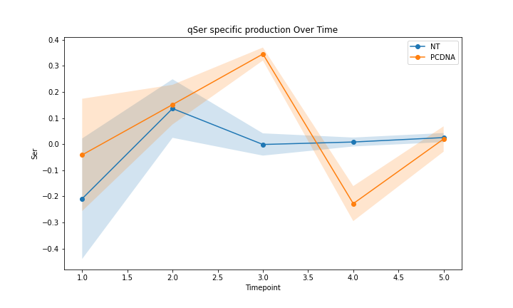
Controls for the study
Glutamine vs Glutamax:
Serine
Alanine
NT
NT GLX
Nearly all amino acids showed the same behavior over the 5 days
Glutamax fed cells had some residual Alanine likely from Gln-Ala breakdown
Consumption (umol/E6 cells-day)
NT
NT GLX
Non-transfected vs blank transfection
Proline
Serine
NT
PCDNA
NT
PCDNA
1/2 measured amino acids had a similar trends and magnitude of flux
Transfected cells showed a spike in fluxes of other amino acids on days 3-4 in 1/3rd of measured amino acids
Consumption (umol/E6 cells-day)

Slide 27
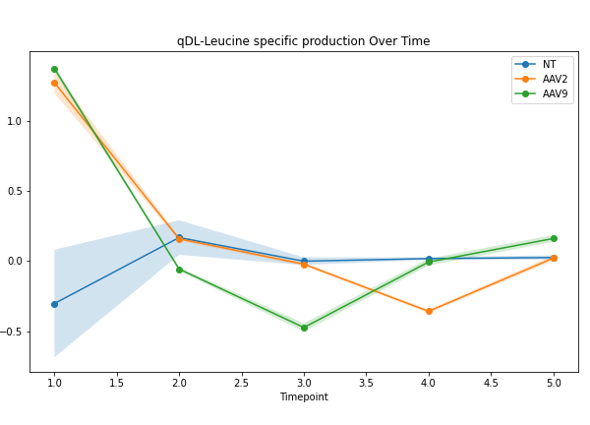
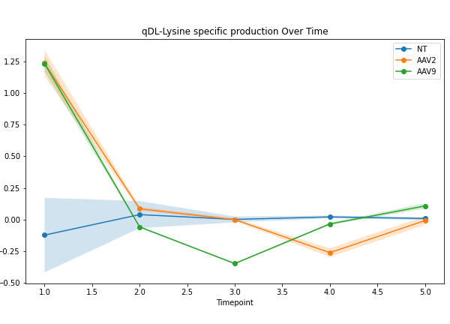
Non-transfected versus AAV-producing consumption trends
Process 2: Leucine
Process 2: Lysine
Consumption (umol/E6 cells-day)
Consumption (umol/E6 cells-day)
Time (dpt)
Time (dpt)
NT:
Low flux (consumption and production) for majority of amino acids
Large consumption of majority of amino acids from D0-D1, followed by “production” and plateauing in later culture days
Potential serotype specific time shift
AAV2 &
AAV9:

Slide 28
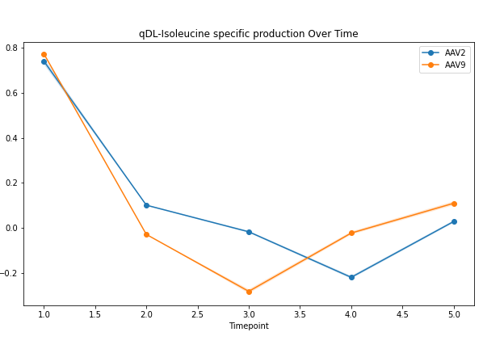
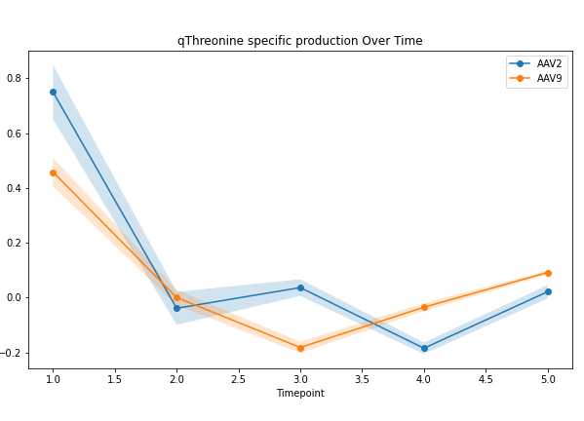
Potential AAV serotype-specific behavior
Process 2: Isoleucine
Process 2: Threonine
Consumption (umol/E6 cells-day)
Consumption (umol/E6 cells-day)
Time (dpt)
Time (dpt)
AAV2
AAV2
AAV9
AAV9
Consumption
Shifted “Production”
Plateau
Consumption
Shifted “Production”
Plateau
Both cultures consumed amino acids early, then shifted to “production”
  AAV9 hit maximum “production” one day earlier than AAV2 (D2 v. D3)
  Trend existed in >50% of amino acids across essential and non-essential groups

Slide 29
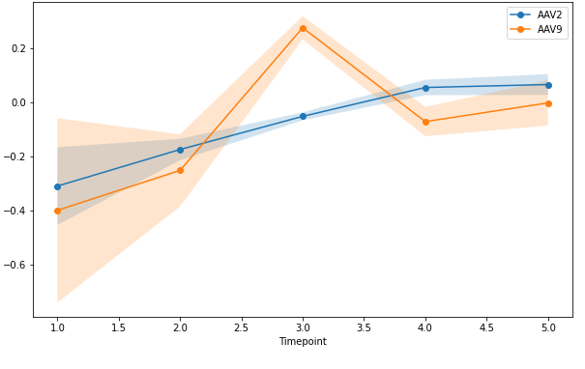
Potential AAV serotype-specific behavior
Process 2: Proline
Proline consumption may be an outlier
  Did not show early consumption or time-shifted “production”
Are there mechanisms to explain this different trend for proline?
Consumption (umol/E6 cells-day)
Time (dpt)

Slide 30
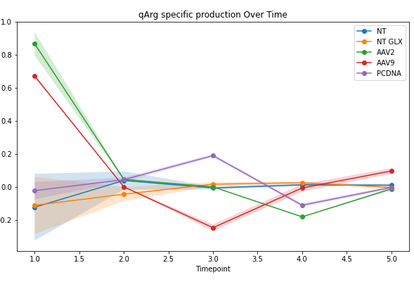
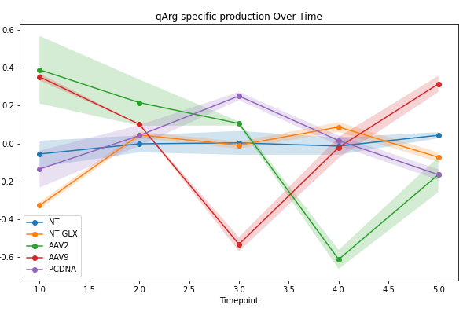
Process1 vs Process2 comparison
‘Slow growth’ Process1: Arginine
‘Good growth’ Process2: Arginine
Consumption (umol/E6 cells-day)
Consumption (umol/E6 cells-day)
AAV9
AAV2
Time (dpt)
Time (dpt)
Similar trends but more accentuated shift among AAV producers on days 3-4 for process 2
Serotype-specific ‘shift’ remains prominent

Slide 31
Standard material received for SEC-MALS method development
Updates:
JHU team visited NIST
Ran standard material on SEC-MALS for AAV full/empty calibration generation
Data analysis ongoing for feasibility of method
Reference material reserved for Mass Photometry
Sample | Titer | Note
1. AAV2 Full Capsids | 4.27X10^11 vector genomes/mL | 90% full capsids
2. AAV2 Empty capsids | 1.34x10^13 capsids/mL | 100% empty capsids

Slide 32
Next steps
Compare AAV2 and AAV9 amino acid consumption with higher seed density
  Aim to exhaust one or multiple amino acids
  Measure AAV titer daily to get consumption/vector produced
Determine equipment capabilities for SEC-MALS and mass photometry
Begin DoE screens for essential amino acid deleted media

