Slide 1
Maximizing Yields of rAAV and Elucidating the Role of Media Components Through Design and Optimization of AMBIC.293 Media
David McNally (MassBiologics/UML), Seongkyu Yoon (UML), Mike Betenbaugh/Michael Bevan (JHU), Kelvin Lee (UD)

Slide 2
UML Update
Batch-to-Batch Variation troubleshooting
  Troubleshooting transfection
  Troubleshooting capsid lysis and qPCR
  AAV2/9 capsid structure (amino acids frequency)
Next steps

Slide 3
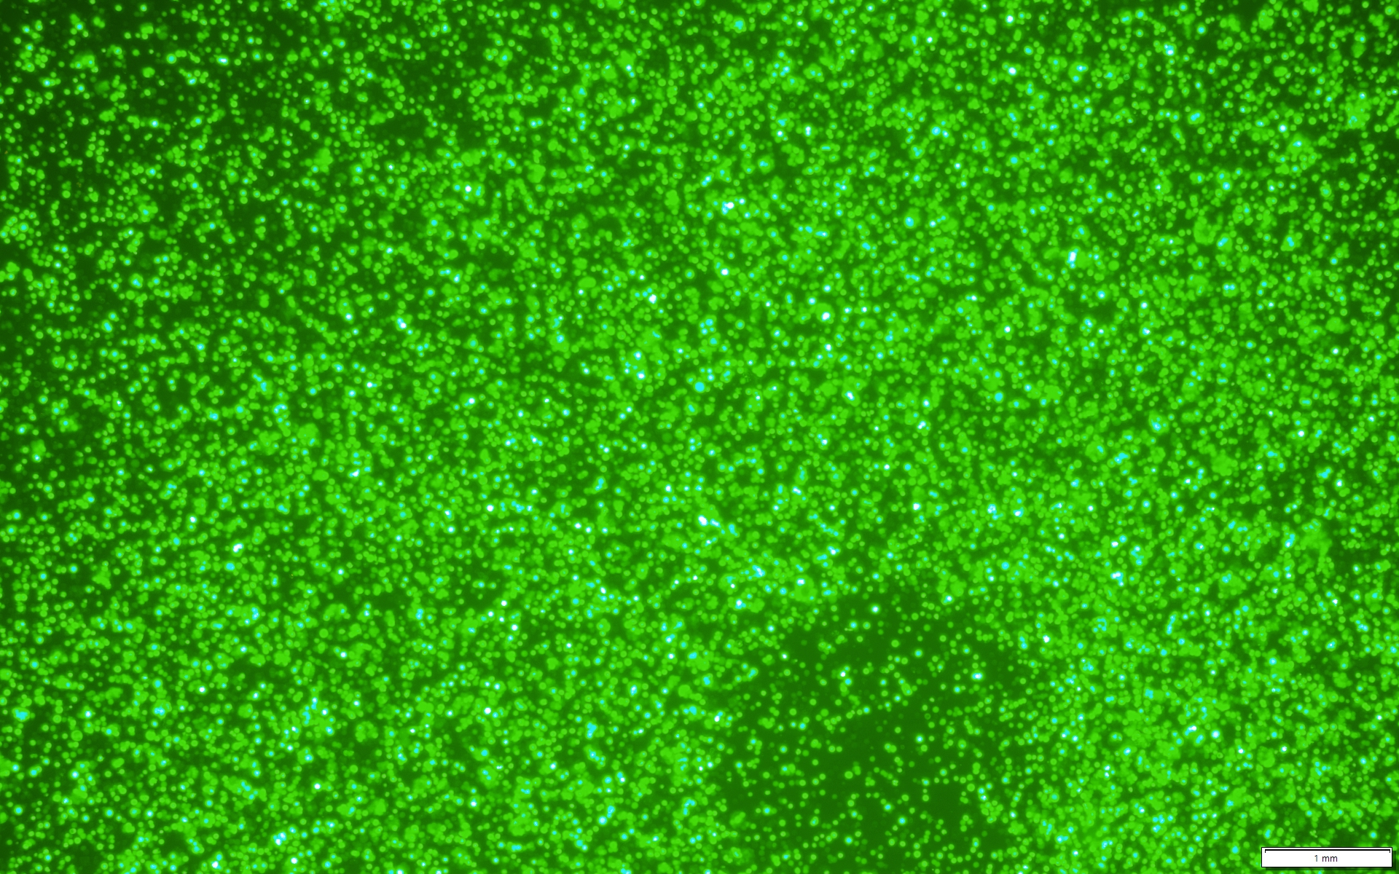
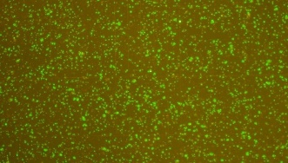
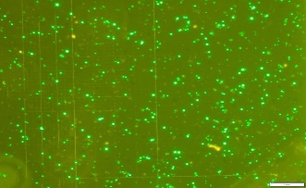
Troubleshooting Transfection
Transfection | Seeding density | PEI:DNA | pHelper :pGOI:pRep/Cap | DNA amount | VCD on harvest day | GFP expression on harvest day | Genome titer
BalanCD HEK293 cells for AAV2 productin (Yongdan) | 2*10⁶ Cells/mL | 1:1 | 1:1:1 | 0.75 pg/cell | 6.2*10⁶ Cells/m |  | 3.93E12 vg/liter
BalanCD HEK293 cells for AAV2 production (Hourieh) | 2*10⁶ Cells/mL | 1:1 | 1:1:1 | 0.75 pg/cell | 5.6*10⁶ Cells/mL |  | 2.8E12 vg/liter
BalanCD HEK293 cells for AAV2 production (George) | 2*10⁶ Cells/mL | 1:1 | 1:1:1 | 0.75 pg/cell | 3*10⁶ Cells/mL |  | 5E12 vg/liter
BalanCD HEK293 cells for AAV9 production (Hourieh) | 2*10⁶ Cells/mL | 1:1 | 1:1:1 | 0.75 pg/cell | 7*10⁶ Cells/mL |  | 9.6E12 vg/liter

Slide 4
Troubleshooting Transfection
Transient transfection under identical conditions are independently conducted by multiple operators.
  The genome titer for AAV2/2 ranged from 2.8E12 vg/liter to 5E12 vg/liter.
Planning to send our purified plasmids to JHU
Cross-comparison of transfection procedure
Check the plasmids
Inclusion of a D3-post transfected sample as a control mitigate potential assay variability.

Slide 5
Troubleshooting Capsid Lysis Method and qPCR
Capsid lysis method (PK treatment vs. Qiagen kit)
Total dilution factor (DNase treatment/ CGT lysis buffer/ CGT dilution buffer)
  BalanCD HEK293 cells for AA2/2 production 2000X (10X*10X*20X)
1000X (10X*10X*10X)
BalanCD HEK293 cells for AAV2/9 production
2000X (10X*10X*20X)
10000X (10X*10X*100X)
sample | PK treatment | Qiagen kit
BalanCD HEK293 cells for AAV2/2 production (Yongdan) | 3.93E12 vg/liter | 2.21E12 vg/liter (2000X dilution)
BalanCD HEK293 cells for AAV2/9 production (Hourieh) | 9.6E12 vg/liter | 1.08E13 vg/liter (2000X dilution) 1.02E13 vg/liter (10000X dilution) 9.25E12 vg/liter (1000X dilution)

Slide 6
Troubleshooting Capsid Lysis Method and qPCR
Switching from AAV5 to linearized GFP as the reference standard
  Employment of both AAV5 and linearized GFP in the last qPCR Robust alignment
Cross-comparison of different qPCR assays (TaqMan vs. SYBR Green)
  Conducting genome titer measurement with JHU sample on harvest day (1E14 vg/liter)

Slide 7
AAV2/9 Capsid Structure
Consisting of a total 60 subunits of 3 distinct viral proteins (VPs)
  VP1, VP2, and VP3, encoded by the cap open reading frame (ORF)
    Ratio (VP1:VP2:VP3) 1:1:10
 | Met | Ala | Asp | Gly | Tyr | Leu | Pro | Typ | Glu | Arg | Gln | His | Val | Ser | Phe | Lys | Ileu | Cys | Thr | Asn
Frequency (all VPs) | 605 | 1970 | 1475 | 2915 | 1570 | 2190 | 2185 | 735 | 1235 | 1280 | 2080 | 730 | 1785 | 2480 | 1710 | 1125 | 1145 | 300 | 2715 | 2985
Percentage frequency | 1.8% | 6% | 4.5% | 8.8% | 4.7% | 6.6% | 6.6% | 2.2% | 3.7% | 3.8% | 6.3% | 2.2% | 5.4% | 7.51% | 5.1% | 3.4% | 3.4% | 0.9% | 8.2% | 9%
The most abundant amino acid Asparagine (9%)
The least abundant amino acid Cysteine (0.9%)
% frequency (Green: UML, Orange: JHU, Blue: UML & JHU)
Asn > Gly > Thr > Ser > Leu = Pro > Gln > Ala > Val > Phe > Tyr > Asp > Arg > Glu > Lys = Ileu > His = Typ > Met > Cys

Slide 8
Next steps
Exchanging the materials between UML and JHU for batch-to-batch variation troubleshooting
Thawing the AMBIC HEK293 cells
  Conducting transfection of AMBIC HEK293 cells for AAV2/9 production in AMBIC HEK media with IronEDTA, CaCl at two scales (shake flask and deep well plate) to ensure we can get the consistent results across diverse experimental scales.
  Conducting transfection of AMBIC HEK293 cells for AAV9 production in AMBIC HEK depleted media after adding back the amino acids.
Collect some data for amino acid measurement in commercial media

Slide 9
JHU Updates
Began AAV2 v AAV9 nutrient study and Chelator study
  Decided not to pursue Rebel analysis
  Low growths, even before study, low titer
Got media
Got AAV standards
  Will do SEC-MALS development first before Mass Photometry @NIST

Slide 10



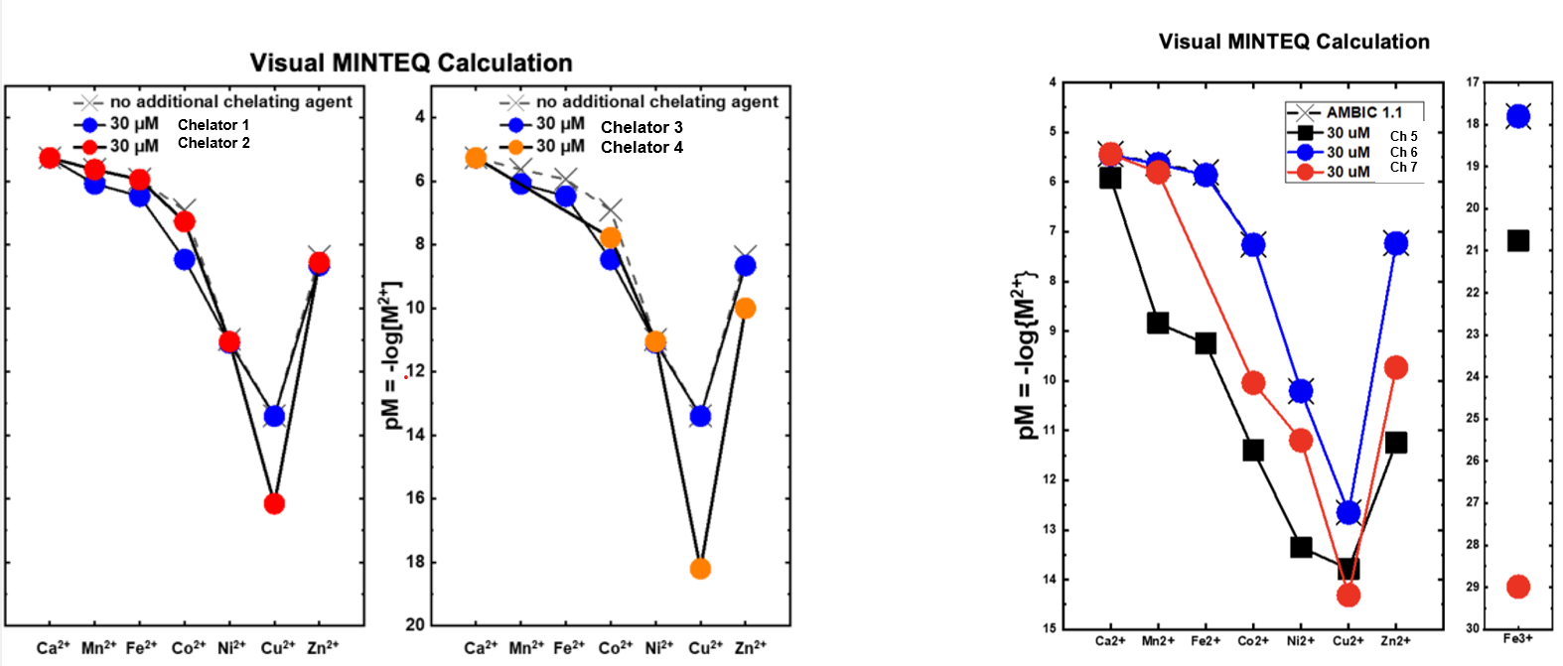
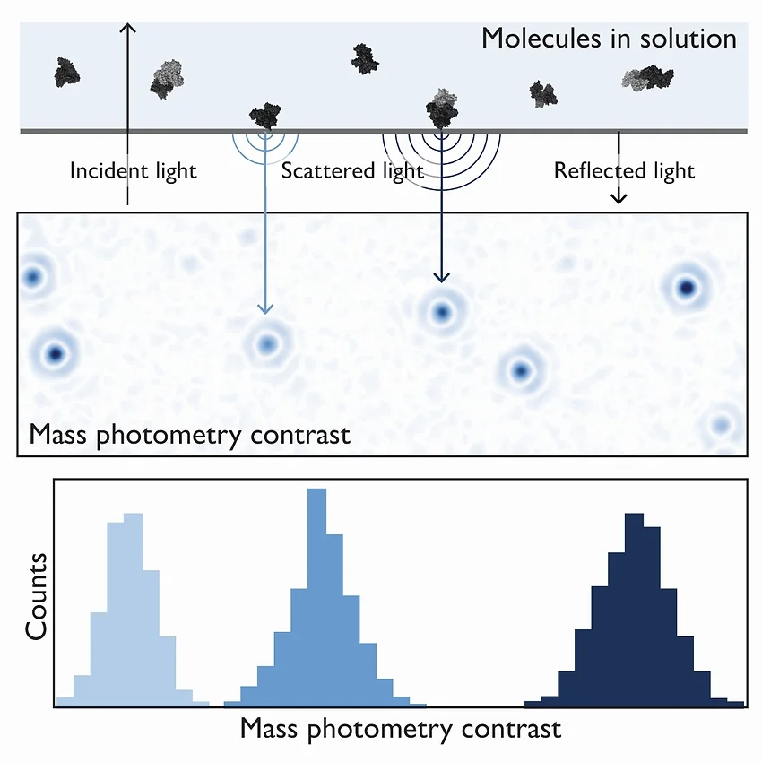
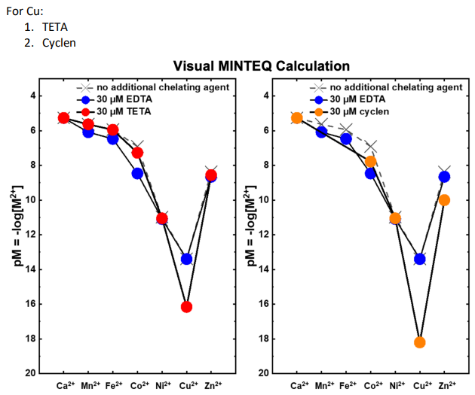
Overview
Inputs
 | Isoleucine (mM) | Leucine (mM) | Lysine (mM) | Tryptophan (mM) | Valine (mM)
1 | 1.2 | 1.8 | 1.3 | 0.25 | 0.93
2 | 1.2 | 1.8 | 2.5 | 0.57 | 3.70
3 | 1.2 | 3.5 | 1.3 | 1.14 | 3.70
4 | 2.3 | 3.5 | 2.5 | 0.57 | 1.85
5 | 2.3 | 3.5 | 5.1 | 1.14 | 0.93
6 | 2.3 | 7.0 | 2.5 | 0.25 | 0.93
7 | 4.6 | 1.8 | 5.1 | 0.57 | 1.85
8 | 4.6 | 7.0 | 1.3 | 0.25 | 1.85
9 | 4.6 | 7.0 | 5.1 | 1.14 | 3.70
Essential Amino Acid DOE
AMBIC 1.293 Shipped, awaiting custom
Comparing AAV2 vs AAV9
Complete
3. Chelator study
Completed, deep well plates validated
4. Mass-Photometry Analysis/SEC-MALS
Standard material received!

Slide 11
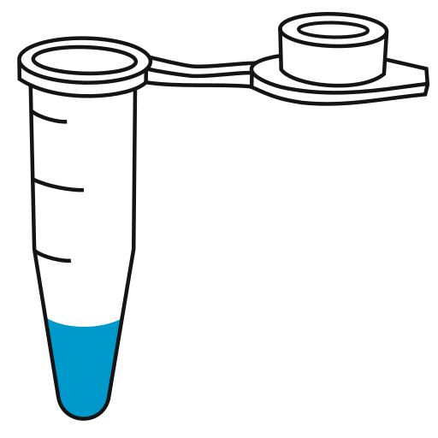
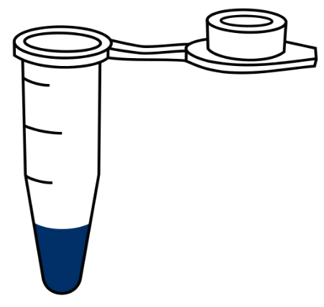
Ongoing AAV Media consumption experiment (Commercial HEK in media)
PEI vs AAV9 vs AAV2
S#​ | Condition​ | Description​
1.​ | NT (Gln) | Untreated freely growing cells in glutamine​
2. | NT (Glx) | Untreated freely growing cells in Glutamax
3.​ | AAV2 | Typical AAV2 transfection process 1pg/cell​
4. | AAV9 | AAV9 transfection 1pg/cell​, same ratio
5.​ | Blank Tx | Transfection with blanks backbone plasmid 1pg/cell​
Daily
Days 3-5
Supernatant for AAV secretion
Supernatant for Glucose, lactate, Rebel analysis
Bulk sample for AAV titer (standard)
Count, watch viability
Pellet for in-cell AAV

Slide 12
AAV2 versus AAV9 growth data
Repeated previous experiment to generate samples for additional timepoints (D0-D5)
Growth trends look generally as expected but with more drastic drop in viability than expected for Tx
Glutamine and Glutamax cells grew almost indistinguishably.
All conditions grew more slowly than is typical (no doubling on day 3 f
NT barely doubleD

Slide 13
AAV2 v. AAV9 Day 3 titer
Repeated previous experiment to generate samples for additional timepoints (D0-D5)
Approximately 40% of AAV9 was secreted
Relative AAV2 and AAV9 titer trends follow past results
Absolute value of titers are low
Low confidence to analyze supernatants via REBEL

Slide 14
Chelator growth study
Scaled up promising chelator (Ch3) to 30mL format to assess if trends are maintained

Slide 15
AAV2 v. AAV9 nutrient study reattempt
Previous run
Current run
Study in progress. Growth data looks more representative of historical data (as of D3)

Slide 16
AAV2 v. AAV9 Day 3 titer reattempt
Titers more closely match historical data on D3 for AAV2 and AAV9
D4 and D5 sample collection still in progress
Confident to continue to supernatant amino acid analysis if trends continue on D4, D5

Slide 17
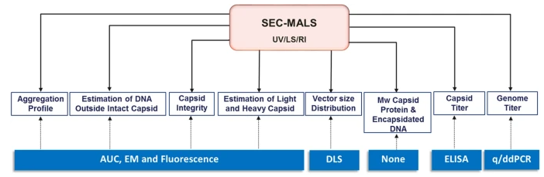
Standard material received for SEC-MALS method development
Sample | Titer | Note
1. AAV2 Full Capsids | 4.27X10^11 vector genomes/mL | 90% full capsids
2. AAV2 Empty capsids | 1.34x10^13 capsids/mL | 100% empty capsids
Potential for aggregation, titer and empty-full numbers in one instrument

Slide 18
Next steps
Continue recovering thawed AMBIC cells in 1.293 media
  Bank cells before further studies
Begin SEC-MALS method development
  Full empty protocol
Complete AAV2 v AAV9 nutrient study
  Harvest up to day 5
  Conduct Rebel analysis

Slide 19
UD Update
Reference Material Generation
Empty/Full Enrichment
HPLC Analysis of Empty:Full using ion-exchange chromatography

Slide 20
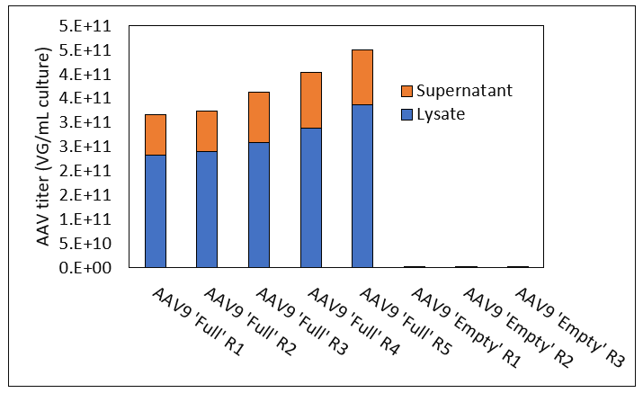
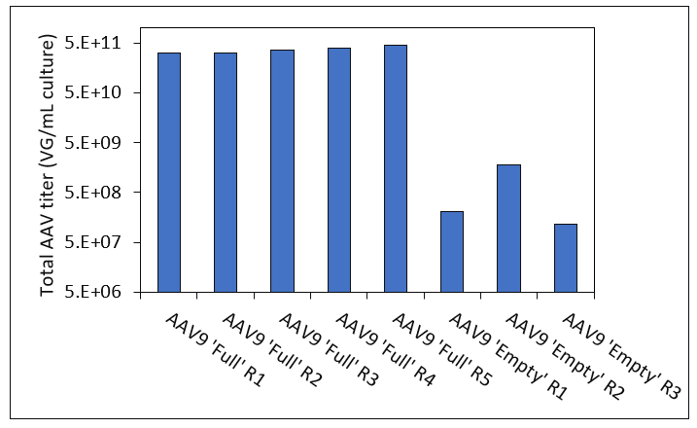
AAV9 Scale-up Material Generation – qPCR
qPCR performed with linearized EGFP plasmid standard curve
‘Empty’ capsid lots show 3-log lower qPCR response compared to ‘Full’ capsid lots
‘Empty’ lots measure near background reading for Null lysate
Average of 3.72 E 11 VG/mL culture for ‘Full’ lots
Total of 6.44 E 14 VGs produced

Slide 21
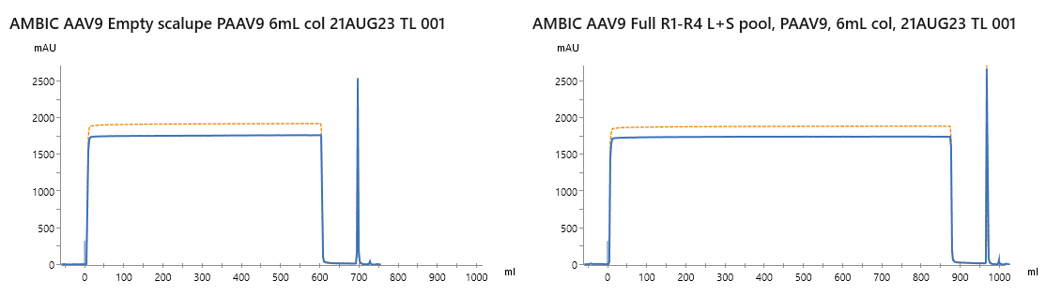
AAV9 Reference Material Generation – Downstream Process Update
AAV9 Empty capsid
PAAV9 chromatogram
AAV9 Full-containing
PAAV9 chromatogram
UV 280 nm
UV 260 nm
30 mL elution pools collected into neutralization buffer for each material lot

Slide 22
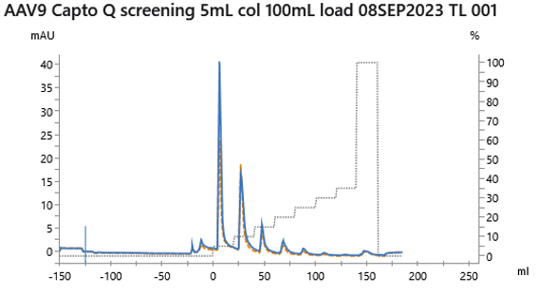
AAV9 Full / Empty separation screening run
Goal – Separate AAV9 full and empty capsids after affinity purification
Target process
Empty removal - 5% Buffer B step
Full elution – 50% Buffer B step

Slide 23
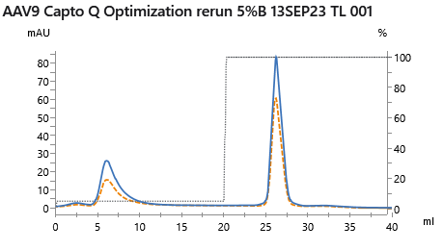
AAV9 Full / Empty separation optimization run
Process analysis
‘empty removal’ peak and ‘full capsid’ peaks were fractionated
Capsid titer (AAVX octet) and VG titer (qPCR) of load material and two fractionated peaks were measured to evaluate separation (full capsid enrichment and yield)
Next steps
If performance is acceptable – process AAV9 material lots to generate AAV9 reference standards with higher full%

Slide 24
AAV9 Full / Empty separation optimization run
Capsid yield balance calculated using AAVX octet
VG yield balance calculated using qPCR
F/E calculated using both AAVX octet and qPCR data
UV 260/280 - 0.61
Capsid yield – 41%
VG yield – 9%
UV 260/280 - 0.75
Capsid yield – 59%
VG yield – 91%
 | F/E calc - load | F/E calc - high salt
AAV9 | 13.0% | 39.8%
Next steps
Re-optimize to further enrich full capsid content
  Use shallow elution gradient
  Use higher % salt step
Apply ‘more accurate’ method to measure F/E
Apply method to affinity-purified vector lots to generate reference material

Slide 25
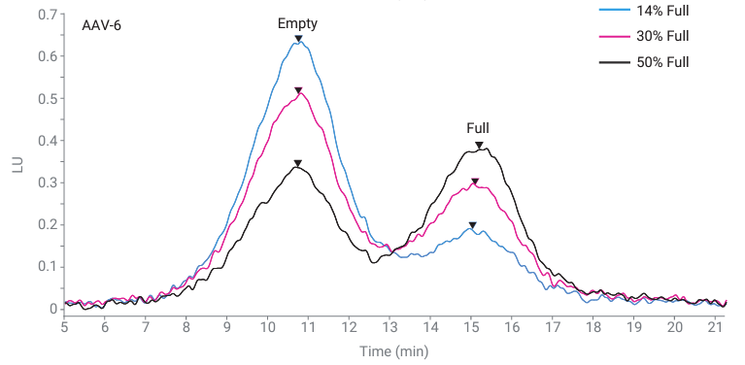
HPLC method development for F/E measurement
Accurate and reproducible F/E capsid ratios can be measured with Agilent Bio SAX strong anion exchange columns
(1)
Relative peak height ~ F/E ratio
Use of standards
Comparison with orthogonal methods
Binary Pump
A: 70 mM bis-tris propane, pH 9.0, 2 mM MgCl₂
B: 70 mM bis-tris propane + 1 M tetramethylammonium chloride, pH 9.0, 2 mM MgCl₂
Time | % A | % B | Flow Rate (mL/min)
0 | 85 | 15 | 0.1
25 | 72.5 | 27.5 | 0.1
25.1 | 0 | 100 | 0.3
28 | 0 | 100 | 0.3
(1) Liau, B. Agilent Applications, 2022‌

