Slide 1








Industry/University Cooperative Research Center (I/UCRC)
Advanced Mammalian Biomanufacturing Innovation Center (AMBIC)
Dissecting Spent Media to Elucidate Components and Mechanisms that Affect Cell Culture Performance
Terry Papoutsakis (UD), Maciek Antoniewicz (UMich)
Mentor Meeting -- April 19, 2023
A National Science Foundation-facilitated
academic – industry – government consortia
to advance precompetitive knowledge in biomanufacturing
Contents are Proprietary to AMBIC and its Members
Terms of Center Membership Agreement Apply
www.ambic.org

Slide 2
Industrial Relevance & Need
CHO cells communicate with each other through the exchange of various components (small and large)
By exchanging small molecules, peptides, proteins, RNA, etc., cells could be homogenizing the cell population and dynamically regulating proliferation and their cellular states
In this project, we will investigate this hypothesis by dissecting spent media and systematically quantifying the impact on cells
In the end, we will provide new approaches to selectively remove unwanted components released by CHO cells
Johns Hopkins University
Clemson University
University of Delaware
University of Massachusetts Lowell
University of Maryland

Slide 3
Microparticles and Exosomes
Johns Hopkins University
Clemson University
University of Delaware
University of Massachusetts Lowell
University of Maryland
  Extracellular vesicles are highly enriched in specific microRNAs**
  MicroRNAs are central to adaptive responses to stress and more broadly to changes in culture conditions
**Belliveau & Papoutsakis, B & B, 2023. DOI 10.1002/bit.28356

Slide 4
Microparticles and Exosomes
Johns Hopkins University
Clemson University
University of Delaware
University of Massachusetts Lowell
University of Maryland
  Exosomes also play an important role in transport of small molecules between cells
  We will use the previously developed Exo-¹³C-MFA approach to quantify metabolic cross-feeding fluxes in CHO cell cultures
Achreja A - Metab Eng - 2017

Slide 5
Project Goals
GOAL 1
Identify growth-inhibiting and growth-promoting extracellular components found in spent media
GOAL 2
Optimize removal of unwanted components from spent media to improve high cell-density cultures (perfusion/fed-batch)
Johns Hopkins University
Clemson University
University of Delaware
University of Massachusetts Lowell
University of Maryland

Slide 6
Objectives
Obtain spent media from IAB members (?)
Alternatively, generate our own spent media using stressed/unstressed cultures
Dissect spent media using various filtration techniques
after separating out CHO cells, microparticles and exosomes
Culture cells in 50% fresh + 50% filtered spent media percentages can be adjusted after preliminary experiments
Identify components that impact culture performance and optimize the removal of unwanted components
Johns Hopkins University
Clemson University
University of Delaware
University of Massachusetts Lowell
University of Maryland

Slide 7
What Causes Cells to Die in Culture?
Small molecules accumulate in spent media (increased osmolality)
  Salts from pH control
  Lactate, ammonium
  Other secreted toxic by-products
  Amino acids (produced by cells and/or from overfeeding)
Proteins, peptides, cell debris (medium size components)
  Secreted extracellular proteins and peptides
  Host cell proteins from damaged cells
Exosomes and microparticles (large size components)
  Extracellular vesicles facilitate dynamic exchange of proteins and RNA*
  Extracellular vesicles are highly enriched in microRNAs**
Johns Hopkins University
Clemson University
University of Delaware
University of Massachusetts Lowell
University of Maryland
* Belliveau & Papoutsakis, B & B, 2022. DOI 10.1002/bit.28053.
**Belliveau & Papoutsakis, B & B, 2023. DOI 10.1002/bit.28356

Slide 8
Proteins and Peptides
In past AMBIC projects, we have shown that CHO cells release proteins that actively metabolize small molecules
Metabolism doesn’t only take place inside CHO cells!!
  Dipeptides are cleaved at high rates in spent media
  Small molecules such as malate, fumarate, oxaloacetate are metabolized outside CHO cells
In this project, we will use ¹³C-tracing to quantify
“inside-metabolism” vs. “outside-metabolism”
  What is the impact of eliminating “outside-metabolism”?
Johns Hopkins University
Clemson University
University of Delaware
University of Massachusetts Lowell
University of Maryland

Slide 9
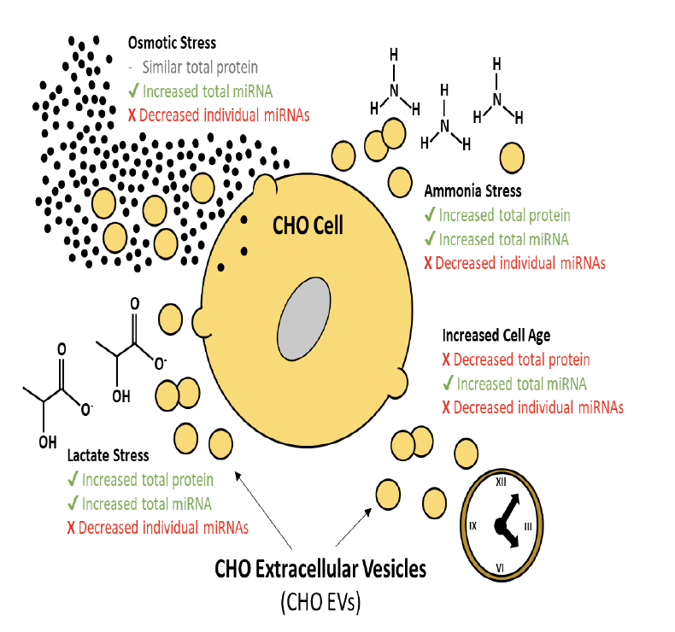
EVs
EVs have not been examined for their biological effects in culture performance
They are loaded with proteins, lipids & small RNAs, which they release in the medium
They are dynamically produced and taken up during culture
Their content varies w/ culture age and conditions (e.g., stress)
Can have positive or negative effects
Johns Hopkins University
Clemson University
University of Delaware
University of Massachusetts Lowell
University of Maryland

Slide 10
Use Filtration to Dissect Spent Media
Small molecules
(<300 Da)
Peptides
(~1 kDa)
Proteins
(10-50 kDa)
Exosomes
Microparticles
1
2
3
4
5
10
20
30
40
50
100
200
300
400
500
nm
Johns Hopkins University
Clemson University
University of Delaware
University of Massachusetts Lowell
University of Maryland
Remove CHO cells
  Use gentle centrifugation
  Use 0.45 μm or 1.0 μm filtration
Remove exosomes and microparticles
  Use high-speed centrifugation
  Use 0.05 μm or 0.10 μm filtration

Slide 11
Use Filtration to Dissect Spent Media
Small molecules
(<300 Da)
Peptides
(~1 kDa)
Proteins
(10-50 kDa)
Exosomes
Microparticles
1
2
3
4
5
10
20
30
40
50
100
200
300
400
500
nm
Johns Hopkins University
Clemson University
University of Delaware
University of Massachusetts Lowell
University of Maryland
Nanofiltration
3-10 nm filters
Ultrafiltration
Millipore Durapore filters (0.10 μm)
Cytive Whatman Nucleopore filters
(0.08 μm, 0.05 μm, 0.03 μm)
Whatman Anotop filters
(0.02 μm, 0.015 μm)
Millipore Ultracel filters (1, 3, 10, 30, and 100 kDa)
Microfiltration
Millipore (0.45 μm)
Millipore (0.20 μm)

Slide 12
To Do List (1)
CHO cell line: AMBIC NIH CHO-K1 cell line
(DHFR expression system, IgG1 with glycosylation on both chains)
Generate spent media (initially up to 1 Liter)
  Use perfusion CHO cell cultures (UDel)
    HyClone ActiPro media with supplements (see below)
  Use fed-batch CHO cell cultures (UMich)
    MilliporeSigma Immediate AdvantageTM growth medium + AMBIC v1.1 feed
  QUESTIONS:
    Can we freeze spent media (-20C, -80C)?
    Any suggestions how to best freeze and thaw frozen media?
Separate out CHO cells, exosomes and microparticles (UDel)
  QUESTIONS:
    Can we freeze exosomes and microparticles (-20C, -80C)?
    We have been freezing them in full culture medium. One thaw, no re-thawing. They retain about 85-95% of biological activity. Need to test for loss of EV #s upon thawing.
Johns Hopkins University
Clemson University
University of Delaware
University of Massachusetts Lowell
University of Maryland

Slide 13
To Do List (2)
Demonstrate that we have removed all EVs (UDel)
Measure particle size counts and distribution (before and after separation)
  EV size & number measurements and separation protocols in place
  EV content and biological effects depend on culture age and stress
  Need to test for any residual EVs after small EV (exosome) separation
  Develop testing protocols for positive or negative impact of EVs (UDel)
  EV content (small RNAs and proteins) and biological efficacy
  changes with culture age and “stress”
Demonstrate that we have removed proteins
  Quantify protein content in different filtration fractions
  Show that external metabolism stops in different filtration fractions
    Quantify dipeptide cleavage
    Quantify malate-fumarate interconversion
Johns Hopkins University
Clemson University
University of Delaware
University of Massachusetts Lowell
University of Maryland

Slide 14
To Do List (3)
Removal of small RNAs (mostly miRs) and all RNAs? (UDel)
  What RNA concentrations in media?
  Do they impact culture performance
  Need to settle on suitable protocols
Test effect of freezing-thawing of spent media on CHO cells
  Compare fast thawing vs. gradual slow thawing
  Perform batch cultures with 50/50 mixtures of fresh and spent medium
  Compare unfrozen spent medium (4ºC) vs. frozen/thawed spent medium
Johns Hopkins University
Clemson University
University of Delaware
University of Massachusetts Lowell
University of Maryland

Slide 15
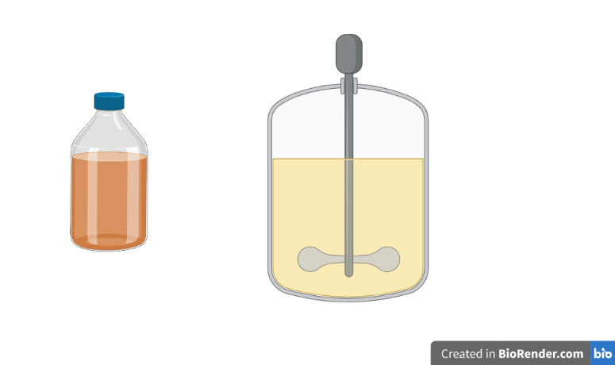
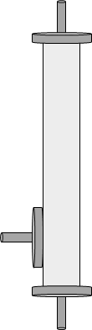

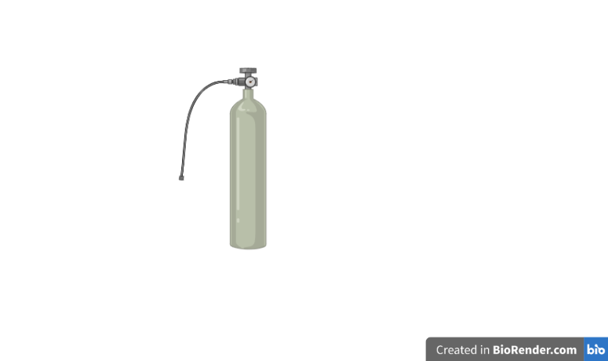
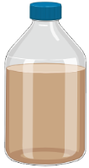
Perfusion HCCF collection during transient and pseudo steady-state regimes
CHO-K1 VRC01 cell line
Preliminary media blend:
HyClone ActiPro basal media
3% (v/v) HyClone Cell Boost 7a
0.3% (v/v) HyClone Cell Boost 7b
Oscillations arising from a manual cell bleed implemented to control the VCD
VCD_{sp}
Johns Hopkins University
Clemson University
University of Delaware
University of Massachusetts Lowell
University of Maryland
VCD [10⁶ cells mL⁻¹ ]
Sampling intervals
Time [Days]
Harvest cell culture fluid (HCCF) collected from perfusion permeate during transient and pseudo steady-state regimes
24-hour collection period at 4 °C
Storage at -80 °C until analysis
Perfusion Bioreactor
TFF
Cell Bleed
O₂
CO₂
Media
Product

Slide 16
Meeting Schedule
Time
    Thursday, 2-3pm EST (any other day or time that works better??)
Frequency
  Every 1.5 to 2 months
  No Zoom meeting in June (update will be provided at the June AMBIC meeting)
  Next meeting in August
Johns Hopkins University
Clemson University
University of Delaware
University of Massachusetts Lowell
University of Maryland

