Slide 1








Industry/University Cooperative Research Center (I/UCRC)
Advanced Mammalian Biomanufacturing Innovation Center (AMBIC)
Develop an Inducible Stable Producer Cell Line for rAAV Production via Site-Specific Integration
Qiang Fu and Emily Doleh
Seongkyu Yoon (PI) / Mark Blenner (Co-PI)
Mentor Meeting – April 17, 2023
A National Science Foundation-facilitated
academic – industry – government consortia
to advance precompetitive knowledge in biomanufacturing
Contents are Proprietary to AMBIC and its Members
Terms of Center Membership Agreement Apply
www.ambic.org

Slide 2
Agenda
Project overview
UD Progress
  Plasmid design and timeline for assembly
UML Progress
Action Items

Slide 3
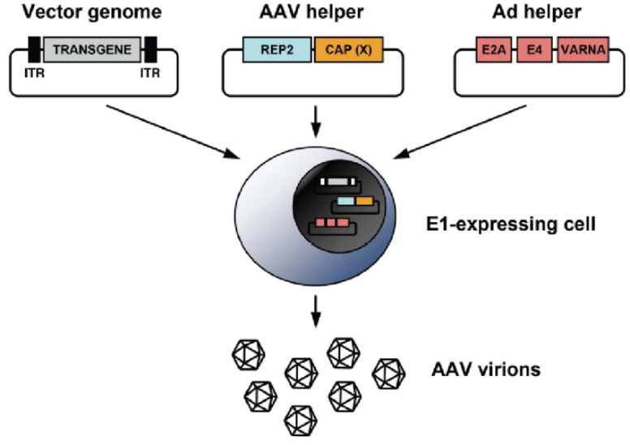
Industrial Relevance & Need
HEK 293 cells
Drawbacks of the traditional rAAV production process that uses transient transfection in HEK293 cells
Complicated and expensive process consuming considerable amount of transfection reagent and plasmids
The lot-to-lot variation of the products
Difficult to scale up
A stable producer of rAAV is needed!

Slide 4
Project Goals
Design inducible circuits that can regulate the timing and level of gene expression for all components necessary to make rAAV
Develop an inducible stable producer cell line with site-specific integration for extensible rAAV production
Objectives
Refactor rAAV rep, cap, and helper genes using variations of the inducible Tet-off promoter
Optimize the rAAV rep, cap, and helper gene expression levels for high titer rAAV, by Kozak sequences and degrons
Establish an inducible stable producer cell line with site specific integration in well-known human genomic safe harbors for rAAV production
Notes:
Why Tet-off promoter rather than Tet-on?
The tet-off-based inducible circuit will be used to eliminate the antibiotics in the rAAV production stage.

Slide 5
Research Workflow & Timeline
Udel
inducible design and plasmid assembly
UML
Crisp-cas9, cell culture, integration
UML & UD
Design of Tet-on/off inducible circuits
Crispr-Cas9 platform development and testing AAVS1, CCR5 and ROSA26 loci
Analytical methods (qPCR, Elisa, RT-qPCR, WB, proteomics)
1-3 M
Tet off/on switch for 3 cassettes via Golden gate
Transfer plasmid
Assembly plasmid
Replication plasmids
AAV parts integration, The baseline of Stable cell line
Testing inducible plasmids via transient
4-8 M
Optimization of gene-level and dynamics by engineered inducible variants, Kozak, and Degron tags
Optimized AAV parts integration, The optimized stable cell line
Evaluate optimized plasmids via transient
9-14 M

Slide 6
UD Progress

Slide 7
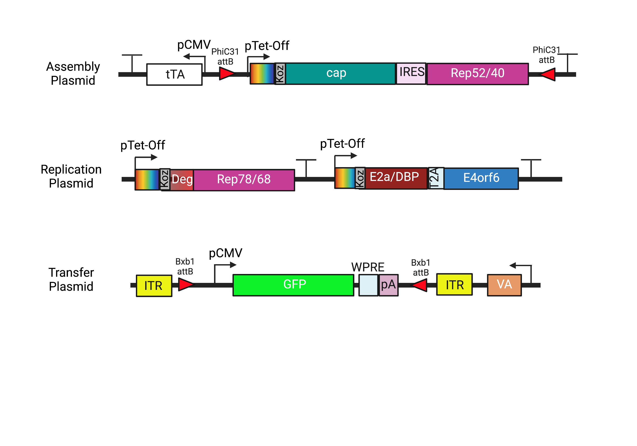
Plasmid Design
All sequences ordered were found from literature and compared with NCBI database

Slide 8
Plasmid Design
Addition of PhiC31 integrase on assembly plasmid to exchange serotypes in future

Slide 9
Plasmid Design
Previously: Silent mutation of BsmBI recognition sites within Cap sequence
→ This can affect AAP due to its shifted reading frame
Therefore, we are using the original Cap sequence for cloning

Slide 10
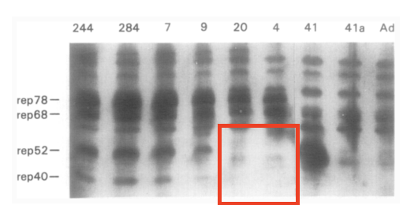
Plasmid Design
Silencing of internal p19 promoter through removal of start codon to stop transcription of Rep52/40
Is this sufficient to silence p19?
Chejanovsky, N.; Carter, B. J. Mutagenesis of an AUG Codon in the Adeno-Associated Virus Rep Gene: Effects on Viral DNA Replication. Virology 1989, 173 (1), 120–128. https://doi.org/10.1016/0042-6822(89)90227-4.

Slide 11
Plasmid Design
Bxb1 sites moved inside ITRs for ease of payload exchange

Slide 12
Plasmid Design
Previously: Silent mutation of BsmBI recognition sites within VA sequence
→ This impacts the structure of the RNA
Therefore, we are using the original VA sequence for cloning

Slide 13
Fragment Design
 | Rep78/68
Sequence Change (AA) | 225: ATG → GGG
Reason | Removal of p19 start codon
Comments | Previous work reported the silencing of the p19 promoter through the mutation of the start codon¹
(1) Chejanovsky, N.; Carter, B. J. Mutagenesis of an AUG Codon in the Adeno-Associated Virus Rep Gene: Effects on Viral DNA Replication. Virology 1989, 173 (1), 120–128. https://doi.org/10.1016/0042-6822(89)90227-4.

Slide 14
Plasmid Assembly Timeline
 | Assembly Plasmid | Replication Plasmid | Transfer Plasmid
Designing | 02/10 - 03/29 | 02/10 - 03/29 | 02/10 - 03/02
Ordering | 03/02 - 04/11 | 03/02 - 04/11 | 03/02 - 3/15
Entry Vector Preparations | 03/15 - 4/25 | 03/15 - 4/25 | 03/15 - 4/25
Golden Gate Assembly | 04/25-present | 04/25-present | 04/25-present

Slide 15
UML Progress

Slide 16
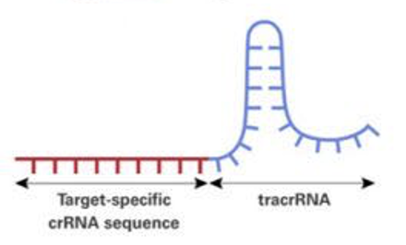
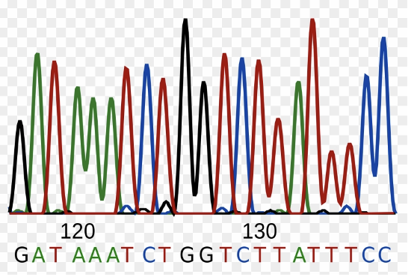
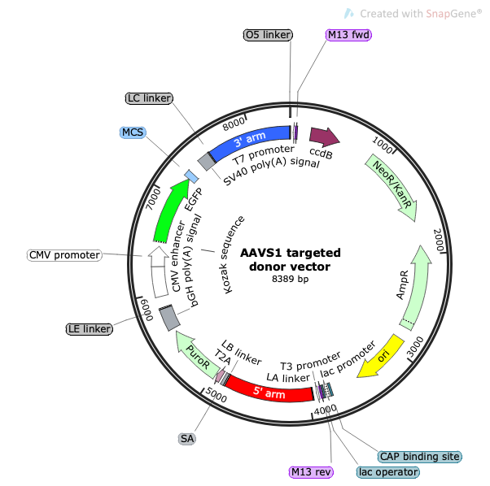
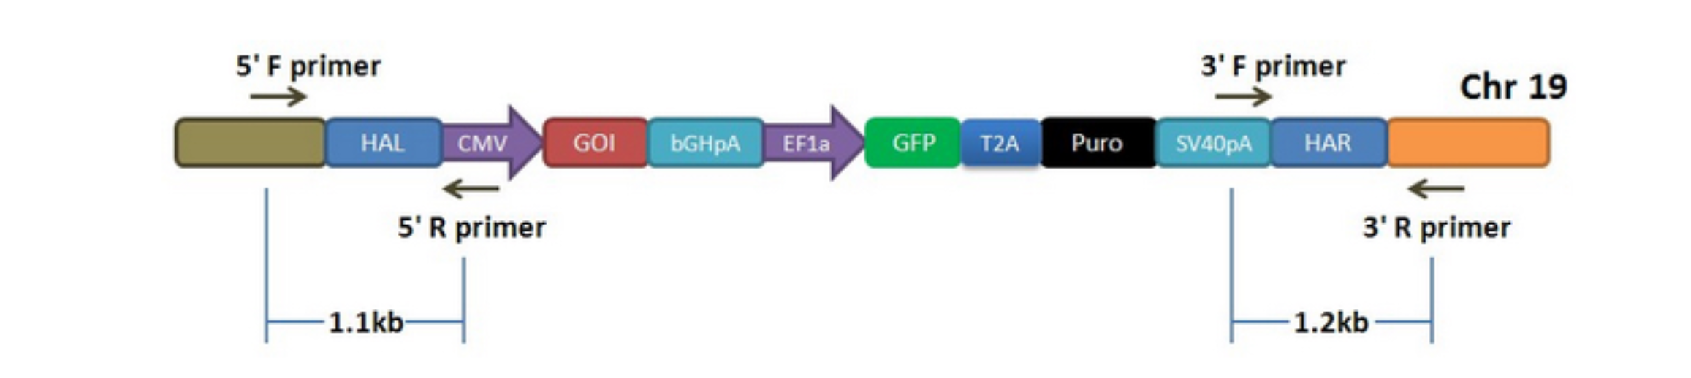
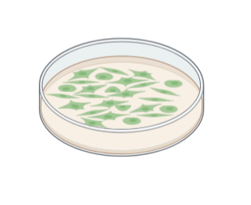
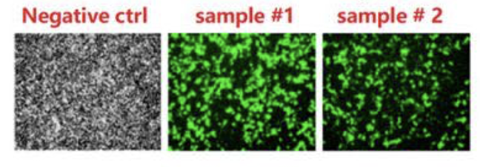

CRISPR-Cas9 mediated target gene knock-in platform:
sgRNA design
Cloning sgRNA to Cas9 vector
plasmid sequencing
Donor plasmids assembly
Genomic DNA extraction and Site-specific integration testing via junction PCR
HEK293 cells transfected with two plasmids & antibiotic selection
Stable cell pool
Single clone isolation
Targeted locus amplification (TLA) and sequencing

Slide 17
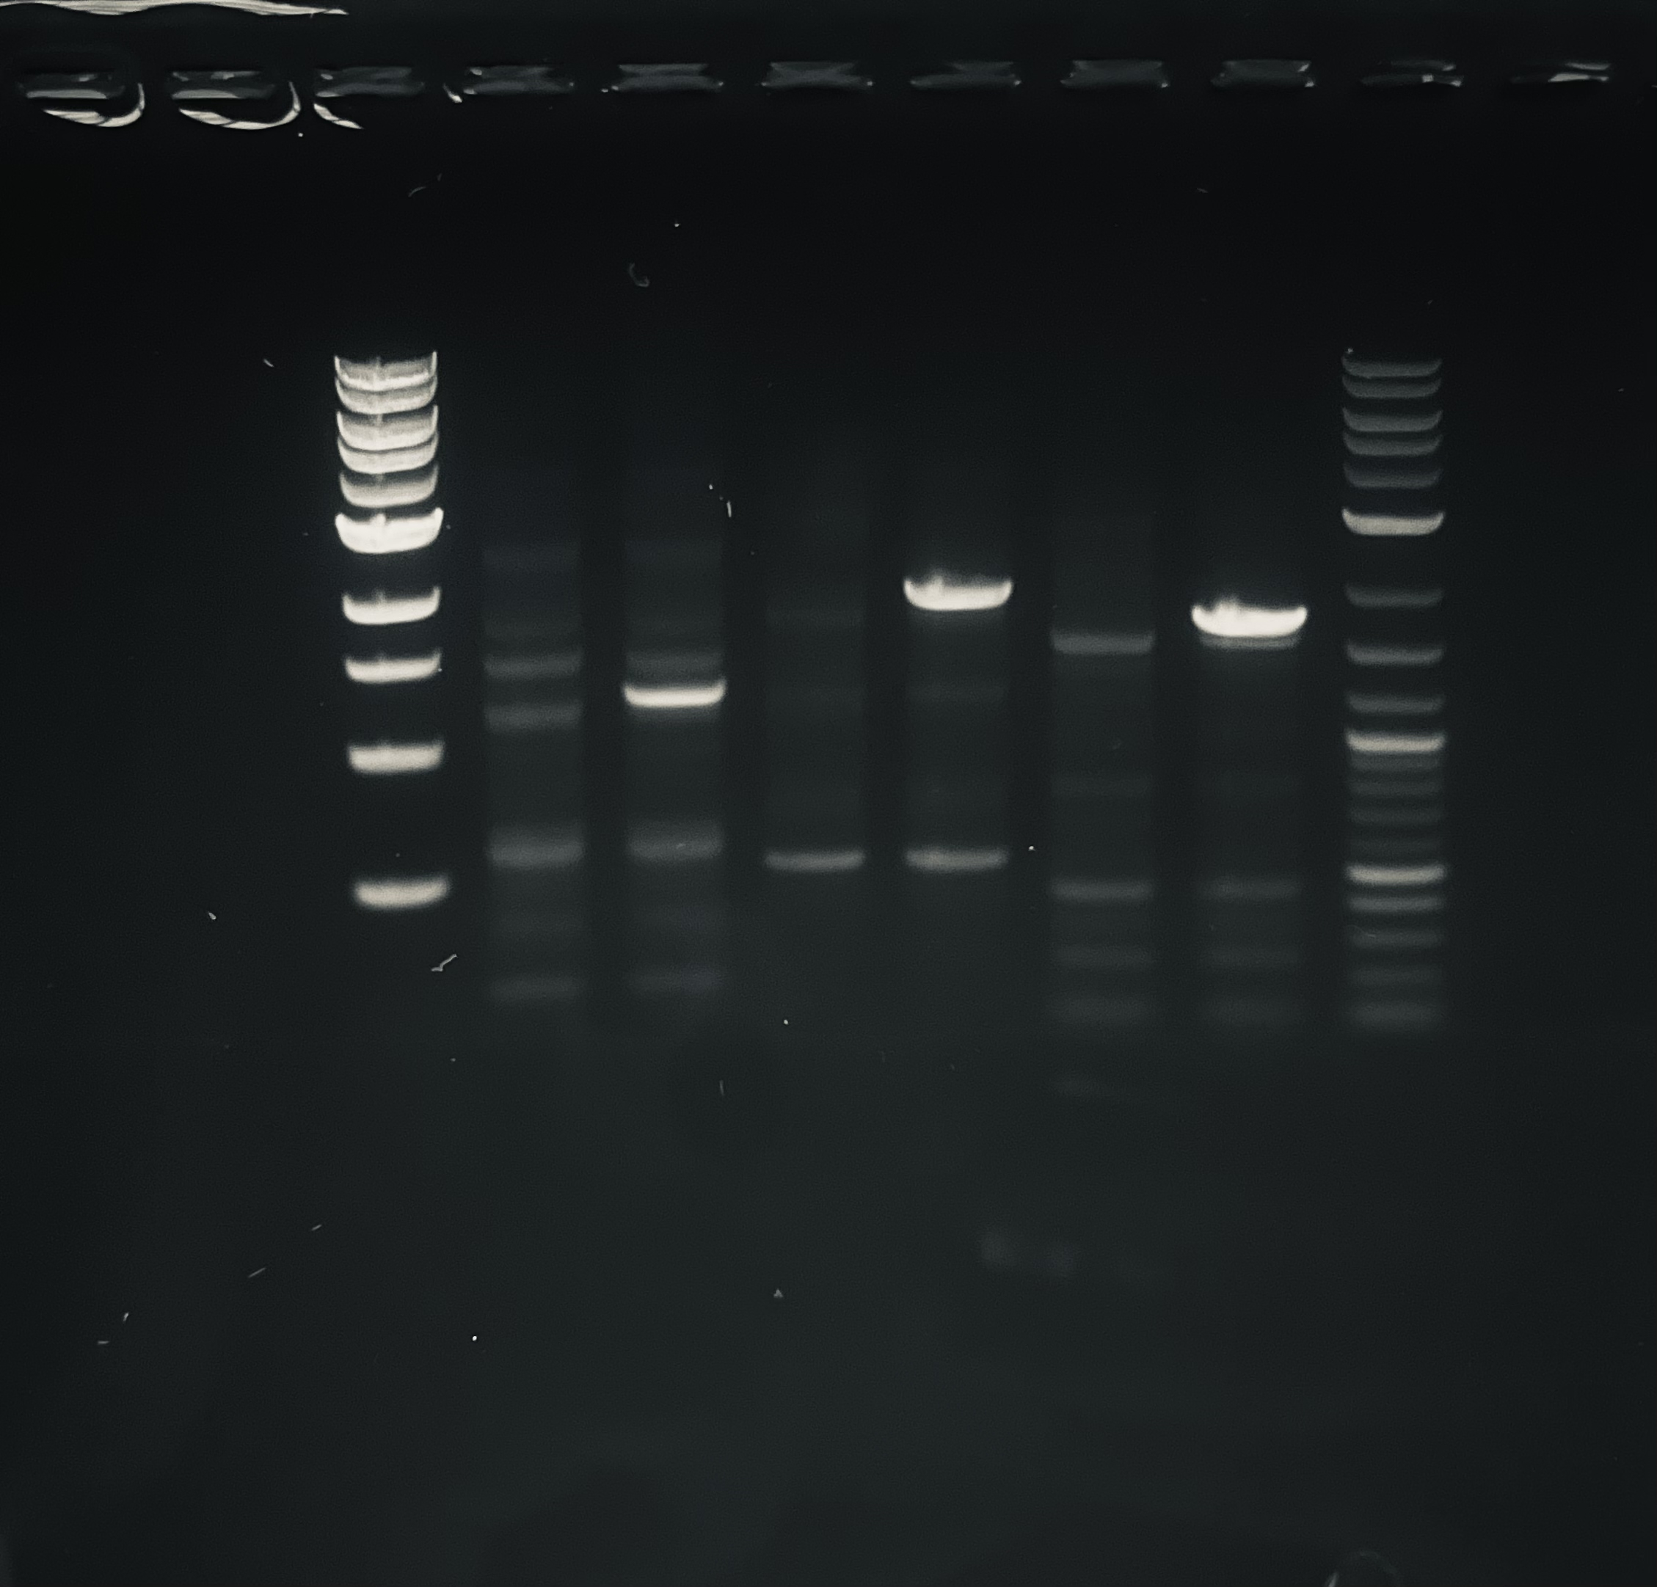
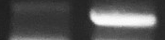
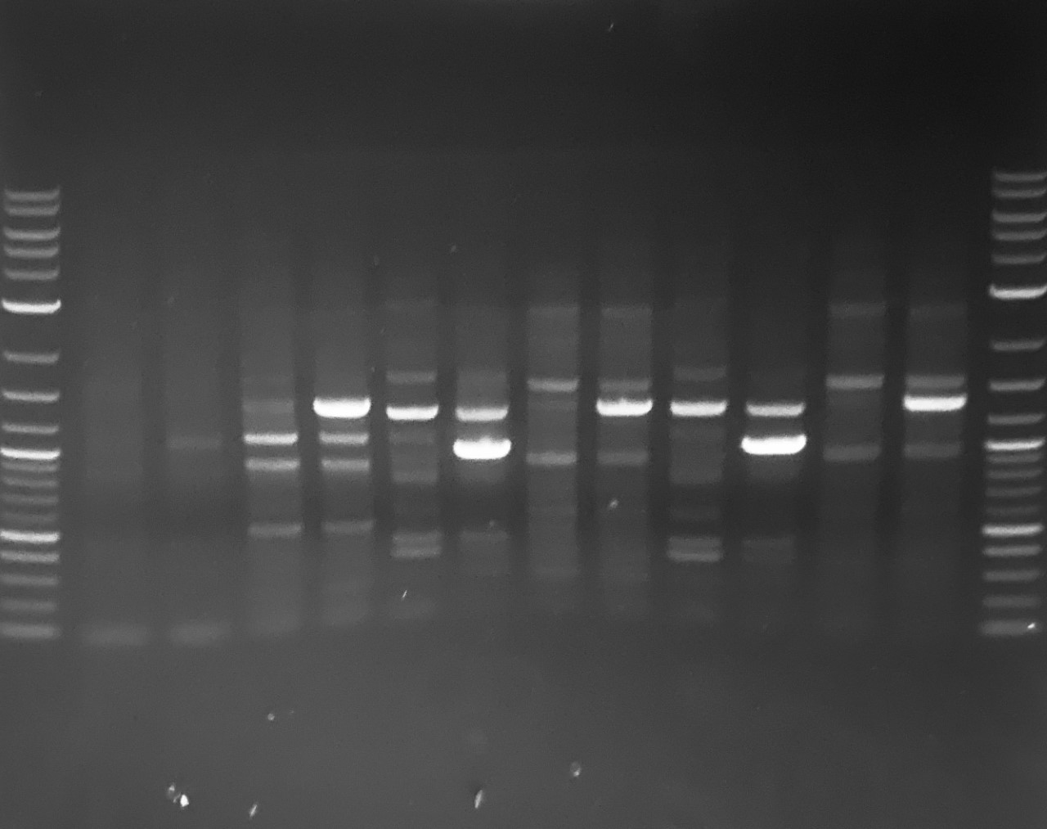
Site-specific integration verification for three loci —5’3’ junction PCR gel electro
AAVS1
5’ junction
3’ junction
NC sample
NC sample
CCR5
Genomic loci | 5’ junction target size | 3’ target size
AAVS1 | 1256 | 1969
CCR5 | 1096 | 1427
ROSA26 | 1023 | 1368
5’ junction
3’ junction
NC sample
NC sample
ROSA26
5’ junction
3’ junction
NC sample
NC sample
Notes:
This is junction PCR results for three loci. Left image shows the expected band in the transfected sample and nothing in the no transfection sample.

Slide 18
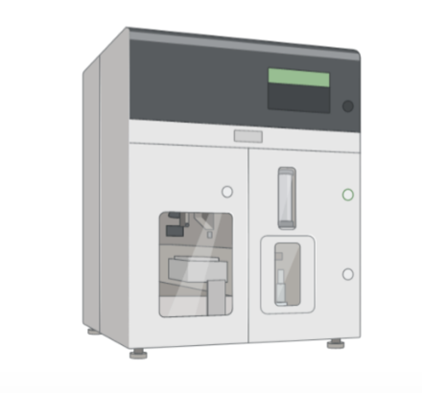
High single clone isolation, Targeted locus amplification and sequencing
Cell sorter to isolate the single clone
High single clone isolation
Targeted locus amplification (TLA) and sequencing
Notes:
Question/Comment: How to assess the genomic integration sites from CRISPR-mediated transgene insertion? It is better to do off-target checking since the site-specific integration is claimed in the project.
Based on the comments, the targeted locus amplification (TLA) from Cergentis or Genomic Vision will be a good plan for integration site analysis. We will conduct this later.

Slide 19
CRISPR-Cas9 mediated target gene knock-in platform:
sgRNA design
Cloning sgRNA to Cas9 vector
plasmid sequencing
Donor plasmids assembly
Genomic DNA extraction and Site-specific integration testing via junction PCR
HEK293 cells transfected with two plasmids & antibiotic selection
Stable cell pool
Single clone isolation
Targeted locus amplification (TLA) and sequencing

Slide 20
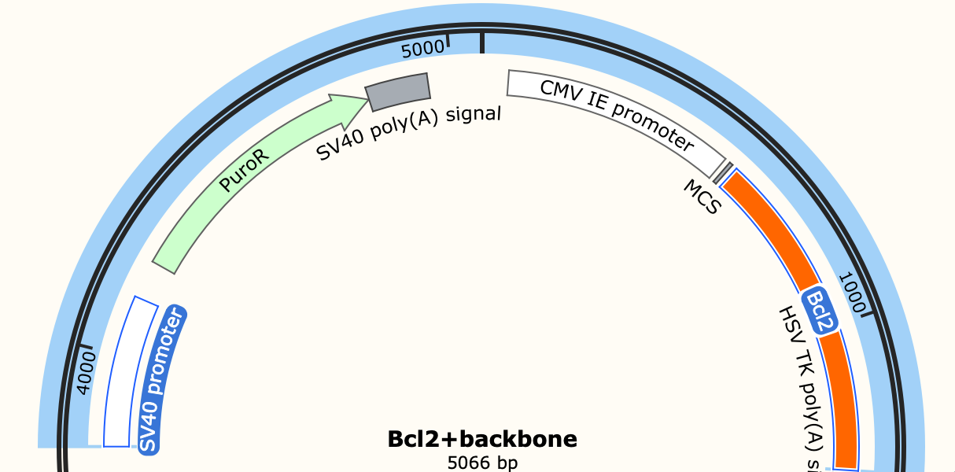
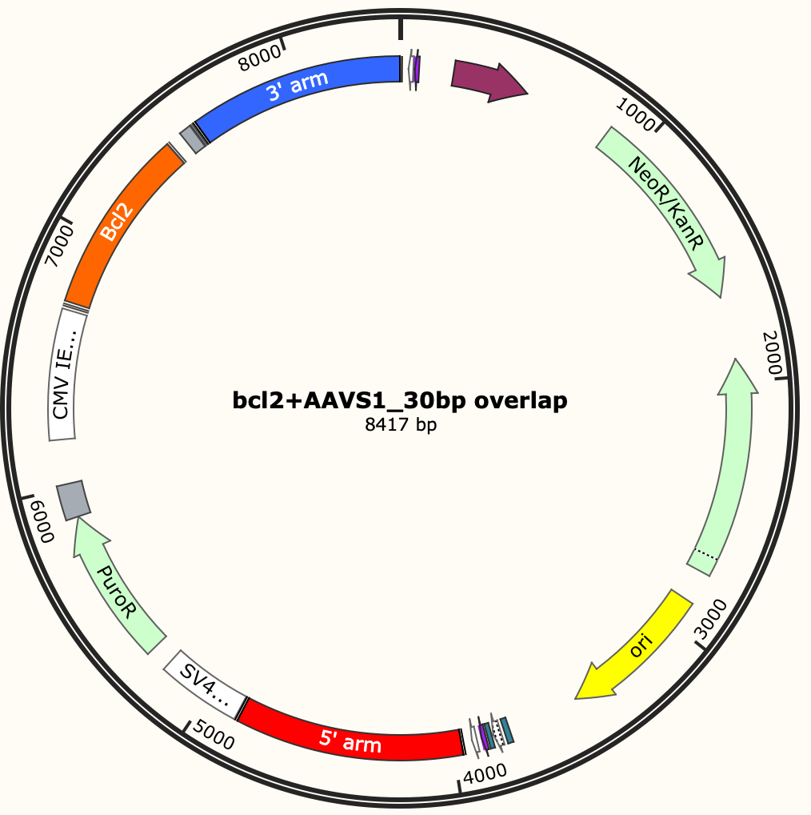
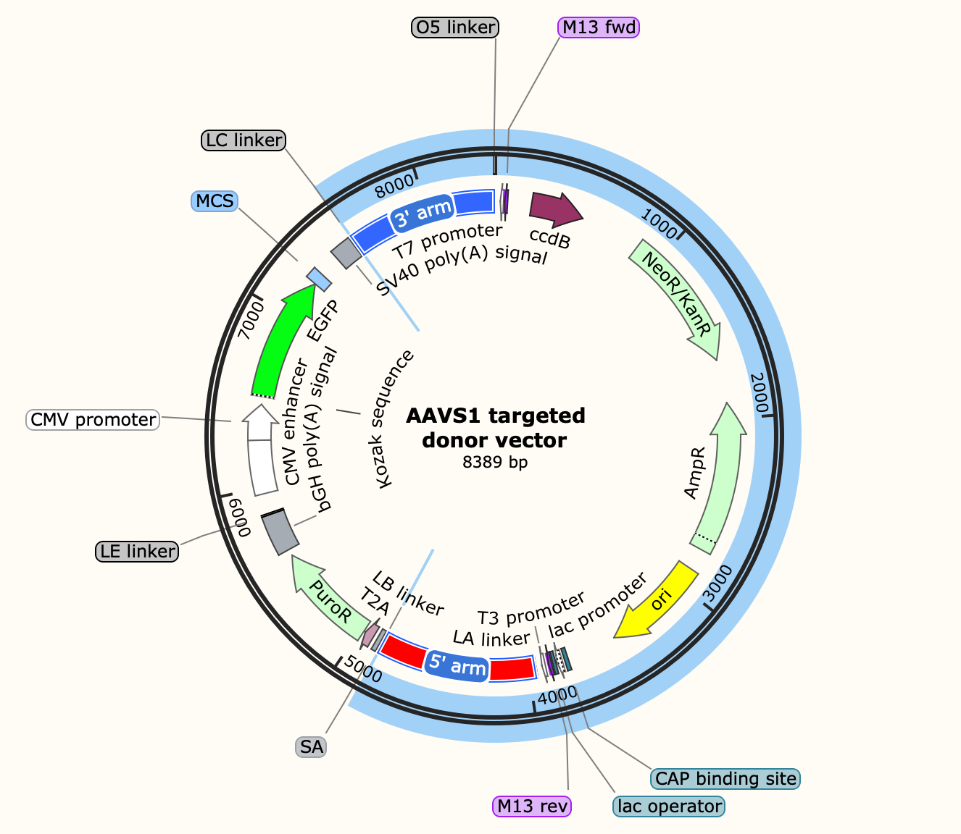
Preliminary experiment for donor plasmid assembly
Part 1+ part 2
Part 1
Gibson
Part 2
Replace GFP with the targeted gene (Bcl2)
Similar strategy will be used to construct AAV donor plasmids later
Notes:
This is the detail of Donor plasmids modification. The GFP as the original Gene of interest was used for Knock-in platform development. For this preliminary experiment, we will replace the GFP with the targeted genes in the donor backbone. For inducible AAV stable cell line development, a similar strategy will be used to construct the AAV donor plasmids.

Slide 21
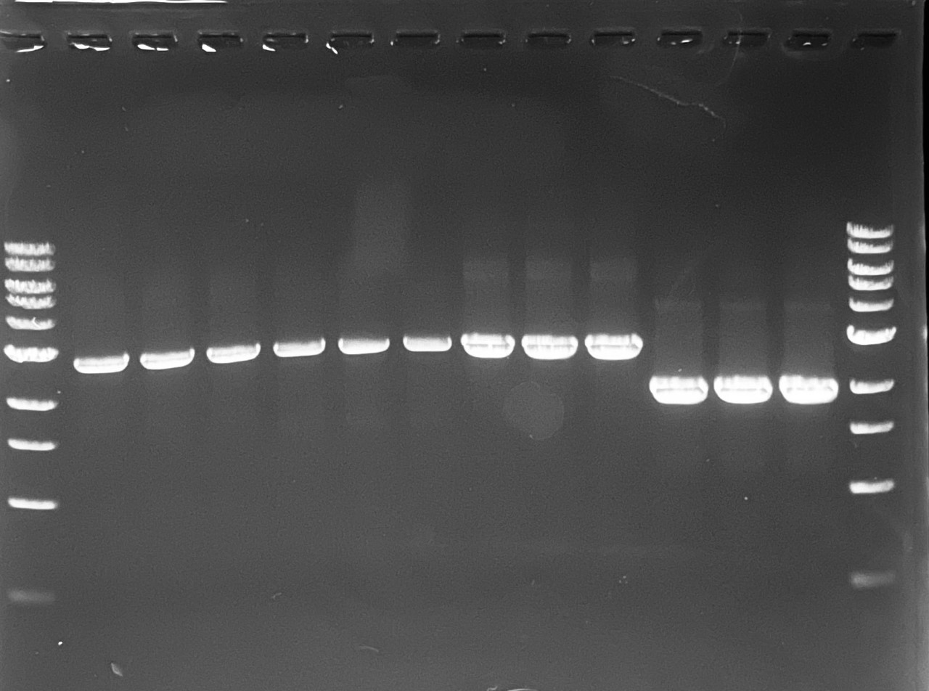
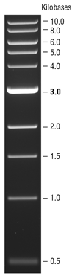
Preliminary experiment for donor plasmid assembly– part 1
Part 1 | PCR fragment size
PBA_BCl2 targeting AAVS1 donor vector | 2701 bp

Slide 22
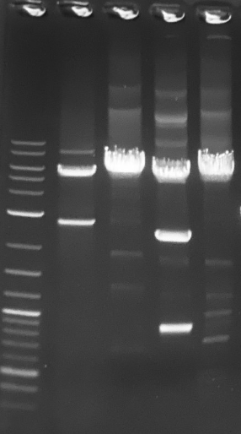
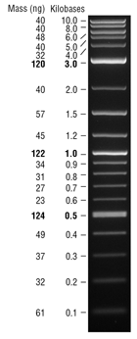
Preliminary experiment for donor plasmid assembly– part 2
Lane 1 | Lane 2 | Lane 3 | Lane 4 | Lane5
Ladder | AAVS1 backbone | AAVS1 backbone with Different primer | CCR5 backbone | Rosa 26 backbone
PCR cloned donor backbone successfully
Improve the annealing temp reduce the non-specific band

Slide 23
Next Steps
UML
  Preliminary experiment for donor plasmid assembly
    Gibson assembly
    Transformation, colony PCR
    Miniprep, sequencing
UD
  Assemble first iteration of plasmids and send to UML for integration
  Begin transient transfection tests

Slide 24
Research Sites – Timeline and Milestones
Q1 2023
Design of Tet-on/off inducible circuits (UD)
Crispr-Cas9 platform development and testing AAVS1, CCR5 and ROSA26 loci (UML)
Q2 2023
Tet off/on switch for 2 AAV cassettes via Golden gate, 1, transfer plasmid, 2, assembly plasmid(UD)
Q3 2023
Analytical methods (qPCR, Elisa, RT-qPCR, WB, proteomics) (UML/UD)
Testing inducible plasmids via transient (UML/UD)
Q4 2023
2024
Cell line productivity and stability evaluation(UML/UD)
Tet off/on switch for the 3rd AAV cassette via Golden gate, 3, replication plasmid(UD)
Site-specific integration of the 3rd cassette and develop the baseline of stable cells (UML)
Optimized AAV parts integration, The optimized stable cell line(UML)
Optimization of gene level and dynamics by engineered inducible variants, Kozak, and Degron tags (UD)
Site-specific integration of 2 cassettes made by UD (UML)
Optimization of gene level and dynamics by engineered inducible variants, Kozak, and Degron tags (UD)
Evaluate optimized plasmids via transient(UML/UD)
AAV production bottlenecks investigation(UD/UML)
Other investigations (UML/UD)

