Slide 1








Industry/University Cooperative Research Center (I/UCRC)
Advanced Mammalian Biomanufacturing Innovation Center (AMBIC)
Develop an Inducible Stable Producer Cell Line for rAAV Production via Site-Specific Integration
Qiang Fu and Emily Doleh
Seongkyu Yoon (PI) / Mark Blenner (Co-PI)
Mentor Meeting – July 15, 2024
A National Science Foundation-facilitated
academic – industry – government consortia
to advance precompetitive knowledge in biomanufacturing
Contents are Proprietary to AMBIC and its Members
Terms of Center Membership Agreement Apply
www.ambic.org

Slide 2
Agenda
Project overview
UD Progress
UML Progress
Action Items

Slide 3
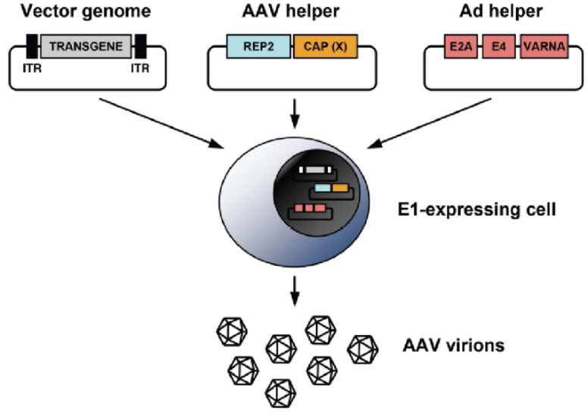
Industrial Relevance & Need
HEK 293 cells
Drawbacks of the traditional rAAV production process that uses transient transfection in HEK293 cells
Complicated and expensive process consuming considerable amount of transfection reagent and plasmids
The lot-to-lot variation of the products
Difficult to scale up
A stable producer of rAAV is needed!

Slide 4
Project Goals
Design inducible circuits that can regulate the timing and level of gene expression for all components necessary to make rAAV
Develop an inducible stable producer cell line with site-specific integration for extensible rAAV production
Objectives
Refactor rAAV rep, cap, and helper genes using variations of the inducible Tet-off promoter
Optimize the rAAV rep, cap, and helper gene expression levels for high titer rAAV, by Kozak sequences and degrons
Establish an inducible stable producer cell line with site specific integration in well-known human genomic safe harbors for rAAV production
Notes:
Why Tet-off promoter rather than Tet-on?
The tet-off-based inducible circuit will be used to eliminate the antibiotics in the rAAV production stage.

Slide 5
UD Progress

Slide 6
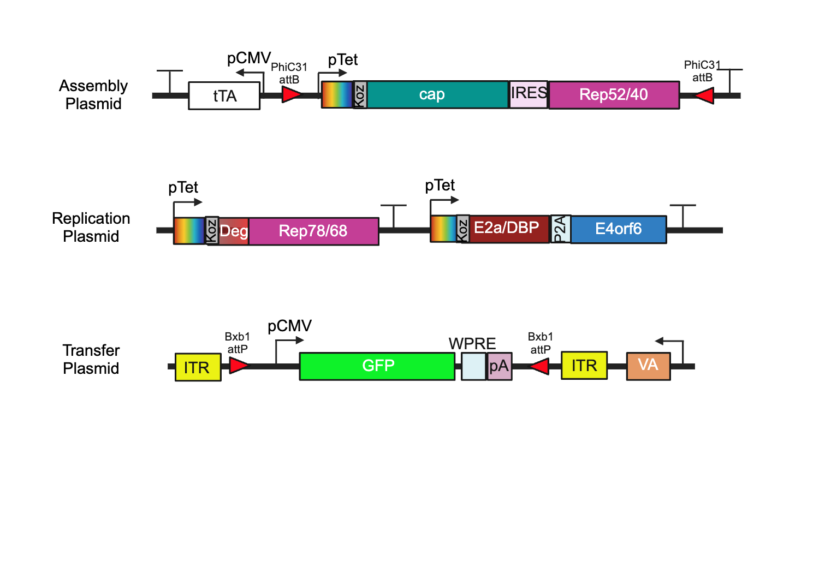
Plasmid Design

Slide 7
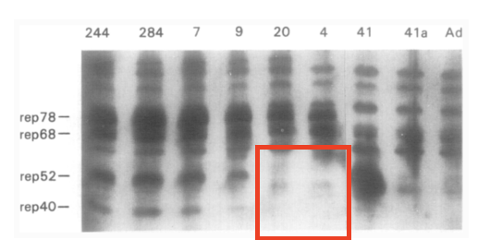
Fragment Design
 | Rep78/68
Sequence Change (AA) | 225: ATG → GGG
Reason | Removal of p19 start codon
Comments | Previous work reported the silencing of the p19 promoter through the mutation of the start codon¹
(1) Chejanovsky, N.; Carter, B. J. Mutagenesis of an AUG Codon in the Adeno-Associated Virus Rep Gene: Effects on Viral DNA Replication. Virology 1989, 173 (1), 120–128. https://doi.org/10.1016/0042-6822(89)90227-4.

Slide 8
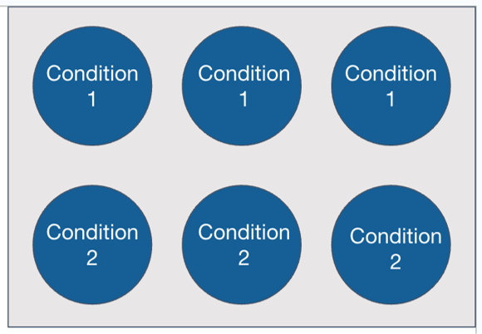
Transient Transfection Test
Using 6-well plates with 3 replicates each I am looking to test 6 conditions:​
1: Transfer plasmid only transfection (negative control)
2: AAV triple transfection using traditional 3 plasmids​
3: tTA (Tet-off) assembly, replication, and transfer plasmid transfection
4: tTA (Tet-off) assembly, replication, and transfer plasmid transfection + 500 ng/mL dox​
5: rtTA (Tet-on) assembly, replication, and transfer plasmid transfection
6: rtTA (Tet-on) assembly, replication, and transfer plasmid transfection + 500 ng/mL dox
Transfection conditions (PEI)
Media working volume | 3 mL
Plating density | 5E5
Total DNA | 2 ug
Plasmid ratio | 1:1:1
PEI:DNA | 1:1
Cocktail volume | 300 uL
Incubation time | 15 min
Cocktail media | OptiMEM

Slide 9
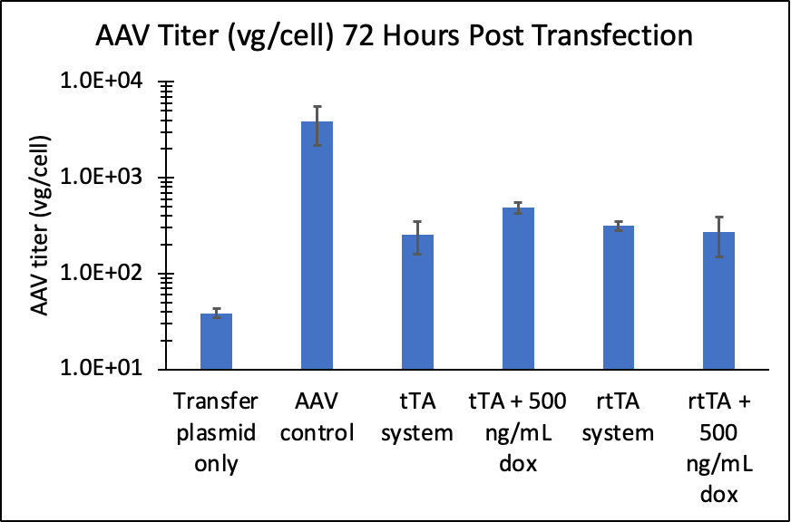
Transient Transfection Test
1: Transfer plasmid only transfection (negative control)
2: AAV triple transfection using traditional 3 plasmids​
3: tTA (Tet-off) assembly, replication, and transfer plasmid transfection
4: tTA (Tet-off) assembly, replication, and transfer plasmid transfection + 500 ng/mL dox​
5: rtTA (Tet-on) assembly, replication, and transfer plasmid transfection
6: rtTA (Tet-on) assembly, replication, and transfer plasmid transfection + 500 ng/mL dox
GOI is replicated but on/off production is not functional in transient transfection → single plasmid transfections to confirm transcript levels and protein presence

Slide 10
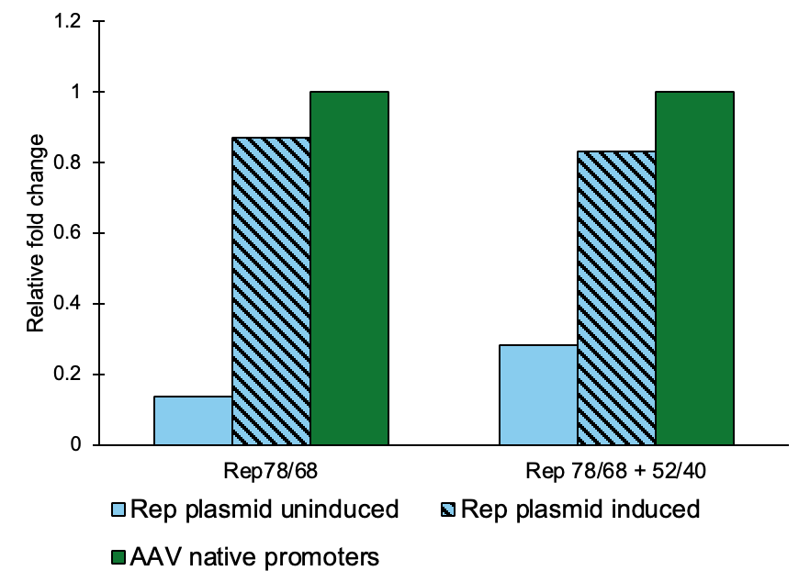
Single Plasmid Transfection for Transcript Quantification (RNA)
Rep is expressed similarly under the Tet and p5 promoters
AAV native promoters = traditional triple transfection
Rep plasmid = replication plasmid 2 plasmid transfection with transactivator
*Fold change calculated using double delta Ct method (GAPDH reference gene and untransfected HEK293T cells as negative control)

Slide 11
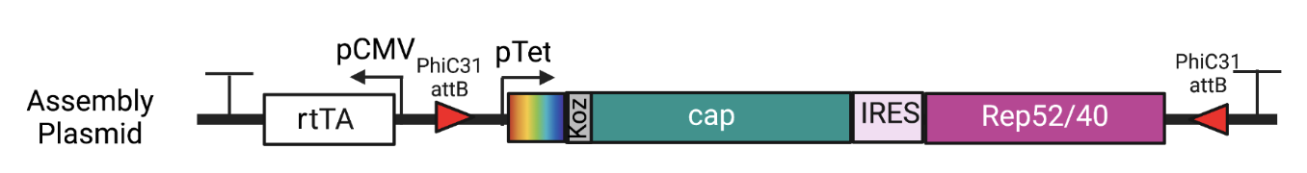
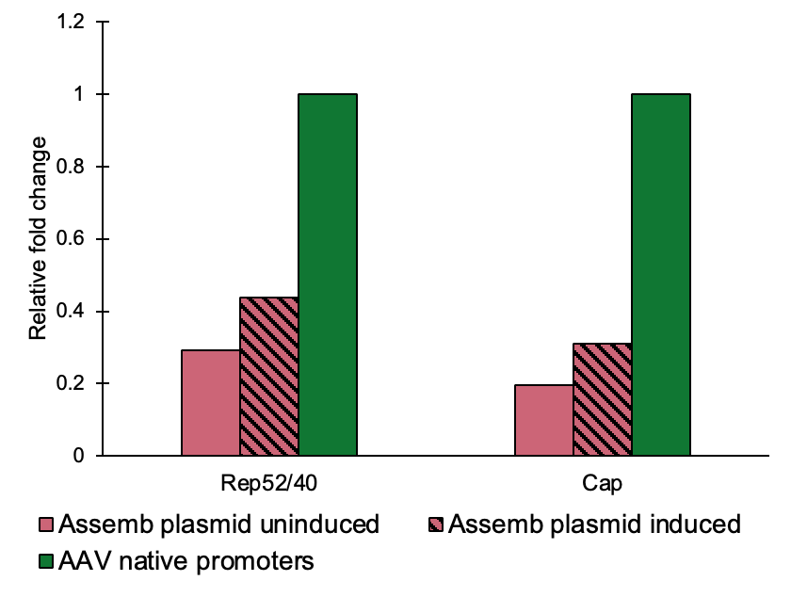
Single Plasmid Transfection for Transcript Quantification (RNA)
Looking to verify inducibility of AAV production genes using qRT-PCR
Cap is underexpressed compared to its expression under the p40 native promoter
  explore other options for increasing gene expression or decreasing background to address issues seeing inducibility in AAV production
Rep78/68 + 52/40
AAV native promoters = traditional triple transfection
Assemb plasmid = assembly plasmid single plasmid transfection
*Fold change calculated using double delta Ct method (GAPDH reference gene and untransfected HEK293T cells as negative control)

Slide 12
UML Progress

Slide 13
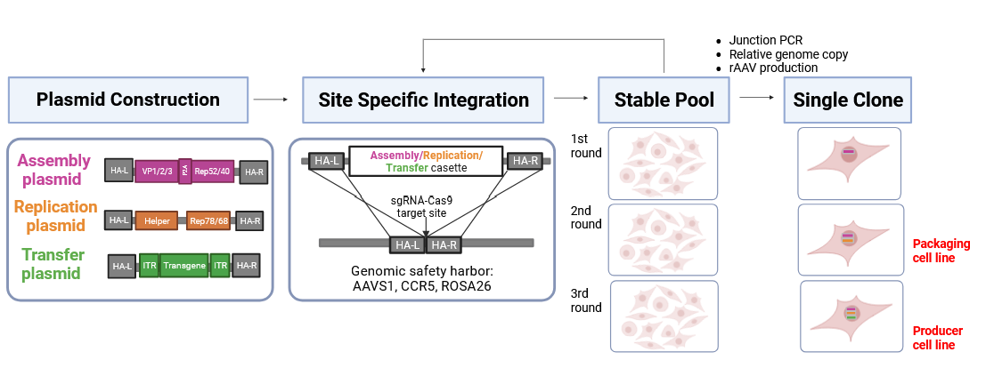
Inducible Stable Cell Line Development Workflow
Sequential integration
1.Pre-packaging
cell line
2. Packaging
cell line
3. Producer
cell line
Baseline vector design
Optimized vector design
Completed
In progress
13
Notes:
This slide is to show the workflow for stable cell line development. There are 4 stages. Plasmid construction, integration, stable pool development and single clone isolation
In the plasmid construction stage, We constructed three sgRNA-cas9 plasmids targeting three specific genome sites in hek cell. We also constructed three donor plasmids including AAV components and homology arms for each sites. So far, the baseline vector design and transient transfection testing were completed. The optimized vector design and testing are in progress.
In the integration stage, we did three round of integration to insert those three plasmids one by one. After the integration and antibiotic selection, we got a stable pool. And there are three criteria to evaluate the stable pools, junction pcr to verify the site specific integration, genome copy assay to confirm the AAV genes integration to host cell genome and the last is the AAV production.
After we met those criteria, we can move on to next round of integration. At the same time, we isolated single clone for further evaluation. After first round of the integration, we can get pre-packaing cell line. After the second round of integration, we can get packaging cell line. After the third round of integration, we can get producer cell line.
Currently, we completed the baseline stable packaging cell line development.
The Optimized stable cell line development will be the workflow and is still in progress.
In the result section, I will focus on the baseline stable packaging cell line evaluation.

Slide 14
Baseline Stable Packaging Cell Line Characterization
  Baseline stable packaging cell line characterization
    Site-specific integration (Junction PCR and out-to-out PCR )
    Genomic level (qPCR)
    Transcript level (RT-qPCR)
    Protein level (Elisa) and rAAV production (qPCR)
  Outcome
    Manuscript and IP: inducible stable packaging cell line

Slide 15
Challenges in 3rd round of stable pool and single clones
Stable cell pool
Challenges
The genome titer can’t be detected in the 3rd stable pol
Capsid titer is relatively low
Root cause analysis and trouble shooting action
Low genome copy numbers of transfer cassettes in targeted integration leads to difficulties in initiating genome replication.
Action: increase genome copies of transfer and assembly cassettes via transposon random integration
Single clone
Either Cap gene or Rep genes missing in the isolated single clones
Action: increase knock in efficiency via small molecule addition

Slide 16
Transposon integration of the transfer cassette to increase the Genome copy
PiggyBac transposon integration includes two parts:
1. Hyperactive piggybac transposase; 2. PB transposon GoI
Workflow:
Construction of the PB transposon GoI (transfer and assembly)
  Gel and whole plasmids sequencing
Transfection of Packaging cell line sc4-7 with transposon plasmids
  Assembly plasmid (increase antibiotic Conc.) and transfer plasmids transfection sequentially
  Transfer and assembly plasmids double transfection
Antibiotics selection
Producer cell pool and AAV production evaluation
  Genome copy analysis
  Genome titer
  Capsid titer

Slide 17
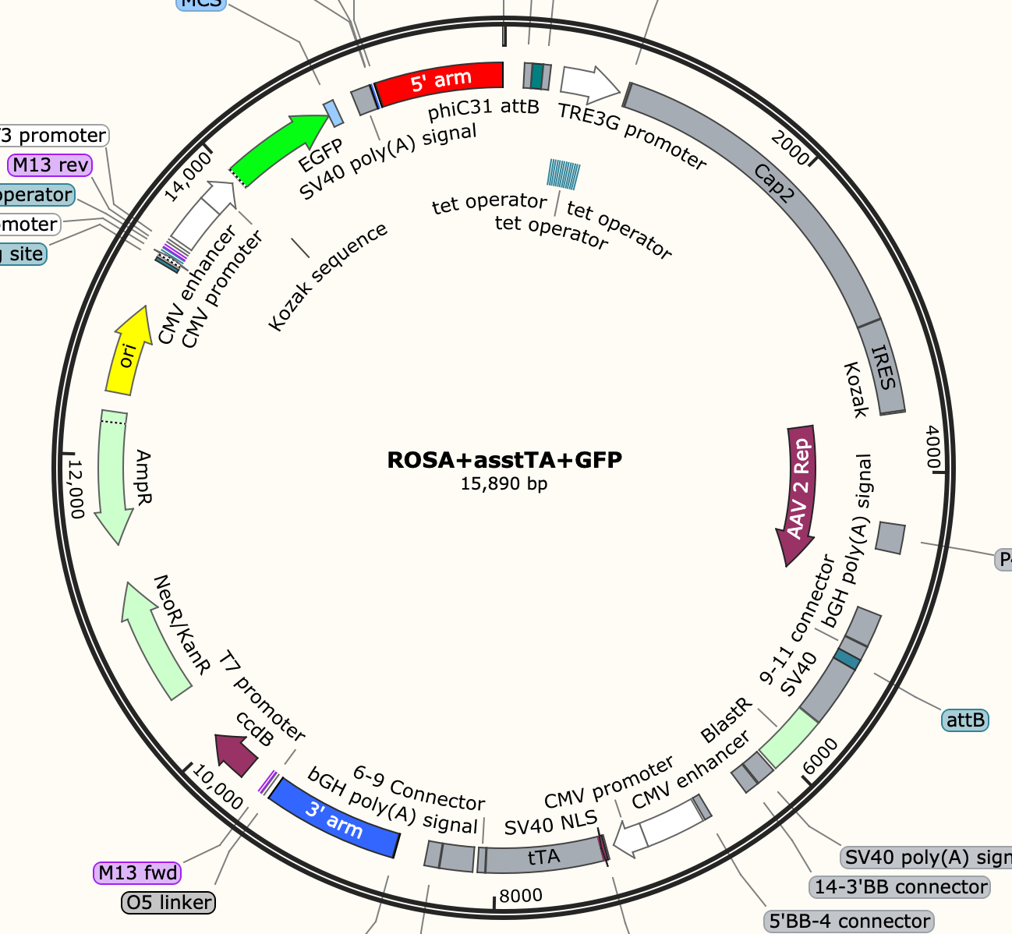
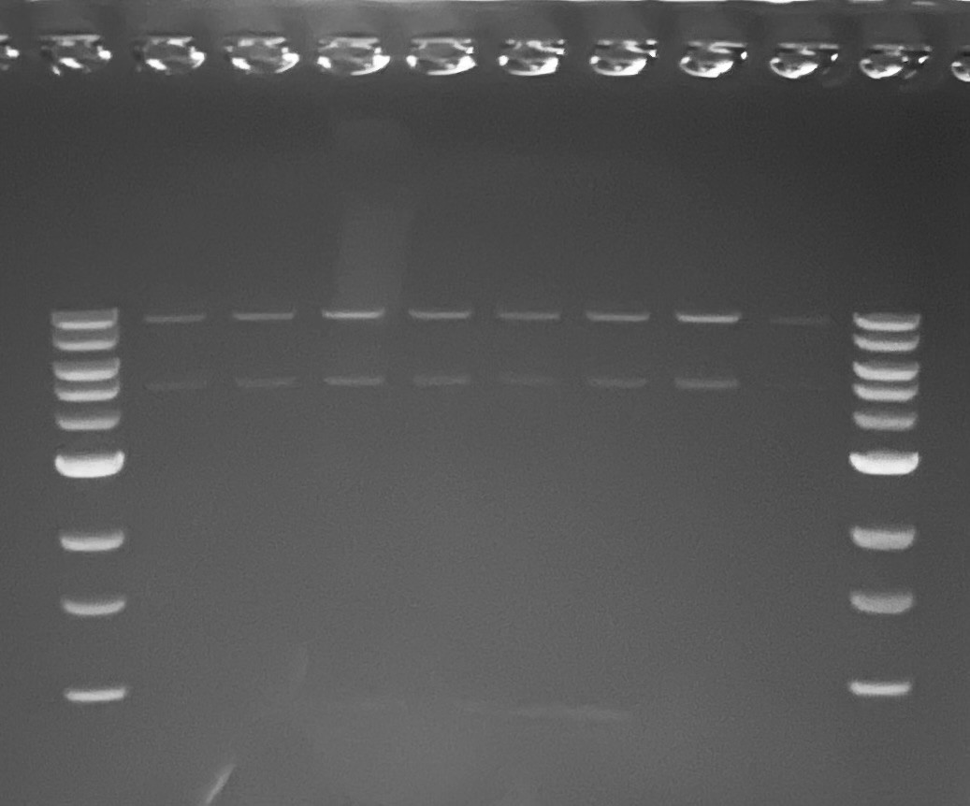
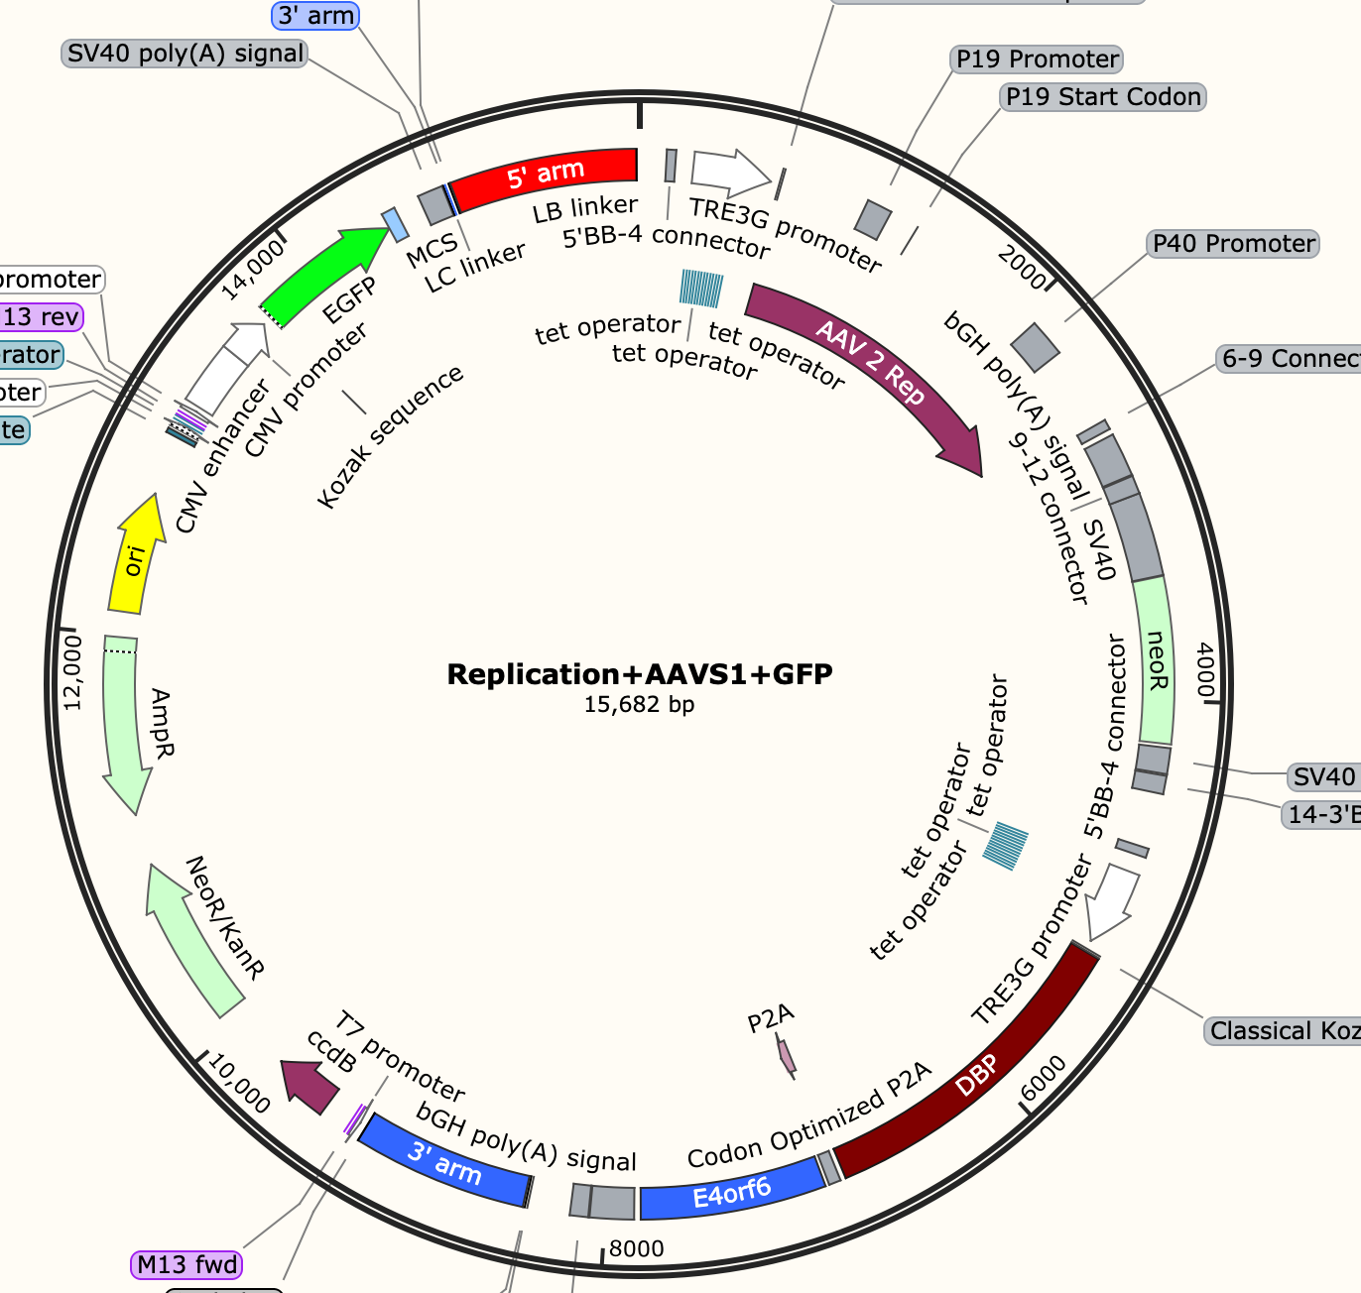
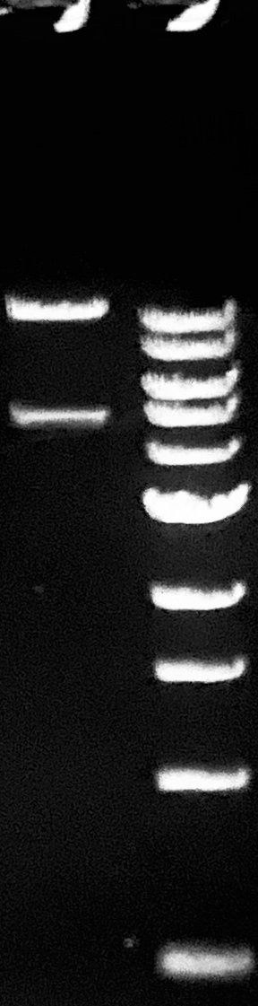
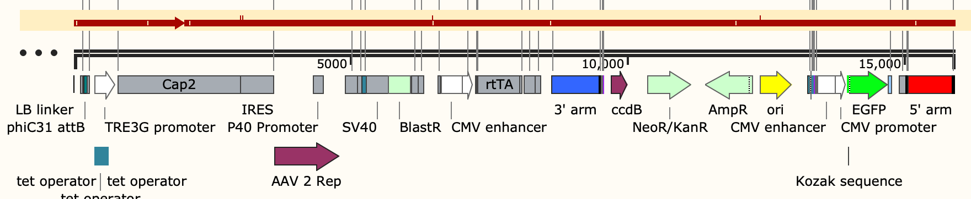
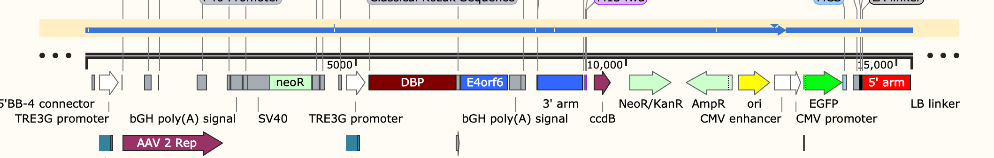
Plasmid construction (PiggyBac transposon)
Assembly PB transposon plasmid Gibson
Transfer PB transposon plasmid Gibson
Sequencing result
10578+5312
Sequencing result
10972bp+4890bp
Confirm the plasmids construction via gel electrophoresis and whole plasmids sequencing

Slide 18
Producer cell pool -- genome copy analysis (transfer cassette)
qPCR assay Cq | Internal | Transfer
n=3 | GAPDH | GFP
SC4-7 + ass+ trans sequential | 25.12 ±0.02 | 18.84 ±0.08
SC4-7 + ass+ trans double | 25.74 ±0.05 | 18.93 ±0.09
SSI 3rd pool | 24.47 ± 0.21 | 22.92 ± 0.05
2^{–∆∆Ct} analysis
Compared to the SSI 3rd pool, the transposon integration increase the GFP copy number to 26-38 folds

Slide 19
Producer cell pool -- genome copy analysis (assembly cassette)
qPCR assay Cq | Internal | Assembly
n=3 | GAPDH | Cap | Rep52
SC4-7 | 25.20 ±0.06 | 23.79 ±0.05 | 21.14 ±0.05
SC4-7 ass+ trans sequential | 25.12 ±0.02 | 23.19 ±0.02 | 20.78 ±0.11
SC4-7 ass+ trans double | 25.74 ±0.05 | 22.72 ±0.13 | 20.88 ±0.11
2^{–∆∆Ct} analysis
Compared to SC4-7, the transposon integration increase the Cap copy number to 1.4-3.1 folds

Slide 20
Producer cell pool – rAAV production genome titer
PC (Positive Control): transient transfection with 3 traditional plasmids
SC 4-7 (Single Clone, packaging cell line): transient transfection with 1 transgene plasmid
SC 4-7 seq and double are the producer cell pools
5 dox represents 5 µg/mL doxycycline inducible reagent

Slide 21
Producer cell pool – rAAV production capsid titer
PC (Positive Control): transient transfection with 3 traditional plasmids
SC 4-7 (Single Clone, packaging cell line): transient transfection with 1 transgene plasmid
SC 4-7 seq and double are the producer cell pools
5 dox represents 5 µg/mL doxycycline inducible reagent

Slide 22
Action Items
UML
Single clone isolation for baseline producers
Increase the knock-in efficiency via small molecule addition
UD
Consider options to control expression dynamics (kozak sequences)
Clone variants of AAV plasmids based on previously tested Tet promoters
Explore ways to increase capsid expression through plasmid design

Slide 23
Research Sites – Timeline and Milestones
Q1 2023
Design of Tet-on/off inducible circuits (UD)
Crispr-Cas9 platform development and testing AAVS1, CCR5 and ROSA26 loci (UML)
Q2 2023
Tet off/on switch for 2 AAV cassettes via Golden gate. 1, replication plasmid, 2, assembly plasmid(UD)
Q3-4 2023
Analytical methods (qPCR, Elisa, RT-qPCR, WB, proteomics) (UML/UD)
Testing inducible plasmids via transient (UML/UD)
Q1-2 2024
Q3-4 2024
Cell line productivity and stability evaluation(UML/UD)
Tet off/on switch for the 3rd AAV cassette via Golden gate, 3, transfer plasmid(UD)
Site-specific integration of the 2nd and 3rd cassette and develop the baseline of stable cells (UML)
Optimized AAV parts integration, The optimized stable cell line(UML)
Optimization of gene level and dynamics by engineered inducible variants (UD); Evaluate optimized plasmids via transient(UML/UD)
Site-specific integration of replication cassette made by UD (UML)
AAV production bottlenecks investigation(UD/UML)
Enhancing the Knockin efficiency and increase the genome copy for transfer cassette (UML)

