Slide 1








Industry/University Cooperative Research Center (I/UCRC)
Advanced Mammalian Biomanufacturing Innovation Center (AMBIC)
Develop an Inducible Stable Producer Cell Line for rAAV Production via Site-Specific Integration
Qiang Fu and Emily Doleh
Seongkyu Yoon (PI) / Mark Blenner (Co-PI)
Mentor Meeting – April 17, 2023
A National Science Foundation-facilitated
academic – industry – government consortia
to advance precompetitive knowledge in biomanufacturing
Contents are Proprietary to AMBIC and its Members
Terms of Center Membership Agreement Apply
www.ambic.org

Slide 2
Agenda
Project overview
UD Progress
  Plasmid design and timeline for assembly
UML Progress
  Crispr-cas9 platform
Action Items

Slide 3
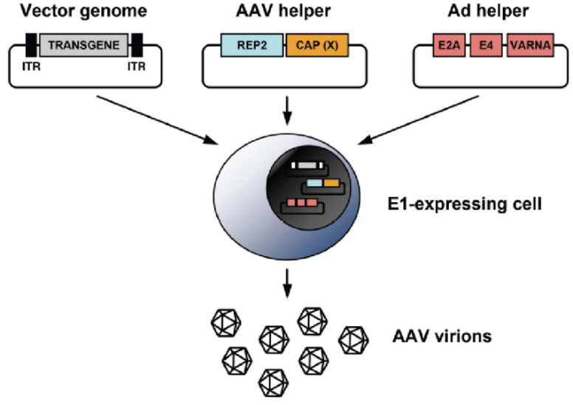
Industrial Relevance & Need
HEK 293 cells
Drawbacks of the traditional rAAV production process that uses transient transfection in HEK293 cells
Complicated and expensive process consuming considerable amount of transfection reagent and plasmids
The lot-to-lot variation of the products
Difficult to scale up
A stable producer of rAAV is needed!

Slide 4
Industrial Relevance & Need
Requirements for establishing a stable producer cell line
High-titer rAAV production
Avoid cytotoxicity of rep and helper genes
High capsid ratio
Balanced expression of rep, cap, helper genes
Consistent production
Site-specific Integration in stable loci
Scalable production
Use of media with no antibiotics
Extensible production
rAAV cargo easy to change out
Notes:
Features required for inducible stable cell line

Slide 5
Project Goals
Design inducible circuits that can regulate the timing and level of gene expression for all components necessary to make rAAV
Develop an inducible stable producer cell line with site-specific integration for extensible rAAV production
Objectives
Refactor rAAV rep, cap, and helper genes using variations of the inducible Tet-off promoter
Optimize the rAAV rep, cap, and helper gene expression levels for high titer rAAV, by Kozak sequences and degrons
Establish an inducible stable producer cell line with site specific integration in well-known human genomic safe harbors for rAAV production
Notes:
Why Tet-off promoter rather than Tet-on?
The tet-off-based inducible circuit will be used to eliminate the antibiotics in the rAAV production stage.

Slide 6
Research Workflow & Timeline
Udel
inducible design and plasmid assembly
UML
Crisp-cas9, cell culture, integration
UML & UD
Design of Tet-on/off inducible circuits
Crispr-Cas9 platform development and testing AAVS1, CCR5 and ROSA26 loci
Analytical methods (qPCR, Elisa, RT-qPCR, WB, proteomics)
1-3 M
Tet off/on switch for 3 cassettes via Golden gate
Transfer plasmid
Assembly plasmid
Replication plasmids
AAV parts integration, The baseline of Stable cell line
Testing inducible plasmids via transient
4-8 M
Optimization of gene-level and dynamics by engineered inducible variants, Kozak, and Degron tags
Optimized AAV parts integration, The optimized stable cell line
Evaluate optimized plasmids via transient
9-14 M

Slide 7
UD Progress

Slide 8
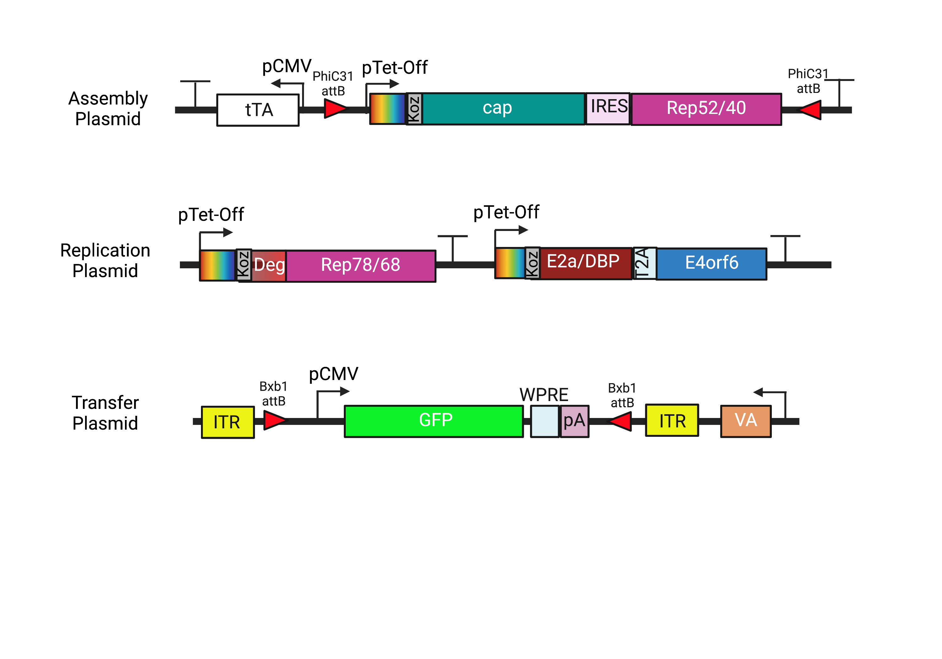
Plasmid Design
All sequences ordered were found from literature and compared with NCBI database

Slide 9
Plasmid Design
Addition of PhiC31 integrase on assembly plasmid to exchange serotypes in future

Slide 10
Plasmid Design
Silent mutation of BsmBI recognition sites within Cap sequence

Slide 11
Plasmid Design
Silencing of internal p19 promoter through removal of start codon to stop transcription of Rep52/40

Slide 12
Plasmid Design
Bxb1 sites moved inside ITRs for ease of payload exchange

Slide 13
Plasmid Design
Silent mutation of BsmBI recognition sites within VA sequence

Slide 14
Fragment Design
 | Cap | Rep78/68 | VA
Sequence Change (AA) | 176: T → A (Gly) 431: A → T (Arg) | 225: ATG → GGG | 88: T → A (Arg)
Reason | Removal of BsmBI cut sites for cloning | Removal of p19 start codon | Removal of BsmBI cut site
Comments | Kept same amino acid with similar codon usage frequency in HEK cells | Previous papers reported the silencing of the p19 promoter through the mutation of the start codon^{1,2}
(1) Chejanovsky, N.; Carter, B. J. Mutagenesis of an AUG Codon in the Adeno-Associated Virus Rep Gene: Effects on Viral DNA Replication. Virology 1989, 173 (1), 120–128. https://doi.org/10.1016/0042-6822(89)90227-4.
(2) Lee, Z.; Lu, M.; Irfanullah, E.; Soukup, M.; Hu, W.-S. Construction of an RAAV Producer Cell Line through Synthetic Biology. ACS Synth. Biol. 2022, 11 (10), 3285–3295. https://doi.org/10.1021/acssynbio.2c00207.

Slide 15
Plasmid Assembly Timeline
 | Assembly Plasmid | Replication Plasmid | Transfer Plasmid
Designing | 02/10 - 03/29 | 02/10 - 03/29 | 02/10 - 03/02
Ordering | 03/02 - 04/11 | 03/02 - 04/11 | 03/02 - 3/15
Cloning | 03/15 - present | 03/15 - present | 03/15 - present
Assembly | 05/15* | 05/15* | 05/15*
*Tentative

Slide 16
UML Progress

Slide 17
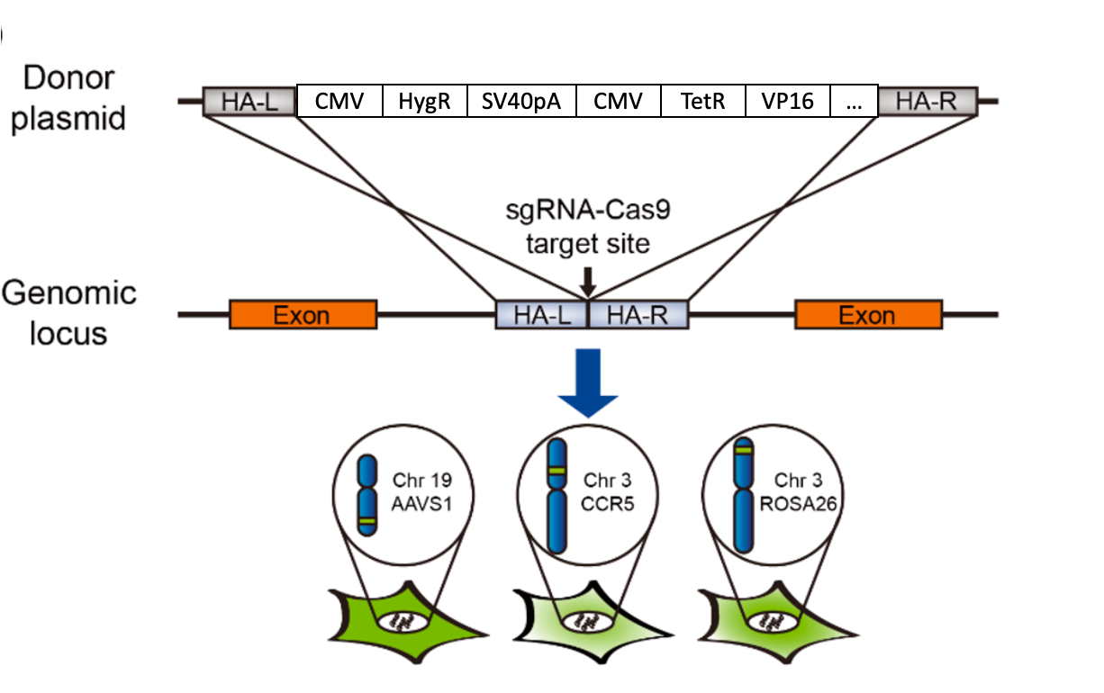

Site-specific integration of Gene of Interest to AAVS1, CCR5 and ROSA26 loci via Crispr-Cas9 system
Packaging, Replication, or Transfer Cassettes
Three GSHs in human cells
AAVS1, chromosome 19 (Bertero etl. 2016)
CCR5, chromosome 3 (Chen et al. 2017)
Rosa26, chromosome 3 (Irion et al. 2007)
Preliminary experiment, site-specific integration of GFP to AAVS1, CCR5 and ROSA26

Slide 18
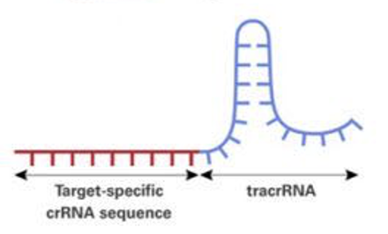
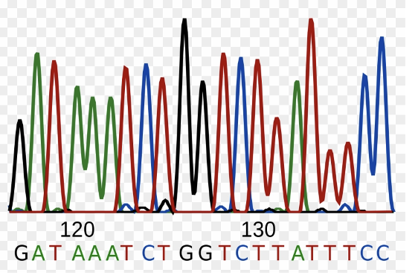
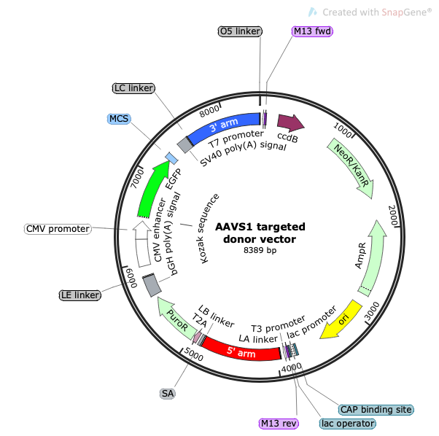
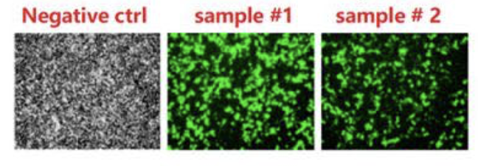
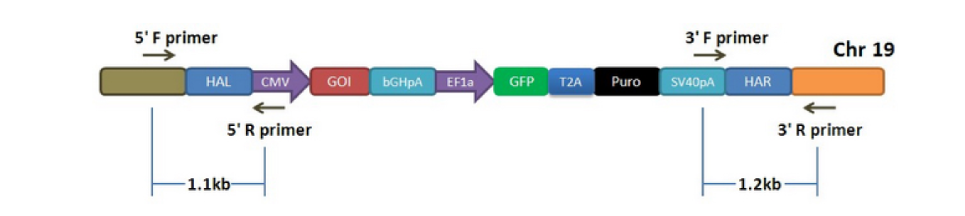
Crispr-cas9 Knock in workflow
1. sgRNA design
2. Cloning sgRNA to Cas9 vector
4. plasmid sequencing
3. Donor plasmids assembly
7. Site-specific integration testing via 5’3’ junction PCR
5. HEK293 cells transfected with two plasmids
6. Genomic DNA extraction

Slide 19
sgRNA- cas9 plasmids construction for three loci
sgRNA for AAVS1 | accccacagtggggccacta
sgRNA for CCR5 | ggagagcttggctctgttgg
sgRNA for ROSA26 | gtcgagtcgcttctcgatta
sgRNA-cas9 backbone
9286 bp
gRNA Oligo design
Cloning sgRNA to Cas9 vector
plasmid sequencing

Slide 20
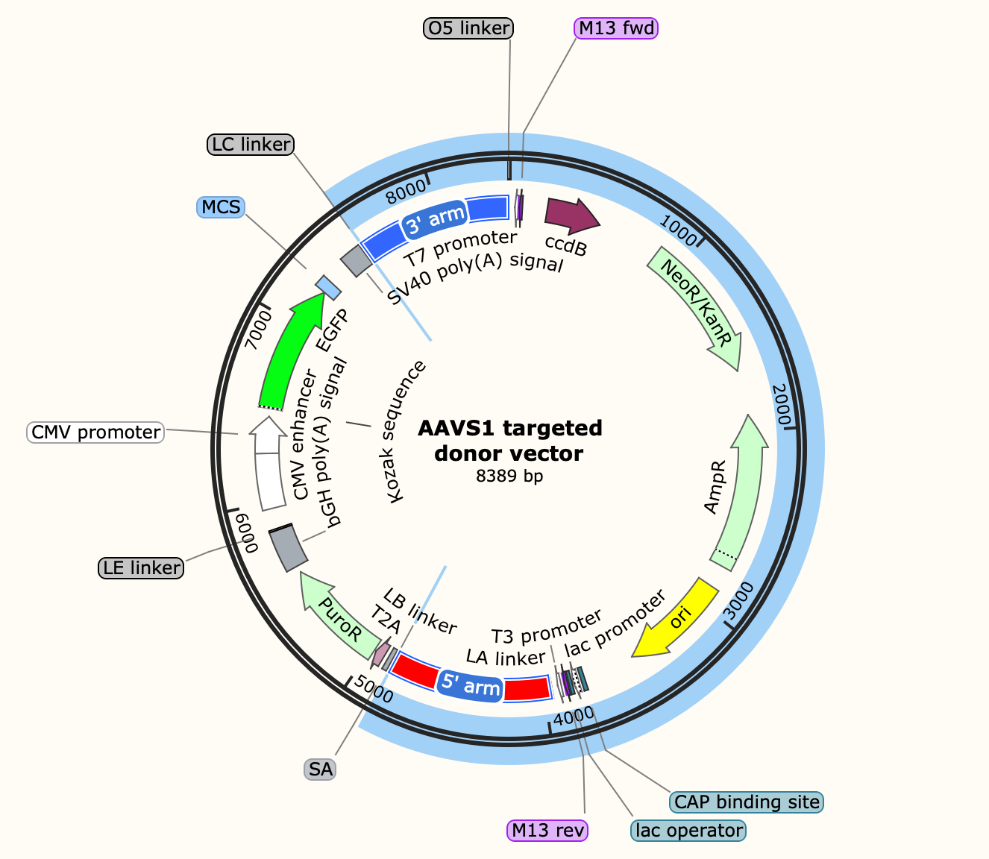
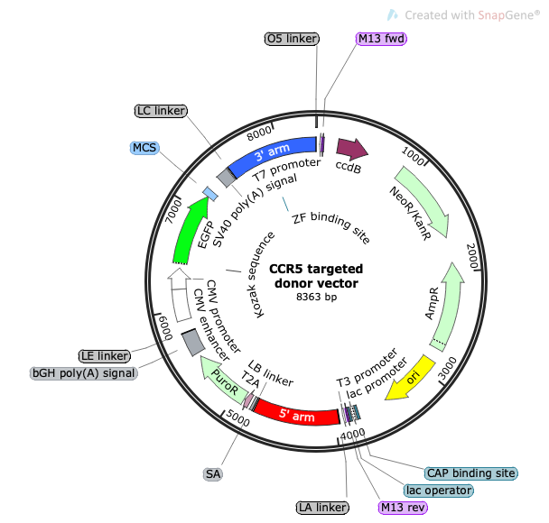
Donor plasmids for three loci
While waiting for the AAV 3 cassettes made by Udel, select the GFP as GoI for the Crispr-cas9 site-specific integration.
After getting the AAV 3 cassettes from Udel, will PCR to clone the donor HA backbone, and connect the HA backbone and Udel inserts via Gibson assembly
  Preliminary experiment to PCR the donor HA backbone and connect with other inserts of interest.

Slide 21
HEK293 cells transfected with two plasmids and antibiotics selection
Selection condition: 2 μg/mL puromycin, one-week microscopy image
Left, no transfection cells. Cells died.
Right upper, cells grow clone-like cluster
Right down, GFP expression under fluorescence.

Slide 22
Site-specific integration verification for three loci —
5’3’ junction PCR
CCR5 Genome sequence
Before integration 13,065 bp
After integration 15,770 bp

Slide 23
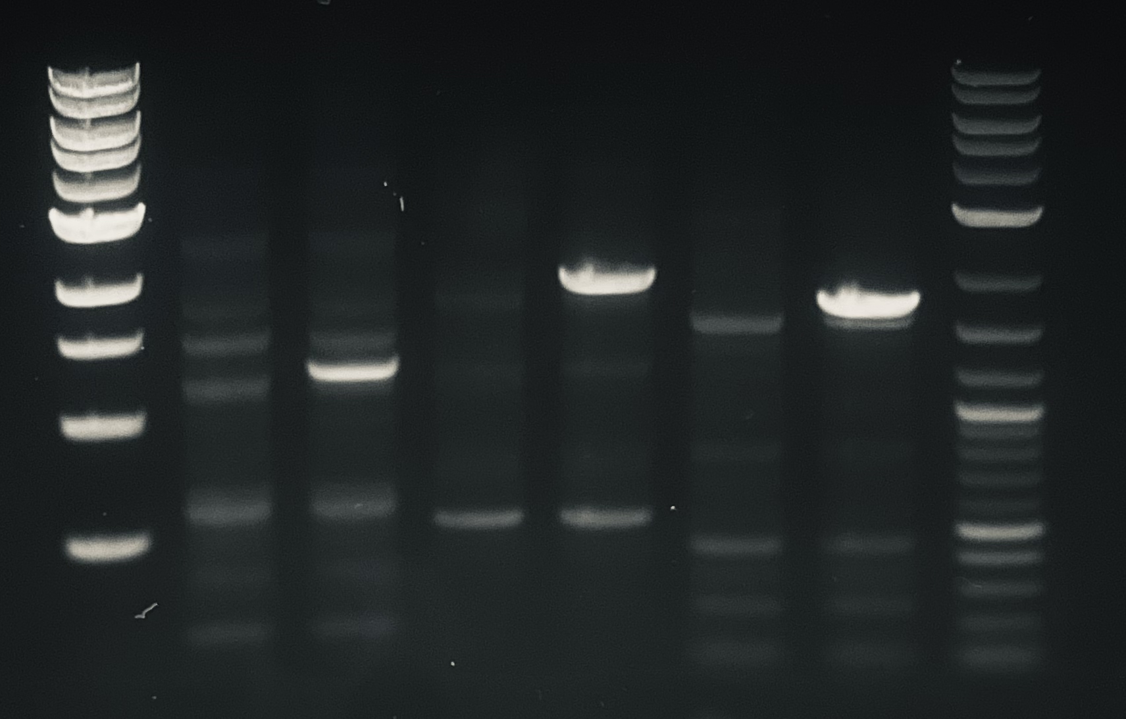
Site-specific integration verification for three loci —
5’3’ junction PCR gel electro
PCR condition: Touchdown PCR
1 2 3 4 5 6 7 8
5’3’ Junction PCR results to confirm site-specific integration at AAVS1 locus. Lane 1&8 is the ladder. Lane 2&4&6 is 293 NC (no transfection). Lane 3&5&7 are 293 samples transfected with donor and sgRNACas9 plasmids.
3000
2000
1500
1200
1000
500
Arrow in lane 3 indicates the 5’ targeted bands (1256 bp) in transfected sample
Arrow in lane 5 indicates the 3’ targeted bands (1969bp) in transfected sample
Arrow in lane 7 indicates the 3’ targeted bands (1714 bp) in transfected sample

Slide 24
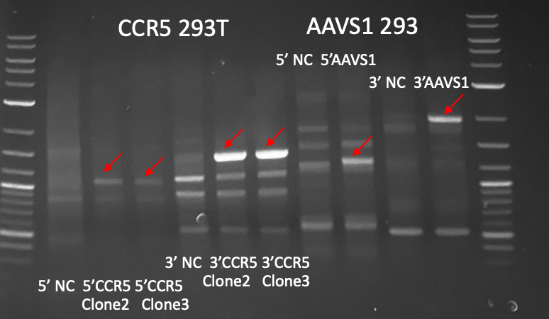
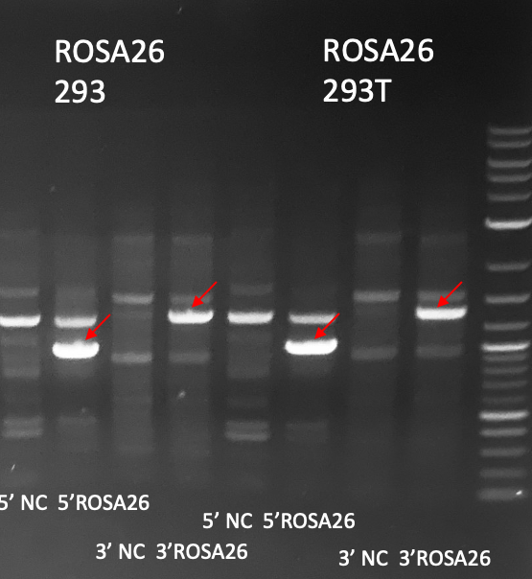
Site-specific integration verification for three loci —
5’3’ junction PCR gel electro
PCR condition: Touchdown PCR
Genomic loci | 5’ junction target size | 3’ target size
AAVS1 | 1256 | 1969
CCR5 | 1096 | 1427
ROSA26 | 1023 | 1368

Slide 25
Next Steps
UML
  Preliminary experiment for donor plasmid assembly
    Design the primer to PCR HA backbone
    PCR to clone the inserts
    Connect the HA backbone and insert via Gibson assembly
UD
  Finish cloning of entry vectors for golden gate assembly
  Assemble first iteration of plasmids
  Begin transient transfection tests and send to UML for integration

Slide 26
Research Sites – Timeline and Milestones
Q1 2023
Design of Tet-on/off inducible circuits (UD)
Crispr-Cas9 platform development and testing AAVS1, CCR5 and ROSA26 loci (UML)
Q2 2023
Tet off/on switch for 2 AAV cassettes via Golden gate, 1, transfer plasmid, 2, assembly plasmid(UD)
Q3 2023
Analytical methods (qPCR, Elisa, RT-qPCR, WB, proteomics) (UML/UD)
Testing inducible plasmids via transient (UML/UD)
Q4 2023
2024
Cell line productivity and stability evaluation(UML/UD)
Tet off/on switch for the 3rd AAV cassette via Golden gate, 3, replication plasmid(UD)
Site-specific integration of the 3rd cassette and develop the baseline of stable cells (UML)
Optimized AAV parts integration, The optimized stable cell line(UML)
Optimization of gene level and dynamics by engineered inducible variants, Kozak, and Degron tags (UD)
Site-specific integration of 2 cassettes made by UD (UML)
Optimization of gene level and dynamics by engineered inducible variants, Kozak, and Degron tags (UD)
Evaluate optimized plasmids via transient(UML/UD)
AAV production bottlenecks investigation(UD/UML)
Other investigations (UML/UD)

