Slide 1








Industry/University Cooperative Research Center (I/UCRC)
Advanced Mammalian Biomanufacturing Innovation Center (AMBIC)
Identifying Inhibitory Waste By-Products in High Density CHO Cell Cultures
Seongkyu Yoon / Michael J. Betenbaugh
(UML/JHU)
Project Update – August 2020
A National Science Foundation-facilitated academic – industry – government consortia to advance precompetitive knowledge in biomanufacturing
Contents are Proprietary to AMBIC and its Members
Terms of Center Membership Agreement Apply
www.ambic.org

Slide 2
Identify Business Value Deliverables
Project Name: Identifying Inhibitory Waste By-Products in High Density CHO Cell Cultures
Project Academic PI: Seongkyu Yoon (UML) / Michael J. Betenbaugh (JHU)
Project IAB Lead: Wai Lam Ling (Merck)
Category | Sub-Category | Business Value Deliverables
Technical Data | Digital Data | Inhibitory metabolic pathway related genes and nutrients list. The nutrients and gene list with their cloning primers to control the inhibitory metabolites accumulation . Spreadsheets containing all identified inhibitory metabolites, origin sources, pathway associations, experimental identification and validation results.
 | Printed Data | Novel inhibitory metabolites ID
Procedure | Manual
 | Protocols | Instrument names (LC, NMR, MS), model numbers, software used in analyses. Description of steps for instrument use and data analyses. Methods used in experimental runs, instrument settings and operation. Hoga1, Got1, Cat, Slc35a1 Gene cloning, plasmid construction, and transient transfection.
 | Design Specifications | Theory and mechanism of action of inhibitory metabolites in batch and fed-batch CHO systems.
Computer Programs | Web-accessed, server-hosted | Data analysis server/web were excluded in the novel inhibitory metabolites protocol
 | Distributed compiled software
 | Formatted, annotated code | Modified Genome-scale Model in Matlab
 | Printed algorithm
Reports | Meeting Slides and Minutes | Monthly meeting slide deck stored on www.AMBIC.org site in “Identifying inhibitory waste by-product in high density CHO cell culture” page.
 | Peer-reviewed publication | Publication in notable journal
 | Thesis or Dissertation | Publication, thesis or dissertation reference associated with work conducted to be distributed to IAB as they become available
 | Internal Technical Report | Internal technical reports associated with work conducted to be distributed to IAB as they become available
 | Public Presentation | Public Presentation at National Meeting. Presentation slides stored on www.AMBIC.org site.
Training | Individual Study Documents | Refer to published research papers and protocols
 | Recorded Webinar
 | Live Class, Course or lab
Material | Organism | AMBIC CHO cells from NIH
 | Process Product or Byproduct | CHO cell metabolic biomarker and inhibitor identification
 | Reference Material | AMBIC 1.0 Media and Feed
Analysis | Testing of IAB material | Under discussion with IAB members
 | Evaluation with IAB data | Metabolome dataset are provided
Johns Hopkins University
Clemson University
University of Delaware
University of Massachusetts Lowell
University of Maryland
Confidential

Slide 3
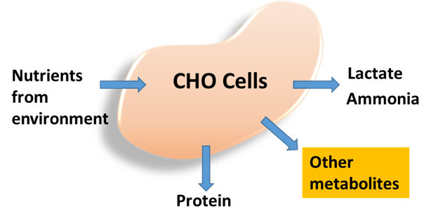
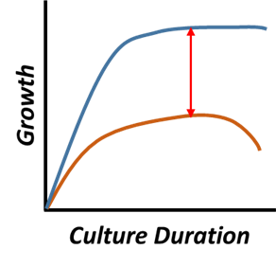
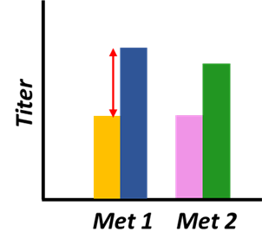
Goals & Objectives
Control accumulation of novel identified inhibitors
  Media optimization
  Pathway optimization by genetic engineering
Optimize the amino acid metabolism pathways
Improve CHO cell fed-batch culture cell density
Johns Hopkins University
Clemson University
University of Delaware
University of Massachusetts Lowell
University of Maryland
Confidential

Slide 4
Control Strategies
Genome-scale model (Jan-March)
  AMBIC 1.0 HCD process specific metabolic model
    30% → 9.6% model error (obj. func. cell growth)
  Simulation on cell responds to inhibitory metabolic pathways
    Nutrients, and Genes regulation
Pathway optimization(genetic engineering):
  Step 1: enzyme and gene selection (Genome-scale model [GeM])
    Multifunctional enzyme (Jan-June)
    → right enzyme contribute to the process
  Step 2: cell line development to upregulate downstream enzymes to consume inhibitory metabolites
    Gene cloning, plasmid construction, transient transfection
Media optimization (AA control):
  Step 1: AA selection and conc. range (GeM)
    Pathway analysis, AA sensitivity analysis (Jan-June)
  Step 2: Targeted control of metabolites, DoE
    PB screening (June – August)
    RSM optimization
Johns Hopkins University
Clemson University
University of Delaware
University of Massachusetts Lowell
University of Maryland
Johns Hopkins University
Clemson University
University of Delaware
University of Massachusetts Lowell
Notes:
Early Covid times, lab shut down, IAB recommends us to utilized the model.
We significantly improve the model by applying process specific metabolomics analysis,
and add multiple functions for the simulation on clone development and media optimization.
The simulation on what is the best genes to regulate to decrease the inhibitor accumulation and promote growth,
and what is the best nutrients to select and their conc. range to abstain the best growth profile.

Slide 5
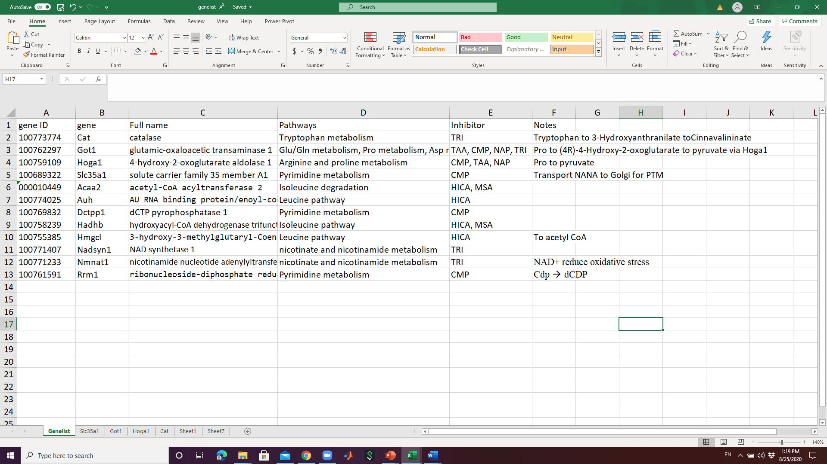
Pathway Optimization
Genome-scale model screening: gene selection
  4723 enzymatic reactions, 1298 genes
  Metabolic pathway analysis
  Proliferation
    AA downstream pathway ↑ → IM ↓ → efficiency of AA pathways ↑ → growth, productivity, product quality ↑
Johns Hopkins University
Clemson University
University of Delaware
University of Massachusetts Lowell
University of Maryland
Johns Hopkins University
Clemson University
University of Delaware
University of Massachusetts Lowell
Notes:
We showed how we identified the AA and the simulation on the optimum concentration range last time. Here is the algorithm for the clone development
we don’t want to metabolites those inhibitors to other non-essential or potentially toxic by-product. So we simulate all the inhibitory metabolites related pathways, to identified the genes that can mitigate the inhibitor accumulation, and also push the inhibitor to energy source, or protein productin

Slide 6
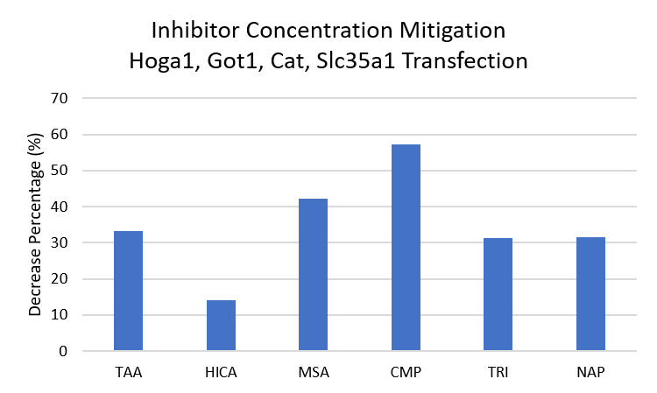
Clone Development
Downstream Genes Upregulation:
  Cat (TRI) : Tryptophan metabolism To acetyl-coA and H2O
  Got1 (TAA, CMP, NAP, TRI) : Glu/Gln metabolism, Pro metabolism, Asp metabolism To acetyl-coA and pyruvate
  Goga1 (CMP, TAA, NAP) : Arginine and proline metabolism To pyruvate
  Slc35a1 (CMP) : pyrimidine metabolism NANA metabolism
Johns Hopkins University
Clemson University
University of Delaware
University of Massachusetts Lowell
University of Maryland
Johns Hopkins University
Clemson University
University of Delaware
University of Massachusetts Lowell
Note: Metabolites start accumulating from d3 to d5, so no significant growth improvement from d1-d4, but extended the growth phase
Notes:
Long list,
Limited time frame, we cloned out 4 genes from different pathways to control different inhibitor accumulation.
Genes were intrincly from CHO, what we did is overexpress them to regulate the CHO cell metabolism more efficiently. As you can tell, those enzymes metabolites the inhibitors to generate energy or glycosylation, which is specifically guided by the GeM

Slide 7
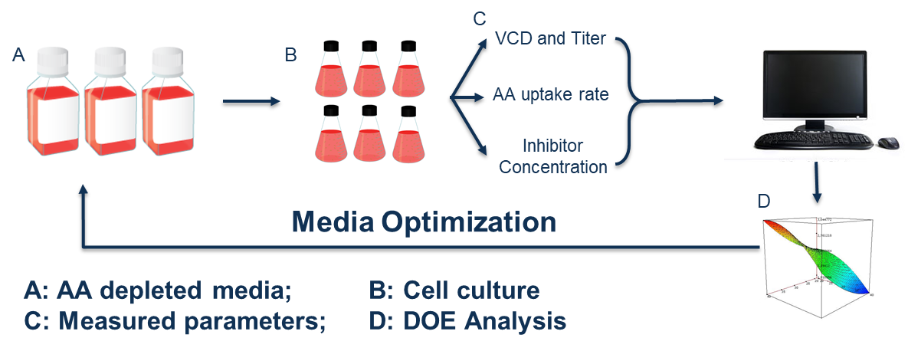
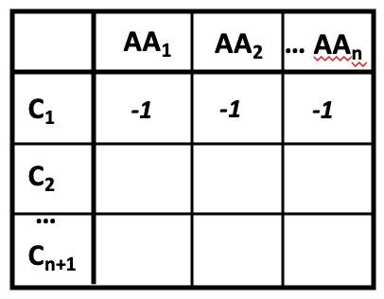
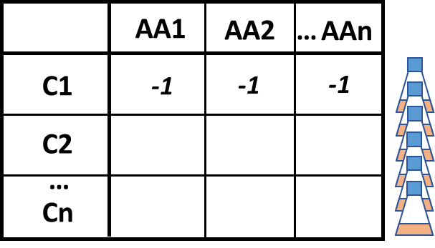
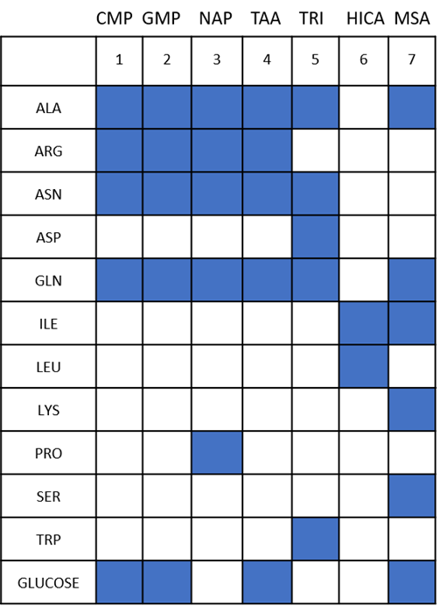
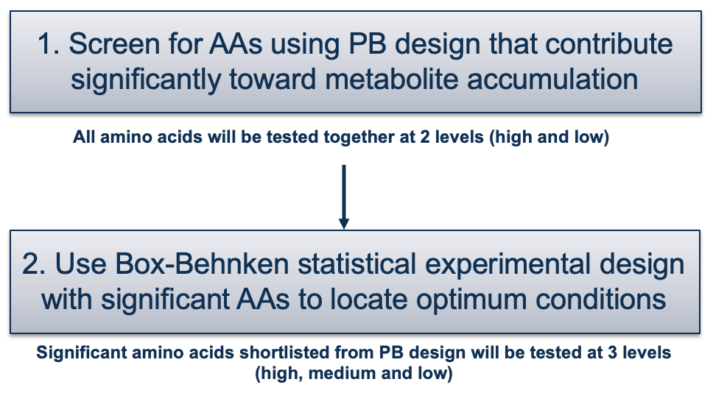
Medium Optimization Strategy
Johns Hopkins University
Clemson University
University of Delaware
University of Massachusetts Lowell
University of Maryland
Control the amino acid source to decrease the inhibitors and increase the productivity
AA precursor matrix
Confidential

Slide 8
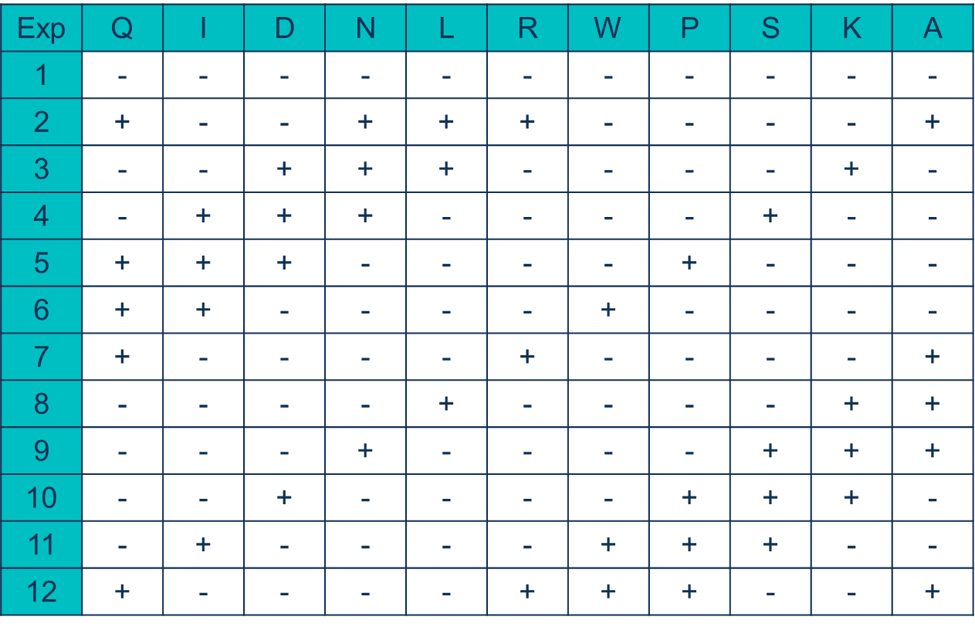
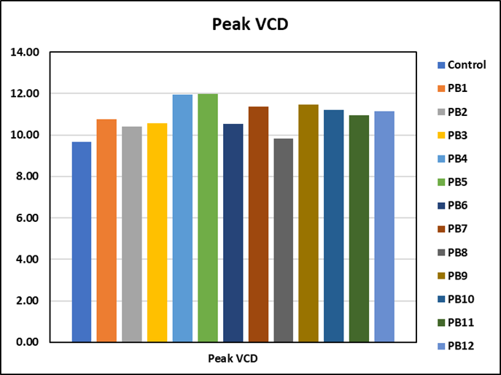
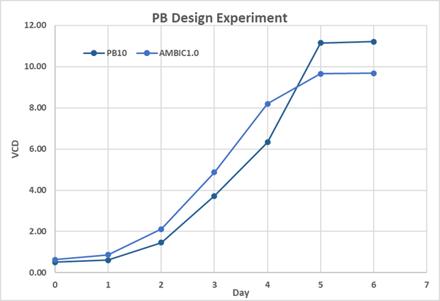
Plackett Burman Design
S. No. | Amino Acid | AMBIC 1.0 Conc (mM) | High Level (+) | Low Level (-)
1 | Gln (Q) | 8.0 | 100% | 50%
2 | Ile (I) | 2.3 | 100% | 50%
3 | Asp (D) | 5.4 | 100% | 25%
4 | Asn (N) | 3.9 | 100% | 50%
5 | Leu (L) | 3.5 | 100% | 75%
6 | Arg (R) | 2.4 | 100% | 75%
7 | Trp (W) | 0.6 | 100% | 50%
8 | Pro (P) | 1.8 | 100% | 50%
9 | Ser (S) | 4.8 | 100% | 25%
10 | Lys (K) | 2.5 | 100% | 50%
Johns Hopkins University
Clemson University
University of Delaware
University of Massachusetts Lowell
University of Maryland
PB design matrix
Dummy Variable for PB design for estimating experimental variance: Alanine (A) – High (100%) and Low (100%)
Cell Culture
Inhibitor
PB #10
Confidential

Slide 9
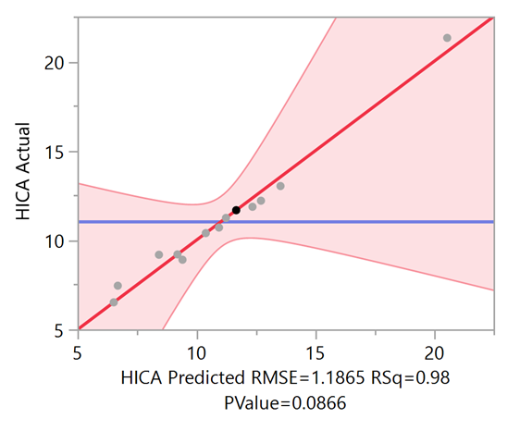
Next Steps
JMP Student Edition 14 for statistical analysis following placket-burman design of experiment
Response equation: Y = A + ∑B_{i}X_{i}
Actual inhibitor concentration is compared to the predicted value for a RSq value > 0.9
Significant AAs will be identified from response equation derived from PB design experiment
Optimize significant AAs in Box-Behnken design experiment to arrive at a control mixture of AAs in the design space
Johns Hopkins University
Clemson University
University of Delaware
University of Massachusetts Lowell
University of Maryland
HICA (uM) = (-8.99244031830233) + 6.88717948717943 * :Arg -0.0974358974359018 * :Asn -1.88641975308642 * :Asp -1.76865384615384 * :Gln + 7.67892976588626 * :Ile +2.81432360742708 * :Leu + 4.59138461538459 * :Lys + 3.03333333333333 * :Pro -1.85085470085469 * :Ser -12.4 * :Trp
Confidential

Slide 10
Challenges, Risks & Mitigation Strategies
Media Optimization:
  Batch culture in shake flasks
Clone Development:
  Batch culture, transient transfection
  Stable clones?
Biomarkers limitation on identification
  Metabolomics without GeM (not ready)
  Based on the accumulation→ metabolic pathway (GeM)
  Not a controlled process → bioreactor
  Few inhibitors → metabolic pathway → enhancers/ inhibitors
Johns Hopkins University
Clemson University
University of Delaware
University of Massachusetts Lowell
University of Maryland
Confidential

Slide 11
Timeline & Milestone Map
January-March
Process specific genome-scale model (GeM) construction
Novel inhibitor quantification method development
March-June
Pathway analysis using GeM: guidance to AA DoE conc. range and gene selection
AA depleted media reconstruction (pH, Osmolarity, AA conc.)
June-August
AA screening DoE, identified the critical AAs
Cloning critical genes to mitigate IM accumulation and increased the peak VCD 50.9% in batch culture
August-December
Patent filed, working on publications and deliverables.
AA RSM optimization DoE
Cloning the HICA controlling gene
Johns Hopkins University
Clemson University
University of Delaware
University of Massachusetts Lowell
University of Maryland
Confidential

Slide 12
Signature Achievements
Genome-scale model improved and applied for critical genes and AA conc. range identification
Four critical CHO cell genes cloned and transfected, IM conc. ↓, peak VCD 50.9% ↑ in batch culture
PB screening DoE showing 5 AA ↓(Gln, Ile, Asn, Leu, Trp), IM conc. ↓, peak VCD ↑
Johns Hopkins University
Clemson University
University of Delaware
University of Massachusetts Lowell
University of Maryland
Confidential

