Slide 1








Industry/University Cooperative Research Center (I/UCRC)
Advanced Mammalian Biomanufacturing Innovation Center (AMBIC)
Quantifying Process Heterogeneity – ‘Smart Marbles’ Analytical Technologies
William E. Bentley & Reza Ghodssi (PIs), University of Maryland
Project Update – August 2020
NOTE: THIS PROJECT IS ON A MAY to MAY CYCLE
A National Science Foundation-facilitated academic – industry – government consortia to advance precompetitive knowledge in biomanufacturing
Contents are Proprietary to AMBIC and its Members
Terms of Center Membership Agreement Apply
www.ambic.org

Slide 2
Goals & Objectives
Goal 1. Develop a low maintenance wireless multicomponent sensing platform for bioprocess monitoring within bioreactors
Goal 2. Develop understanding of process heterogeneity in cell cultures and relate to product heterogeneity.
Johns Hopkins University
Clemson University
University of Delaware
University of Massachusetts Lowell
University of Maryland
Objective 1. Design, build, test functioning wireless and real time communication system for ‘smart marble’ or bioProcess online analytical device, ‘bPod’.
Objective 2. Design, build, test functioning biofabricated sensor platform for ‘bPod’. Test prototype for assessment of dissolved oxygen.
Objective 3. Demonstrate continuous online, in situ measurements of process parameters in bioreactor.
Confidential

Slide 3
Identify Business
Value Deliverables
Project Name: Quantifying Process Heterogeneity – ‘Smart Marbles’
Project Academic PI: Bentley
Project IAB Lead: Mike Mollet (AstraZeneca)
Category | Sub-Category | Business Value Deliverables
Technical Data | Digital Data | Data from bPod
 | Printed Data | Manuscript describing design and use; Patent Application
Procedure | Manual | Operators Manual
 | Protocols | Methodologies for assembly and use
 | Design Specifications | Specifications of design (i.e., housing, power, communications, sensors)
Computer Programs | Web-accessed, server-hosted
 | Distributed compiled software
 | Formatted, annotated code | Code for conversation of current to DO; annotated programming of Bluetooth – will be distributed
 | Printed algorithm
Reports | Meeting Slides and Minutes | Minutes of mentor meetings
 | Peer-reviewed publication | Two publications have appeared during 2020
 | Thesis or Dissertation | One MS thesis (Stine) – he is continuing towards PhD
 | Internal Technical Report
 | Public Presentation
Training | Individual Study Documents
 | Recorded Webinar
 | Live Class, Course or lab
Material | Organism
 | Process Product or Byproduct | Will create several for testing at various sites.
 | Reference Material
Analysis | Testing of IAB material
 | Evaluation with IAB data
Johns Hopkins University
Clemson University
University of Delaware
University of Massachusetts Lowell
University of Maryland
Confidential

Slide 4
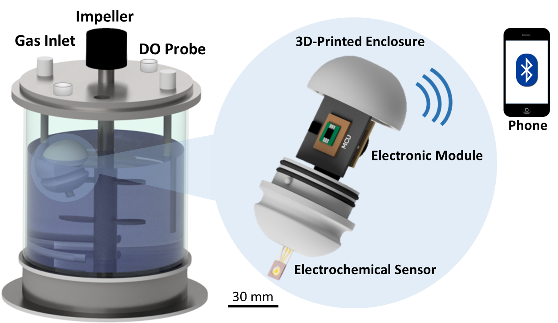
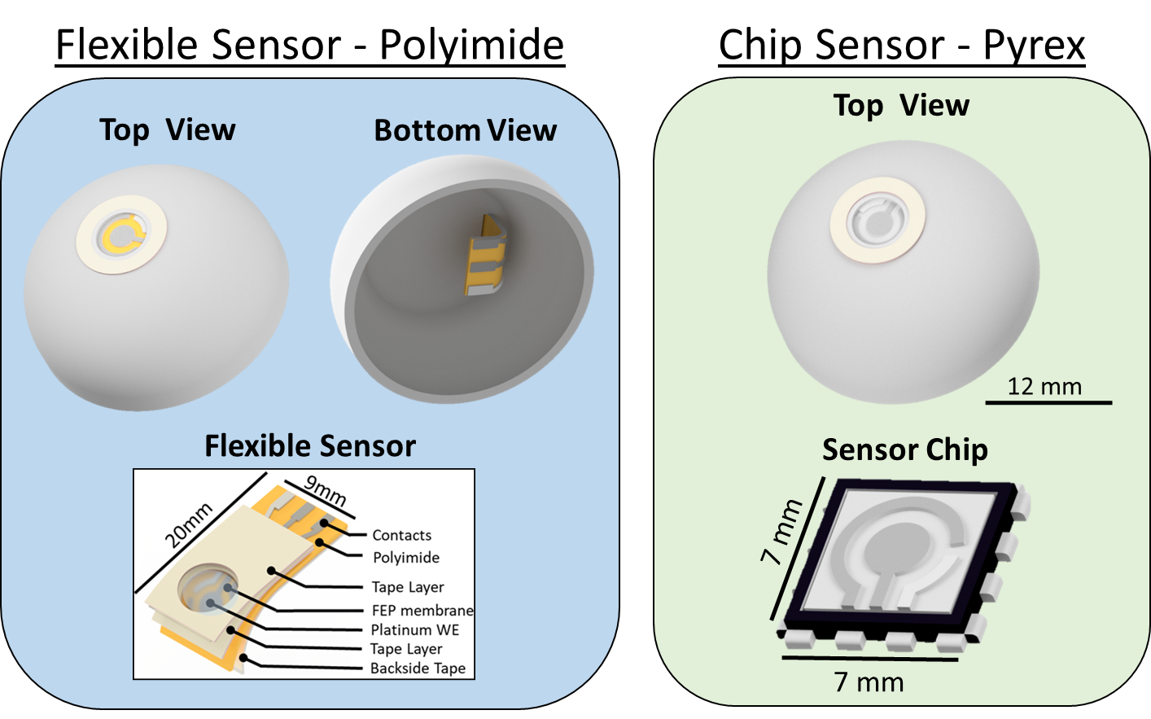
Key Research Results
Johns Hopkins University
Clemson University
University of Delaware
University of Massachusetts Lowell
University of Maryland
Results & Discussion
Summary of bPod Functions
Power Consumption
Calibration Results
Real-time Monitoring
Confidential

Slide 5
bPod Version 1
Johns Hopkins University
Clemson University
University of Delaware
University of Massachusetts Lowell
University of Maryland
Stine, J.M., Beardslee, L.A., Sathyam, R.M., Bentley, W.E., and R. Ghodssi (2020) Electrochemical Dissolved Oxygen Sensor-Integrated Platform for Wireless In Situ Bioprocess Monitoring, Sensors and Actuators B: Chemical, DOI: 10.1016/j.snb.2020.12838.
Confidential

Slide 6
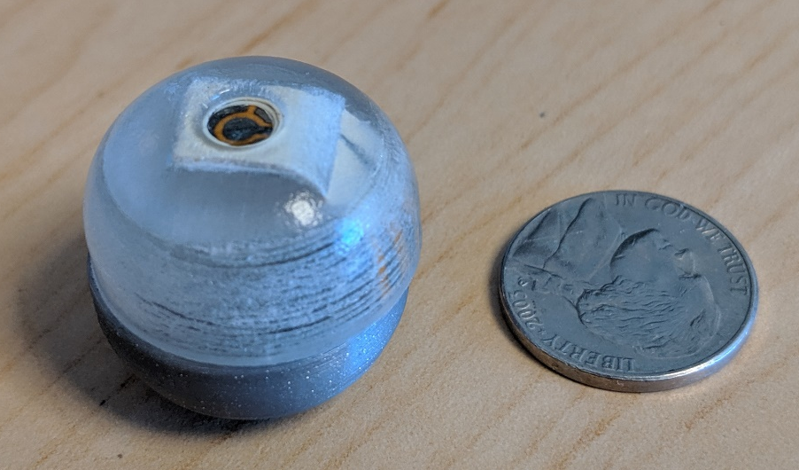
bPod Version 2
Johns Hopkins University
Clemson University
University of Delaware
University of Massachusetts Lowell
University of Maryland
Stine, J., Beardslee, L., Chu, S., Liu, S., Motabar, D., Bentley, W.E., and R. Ghodssi (2020) Wireless Sensor-Integrated Platform for Localized Dissolved Oxygen Sensing in Bioreactors, IEEE Journal of Microelectromechanical Systems, (in press).
Confidential

Slide 7
Challenges, Risks & Mitigation Strategies
Next-generation “bPod” issues for the next 6 months:
Communication distance
Housing stability - robustness
Sterilization
Buoyancy
Localization within tank
Testing at ”local” IAB site(s)
IP and startup company? (Thanks to Takeda and Sanofi!)
Mitigation Strategies:
Additional Post-doc
Maryland Device Development Fund
MII / TEDCO
Johns Hopkins University
Clemson University
University of Delaware
University of Massachusetts Lowell
University of Maryland
Confidential

Slide 8
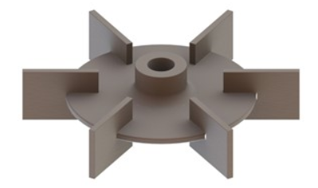
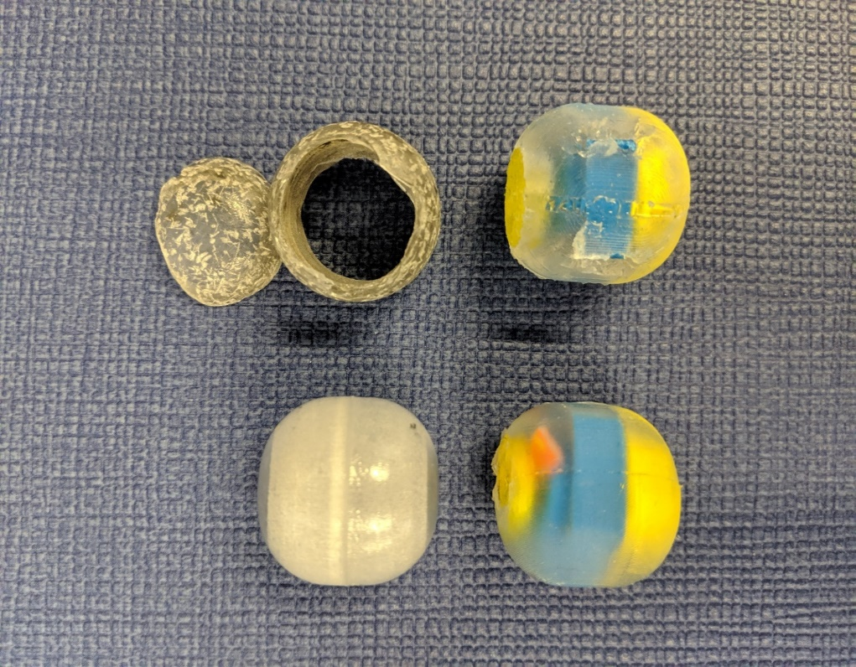
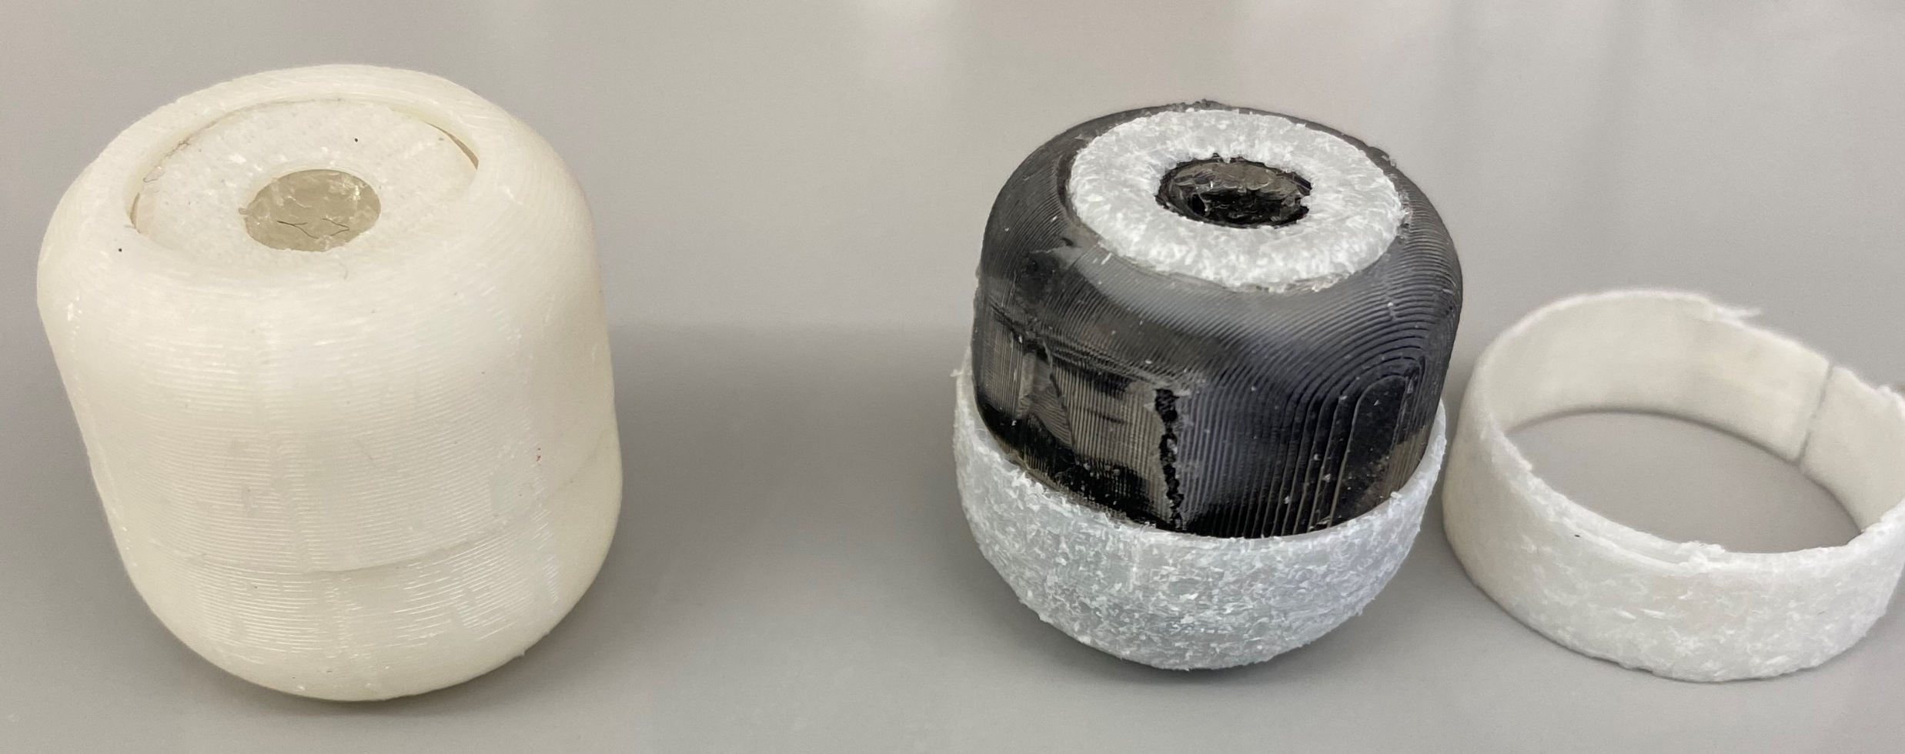


Robustness Testing - Results
Parameters used:
$Power number; Np$= 6 (Rushton Turbine)
$Water density; ρ$ = 1000 g/m³
$Agitation speed;N3=$ 100 rpm
$Impeller outer diameter; d3$= 76 mm
$Full working volume; V$= 7L
Time to shell breakage
Johns Hopkins University
Clemson University
University of Delaware
University of Massachusetts Lowell
University of Maryland
Shell Material | Trial 1 | Trial 2 | Average
MED610 | 1 hr | 1 hr 7 min | 1 hr 4 min
PDMS (inner) ABS-M30i (outer) | 50 hrs 45 min | ~25 hrs | ~38 hrs
Rushton turbine
MED610
Testing robustness at a P/V=10 using a single Rushton turbine impeller
Evaluating shell materials that are biocompatible and available for 3D printing and/or molding using on-campus resources
Found that having a softer inner material paired with harder outer shell substantially lifetime
PDMS (only)
PDMS (inner)
ABS-M30i (outer)
Confidential

Slide 9
Timeline & Milestone Map
Q5-8
Scale-down completed
Sensor area, electrode design, communications distance, buoyancy
Q6-7
‘Continuous’ sampling
Evaluate power requirements, battery life
Q7-8
Examine impeller contact vs multiple stationary systems
Test in tank & fix units to baffles or shaft
Q7-8
Scale manufacturing and make widely available to IAB
Test γ irradiation for stability of electronics
Johns Hopkins University
Clemson University
University of Delaware
University of Massachusetts Lowell
University of Maryland
Confidential

Slide 10
Signature Achievements
First Gen:
Overcame leaks, sensor membrane assembly, sensor delay time.
Developed wireless communication.
Calibrated DO measurements relative to Ingold probe.
Next-gen:
Designed & fabricated reduced circuit.
Designed 3D housing, modified for robustness.
Revised sensor design.
To do:
Sterilize, and test, test, test!
Johns Hopkins University
Clemson University
University of Delaware
University of Massachusetts Lowell
University of Maryland
Confidential

