Slide 1







Industry/University Cooperative Research Center (I/UCRC)
Advanced Mammalian Biomanufacturing Innovation Center (AMBIC)
Optimizing Nutrient Concentration Levels in Media and Feed Formulations
November 19th, 2019
Marc Donohue, Alan Stone, Michael Betenbaugh
(Johns Hopkins University)
A National Science Foundation-facilitated
academic – industry – government consortia
to advance precompetitive knowledge in biomanufacturing
Contents are Proprietary to AMBIC and its Members
Terms of Center Membership Agreement Apply

Slide 2
Outline
Experimental Updates
Computational Updates
GUI Distribution Updates

Slide 3
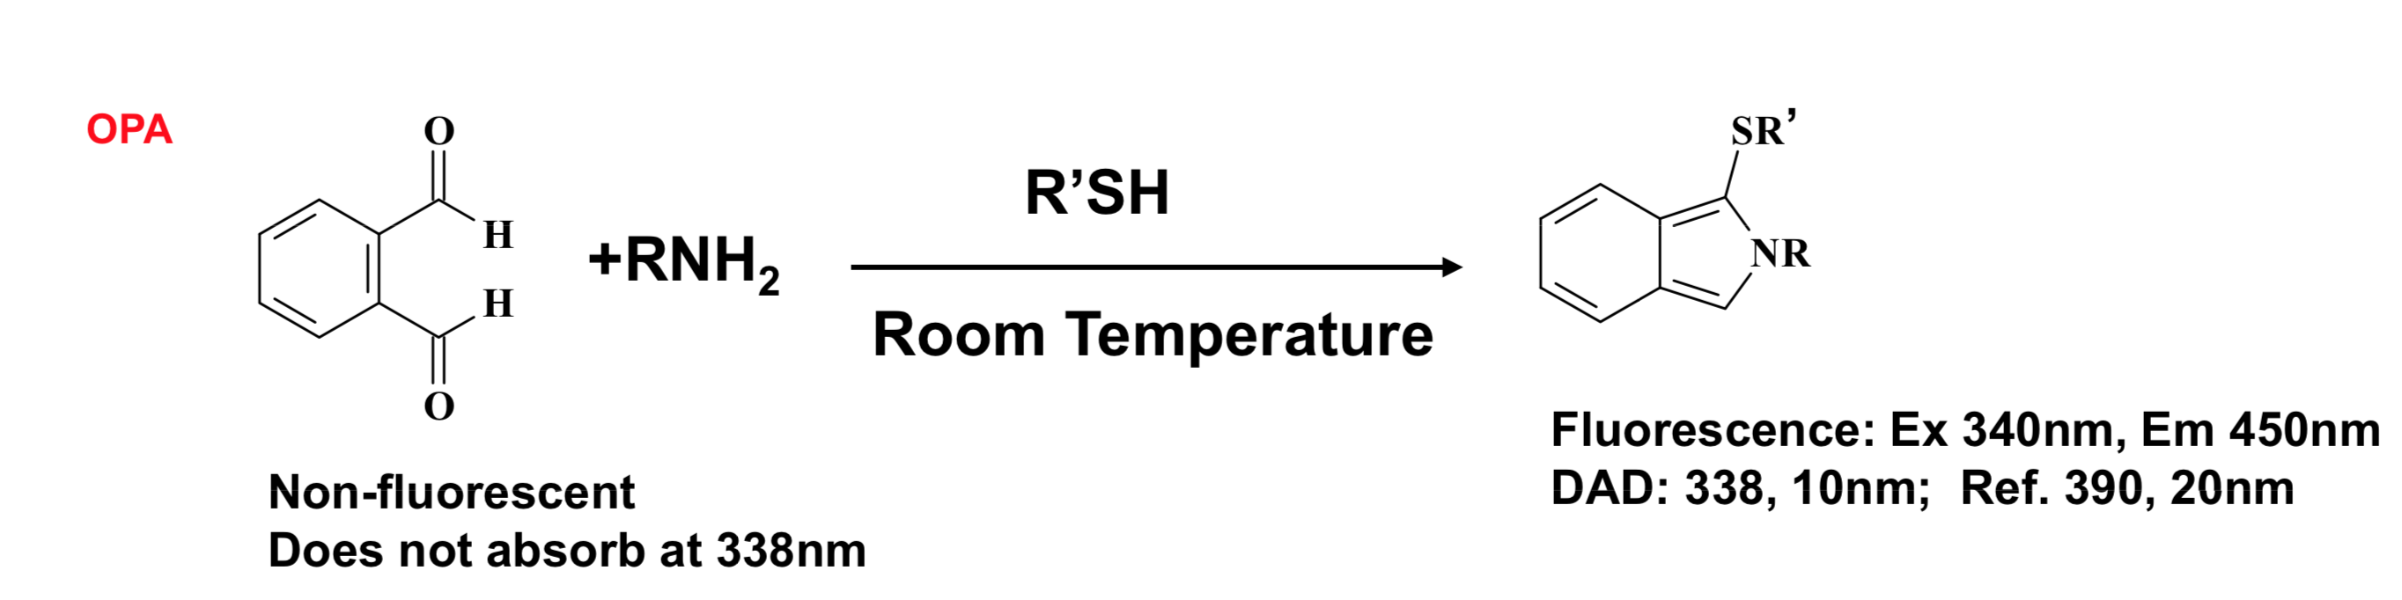
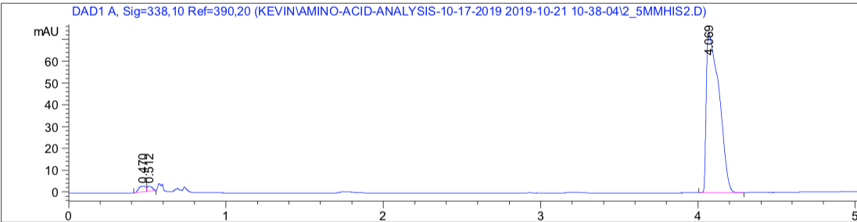
Experimental Updates: Measuring Solubility Limits with HPLC
OPA Derivatization method:
Solubility Protocol:
  Prepare saturated amino acid solution, leave stirring for >24h
  Prepare calibration standards, 8-10mM max concentration
  Prepare dilutions of saturated AA sample
  Run all calibrations / saturated samples with at least n=3 injections
Histidine Chromatogram: 5mM

Slide 4
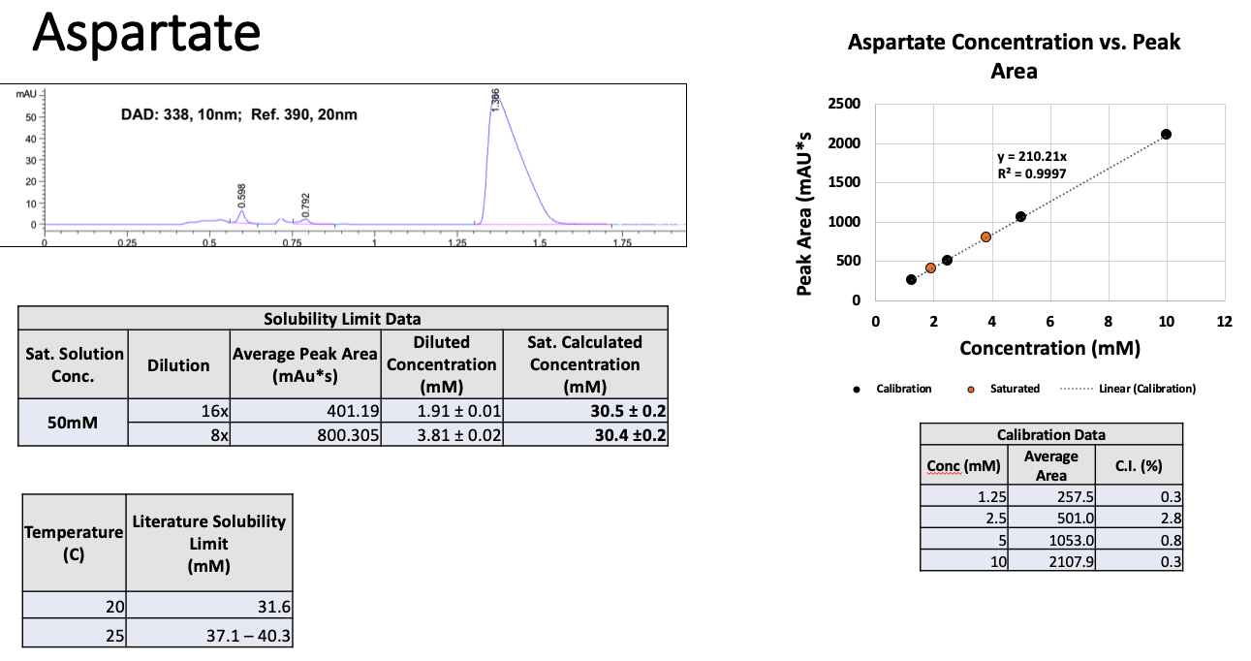
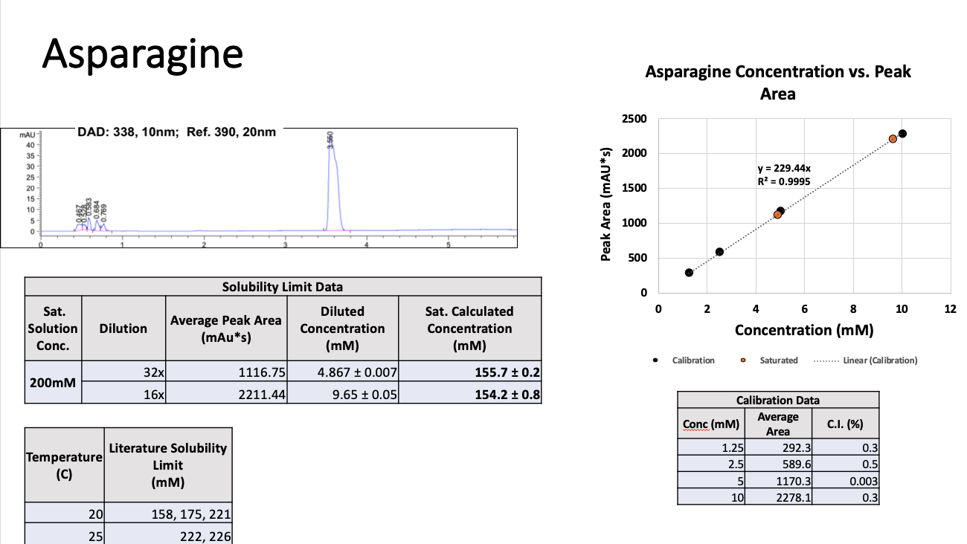
Experimental Updates: Previous Results
Previously:
Made one stock solution for calibration, measured dilutions of stock solution in triplicate
  This did not account for variation in preparing stock solutions
Only 1 saturated amino acid sample
Now:
Make 3 calibration solutions at different concentrations, measure each in triplicate
  This accounts for variation in stock sample solution prep
  Changed to measuring mass of AA and mass of H2O
Make 2 saturated samples, test each at 2 temperatures (21C, 37C)

Slide 5
Experimental Updates: Current Results
 | Solubility (g/kg) | Literature Value(g/kg)
Asparagine | 25.3 ± 0.2 (800X) | 24.9
Alanine | 155 ± 2 (800X） | 157.9
Serine | 345 ± 3 (1200X) | 367.8
Data generated for His, Thr, Glu, currently processing

Slide 6
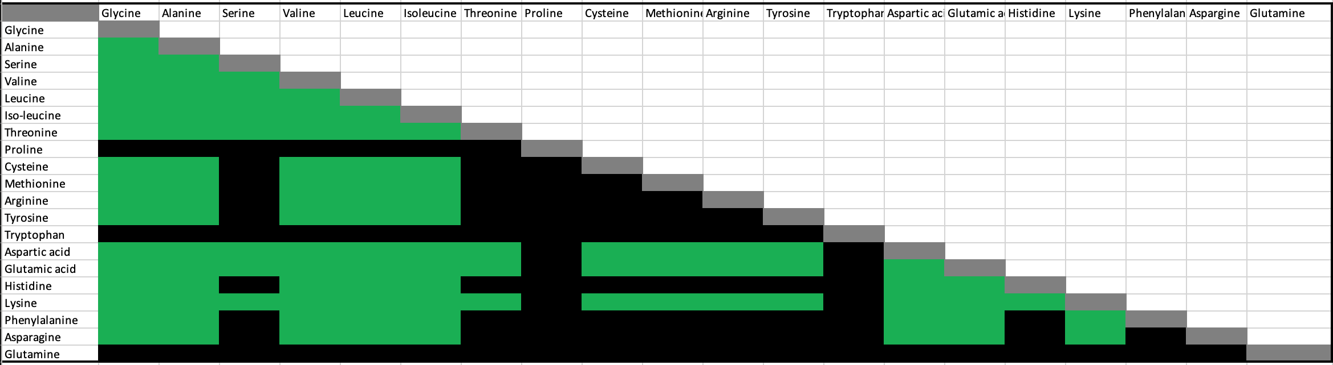
Updated Experimental Plan
Continue measuring binary solubility for AAs
Carry out ternary mixture solubility tests:
  55 combinations to be tested --> ~600 samples
Identify a multicompound case to confirm with model

Slide 7
Computational Updates Outline
Conceptual overview
Accomplishments and Future Modeling challenges
pH Updates and Future Work

Slide 8
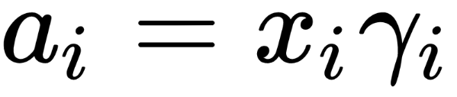

Background: Activity and Activity Coefficient
Activity of a species drives flow from one phase or mixture to another, similar to electric potential or temperature dictating electron / heat flow
The higher the activity = higher tendency of a substance to precipitate
At equilibrium, activity of all substances in all mixtures/phases are equal
The activity is concentration multiplied by some activity coefficient

Slide 9
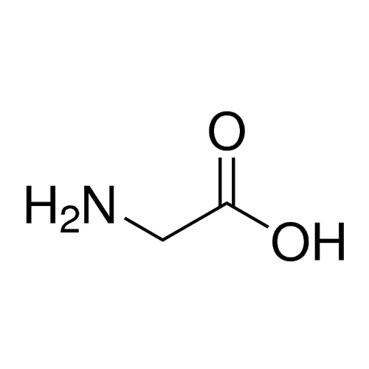
Background: UNIFAC
Activity coefficient of a species depends on chemical composition of both species and the mixture
UNIFAC splits a species into constituent chemical functional groups, and assumes interactions between all functional groups
Functional group interactions are combined for total effect on molecule activity
Net Effect:
Activity coefficient goes down
Solubility goes up

Slide 10
Background: Work Up to June Conference and Feedback
Compiled literature AA data from various sources
Regressed UNIFAC interaction parameters for amino acid functional groups
Developed a GUI capable of predicting solubilities of multi-compound mixtures
Feedback:
  Enable all AA solubility predictions. This required development of experimental methods for measuring solubilities
  Model pH effect on amino acid dependence. This required an expansion of the model and a new modeling approach.

Slide 11
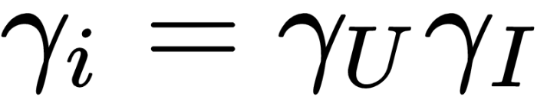
Background: Charged Species
Charged species need to be considered for pH predictions, as well as the presence of salts in solution
UNIFAC does not account for net charge / ionic interactions effects on activity coefficient
Modify UNIFAC activity coefficient result by considering charged species as point charge

Slide 12
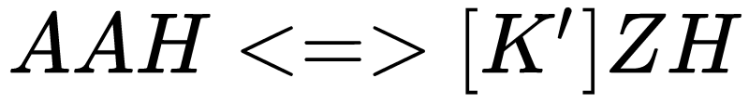
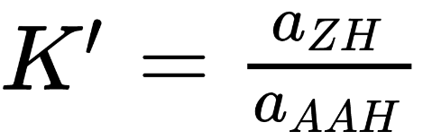
Background: Zwitterions
Most amino acids exist as a zwitterion at a neutral pH
We assume zwitterion + neutral forms to be the same, since ratio of zwitterion to neutral amino acid is a constant ratio, and K’ is large.

Slide 13


Background: pH and Equilibria
pH changes cause new species to form, which are charged and thus do not precipitate according to new reaction equilibria
These equilibria dictate the ratios of the amino acid present in all three forms, and thus their concentration and activity
Precipitation occurs when the activity of the neutral species reaches the critical value, as only the neutral species can precipitate

Slide 14
Background: Complexation and Scale
Including pH increases complexity more than just zwitterion inclusion. In practice, pH changes driven by HCl or NaOH.
Counter ions also form amino acid salts, which likely precipitate earlier than the neutral amino acid
For media, other ions would also be present
For each counter-ion + AA pair, have to determine equilibrium ratios, a significant increase in project scope.

Slide 15
Background: Multicompound and Flexibility
For predicting solubility with multiple species in media which can undergo complexation:
All the relevant equilibria (gathered in Dr. Stone’s chemical complexation project) has to be accessible
Based on input species, dynamically call equilibrium data, create problem to be called, and solve problem
This process would have to be automated to be scalable

Slide 16
Computational Updates: pH predictions
Modeled pH predictions are available for all binary systems
Found interesting properties in Amino acids with acidic / basic side chains, causing us to model these slightly differently
Implemented an in-house solver for use in Python to address convergence issues with out-of-the-box solvers
Developed GUI-compatible code for neutral side-chain solubility predictions
By end of year, we will have code for all 3 types of amino acids implemented in python and incorporated in the GUI

Slide 17
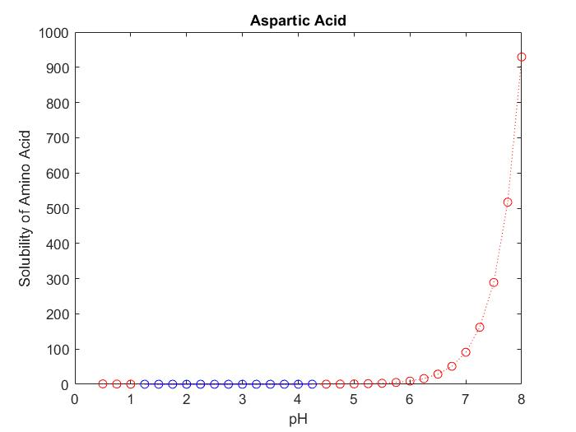
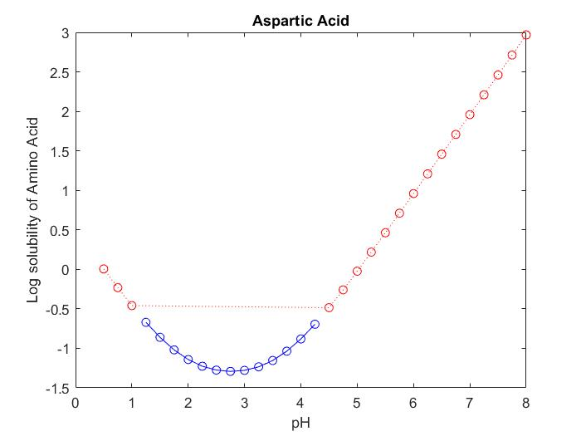
Aspartic Acid
cv
HAAH2(+)
HAAH
HAA-
AA(-2)
HAANa
cv

Slide 18
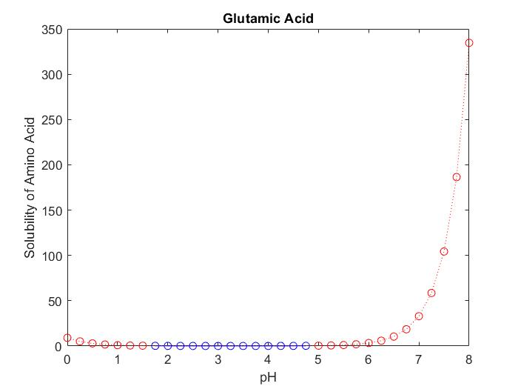
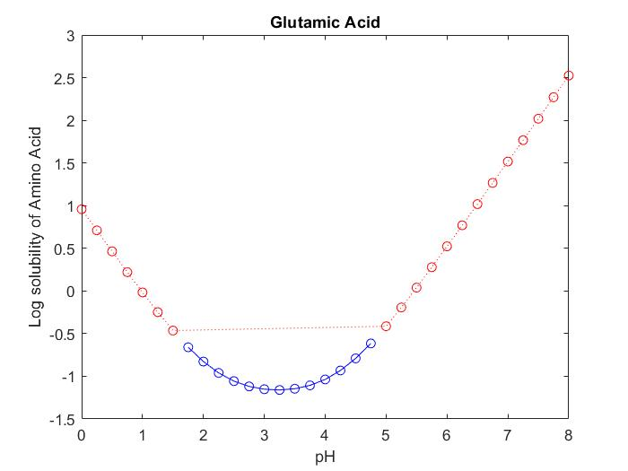
Glutamic Acid
HAAH2(+)
HAAH
HAA-
AA(-2)
cv

Slide 19
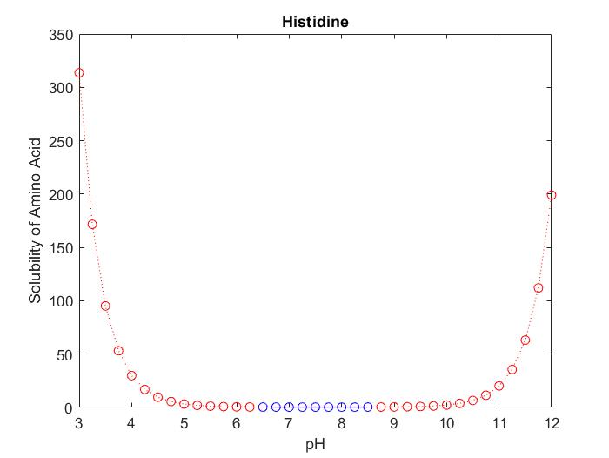
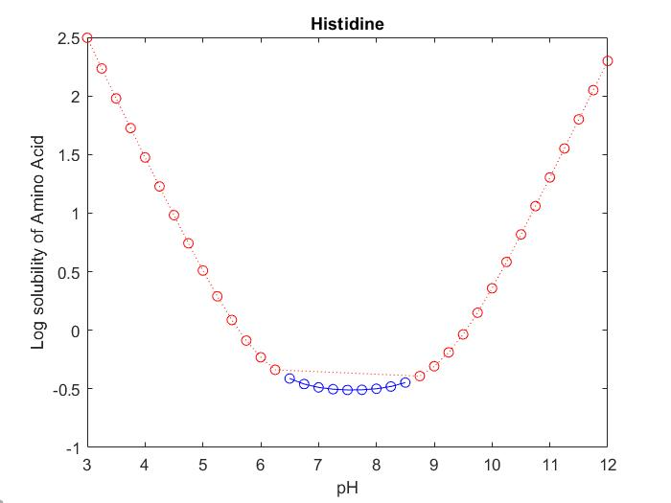
Histidine
HAAH3(+2)
HAAH2(+)
HAAH
AA(-)
cv

Slide 20
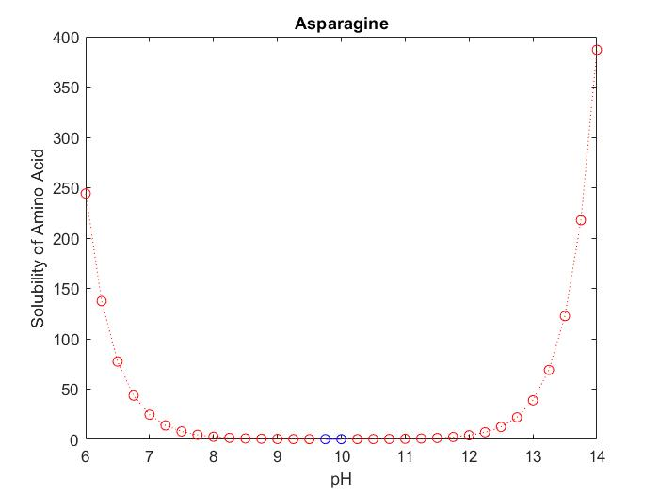
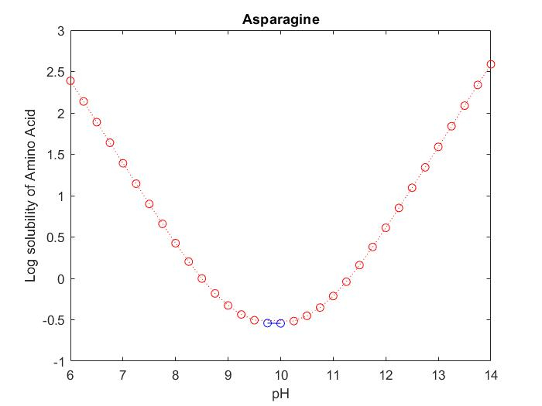
Asparagine

Slide 21
GUI Distribution Updates
We are sending out a notice to all AMBIC company disclosing the GUI
60 days to respond, once response is received, then must ‘negotiate’ a non-exclusive, royalty-free license from JHU
Will be updated from current demo version.

