Slide 1


Metabolic Model-based Tools for Optimizing Chinese Hamster Ovary Bioprocesses
Michael Betenbaugh
Johns Hopkins University
Seongkyu Yoon
University of Massachusetts Lowell
Johns Hopkins University
Clemson University
University of Delaware
University of Massachusetts Lowell
Johns Hopkins University
Clemson University
University of Delaware
University of Massachusetts Lowell
University of Maryland
Confidential

Slide 2
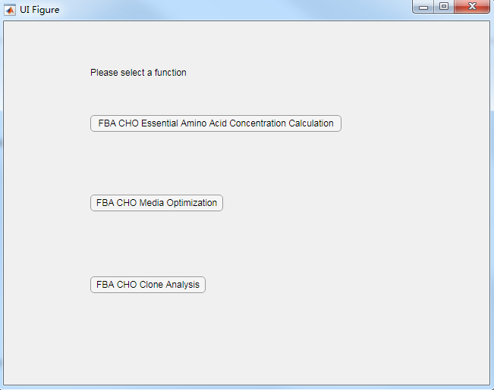
Introduction
This comprehensive tool combines three functions that utilize the genome-scale model developed for Chinese Hamster Ovary (CHO) cell (https://doi.org/10.1016/j.cels.2016.10.020)
Stand-alone .exe version created using MATLAB
1st function: Amino acid level prediction tool for CHO cell culture
2nd function: Media optimization tool for CHO culture
3rd function: Clone analysis tool for CHO cell line
Johns Hopkins University
Clemson University
University of Delaware
University of Massachusetts Lowell
Johns Hopkins University
Clemson University
University of Delaware
University of Massachusetts Lowell
University of Maryland
Confidential

Slide 3
Amino Acid Level Prediction Tool for Chinese Hamster Ovary Cell Culture
Michael Betenbaugh
Johns Hopkins University
Johns Hopkins University
Clemson University
University of Delaware
University of Massachusetts Lowell
Johns Hopkins University
Clemson University
University of Delaware
University of Massachusetts Lowell
University of Maryland
Confidential

Slide 4
Introduction
Objective for this tool:
Facilitate CHO bioprocesses by providing predictive capabilities on key nutrient levels for improved process monitoring and control
Use easy-to-measure inputs (cell density) to predict hard-to-measure properties (amino acid levels)
Used Software and Algorithms:
Stand-alone .exe version created using MATLAB
COBRA Toolbox (https://opencobra.github.io/cobratoolbox/latest/index.html#), under GNU General Public License version 3.0
Developed “ENM” algorithm (doi.org/10.1038/s41540-019-0103-6)
Johns Hopkins University
Clemson University
University of Delaware
University of Massachusetts Lowell
Johns Hopkins University
Clemson University
University of Delaware
University of Massachusetts Lowell
University of Maryland
Confidential

Slide 5
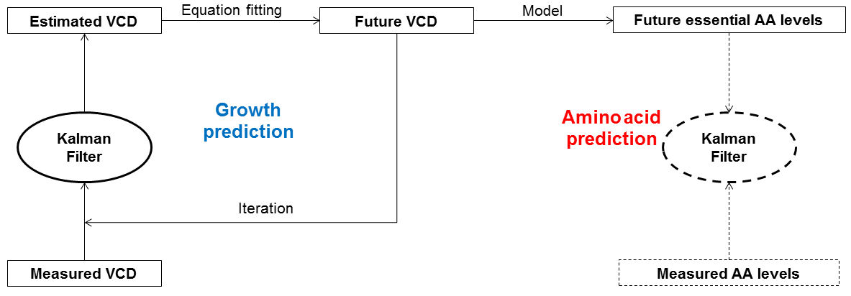
Amino acid level prediction algorithm
Viable Cell Desnity (VCD) measurements and growth prediction precede AA prediction
Growth behavior predicted by equation fitting/two-point extrapolation
Essential AA level estimated by CHO model and ENM approach (published, doi.org/10.1038/s41540-019-0103-6)
Switchable Kalman filter mitigates negative impact of input error
Johns Hopkins University
Clemson University
University of Delaware
University of Massachusetts Lowell
Confidential

Slide 6
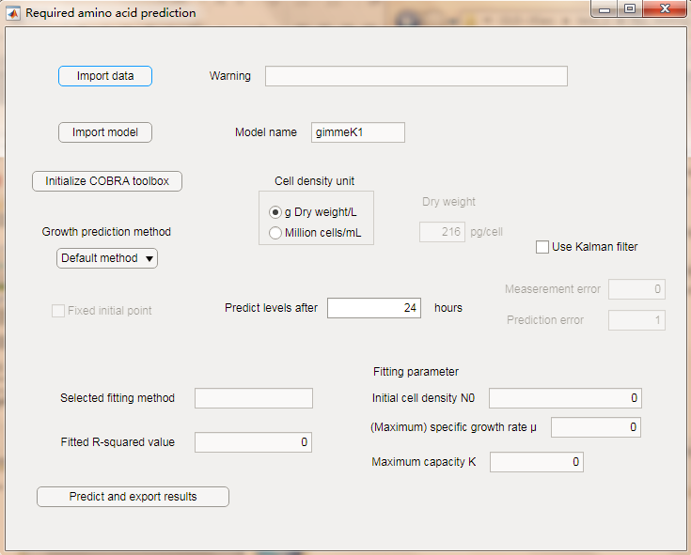
Graphical User Interface (GUI)
A Graphical User Interface (GUI) was made for AA level predictions
Input and initialize
Johns Hopkins University
Clemson University
University of Delaware
University of Massachusetts Lowell
Johns Hopkins University
Clemson University
University of Delaware
University of Massachusetts Lowell
University of Maryland
Prediction parameters setting
Output
Confidential

Slide 7
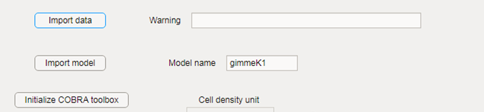
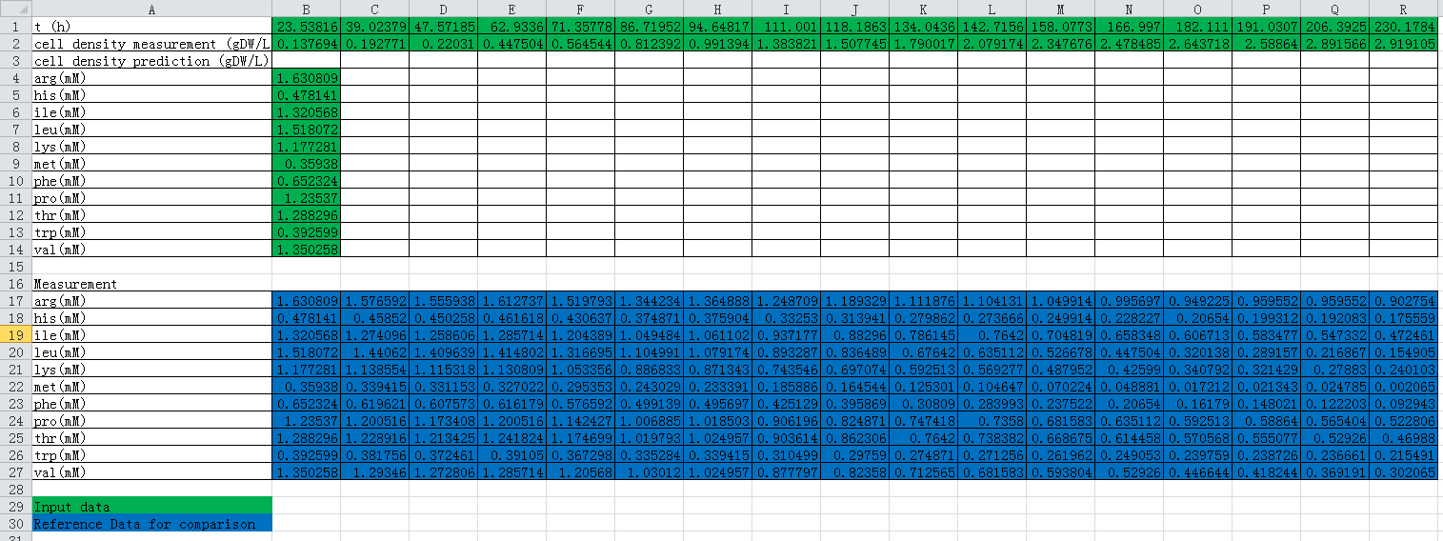
Input Data and Model
Files to be loaded into the GUI:
Genome-scale model input into this GUI in .mat (MATLAB) format
Input data (cell density, initial amino acid levels) in Excel format
Johns Hopkins University
Clemson University
University of Delaware
University of Massachusetts Lowell
Johns Hopkins University
Clemson University
University of Delaware
University of Massachusetts Lowell
University of Maryland
Required input data: 1st line: Culture time; 2nd line: VCD measurement; 1st column: initial amino acid levels
For record and comparison: Amino acid level measurements
Confidential

Slide 8
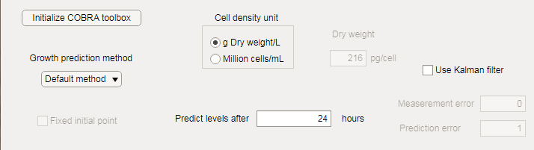
Prediction Method Selection and Parameter Setting
Johns Hopkins University
Clemson University
University of Delaware
University of Massachusetts Lowell
Johns Hopkins University
Clemson University
University of Delaware
University of Massachusetts Lowell
University of Maryland
Growth estimation method can be selected:
  Fitting, Logistic growth equation (needs >3 VCD measurements)
  Fitting, Exponential growth equation (needs >3 VCD measurements)
  Two-point extrapolation method (needs > 2 VCD measurements)
  Default method (run all fitting methods and select the fitting that gives the largest R² value; two-point extrapolation if R² < 95% )
Users can choose to predict future level after how many hours
Kalman filter can be turned on/off; estimated measurement and prediction errors are needed for input
Confidential

Slide 9
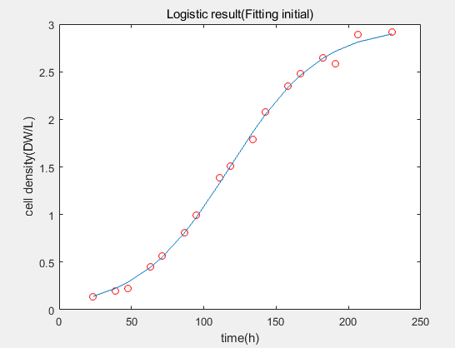
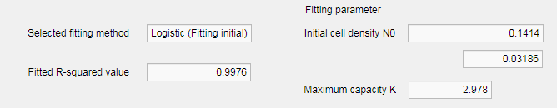
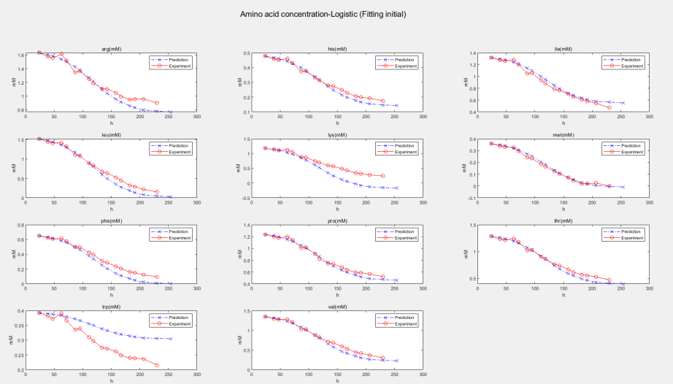
Output from the GUI
1st output: Growth curve fitting results (with plot) and parameters; with cell density estimated for one future time point
2nd output: As many as 12 amino acid levels predicted (with plot) if no measurement is provided for the given time points, as well as levels predicted for a future time point
Johns Hopkins University
Clemson University
University of Delaware
University of Massachusetts Lowell
Johns Hopkins University
Clemson University
University of Delaware
University of Massachusetts Lowell
University of Maryland
Confidential

Slide 10
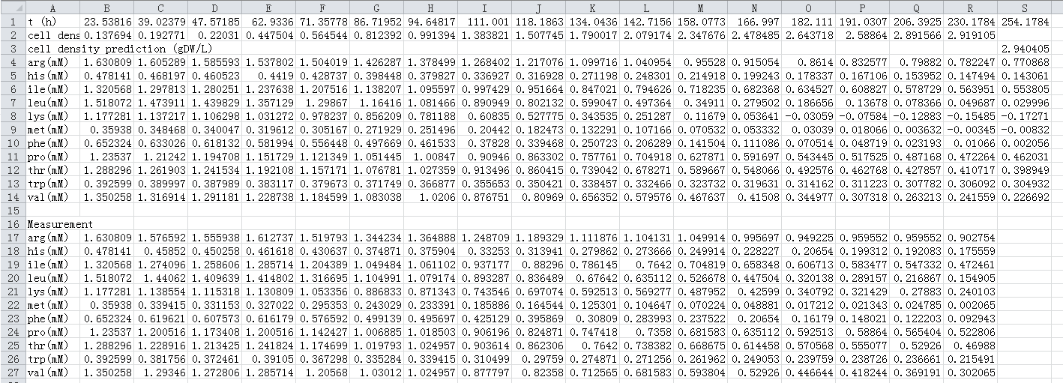
Output from the GUI
3rd output: A new Excel file containing previous inputs as well as predictions of future time points; this file can be used as input for next time point prediction
Johns Hopkins University
Clemson University
University of Delaware
University of Massachusetts Lowell
Johns Hopkins University
Clemson University
University of Delaware
University of Massachusetts Lowell
University of Maryland
Confidential

Slide 11
Output from the GUI
These outputs can be used as an estimation of future states in the CHO cell culture (i.e. bioreactors in CHO bioprocesses)
Future states can be used as guidance to design process control strategies
Johns Hopkins University
Clemson University
University of Delaware
University of Massachusetts Lowell
Johns Hopkins University
Clemson University
University of Delaware
University of Massachusetts Lowell
University of Maryland
Confidential

Slide 12
Media Optimization and Clone Analysis Tools
Seongkyu Yoon
University of Massachusetts Lowell
Johns Hopkins University
Clemson University
University of Delaware
University of Massachusetts Lowell
Johns Hopkins University
Clemson University
University of Delaware
University of Massachusetts Lowell
University of Maryland
Confidential

Slide 13
Introduction
Objective for this tool:
Suggest target nutrients for optimizing culture media for CHO cells based on genome-scale model predictions of maximal growth rate/protein productivity
Suggest key metabolic pathways which affect the maximal growth/productivity as targets for cell line engineering
Used Software and Algorithms:
Stand-alone .exe version created using MATLAB
COBRA Toolbox (https://opencobra.github.io/cobratoolbox/latest/index.html#), under GNU General Public License version 3.0
Johns Hopkins University
Clemson University
University of Delaware
University of Massachusetts Lowell
Johns Hopkins University
Clemson University
University of Delaware
University of Massachusetts Lowell
University of Maryland
Confidential

Slide 14
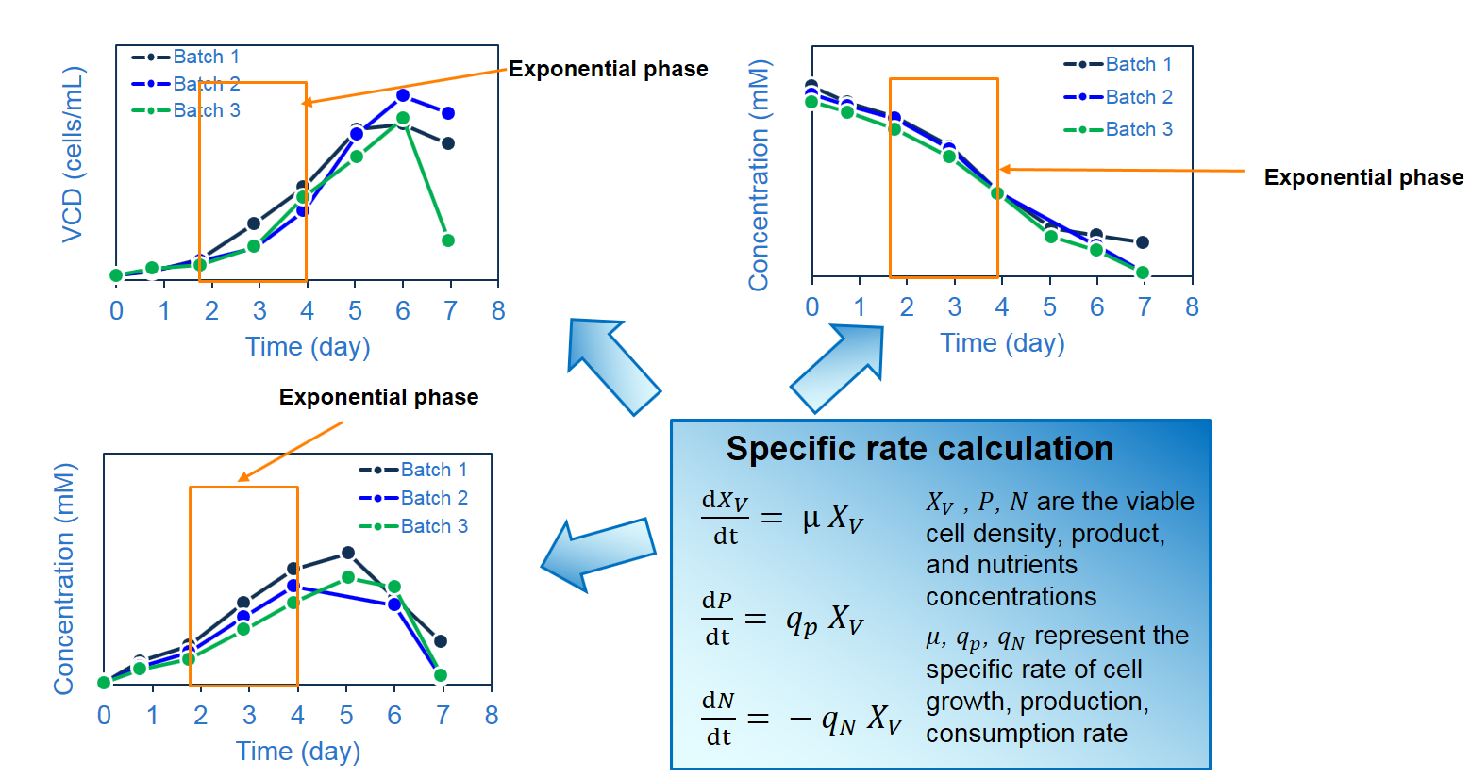
Experiments required for GUI
Cell culture experiments
Johns Hopkins University
Clemson University
University of Delaware
University of Massachusetts Lowell
Johns Hopkins University
Clemson University
University of Delaware
University of Massachusetts Lowell
University of Maryland
To calculate the specific consumption/production rates used as model constraints (model inputs)
Confidential

Slide 15
Experiments required for GUI
Data collection template (mg/mL, mmol/L)
 | D0 | D1 | D2 | D3 | … | D14 | Basal media | Feed media
Glucose
Glutamate
NH4
lactate
Alanine
Serine
Cell growth
IgG
Johns Hopkins University
Clemson University
University of Delaware
University of Massachusetts Lowell
Johns Hopkins University
Clemson University
University of Delaware
University of Massachusetts Lowell
University of Maryland
Specific rates template (mmol/gDW hr)
 | Batch1 | Batch 2 | Batch 3
Glucose
Glutamate
NH4
lactate
Alanine
Serine
Cell growth
IgG
Specific rates calculation Equations
GUI (MATLAB)
Confidential

Slide 16
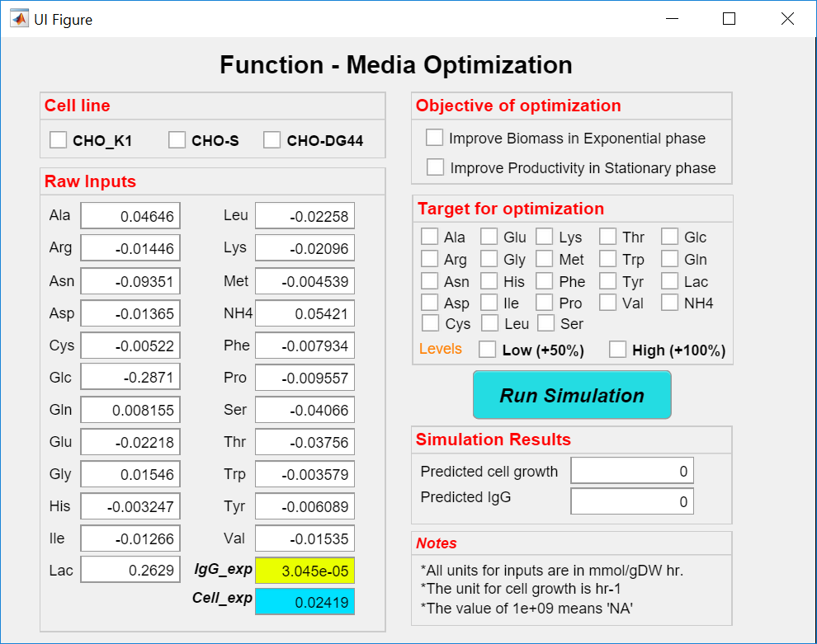
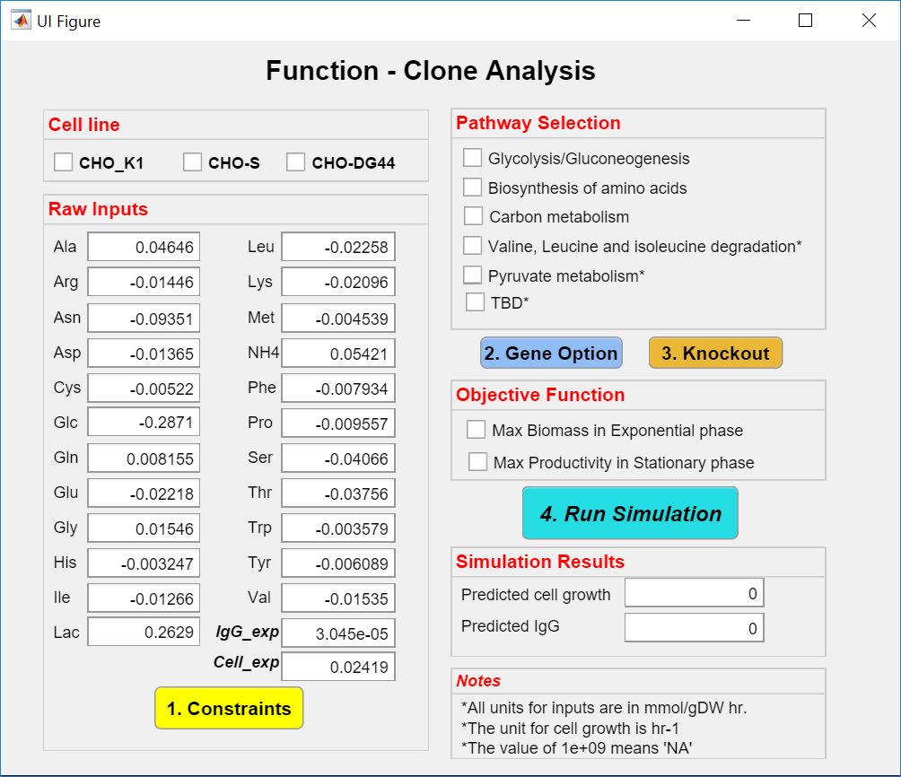
GUI
Media optimization
Cell line analysis
Johns Hopkins University
Clemson University
University of Delaware
University of Massachusetts Lowell
University of Maryland
Input: Measured metabolite fluxes + target nutrient to optimize
Output: Expected max growth or productivity change
Input: Measured metabolite fluxes + target gene to knockout
Output: Expected max growth or productivity change
Confidential

Slide 17
GUI - Media optimization
A Graphical User Interface (GUI) was made for media optimization (mainly for feed media）
GUI window
Johns Hopkins University
Clemson University
University of Delaware
University of Massachusetts Lowell
Network of Cell lines
Specify constraint inputs
Objective function
Targeted nutrient to optimize
Run simulation
Click 1
Confidential

Slide 18
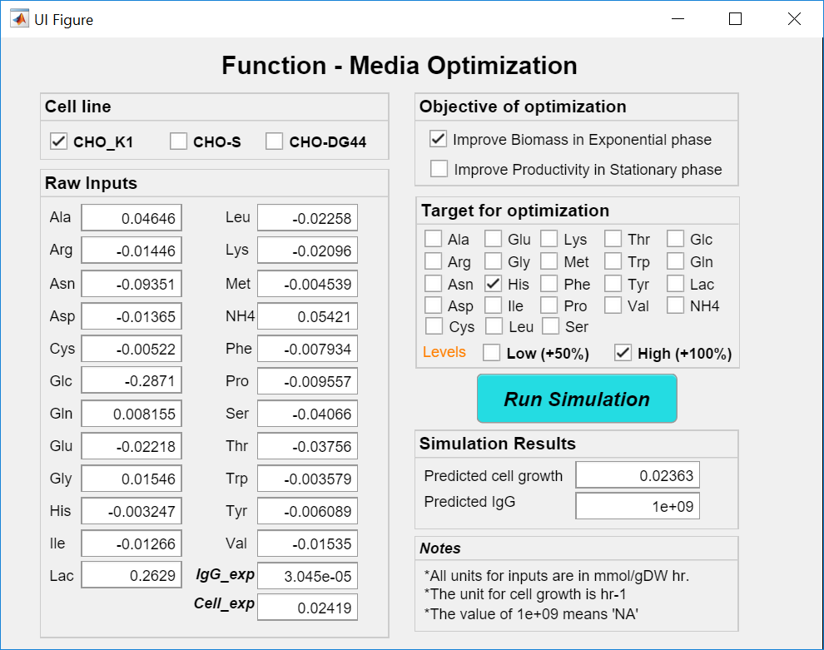
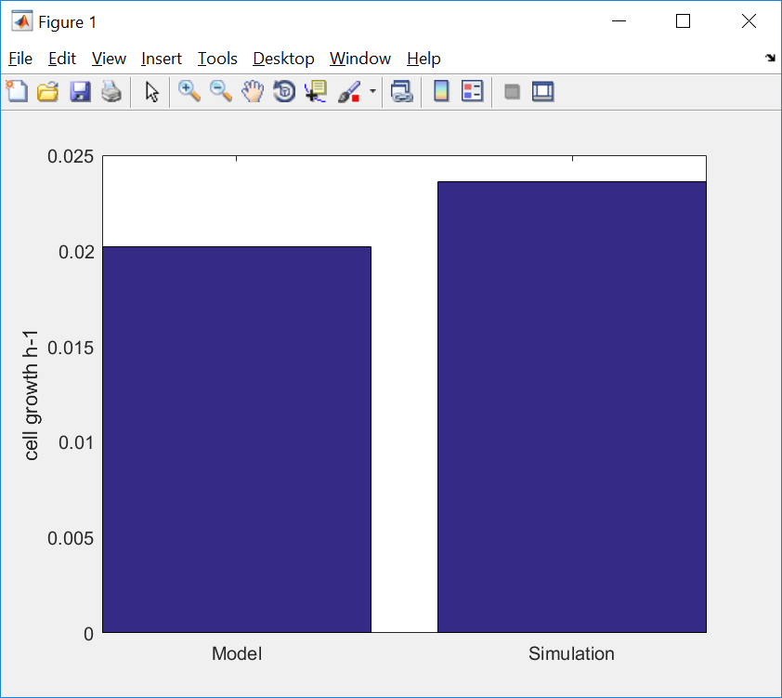

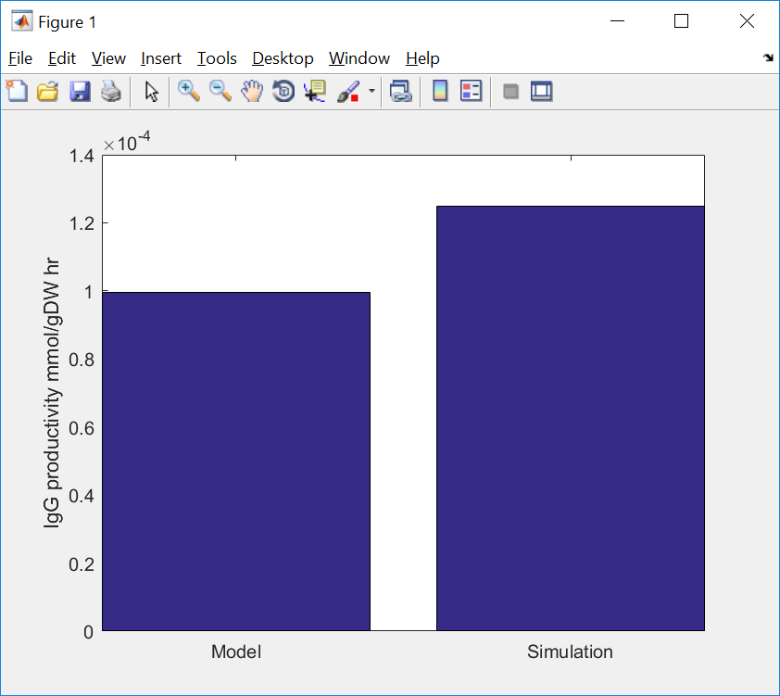
Media optimization GUI - examples
His can be used for future design
Johns Hopkins University
Clemson University
University of Delaware
University of Massachusetts Lowell
Optimize cell growth during exponential phase
Pro can be used for future design
Optimize IgG productivity during stationary phase
Confidential

Slide 19
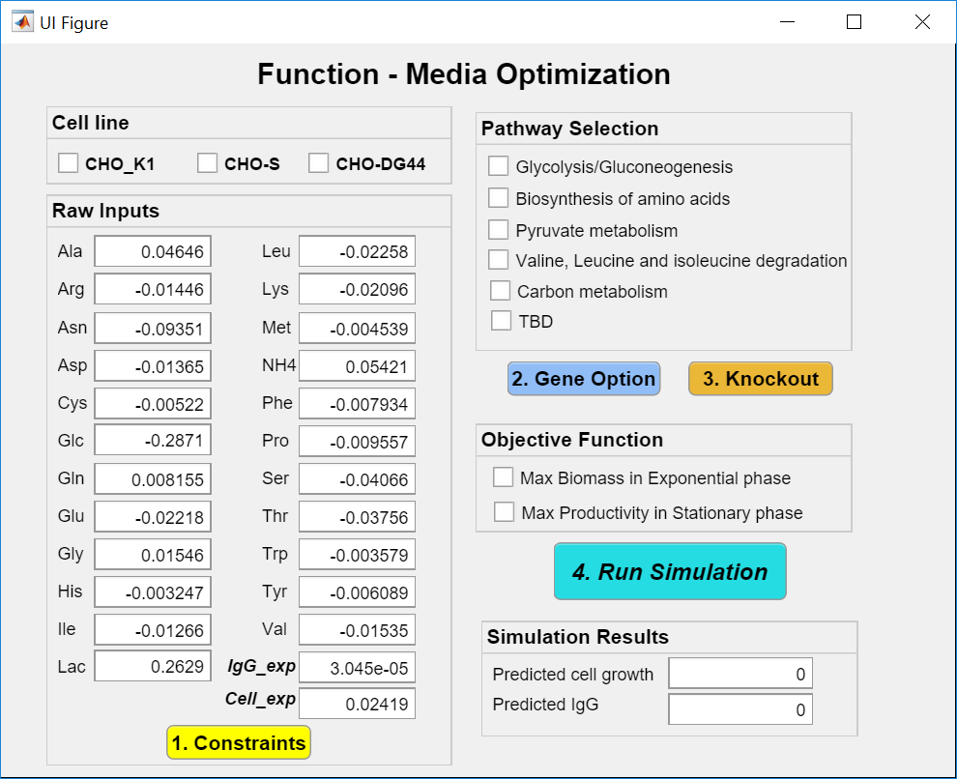
GUI – Cell line analysis
A Graphical User Interface (GUI) was made for clone analysis (mainly for gene knockout/knock in simulation）
Main GUI window
Johns Hopkins University
Clemson University
University of Delaware
University of Massachusetts Lowell
Network of Cell lines
Specify constraint inputs
Pathway selection (sub GUI)
Gene knockout
Objective function
Run simulation
Click 3
Click 2
Click 4
Click 1
Confidential

Slide 20
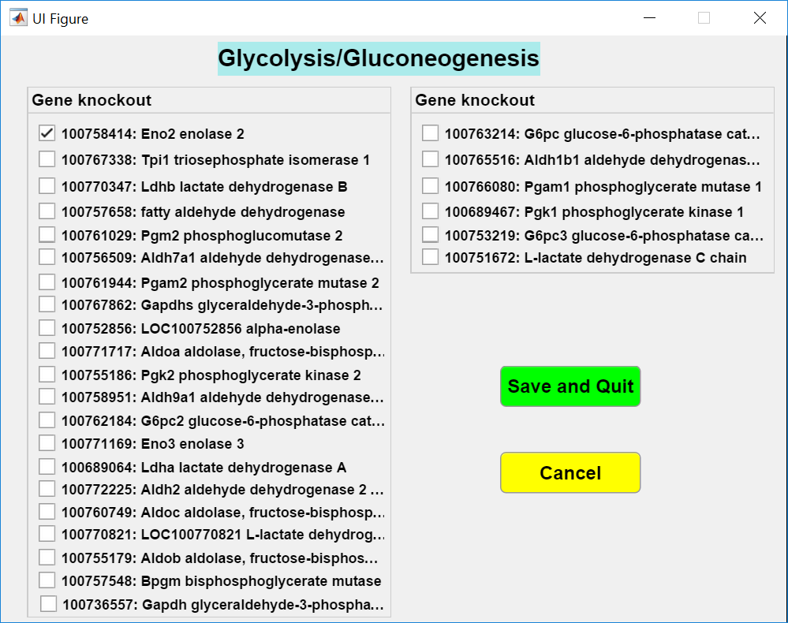
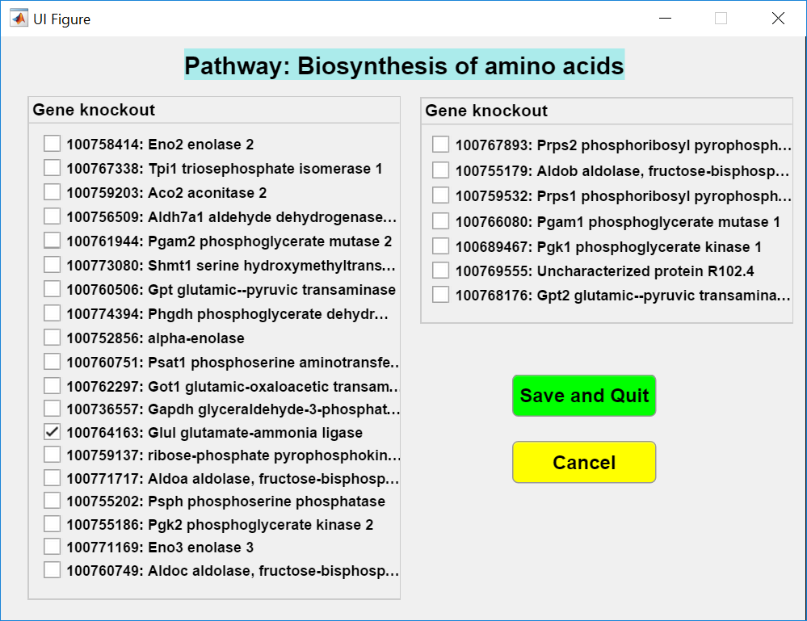
Clone analysis GUI – examples
Sub GUI window
Gene lists:
  Gene symbol
  Gene description
Johns Hopkins University
Clemson University
University of Delaware
University of Massachusetts Lowell
Confidential

Slide 21
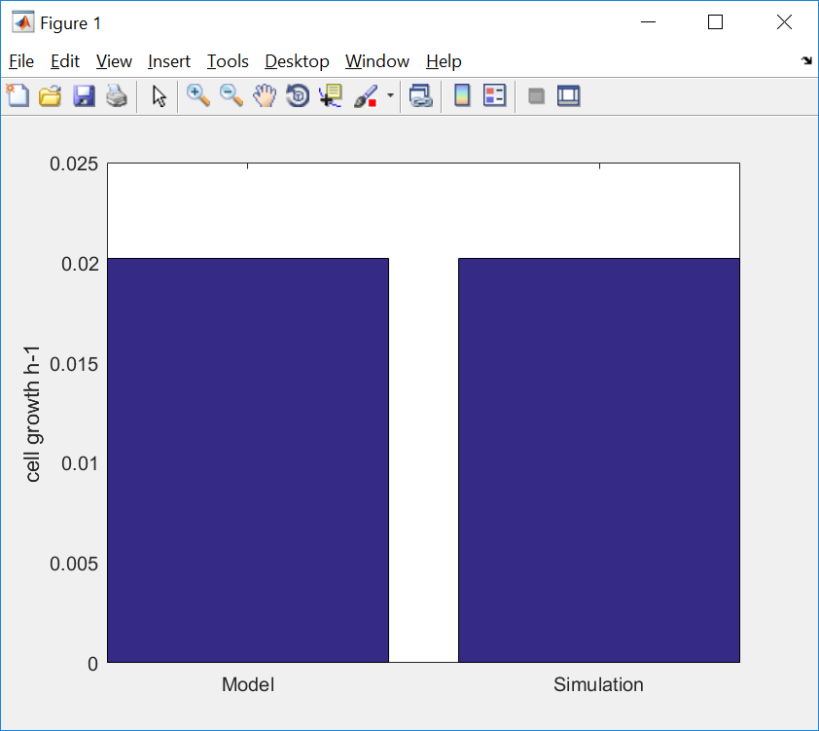
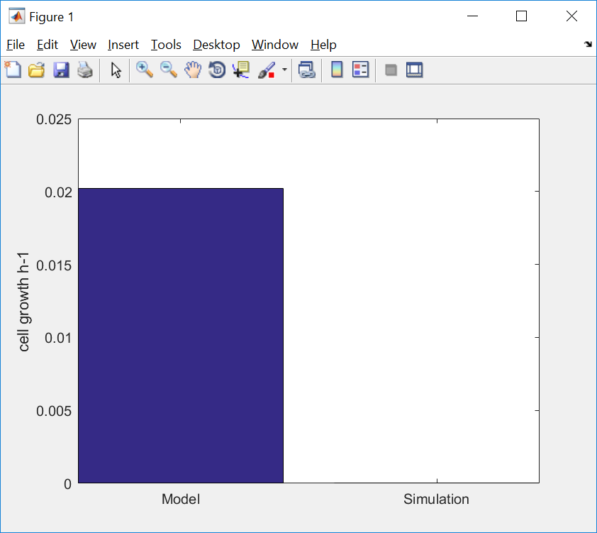
Clone analysis GUI - examples
Knockout
Gene: 100758414
Johns Hopkins University
Clemson University
University of Delaware
University of Massachusetts Lowell
Knockout
Gene: 100764163
Confidential

