Slide 1
GUI test cases for demo
- Jayanth (07/08/2019)

Slide 2
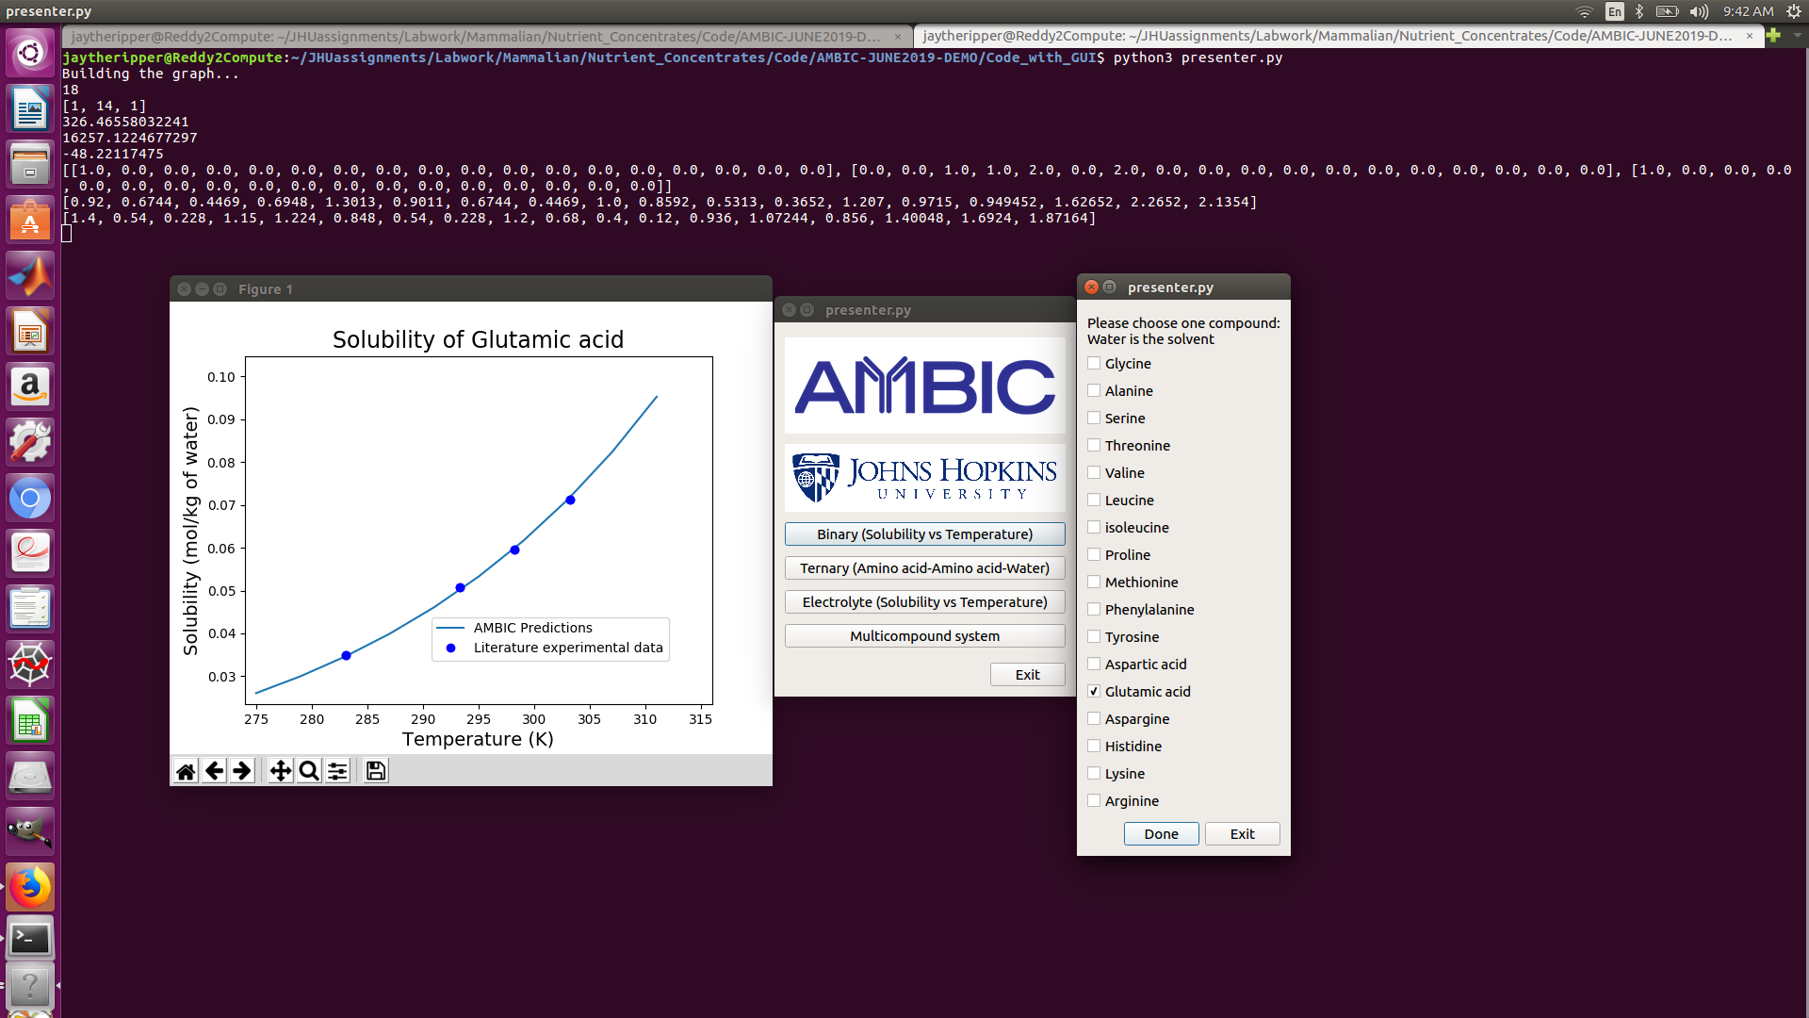
Binary system
- Click on the binary system button

Slide 3
Case 1 – Solubility vs temperature for Glutamic acid
Click on the box next to Glutamic acid and hit run to get the output solubility vs temperature of the amino acid

Slide 4
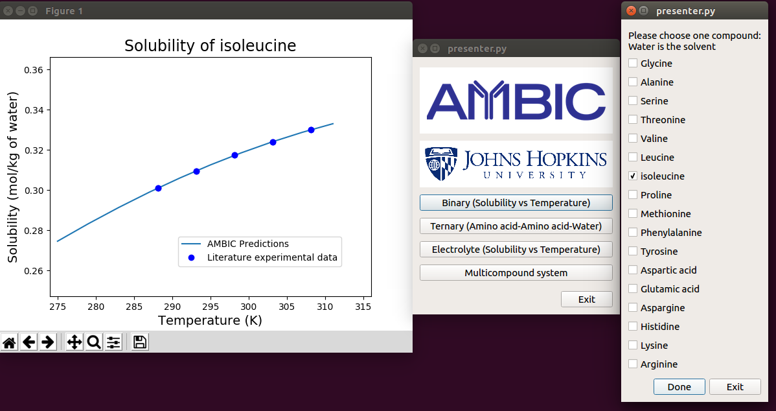
Case 2 – Solubility vs temperature for isoleucine
Click on the box next to isoleucine and hit run to get the output solubility vs temperature of the amino acid

Slide 5
Ternary system
- Click on the ternary system button

Slide 6
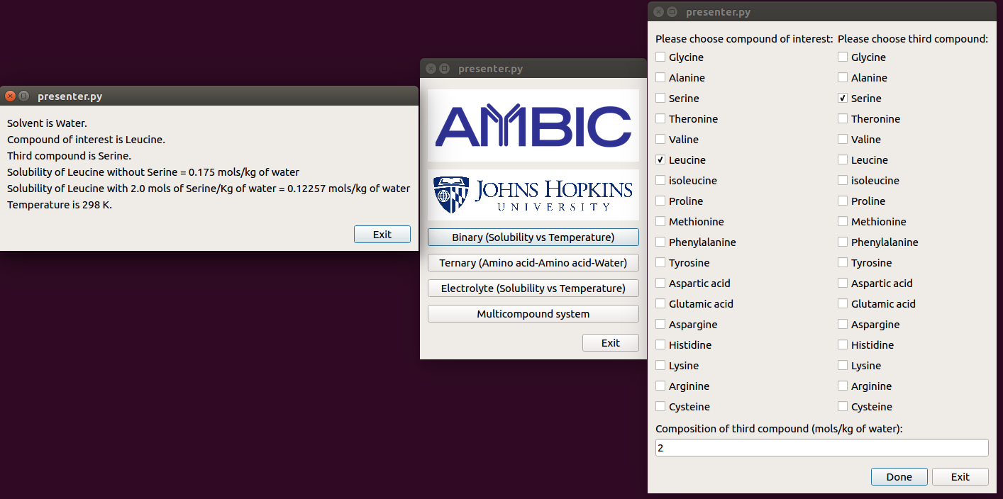
Case 1 – Ternary system of Serine and Leucine
Click on the box next to leucine in the first column and the box next to serine in the next column and enter the composition of serine in the solution below. The output shows that the solubility of leucine reduced while adding serine.

Slide 7
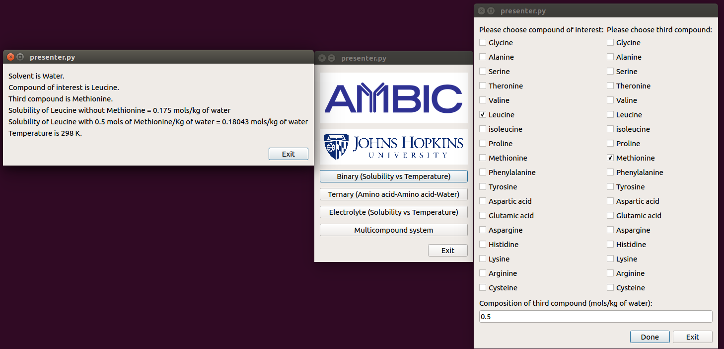
Case 2 – Ternary system of Leucine and Methionine
Click on the box next to leucine in the first column and the box next to methionine in the next column and enter the composition of methionine in the solution below. The output shows that the solubility of leucine increases while adding methionine.

Slide 8
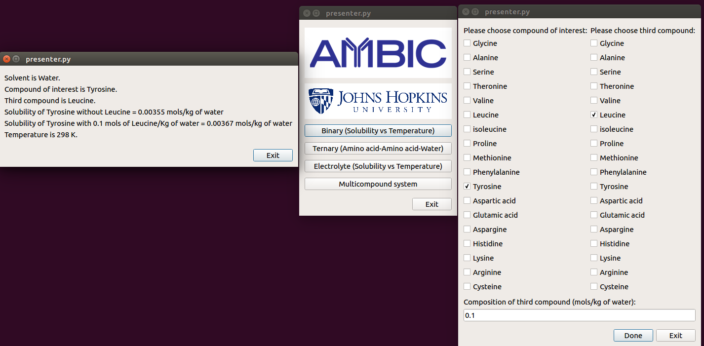
Case 3 – Ternary system of Tyrosine and Leucine
Click on the box next to Tyrosine in the first column and the box next to Leucine in the next column and enter the composition of Leucine in the solution below. The output shows that the solubility of Tyrosine increases while adding Leucine.

Slide 9
Electrolyte
- Click on the electrolyte system button

Slide 10
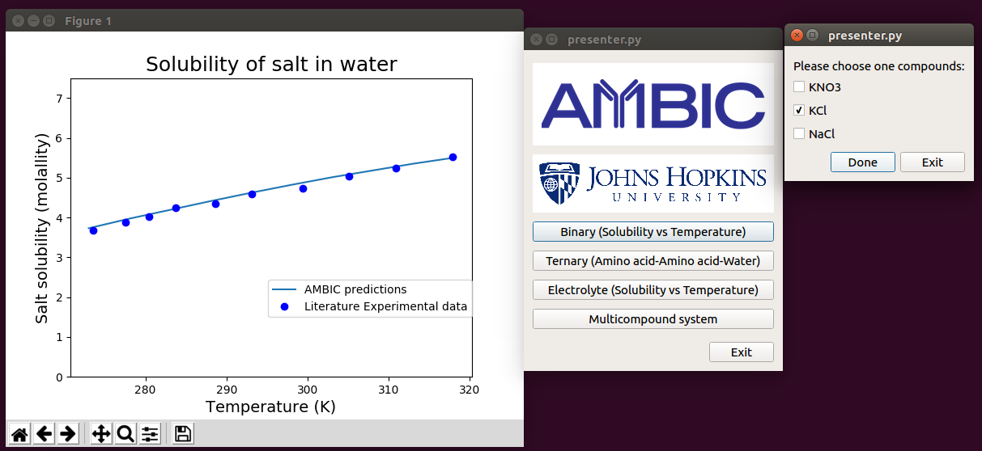
Case 1 – Solubility vs temperature of KCl

Slide 11
Multicompound
- Click on the multicompound system button

Slide 12
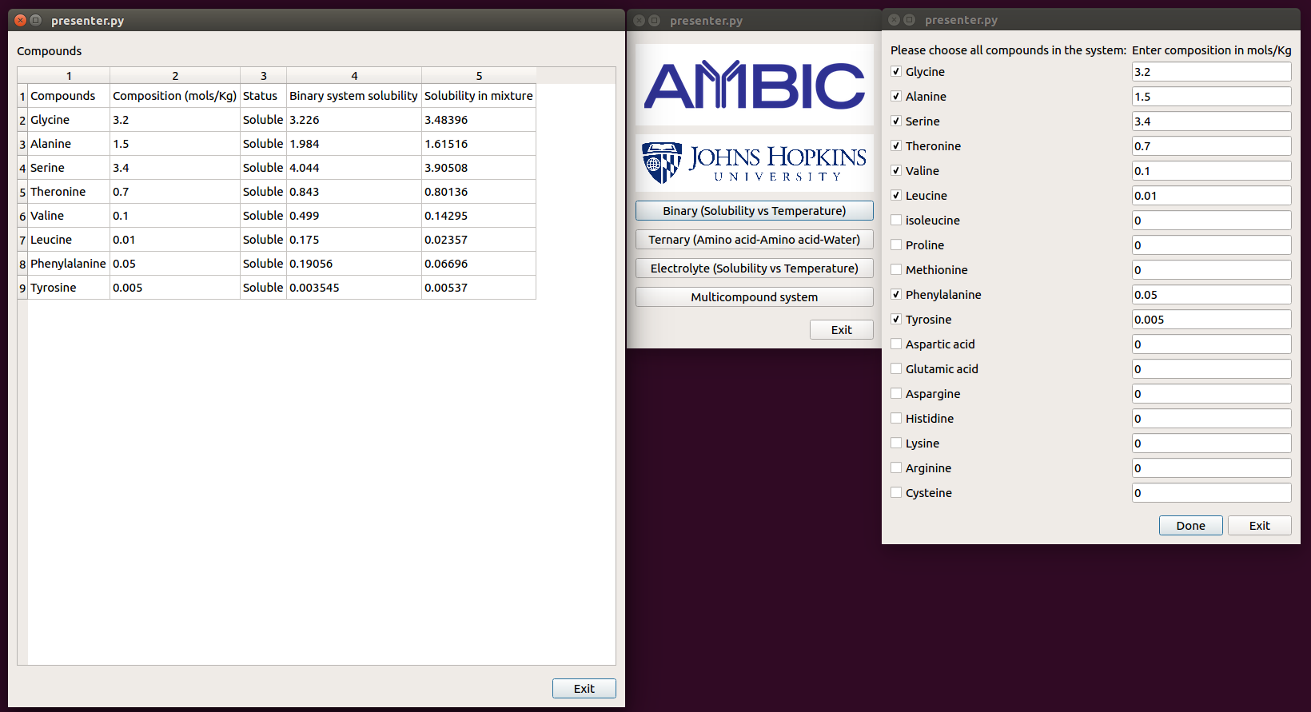
Case 1- Everything is soluble
Click on the amino acids above at the respective concentrations for the case where all the amino acids in the mixture are soluble. The columns 4 and 5 of the output show the increase/decrease in solubility.

Slide 13
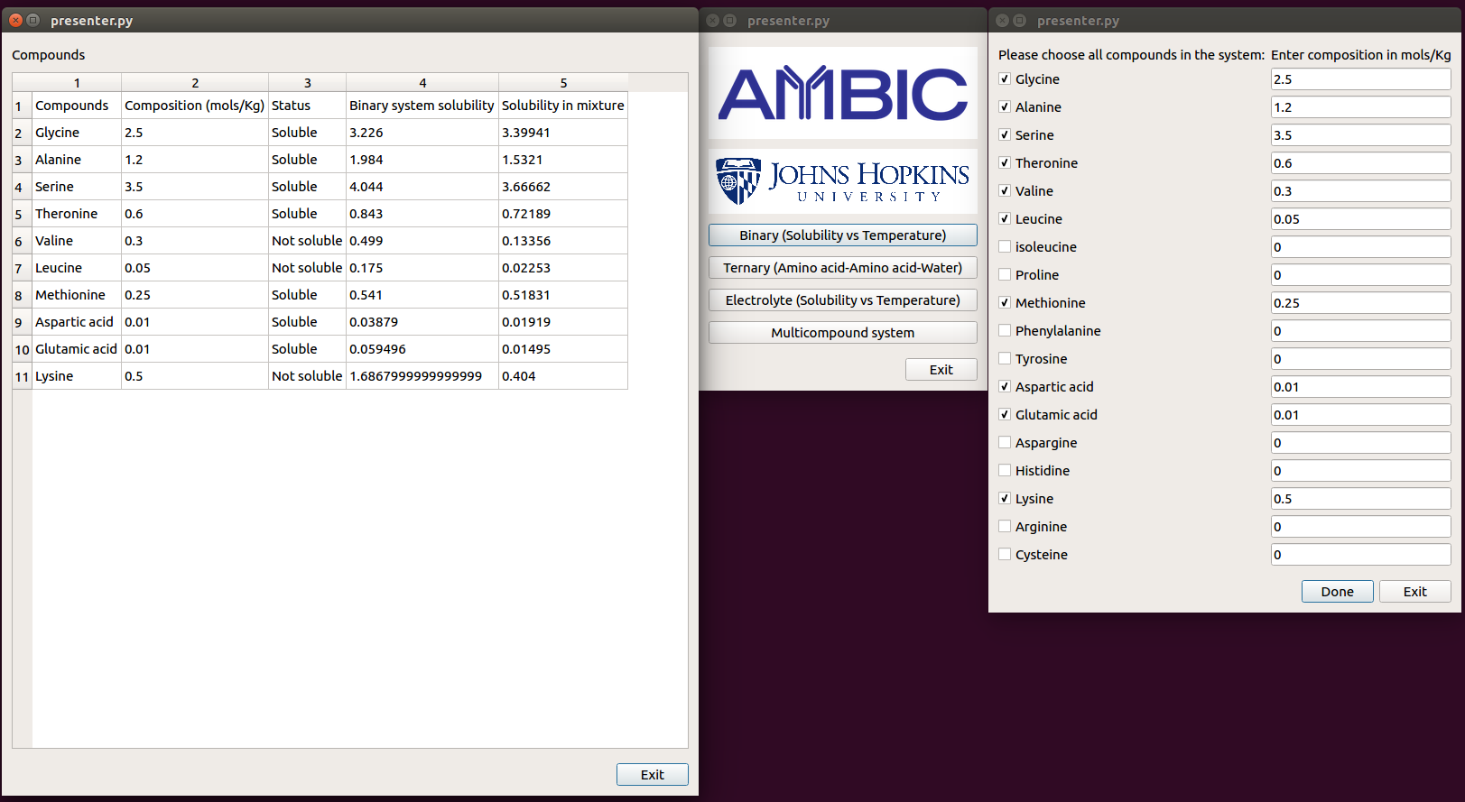
Case 2 – Some amino acids are insoluble
Click on the amino acids above at the respective concentrations for the case where some amino acids precipitate. The columns 4 and 5 of the output show the increase/decrease in solubility. Column 3 shows which amino acid precipitated.

